Slide 1
Closing Remarks
By Doug Purcell

Slide 2
Please Take 5 Minutes to Fill Out Class Evals
https://bit.ly/2LOVYc2

Slide 3
The next phrase in your python development
You know should have a good grasp of the fundamentals of python
The next step is to start planning out what you want to build with python for your workflow
Also, think about what type of program you will build. Python can do GUIs, web apps, or good ole fashion command line scripts

Slide 4
If You need Help With Your Project
Break your bigger problem into smaller chunks
Create a new project in PyCharm
Create a main.py file which will run your program
Think about all of the core functionality your program will need and then break them down into separate modules. This will help you reduce your problem into smaller chunks which is easier to work with: https://learnitsuppor-qnu1597.slack.com

Slide 5
What’s Next?
Want to learn more specific applications of python?
Machine learning libraries
Web development with Django or Flask
Creating Desktop apps
Make sure to post your inquieries on the Slack channel: https://learnitsuppor-qnu1597.slack.com
It’s an easy way for me to monitor your interests

Slide 6
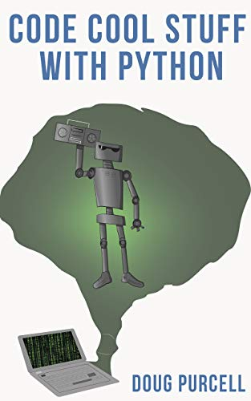
Can’t Think of Any Projects to Work On?

Slide 7
Feel Free to Connect on Social Media
My LinkedIn profile: https://www.linkedin.com/in/doug-purcell

Slide 8
It Was a Pleasure, You Guys Rock!
The journey of a 1000 miles begins with a single step. I’m pretty sure you’re wayyyyy pass that first step.
Best of luck in your future python journey. 🐍

