Slide 1



Reconciling Enumerative and Deductive Program Synthesis
Kangjing Huang Xiaokang Qiu Peiyuan Shen Yanjun Wang
Notes:
Hello everyone! I’m Yanjun Wang. Today I’ll be introducing our paper on reconciling enumerative and deductive synthesis. This is a joint work with Kangjing Huang, Peiyuan Shen and my advisor Xiaokang Qiu from Purdue University.

Slide 2
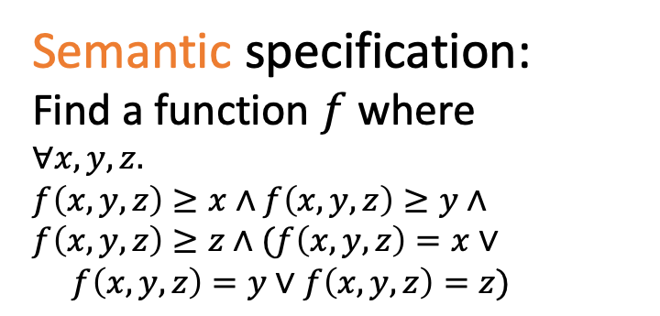
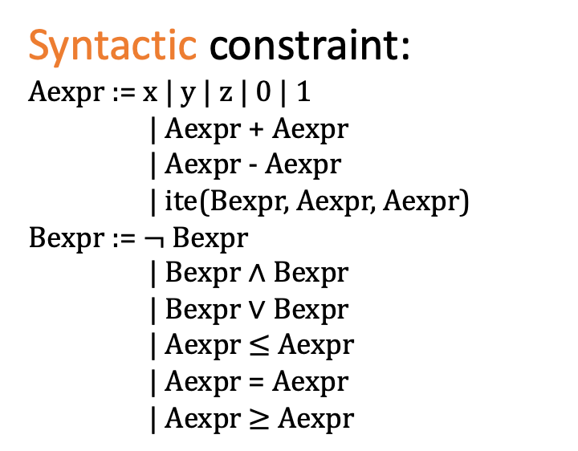
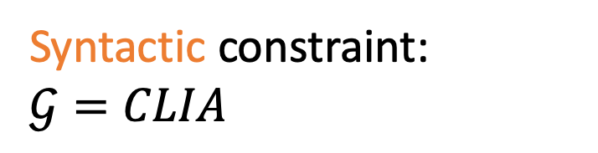
Syntax-guided Synthesis
Semantic specification:
Find a function $f$ where
$$∀x,y,z.$$
$$f\left(x, y,z\right)≥x∧f\left(x,y,z\right)≥y∧$$
$$f\left(x,y,z\right)≥z∧(f\left(x,y,z\right)=x∨$$
$f\left(x,y,z\right)=y∨f\left(x,y,z\right)=z)$
Semantic specification:
“Find the max of three integers”
Syntactic constraint:
Aexpr := x | y | z | 0 | 1
| Aexpr + Aexpr
| Aexpr - Aexpr
| ite(Bexpr, Aexpr, Aexpr)
Bexpr := $¬$ Bexpr
| Bexpr $∧$ Bexpr
| Bexpr $∨$ Bexpr
| Aexpr $≤$ Aexpr
| Aexpr = Aexpr
| Aexpr $≥$ Aexpr
Syntactic constraint:
$$𝒢=CLIA$$
Syntax-guided Synthesizer
$$f(x,y,z)≡ite(x≥y∧x≥z, x, ite(y≥z, y,z))$$
Notes:
Syntax-guided synthesis aims to find a program satisfying not only a semantic specification but also a syntactic specification. The semantic specification describes what the program is supposed to compute, for example, finding the max of three integers. And the syntactic constraint describes which operators can be used in the implementation. Here shows a grammar having standard linear arithmetic operators with conditionals. The expected output program should satisfy both two specifications.

Slide 3


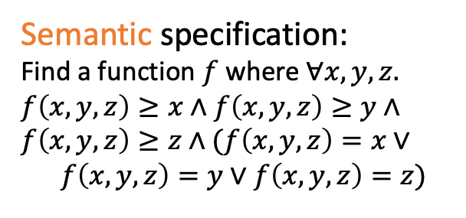

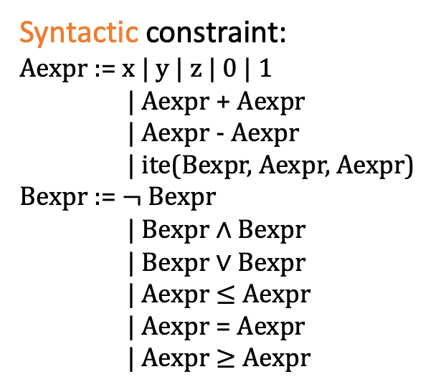

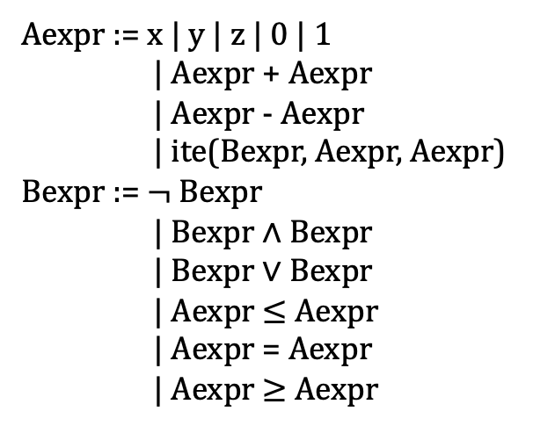


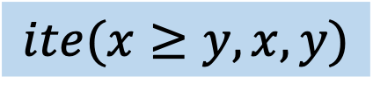
State-of-the-art: Enumerative Synthesis
Semantic specification:
Find a function $f$ where $∀x,y,z.$
$$f\left(x, y,z\right)≥x∧f\left(x,y,z\right)≥y∧$$
$$f\left(x,y,z\right)≥z∧(f\left(x,y,z\right)=x∨$$
$f\left(x,y,z\right)=y∨f\left(x,y,z\right)=z)$
Search space
check
$$x$$
$$x+y$$
Generally applicable
Syntactic constraint:
Aexpr := x | y | z | 0 | 1
| Aexpr + Aexpr
| Aexpr - Aexpr
| ite(Bexpr, Aexpr, Aexpr)
Bexpr := $¬$ Bexpr
| Bexpr $∧$ Bexpr
| Bexpr $∨$ Bexpr
| Aexpr $≤$ Aexpr
| Aexpr = Aexpr
| Aexpr $≥$ Aexpr
$$ite(x≥y,x,y)$$
$$z$$
Aexpr := x | y | z | 0 | 1
| Aexpr + Aexpr
| Aexpr - Aexpr
| ite(Bexpr, Aexpr, Aexpr)
Bexpr := $¬$ Bexpr
| Bexpr $∧$ Bexpr
| Bexpr $∨$ Bexpr
| Aexpr $≤$ Aexpr
| Aexpr = Aexpr
| Aexpr $≥$ Aexpr
$$y$$
Limited in scalability
$$…$$
$$y+z$$
Sized-Ordered: EUSolver [Alur et al. TACAS’17]
Counterexample-based: CEGIS [Solar-Lezama et al. ASPLOS’06]
Learning-based: LoopInvGen [Padhi et al. PLDI’16]
Notes:
Currently, there are two classes of synthesis techniques that have been widely used. The first one is enumerative synthesis. Given the SyGuS problem, enumerative synthesis is to systematically enumerate the possible implementations and check if they are the desired ones. The enumeration can follow a size-based order. Or the enumeration order can also be counterexample based, such as CEGIS. The search strategy can also be learning-based. The enumeration approach is generally applicable to different kinds of SyGuS problems, however, it’s very limited in scalability especially when the size of the expected program grows.
The goal of the synthesizer is to search for a candidate program that matches a set of input-output examples.

Slide 4
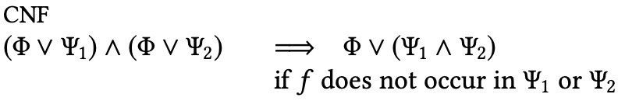
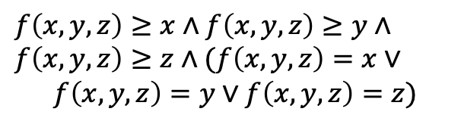
State-of-the-art: Deductive Synthesis
Semantic specification:
Find a function $f$ where $∀x,y,z.$
$$f\left(x, y,z\right)≥x∧f\left(x,y,z\right)≥y∧$$
$$f\left(x,y,z\right)≥z∧(f\left(x,y,z\right)=x∨$$
$f\left(x,y,z\right)=y∨f\left(x,y,z\right)=z)$
$$f\left(x, y,z\right)≥x∧f\left(x,y,z\right)≥y∧$$
$$f\left(x,y,z\right)≥z∧(f\left(x,y,z\right)=x∨$$
$f\left(x,y,z\right)=y∨f\left(x,y,z\right)=z)$
$$f(x,y,z)≡ite(x≥y∧x≥z, x, ite(y≥z, y,z))$$
Efficient
…
Syntactic constraint:
Aexpr := x | y | z | 0 | 1
| Aexpr + Aexpr
| Aexpr - Aexpr
| ite(Bexpr, Aexpr, Aexpr)
Bexpr := $¬$ Bexpr
| Bexpr $∧$ Bexpr
| Bexpr $∨$ Bexpr
| Aexpr $≤$ Aexpr
| Aexpr = Aexpr
| Aexpr $≥$ Aexpr
Specific to some grammars or applications
$$f\left(x, y,z\right)≥x∧f\left(x,y,z\right)≥y∧f\left(x,y,z\right)≥z∧…$$
CVC4 [Reynolds et al. CAV’15]
Notes:
The other commonly-used technique is deductive synthesis, which essentially constructs an implementation from the specification through a symbolic procedure. Deduction sometimes can be automated to synthesize programs. For example, cvc4 employs a very powerful symbolic synthesis algorithm, called counterexample guided quantifier instantiation that can handle a class of integer arithmetic synthesis problem very efficiently. The downside of deductive synthesis is that it’s often very specific to some fixed grammars or applications, and can not be general to arbitrary synthesis tasks.

Slide 5


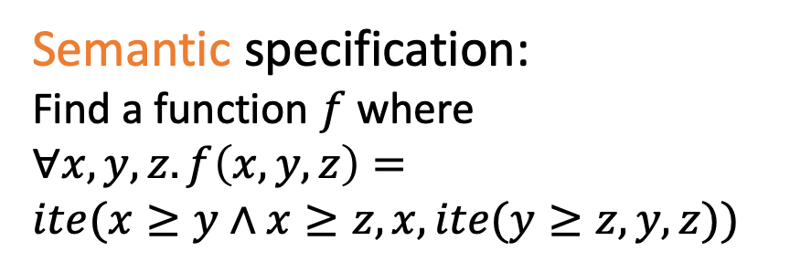
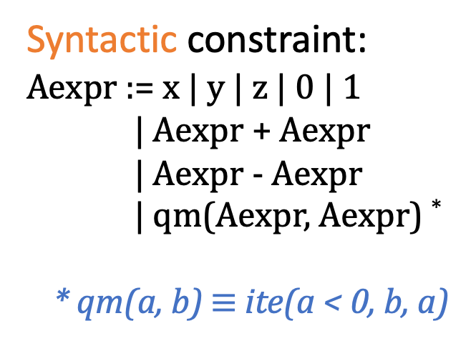
SyGuS problem: qm_max3
Syntactic constraint:
Aexpr := x | y | z | 0 | 1
| Aexpr + Aexpr
| Aexpr - Aexpr
| qm(Aexpr, Aexpr) *
* qm(a, b) $≡$ ite(a < 0, b, a)
Syntactic constraint:
$$𝒢=CLIA$$
Semantic specification:
“Find the max of three integers”
Semantic specification:
Find a function $f$ where
$$∀x,y,z. f\left(x, y, z\right)=$$
$$ite(x≥y∧x≥z, x, ite(y≥z, y, z))$$
Syntax-guided Synthesizer
Timeout
Notes:
Since the syntactic specification used in previously shown problem is quite standard, existing tools can handle this problem in reasonable time. However, if the sygus problem is tweaked a bit. We use the synthesized program of the previous problem as the semantic specification. And instead of using a standard CLIA grammar, the syntactic specification constrain the search space with very few operators, such as variables, constants, plus, minus and a special defined function qm. Qm takes two arguments a and b, if a is less than zero, then return b, otherwise return a. Given this slightly modified sygus problem, there is no existing tool can solve this problem in 20 mins. The performance of SyGuS solvers is still a hurdle to a wider adoption of this approach.

Slide 6


Our Approach: Cooperative Synthesis
P
Repeatedly split
A
B
Novel algorithms
AA
AA
BA
BB
AB
BA
BB
Syntax-guided
Deduction
…
Height-based
Enumeration
…
Notes:
To push the performance limit of syntax-guided synthesis, in this paper, we present a novel synthesis framework, called cooperative synthesis. Given a sygus problem P, the cooperative synthesis framework will split a large synthesis problem into smaller subproblems using a set of novel divide-and-conquer strategies. And then these subproblems can be further split to smaller ones, each of which will be much easier to solve than the original problem. In other words, the split process can be repeated. We also designed two novel synthesis algorithms that are baked in the cooperative synthesis framework, an enumerative one and a deductive one, which allow us to switch between the best part of enumerative synthesis and deductive synthesis. The subproblems are solved separately by these two synthesis algorithms. Their solutions are then combined to form a final solution.

Slide 7


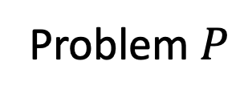
Cooperative Synthesis
Type-A subproblem
qm_max3
Problem $P$
Syntax-guided
Deduction
Simplified
Divide-and-conquer
Strategies
Indivisible
Type-B subproblem
Solution
Height-based
Enumeration
Notes:
Let’s walk through the workflow of cooperative synthesis. Given a sygus problem P, our deductive synthesis engine will first attempt to solve the problem purely deductively. If the deductive synthesizer can solve this problem, great, problem solved! If it can not directly solve the problem P, it attempts to simplify the problem as much as possible. Our divide-and-conquer splitter will take over and attempt to apply our divide-and-conquer strategies to split the problem. Once a problem can be split, the subproblem, here we call it Type-A subproblem, will be sent back to the deductive synthesizer and the whole procedure starts to solve this smaller problem. If this subproblem can be solved, with the help of the solution of this subproblem, a subproblem B can be constructed and it will be easier to solve than the original problem P. Sooner or later the synthesis problem cannot be divided or simplified anymore, then it will be handled by our enumerative synthesizer and it will try to search the solution through a height-based enumeration. Each of these three parts will get clearer in the rest of the talk. Let’s use the qm_max3 problem as a running example. Our deductive synthesis engine will first attempt to solve the problem. However, the problem can not be solved directly, so our divide-and-conquer splitter steps in.

Slide 8
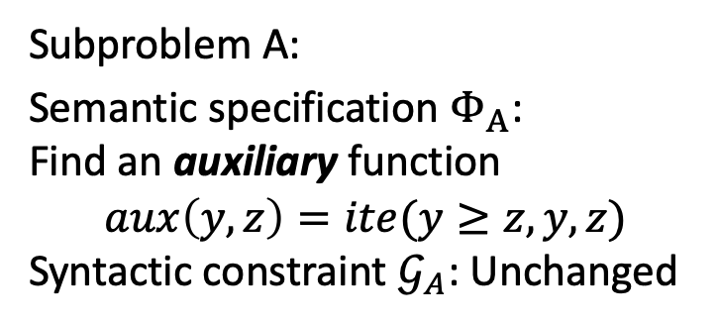
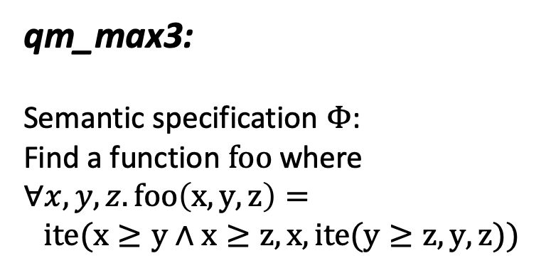
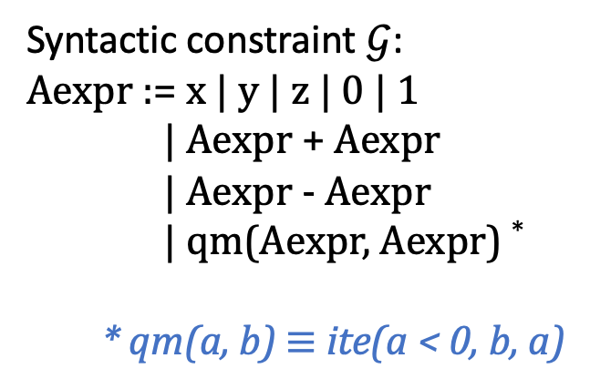
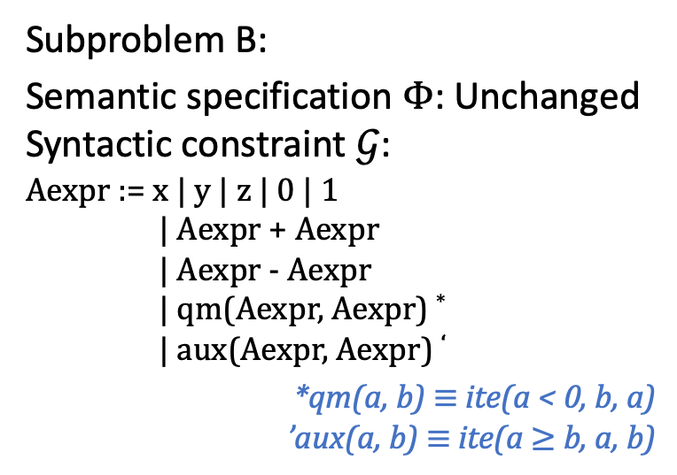
Subterm-Based Division
Subproblem A:
Semantic specification $Φ_{A}$:
Find an auxiliary function
$$aux\left(y,z\right)=ite(y≥z,y,z)$$
Syntactic constraint $𝒢_{A}$: Unchanged
qm_max3:
Semantic specification $Φ$:
Find a function $foo$ where
$$∀x, y, z. foo\left(x, y, z\right)=$$
$$ite(x≥y∧x≥z, x, ite(y≥z, y, z))$$
Subproblem B:
Semantic specification $Φ$: Unchanged
Syntactic constraint $𝒢$:
Aexpr := x | y | z | 0 | 1
| Aexpr + Aexpr
| Aexpr - Aexpr
| qm(Aexpr, Aexpr) *
| aux(Aexpr, Aexpr) ‘
*qm(a, b) $≡$ ite(a < 0, b, a)
’aux(a, b) $≡$ ite(a $≥$ b, a, b)
Syntactic constraint $𝒢$:
Aexpr := x | y | z | 0 | 1
| Aexpr + Aexpr
| Aexpr - Aexpr
| qm(Aexpr, Aexpr) *
* qm(a, b) $≡$ ite(a < 0, b, a)
Notes:
One of our divide-and-conquer strategies, called subterm-based division, can be applied to the problem qm_max3. The solution to the original problem is hard to synthesize as the syntax tree of the solution is large. However, one may wonder if we can synthesize an auxiliary function aux that is equivalent to a subterm / subexpression of the original target expression. The subproblem A is obviously easier to solve as the solution size is smaller. With the implementation of auxiliary function aux being found, we can add aux to the grammar and then the next task is to synthesize qm_max3 with the updated syntactic specification. This subproblem B is more solvable than the original problem as subproblem B's grammar allows one extra operator aux.
Subproblem a:
Sementatic:
Syntactic: same
Subproblem b:
Sementatic: unchanged/same
Syntactic: …

Slide 9
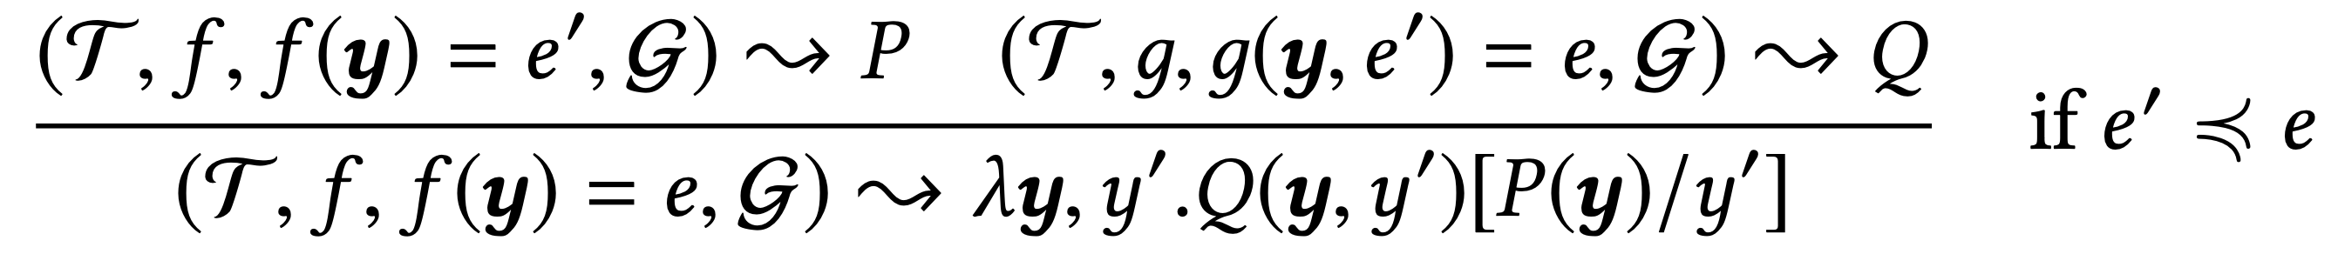

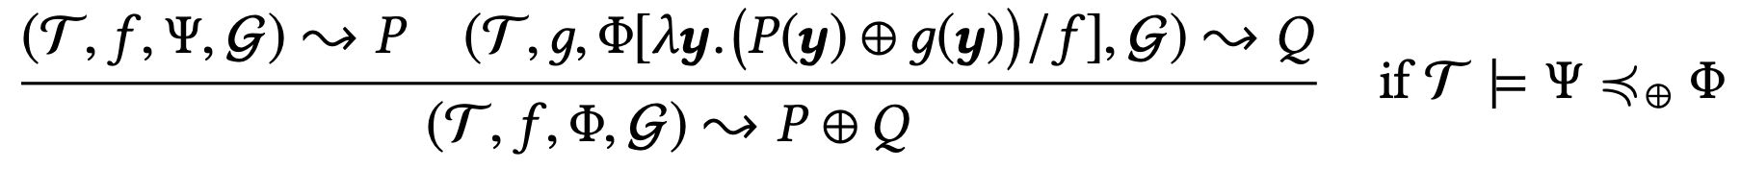
Divide-and-Conquer Strategies
No solution will be missed along the division
Subterm-Based Division
Fixed-Term-Based Division
Weaker-Spec-Based Division
Notes:
Besides subterm-based division, we also have fixed-term based division and weaker-spec-based division. A nice feature about these divisions is that no solution will be missed along the division. In other words, whenever a division is possible, we can safely divide the problem without worrying about missing any solution. Please find more details about our divide-and-conquer strategies in our paper.
[Polish the slide, and mention the completeness, i.e., no solution will be missed along the division.]

Slide 10


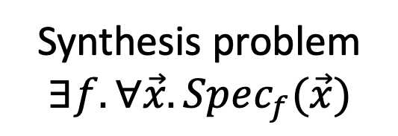


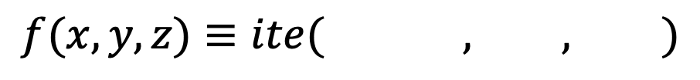

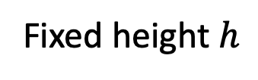


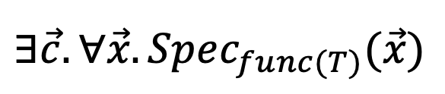
Height-based Enumeration
Decision Tree Representation
Synthesis problem
$$∃f. ∀\vec{x}.Spec_{f}(\vec{x})$$
$$c_{1}^{0}x+c_{2}^{0}y+c_{3}^{0}z+c_{4}^{0}≥0$$
Fixed height $h$
$$x≥y$$
$$x$$
$$y$$
$$f(x,y,z)≡ite( , , )$$
True
False
$$∃\vec{c}. ∀\vec{x}.Spec_{func(T)}(\vec{x})$$
$$c_{1}^{1}x+c_{2}^{1}y+c_{3}^{1}z+c_{4}^{1}$$
$$c_{1}^{2}x+c_{2}^{2}y+c_{3}^{2}z+c_{3}^{2}$$
CEGIS [1]
[1] Solar-Lezama et al. Combinatorial sketching for finite programs. ASPLOS’06.
Notes:
To further solve the subproblems, we need our enumerative and deductive synthesizers. Now let me first introduce our enumerative synthesis algorithm. We use a decision tree representation for our to-be-synthesized functions. The reason why we use this representation can be illustrated through the following example. Given a function f which takes three arguments x, y and z and returns the max of x and y. This function can be constructed as a decision tree, of which the non-leaf node represents a conditional and the leaf nodes store expressions. Each expression in the node can be further represented by a polynomial with a set of coefficients. Representing functions as decision trees of a fixed height, which is two in this example, the synthesis problem then becomes searching for the twelve coefficients in the decision trees, so that for any input vector x, the specification is satisfied. With the help of the decision tree representation, we can reduce the synthesis problem from a second order specification to a first-order query, which can be solved by standard CEGIS query.

Slide 11





Height-based Enumeration
CEGIS search within a fixed height
Enumerate from the smallest height
Increase height when synthesis fails
Retain a counterexample set
Synthesis problem
$$∃f. ∀\vec{x}.Spec_{f}(\vec{x})$$
Fixed height $h$
Candidate implementation $f$
$$∃\vec{c}. ∀\vec{x}.Spec_{func(T)}(\vec{x})$$
succeed
Synthesis
fail
$$h≔h+1$$
Verification
Height $h$
CEGIS [1]
succeed
Input points $G$
Done
Add counterexample to $G$
[1] Solar-Lezama et al. Combinatorial sketching for finite programs. ASPLOS’06.
Notes:
With the decision tree encoding, we can symbolically search candidate functions within a fixed height based on a standard CEGIS framework, then enumerate on different tree heights. The enumeration starts from the smallest tree height, which guarantees to find a smallest solution. Once the synthesizer in CEGIS loop fails to find a solution within a height, we increment the height and continue searching in the new height. A counterexample set is retained through the entire searching process.
The decision tree representation also make it possible that we can enumerate the smallest height of the tree which guarantees to find a smallest solution. In each fixed height, we symbolically search for feasible assignments of the coefficients. Once a candidate can not be found in a certain fixed-height, we increase the solution height by one and start another round of CEGIS loop. This nature of height-based enumeration also makes the parallelization of the enumeration possible. Each thread in the thread pool can run the fixed-height search in a unique height, then return the solution if anyone of them finds the solution.

Slide 12
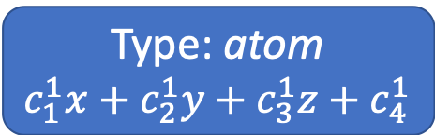
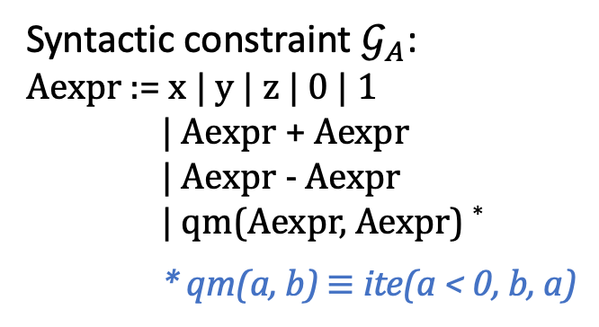
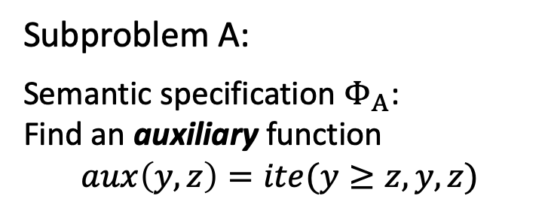
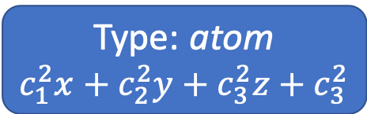
Height-based Enumeration
Decision tree encoding can be generalized to arbitrary grammar.
Subproblem A:
Semantic specification $Φ_{A}$:
Find an auxiliary function
$$aux\left(y,z\right)=ite(y≥z,y,z)$$
Type: qm
Syntactic constraint $𝒢_{A}$:
Aexpr := x | y | z | 0 | 1
| Aexpr + Aexpr
| Aexpr - Aexpr
| qm(Aexpr, Aexpr) *
* qm(a, b) $≡$ ite(a < 0, b, a)
Type: atom
$$c_{1}^{1}x+c_{2}^{1}y+c_{3}^{1}z+c_{4}^{1}$$
Type: atom
$$c_{1}^{2}x+c_{2}^{2}y+c_{3}^{2}z+c_{3}^{2}$$
Notes:
In previous slide, we talked about how we represent CLIA functions as decision trees. The decision tree encoding can also be generalized to arbitrary grammar. In addition to coefficients for variables, we introduce an extra variable to indicate the type of each node in the tree. Take the subproblem A of qm_max3 for example. Here is one of candidate functions that can be represented in a tree of height 2. The type variable in the root node indicates that it is the qm operator, and the leaf nodes are two polynomials served as two arguments passed to function qm.
Type: atom

Slide 13
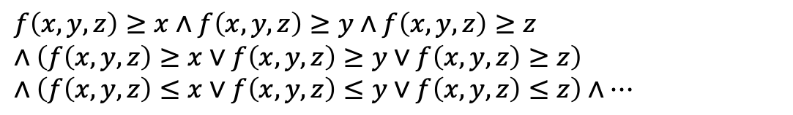
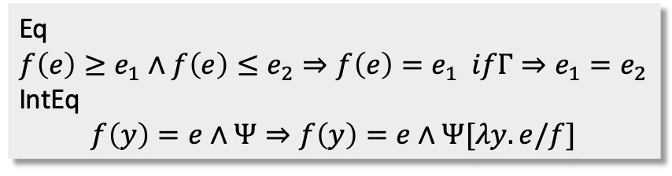
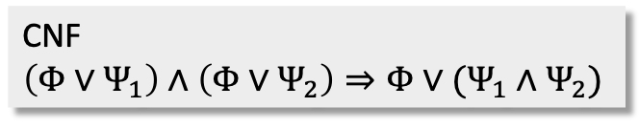
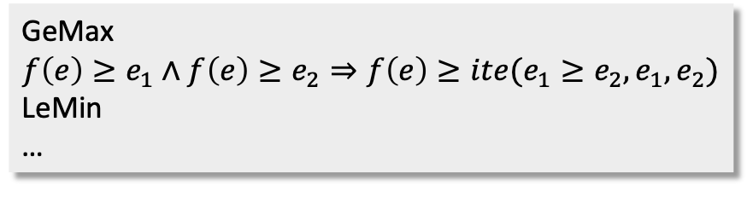
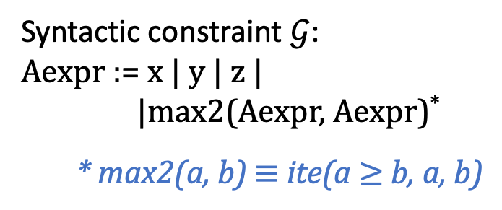
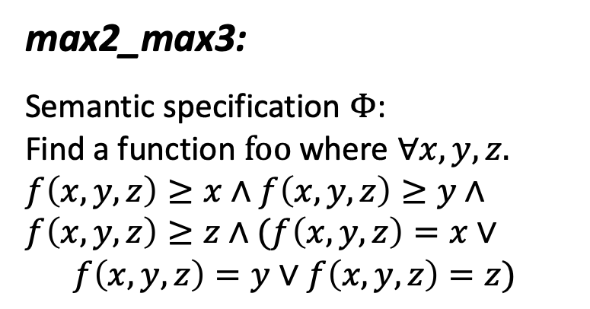
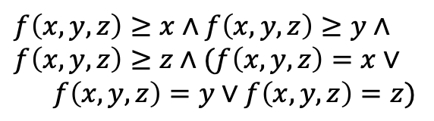
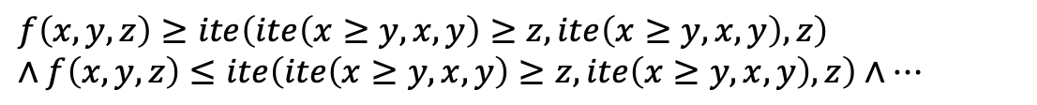
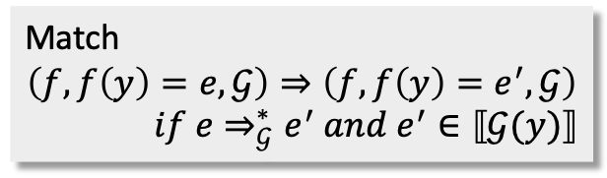
Syntax-guided Deduction
max2_max3:
Semantic specification $Φ$:
Find a function $foo$ where $∀x,y,z.$
$$f\left(x, y,z\right)≥x∧f\left(x,y,z\right)≥y∧$$
$$f\left(x,y,z\right)≥z∧(f\left(x,y,z\right)=x∨$$
$f\left(x,y,z\right)=y∨f\left(x,y,z\right)=z)$
$$f\left(x, y,z\right)=max2(max2\left(x,y\right),z)$$
$$f\left(x, y,z\right)=ite(ite\left(x≥y,x,y\right)≥z,ite\left(x≥y,x,y\right),z)$$
Match
$$\left(f, f\left(y\right)=e,𝒢\right)⇒\left(f, f\left(y\right)=e^{′},𝒢\right)$$
$$if e⇒_{𝒢}^{∗}e^{′} and e^{′}∈⟦𝒢(y)⟧$$
$$f\left(x, y,z\right)≥x∧f\left(x,y,z\right)≥y∧$$
$$f\left(x,y,z\right)≥z∧(f\left(x,y,z\right)=x∨$$
$f\left(x,y,z\right)=y∨f\left(x,y,z\right)=z)$
$$f\left(x, y,z\right)≥ite\left(ite\left(x≥y,x,y\right)≥z,ite\left(x≥y,x,y\right),z\right)$$
$$∧f\left(x,y,z\right)≤ite\left(ite\left(x≥y,x,y\right)≥z,ite\left(x≥y,x,y\right),z\right)∧…$$
Eq
$$f\left(e\right)≥e_{1}∧f\left(e\right)≤e_{2}⇒f\left(e\right)=e_{1} ifΓ⇒e_{1}=e_{2}$$
IntEq
$$f\left(y\right)=e∧Ψ⇒f\left(y\right)=e∧Ψ[λy.e/f]$$
$$f\left(x, y,z\right)≥x∧f\left(x,y,z\right)≥y∧f\left(x,y,z\right)≥z$$
$$∧\left(f\left(x,y,z\right)≥x∨f\left(x,y,z\right)≥y∨f\left(x,y,z\right)≥z\right)∧\left(f\left(x,y,z\right)≤x∨f\left(x,y,z\right)≤y∨f\left(x,y,z\right)≤z\right)∧…$$
Syntactic constraint $𝒢$:
Aexpr := x | y | z |
|max2(Aexpr, Aexpr)*
* max2(a, b) $≡$ ite(a $≥$ b, a, b)
GeMax
$$f\left(e\right)≥e_{1}∧f\left(e\right)≥e_{2}⇒f\left(e\right)≥ite(e_{1}≥e_{2}, e_{1}, e_{2})$$
LeMin
…
CNF
$\left(Φ∨Ψ_{1}\right)∧\left(Φ∨Ψ_{2}\right)⇒Φ∨(Ψ_{1}∧Ψ_{2})$
Notes:
Introduced our enumerative synthesis algorithm, let me illustrate our deductive synthesis component through another sygus problem max2_max3. The only difference from qm_max3 is about the grammar. The desired function can only use the three variables and a defined function max2 which compute the max of two integer arguments.
Given the semantic specification of max3, the deductive synthesizer first use the CNF rule to normalize the formula to the conjunctive normal form. Then the set of rules, such as GeMax will be applied to the formula, which basically groups the terms using if-then-else operators. Then the eq and inteq rules step in, make the function represented as a single term. Finally, we can apply the match rule, using max2 to replace matched subterms. Now the specification has already become a solution.
. The semantic specification is still to find a function f, that computes the max of three integers.

Slide 14
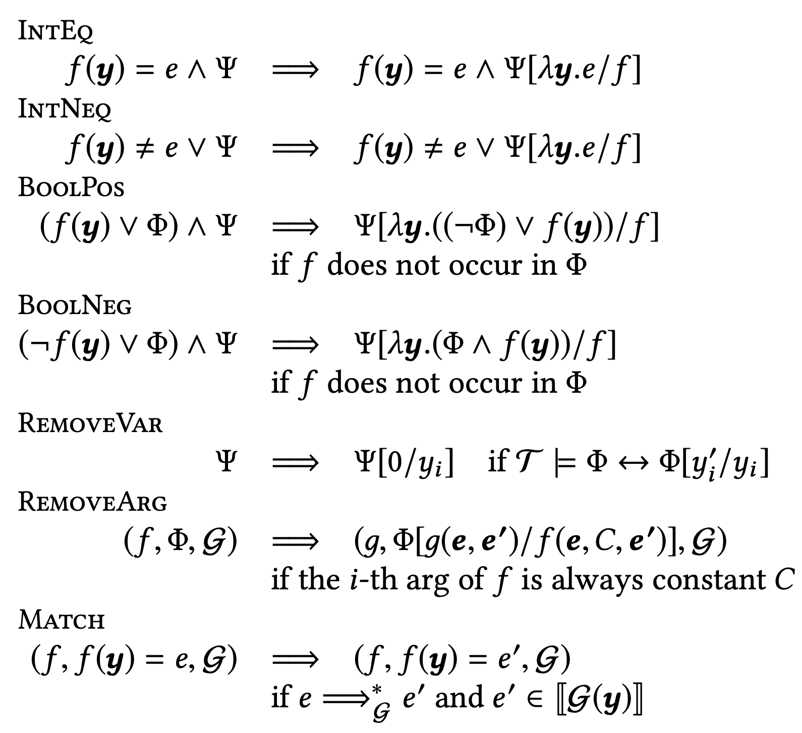
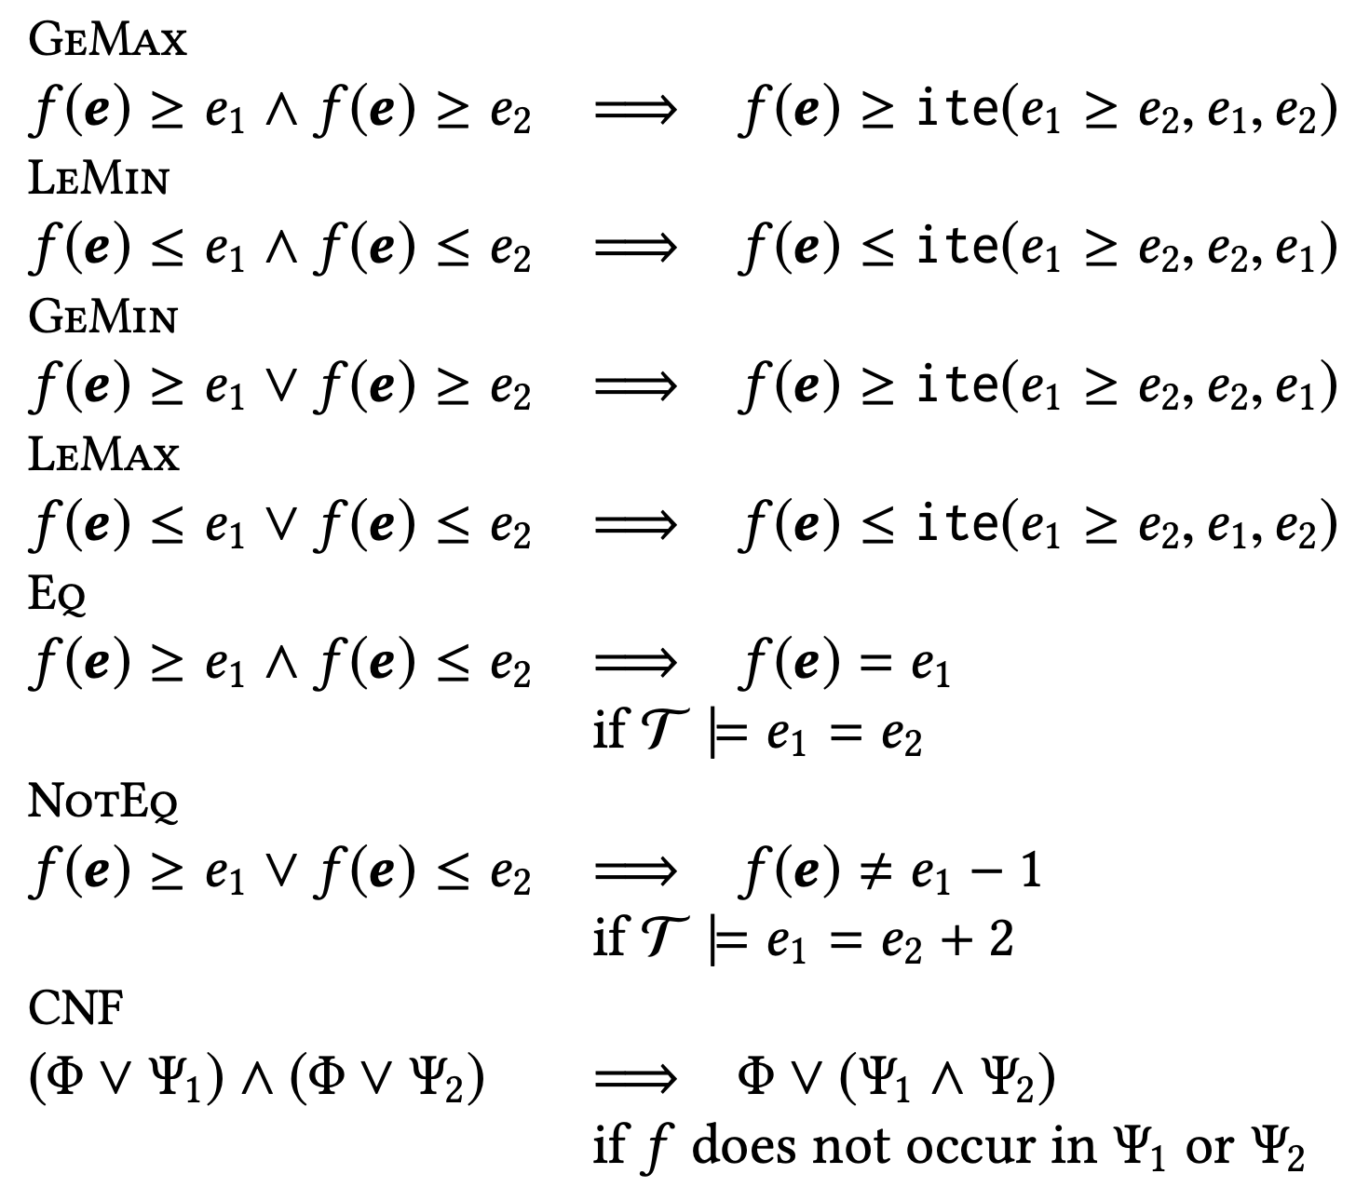

Syntax-guided Deduction
Deductive rules for arbitrary grammar
Deductive rules for $𝓖_{CLIA}$
Notes:
We designed a set of deductive rules that can be applied to problems with arbitrary grammar. And we also designed a set of rules that are specific to conditional linear arithmetic. Please refer to our paper for more information.
[And loop invariant synthesis?]

Slide 15

Evaluation
Implemented as a SyGuS solver, called DryadSynth
Evaluated on SyGuS-Comp’19 benchmarks from CLIA, INV and General tracks with CLIA background theory (715 in total)¹
Experiments are conducted on the StarExec platform (4-core, 2.4GHz CPU and 128GB memory, with a 30-minute timeout)
Compared with state-of-the-art SyGuS solvers²: CVC4, EUSolver, LoopInvGen
¹Omit benchmarks with let-macros due to lack of support
²CVC4: master branch on 11/21/19
EUSolver: SyGuS-Comp’18
LoopInvGen: master branch on 11/22/19
*Available at: https://github.com/purdue-cap/DryadSynth
Notes:
Our cooperative synthesis algorithm is implemented as a sygus solver, called DryadSynth. The solver is publicly available. We evaluated DryadSynth on benchmarks with CLIA background theory from the latest sygus competition. The benchmarks come from three tracks of the competition, including synthesizing functions with standard CLIA grammar, synthesizing loop invariants and synthesizing functions with arbitrary grammars. It wound up with 715 benchmarks in total. The experiments are conducted on the StarExec platform which is also used by the competition. Each synthesis job is running on a node with a 30 minutes timeout. To evaluate the performance of DryadSynth, we compare our results with state-of-the-art sygus solvers, namely CVC4, EUSolver and loopinvgen. CVC4 and eusolver are two general purpose sygus solvers, while loopinvgen is designed for loop invariant synthesis.

Slide 16
Evaluation: Solved & Fastest Solved
Solved benchmarks (breakdown by tracks)
Fastest solved benchmarks (breakdown by tracks)
Notes:
We compared the number of solved and fastest solved benchmarks with other solvers. The definition of fasted solved follows the pseudo-logarithmic time scale used in the competition. DryadSynth, on the leftmost side of these diagrams, solved and fastest solved more benchmarks than the existing tools in each track.

Slide 17
Evaluation: Total Solving Time
Comparison of solvers on total solved benchmarks and total solving time
Notes:
We also compared the solvers on their number of total solved benchmarks and the total solving time of solved benchmarks. DryadSynth, represented by a green triangle, solved more benchmarks in CLIA and General track with less total time spent.

Slide 18
Evaluation: Solving time per benchmark
Solving time per benchmark in ascending order
Notes:
We sorted the solving time of each benchmark in the ascending order. DryadSynth has better scalability than the other synthesizers. Although we have a constant overhead on the easier-to-solved benchmarks, the solving time increases more mildly toward more challenging benchmarks than other synthesizers.

Slide 19
Evaluation: Ablation Studies
Cooperative synthesis vs. Plain height-based enumeration
Cooperative synthesis vs. Plain deduction
Notes:
To evaluate whether the combination of enumerative synthesis and deductive synthesis improves the performance, we also did several ablation studies. The graph on the left shows the solving time of full-fledged cooperative synthesis framework and the plain height-based enumeration synthesis algorithm on all benchmarks. With the help of divide-and-conquer and solving some subproblems by deduction, our cooperative synthesis clearly outperformed the plain height-based enumeration for the vast majority of the benchmarks. The graph on the right compares the number of benchmarks solved by deductive synthesis algorithm only and the number of benchmarks solved hybridly. Two thirds of the benchmarks can only be solved by full-fledged cooperative synthesis. Please refer to our paper for more experimental results.
The plain height-based enumeration procedure performed slightly better for several easier-to-solve problems, though, as they are simple enough and divide-and-conquer cannot help much.

Slide 20

Cooperative Synthesis
Thanks!
DryadSynth
Height-based
Enumeration
Divide-and-conquer
Strategies
Syntax-guided
Deduction
*Available at: https://github.com/purdue-cap/DryadSynth
Notes:
In summary, in this paper, we introduced a synthesis framework, called cooperative synthesis. We designed a set of novel divide-and-conquer strategies and each synthesis problem is repeatedly split into subproblems based on these strategies. Cooperative synthesis framework also features two novel synthesis algorithms, an enumerative one and a deductive one. The subproblems are solved separatively by one of these two algorithms. Their solutions are then combined to construct a final solution to the problem. This cooperative synthesis framework has been embodied into a sygus solver, called DryadSynth. The experimental results show that DryadSynth outperforms existing tools on sygus-comp benchmarks with CLIA background theory, and the novel way of combining enumerative synthesis and deductive synthesis indeed improves the performance. Thank you for your attention. I’m happy to take any question.

