Slide 1
Intro to Linux
2016-09-28 - Evan Widloski
Notes:
things to add
- arrays
- backticks
- wget text vs del file example script

Slide 2
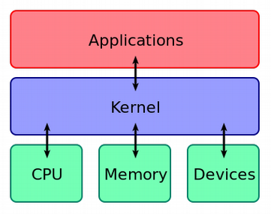
What be Linux?
Linux is a kernel, core of an operating system
  Talks to the hardware – RAM, HD, video card, etc
Created by Linux Torvalds in 1991
Say 'GNU/Linux' for added pedanticism
Notes:
Bourne Shell - Stephen Bourne, Unix Version 7

Slide 3
Linux Distributions
Linux is open source and easy to repurpose
Highly modular
Linux has hundreds of variants - 'distros'
Minor changes between distros
  Default desktop manager
  Package manager
  Init system
  Installation process
Notes:
Bourne Shell - Stephen Bourne, Unix Version 7

Slide 4
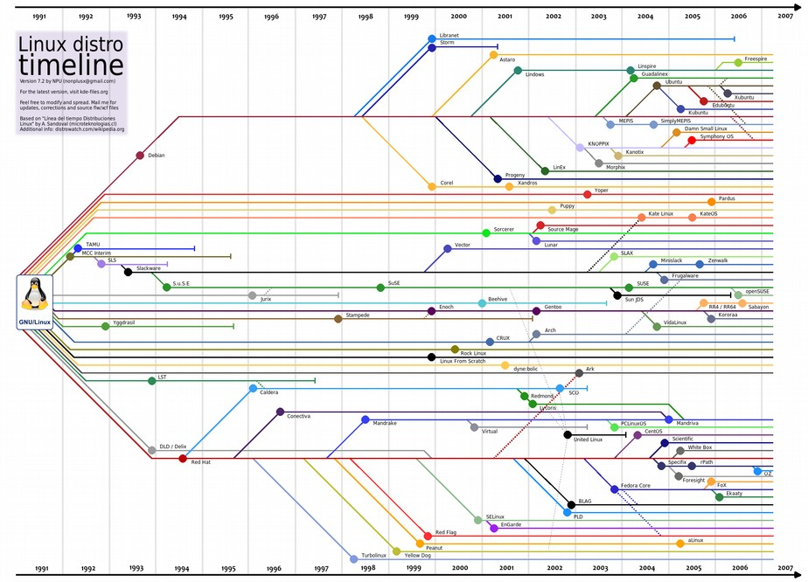
Notes:
Bourne Shell - Stephen Bourne, Unix Version 7

Slide 5
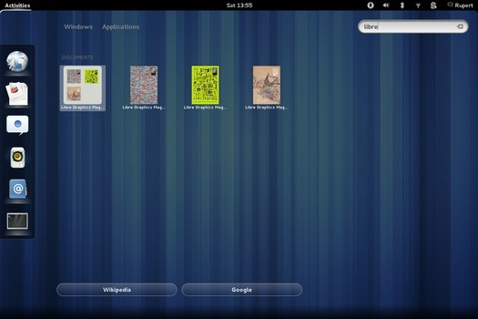
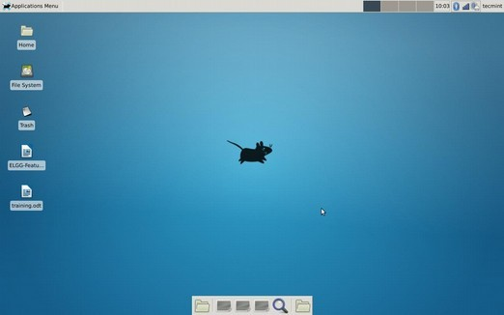
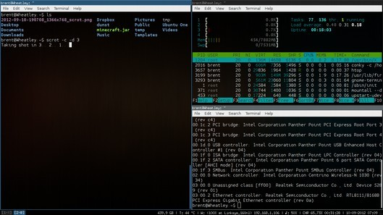
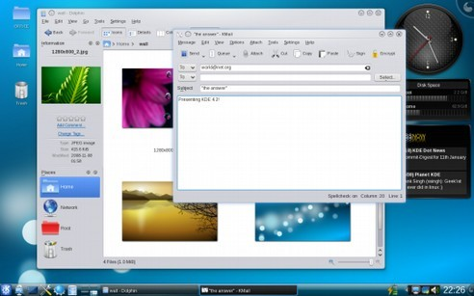
Notes:
Bourne Shell - Stephen Bourne, Unix Version 7

Slide 6
Uses for Linux
Embedded devices
  Routers, single board computers (RPi)
Android
Supercomputers
Schools and universities
Desktop operating systems
Notes:
Bourne Shell - Stephen Bourne, Unix Version 7

Slide 7
Common Terminology
root user - administrator account
directory - Windows calls these folders (us too, sometimes)
path - full location of directory or file
terminal, console, shell - command line
binary file - file that can't be read by a human
commands - programs run from the command line
Notes:
Bourne Shell - Stephen Bourne, Unix Version 7

Slide 8
Paths
/ - root directory ~/ - home directory ./ - current directory ../ - parent directory Where is ~/../../ located? | <-- Absolute <-- Absolute <-- Relative <-- Relative
Notes:
Bourne Shell - Stephen Bourne, Unix Version 7

Slide 9
Common Folders
/home/ - all user home directories
/etc/ - config files (editable text configs)
/bin, /usr/bin, /usr/share/bin - system programs (binaries)
/tmp - temporary directory, wiped after reboot
Notes:
Bourne Shell - Stephen Bourne, Unix Version 7

Slide 10
File/Directory Commands
ls directory - list files in directory
mv file1 file2 - move/rename file
cp file1 file2 - copy file
rm file - remove file
mkdir directory- make a directory
Notes:
Bourne Shell - Stephen Bourne, Unix Version 7

Slide 11
File/Directory Commands
wget http://purduelug.org/wiki/linux101/intro/cats.zip unzip cats.zip cd cats ls cp calico persian ls cd ~
Notes:
Bourne Shell - Stephen Bourne, Unix Version 7

Slide 12
I need help
command -h, command --help - command built in help
man command - man page
  Installed when program is installed
  Doesn't exist for all commands
Notes:
Bourne Shell - Stephen Bourne, Unix Version 7

Slide 13
Finding and Searcing Files
find - searches for files in a specific directory
grep - search file contents
cat - print file contents
Notes:
Bourne Shell - Stephen Bourne, Unix Version 7

Slide 14
Finding and Searcing Files
find cats/ -name '*calico*' cat cats/calico grep cats/calico fur | <-- search cats/ for calico <-- print contents of calico <-- search cats/calico for fur
Notes:
Bourne Shell - Stephen Bourne, Unix Version 7

Slide 15
Piping and Less
command1 | command2 - send command1 output to command2
command | less - display output in scrolling menu
cat a_really_long_file cat a_really_long_file | less cat a_really_long_file | grep ala
Notes:
Bourne Shell - Stephen Bourne, Unix Version 7

Slide 16
Debugging and System Logs
sudo journalctl - view system logs
sudo journalctl > ~/system_log.txt - save log to file
Older, but still supported:
dmesg | less - show kernel messages (display messages)
cat /var/log/syslog - show kernel + application messages
cat /var/log/messages - show kernel + application messages
Notes:
Bourne Shell - Stephen Bourne, Unix Version 7

Slide 17
Installing Software
Most software in Linux is installed with a package manager.
package - program or bundle of programs installed together
package manager - program for installing/removing packages
software repository or “repo” - remote file server
Tell package manager which program you want to install
Package manager checks 'repo' if package is available
Package manager downloads and installs package
How does this compare to Windows?
Notes:
Bourne Shell - Stephen Bourne, Unix Version 7

Slide 18
Installing Software
Ubuntu/Debian/Mint - apt or apt-get/apt-cache
Fedora/Redhat - dnf or yum
OpenSUSE - zypper
Arch - pacman or yaourt
Lots of package managers, but they all work in the same way.
Notes:
Bourne Shell - Stephen Bourne, Unix Version 7

Slide 19
Installing Software
apt search package - search repo for package
sudo apt install package - install package (as superuser)
sudo apt remove package - remove package (as superuser)
Lots of package managers, but they all work in the same way.
Notes:
Bourne Shell - Stephen Bourne, Unix Version 7

Slide 20
Notes:
Bourne Shell - Stephen Bourne, Unix Version 7

Slide 21
~/.bashrc
PATH variable tells bash where to look for commands
PATH=$PATH:~/bin
alias creates a shortcut to a command
alias ls='ls --color=auto'
alias ll='ls -la'
alias ..='cd ..'
Notes:
where bash should look for commands
echo $PATH
export allows to be seen by others
PS - prompt statement
PS1 - default
PS2 - >

Slide 22
.bashrc
PS1="\[\e[00;32m\]\u\[\e[0m\]\[\e[00;34m\]\h\[\e[0m\]\[\e[00;33m\]\@\[\e[0m\]\[\e[00;37m\]:\[\e[0m\]\[\e[00;36m\]\w\[\e[0m\]\[\e[00;37m\]>\v\[\e[0m\]\[\e[00;32m\]:\[\e[0m\]\[\e[00;31m\]\W\[\e[0m\]"
Change Prompt Statement (PS1)
evan@computer:07:23 AM:/usr/local/src>bash:src:
bashrcgenerator.com
Notes:
where bash should look for commands
echo $PATH
export allows to be seen by others
PS - prompt statement
PS1 - default
PS2 - >

Slide 23
Next event Stay updated at | Member Meeting Tuesday, Oct. 3rd 6pm, REC 108 purduelug.org/calendar irc://irc.freenode.net#purduelug purduelug.org/calendar
Notes:
http://blog.openhatch.org/2013/teaching-open-source-at-purdue-university/

Slide 24
Notes:
http://blog.openhatch.org/2013/teaching-open-source-at-purdue-university/

