Slide 1

Purdue Linux Users Group Presents
Linux 201: Session 1
Everything you ever wanted to do in VIM
Thor Smith

Slide 2

Movement

Slide 3
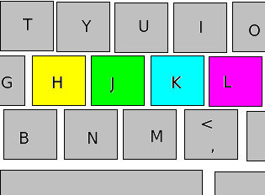
Use the Home Row Keys
h – Move Left
j – Move Down
k – Move Up
l – Move right

Slide 4
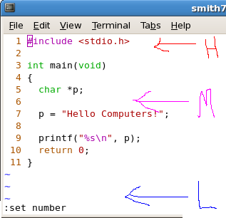
Jump Around the Window
:set number
  Display line nums
H – Top of Window
M – Mid of Window
L – Bottom of window

Slide 5
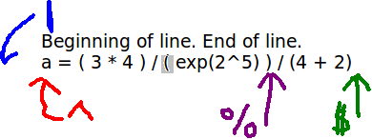
Move To Beginning and End of Lines
^ - First character
$ - Last character
| - Beginning of Line
% - Move between parentheses/brackets

Slide 6

Move Between Words
w - next word (first letter)
b - prev word (first letter)
e – next word (last letter)
ge – prev word (last letter)

Slide 7
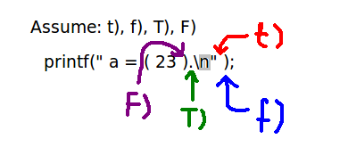
Move Between Characters
t(c) – move forward just before c
f(c) – move forward just after c
T(c) – move backward just before c
F(c) – move backward just after c

Slide 8

Move Around the File
G – last line of file
gg – first line
2 gg – second line
z – center around line
:2 – second line
Page Up/Page Down

Slide 9
Editing

Slide 10
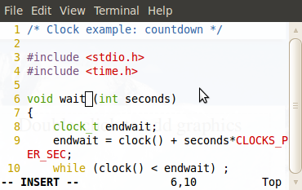
Insert Mode
i – enter insert mode
[esc] – exit insert mode

Slide 11
Deleting, Yanking, and Pasting
Delete (Cut): The text that's deleted is removed from the file and put into the default register.
Yank (Copy): The text that's yanked is copied into the default register.
Paste: Text in default register inserted at cursor.
Other Registers: Any letter can be used as a register by prefixing it with a double quote. Ex1: “a yy Ex2: “b dd Ex3: “a p

Slide 12
Delete and Replace Characters
x – delete character
  (better than backspace)
r – replace character
~ - increment number

Slide 13
Delete (Cut) Lines
dd – delete 1 line
2dd – delete 2 lines
d$ -- delete from cursor to end of line
d^ -- delete from cursor to first character in line.

Slide 14
Yank (Copy) Lines
yy – yank 1 line
2yy – yank 2 lines
y$ -- yank from cursor to end of line
y^ -- yank from cursor to first character in line.

Slide 15
Generalized Deleting and Yanking
The letter “d” or “y” followed by any movement command will delete or yank from the cursor to that position.
d(movement) or y(movement)
dw y%
d2w y3e
dG y128gg
dtr yf)

Slide 16
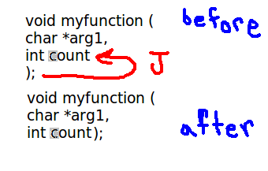
Join Lines of Text
J – appends the line below to the current line.

Slide 17
Indenting Lines of Code
>> - indent one line to the right
<< - indent one line to the left
2>> - indent two lines to the right
2<< - indent two lines to the left
== - auto-indent one line of code
10== - auto-indent 10 lines of code

Slide 18
Indenting Lines of Code
>, <, and = have the same form as d, and y. However, they affect whole lines.
>G – indent all lines from cursor to end of file
<12gg – unindent all lines from cursor to line 12
=L – auto-indent all lines from cursor to bottom of screen

Slide 19
Undo/Redo
u – undo last edit
^R – redo last edit

Slide 20
Advanced Insert Mode
a – insert after cursor
A – insert at end of line
I – insert at beginning of line
s – replace character and edit.
o – new line below
O – new line above

Slide 21
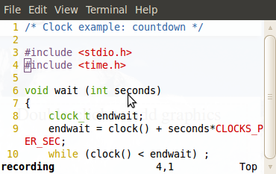
Advanced Editing, Macros
qc – start recording 'c'
q – stop recording
@c – execute recording 'c'
@@ - execute last recording
12@@ execute last recording 12 times.

Slide 22
Search & Replace

Slide 23
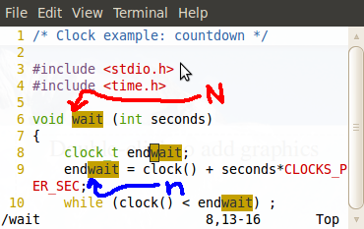
Searching Backwards and Forwards
Search Highlighting
:set hlsearch
/the – search forwards for “the”
?the – search backwards for “the”
n – next match
N – previous match

Slide 24
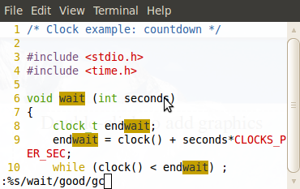
Replace
Replace “hi” with “lo” for all “hi” in the file.
:%s/hi/lo/g
Same thing, but ask me before each replacement.
:%s/hi/lo/gc

Slide 25
Customizing

Slide 26
.vimrc File
Goes in your home directory
Whenever you start a new vim session, vim references this file if it exists and runs all of the commands in it.
A .vimrc file can be run inside of a vim session by typing:
  :source ~/.vimrc

Slide 27
Useful Configurations
Line numbers:
  :set number
Highlighted Searching
  :set hlsearch
Pasting code into vim (preserve indentation)
  :set paste → Turns on pasting
  :set nopaste → Make sure to turn it off!

Slide 28
Controlling Indentation and Tabs
Set tab width to a reasonable length
  :set tabstop=2
Set automatic indentation when coding
  :set autoindent
  :set smartindent
Set indentation width (different from tab width)
  :set shiftwidth=2

Slide 29
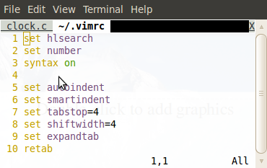
Open Multiple Tabs!!!
vim -p file1 file2
:tabnew file3 – open new tab for file3
gt – switch to next tab
gT – switch to previous tab
:q – quit tab

Slide 30
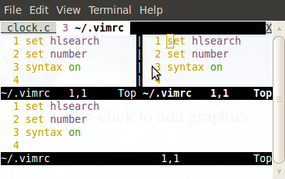
Multiple Windows
^wv – split windows vertically
^ws – split windows horizontally
^ww – move to next window

Slide 31
Resources
Vim Documentation: (for cards)
http://vim.wikia.com/wiki/Vim_documentation

Slide 32
Questions?

Slide 33
Announcements
Linux 201 Session 2: Python is Feb 13th here from 7-8pm

