Slide 1
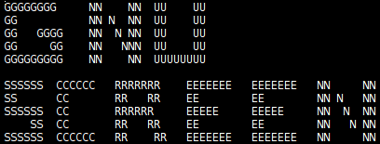
GNU Screen
By Nick Geirland

Slide 2
Plugging for PLUG
Github
Next 201

Slide 3
Basics
Invoking screen
C-a (C-a a)
: (nethack)
Case Sensitive
Window Manager
C-a ?

Slide 4
Workspaces
C-a (C-)c (C)
C-a 0-9
C-a “
C-a A (title)
C-a '
Specific Windows (:screen)

Slide 5
More Workspaces
C-a (C-)n (spc)
C-a (C-)p (bckspc)
C-a C-a

Slide 6
Killing
C-a (C-)k
C-a x (kind of)
C-a \

Slide 7
Detach and Retach
C-a D D
C-a (C-)d
Screen -r
Autodetach on (default) off (hangup)
Set password in screenrc

Slide 8
Copying and Logging
C-a (C-)[ (esc)
C-a (C-)]
C-a < > =
C-a {
C-a }
C-a H
C-a h

Slide 9
Sub-Windows
C-a |
C-a S
C-a Tab
C-a Q
C-a X
Resize (+,-,set,=,max,min)

Slide 10
Multiuser
C-a :multiuser on
C-a :acladd
C-a :aclchg
C-a :acldel
C-a *

Slide 11
Questions?

