Slide 1
Linux 201: Session 1
Speaker: Alex Ryker
Email: aryker@purdue.edu

Slide 2
Setting up a Linux Lab
Linux is free, and hardware is getting cheaper every day. Because of this, many serious programmers have created their own laboratories for hardware and software development.
This is a very attainable goal, but it comes with its fair share of challenges. Through these presentations, you will learn how to set up your own Linux-based development environment.

Slide 3
Choosing Your Linux Distribution
Which version or versions of Linux you decide to use will vary widely based on several things:
  Your development focus. Are you writing games, networking software, distributed systems, or something else?
  Your hardware. Does your lab consist of mostly higher-end machines, or are you using older, more dated technology?
  Personal preference. Are you more familiar with a particular environment? Does one distro bundle more of your favorite programs?

Slide 4
Suggestions/Starting Points
Ubuntu is great for general-purpose use, and it's very user-friendly. It won't run well on older hardware, however.
Fedora is another good general-purpose distro. It's less friendly for beginners, and its tool set is a bit different.
Puppy Linux works great for old machines with small amounts of RAM.
Network Security Toolkit(NST) is ideal for networking stuff, and it's a great choice for a router replacement/firewall.

Slide 5
Your Physical Environment
Limited space can be a major obstacle. Keep these things in mind when choosing a lab space:
  Power. Are there enough outlets for your needs?
  Privacy. How easy would it be for someone to steal something?
  Comfort. What is the normal ambient temperature, and can it be easily heated or cooled? Is there ample ventilation?

Slide 6
Suggestions
Depending on your circumstances, you may need to make heavy use of power strips. Keep the total current draw for the room in the back of your mind, so you don't blow breakers or start fires.
Electronic equipment generates a lot of heat. Make sure the area is sufficiently ventilated and cooled, especially if you are also planning to work with chemicals or soldering irons.
Making use of shelving can give you a lot of extra room. Shelving is usually cheap—it's also very easy to build from scratch!

Slide 7
Choosing Hardware
Depending on your circumstances, your options for hardware may be limited. Keep these things in mind when adding hardware to your lab:
  Price. You can usually find used computers at very reasonable prices.
  Power. You will often find that lower-end hardware is capable of more than you would expect. This is especially true for Linux, since there are distros specifically designed for low-end hardware.

Slide 8
Suggestions/Starting Points
Find a local computer repair shop. They will typically have used computers for sale at a reasonable price that have been wiped and work like the day they were bought.
Don't buy too much at once— add RAM gradually, and only when needed. This will save you lots of money in the long run.
Don't buy anything if you don't have a clear purpose in mind for it.

Slide 9
Example Work Environment
Over the summer, I turned my bedroom into an efficient development environment, without spending a fortune. I use my lab for the following things:
  Distributed System research for Purdue.
  Gaming and game development.
  Electronics and circuitry work.
  FTP and web hosting.
  Robotics
  Schoolwork and general programming.

Slide 10
Hardware and Software
Alienware M17x Laptop
  Main development machine.
  3.0 GHz, 8GB RAM
  Dual-boots NST and Windows 7, Ubuntu VM
Insignia PC
  Acts as the router and firewall for my LAN.
  Runs NST
Dell PC
  Acts as an FTP server
  Runs NST

Slide 11
Hardware and Software
Dell PC
  Runs Windows XP
  Good for testing program compatibility
  I can play older games on it
Ancient Gateway
  Runs a custom distro, very stripped-down
  Used for network testing, and as an extra node in the network.
Toshiba Netbook
  Runs NST, used for testing and as an extra node.

Slide 12
Other Tools
Oscilloscope
Small Window A/C Unit
Homemade shelving
Lamp
Soldering iron
Electronics and woodworking tools
Storage Cabinet
Comfy chair

Slide 13
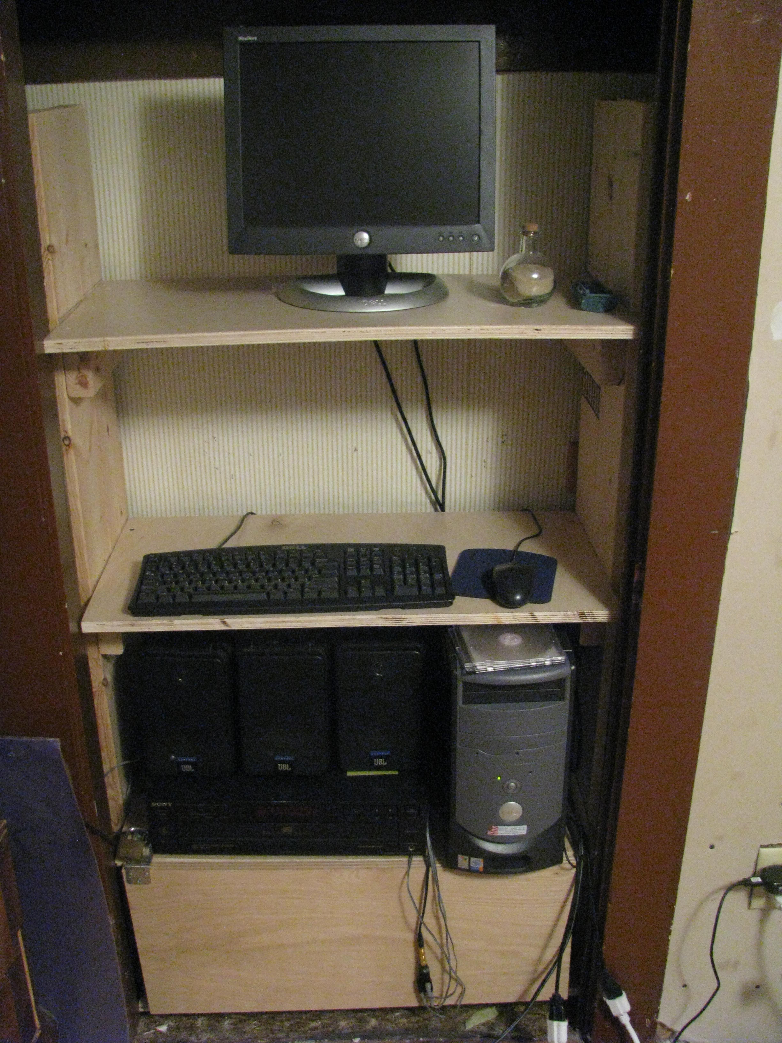

Slide 14
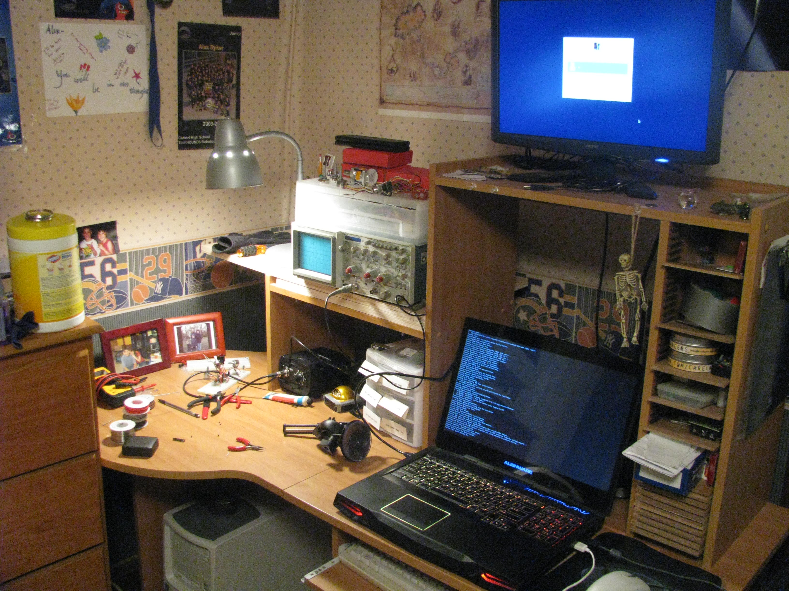

Slide 15
Useful Services
Linux has a plethora of tools that you will find invaluable while working on your projects. A few notable ones are:
  SSH
  SCP
  FTP and SFTP
  SSMTP
For now, we will go through a brief overview of each of these. They will be covered in a more in-depth manner in future sessions.

Slide 16
SSH and SCP
SSH stands for Secure Shell, and it allows you to remotely connect to another machine via the Linux terminal. From there you can run any valid terminal commands, and they will be executed on the remote machine.
SCP stands for Secure Copy, and as the name implies, it allows you to securely copy files from one computer to another via the SSH protocol.

Slide 17
FTP and SFTP
FTP stands for File Transfer Protocol. It is widely used on servers to allow the transfer of files between computers over the internet. It is not secure like SCP, but it is more versatile.
SFTP stands for Secure FTP. Like SCP, it is a file-transfer system based on the SSH protocol. It offers the security of SCP combined with the capability of FTP.

Slide 18
SSMTP
SSMTP is a program used to send emails. It is not a full mail server program, as it cannot receive mail, only send it. It is widely used on Linux servers to send automated notifications to the system administrators.

Slide 19
The Coming Sessions
In the next session, we will be looking at setting up a custom LAN with a Linux machine acting as the router.
In future sessions, we will also be looking at custom-designed firewalls, useful software tools, and adding embedded electronics to your work area to make it smarter.
Please fill out the short survey—we will be creating at least one session based on your feedback!

Slide 20
Upcoming Events
Session 2 of Linux 201 will be at 6:00 PM on Thursday, September 27 in LWSN 1106.
Session 2 of Linux 101 will be at 7:00 PM on Thursday, September 27 in LWSN B158.
The next PLUG member meeting is at 6:00 PM on Monday, September 24.

Slide 21
Questions/Comments?
Feel free to email me: aryker@purdue.edu
My office hours are on Mondays from 4:30-5:30 PM in the PLUG office(LWSN B128).

