Slide 1
Linux 201: Session 2
Speaker: Alex Ryker
Email: aryker@purdue.edu

Slide 2
Setting Up a LAN
Most household LANs are connected to the internet via a small router, such as a Linksys WRT54G. It is typically configured to act as a firewall and perform Network Address Translation(NAT). This protects the LAN from the outside world, while still allowing machines inside the LAN to connect to the internet.
Despite the ease of setup involved with a typical router, it does not always offer the freedom and capability that many developers need.

Slide 3
Setting Up a LAN
Almost any computer running a capable Linux distribution can be configured to act as a router. This has several advantages:
  A full suite of Linux tools is available
  Firewalls become completely customizeable
  Packet capture becomes much easier
  Additional services, such as FTP or proxy servers, can be configured without the need for a separate machine.

Slide 4
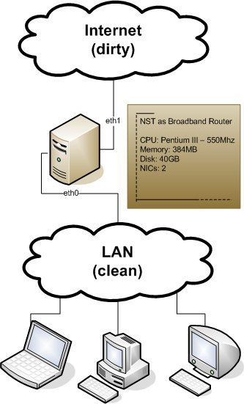
Setting Up a LAN

Slide 5
Problems and Solutions
Setting up a Linux box as a router for your LAN is fairly complicated. Some of the issues we will address are:
  Establishing internet connectivity throughout the LAN
  Getting wifi working
  Planning for unexpected shutdowns
  Custom-building a firewall
  Setting up extra services

Slide 6
Hardware Setup
In order for a computer to act as a router, it must have a minimum of two network interfaces—one will connect directly to the internet, and the other will connect to your LAN.
Desktop computers with multiple network interfaces are relatively uncommon. Fortunately, USB wireless adapters are available, and several have support built into many Linux distros by default. This is a simple, cost-effective way to add an an extra interface.

Slide 7
Hardware Setup
Even so, unless your computer is very special, you will still need something to act as a bridge in order to provide connectivity for the other machines in your network.
Depending on how you want to configure your LAN, you can either use a stricly wired bridge, which will only provide connectivity via ethernet cable, or you can use a router to provide both wired and wireless connection to your LAN. We will cover this in a few moments.

Slide 8
Hardware Setup
Even so, unless your computer is very special, you will still need something to act as a bridge in order to provide connectivity for the other machines in your network.
Depending on how you want to configure your LAN, you can either use a stricly wired bridge, which will only provide connectivity via ethernet cable, or you can use a router to provide both wired and wireless connection to your LAN. We will cover this in a few moments.

Slide 9
Assumptions For This Example
For the sake of this presentation, we will go through the process of setting up a LAN such that:
  A desktop computer running Linux will be acting as the firewall.
  A router is acting as a bridge for the network, providing both wired and wireless connectivity.
  We want to dynamically assign IP addresses to each client machine in the network.
  The interface connecting to the internet is wlan0, and the interface connecting to the LAN is em1.

Slide 10
Initial Router Configuration
Even though our client machines will have dynamic IP addresses, we still need to ensure that our new router has a static IP address.
This can be done easily by writing a short config file.

Slide 11
Initial Router Configuration
Even though our client machines will have dynamic IP addresses, we still need to ensure that our new router has a static IP address.
This can be done easily by writing a short config file.
To do this, you need to create the file:
  /etc/sysconfig/network-scripts/ifcfg-<YOUR NETWORK INTERFACE>

Slide 12
Initial Router Configuration
The script should be created as follows:
cd /etc/sysconfig/network-scripts/
emacs ifcfg-em1

Slide 13
Initial Router Configuration
The script should look something like this:
DEVICE=em1
BOOTPROTO=static
IPADDR=192.168.10.1
NETMASK=255.255.255.0
NETWORK=192.168.10.0
BROADCAST=192.168.10.255
GATEWAY=192.168.10.1
ONBOOT=yes
NM_CONTROLLED=no

Slide 14
Initial Router Configuration
After you write this script, the network service on the Linux machine needs to be restarted:
  sudo systemctl restart network.service

Slide 15
DHCP
Dynamic Host Configuration Protocol, or DHCP, is a network protocol that is used to automatically assign every computer in a network an IP address in order to provide network connectivity.
Most routers have this service enabled by default, so we must first disable DHCP for our ordinary router. This will vary based on the specific model of router, but usually can be done through the router's web interface.

Slide 16
DHCP
There is a service in Linux for running a DHCP server that can be enabled once installed. First, however, it needs to be configured as well, via the config file:
cd /etc/dhcp/
cp ./dhcp.conf ./dhcp.conf.orig
emacs dhcpd.conf
Note: It is always a good idea to make backups of scripts when you modify them.

Slide 17
DHCP
Remove the current contents of the file, and replace them with something like the following:

Slide 18
DHCP
ddns-update-style interim;
ignore client-updates;
get-lease-hostnames true;
subnet 192.168.10.0 netmask 255.255.255.0 {
option routers 192.168.10.1;
option subnet-mask 255.255.255.0;
option nis-domain "your.domain";
option domain-name "your.domain";
option domain-name-servers 8.8.8.8;
option time-offset -18000;
option ntp-servers 192.168.10.1;
range dynamic-bootp 192.168.10.100 192.168.10.150;
default-lease-time 21600;
max-lease-time 43200;
}

Slide 19
DHCP
This script will ensure that every client machine on your LAN will be given an IP address in the format 192.168.10.1xx.
Also note that this script makes use of Google's publicly available DNS server.
All these options can be changed based on your preferences.

Slide 20
DHCP
To start the DHCP service, use the following commands:
  sudo chkconfig dhcpd on
  sudo service dchpd start

Slide 21
Network Address Translation(NAT)
In order to provide internet connectivity to all machines in the LAN, a router needs to take all incoming and outgoing network packets, and modify their IP information so that:
  Outgoing packets are seen by recipients as sent from the forward-facing, public IP address.
  Incoming packets are routed back through the LAN to the correct machine.
This is called Network Address Translation, or NAT. Most routers do this by default, but you will have to manually configure it for a Linux computer acting as a router.

Slide 22
Network Address Translation(NAT)
To configure your router for NAT, you can use the software tool iptables.
Iptables is used to build custom firewalls, so using iptables for your NAT has the added bonus of setting up a blank firewall that you can customize according to your needs later.

Slide 23
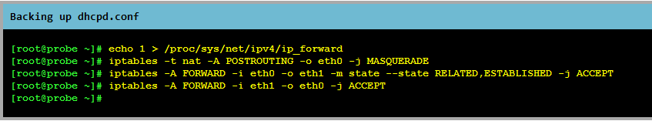
Network Address Translation(NAT)
To configure iptables for NAT, enter the following commands as root:

Slide 24
Success!
Your Linux machine should now be set up for basic router functionality.
If you are still having problems, you may need to check your routing table for erroneous entries:
  sudo route -n

Slide 25
The Coming Sessions
During the next session, we will go over a few more networking concepts, and cover some common bugs that can crop up in this process, as well as a few alternatives to the method presented today.
In future sessions, we will cover useful development tools and security concepts. We will also go over adding Windows machines and embedded electronics to your lab.

Slide 26
Upcoming Events
Session 3 of Linux 201 will be on Thursday, October 11 at 6:30 PM in LWSN 1106.
Session 3 of Linux 101 will also be on Thursday, October 11 at 7:00 PM in LWSN B158.
The MATH supercomputer tour will be on Thursday, October 18 at 6:00 PM
The PLUG Hackathon will either be on October 20 or 27—let us know which works better for you!

Slide 27
Questions/Comments?
Feel free to email me: aryker@purdue.edu
My office hours are on Mondays from 4:30-5:30 PM in the PLUG office(LWSN B128).
Posts on the PLUG Facebook page typically get quick responses—feel free to ask a question there.
I wrote a Wiki article about the material presented today—you can find it here:
http://wiki.networksecuritytoolkit.org/nstwiki/index.php/Firewall_Setup_Tips

