Slide 1
Linux 201: Session 3
Speaker: Alex Ryker
Email: aryker@purdue.edu

Slide 2
Commonly Used Tools
There are many software packages available for Linux that can make your life very convenient. This presentation will cover the installation and use of some of the most popular server tools.

Slide 3
SSH
SSH stands for Secure Shell, and is used for remote terminal access. It is installed by default on most Linux distros.

Slide 4
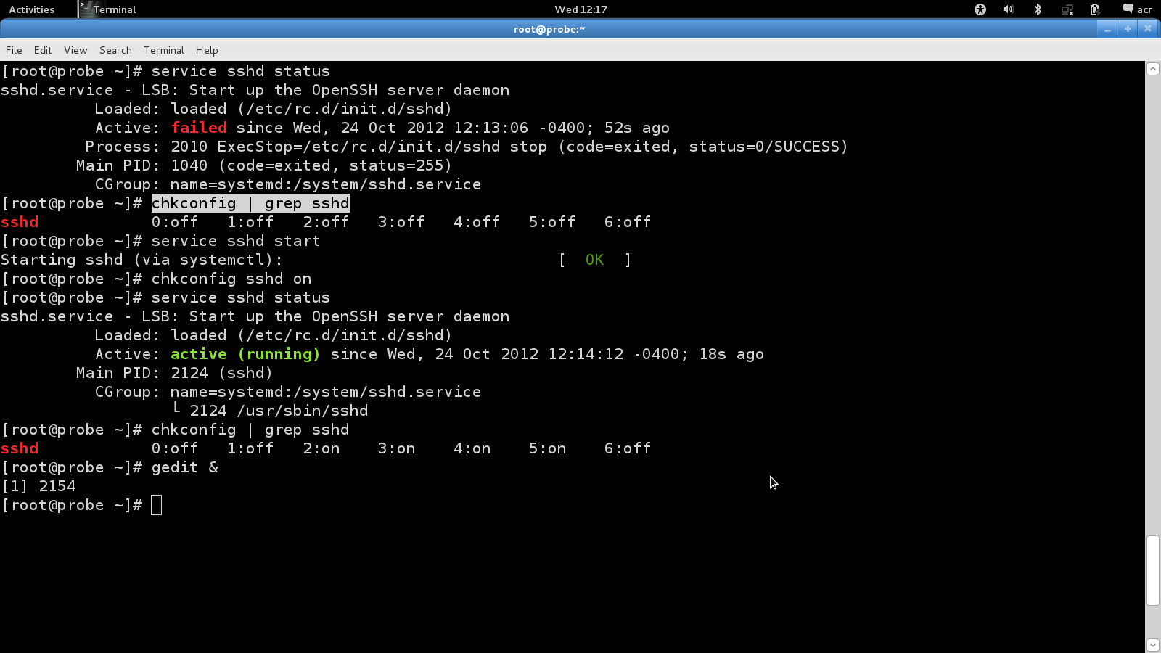
SSH

Slide 5
VSFTPD
Very Secure File Transfer Protocol Daemon turns your Linux machine into an FTP server. It has many options that can be set through a configuration file.
http://www.linuxhomenetworking.com/wiki/index.php/Quick_HOWTO_:_Ch15_:_Linux_FTP_Server_Setup

Slide 6
SSMTP
SSMTP is a send-only email program can be used to send emails to a given email address. It is commonly used in server scripts to alert the server administrator that something important is happening.
A sample configuration script for SSMTP can be found here:
http://purduelug.org/wiki/index.php/How_To_Set_Up_SSMTP

Slide 7
Tunneling
Tunneling is the process of encapsulating one network protocol inside of another. A common application of this is to tunnel an unencrypted protocol through SSH.
You can find an example of SSH tunneling here:
  http://www.linuxjournal.com/content/ssh-tunneling-poor-techies-vpn

Slide 8
Nmap/Zenmap
Nmap is a network scanning tool. It does many useful things, such as scanning for open ports, what OS the target system is using, and what services it is running.
Nmap runs exclusively in the Linux terminal. However, there is a graphical version of Nmap called Zenmap that is much easier to use.

Slide 9
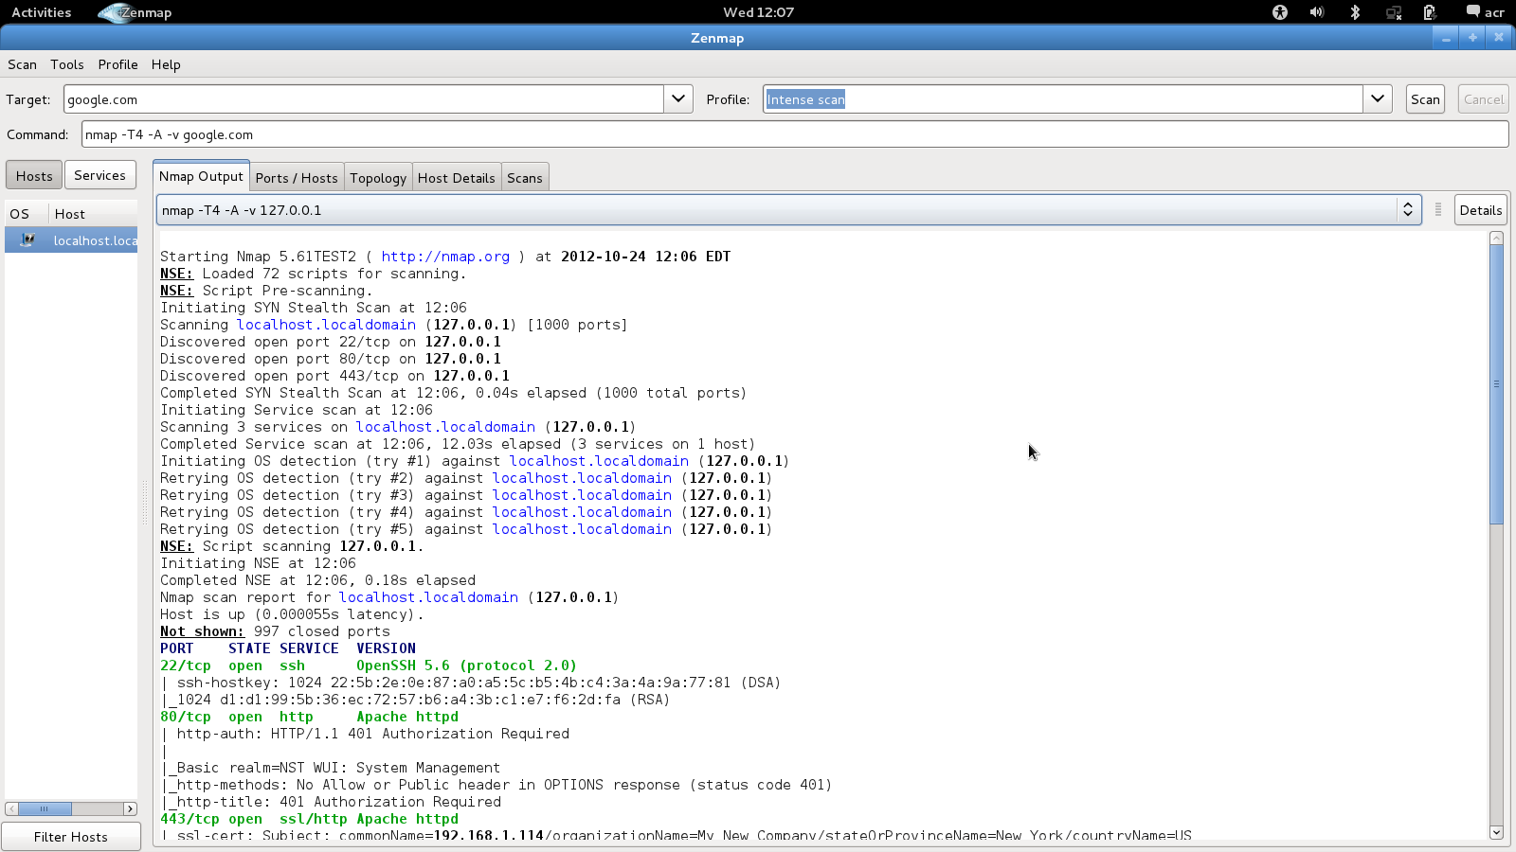
Nmap/Zenmap

Slide 10
Kismet
Kismet is a wireless network scanner. It can detect hidden networks, and work as an instrusion detection system.

Slide 11
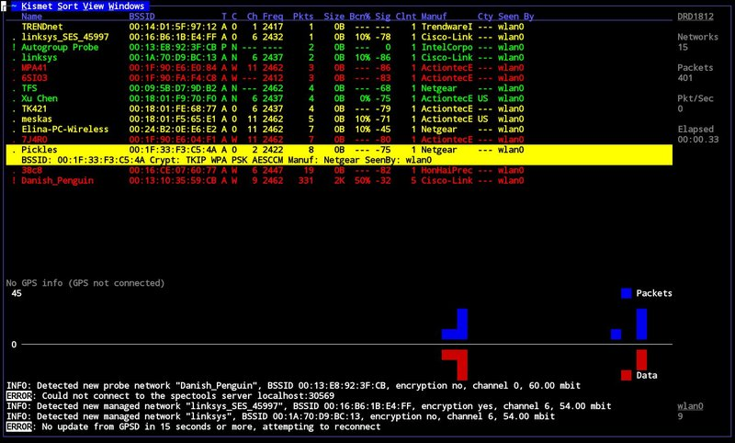
Kismet

Slide 12
Wireshark
Wireshark is a network protocol analyzer. It can capture packets as they travel over a given network and present them in a comprehensive way for the user to examine.
It is one of the most widely-used network security tools in the world, and can be a huge help when examining your network for vulnerabilities.

Slide 13
VNC
VNC stands for Virtual Network Computing. It is a protocol for screen-sharing over networks.
It is very common to run servers without any sort of monitor or input devices connected. This saves space, since one your services are set up, you rarely need to directly interact with the server machine. As such, VNC can be an invaluable tool if you need to look at actual screen output from your server.
There are links to VNC server setup guides here: http://purduelug.org/wiki/index.php/How-To_Pages

Slide 14
Telnet
Telnet is a protocol for remote terminal control, similar to SSH. However, unlike SSH, Telnet sends all its data as plaintext. This is obviously very insecure.
The following demonstration shows how easy it is to use Wireshark to snoop on a Telnet connection, and should serve as a warning to use SSH whenever possible!

Slide 15
The Coming Sessions
During the next session, we will go more in-depth into security. We will cover custom firewall creation with iptables, and go over some common vulnerabilities to avoid.

Slide 16
Upcoming Events
Session 4 of Linux 201 will be on Thursday, November 8 at 6:30 PM in LWSN 1106.
Session 4 of Linux 101 will also be on Thursday, November 8 at 7:00 PM in LWSN B158.

Slide 17
Questions/Comments?
Feel free to email me: aryker@purdue.edu
My office hours are on Mondays from 4:30-5:30 PM in the PLUG office(LWSN B128).
Posts on the PLUG Facebook page typically get quick responses—feel free to ask a question there.
Most of the material covered today has accompanying articles that go more in-depth about setup and features. They can all be found on the PLUG Wiki.

