Slide 1


Slide 2


Slide 3


Slide 4
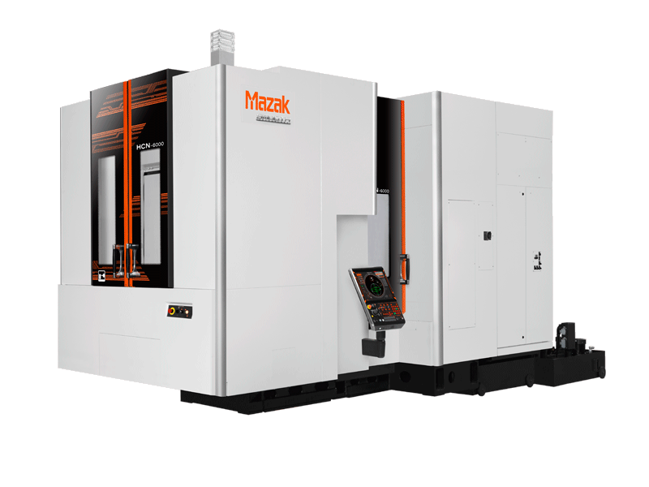

Slide 5
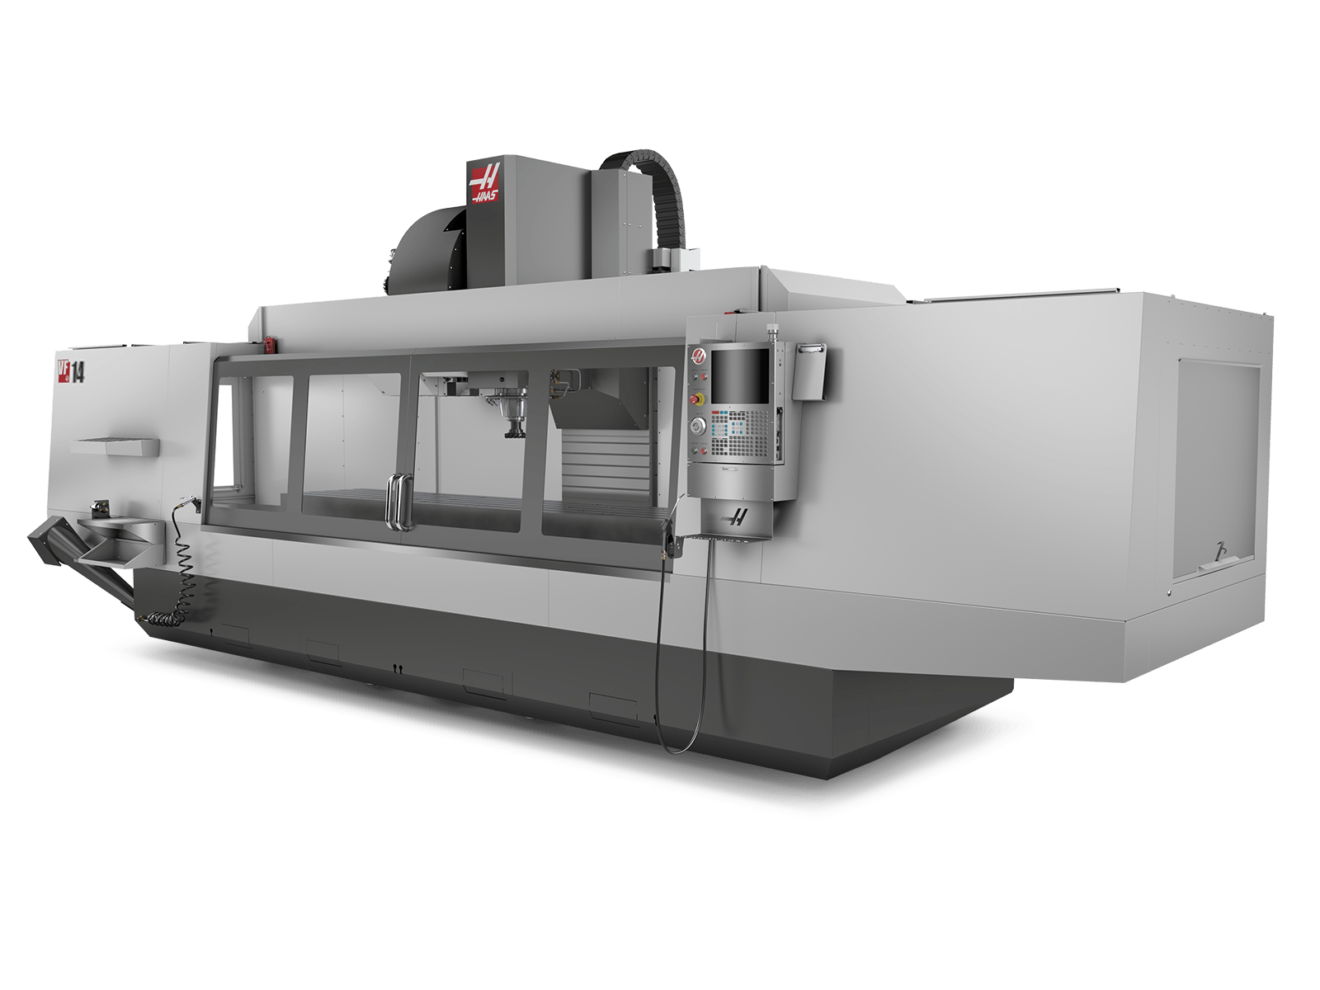

Slide 6


Slide 7


Slide 8


Slide 9




Slide 10





Slide 11





Slide 12




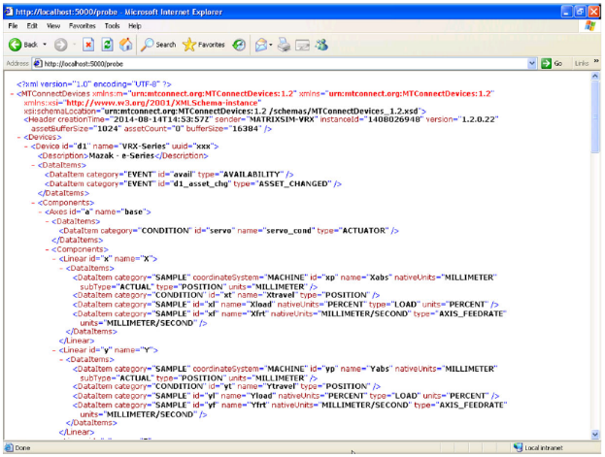



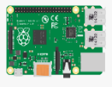
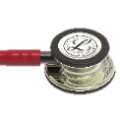


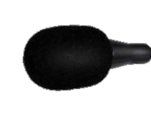
Real-time visualization
MySQL DB
(Purdue SENSE server)
Grafana dashboard
(Purdue SENSE server)
End-users
Agent collector
MTConnect Agent
TCP/IP
Sound data
Raw IoT sensor data collection
MTConnect
Adapter
MTConnect agent (web server)
MTConnect
Adapter
@Spindle
BOX.COM cloud storage
Mazatrol 640M controller
USB Comm.
@X-axis motor
Serial communication
(Modbus RTU)
REST API
@Y-axis motor
@Base
@Z-axis motor
IFM vibration and temperature sensor
@Main power
HCN-6000 II
Power meter
@Inside of machine
IFM IO-Link master
Sound sensors

Slide 13



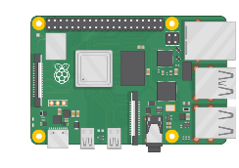

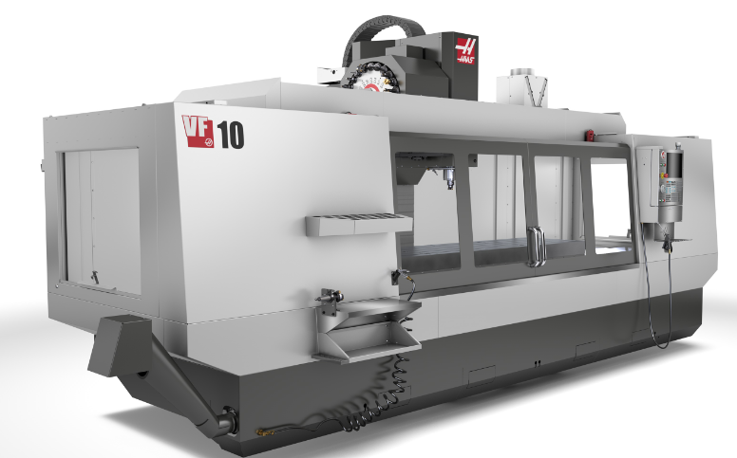

Real-time visualization and data analytics
Adapter
MySQL DB
(Purdue SENSE server)
Spindle
Position
Execution
Tool number
…
Raspberry Pi
Grafana dashboard
(Purdue SENSE server)
NGC
(Next Generation Control)
ISS @base
Sound data
Raw IoT sensor data collection
Haas VF10/50
Purdue-BOX.COM cloud storage
Microphone @inside

