Slide 1
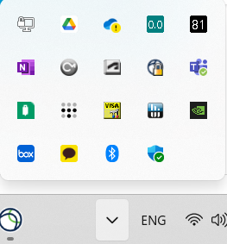
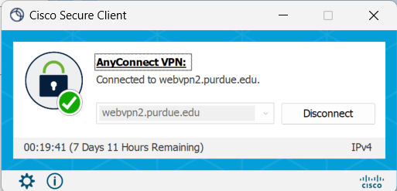
1. Left Click!
3. Connect
2. Type as “webvpn2.purdue.edu”

