Slide 1
PLEASE SIGN IN AT ONE OF THE 2 COMPUTERS UP FRONT
PSPE FALL 2013 CALLOUT

Slide 2
PSPE FALL 2013 CALLOUT
8/29/13
Notes:
Riley

Slide 3

What is PSPE?
PSPE stands for Purdue Society of Professional Engineers
Student chapter of:
National Society of Professional Engineers (NSPE)
Indiana Society of Professional Engineers (ISPE)
Notes:
Riley

Slide 4

Who we are:
Executive Committee
Riley Barta– President
Julian Hayes – Vice President
Jon Baker – Treasurer
Albert Sroka –Secretary
Committee Heads
Julian Hayes – Events Committee Head
Will Gresiak – Social Committee Head
Ryan Hom – Research Roundtable Head
Udit Vyas – Order of Engineer/MathCounts Head
Faculty Advisors
Dr. Vincent Drnevich, P.E. – Professor Emeritus of Civil Engineering
Brandon Fulk, P.E. – Internship coordinator for CEM
Notes:
Everyone introduce yourself here

Slide 5
What Does PSPE Do?
Encourages professionalism and professional licensure among students and staff
Fosters the Code of Engineering Ethics in the engineering community
Sponsors activities that promote awareness of career opportunities and the role of professional engineers
Notes:
Riley

Slide 6

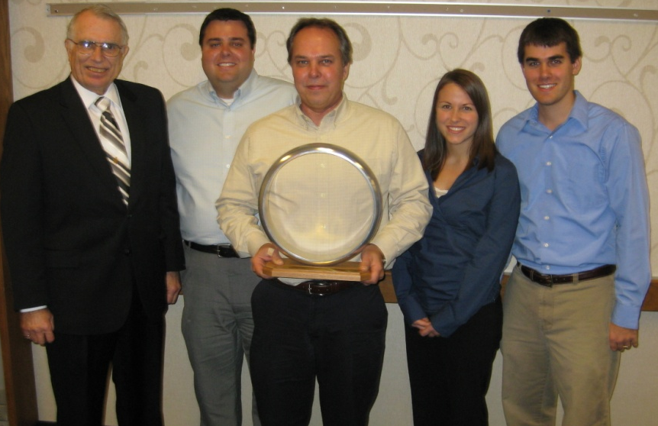
What Does PSPE Do?
Order of the Engineer Ceremony
Order of the Engineer inductees wear a stainless steel ring on the small finger of their working hand as a visible reminder of the oath of integrity and ethics that they take as part of the ceremony.
Participants must either be graduating engineering students or previous engineering graduates.
Notes:
Udit

Slide 7
What Does PSPE Do?
MATHCOUNTS is a regional and national competition promoting middle school mathematical achievements.
MATHCOUNTS is one of the country's largest and most successful education partnerships involving volunteers, educators, industry sponsors, and students.
Notes:
Udit

Slide 8

What Does PSPE Do?
Research Roundtable
It’s basically an Industrial Roundtable for research
Students can approach companies and professors and their graduate students about research opportunities
Find information about research opportunities in one location and take the first step toward contributing to a research team
Notes:
Ryan

Slide 9
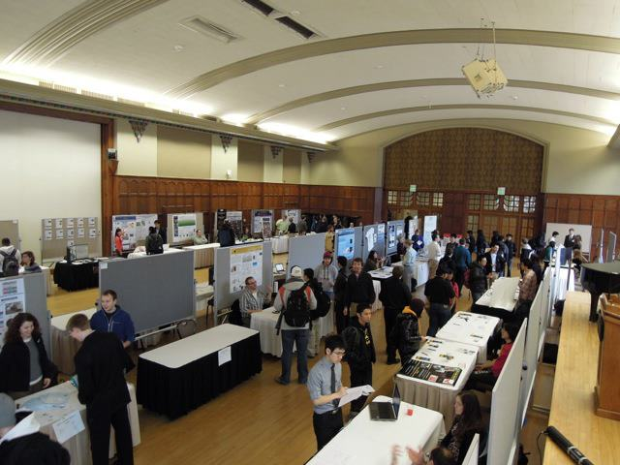
Research Roundtable Spring 2013
Notes:
Ryan

Slide 10
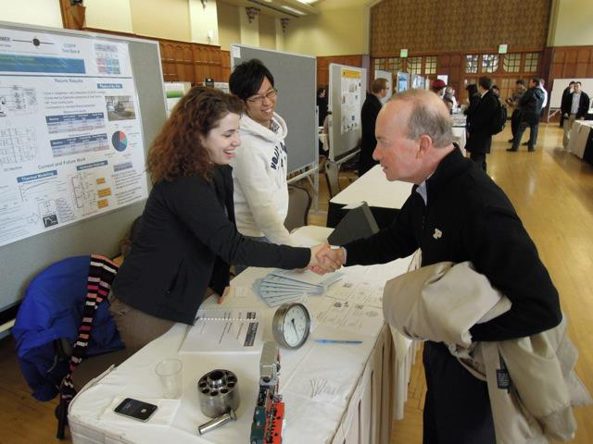
Research Roundtable Spring 2013
Notes:
Ryan

Slide 11
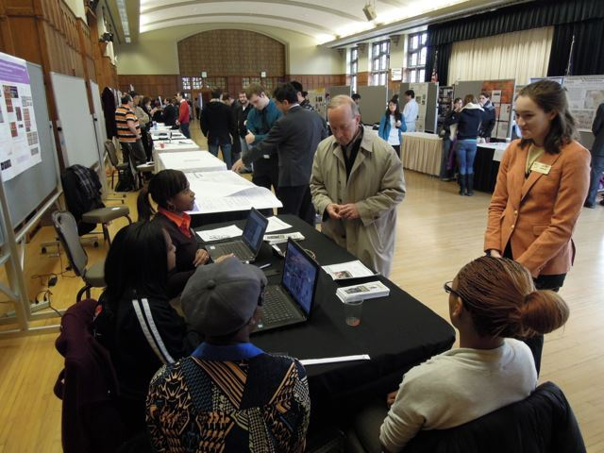
Research Roundtable Spring 2013
Notes:
Ryan

Slide 12
What Does PSPE Do?
Rube Goldberg Team
In short: A Rube Goldberg Machine takes a simple task (such as turning on a light, or feeding a fish (if you’ve seen Rueben Lucius Goldberg’s drawings)) and makes it extremely complicated.
PSPE’s team holds World Record for machine with most steps
Builds a machine every year in the spirit of the famous cartoon by Rube Goldberg
Competition held every year at the Armory
Notes:
Rube Goldberg President - Adam

Slide 13
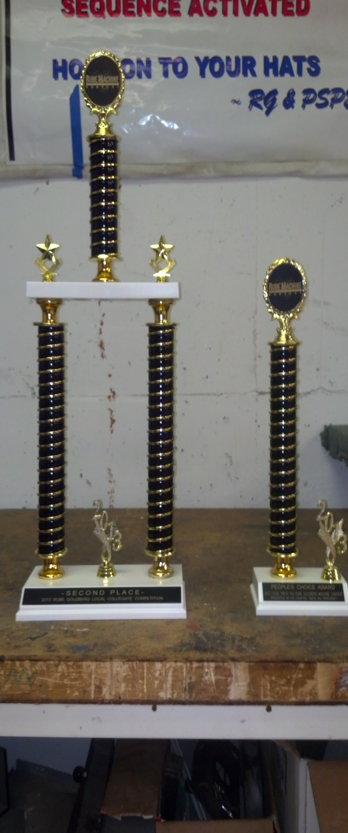
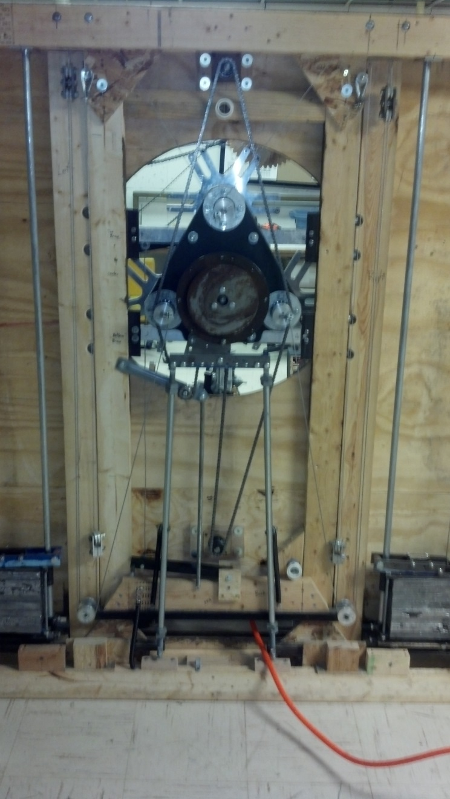
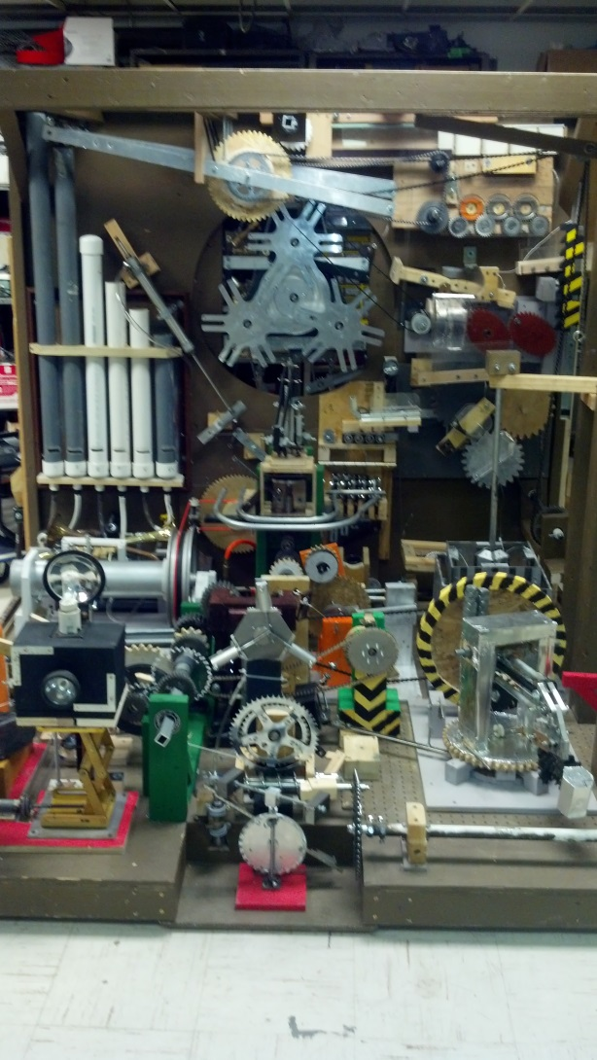
LAST YEARS MACHINE
BACK
FRONT
Notes:
Rube Goldberg President - Adam

Slide 14
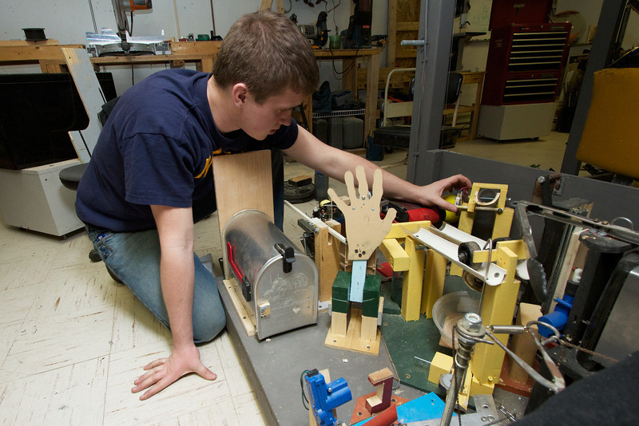
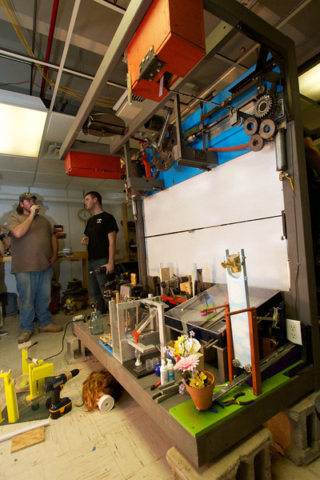
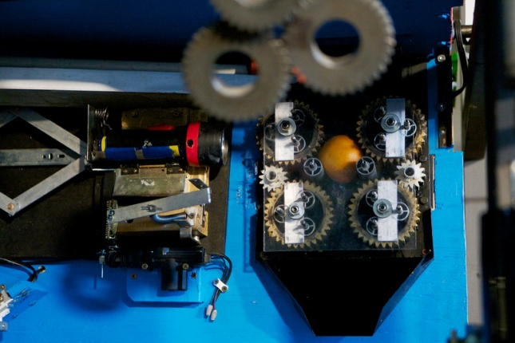
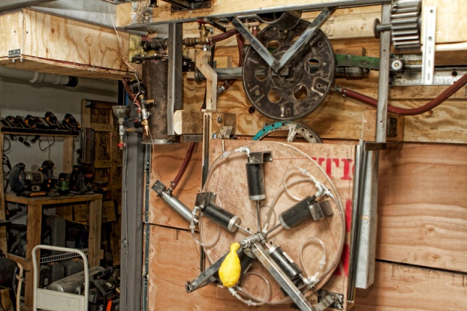
PSPE Rube Goldberg Team
Notes:
Rube Goldberg President - Adam

Slide 15
Rube Goldberg Fall 2013 Callout
Tomorrow night (8/30), 6:30 PM
HAMP (Civil) 2101
Notes:
Rube Goldberg President - Adam

Slide 16
What Does PSPE Do?
Events
We hope to have more companies come to speak to our members and take resumes
Professional development speakers (Resume talks, interview tips)
Special speakers for our members
Food at some member-only events
Dinner etiquette with Anthony Cawdron
CAT plant tour
Dr. Drnevich PE Licensure Talk
Notes:
Julian

Slide 17
What Does PSPE Do?
Service/Social
In charge of membership social events (at least 1 per semester)
The chief volunteers for the Order of the Engineer Ceremony and the MathCounts competition
Does service and volunteer work around campus and Lafayette/West Lafayette
In charge of float or poster for homecoming parade
Notes:
Will

Slide 18
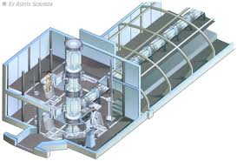
How Can PSPE Benefit You?
Offers leadership opportunities to give you an edge over your peers
Opportunities to speak with companies and other distinguished individuals
Sponsors events and distributes information to help you prepare for the Fundamentals of Engineering Exam and eventual Professional Licensure
Opportunities to be a committee member and help organize events for PSPE
In addition to your PSPE membership, you will receive free student membership into NSPE and ISPE
Great resume booster
Notes:
Riley

Slide 19
Leadership Opportunities
We are always looking for more leaders
Committee Positions Available:
Events
Social/Service
OE/MathCounts
Research Roundtable
We are in need of a Webmaster
Rube Goldberg Team is seeking new members
If you are interested in a position, come ask us about its responsibilities after the presentation.
Notes:
Riley

Slide 20
How to Join
Applications:
Due by Friday 9/06/2013
At front of room and on our website www.engineering.purdue.edu/PSPE/
Membership Dues:
$15 for the semester
$25 for the full year
It is mandatory to pay your dues when you turn your membership form
Must be an Engineering student to join PSPE.
Webmaster may be a non-engineering student
However, any major is welcomed with the Rube Goldberg Team
Information for joining NSPE and ISPE will be provided when you become a member.
Notes:
Jon

Slide 21
Committee Callout
For PSPE Members interested in joining a committee (Events, Research Roundtable, Service/Social)
Wednesday, September 4th at 6:30 PM
Location: Forney 1043
Please contact us (by email or at our office) if you are interested in joining a committee, but cannot attend this meeting
Committee Applications will be due Wednesday, September 11th
Notes:
Riley

Slide 22
Fall 2013 Office Hours
Our office is located at HAMP (Civil) 1250
Every Tuesday
11:00 AM to 12:00 PM – Julian Hayes
12:00 PM to 1:30 PM – Will Gresiak
1:30 PM to 2:30 PM – Ryan Hom
2:30 PM to 3:30 PM – Riley Barta
3:30 PM to 4:30 PM – Jon Baker
4:30 PM to 5:30 PM – Udit Vyas
By Request – Albert Sroka
Email us at pspe@ecn.purdue.edu if you would like to schedule an appointment outside of these times
Notes:
Riley

Slide 23
Contact Us
Our website
www.engineering.purdue.edu/PSPE/
Our Email
pspe@ecn.purdue.edu
PSPE Rube Goldberg
web.ics.purdue.edu/~pe/
Facebook
Facebook.com/pspe1
Twitter
@PurdueSPE
BoilerLink (GetInvolved)
boilerlink.purdue.edu/organization/pspe
PSPE office – HAMP (Civil) 1250
Notes:
Julian

Slide 24
FE Exam Announcements
Deadline for registering for the October 2013 FE Exam is Thursday, September 5th
That is exactly 1 week from tonight
Exam may be taken by seniors graduating in December
Individuals must complete a student application and mail it to NCEES at the address on the form before September 5, 2013
After submitting the FE approval application, register online with NCEES (deadline: September 5, 2013) to reserve your seat for the exam
NCEES Website for Indiana engineering exam registration
http://ncees.org/exams/state-pages/indiana-engineering-exam-registration/
Notes:
Ryan

Slide 25
Today’s Speaker
Brad Bowen
Former president of ISPE (Indiana Society of Professional Engineers)
Director of Energy and Engineering, Purdue Physical Facilities
Notes:
Riley
Brad Bowen will present, then we will resume our slideshow and display the last 2 slides.

Slide 26
THANK YOU ALL FOR COMING!!! DON’T FORGET TO SIGN IN AT ONE OF THE TWO COMPUTERS UP FRONT!
Notes:
Riley

Slide 27
Contact Us
Our website
engineering.purdue.edu/PSPE/
Our Email
pspe@ecn.purdue.edu
PSPE Rube Goldberg
web.ics.purdue.edu/~pe/
Facebook
Facebook.com/pspe1
Twitter
@PurdueSPE
BoilerLink (GetInvolved)
boilerlink.purdue.edu/organization/pspe
PSPE office – HAMP (Civil) 1250
Notes:
julian

