Slide 1
1. Practical Quantum Computing for Scientists

Slide 2
Lecture 1: Quantum Bits, Gates, and Circuits
Quantum Computing and IBM Qiskit
Quantum Mechanisms for Computing
Quantum Algorithms and Applications
Hands-on Exercise on IBM Q.

Slide 3
Quantum Computing
A host of new computer technologies has emerged within the last few years, and quantum computing is arguably the technology requiring the greatest paradigm shift on the part of developers.
Quantum computers were proposed in the 1980s by Richard Feynman and Yuri Manin.
Quantum computers are here, the next big challenge: A quantum skills shortage. The quantum computing industry will be a $65 billion market by 2030; others anticipate that up to 20% of organizations could be budgeting for quantum computing in 2023, up from 1% in 2018 - Gartner

Slide 4
Quantum Computing
The foundational core of quantum computing is to store information in quantum states of matter and to use quantum gate operations to compute on that information, by harnessing and learning to "program" quantum interference.

Slide 5
Quantum Computing
Quantum Computing harnesses the laws of quantum mechanics to solve problems to complex for classical computers
Model the behavior of individual atoms in a molecule
Identify subtle patterns of fraud in financial transactions
Combinatorial problems (Travelling Salesman, Maximum Independent Vertex Set)
Process large data sets for AI and Data Science

Slide 6
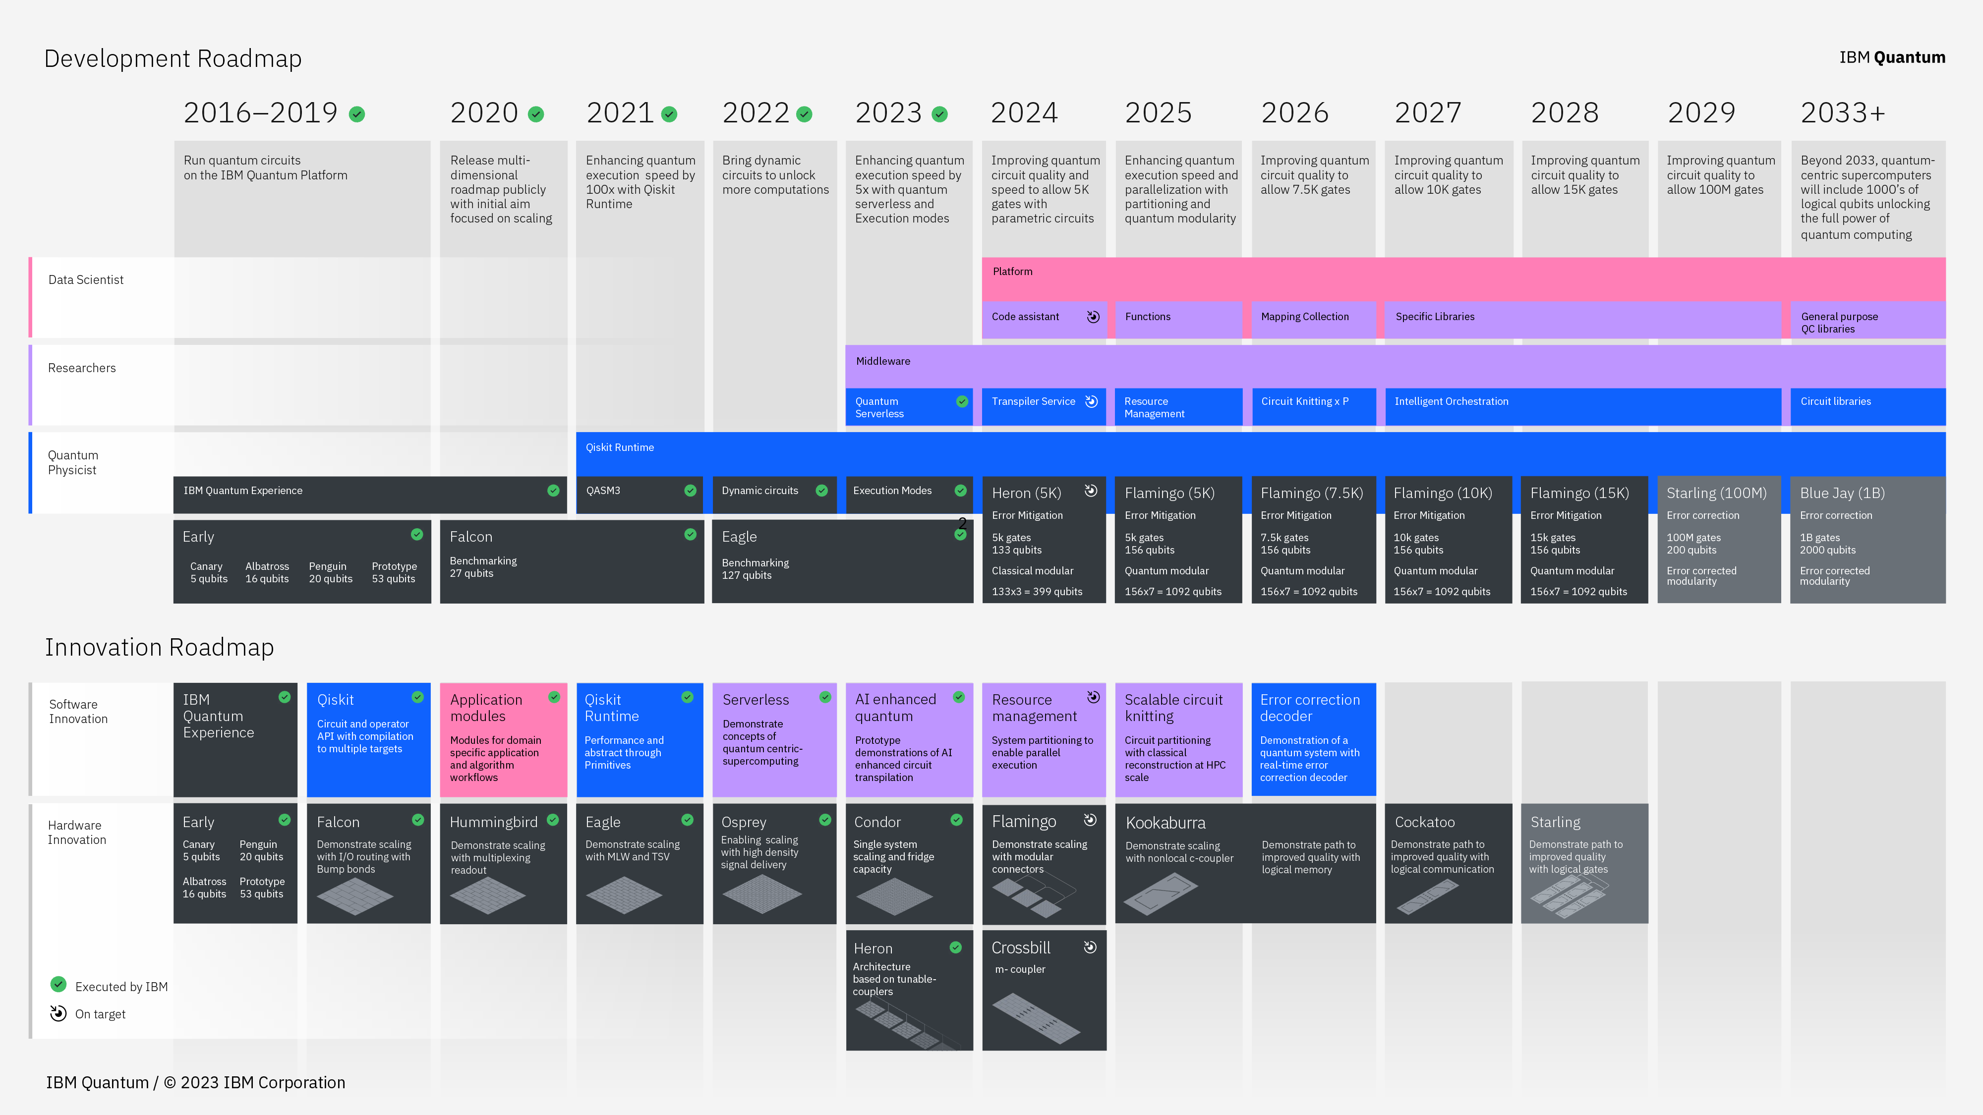
IBM Quantum Computing Roadmap

Slide 7
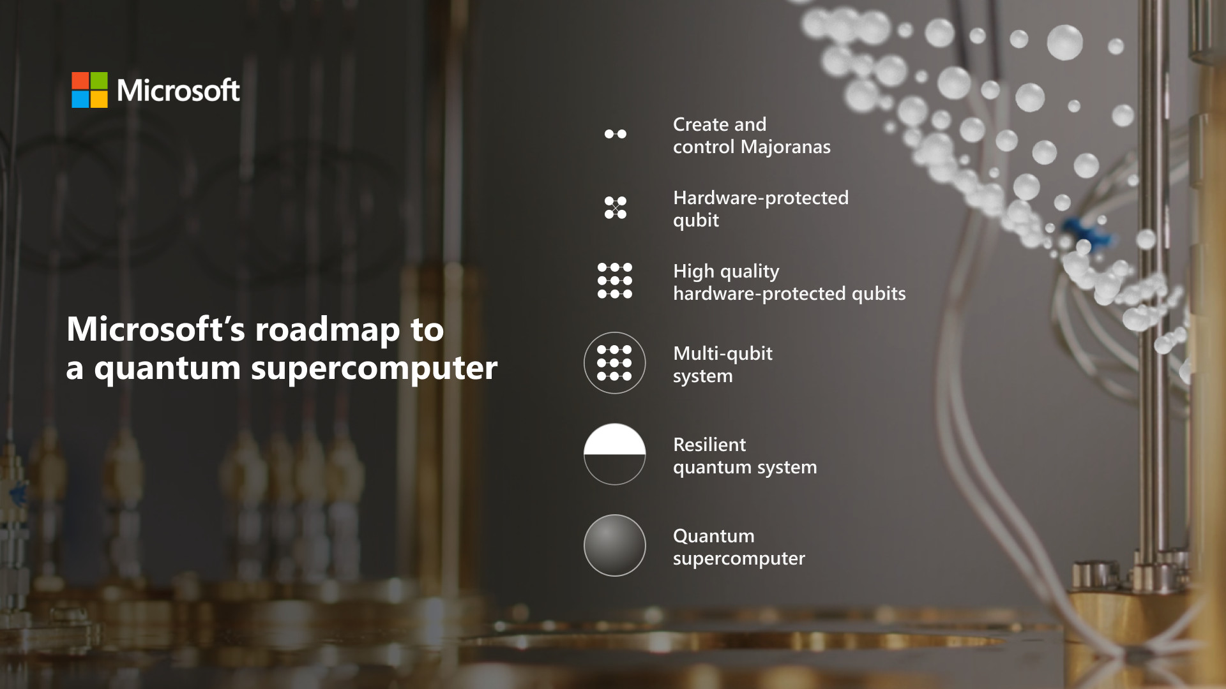
Microsoft Quantum Computing Roadmap

Slide 8
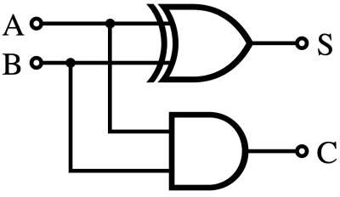
Circuits for addition in classical computing
A classical logic circuit is a set of gate operations on bits and is the unit of computation.
Truth table
XOR
A (input) | B (input) | S (sum) | C (carry out)
0 | 0 | 0 | 0
0 | 1 | 1 | 0
1 | 0 | 1 | 0
1 | 1 | 0 | 1
AND
Half adders circuit
Inputs are on the left, outputs are on the right, and operations are represented by symbols between them.

Slide 9

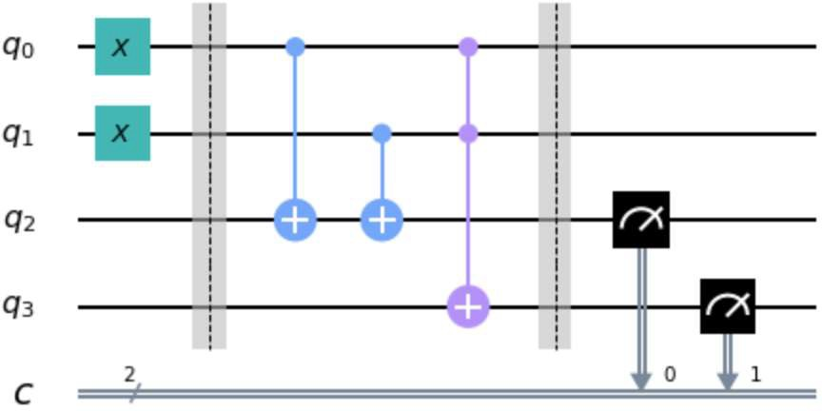
Models of Quantum Computing
For quantum computers, we use the same basic idea but have different conventions for how to represent inputs, outputs, and the symbols used for operations.
A sequence of basic quantum gates are applied on quantum bits.
Quantum gate
Quantum bits
Measurement
Half adders circuit in quantum computing
4

Slide 10


Typical single-qubit gates
NOT gate
Hadamard gate
Superposition
5

Slide 11
Single-qubit quantum state
|0⟩ and |1⟩ are vectors in the two-dimensional complex vector space ℂ² :
1
0
0
1
|0⟩ =
and |1⟩ =
For example, X gate is
0 1
1 0
X =
0 1 1
1 0 0
0
1
X |0⟩ =
=
= |1⟩

Slide 12
Single-qubit quantum state and unitary evolution
The arbitrary quantum state can be represented as a linear combination of |0⟩ and
|1⟩.
|𝜓⟩ = 𝛼|0⟩ + 𝛽|1⟩
where 𝛼 and 𝛽 are complex numbers such that 𝛼 ² + 𝛽 ² = 1.
The quantum state is evolved by Unitary operator 𝑈.
|𝜓′⟩ = 𝑈|𝜓⟩
𝑈†𝑈 = 𝑈𝑈† = 𝐼,
The quantum operation is reversible.
𝑈⁻¹𝑈|𝜓⟩ = |𝜓⟩
_{𝑈}† _{= 𝑈}−1
© 2024 International Business Machines Corporation
7

Slide 13
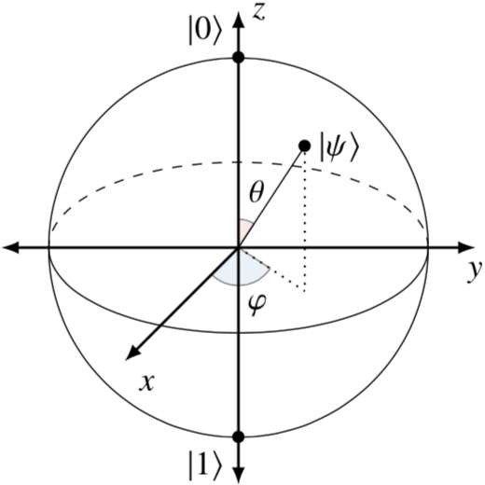
Bloch Sphere
A quantum state of single-qubit is
|𝜓⟩ = 𝛼|0⟩ + 𝛽|1⟩ 𝑠. 𝑡. 𝛼 ² + 𝛽 ² = 1
This allows us to write the quantum state as
𝜃 2
𝜃 2
𝑐𝑜𝑠 ^{𝜃}
|𝜓⟩ = 𝑐𝑜𝑠
|0⟩ + 𝑒^{𝒾𝜑} 𝑠𝑖𝑛
|1⟩ ＝
2
𝑒^{𝒾𝜑}𝑠𝑖𝑛 ^{𝜃}
2
The single qubit quantum state can be mapped to
the Bloch sphere.
8

Slide 14
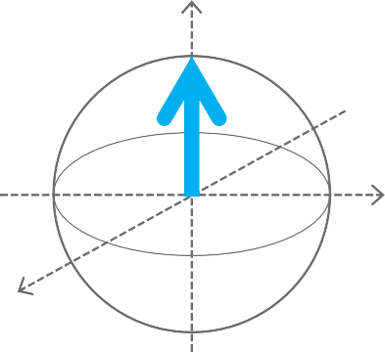
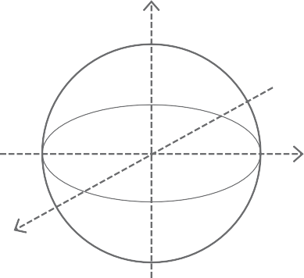


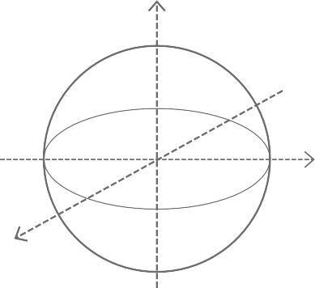
Bloch sphere
Equator: equal superposition
|0>
North pole |𝟎⟩ ^{𝔃}
𝔃
Axis between
x-axis and z-axis
𝔂
𝔂
𝟏
𝟏
𝔁
𝔁
|𝟎⟩ +
|𝟏⟩
𝟐
𝟐
or | +⟩
𝔃
𝔃
𝟏
𝟏
|1>
|𝟎⟩ −
|𝟏⟩
𝟐
𝟐
A pure quantum state is
a vector pointing from the center to a point on the sphere of radius 1.
or | −⟩
𝔂
𝔂
𝔁
South pole |𝟏⟩
𝔁
9

Slide 15

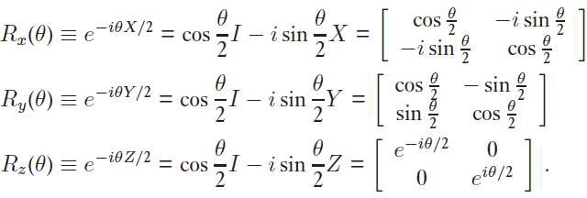
Typical single-qubit gates
Reference: https://javafxpert.github.io/grok-bloch/
10
© 2024 International Business Machines Corporation

Slide 16
Superposition
Superposition is creating a quantum state that is a combination of |0⟩ and |1⟩
|𝜓⟩ = 𝛼|0⟩ + 𝛽|1⟩ =
𝛼
𝛽
𝑠. 𝑡. 𝛼 ² + 𝛽 ² = 1
Note that if 𝛼 and 𝛽 are non-zero, then the qubit’s state contains both |0⟩ and |1⟩.
This is what people mean when they say that a qubit can be “0 and 1 at the same
time.”
11

Slide 17
Measurement
Measurement is forcing the qubit’s state
𝛼|0⟩ + 𝛽|1⟩ 𝑠. 𝑡. 𝛼 ² + 𝛽 ² = 1
to |0⟩ or |1⟩ by observing it, where
|𝛼|² is the probability we will get |0⟩ when we measure.
|𝛽|² is the probability we will get |1⟩ when we measure.
So, 𝛼 and 𝛽 are called probability amplitudes.
(Born rule)
For example,
² |0⟩ + ² |1⟩ has an equal probability of becoming |0⟩ or |1⟩, and
2 2
³ |0⟩ — ¹ i |1⟩ has a 75% chance of becoming |0⟩.
2 2
12

Slide 18
Measurement operators
In case of standard basis measurements, the measurement operators are
0 0 .
0 1
𝑀₀ = 0⟩ۦ0 =
¹ ⁰ , 𝑀₁ = 1⟩ۦ1 =
0 0
Standard basis is |0⟩ and |1⟩.
If the state of the quantum system is |𝜓⟩ = 𝛼|0⟩ + 𝛽|1⟩, then the probabilities of observing
the outcome are
1 0 1 0
0 0 0 0
0 0 0 0
0 1 0 1
𝛼
𝛽
_{𝛼} 2
𝑝₀(𝑜𝑢𝑡𝑐𝑜𝑚𝑒 𝑖𝑠 0) = ۦ𝜓|𝑀† 𝑀₀|𝜓⟩ = 𝛼∗, 𝛽∗
=
0
𝑝₁(𝑜𝑢𝑡𝑐𝑜𝑚𝑒 𝑖𝑠 1) = ۦ𝜓|𝑀† 𝑀₁|𝜓⟩ = 𝛼∗, 𝛽∗
𝛼
𝛽
=
_{𝛽} 2
1
and the quantum states after the measurement are
𝑀₀|𝜓⟩
= ^{𝛼} |0⟩ ≅ |0⟩,
𝑀₁|𝜓⟩
= ^{𝛽} |1⟩ ≅ |1⟩
𝛼
𝛽
ۦ𝜓|𝑀† 𝑀₀|𝜓⟩
ۦ𝜓|𝑀† 𝑀₁|𝜓⟩
0
1
13

Slide 19
Global phase
Suppose that |𝜓⟩ and |𝜙⟩ are unit vectors representing quantum states, and
assume that there exists a complex number 𝛼 on the unit circle (meaning that
𝛼 = 1 , or alternatively 𝛼 = 𝑒^{𝑖𝜃} for some real number 𝜃) such that
|𝜙⟩ = 𝛼|𝜓⟩.
Then, the vectors |𝜓⟩ and |𝜙⟩ are said to differ by a global phase. We also refer to 𝛼 as a global phase.
The two states are considered to be equivalent, because when we measure them, we got the same result:
ۦ𝜙|𝑀† 𝑀_{𝑗}|𝜙⟩ = 𝛼∗𝛼ۦ𝜓|𝑀† 𝑀_{𝑗}|𝜓⟩ = ۦ𝜓|𝑀† 𝑀_{𝑗}|𝜓⟩
𝑗 𝑗 𝑗
For example,
Different state:
Same state:
and | −⟩ =
and
| +⟩ = ¹ |0⟩ + ¹ |1⟩
2 2
¹ |0⟩ − ¹ |1⟩
2 2
| −⟩ = ¹ |0⟩ − ¹ |1⟩
2 2
−| −⟩ = − ¹ |0⟩ + ¹ |1⟩
2 2
14

Slide 20
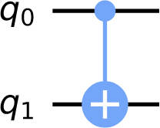
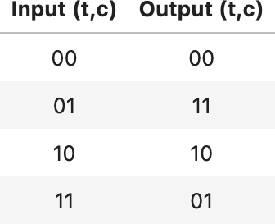
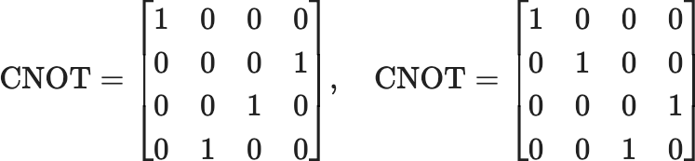
Typical two-qubit gates
CNOT gate is a conditional gate that performs an X-gate on the target qubit, if the state of the control qubit is |1>.
Truth table
control
Acting on the 4D-statevector, it has one of the two matrices, depending on which qubit is the control and which is the target.
target
Note: Qiskit uses Little Endian, |𝑞₁𝑞₀⟩
Different books, simulators and papers order their qubits differently. In Qiskit, the left matrix corresponds to the CNOT in the circuit above.
15

Slide 21
Superposition of multiple systems
A one-qubit system can be in the superposition of two states:
|0⟩ , |1⟩
A two-qubit system can be in the superposition of 2² states:
|0⟩⨂|0⟩, |1⟩ ⨂|0⟩, |0⟩ ⨂|1⟩ , |1⟩ ⨂|1⟩
An n-qubit system can be in the superposition of 2^{𝑛} states:
|0⟩_{𝑛−1}⨂ ⋯ ⨂|0⟩₀, |0⟩_{𝑛−1}⨂ ⋯ ⨂|0⟩₁⨂|1⟩₀, ⋯ , |1⟩_{𝑛−1}⨂ ⋯ ⨂|1⟩₀
21

Slide 22







*Important Notations in Quantum Computing
Tensor products
= |00⟩
More generally,
22

Slide 23
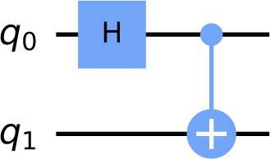
Entangled state
An entangled state is a state |𝜓⟩_{𝐴B} consisting of quantum states
|𝜓⟩_{𝐴} and |𝜓⟩_{B} that cannot be represented by a tensor product of individual quantum states.
|0⟩⨂|0⟩ → 𝐻⨂𝐼 → ¹ (|0⟩ + |1⟩)⨂|0⟩
2
1
=
|00⟩ + |10⟩
2
→ 𝐶𝑁𝑂𝑇 →
¹ (|00⟩ + |11⟩)
2
|𝜓⟩ =
1
|00⟩ + |11⟩ is a unit vector.
𝐴B
2
However,
1
|00⟩ + |11⟩ ≠ (𝑎₀|0⟩ + 𝑎₁|1⟩)⨂(𝑏₀|0⟩ + 𝑏₁|1⟩)
There is no coefficient which satisfies this equation.
2
18

Slide 24






Basis gate set
Only a limited set of gates can be executed directly on the hardware.
The basis gate set of an IBM Quantum Eagle processor is
ECR, ID, RZ, SX, X .
0 0 1 𝑖
0 0 𝑖 1
1 −𝑖 0 0
−𝑖 1 0 0
ECR (Echoed Cross Resonance) = ¹
2
SX (sqrt X) = ¹
1 + 𝑖
1 − 𝑖
1 − 𝑖
1 + 𝑖
2

Slide 25
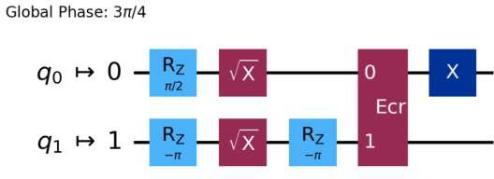
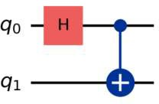
Basis gate set
Only a limited set of gates can be executed directly on the hardware. Other gates can be transpiled into these basis gates.
Transpile to an Eagle

Slide 26
Hands on

Slide 27
Lecture 2: Quantum Bits, Gates, and Circuits
Understanding Quantum Computation with Circuit Models using quantum bits and gates.
Hands on using Qiskit
Single-qubit quantum gates
State vector simulator, Bloch sphere
Multi-qubit quantum gates
Aer simulator, Real device, Qiskit Patterns
GHZ state of 8 qubits with the shallowest depth
22

