Slide 1

PHYS598500 · WEEK 2
Circuit Quantization and Josephson Anharmonicity
PHYS598500 · Week 2 · T2
Circuit Quantization and Josephson Anharmonicity
Hardware → Protection → Superconductivity → Josephson Nonlinearity
Manual slide source
01 / 100
Notes:
[01/100] Circuit Quantization and Josephson Anharmonicity
PHYS598500 · WEEK 2
Circuit Quantization and Josephson Anharmonicity
PHYS598500 · Week 2 · T2
Hardware → Protection → Superconductivity → Josephson Nonlinearity
Manual slide source
01 / 100

Slide 2
PHYS598500 · WEEK 2
What Must a Quantum Hardware Platform Actually Do?
Hardware-first prelude · 30–40 min
What Must a Quantum Hardware Platform Actually Do?
Start from the machine, then earn the Hamiltonian
Manual slide source
02 / 100
Notes:
[02/100] What Must a Quantum Hardware Platform Actually Do?
PHYS598500 · WEEK 2
What Must a Quantum Hardware Platform Actually Do?
Hardware-first prelude · 30–40 min
Start from the machine, then earn the Hamiltonian
Manual slide source
02 / 100

Slide 3
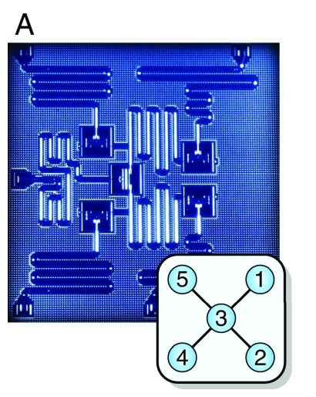
PHYS598500 · WEEK 2
What Must a Quantum Hardware Platform Actually Do?
Superconducting Circuits · Josephson Artificial Atoms
Representative companies: IBM Quantum, Google Quantum AI, Rigetti, IQM, Fujitsu, SEEQC, Alice & Bob, D-Wave
Superconducting processor used in a cross-platform algorithm comparison. Figure 1a, Linke et al., PNAS 114, 3305 (2017), doi:10.1073/pnas.1618020114.
Manual slide source
03 / 100
Notes:
[03/100] What Must a Quantum Hardware Platform Actually Do?
PHYS598500 · WEEK 2
What Must a Quantum Hardware Platform Actually Do?
Superconducting Circuits · Josephson Artificial Atoms
Representative companies: IBM Quantum, Google Quantum AI, Rigetti, IQM, Fujitsu, SEEQC, Alice & Bob, D-Wave
Superconducting processor used in a cross-platform algorithm comparison. Figure 1a, Linke et al., PNAS 114, 3305 (2017), doi:10.1073/pnas.1618020114.
Manual slide source
03 / 100

Slide 4
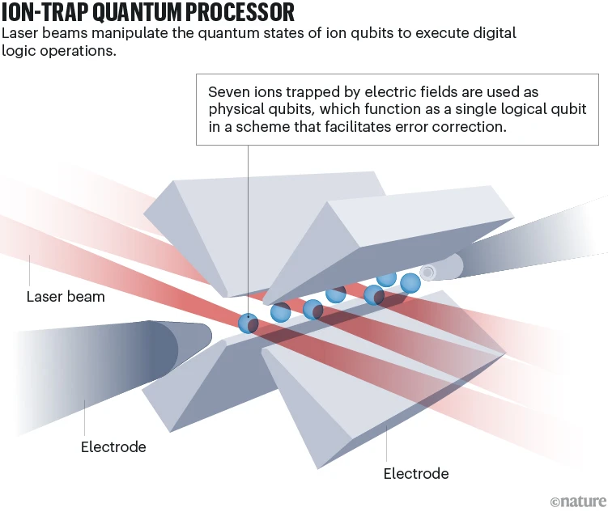
PHYS598500 · WEEK 2
What Must a Quantum Hardware Platform Actually Do?
Trapped Ions · Atomic Qubits in a Quantum CCD
Representative companies: IonQ, Quantinuum, AQT, eleQtron
Ion-trap quantum processor: laser beams manipulate seven trapped-ion qubits between surrounding electrodes. E. Cartlidge, Nature (24 May 2023), source.
Manual slide source
04 / 100
Notes:
[04/100] What Must a Quantum Hardware Platform Actually Do?
PHYS598500 · WEEK 2
What Must a Quantum Hardware Platform Actually Do?
Trapped Ions · Atomic Qubits in a Quantum CCD
Representative companies: IonQ, Quantinuum, AQT, eleQtron
Ion-trap quantum processor: laser beams manipulate seven trapped-ion qubits between surrounding electrodes. E. Cartlidge, Nature (24 May 2023), source.
Manual slide source
04 / 100

Slide 5
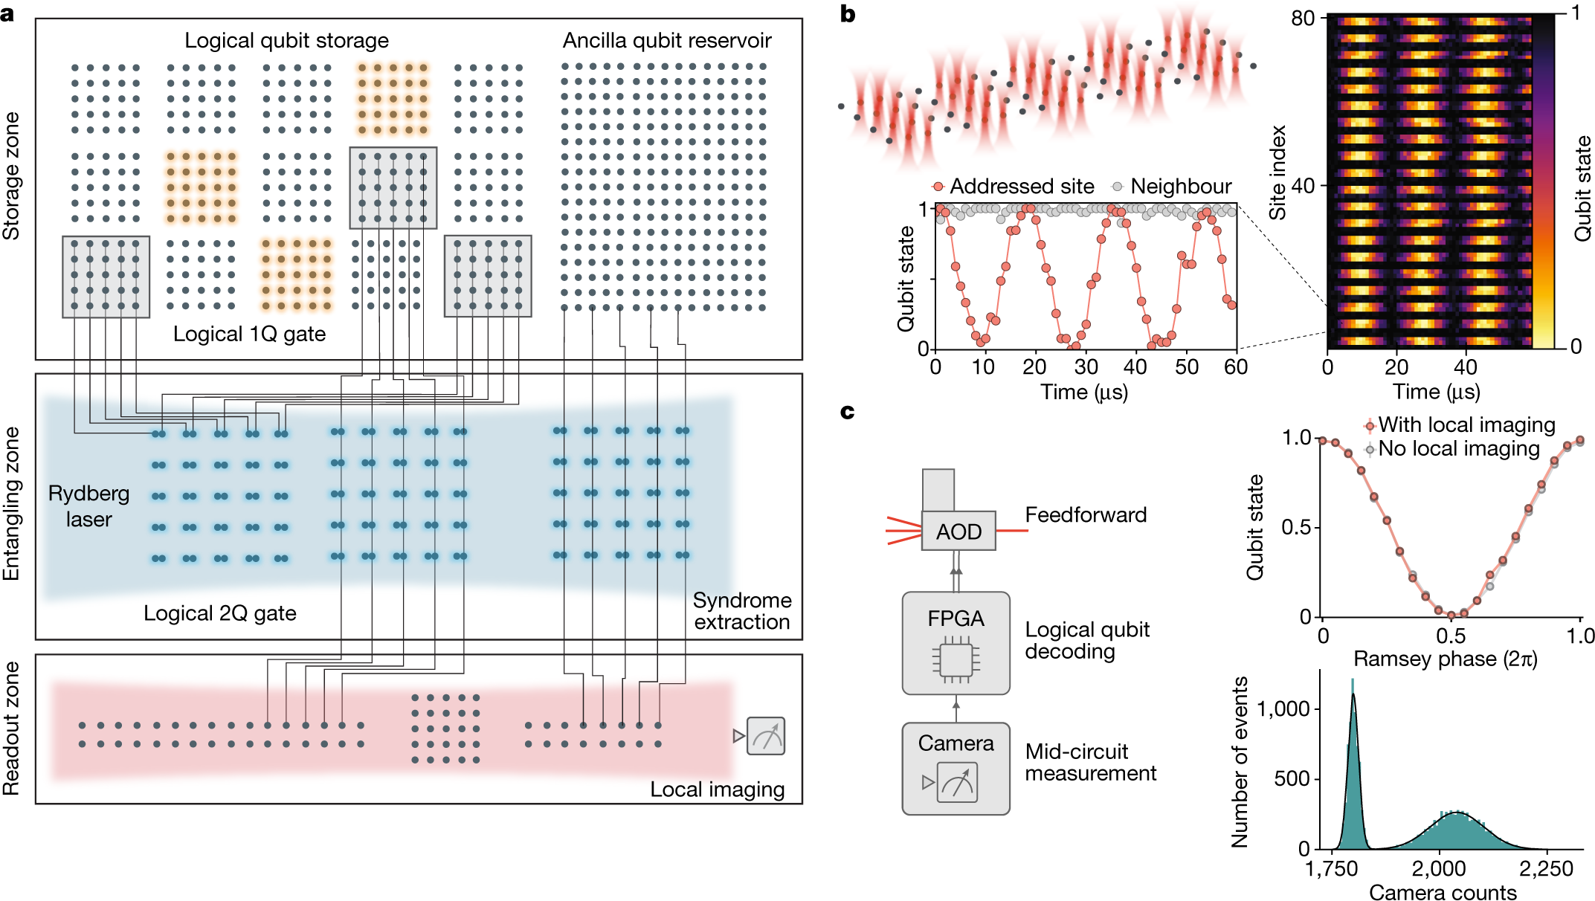
PHYS598500 · WEEK 2
What Must a Quantum Hardware Platform Actually Do?
Neutral Atoms · Reconfigurable Tweezer Arrays
Representative companies: QuEra, Pasqal, Atom Computing, Infleqtion
Programmable logical processor with spatially separated storage, Rydberg-entangling, and readout zones. Figure 1, Bluvstein et al., Nature 626, 58 (2024), doi:10.1038/s41586-023-06927-3.
Manual slide source
05 / 100
Notes:
[05/100] What Must a Quantum Hardware Platform Actually Do?
PHYS598500 · WEEK 2
What Must a Quantum Hardware Platform Actually Do?
Neutral Atoms · Reconfigurable Tweezer Arrays
Representative companies: QuEra, Pasqal, Atom Computing, Infleqtion
Programmable logical processor with spatially separated storage, Rydberg-entangling, and readout zones. Figure 1, Bluvstein et al., Nature 626, 58 (2024), doi:10.1038/s41586-023-06927-3.
Manual slide source
05 / 100

Slide 6
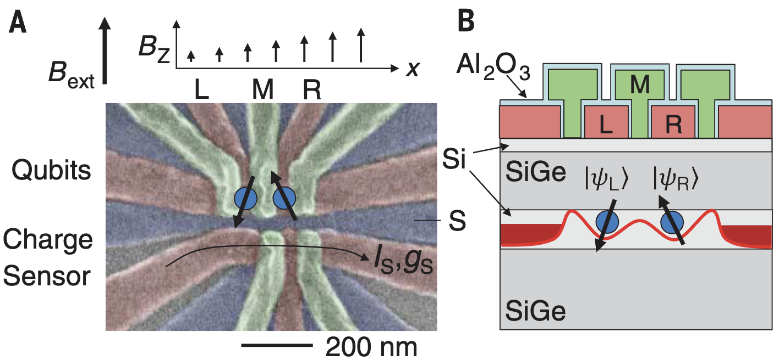
PHYS598500 · WEEK 2
What Must a Quantum Hardware Platform Actually Do?
Semiconductor Spins · Two Electrons, One CNOT
Representative companies: Intel, Diraq, Quantum Motion, Equal1, Silicon Quantum Computing
Two electron-spin qubits in a Si/SiGe double quantum dot and the magnetic-field gradient used for addressability. Figure 1, Zajac et al., Science 359, 439 (2018), doi:10.1126/science.aao5965.
Manual slide source
06 / 100
Notes:
[06/100] What Must a Quantum Hardware Platform Actually Do?
PHYS598500 · WEEK 2
What Must a Quantum Hardware Platform Actually Do?
Semiconductor Spins · Two Electrons, One CNOT
Representative companies: Intel, Diraq, Quantum Motion, Equal1, Silicon Quantum Computing
Two electron-spin qubits in a Si/SiGe double quantum dot and the magnetic-field gradient used for addressability. Figure 1, Zajac et al., Science 359, 439 (2018), doi:10.1126/science.aao5965.
Manual slide source
06 / 100

Slide 7
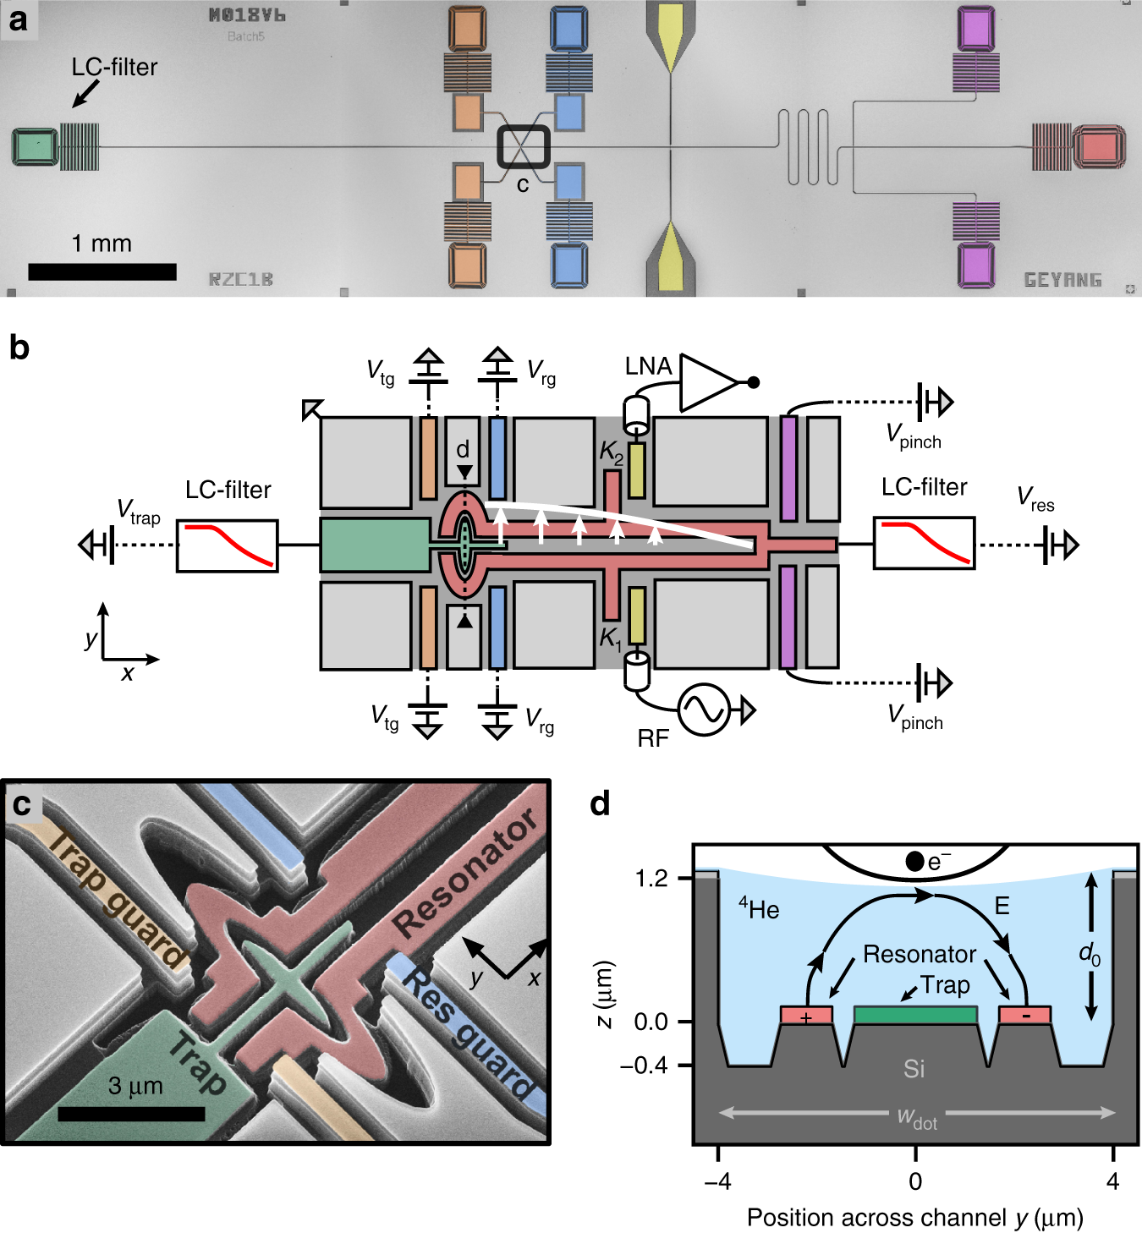
PHYS598500 · WEEK 2
What Must a Quantum Hardware Platform Actually Do?
Electrons on Helium · A Nearly Defect-Free Interface
Representative company: EeroQ
Electron-on-helium quantum dot integrated with circuit QED: device, control schematic, micrograph, and cross-section. Figure 1, Koolstra et al., Nature Communications 10, 5323 (2019), doi:10.1038/s41467-019-13335-7.
Manual slide source
07 / 100
Notes:
[07/100] What Must a Quantum Hardware Platform Actually Do?
PHYS598500 · WEEK 2
What Must a Quantum Hardware Platform Actually Do?
Electrons on Helium · A Nearly Defect-Free Interface
Representative company: EeroQ
Electron-on-helium quantum dot integrated with circuit QED: device, control schematic, micrograph, and cross-section. Figure 1, Koolstra et al., Nature Communications 10, 5323 (2019), doi:10.1038/s41467-019-13335-7.
Manual slide source
07 / 100

Slide 8
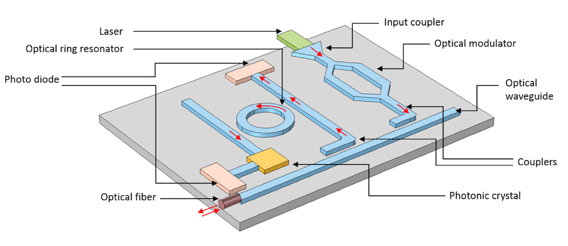

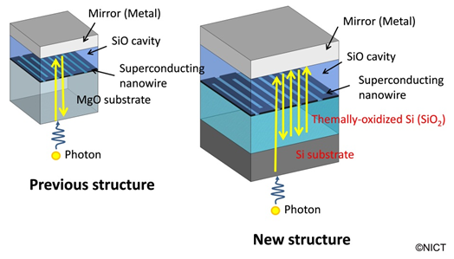
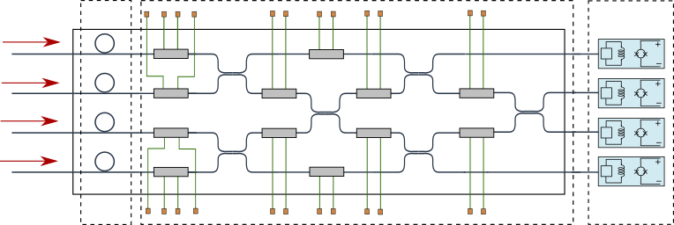
PHYS598500 · WEEK 2
What Must a Quantum Hardware Platform Actually Do?
Photonics · Light Is Both the Qubit and the Bus
Representative companies: Xanadu, PsiQuantum, Quandela, ORCA Computing
Photonic chip, superconducting nanowire detector, and Gaussian boson sampling network. Direct images: PIC, detector, and GBS.
Manual slide source
08 / 100
Notes:
[08/100] What Must a Quantum Hardware Platform Actually Do?
PHYS598500 · WEEK 2
What Must a Quantum Hardware Platform Actually Do?
Photonics · Light Is Both the Qubit and the Bus
Representative companies: Xanadu, PsiQuantum, Quandela, ORCA Computing
Photonic chip, superconducting nanowire detector, and Gaussian boson sampling network. Direct images: PIC, detector, and GBS.
Manual slide source
08 / 100

Slide 9
PHYS598500 · WEEK 2
What Must a Quantum Hardware Platform Actually Do?
DiVincenzo Criteria: A Hardware Design Contract
1 · Scalable qubits
2 · Initialization
3 · Long coherence
4 · Universal control
A scalable physical system with well-characterized qubits
Prepare a simple fiducial state such as $|00⋯0⟩$
Decoherence times must greatly exceed operation times
A universal set of one- and two-qubit gates
5 · Measurement
6 · Stationary ↔ flying
7 · Transmission
Qubit-specific, high-fidelity readout
Interconvert memory qubits and communication qubits
Faithfully send flying qubits between locations
Criterion | Superconducting-circuit implementation | Hidden engineering bill
Initialize / measure | Dilution cooling, active reset, dispersive microwave readout | Thermal photons, amplifier chain, assignment error
Control / coherence | Nanosecond microwave pulses and tunable couplers | Leakage, crosstalk, calibration drift, dielectric and quasiparticle loss
Scale / communicate | Lithographic circuits, microwave buses, modular links | Frequency crowding, packaging, wiring heat load, microwave–optical conversion
Source: D. P. DiVincenzo, “The Physical Implementation of Quantum Computation” (2000), IBM Research publication page.
Manual slide source
09 / 100
Notes:
[09/100] What Must a Quantum Hardware Platform Actually Do?
PHYS598500 · WEEK 2
What Must a Quantum Hardware Platform Actually Do?
DiVincenzo Criteria: A Hardware Design Contract
1 · Scalable qubits
A scalable physical system with well-characterized qubits
2 · Initialization
Prepare a simple fiducial state such as
3 · Long coherence
Decoherence times must greatly exceed operation times
4 · Universal control
A universal set of one- and two-qubit gates
5 · Measurement
Qubit-specific, high-fidelity readout
6 · Stationary ↔ flying
Interconvert memory qubits and communication qubits
7 · Transmission
Faithfully send flying qubits between locations
Source: D. P. DiVincenzo, “The Physical Implementation of Quantum Computation” (2000), IBM Research publication page.
Manual slide source
09 / 100

Slide 10
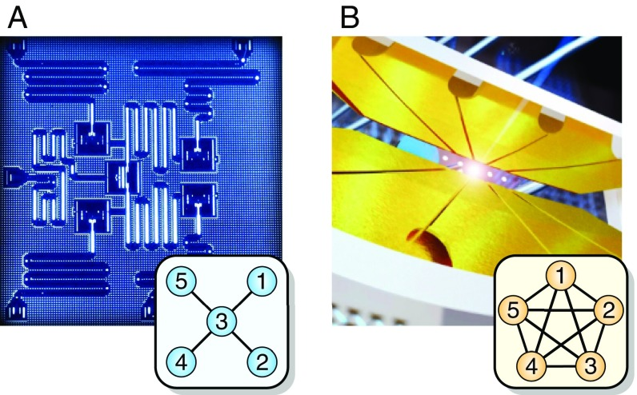
PHYS598500 · WEEK 2
What Must a Quantum Hardware Platform Actually Do?
Superconducting Circuits vs Trapped Ions
Parameter | Superconducting circuit | Trapped ion
Qubit | Engineered Josephson artificial atom | Natural ¹⁷¹Yb⁺ hyperfine states
Tuning and calibration | Tunable frequency and coupling. Fabrication spread and drift require recalibration. | Atoms are identical. Lasers and collective motional modes still require calibration.
Coherence $T_{2}$ | ≈ 60 μs | $T_{2}^{∗}$ ≈ 0.5 s
Two-qubit gate | 250–450 ns | 250 μs
$T_{2}/t_{2Q}$ | ≈ $1.3\text{–}2.4×{10}^{2}$ | ≈ $2×{10}^{3}$
Connectivity | Fixed, sparse star graph in this chip | All-to-all within the five-ion chain
Physical motion | Qubits stay fixed. Quantum states move through gates. | The chain stayed fixed here. QCCD systems can shuttle and split ions.
Figure 1, Linke et al., PNAS 114, 3305 (2017), doi:10.1073/pnas.1618020114.
Engineering trade-off: Stronger isolation preserves coherence but slows control. Stronger coupling speeds control but opens more noise channels.
Times and connectivity are the measured 2017 devices in Linke et al. Ion shuttling reference: Pino et al., Nature 592, 209 (2021), doi:10.1038/s41586-021-03318-4.
Manual slide source
10 / 100
Notes:
[10/100] What Must a Quantum Hardware Platform Actually Do?
PHYS598500 · WEEK 2
What Must a Quantum Hardware Platform Actually Do?
Superconducting Circuits vs Trapped Ions
Figure 1, Linke et al., PNAS 114, 3305 (2017), doi:10.1073/pnas.1618020114.
Engineering trade-off: Stronger isolation preserves coherence but slows control. Stronger coupling speeds control but opens more noise channels.
Times and connectivity are the measured 2017 devices in Linke et al. Ion shuttling reference: Pino et al., Nature 592, 209 (2021), doi:10.1038/s41586-021-03318-4.
Manual slide source
10 / 100

Slide 11
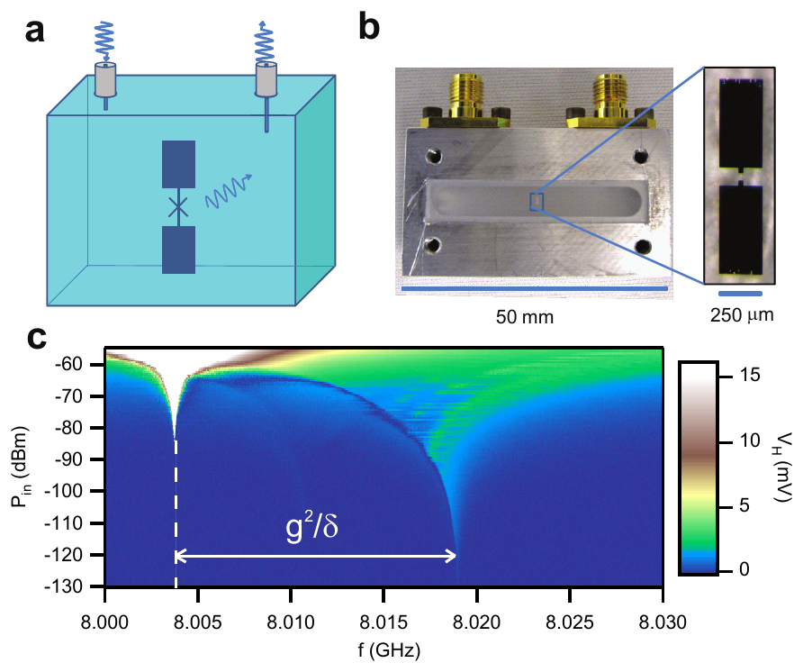
PHYS598500 · WEEK 2
What Must a Quantum Hardware Platform Actually Do?
Planar Layout and 3D Cavity Solve Different Electromagnetic Problems
Planar chip layout. Readout resonators, control wiring, coupling graph, and chip edges are all part of the mode structure. Cropped from Figure 1A, Linke et al., PNAS (2017), DOI.
3D circuit QED. The enclosure itself becomes the resonator. The photograph and micrograph show the centimetre cavity and transmon antenna; panel c shows the nonlinear cavity response.
Figure 1, Paik et al., Phys. Rev. Lett. 107, 240501 (2011), DOI.
Manual slide source
11 / 100
Notes:
[11/100] What Must a Quantum Hardware Platform Actually Do?
PHYS598500 · WEEK 2
What Must a Quantum Hardware Platform Actually Do?
Planar Layout and 3D Cavity Solve Different Electromagnetic Problems
Planar chip layout. Readout resonators, control wiring, coupling graph, and chip edges are all part of the mode structure. Cropped from Figure 1A, Linke et al., PNAS (2017), DOI.
3D circuit QED. The enclosure itself becomes the resonator. The photograph and micrograph show the centimetre cavity and transmon antenna; panel c shows the nonlinear cavity response. Figure 1, Paik et al., Phys. Rev. Lett. 107, 240501 (2011), DOI.
Manual slide source
11 / 100

Slide 12
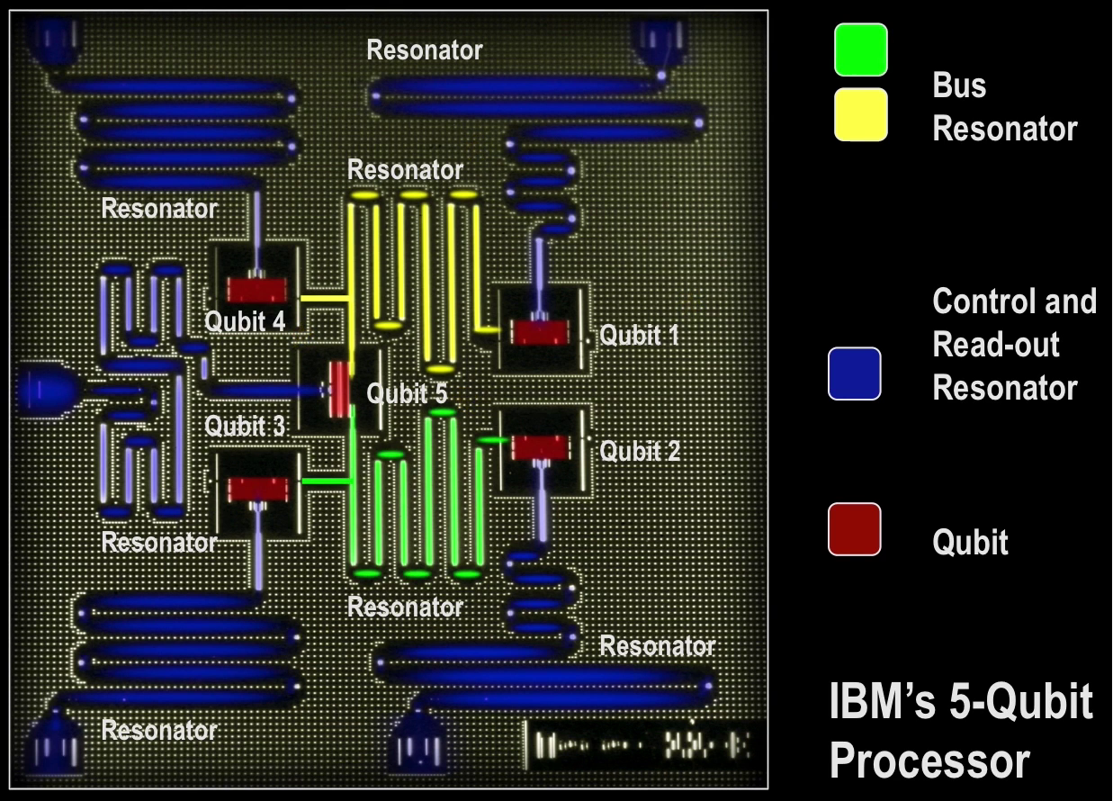
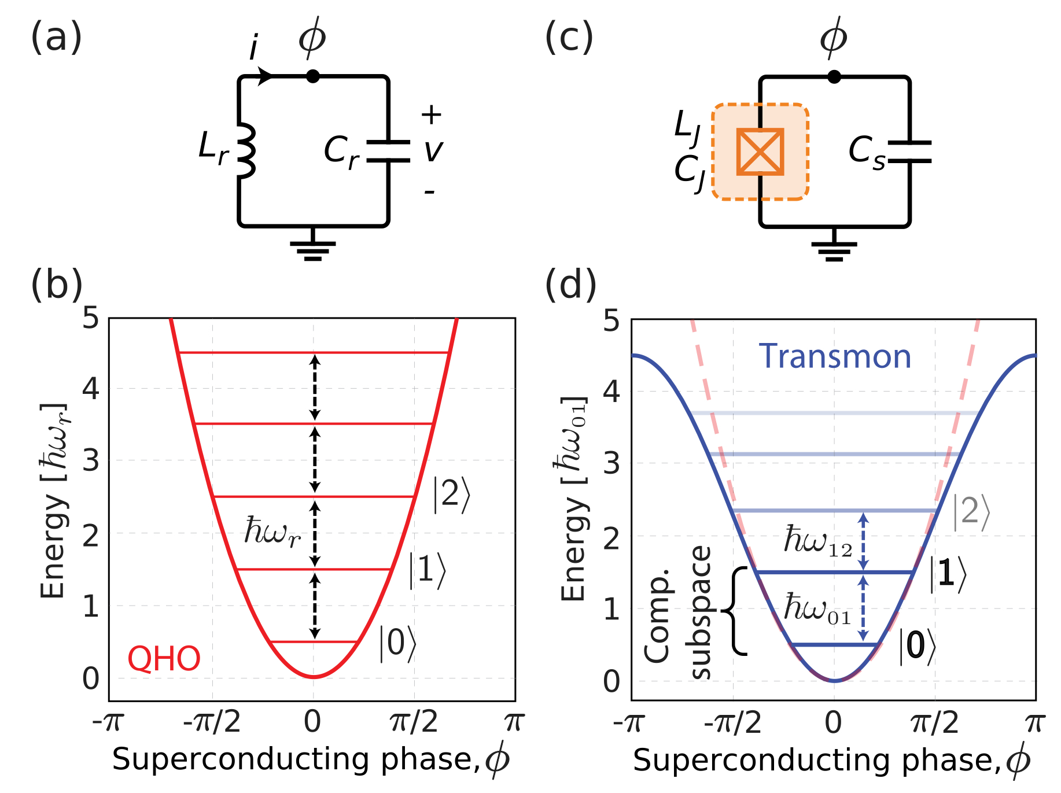
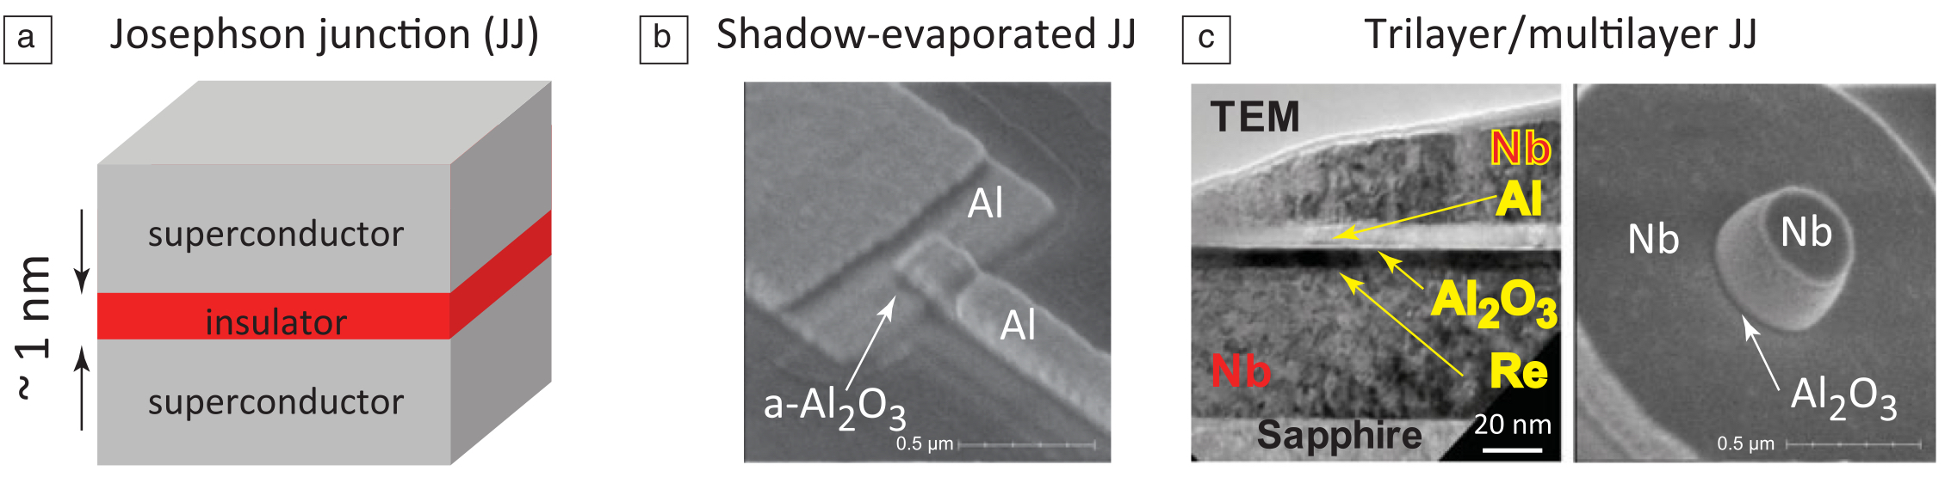
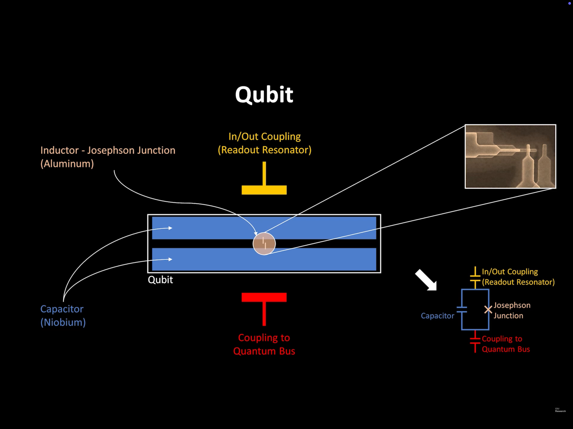
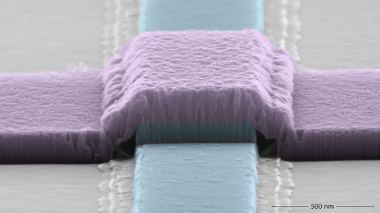
https://www.researchgate.net/figure/An-image-of-IBMs-five-qubit-processor-with-its-main-elements-highlighted-including-the_fig4_358153899 · https://www.youtube.com/watch?v=2pB87H3_F_c · https://www.anl.gov/article/resurrecting-niobium-for-quantum-science · Ref: 10.1557/mrs.2013.229 · https://electronics360.globalspec.com/article/13553/how-quantum-computers-work
Notes:
[12/100] Source PPT · Page 82
https://www.researchgate.net/figure/An-image-of-IBMs-five-qubit-processor-with-its-main-elements-highlighted-including-the_fig4_358153899 · https://www.youtube.com/watch?v=2pB87H3_F_c · https://www.anl.gov/article/resurrecting-niobium-for-quantum-science · Ref: 10.1557/mrs.2013.229 · https://electronics360.globalspec.com/article/13553/how-quantum-computers-work

Slide 13
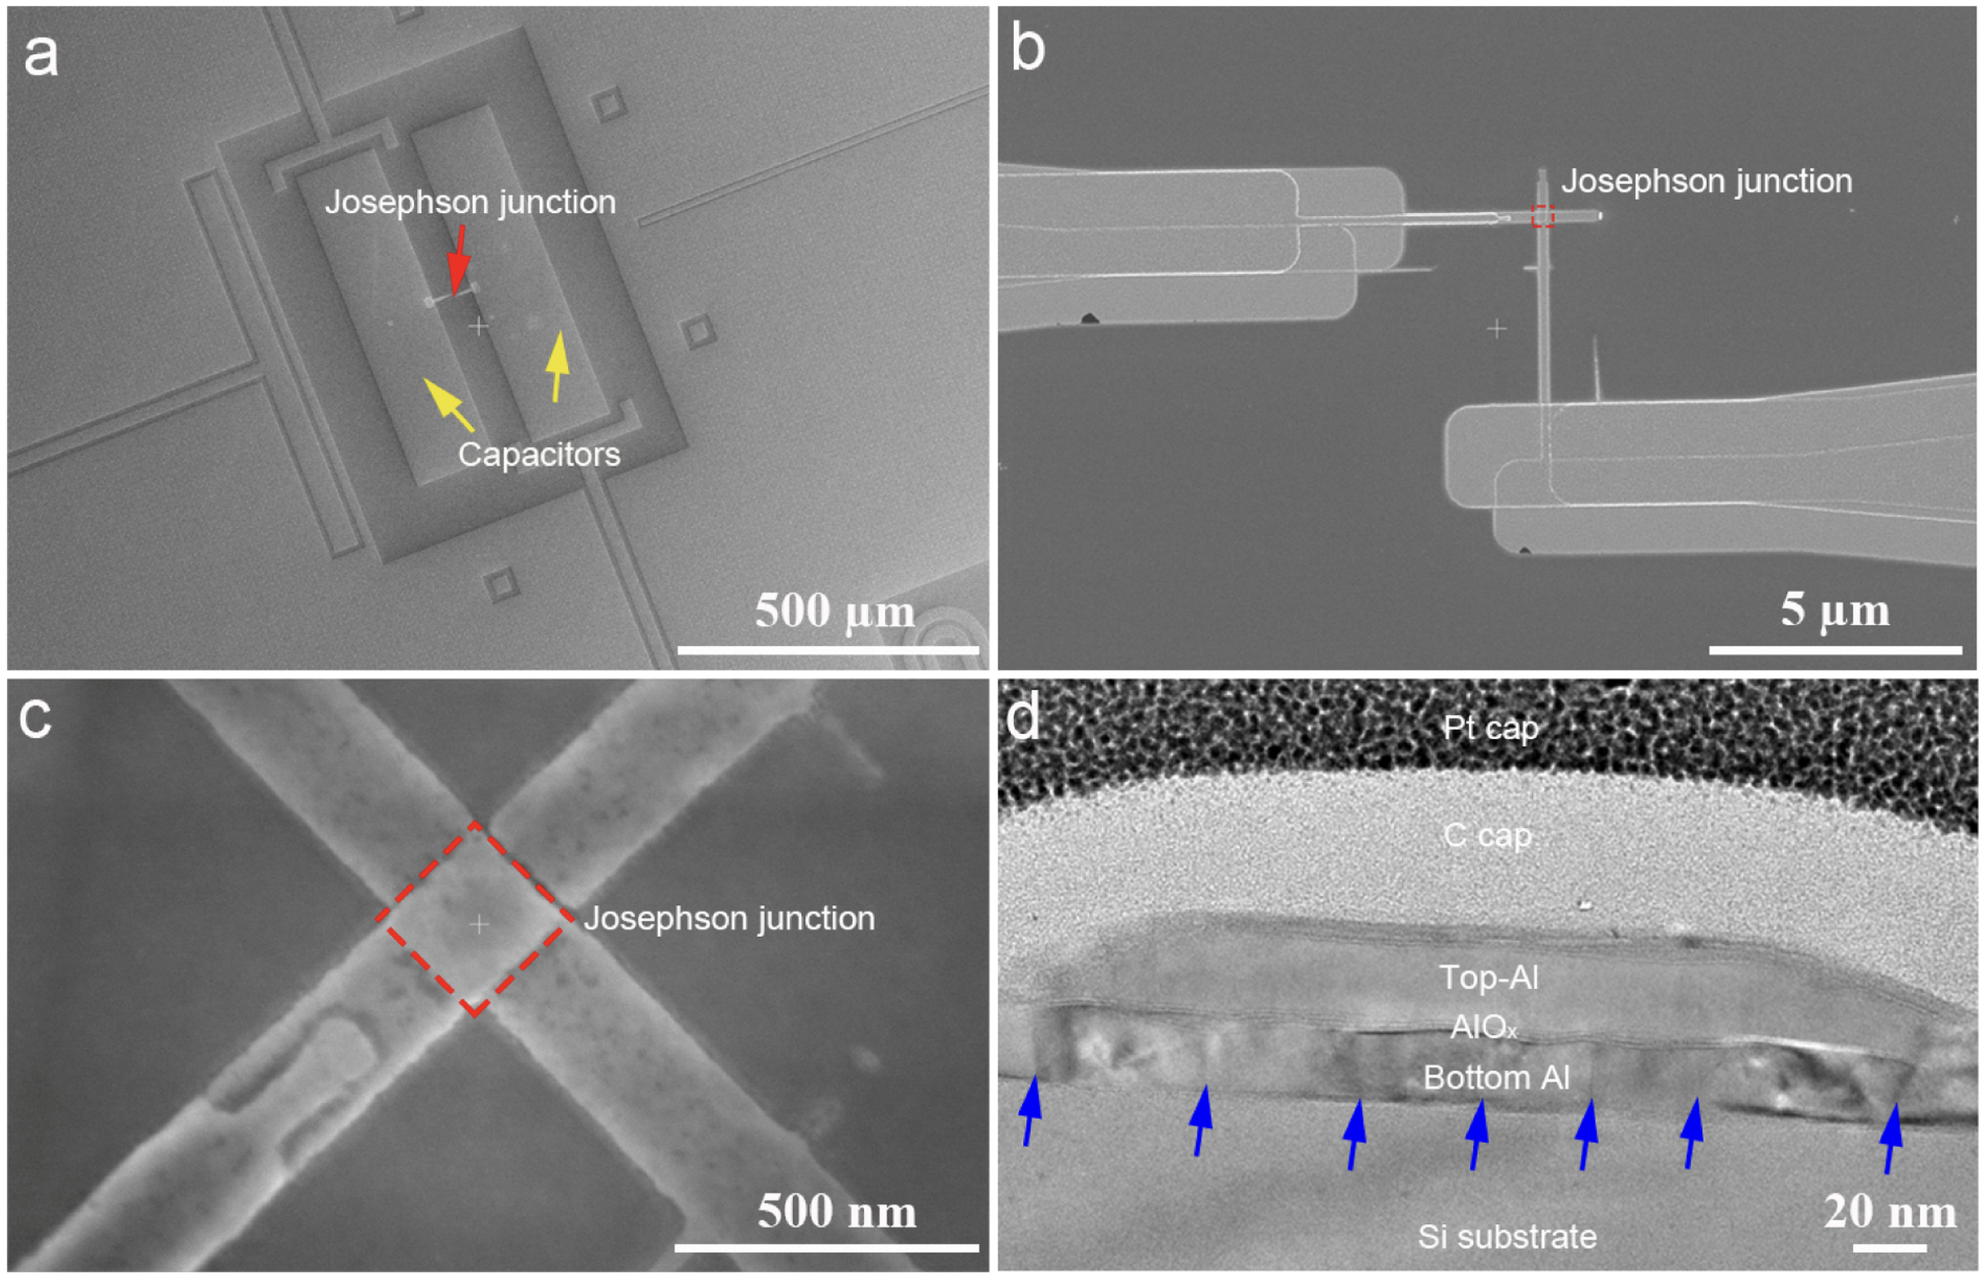
Zooming into the junction: the cross-sectional TEM (d) shows the Pt cap, C cap, Top-Al, the ~1 nm AlO_{x} tunnel barrier, Bottom Al on Si, with interfacial defects (blue arrows).
Sources: IBM processor image · IBM qubit-cell schematic · Argonne niobium-junction article · Al/AlO_{x}/Al TEM, DOI: 10.1557/mrs.2013.229 · Electronics360 overview
Notes:
[13/100] Source PPT · Page 82
Zooming into the junction: the cross-sectional TEM (d) shows the Pt cap, C cap, Top-Al, the ~1 nm AlOx tunnel barrier, Bottom Al on Si, with interfacial defects (blue arrows).
Sources: IBM processor image · IBM qubit-cell schematic · Argonne niobium-junction article · Al/AlOx/Al TEM, DOI: 10.1557/mrs.2013.229 · Electronics360 overview

Slide 14
PHYS598500 · WEEK 2
IBM Five-Qubit Processor
Five Qubits Share Readout and Bus Resonators
Each qubit occupies a local circuit cell.
The bus resonator provides shared coupling.
The physical layout belongs to the Hamiltonian.
IBM's five-qubit processor. Red regions mark qubits, yellow identifies the shared bus, and blue identifies control and readout resonators.
Reference retained from PPT P82: [1] ResearchGate figure, IBM five-qubit processor.
Manual slide source
14 / 100
Notes:
[14/100] IBM Five-Qubit Processor
PHYS598500 · WEEK 2
IBM Five-Qubit Processor
Five Qubits Share Readout and Bus Resonators
IBM's five-qubit processor. Red regions mark qubits, yellow identifies the shared bus, and blue identifies control and readout resonators.
Each qubit occupies a local circuit cell.
The bus resonator provides shared coupling.
The physical layout belongs to the Hamiltonian.
Reference retained from PPT P82: [1] ResearchGate figure, IBM five-qubit processor.
Manual slide source
14 / 100

Slide 15
PHYS598500 · WEEK 2
IBM Five-Qubit Processor
One Qubit Connects a Capacitor, Junction, Readout Port, and Bus
The niobium pads provide the large shunt capacitance. The aluminum Josephson junction adds nonlinear inductance. Separate couplers connect the cell to its readout resonator and the quantum bus.
Reference retained from PPT P82: [2] https://www.youtube.com/watch?v=2pB87H3_F_c.
Manual slide source
15 / 100
Notes:
[15/100] IBM Five-Qubit Processor
PHYS598500 · WEEK 2
IBM Five-Qubit Processor
One Qubit Connects a Capacitor, Junction, Readout Port, and Bus
The niobium pads provide the large shunt capacitance. The aluminum Josephson junction adds nonlinear inductance. Separate couplers connect the cell to its readout resonator and the quantum bus.
Reference retained from PPT P82: [2] https://www.youtube.com/watch?v=2pB87H3_F_c.
Manual slide source
15 / 100

Slide 16
PHYS598500 · WEEK 2
Qubit Cell and Junction Stack
From the Qubit Cell to the Nanometre Junction Stack
The niobium pads provide the large shunt capacitance. The aluminum Josephson junction adds nonlinear inductance. Separate couplers connect the cell to its readout resonator and the quantum bus.
Zooming into the junction: the cross-sectional TEM (d) shows the Pt cap, C cap, Top-Al, the ~1 nm AlO_{x} tunnel barrier, Bottom Al on Si, with interfacial defects (blue arrows).
Qubit cell: https://www.youtube.com/watch?v=2pB87H3_F_c · ResearchGate, IBM five-qubit processor. Al/AlO_{x}/Al junction TEM: 10.1016/j.apsusc.2023.158337.
Manual slide source
16 / 100
Notes:
[16/100] Qubit Cell and Junction Stack
PHYS598500 · WEEK 2
Qubit Cell and Junction Stack
From the Qubit Cell to the Nanometre Junction Stack
The niobium pads provide the large shunt capacitance. The aluminum Josephson junction adds nonlinear inductance. Separate couplers connect the cell to its readout resonator and the quantum bus.
Zooming into the junction: the cross-sectional TEM (d) shows the Pt cap, C cap, Top-Al, the ~1 nm AlOx tunnel barrier, Bottom Al on Si, with interfacial defects (blue arrows).
Qubit cell: https://www.youtube.com/watch?v=2pB87H3_F_c · ResearchGate, IBM five-qubit processor. Al/AlOx/Al junction TEM: 10.1016/j.apsusc.2023.158337.
Manual slide source
16 / 100

Slide 17
PHYS598500 · WEEK 2
Josephson Junction Hardware
A Nanometre-Scale Barrier Sets the Junction Properties
The insulating barrier is roughly one nanometre thick. Shadow-evaporated Al/AlOx/Al junctions and multilayer processes realize the same superconducting tunnel element with different fabrication stacks.
A fabricated junction viewed at submicrometre scale.
References retained from PPT P82: [3] Argonne, “Resurrecting niobium for quantum science”. [4] Ref: 10.1557/mrs.2013.229.
Manual slide source
17 / 100
Notes:
[17/100] Josephson Junction Hardware
PHYS598500 · WEEK 2
Josephson Junction Hardware
A Nanometre-Scale Barrier Sets the Junction Properties
The insulating barrier is roughly one nanometre thick. Shadow-evaporated Al/AlOx/Al junctions and multilayer processes realize the same superconducting tunnel element with different fabrication stacks.
A fabricated junction viewed at submicrometre scale.
References retained from PPT P82: [3] Argonne, “Resurrecting niobium for quantum science”. [4] Ref: 10.1557/mrs.2013.229.
Manual slide source
17 / 100

Slide 18
PHYS598500 · WEEK 2
Transmon Spectrum
Josephson Nonlinearity Separates the Transmon Transitions
Linear LC oscillator.
$$ℏω_{r}$$
Transmon circuit.
$$−E_{J}cosϕ$$
$$ω_{12}$$
$$ω_{01}$$
Computational subspace.
$$|0⟩↔|1⟩$$
$$|2⟩$$
The LC resonator has equally spaced levels. Replacing the linear inductor with a Josephson element produces a cosine potential and unequal transition frequencies.
Reference retained from PPT P82: [5] Electronics360, “How quantum computers work”.
Manual slide source
18 / 100
Notes:
[18/100] Transmon Spectrum
PHYS598500 · WEEK 2
Transmon Spectrum
Josephson Nonlinearity Separates the Transmon Transitions
The LC resonator has equally spaced levels. Replacing the linear inductor with a Josephson element produces a cosine potential and unequal transition frequencies.
Linear LC oscillator.
Transmon circuit.
Computational subspace.
Reference retained from PPT P82: [5] Electronics360, “How quantum computers work”.
Manual slide source
18 / 100

Slide 19
PHYS598500 · WEEK 2
What Is a Superconductor?
Microscopic ingredients → circuit variables
What Is a Superconductor?
Gap, phase stiffness, and the length scales that hardware designers inherit
Manual slide source
19 / 100
Notes:
[19/100] What Is a Superconductor?
PHYS598500 · WEEK 2
What Is a Superconductor?
Microscopic ingredients → circuit variables
Gap, phase stiffness, and the length scales that hardware designers inherit
Manual slide source
19 / 100

Slide 20
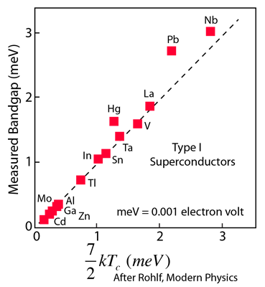
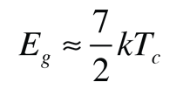
PHYS598500 · WEEK 2
Superconductivity Primer
Below $T_{c}$, Electrons Form a Collective State
Pairing. Electrons near the Fermi level acquire a weak effective attraction through the crystal lattice and form Cooper pairs.
Condensation. The pairs behave collectively and share a phase-coherent ground state.
Energy gap. Creating quasiparticles or breaking a pair requires a finite energy $Δ$.
Zero dc resistivity. At low temperature, the gap suppresses the scattering processes responsible for ordinary resistance.
Measured band-gap evidence for a Type-I superconductor.
The weak-coupling BCS relation connects the zero-temperature gap to $T_{c}$.
Source and images: HyperPhysics, “BCS Theory of Superconductivity”.
Manual slide source
20 / 100
Notes:
[20/100] Superconductivity Primer
PHYS598500 · WEEK 2
Superconductivity Primer
Below , Electrons Form a Collective State
Pairing. Electrons near the Fermi level acquire a weak effective attraction through the crystal lattice and form Cooper pairs.
Condensation. The pairs behave collectively and share a phase-coherent ground state.
Energy gap. Creating quasiparticles or breaking a pair requires a finite energy .
Zero dc resistivity. At low temperature, the gap suppresses the scattering processes responsible for ordinary resistance.
Measured band-gap evidence for a Type-I superconductor.
The weak-coupling BCS relation connects the zero-temperature gap to .
Source and images: HyperPhysics, “BCS Theory of Superconductivity”.
Manual slide source
20 / 100

Slide 21
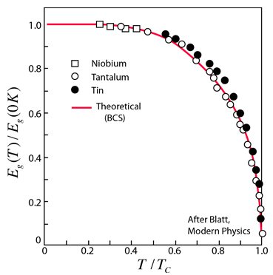
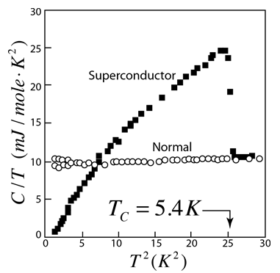
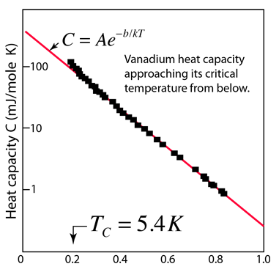
PHYS598500 · WEEK 2
Superconductivity Primer
The Gap Closes at $T_{c}$ and Changes the Heat Capacity
Microwave absorption. The measured gap decreases toward zero as the sample approaches $T_{c}$.
Vanadium heat capacity. The superconducting and field-driven normal states follow different temperature dependences.
Activated behavior. The exponential low-temperature response provides evidence for a finite excitation gap.
The gap weakens as $T$ approaches $T_{c}$. Above the transition, the paired state disappears and normal resistivity returns.
Source and images: HyperPhysics, “BCS Theory of Superconductivity”. Vanadium data cited there to W. S. Korak et al., Phys. Rev. 102, 656 (1956).
Manual slide source
21 / 100
Notes:
[21/100] Superconductivity Primer
PHYS598500 · WEEK 2
Superconductivity Primer
The Gap Closes at and Changes the Heat Capacity
Microwave absorption. The measured gap decreases toward zero as the sample approaches .
Vanadium heat capacity. The superconducting and field-driven normal states follow different temperature dependences.
Activated behavior. The exponential low-temperature response provides evidence for a finite excitation gap.
The gap weakens as approaches . Above the transition, the paired state disappears and normal resistivity returns.
Source and images: HyperPhysics, “BCS Theory of Superconductivity”. Vanadium data cited there to W. S. Korak et al., Phys. Rev. 102, 656 (1956).
Manual slide source
21 / 100

Slide 22
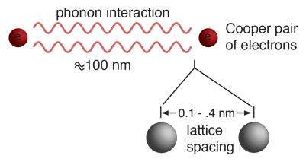
PHYS598500 · WEEK 2
Superconductivity Primer
Pairing Extends Far Beyond One Lattice Spacing
Single electrons are fermions. The Pauli exclusion principle prevents them from all occupying one state.
A pair has integer total spin. Cooper pairs can therefore show boson-like collective behavior.
The binding energy is small. It is typically measured in millielectron-volts, so superconductivity requires low temperature.
The phase is macroscopic. A common condensate phase later becomes the circuit variable across a Josephson junction.
A Cooper pair can correlate electrons over hundreds of nanometres, much farther than the spacing between neighboring ions.
Source and image: HyperPhysics, “Cooper Pairs”.
Manual slide source
22 / 100
Notes:
[22/100] Superconductivity Primer
PHYS598500 · WEEK 2
Superconductivity Primer
Pairing Extends Far Beyond One Lattice Spacing
A Cooper pair can correlate electrons over hundreds of nanometres, much farther than the spacing between neighboring ions.
Single electrons are fermions. The Pauli exclusion principle prevents them from all occupying one state.
A pair has integer total spin. Cooper pairs can therefore show boson-like collective behavior.
The binding energy is small. It is typically measured in millielectron-volts, so superconductivity requires low temperature.
The phase is macroscopic. A common condensate phase later becomes the circuit variable across a Josephson junction.
Source and image: HyperPhysics, “Cooper Pairs”.
Manual slide source
22 / 100

Slide 23
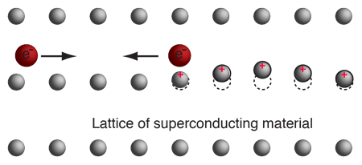
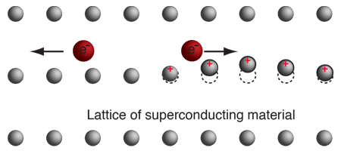
PHYS598500 · WEEK 2
Superconductivity Primer
A Lattice Distortion Couples Two Electrons
1
2
The bare Coulomb interaction remains repulsive. The delayed response of the lattice adds an effective low-energy attraction that can bind time-reversed electron states.
Source and images: HyperPhysics, “A model of Cooper pair attraction”.
Manual slide source
23 / 100
Notes:
[23/100] Superconductivity Primer
PHYS598500 · WEEK 2
Superconductivity Primer
A Lattice Distortion Couples Two Electrons
1
2
The bare Coulomb interaction remains repulsive. The delayed response of the lattice adds an effective low-energy attraction that can bind time-reversed electron states.
Source and images: HyperPhysics, “A model of Cooper pair attraction”.
Manual slide source
23 / 100

Slide 24
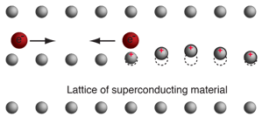
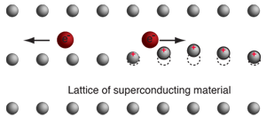
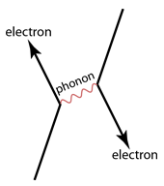
PHYS598500 · WEEK 2
Superconductivity Primer
Real-Space Distortion and Phonon Exchange Describe the Same Coupling
The first electron polarizes the ionic lattice.
The displaced lattice attracts the second electron.
A phonon-exchange diagram represents the same effective interaction in momentum and energy language.
The microscopic interaction supports a collective condensate only when pairing wins over thermal agitation and other pair-breaking processes.
Source and images: HyperPhysics, “Model of Pair Attraction”.
Manual slide source
24 / 100
Notes:
[24/100] Superconductivity Primer
PHYS598500 · WEEK 2
Superconductivity Primer
Real-Space Distortion and Phonon Exchange Describe the Same Coupling
The first electron polarizes the ionic lattice.
The displaced lattice attracts the second electron.
A phonon-exchange diagram represents the same effective interaction in momentum and energy language.
The microscopic interaction supports a collective condensate only when pairing wins over thermal agitation and other pair-breaking processes.
Source and images: HyperPhysics, “Model of Pair Attraction”.
Manual slide source
24 / 100

Slide 25
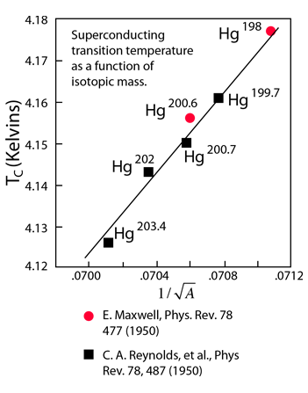
PHYS598500 · WEEK 2
Superconductivity Primer
The Isotope Effect Connects $T_{c}$ to Atomic Mass
A purely electronic model would miss this dependence. Changing the isotope changes nuclear mass without changing the electron count.
Lattice vibration frequencies depend on mass. The shift in $T_{c}$ therefore links the pairing scale to lattice motion.
The result supported phonon-mediated pairing. It became an important experimental clue behind BCS theory.
Mercury isotopes show that the superconducting transition temperature depends on nuclear mass.
Source and image: HyperPhysics, “Isotope Effect, Mercury”.
Manual slide source
25 / 100
Notes:
[25/100] Superconductivity Primer
PHYS598500 · WEEK 2
Superconductivity Primer
The Isotope Effect Connects to Atomic Mass
Mercury isotopes show that the superconducting transition temperature depends on nuclear mass.
A purely electronic model would miss this dependence. Changing the isotope changes nuclear mass without changing the electron count.
Lattice vibration frequencies depend on mass. The shift in therefore links the pairing scale to lattice motion.
The result supported phonon-mediated pairing. It became an important experimental clue behind BCS theory.
Source and image: HyperPhysics, “Isotope Effect, Mercury”.
Manual slide source
25 / 100

Slide 26
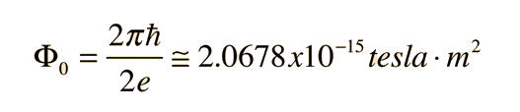
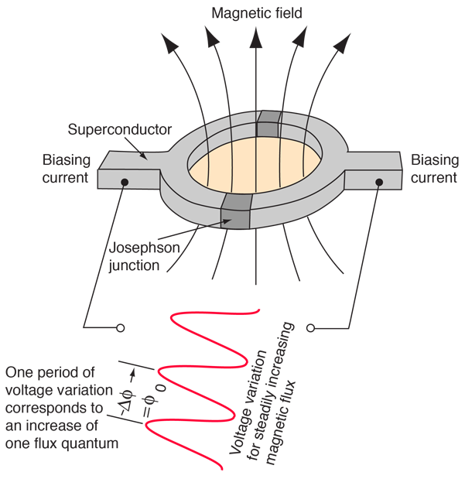
PHYS598500 · WEEK 2
Superconductivity Primer
A SQUID Converts Magnetic Flux into a Voltage Signal
Flux enters the interference response in units of $Φ_{0}=h/2e$.
Two Josephson junctions form a loop. Their phase differences depend on the enclosed magnetic flux.
A constant bias current produces a periodic voltage. Counting the oscillations measures the change in flux.
Magnetometer scale. HyperPhysics quotes a threshold near ${10}^{−14}T$, below the magnetic field produced by the human brain.
The loop converts phase interference into a measurable periodic voltage response.
Source and images: HyperPhysics, “SQUID Magnetometer”.
Manual slide source
26 / 100
Notes:
[26/100] Superconductivity Primer
PHYS598500 · WEEK 2
Superconductivity Primer
A SQUID Converts Magnetic Flux into a Voltage Signal
Flux enters the interference response in units of .
Two Josephson junctions form a loop. Their phase differences depend on the enclosed magnetic flux.
A constant bias current produces a periodic voltage. Counting the oscillations measures the change in flux.
Magnetometer scale. HyperPhysics quotes a threshold near , below the magnetic field produced by the human brain.
The loop converts phase interference into a measurable periodic voltage response.
Source and images: HyperPhysics, “SQUID Magnetometer”.
Manual slide source
26 / 100

Slide 27
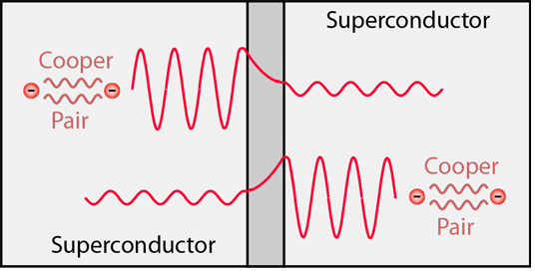
PHYS598500 · WEEK 2
Superconductivity Primer
Cooper Pairs Tunnel Through a Thin Insulator
DC Josephson effect. A supercurrent flows at zero voltage, with $I=I_{c}sinφ$.
AC Josephson effect. A constant voltage makes the phase evolve at a frequency proportional to that voltage.
Circuit consequence. The junction stores a nonlinear phase-dependent energy, which gives superconducting qubits their anharmonic spectrum.
The pair wavefunctions penetrate the insulating barrier and establish a phase-sensitive coupling.
Source and image: HyperPhysics, “Josephson Junction”.
Manual slide source
27 / 100
Notes:
[27/100] Superconductivity Primer
PHYS598500 · WEEK 2
Superconductivity Primer
Cooper Pairs Tunnel Through a Thin Insulator
The pair wavefunctions penetrate the insulating barrier and establish a phase-sensitive coupling.
DC Josephson effect. A supercurrent flows at zero voltage, with .
AC Josephson effect. A constant voltage makes the phase evolve at a frequency proportional to that voltage.
Circuit consequence. The junction stores a nonlinear phase-dependent energy, which gives superconducting qubits their anharmonic spectrum.
Source and image: HyperPhysics, “Josephson Junction”.
Manual slide source
27 / 100

Slide 28


PHYS598500 · WEEK 2
Superconductivity Primer
Frequency Provides a Precise Realization of Voltage
The conversion uses fundamental constants. The Josephson frequency satisfies $f=(2e/h)V$.
One microvolt corresponds to about 483.6 MHz. Frequency can be measured with exceptionally high precision.
Junction arrays scale the voltage. HyperPhysics describes a 19,000-junction NIST chip producing a standard near 10 V.
Josephson oscillation frequency is proportional to voltage.
The same phase-voltage relation that supports metrology also controls microwave-driven superconducting circuits.
The numerical conversion for an applied voltage of $1μV$.
Source and images: HyperPhysics, “Josephson Voltage Standard” and “The Standard Volt”.
Manual slide source
28 / 100
Notes:
[28/100] Superconductivity Primer
PHYS598500 · WEEK 2
Superconductivity Primer
Frequency Provides a Precise Realization of Voltage
The conversion uses fundamental constants. The Josephson frequency satisfies .
One microvolt corresponds to about 483.6 MHz. Frequency can be measured with exceptionally high precision.
Junction arrays scale the voltage. HyperPhysics describes a 19,000-junction NIST chip producing a standard near 10 V.
The same phase-voltage relation that supports metrology also controls microwave-driven superconducting circuits.
Josephson oscillation frequency is proportional to voltage.
The numerical conversion for an applied voltage of .
Source and images: HyperPhysics, “Josephson Voltage Standard” and “The Standard Volt”.
Manual slide source
28 / 100

Slide 29
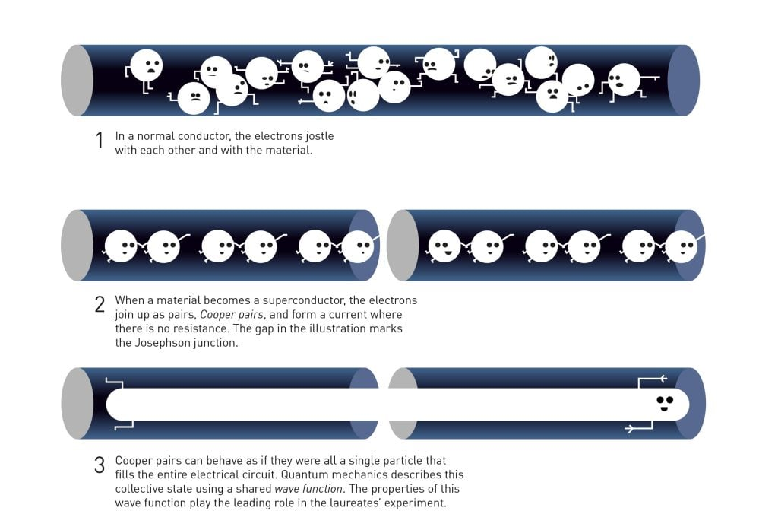
PHYS598500 · WEEK 2
What Is a Superconductor?
A Superconductor Is an Ordered Quantum Phase
Gap $Δ$: pairing removes low-energy single-particle states; quasiparticles cost energy and are thermally suppressed.
Phase stiffness: $Ψ(r)=\sqrt{n_{s}(r)}e^{iθ(r)}$. Many Cooper pairs share a collective phase that becomes a circuit coordinate.
Meissner screening: magnetic response is part of the ordered phase; zero dc resistance by itself is not the full definition.
For qubits: the gap reduces dissipation; the phase gives a coherent degree of freedom. Neither protects against all quasiparticles, vortices, lossy interfaces, or radiation.
Official Nobel 2025 Figure 5. Normal conduction, Cooper pairing, the junction gap, and the collective wavefunction are shown in one physical sequence. © Johan Jarnestad / The Royal Swedish Academy of Sciences, official popular background.
microscopic order parameter $θ$
→
gauge-invariant phase difference $φ$
→
flux, current, and circuit energy
Manual slide source
29 / 100
Notes:
[29/100] What Is a Superconductor?
PHYS598500 · WEEK 2
What Is a Superconductor?
A Superconductor Is an Ordered Quantum Phase
Official Nobel 2025 Figure 5. Normal conduction, Cooper pairing, the junction gap, and the collective wavefunction are shown in one physical sequence. © Johan Jarnestad / The Royal Swedish Academy of Sciences, official popular background.
Gap : pairing removes low-energy single-particle states; quasiparticles cost energy and are thermally suppressed.
Phase stiffness: . Many Cooper pairs share a collective phase that becomes a circuit coordinate.
Meissner screening: magnetic response is part of the ordered phase; zero dc resistance by itself is not the full definition.
For qubits: the gap reduces dissipation; the phase gives a coherent degree of freedom. Neither protects against all quasiparticles, vortices, lossy interfaces, or radiation.
microscopic order parameter
→
gauge-invariant phase difference
flux, current, and circuit energy
Manual slide source
29 / 100

Slide 30
PHYS598500 · WEEK 2
What Is a Superconductor?
Gap Protection Is Exponential, Not Absolute
$Δ(0)≃1.764k_{B}T_{c}$
and
$Δ(T)≈Δ(0)tanh\left[1.74\sqrt{T_{c}/T−1}\right]$
Al
Nb
Ta
TiN / NbTiN
$T_{c}≈1.2$ K, $Δ_{0}≈0.18$ meV. Excellent Al/AlO${}_{x}$/Al tunnel junctions; native oxide can also host TLS loss.
$T_{c}≈9.2$ K, $Δ_{0}≈1.4$ meV. Robust wiring and resonators; multiple oxides and interfaces require control.
$T_{c}≈4.5$ K, $Δ_{0}≈0.68$ meV. High-coherence capacitor films in optimized processes; phase and surface chemistry matter.
Useful for low-loss or high-kinetic-inductance structures; stoichiometry, stress, and process compatibility are design variables.
For equilibrium quasiparticles at $T≪T_{c}$,
$$n_{qp}(T)∝\sqrt{Δk_{B}T}e^{−Δ/k_{B}T}.$$
Cooling from kelvin to millikelvin temperatures should therefore empty quasiparticles exponentially. Observed devices still see nonequilibrium quasiparticles from stray infrared radiation, cosmic rays, pair-breaking phonons, and imperfect thermalization.
Manual slide source
30 / 100
Notes:
[30/100] What Is a Superconductor?
PHYS598500 · WEEK 2
What Is a Superconductor?
Gap Protection Is Exponential, Not Absolute
and
Al
K, meV. Excellent Al/AlO/Al tunnel junctions; native oxide can also host TLS loss.
Nb
K, meV. Robust wiring and resonators; multiple oxides and interfaces require control.
Ta
K, meV. High-coherence capacitor films in optimized processes; phase and surface chemistry matter.
TiN / NbTiN
Useful for low-loss or high-kinetic-inductance structures; stoichiometry, stress, and process compatibility are design variables.
For equilibrium quasiparticles at ,
Cooling from kelvin to millikelvin temperatures should therefore empty quasiparticles exponentially. Observed devices still see nonequilibrium quasiparticles from stray infrared radiation, cosmic rays, pair-breaking phonons, and imperfect thermalization.
Manual slide source
30 / 100

Slide 31
PHYS598500 · WEEK 2
What Is a Superconductor?
Penetration Depth and Coherence Length Govern Different Physics
$λ$: field screening
Magnetic field and supercurrent decay over the London penetration depth.
$ξ$: order-parameter healing
The condensate amplitude recovers over the coherence length near a defect or boundary.
$∇^{2}B=B/λ_{L}^{2},λ_{L}=\sqrt{m^{∗}/(μ_{0}n_{s}q^{∗2})}$
versus
$ξ_{0}≃ℏv_{F}/(πΔ)$
Bulk classification
Thin-film reality
$$κ_{GL}=\frac{λ}{ξ},κ_{GL}≶\frac{1}{\sqrt{2}}$$
When film thickness $d≪λ$, screening becomes nonlocal over the Pearl scale
$$Λ=\frac{2λ^{2}}{d}.$$
separates ideal type-I and type-II behavior. Type-II films can admit quantized vortices that become mobile loss and dephasing sources.
Thickness, linewidth, slots, and ground-plane holes therefore affect current crowding, kinetic inductance, vortex entry, and microwave loss.
Design takeaway: $λ$ tells us where current and field live; $ξ$ tells us how sharply superconductivity can vary. Geometry must be compared with both, not merely with the microwave wavelength.
Manual slide source
31 / 100
Notes:
[31/100] What Is a Superconductor?
PHYS598500 · WEEK 2
What Is a Superconductor?
Penetration Depth and Coherence Length Govern Different Physics
: field screening
Magnetic field and supercurrent decay over the London penetration depth.
: order-parameter healing
The condensate amplitude recovers over the coherence length near a defect or boundary.
versus
Bulk classification
separates ideal type-I and type-II behavior. Type-II films can admit quantized vortices that become mobile loss and dephasing sources.
Thin-film reality
When film thickness , screening becomes nonlocal over the Pearl scale
Thickness, linewidth, slots, and ground-plane holes therefore affect current crowding, kinetic inductance, vortex entry, and microwave loss.
Design takeaway: tells us where current and field live; tells us how sharply superconductivity can vary. Geometry must be compared with both, not merely with the microwave wavelength.
Manual slide source
31 / 100

Slide 32
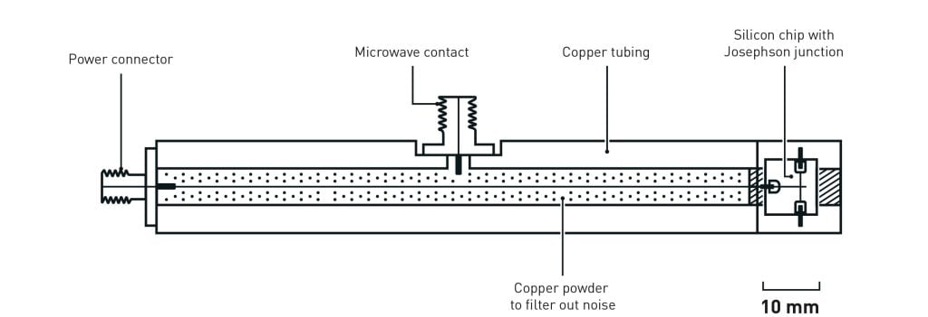
PHYS598500 · WEEK 2
What Is a Superconductor?
What the Prize Actually Recognized
Laureates: John Clarke, Michel H. Devoret, and John M. Martinis
“for the discovery of macroscopic quantum mechanical tunnelling and energy quantisation in an electric circuit”
Macroscopic tunnelling: the junction phase escapes a metastable zero-voltage well even when thermal activation is frozen out.
Energy quantisation: microwave activation resolves discrete levels of that same collective circuit coordinate.
Official Nobel 2025 Figure 6. A centimetre-scale chip and heavily filtered microwave apparatus made the collective phase of billions of Cooper pairs behave as one quantum degree of freedom. © Johan Jarnestad / The Royal Swedish Academy of Sciences, official source.
Why it matters here: a fabricated electrical mode can be a quantum mechanical particle—and therefore can be engineered as an artificial atom.
Official award summary: Nobel Prize in Physics 2025.
Manual slide source
32 / 100
Notes:
[32/100] What Is a Superconductor?
PHYS598500 · WEEK 2
What Is a Superconductor?
What the Prize Actually Recognized
Official Nobel 2025 Figure 6. A centimetre-scale chip and heavily filtered microwave apparatus made the collective phase of billions of Cooper pairs behave as one quantum degree of freedom. © Johan Jarnestad / The Royal Swedish Academy of Sciences, official source.
Laureates: John Clarke, Michel H. Devoret, and John M. Martinis
“for the discovery of macroscopic quantum mechanical tunnelling and energy quantisation in an electric circuit”
Macroscopic tunnelling: the junction phase escapes a metastable zero-voltage well even when thermal activation is frozen out.
Energy quantisation: microwave activation resolves discrete levels of that same collective circuit coordinate.
Why it matters here: a fabricated electrical mode can be a quantum mechanical particle—and therefore can be engineered as an artificial atom.
Official award summary: Nobel Prize in Physics 2025.
Manual slide source
32 / 100

Slide 33
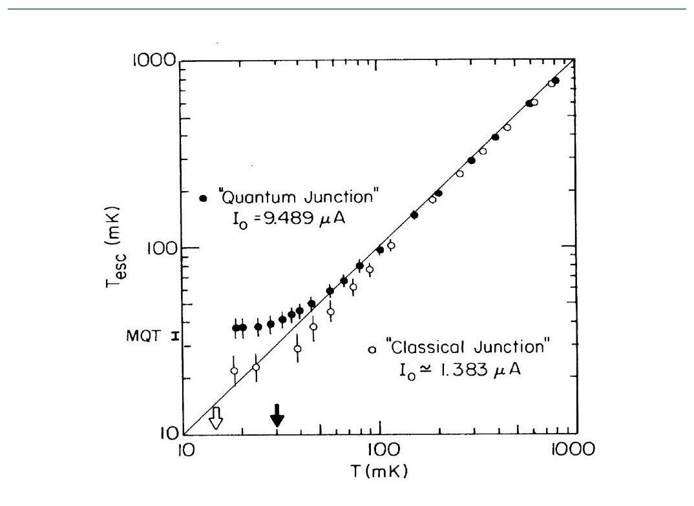
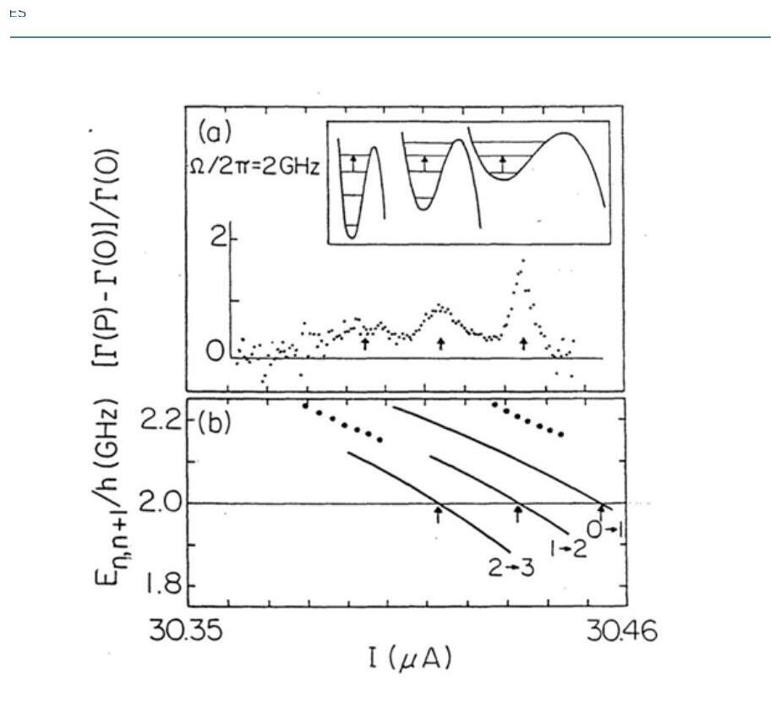
PHYS598500 · WEEK 2
What Is a Superconductor?
The Evidence: Escape Statistics + Junction Spectroscopy
Macroscopic quantum tunnelling. The “quantum junction” escape temperature stops following the thermal line below the crossover; the control junction verifies that the cryostat itself is colder. Cropped from Figure 3 of the official 2025 scientific background.
Quantised junction levels. A 2-GHz microwave drive enhances escape when it matches transitions out of the first, second, and third excited levels of the tilted Josephson potential. Cropped from Figure 4 of the official scientific background.
Logical chain: discrete microwave resonances establish level quantisation; low-temperature escape statistics establish tunnelling of the macroscopic phase coordinate.
Manual slide source
33 / 100
Notes:
[33/100] What Is a Superconductor?
PHYS598500 · WEEK 2
What Is a Superconductor?
The Evidence: Escape Statistics + Junction Spectroscopy
Macroscopic quantum tunnelling. The “quantum junction” escape temperature stops following the thermal line below the crossover; the control junction verifies that the cryostat itself is colder. Cropped from Figure 3 of the official 2025 scientific background.
Quantised junction levels. A 2-GHz microwave drive enhances escape when it matches transitions out of the first, second, and third excited levels of the tilted Josephson potential. Cropped from Figure 4 of the official scientific background.
Logical chain: discrete microwave resonances establish level quantisation; low-temperature escape statistics establish tunnelling of the macroscopic phase coordinate.
Manual slide source
33 / 100

Slide 34

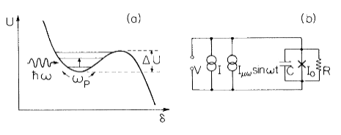
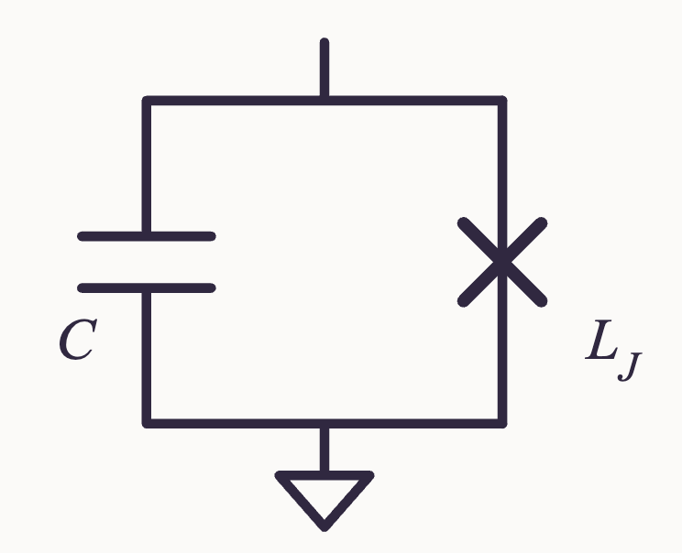
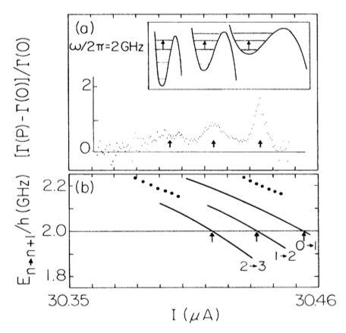
PHYS598500 · WEEK 2
1985: Energy Quantization
1985: Energy Quantization in a Circuit
(a) Quantized levels in the washboard potential; (b) bias circuit with microwave drive. Ref. [3]
Nobel Prize in Physics 2025. Ref. [1]
$$ω=\frac{1}{\sqrt{L_{J}C}}∝\sqrt[4]{I_{c}^{2}−I^{2}}$$
Spectroscopy of the junction levels. A 2-GHz drive enhances the escape rate when it matches a level spacing (a); the resonant bias currents track the calculated transitions $0→1$, $1→2$, $2→3$ (b). As $I→I_{c}$ the spacing shrinks, as $ω∝(I_{c}^{2}−I^{2})^{1/4}$ predicts. Ref. [3]
Manual slide source
34 / 100
Notes:
[34/100] 1985: Energy Quantization
PHYS598500 · WEEK 2
1985: Energy Quantization
1985: Energy Quantization in a Circuit
Nobel Prize in Physics 2025. Ref. [1]
(a) Quantized levels in the washboard potential; (b) bias circuit with microwave drive. Ref. [3]
Spectroscopy of the junction levels. A 2-GHz drive enhances the escape rate when it matches a level spacing (a); the resonant bias currents track the calculated transitions , , (b). As the spacing shrinks, as predicts. Ref. [3]
Manual slide source
34 / 100

Slide 35
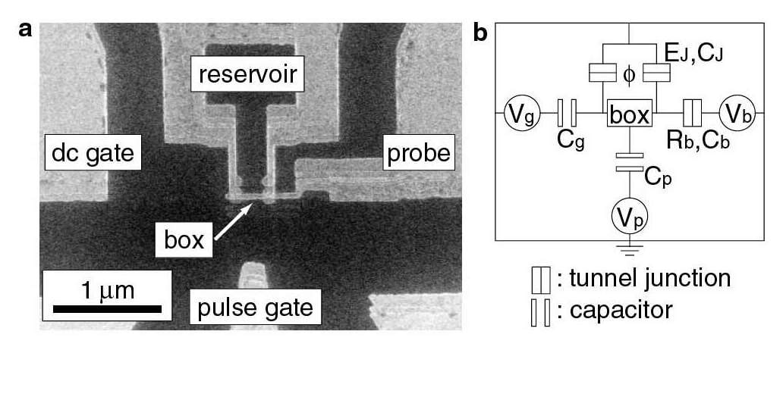
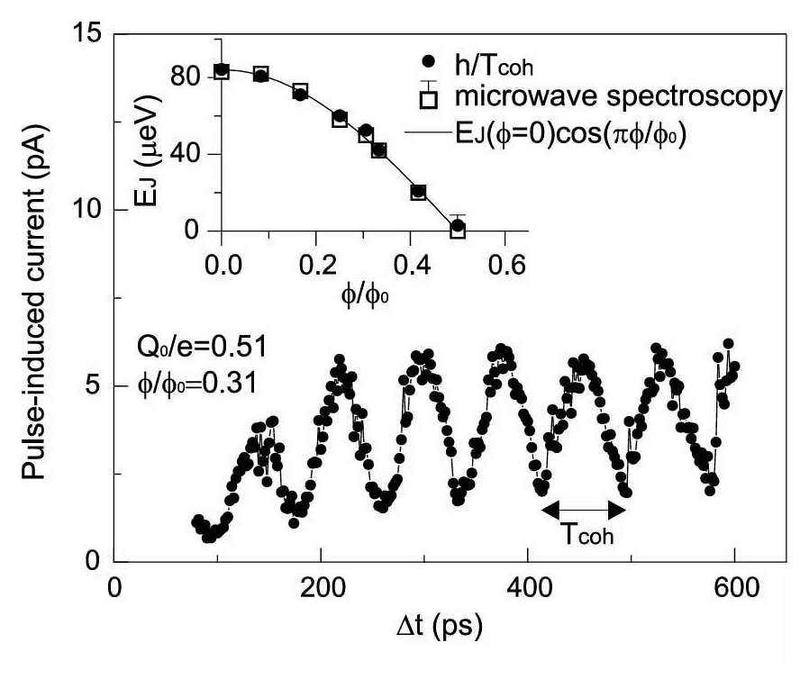
PHYS598500 · WEEK 2
What Is a Superconductor?
From Spectroscopy to Coherent Control (1997–1999)
The device is the Hamiltonian. The island (“box”), Josephson junctions, gates, probe junction, and capacitances are visible in the micrograph and circuit model.
Figure 1, Nakamura, Pashkin & Tsai, Nature 398, 786 (1999), DOI.
Time domain agrees with the earlier spectrum. The main panel resolves coherent charge oscillations versus pulse length. In the inset, $E_{J}$ extracted from the oscillation period agrees with microwave spectroscopy—the 1997 Nakamura–C. D. Chen–J. S. Tsai result cited as Ref. 4 in the paper.
Figure 4, Nakamura, Pashkin & Tsai (1999).
Manual slide source
35 / 100
Notes:
[35/100] What Is a Superconductor?
PHYS598500 · WEEK 2
What Is a Superconductor?
From Spectroscopy to Coherent Control (1997–1999)
The device is the Hamiltonian. The island (“box”), Josephson junctions, gates, probe junction, and capacitances are visible in the micrograph and circuit model. Figure 1, Nakamura, Pashkin & Tsai, Nature 398, 786 (1999), DOI.
Time domain agrees with the earlier spectrum. The main panel resolves coherent charge oscillations versus pulse length. In the inset, extracted from the oscillation period agrees with microwave spectroscopy—the 1997 Nakamura–C. D. Chen–J. S. Tsai result cited as Ref. 4 in the paper. Figure 4, Nakamura, Pashkin & Tsai (1999).
Manual slide source
35 / 100

Slide 36
PHYS598500 · WEEK 2
What Is a Superconductor?
The Citation Chain Matters
1997 · frequency domain
Nakamura, C. D. Chen & J. S. Tsai observed Josephson-induced level splitting between coherently superposed macroscopic charge states, PRL 79, 2328.
1999 · time domain
Nakamura, Pashkin & Tsai used fast gate pulses to drive and read out coherent oscillations of a single-Cooper-pair box, Nature 398, 786.
Historical distinction: these charge-qubit papers are not the 2025 Nobel-winning experiments. They convert quantised Josephson-circuit physics into a controllable computational two-level system.
Why this 1999 panel also points back to Chen. The main graph is the time-domain oscillation; the inset overlays $E_{J}$ inferred from it with microwave-spectroscopy data cited as Ref. 4—the 1997 Nakamura–C. D. Chen–J. S. Tsai paper. Figure 4, Nakamura, Pashkin & Tsai, Nature 398, 786 (1999), DOI.
Manual slide source
36 / 100
Notes:
[36/100] What Is a Superconductor?
PHYS598500 · WEEK 2
What Is a Superconductor?
The Citation Chain Matters
Why this 1999 panel also points back to Chen. The main graph is the time-domain oscillation; the inset overlays inferred from it with microwave-spectroscopy data cited as Ref. 4—the 1997 Nakamura–C. D. Chen–J. S. Tsai paper. Figure 4, Nakamura, Pashkin & Tsai, Nature 398, 786 (1999), DOI.
1997 · frequency domain
Nakamura, C. D. Chen & J. S. Tsai observed Josephson-induced level splitting between coherently superposed macroscopic charge states, PRL 79, 2328.
1999 · time domain
Nakamura, Pashkin & Tsai used fast gate pulses to drive and read out coherent oscillations of a single-Cooper-pair box, Nature 398, 786.
Historical distinction: these charge-qubit papers are not the 2025 Nobel-winning experiments. They convert quantised Josephson-circuit physics into a controllable computational two-level system.
Manual slide source
36 / 100

Slide 37
PHYS598500 · WEEK 2
Opening: What Are Artificial Atoms?
Opening: What Are Artificial Atoms?
Manual slide source
37 / 100
Notes:
[37/100] Opening: What Are Artificial Atoms?
PHYS598500 · WEEK 2
Opening: What Are Artificial Atoms?
Manual slide source
37 / 100

Slide 38
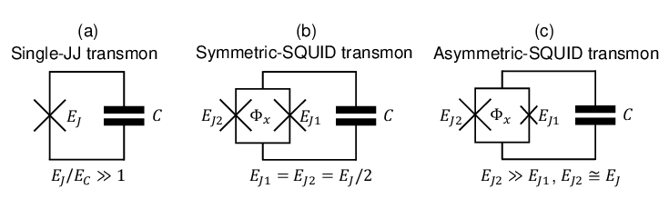
PHYS598500 · WEEK 2
Opening: What Are Artificial Atoms?
Properties of the transmon
The current mainstream superconducting qubit
The transmon is an artificial atom: instead of an electron bound to a nucleus, it is a circuit made of a Josephson junction (a nonlinear inductance) shunted by a large capacitor. Its energy levels are quantized like a real atom, but can be engineered by choosing the circuit values—the idea developed throughout this module.
Manual slide source
38 / 100
Notes:
[38/100] Opening: What Are Artificial Atoms?
PHYS598500 · WEEK 2
Opening: What Are Artificial Atoms?
Properties of the transmon
The current mainstream superconducting qubit
The transmon is an artificial atom: instead of an electron bound to a nucleus, it is a circuit made of a Josephson junction (a nonlinear inductance) shunted by a large capacitor. Its energy levels are quantized like a real atom, but can be engineered by choosing the circuit values—the idea developed throughout this module.
Manual slide source
38 / 100

Slide 39
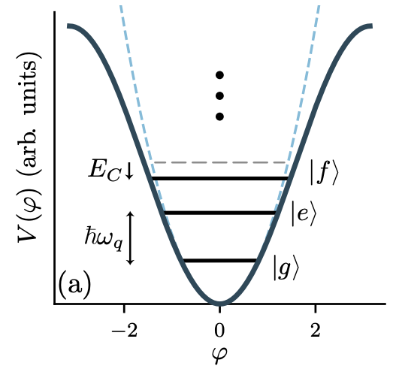
PHYS598500 · WEEK 2
Opening: What Are Artificial Atoms?
▲ Potential-energy curves and the quantized energy levels of the transmon. The spacing between adjacent levels is not equal (anharmonicity), so the transition between the ground state and the first excited state can be addressed independently of the higher levels.
Ref: DOI:10.48550/arXiv.2203.04164
Manual slide source
39 / 100
Notes:
[39/100] Opening: What Are Artificial Atoms?
PHYS598500 · WEEK 2
Opening: What Are Artificial Atoms?
▲ Potential-energy curves and the quantized energy levels of the transmon. The spacing between adjacent levels is not equal (anharmonicity), so the transition between the ground state and the first excited state can be addressed independently of the higher levels.
Ref: DOI:10.48550/arXiv.2203.04164
Manual slide source
39 / 100

Slide 40
PHYS598500 · WEEK 2
Opening: What Are Artificial Atoms?
Question 1: Why Can a Macroscopic Circuit Have Quantum Energy Levels?
“Macroscopic” does not mean “necessarily classical.” Cooper pairs in a superconductor form a condensate with a shared phase. At low temperature, with low loss and a controlled electromagnetic environment, collective circuit modes can retain quantum coherence long enough to be useful. What is quantized is not the position of an individual electron, but the charge, flux, and phase degrees of freedom of the circuit mode as a whole.
First Correct a Common Misconception: Many Particles Do Not Necessarily Mean Many Degrees of Freedom
A piece of superconducting metal certainly contains an enormous number of electrons, but at low energy we do not need to track them individually. The electrons first form Cooper pairs and then condense into a many-body quantum state with long-range phase coherence. It can be represented by a macroscopic order parameter:
$$Ψ(r,t)=\sqrt{n_{s}(r,t)}e^{iθ(r,t)}.$$
Manual slide source
40 / 100
Notes:
[40/100] Opening: What Are Artificial Atoms?
PHYS598500 · WEEK 2
Opening: What Are Artificial Atoms?
Question 1: Why Can a Macroscopic Circuit Have Quantum Energy Levels?
“Macroscopic” does not mean “necessarily classical.” Cooper pairs in a superconductor form a condensate with a shared phase. At low temperature, with low loss and a controlled electromagnetic environment, collective circuit modes can retain quantum coherence long enough to be useful. What is quantized is not the position of an individual electron, but the charge, flux, and phase degrees of freedom of the circuit mode as a whole.
First Correct a Common Misconception: Many Particles Do Not Necessarily Mean Many Degrees of Freedom
A piece of superconducting metal certainly contains an enormous number of electrons, but at low energy we do not need to track them individually. The electrons first form Cooper pairs and then condense into a many-body quantum state with long-range phase coherence. It can be represented by a macroscopic order parameter:
Manual slide source
40 / 100

Slide 41
PHYS598500 · WEEK 2
Opening: What Are Artificial Atoms?
Here $n_{s}$ describes the condensate density and $θ$ its phase. The absolute phase is not itself observable; the gauge-invariant phase difference between superconducting nodes is what enters the current, magnetic flux, and circuit energy. In other words, many microscopic particles can collectively form a small number of controllablecollective coordinates. The real question is not “How many electrons are in the circuit?” but “How many independent modes remain in its low-energy dynamics?”
By analogy, a tuning fork also contains many atoms, yet its lowest vibration can be described by a single normal-mode amplitude. The crucial difference for a superconducting circuit is that this collective mode can enter the quantum limit in a cold, low-loss environment instead of behaving only as a classical vibration.
From a Macroscopic Phase to a Quantizable Circuit Mode
A superconductor provides more than “zero resistance.” The superconducting gap suppresses low-energy quasiparticle excitations, while the condensate provides phase stiffness. With suitable capacitances, inductances, and boundary conditions, the circuit can retain only a few low-loss electromagnetic modes. For one such mode, the branch flux becomes the coordinate (formalized in Question 2):
Manual slide source
41 / 100
Notes:
[41/100] Opening: What Are Artificial Atoms?
PHYS598500 · WEEK 2
Opening: What Are Artificial Atoms?
Here describes the condensate density and its phase. The absolute phase is not itself observable; the gauge-invariant phase difference between superconducting nodes is what enters the current, magnetic flux, and circuit energy. In other words, many microscopic particles can collectively form a small number of controllablecollective coordinates. The real question is not “How many electrons are in the circuit?” but “How many independent modes remain in its low-energy dynamics?”
By analogy, a tuning fork also contains many atoms, yet its lowest vibration can be described by a single normal-mode amplitude. The crucial difference for a superconducting circuit is that this collective mode can enter the quantum limit in a cold, low-loss environment instead of behaving only as a classical vibration.
From a Macroscopic Phase to a Quantizable Circuit Mode
A superconductor provides more than “zero resistance.” The superconducting gap suppresses low-energy quasiparticle excitations, while the condensate provides phase stiffness. With suitable capacitances, inductances, and boundary conditions, the circuit can retain only a few low-loss electromagnetic modes. For one such mode, the branch flux becomes the coordinate (formalized in Question 2):
Manual slide source
41 / 100

Slide 42
PHYS598500 · WEEK 2
Opening: What Are Artificial Atoms?
This is the shortest existence proof that a macroscopic circuit can have discrete quantum levels: first identify a collective mode with a restoring energy, then quantize that mode. Question 2 will formally explain why $Φ$ and $Q$ form a conjugate pair; Question 3 will then ask why this ladder of equally spaced levels still cannot serve directly as a qubit.
The Existence of Energy Levels Is One Thing; Resolving Them Experimentally Is Another
Formal quantization guarantees $E_{m}$. But if thermal fluctuations or the environment-induced linewidth exceed the level spacing, an experiment will reveal only an approximately continuous classical response. Resolving the lowest few levels requires at least
$$k_{B}T≪ℏω,ℏκ,ℏγ_{ϕ}≪ℏω,$$
where $κ$ is the mode's energy-decay rate and $γ_{ϕ}$ its dephasing rate. The first condition suppresses thermal excitation; the other two prevent relaxation and phase noise from broadening the levels beyond recognition. The mean thermal excitation number is
Manual slide source
42 / 100
Notes:
[42/100] Opening: What Are Artificial Atoms?
PHYS598500 · WEEK 2
Opening: What Are Artificial Atoms?
This is the shortest existence proof that a macroscopic circuit can have discrete quantum levels: first identify a collective mode with a restoring energy, then quantize that mode. Question 2 will formally explain why and form a conjugate pair; Question 3 will then ask why this ladder of equally spaced levels still cannot serve directly as a qubit.
The Existence of Energy Levels Is One Thing; Resolving Them Experimentally Is Another
Formal quantization guarantees . But if thermal fluctuations or the environment-induced linewidth exceed the level spacing, an experiment will reveal only an approximately continuous classical response. Resolving the lowest few levels requires at least
where is the mode's energy-decay rate and its dephasing rate. The first condition suppresses thermal excitation; the other two prevent relaxation and phase noise from broadening the levels beyond recognition. The mean thermal excitation number is
Manual slide source
42 / 100

Slide 43
PHYS598500 · WEEK 2
Opening: What Are Artificial Atoms?
$${\overset{¯}{n}}_{th}=\frac{1}{e^{ℏω/k_{B}T}−1}.$$
For example, when $f=ω/2π=5GHz$, $hf/k_{B}≈0.24K$. If the chip mode is genuinely thermalized to $T=20mK$, then ${\overset{¯}{n}}_{th}≈6×{10}^{−6}$: the system is almost always in its ground state. In practice, attenuation, filtering, shielding, and good packaging are still required to keep hot photons and external noise from raising the effective temperature.
Why Do Everyday Circuits Still Look Classical?
An ordinary RLC circuit is not “devoid of quantum mechanics.” Its quantum structure is usually hidden by three effects: room temperature populates many levels; resistance and environmental coupling broaden the linewidth; and strong driving fills the mode with many quanta. For a coherent state with mean photon number $N=|α|^{2}≫1$, relative fluctuations shrink approximately as $1/\sqrt{N}$, so the motion approaches a classical waveform. Superconductivity, dilution refrigeration, and microwave engineering push the same kind of circuit back into the regime $N∼0,1$ with sufficiently low loss.
Manual slide source
43 / 100
Notes:
[43/100] Opening: What Are Artificial Atoms?
PHYS598500 · WEEK 2
Opening: What Are Artificial Atoms?
For example, when , . If the chip mode is genuinely thermalized to , then : the system is almost always in its ground state. In practice, attenuation, filtering, shielding, and good packaging are still required to keep hot photons and external noise from raising the effective temperature.
Why Do Everyday Circuits Still Look Classical?
An ordinary RLC circuit is not “devoid of quantum mechanics.” Its quantum structure is usually hidden by three effects: room temperature populates many levels; resistance and environmental coupling broaden the linewidth; and strong driving fills the mode with many quanta. For a coherent state with mean photon number , relative fluctuations shrink approximately as , so the motion approaches a classical waveform. Superconductivity, dilution refrigeration, and microwave engineering push the same kind of circuit back into the regime with sufficiently low loss.
Manual slide source
43 / 100

Slide 44
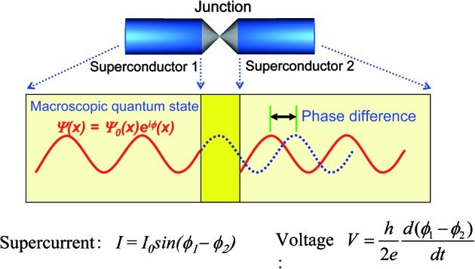
PHYS598500 · WEEK 2
Opening: What Are Artificial Atoms?
A Josephson Junction Converts Phase into Current and Energy
Paper schematic—not a redrawn course icon. The macroscopic order parameters on the two sides acquire a phase difference that directly determines current and voltage.
Figure 1, J. S. Tsai, Proc. Jpn. Acad. B 86, 275 (2010), DOI.
Manual slide source
44 / 100
Notes:
[44/100] Opening: What Are Artificial Atoms?
PHYS598500 · WEEK 2
Opening: What Are Artificial Atoms?
A Josephson Junction Converts Phase into Current and Energy
Paper schematic—not a redrawn course icon. The macroscopic order parameters on the two sides acquire a phase difference that directly determines current and voltage. Figure 1, J. S. Tsai, Proc. Jpn. Acad. B 86, 275 (2010), DOI.
Manual slide source
44 / 100

Slide 45
PHYS598500 · WEEK 2
Opening: What Are Artificial Atoms?
Josephson Phase: Kinematics and Inductance
Expand and rearrange. The phase $φ$ is the canonical coordinate conjugate to the Cooper-pair charge; its rate of change fixes the voltage:
$$\overset{˙}{φ}=\frac{2e}{ℏ}V=\frac{2π}{Φ_{0}}V,I=I_{c}sinφ,Φ=\frac{Φ_{0}}{2π}φ.$$
Because the current is a sinusoid of the phase, the effective junction inductance is phase-dependent:
$$L_{J}≡\frac{dΦ}{dI}=\frac{\frac{dΦ}{dφ}}{\frac{dI}{dφ}}=\frac{\frac{Φ_{0}}{2π}}{I_{c}cosφ}=\frac{Φ_{0}}{2πI_{c}cosφ}.$$
The Josephson Energy
$$U_{J}=\int_{0}^{T}{IVdt=\int_{0}^{T}{I_{c}sinφ\frac{Φ_{0}}{2π}\overset{˙}{φ}dt=\frac{I_{c}Φ_{0}}{2π}\int_{0}^{\overset{¯}{φ}}{sinφdφ=\frac{I_{c}Φ_{0}}{2π}\left[1−cos\overset{¯}{φ}\right].}}}$$
Define the Josephson energy $E_{J}$ so that $U_{J}(φ)=E_{J}(1−cosφ)$. Since potential energy is defined only up to an additive constant, the conventional form is $U_{J}(φ)=−E_{J}cosφ$. The capacitive energy is:
$$E_{J}≡\frac{I_{c}Φ_{0}}{2π}=\frac{ℏI_{c}}{2e}$$
Manual slide source
45 / 100
Notes:
[45/100] Opening: What Are Artificial Atoms?
PHYS598500 · WEEK 2
Opening: What Are Artificial Atoms?
Josephson Phase: Kinematics and Inductance
Expand and rearrange. The phase is the canonical coordinate conjugate to the Cooper-pair charge; its rate of change fixes the voltage:
Because the current is a sinusoid of the phase, the effective junction inductance is phase-dependent:
The Josephson Energy
Define the Josephson energy so that . Since potential energy is defined only up to an additive constant, the conventional form is . The capacitive energy is:
Manual slide source
45 / 100

Slide 46
PHYS598500 · WEEK 2
Opening: What Are Artificial Atoms?
Lagrangian and the Canonical Pair
$$U_{C}=\frac{1}{2}CV^{2}=\frac{1}{2}C{\left(\frac{ℏ}{2e}\overset{˙}{φ}\right)}^{2}.$$
Using the conventional Josephson potential $U_{J}=−E_{J}cosφ$, the Lagrangian is $T−U$:
$$L(φ,\overset{˙}{φ})=\frac{1}{2}C{\left(\frac{ℏ}{2e}\overset{˙}{φ}\right)}^{2}−\left(−E_{J}cosφ\right)=\frac{1}{2}C{\left(\frac{ℏ}{2e}\right)}^{2}{\overset{˙}{φ}}^{2}+E_{J}cosφ.$$
From the Josephson voltage–phase relation and the capacitor relation, $V=\frac{ℏ}{2e}\overset{˙}{φ}$ and $Q=CV$:
$$Q=C\frac{ℏ}{2e}\overset{˙}{φ}.$$
If the charge is written in terms of the Cooper-pair number $n$, $Q=2en$, then the canonical momentum conjugate to $φ$ is:
$$p_{φ}≡\frac{∂L}{∂\overset{˙}{φ}}=C{\left(\frac{ℏ}{2e}\right)}^{2}\overset{˙}{φ}=\frac{ℏ}{2e}\left(C\frac{ℏ}{2e}\overset{˙}{φ}\right)=\frac{ℏ}{2e}Q=\frac{ℏ}{2e}(2en)=ℏn.$$
Manual slide source
46 / 100
Notes:
[46/100] Opening: What Are Artificial Atoms?
PHYS598500 · WEEK 2
Opening: What Are Artificial Atoms?
Lagrangian and the Canonical Pair
Using the conventional Josephson potential , the Lagrangian is :
From the Josephson voltage–phase relation and the capacitor relation, and :
If the charge is written in terms of the Cooper-pair number , , then the canonical momentum conjugate to is:
Manual slide source
46 / 100

Slide 47
PHYS598500 · WEEK 2
Opening: What Are Artificial Atoms?
The Hamiltonian: $4E_{C}n^{2}−E_{J}cosφ$
The Hamiltonian is obtained through the Legendre transformation $H=p_{φ}\overset{˙}{φ}−L$. Solving for $\overset{˙}{φ}$ and substituting:
$$\overset{˙}{φ}=\frac{p_{φ}}{C{\left(\frac{ℏ}{2e}\right)}^{2}},H=\frac{p_{φ}^{2}}{C{\left(\frac{ℏ}{2e}\right)}^{2}}−\frac{1}{2}\frac{p_{φ}^{2}}{C{\left(\frac{ℏ}{2e}\right)}^{2}}−E_{J}cosφ=\frac{p_{φ}^{2}}{2C{\left(\frac{ℏ}{2e}\right)}^{2}}−E_{J}cosφ.$$
Recognising $p_{φ}=\frac{ℏ}{2e}Q$, the first term becomes $\frac{Q^{2}}{2C}$; with $Q=2en$:
$$H=\frac{Q^{2}}{2C}−E_{J}cosφ=\frac{(2en)^{2}}{2C}−E_{J}cosφ=\frac{2e^{2}}{C}n^{2}−E_{J}cosφ.$$
Define the charging energy $E_{C}≡\frac{e^{2}}{2C}$, so that $\frac{2e^{2}}{C}=4E_{C}$:
$$H=4E_{C}n^{2}−E_{J}cosφ.$$
Manual slide source
47 / 100
Notes:
[47/100] Opening: What Are Artificial Atoms?
PHYS598500 · WEEK 2
Opening: What Are Artificial Atoms?
The Hamiltonian:
The Hamiltonian is obtained through the Legendre transformation . Solving for and substituting:
Recognising , the first term becomes ; with :
Define the charging energy , so that :
Manual slide source
47 / 100

Slide 48
PHYS598500 · WEEK 2
Opening: What Are Artificial Atoms?
Quantization: $[\overset{^}{φ},\overset{^}{n}]=i$
To quantize the circuit, promote $φ$ and $p_{φ}$ to operators obeying the canonical commutation relation:
$$[\overset{^}{φ},{\overset{^}{p}}_{φ}]=[\overset{^}{φ},ℏ\overset{^}{n}]=iℏ⟹[\overset{^}{φ},\overset{^}{n}]=i.$$
The phase and number eigenstates are defined by $\overset{^}{φ}|φ⟩=φ|φ⟩$ and $\overset{^}{n}|n⟩=n|n⟩$. In the phase representation $\overset{^}{φ}$ acts multiplicatively and $\overset{^}{n}$ is a derivative:
$$\overset{^}{n}=−i\frac{∂}{∂φ}.$$
Manual slide source
48 / 100
Notes:
[48/100] Opening: What Are Artificial Atoms?
PHYS598500 · WEEK 2
Opening: What Are Artificial Atoms?
Quantization:
To quantize the circuit, promote and to operators obeying the canonical commutation relation:
The phase and number eigenstates are defined by and . In the phase representation acts multiplicatively and is a derivative:
Manual slide source
48 / 100

Slide 49
PHYS598500 · WEEK 2
Opening: What Are Artificial Atoms?
The Schrödinger Equation
Indeed, $[\overset{^}{φ},\overset{^}{n}]|φ⟩=\left[φ,−i\frac{∂}{∂φ}\right]|φ⟩=−iφ∂_{φ}ψ+i∂_{φ}(φψ)=i|φ⟩$. The Hamiltonian operator is therefore $\overset{^}{H}=4E_{C}{\overset{^}{n}}^{2}−E_{J}cos\overset{^}{φ}=−4E_{C}\frac{∂^{2}}{∂φ^{2}}−E_{J}cosφ$, and the time-independent Schrödinger equation becomes:
$$\left[−4E_{C}\frac{∂^{2}}{∂φ^{2}}−E_{J}cosφ\right]|φ⟩=E|φ⟩.$$
Manual slide source
49 / 100
Notes:
[49/100] Opening: What Are Artificial Atoms?
PHYS598500 · WEEK 2
Opening: What Are Artificial Atoms?
The Schrödinger Equation
Indeed, . The Hamiltonian operator is therefore , and the time-independent Schrödinger equation becomes:
Manual slide source
49 / 100

Slide 50
PHYS598500 · WEEK 2
Opening: What Are Artificial Atoms?
The Integer Spectrum of the Cooper-Pair Number
The Josephson phase is an angular variable defined modulo $2π$, so the phase degree of freedom is compact, $φ∈S^{1}$. The operator $\overset{^}{n}$ generates phase translations. With $\overset{^}{U}(α)=e^{−iα\overset{^}{n}}$ and the Baker–Campbell–Hausdorff relation:
$${\overset{^}{U}}^{†}(α)\overset{^}{φ}\overset{^}{U}(α)=\overset{^}{φ}+iα[\overset{^}{n},\overset{^}{φ}]=\overset{^}{φ}+α,[\overset{^}{n},\overset{^}{φ}]=−i.$$
$$\overset{^}{U}(α)|φ⟩=e^{−iα\overset{^}{n}}|φ⟩=|φ+α⟩.$$
Because the phase is an angular variable, a translation by $2π$ returns to the same physical phase, $|φ+2π⟩=|φ⟩$. Hence $e^{−i2π\overset{^}{n}}|φ⟩=|φ⟩$, and since this holds for the complete phase basis:
$$e^{−i2π\overset{^}{n}}=\overset{^}{I}⟹e^{−i2πn}=1⟹n∈Z,n=0,±1,±2,…$$
Manual slide source
50 / 100
Notes:
[50/100] Opening: What Are Artificial Atoms?
PHYS598500 · WEEK 2
Opening: What Are Artificial Atoms?
The Integer Spectrum of the Cooper-Pair Number
The Josephson phase is an angular variable defined modulo , so the phase degree of freedom is compact, . The operator generates phase translations. With and the Baker–Campbell–Hausdorff relation:
Because the phase is an angular variable, a translation by returns to the same physical phase, . Hence , and since this holds for the complete phase basis:
Manual slide source
50 / 100

Slide 51
PHYS598500 · WEEK 2
Opening: What Are Artificial Atoms?
The $⟨φ|n⟩$ Basis and the Meaning of $n$
Projecting the number eigenvalue equation onto the phase basis, the overlap is a plane wave $⟨φ|n⟩=Ae^{inφ}$. Periodicity $⟨φ+2π|n⟩=⟨φ|n⟩$ gives $e^{i2πn}=1$, and the normalization $\int_{0}^{2π}{|⟨φ|n⟩|^{2}dφ=1}$ fixes $|A|=1/\sqrt{2π}$. Choosing $A$ real and positive:
$$⟨φ|n⟩=\frac{1}{\sqrt{2π}}e^{inφ},n∈Z.$$
The charge operator is $\overset{^}{Q}=2e\overset{^}{n}$. Acting on a number eigenstate, $\overset{^}{Q}|n⟩=2en|n⟩$, so the charge eigenvalue is $Q_{n}=2en$. Changing the Cooper-pair number by one, $n→n±1$, changes the charge by $ΔQ=±2e$.
Manual slide source
51 / 100
Notes:
[51/100] Opening: What Are Artificial Atoms?
PHYS598500 · WEEK 2
Opening: What Are Artificial Atoms?
The Basis and the Meaning of
Projecting the number eigenvalue equation onto the phase basis, the overlap is a plane wave . Periodicity gives , and the normalization fixes . Choosing real and positive:
The charge operator is . Acting on a number eigenstate, , so the charge eigenvalue is . Changing the Cooper-pair number by one, , changes the charge by .
Manual slide source
51 / 100

Slide 52
PHYS598500 · WEEK 2
Opening: What Are Artificial Atoms?
Fourier Series and the Josephson Coupling
The charge eigenstates are complete, $\sum_{n∈Z}{|n⟩⟨n|=\overset{^}{I}}$, so $|Ψ⟩=\sum_{n∈Z}{c_{n}|n⟩}$. Projecting onto the phase basis relates the two bases by a Fourier series:
$$⟨φ|Ψ⟩=\sum_{n∈Z}{c_{n}⟨φ|n⟩=\frac{1}{\sqrt{2π}}\sum_{n∈Z}{c_{n}e^{inφ}}.}$$
The Josephson term $−E_{J}cos\overset{^}{φ}=−\frac{E_{J}}{2}\left(e^{i\overset{^}{φ}}+e^{−i\overset{^}{φ}}\right)$ acts on a charge eigenstate by shifting it, because $⟨φ|e^{±i\overset{^}{φ}}|n⟩=⟨φ|n±1⟩$:
$$e^{±i\overset{^}{φ}}|n⟩=|n±1⟩.$$
Manual slide source
52 / 100
Notes:
[52/100] Opening: What Are Artificial Atoms?
PHYS598500 · WEEK 2
Opening: What Are Artificial Atoms?
Fourier Series and the Josephson Coupling
The charge eigenstates are complete, , so . Projecting onto the phase basis relates the two bases by a Fourier series:
The Josephson term acts on a charge eigenstate by shifting it, because :
Manual slide source
52 / 100

Slide 53
PHYS598500 · WEEK 2
Opening: What Are Artificial Atoms?
The Hamiltonian in the Charge Basis
Thus $e^{±i\overset{^}{φ}}$ transfers one Cooper pair across the junction. Combining the charging and Josephson terms, the full Hamiltonian in the charge basis is:
$$\overset{^}{H}=4E_{C}\sum_{n∈Z}{n^{2}|n⟩⟨n|−\frac{E_{J}}{2}\sum_{n∈Z}{\left(|n+1⟩⟨n|+|n⟩⟨n+1|\right)}}.$$
Manual slide source
53 / 100
Notes:
[53/100] Opening: What Are Artificial Atoms?
PHYS598500 · WEEK 2
Opening: What Are Artificial Atoms?
The Hamiltonian in the Charge Basis
Thus transfers one Cooper pair across the junction. Combining the charging and Josephson terms, the full Hamiltonian in the charge basis is:
Manual slide source
53 / 100

Slide 54
PHYS598500 · WEEK 2
Opening: What Are Artificial Atoms?
When Is $φ≡φ+2π$ the Right Statement?
Josephson element: observables are periodic
Isolated island: compact configuration space
$$I(φ)=I_{c}sinφ,U_{J}(φ)=−E_{J}cosφ,U_{J}(φ+2π)=U_{J}(φ).$$
For a Cooper-pair box or transmon, wavefunctions obey a twisted boundary condition
The relative condensate phase is angular. A phase advance by $2π$ returns the local Josephson energy and current to the same value.
$$ψ(φ+2π)=e^{i2πn_{g}}ψ(φ),$$
equivalent to an integer charge spectrum $n$ with offset charge $n_{g}$. Compactness and charge quantisation are Fourier-dual statements.
Inductive shunt: unwrap the phase
What stays quantised?
Adding $\frac{1}{2}E_{L}(φ−φ_{ext})^{2}$ distinguishes neighbouring Josephson wells. For fluxonium and related circuits, $φ∈R$ is normally treated as an extended flux coordinate.
Fluxoid quantisation constrains phase winding around superconducting loops, while the node-flux coordinate used in circuit quantisation can span many $2π$ wells. The circuit topology decides the boundary condition.
Safe statement: the Josephson potential is always $2π$-periodic; the quantum coordinate is compact only when the circuit topology and boundary conditions make it so.
Manual slide source
54 / 100
Notes:
[54/100] Opening: What Are Artificial Atoms?
PHYS598500 · WEEK 2
Opening: What Are Artificial Atoms?
When Is the Right Statement?
Josephson element: observables are periodic
The relative condensate phase is angular. A phase advance by returns the local Josephson energy and current to the same value.
Isolated island: compact configuration space
For a Cooper-pair box or transmon, wavefunctions obey a twisted boundary condition
equivalent to an integer charge spectrum with offset charge . Compactness and charge quantisation are Fourier-dual statements.
Inductive shunt: unwrap the phase
Adding distinguishes neighbouring Josephson wells. For fluxonium and related circuits, is normally treated as an extended flux coordinate.
What stays quantised?
Fluxoid quantisation constrains phase winding around superconducting loops, while the node-flux coordinate used in circuit quantisation can span many wells. The circuit topology decides the boundary condition.
Safe statement: the Josephson potential is always -periodic; the quantum coordinate is compact only when the circuit topology and boundary conditions make it so.
Manual slide source
54 / 100

Slide 55
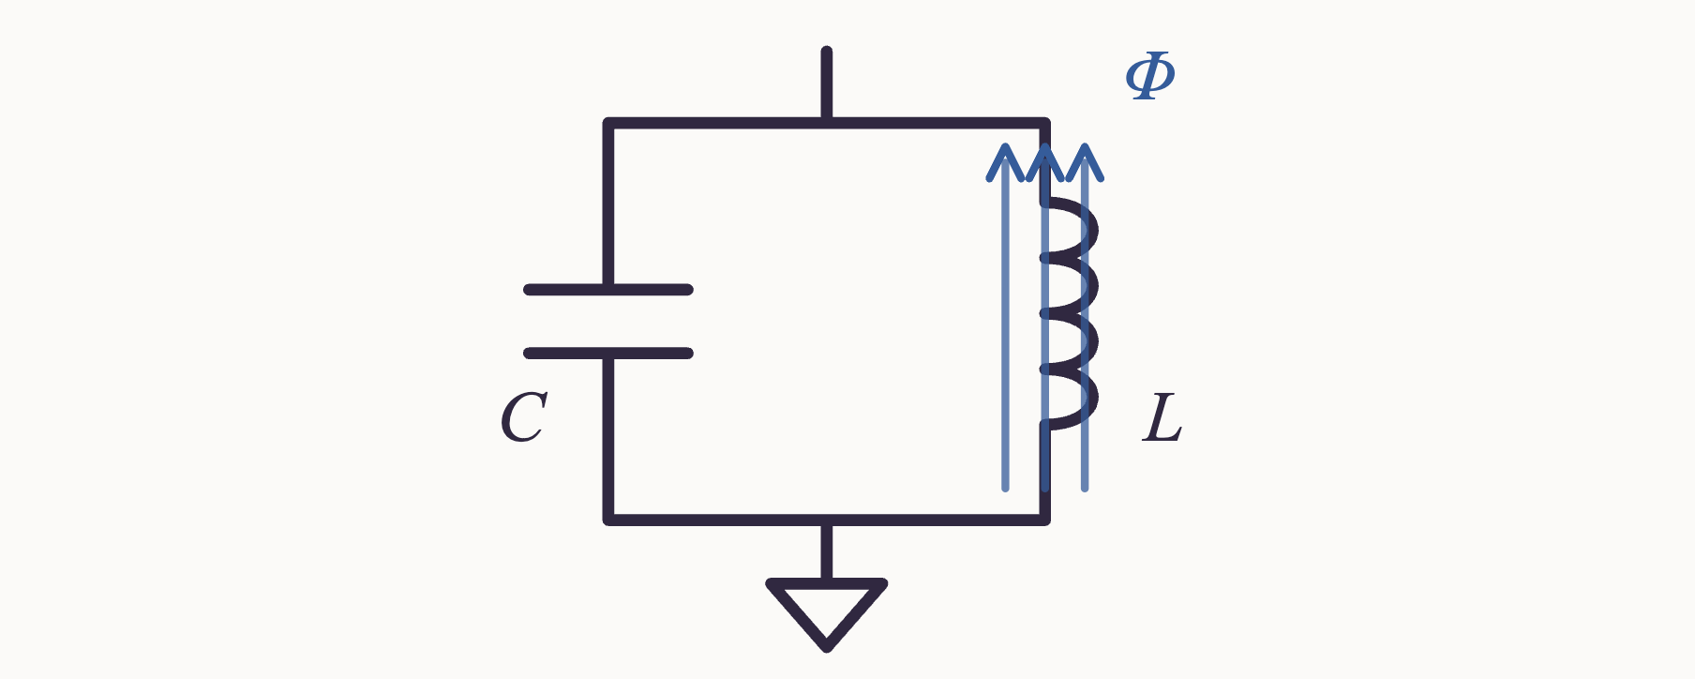
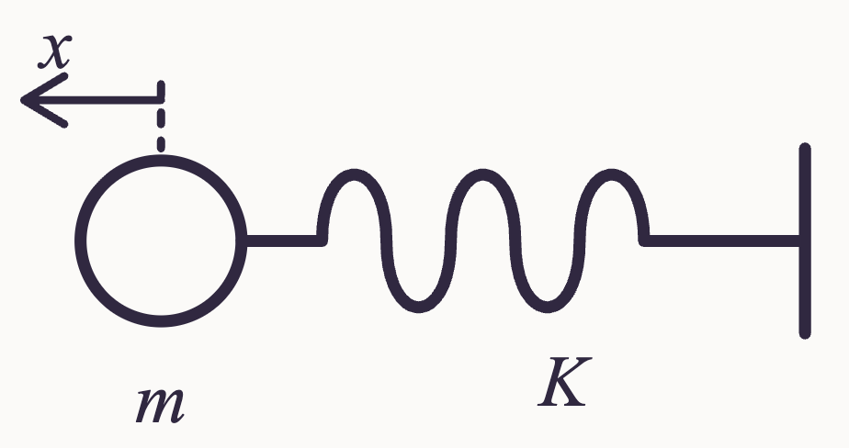
PHYS598500 · WEEK 2
LC Circuit (II)
LC Circuit: Lagrangian and Hamiltonian
$$\left\{\begin{matrix}\text{Capacitor: }I_{C}=C\frac{dV_{C}}{dt} \\ \text{Inductor: }V_{L}=L\frac{dI_{L}}{dt}\end{matrix}\right. → E=\int_{0}^{t}{IVdt → \left\{\begin{matrix}E_{C}=\frac{Q^{2}}{2C} \\ E_{L}=\frac{L{\overset{˙}{Q}}^{2}}{2}\end{matrix}\right. ↔ \left\{\begin{matrix}V=\frac{1}{2}Kx^{2} \\ T=\frac{1}{2}m{\overset{˙}{x}}^{2}\end{matrix}\right.}$$
$$Φ≡\int_{0}^{t}{V_{L}dt=\int_{0}^{t}{L\frac{dI_{L}}{dt}dt=L\overset{˙}{Q},\frac{dΦ}{dt}=V_{L}=V_{C}=\frac{Q}{C} → Q=C\overset{˙}{Φ}}}$$
$$→ E_{C}=\frac{C{\overset{˙}{Φ}}^{2}}{2},E_{L}=\frac{Φ^{2}}{2L}$$
$$\text{Lagrangian }L=\frac{C{\overset{˙}{Φ}}^{2}}{2}−\frac{Φ^{2}}{2L},\text{conjugate momentum }Π=\frac{∂L}{∂\overset{˙}{Φ}}=C\overset{˙}{Φ}=Q$$
$$\text{Hamiltonian }H=Π\overset{˙}{Φ}−L=\frac{Q^{2}}{2C}+\frac{Φ^{2}}{2L}$$
$$\text{Canonical quantization: }[\overset{^}{Φ},\overset{^}{Q}]=iℏ ↔ [x,p]=iℏ$$
Manual slide source
55 / 100
Notes:
[55/100] LC Circuit (II)
PHYS598500 · WEEK 2
LC Circuit (II)
LC Circuit: Lagrangian and Hamiltonian
Manual slide source
55 / 100

Slide 56
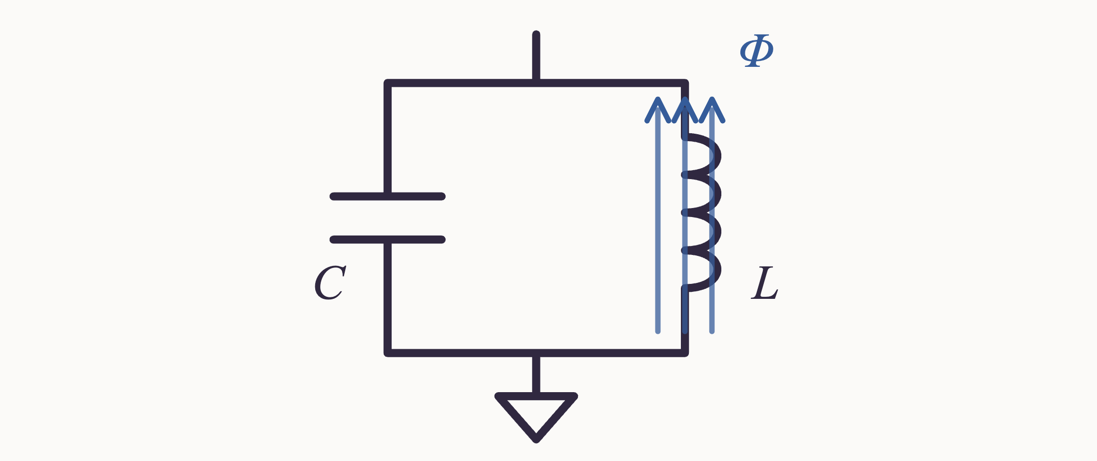
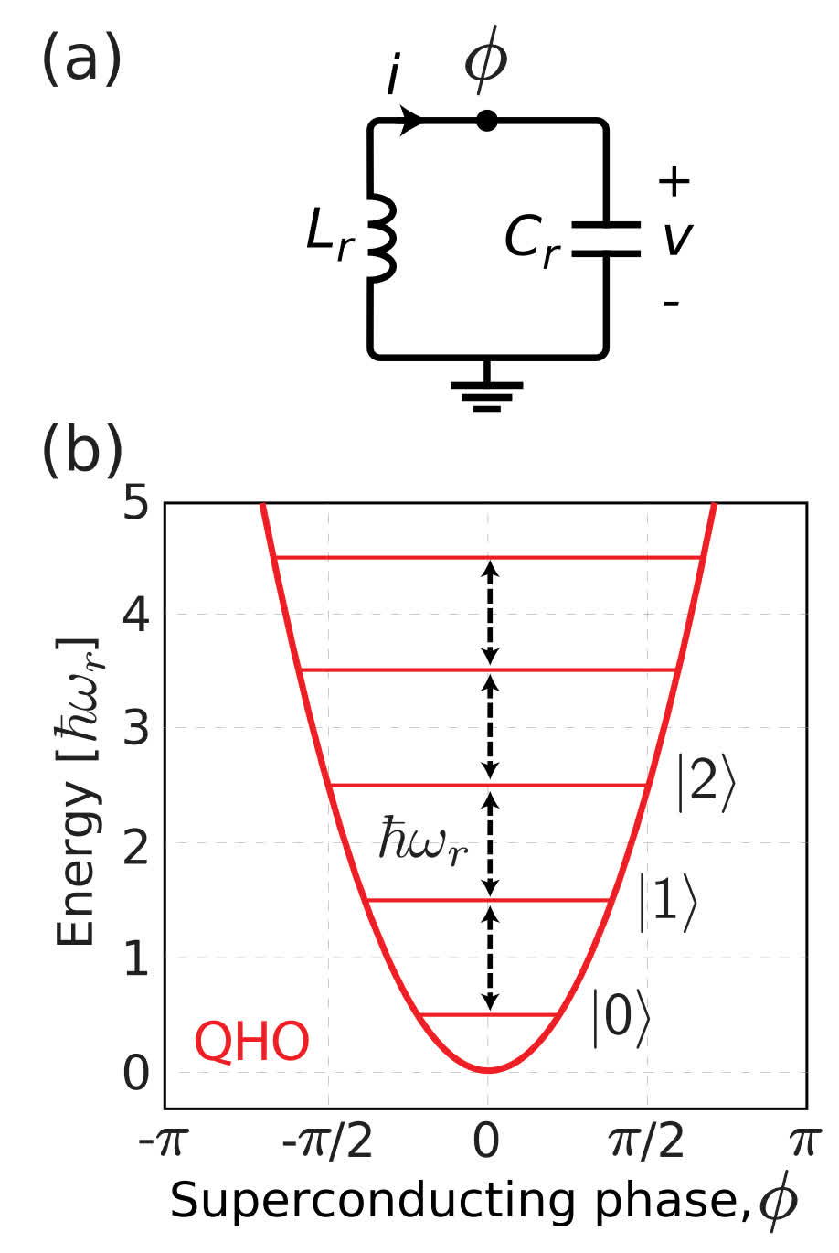
PHYS598500 · WEEK 2
LC Circuit (III)
LC Circuit: Ladder Operators
$$\overset{^}{H}=\frac{{\overset{^}{Q}}^{2}}{2C}+\frac{{\overset{^}{Φ}}^{2}}{2L},[\overset{^}{Φ},\overset{^}{Q}]=iℏ$$
$$\left\{\begin{matrix}\overset{^}{a}=\sqrt{\frac{1}{2ℏ}\sqrt{\frac{L}{C}}}\left(\sqrt{\frac{C}{L}}\overset{^}{Φ}+i\overset{^}{Q}\right) \\ {\overset{^}{a}}^{†}=\sqrt{\frac{1}{2ℏ}\sqrt{\frac{L}{C}}}\left(\sqrt{\frac{C}{L}}\overset{^}{Φ}−i\overset{^}{Q}\right)\end{matrix}\right.$$
$$\overset{^}{H}=ℏω\left({\overset{^}{a}}^{†}\overset{^}{a}+\frac{1}{2}\right),ω=\frac{1}{\sqrt{LC}}$$
Quantum harmonic oscillator: equally spaced levels $ℏω_{r}$ — no isolated two-level system yet. Ref. [2]
Manual slide source
56 / 100
Notes:
[56/100] LC Circuit (III)
PHYS598500 · WEEK 2
LC Circuit (III)
LC Circuit: Ladder Operators
Quantum harmonic oscillator: equally spaced levels — no isolated two-level system yet. Ref. [2]
Manual slide source
56 / 100

Slide 57
PHYS598500 · WEEK 2
Opening: What Are Artificial Atoms?
$$\overset{^}{n}=−i\frac{∂}{∂φ},e^{±i\overset{^}{φ}}|n⟩=|n±1⟩.$$
The final expression makes the physical relation between phase and charge explicit: $e^{±i\overset{^}{φ}}$ changes the Cooper-pair number on the island by one. The Josephson term can therefore also be written as
$$−E_{J}cos\overset{^}{φ}=−\frac{E_{J}}{2}\left(e^{i\overset{^}{φ}}+e^{−i\overset{^}{φ}}\right),$$
In the phase picture it is a cosine potential; in the charge picture it is coherent tunneling between adjacent charge states. The two pictures describe the same Hamiltonian.
Charge and phase therefore cannot both have arbitrarily precise values. The differences among later qubit types can all be viewed as rearrangements, at different energy scales, of the fluctuations, localization, and sensitivity of this conjugate pair. A larger charging energy tends to restrict charge fluctuations; a larger Josephson energy tends to localize phase near a minimum of the cosine potential. The two cannot both be narrowed without limit.
Manual slide source
57 / 100
Notes:
[57/100] Opening: What Are Artificial Atoms?
PHYS598500 · WEEK 2
Opening: What Are Artificial Atoms?
The final expression makes the physical relation between phase and charge explicit: changes the Cooper-pair number on the island by one. The Josephson term can therefore also be written as
In the phase picture it is a cosine potential; in the charge picture it is coherent tunneling between adjacent charge states. The two pictures describe the same Hamiltonian.
Charge and phase therefore cannot both have arbitrarily precise values. The differences among later qubit types can all be viewed as rearrangements, at different energy scales, of the fluctuations, localization, and sensitivity of this conjugate pair. A larger charging energy tends to restrict charge fluctuations; a larger Josephson energy tends to localize phase near a minimum of the cosine potential. The two cannot both be narrowed without limit.
Manual slide source
57 / 100

Slide 58
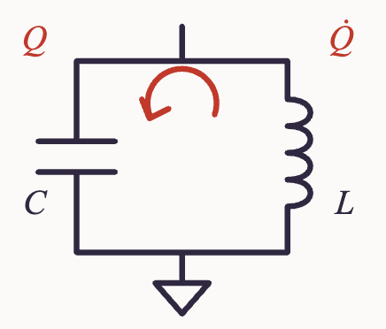
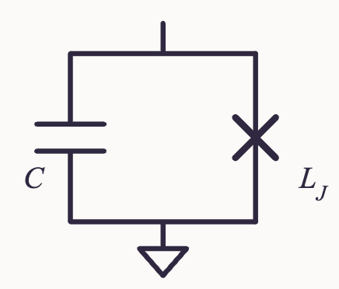
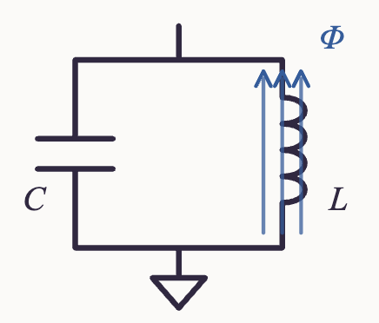



PHYS598500 · WEEK 2
LC Circuit (I)
LC Circuit: Charge or Flux as the Coordinate?
charge $Q$ → kinetic term
Josephson $L_{J}$
flux $Φ$ → potential term
tunable $Φ_{B}$
$E=\frac{Q^{2}}{2C}+\frac{L{\overset{˙}{Q}}^{2}}{2}$
→
$E=\frac{C{\overset{˙}{Φ}}^{2}}{2}+\frac{Φ^{2}}{2L}$
→
$E=\frac{C{\overset{˙}{Φ}}^{2}}{2}+\frac{Φ^{2}}{2L(Φ_{B})}−β(Φ_{B})Φ^{4}+⋯$
QHO: equally spaced levels $ℏω_{r}$ — the reference harmonic potential.
Transmon: anharmonic spacing $ℏω_{12}$ — the computational subspace. Ref. [2]
With charge $Q$ as the coordinate the Josephson inductance puts the nonlinearity in the kinetic term; with flux $Φ$ it becomes a nonlinear potential — the familiar anharmonic-oscillator problem.
Manual slide source
58 / 100
Notes:
[58/100] LC Circuit (I)
PHYS598500 · WEEK 2
LC Circuit (I)
LC Circuit: Charge or Flux as the Coordinate?
charge → kinetic term
Josephson
flux → potential term
tunable
→
QHO: equally spaced levels — the reference harmonic potential.
Transmon: anharmonic spacing — the computational subspace. Ref. [2]
With charge as the coordinate the Josephson inductance puts the nonlinearity in the kinetic term; with flux it becomes a nonlinear potential — the familiar anharmonic-oscillator problem.
Manual slide source
58 / 100

Slide 59
PHYS598500 · WEEK 2
Opening: What Are Artificial Atoms?
Question 3: Why is the simplest artificial atom still not a qubit?
A quantized LC circuit already has discrete energy levels:
$${\overset{^}{H}}_{LC}=\frac{{\overset{^}{Q}}^{2}}{2C}+\frac{{\overset{^}{Φ}}^{2}}{2L}=ℏω\left({\overset{^}{a}}^{†}\overset{^}{a}+\frac{1}{2}\right),ω=\frac{1}{\sqrt{LC}}.$$
First establish that an LC circuit really is a quantum system
Define the characteristic impedance $Z=\sqrt{L/C}$, so the flux and charge operators can be written as
$$\overset{^}{Φ}=Φ_{zpf}(\overset{^}{a}+{\overset{^}{a}}^{†}),\overset{^}{Q}=−iQ_{zpf}(\overset{^}{a}−{\overset{^}{a}}^{†}),$$
Manual slide source
59 / 100
Notes:
[59/100] Opening: What Are Artificial Atoms?
PHYS598500 · WEEK 2
Opening: What Are Artificial Atoms?
Question 3: Why is the simplest artificial atom still not a qubit?
A quantized LC circuit already has discrete energy levels:
First establish that an LC circuit really is a quantum system
Define the characteristic impedance , so the flux and charge operators can be written as
Manual slide source
59 / 100

Slide 60
PHYS598500 · WEEK 2
Opening: What Are Artificial Atoms?
$$Φ_{zpf}=\sqrt{\frac{ℏZ}{2}},Q_{zpf}=\sqrt{\frac{ℏ}{2Z}},Φ_{zpf}Q_{zpf}=\frac{ℏ}{2}.$$
Even in the ground state, flux and charge retain zero-point fluctuations. The energy eigenstates $|m⟩$ are also genuinely discrete:
$$E_{m}=ℏω\left(m+\frac{1}{2}\right),m=0,1,2,…$$
The problem, then, is not that the LC oscillator is “insufficiently quantum.” Quite the opposite: it is an overly ideal linear quantum system in which every rung obeys exactly the same rule.
An equally spaced spectrum makes all adjacent transition frequencies coincide
The transition frequency between adjacent levels is
$$ω_{m,m+1}=\frac{E_{m+1}−E_{m}}{ℏ}=ω,$$
Manual slide source
60 / 100
Notes:
[60/100] Opening: What Are Artificial Atoms?
PHYS598500 · WEEK 2
Opening: What Are Artificial Atoms?
Even in the ground state, flux and charge retain zero-point fluctuations. The energy eigenstates are also genuinely discrete:
The problem, then, is not that the LC oscillator is “insufficiently quantum.” Quite the opposite: it is an overly ideal linear quantum system in which every rung obeys exactly the same rule.
An equally spaced spectrum makes all adjacent transition frequencies coincide
The transition frequency between adjacent levels is
Manual slide source
60 / 100

Slide 61
PHYS598500 · WEEK 2
Opening: What Are Artificial Atoms?
Therefore,
$$ω_{01}=ω_{12}=ω_{23}=⋯.$$
A resonant microwave tone sees not only $|0⟩↔|1⟩$ but also every higher transition. Frequency selectivity cannot tell the system to use only the two lowest levels.
The drive Hamiltonian shows why leakage is unavoidable
Suppose the oscillator is driven by a capacitively coupled microwave voltage. Ignoring a coupling prefactor that does not affect the main point, the control term can be written as
$${\overset{^}{H}}_{d}(t)=ℏϵ(t)(\overset{^}{a}+{\overset{^}{a}}^{†}).$$
The matrix element between adjacent levels is
Manual slide source
61 / 100
Notes:
[61/100] Opening: What Are Artificial Atoms?
PHYS598500 · WEEK 2
Opening: What Are Artificial Atoms?
Therefore,
A resonant microwave tone sees not only but also every higher transition. Frequency selectivity cannot tell the system to use only the two lowest levels.
The drive Hamiltonian shows why leakage is unavoidable
Suppose the oscillator is driven by a capacitively coupled microwave voltage. Ignoring a coupling prefactor that does not affect the main point, the control term can be written as
The matrix element between adjacent levels is
Manual slide source
61 / 100

Slide 62
PHYS598500 · WEEK 2
Opening: What Are Artificial Atoms?
$$⟨m+1|\overset{^}{a}+{\overset{^}{a}}^{†}|m⟩=\sqrt{m+1}.$$
The drive initially pushes $|0⟩$ toward $|1⟩$. Once $|1⟩$ acquires population, the same frequency also drives $|1⟩→|2⟩$ exactly on resonance, with a matrix element larger by a factor of $\sqrt{2}$. The same pattern continues upward. Therefore, $\{|0⟩,|1⟩\}$ is not a closed invariant subspace under this control.
A stronger statement: a linear drive creates a coherent state, not a pure $|1⟩$ state
Under the rotating-wave approximation, a driven harmonic oscillator can be written as
$${\overset{^}{H}}_{rot}(t)=ℏ\left[ϵ(t){\overset{^}{a}}^{†}+ϵ^{∗}(t)\overset{^}{a}\right].$$
If the initial state is the vacuum, any such linear pulse can only produce a displacement:
$$|0⟩⟶\overset{^}{D}(α)|0⟩=|α⟩,P_{m}=e^{−|α|^{2}}\frac{|α|^{2m}}{m!}.$$
Manual slide source
62 / 100
Notes:
[62/100] Opening: What Are Artificial Atoms?
PHYS598500 · WEEK 2
Opening: What Are Artificial Atoms?
The drive initially pushes toward . Once acquires population, the same frequency also drives exactly on resonance, with a matrix element larger by a factor of . The same pattern continues upward. Therefore, is not a closed invariant subspace under this control.
A stronger statement: a linear drive creates a coherent state, not a pure state
Under the rotating-wave approximation, a driven harmonic oscillator can be written as
If the initial state is the vacuum, any such linear pulse can only produce a displacement:
Manual slide source
62 / 100

Slide 63
PHYS598500 · WEEK 2
Opening: What Are Artificial Atoms?
To maximize $P_{1}$ one must choose $|α|^{2}=1$, but then $P_{1}^{max}=e^{−1}≈0.368$, and the remaining population is still distributed over $|0⟩,|2⟩,…$. In other words, applying a conventional qubit “$π$ pulse” to a bare harmonic oscillator cannot deterministically flip $|0⟩$ to $|1⟩$.
A qubit also requires spectral addressability
Define the anharmonicity
$$α≡ω_{12}−ω_{01}.$$
For a harmonic oscillator, $α=0$. Only when nonlinearity makes $α≠0$ can the drive frequency select the computational transition through $ω_{01}$ while remaining off-resonant from $ω_{12}$. For a simple pulse, we generally want
$$|α|≫Ω_{R},κ,γ_{ϕ},$$
Manual slide source
63 / 100
Notes:
[63/100] Opening: What Are Artificial Atoms?
PHYS598500 · WEEK 2
Opening: What Are Artificial Atoms?
To maximize one must choose , but then , and the remaining population is still distributed over . In other words, applying a conventional qubit “ pulse” to a bare harmonic oscillator cannot deterministically flip to .
A qubit also requires spectral addressability
Define the anharmonicity
For a harmonic oscillator, . Only when nonlinearity makes can the drive frequency select the computational transition through while remaining off-resonant from . For a simple pulse, we generally want
Manual slide source
63 / 100

Slide 64
PHYS598500 · WEEK 2
Opening: What Are Artificial Atoms?
where $Ω_{R}$ is the Rabi rate. A faster drive has a broader bandwidth, and the leakage amplitude typically increases on the scale of $Ω_{R}/|α|$; a slower drive instead accumulates more decoherence. This is the speed–leakage trade-off later addressed by pulse shaping and DRAG control.
A precise statement: A harmonic oscillator is not incapable of carrying quantum information. With multiple Fock states, cat states, or another bosonic encoding, an oscillator can still serve as a logical qubit. But if only ordinary linear microwave control is allowed, a bare LC oscillator does not naturally provide an independently controllable two-lowest-level qubit.
In-class task: Draw harmonic and anharmonic spectra and mark which transitions are connected by a drive at the same frequency.
Conclusion to Question 3:“Discrete energy levels” only guarantee that the system is quantum; “unequally spaced energy levels” are what make $|0⟩↔|1⟩$ frequency-selective and suppress leakage to a controllable level.
Manual slide source
64 / 100
Notes:
[64/100] Opening: What Are Artificial Atoms?
PHYS598500 · WEEK 2
Opening: What Are Artificial Atoms?
where is the Rabi rate. A faster drive has a broader bandwidth, and the leakage amplitude typically increases on the scale of ; a slower drive instead accumulates more decoherence. This is the speed–leakage trade-off later addressed by pulse shaping and DRAG control.
A precise statement: A harmonic oscillator is not incapable of carrying quantum information. With multiple Fock states, cat states, or another bosonic encoding, an oscillator can still serve as a logical qubit. But if only ordinary linear microwave control is allowed, a bare LC oscillator does not naturally provide an independently controllable two-lowest-level qubit.
In-class task: Draw harmonic and anharmonic spectra and mark which transitions are connected by a drive at the same frequency.
Conclusion to Question 3:“Discrete energy levels” only guarantee that the system is quantum; “unequally spaced energy levels” are what make frequency-selective and suppress leakage to a controllable level.
Manual slide source
64 / 100

Slide 65
PHYS598500 · WEEK 2
Opening: What Are Artificial Atoms?
$$E_{C}≡\frac{e^{2}}{2C_{Σ}}.$$
The Hamiltonian becomes
$$\overset{^}{H}=4E_{C}(\overset{^}{n}−n_{g})^{2}−E_{J}cos\overset{^}{φ}.$$
In the “quantum particle” picture, $φ$ is position and $n$ is momentum; $E_{C}$ sets the kinetic-energy scale, while $E_{J}$ sets the depth of the periodic potential. Changing the junction critical current changes $E_{J}$, and changing the shunt capacitance changes $E_{C}$. The “mass, confinement strength, and spectrum” of this artificial atom can therefore all be designed through its circuit.
Higher-order terms of the cosine break equal spacing
In the linearized approximation, retain only the quadratic term near a potential minimum:
$$−E_{J}cosφ=−E_{J}+\frac{E_{J}}{2}φ^{2}−\frac{E_{J}}{24}φ^{4}+\frac{E_{J}}{720}φ^{6}−⋯.$$
Manual slide source
65 / 100
Notes:
[65/100] Opening: What Are Artificial Atoms?
PHYS598500 · WEEK 2
Opening: What Are Artificial Atoms?
The Hamiltonian becomes
In the “quantum particle” picture, is position and is momentum; sets the kinetic-energy scale, while sets the depth of the periodic potential. Changing the junction critical current changes , and changing the shunt capacitance changes . The “mass, confinement strength, and spectrum” of this artificial atom can therefore all be designed through its circuit.
Higher-order terms of the cosine break equal spacing
In the linearized approximation, retain only the quadratic term near a potential minimum:
Manual slide source
65 / 100

Slide 66
PHYS598500 · WEEK 2
Opening: What Are Artificial Atoms?
The minus sign means that the spacing between adjacent levels decreases at higher energy. This result comes from the negative quartic correction of the cosine; it is precisely what detunes the $ω_{01}$ drive from $ω_{12}$ and makes selective control of the two lowest levels possible.
The same cosine provides two complementary intuitions in two different bases
phase basis: $−E_{J}cosφ$ forms periodic wells; as $E_{J}/E_{C}$ increases, the low-energy wavefunction becomes more localized near one minimum.
charge basis: $−E_{J}cos\overset{^}{φ}$ couples $|n⟩$ and $|n±1⟩$, turning crossings of the bare charge-state energies into avoided crossings.
Conclusion to Question 4: A Josephson junction does not simply “add another inductor”; it replaces a quadratic potential with a cosine potential designable through $E_{J}$. Its quadratic part sets the dominant frequency, while its quartic and higher-order terms create anharmonicity. This is how an artificial atom acquires a controllable spectrum.
Josephson Junction
Manual slide source
66 / 100
Notes:
[66/100] Opening: What Are Artificial Atoms?
PHYS598500 · WEEK 2
Opening: What Are Artificial Atoms?
The minus sign means that the spacing between adjacent levels decreases at higher energy. This result comes from the negative quartic correction of the cosine; it is precisely what detunes the drive from and makes selective control of the two lowest levels possible.
The same cosine provides two complementary intuitions in two different bases
phase basis: forms periodic wells; as increases, the low-energy wavefunction becomes more localized near one minimum.
charge basis: couples and , turning crossings of the bare charge-state energies into avoided crossings.
Conclusion to Question 4: A Josephson junction does not simply “add another inductor”; it replaces a quadratic potential with a cosine potential designable through . Its quadratic part sets the dominant frequency, while its quartic and higher-order terms create anharmonicity. This is how an artificial atom acquires a controllable spectrum.
Josephson Junction
Manual slide source
66 / 100

Slide 67
PHYS598500 · WEEK 2
Opening: What Are Artificial Atoms?
$$H_{0}$$
$$V$$
$$K$$
$$iℏ\frac{∂}{∂t}\left(\begin{matrix}\sqrt{n_{A}}e^{iθ_{A}} \\ \sqrt{n_{B}}e^{iθ_{B}}\end{matrix}\right)=\left(\begin{matrix}H_{0}−\frac{qV}{2} & K \\ K & H_{0}+\frac{qV}{2}\end{matrix}\right)\left(\begin{matrix}\sqrt{n_{A}}e^{iθ_{A}} \\ \sqrt{n_{B}}e^{iθ_{B}}\end{matrix}\right).$$
$$q=−2e$$
$$iℏ\frac{∂}{∂t}\left(\begin{matrix}\sqrt{n_{A}}e^{iθ_{A}} \\ \sqrt{n_{B}}e^{iθ_{B}}\end{matrix}\right)=\left(\begin{matrix}H_{0}+eV & K \\ K & H_{0}−eV\end{matrix}\right)\left(\begin{matrix}\sqrt{n_{A}}e^{iθ_{A}} \\ \sqrt{n_{B}}e^{iθ_{B}}\end{matrix}\right).$$
The first equation is: $iℏ\frac{∂}{∂t}(\sqrt{n_{A}}e^{iθ_{A}})=\frac{i}{2}\frac{e^{iθ_{A}}}{\sqrt{n_{A}}}\frac{∂n_{A}}{∂t}−\sqrt{n_{A}}e^{iθ_{A}}\frac{∂θ_{A}}{∂t}=(H_{0}+eV)\sqrt{n_{A}}e^{iθ_{A}}+K\sqrt{n_{B}}e^{iθ_{B}}.$ Separating real and imaginary parts gives: $\frac{i}{2}ℏ\frac{∂n_{A}}{∂t}−n_{A}ℏ\frac{∂θ_{A}}{∂t}=(H_{0}+eV)n_{A}+K\sqrt{n_{A}n_{B}}e^{i(θ_{B}−θ_{A})}.$ Its complex-conjugate equation is: $−\frac{i}{2}ℏ\frac{∂n_{A}}{∂t}−n_{A}ℏ\frac{∂θ_{A}}{∂t}=(H_{0}+eV)n_{A}+K\sqrt{n_{A}n_{B}}e^{−i(θ_{B}−θ_{A})}.$
Manual slide source
67 / 100
Notes:
[67/100] Opening: What Are Artificial Atoms?
PHYS598500 · WEEK 2
Opening: What Are Artificial Atoms?
The first equation is: Separating real and imaginary parts gives: Its complex-conjugate equation is:
Manual slide source
67 / 100

Slide 68
PHYS598500 · WEEK 2
Opening: What Are Artificial Atoms?
Add and subtract the two conjugate equations for site A. The sum isolates the phase dynamics; the difference isolates the population dynamics:
$−2n_{A}ℏ{\overset{˙}{θ}}_{A}$
$=$
$2(H_{0}+eV)n_{A}+2K\sqrt{n_{A}n_{B}}cos(θ_{B}−θ_{A})$
$ℏ{\overset{˙}{θ}}_{A}$
$=$
$−(H_{0}+eV)−K\sqrt{\frac{n_{B}}{n_{A}}}cos(θ_{B}−θ_{A})$
$iℏ{\overset{˙}{n}}_{A}$
$=$
$2iK\sqrt{n_{A}n_{B}}sin(θ_{B}−θ_{A})$
$ℏ{\overset{˙}{n}}_{A}$
$=$
$2K\sqrt{n_{A}n_{B}}sin(θ_{B}−θ_{A})$
Manual slide source
68 / 100
Notes:
[68/100] Opening: What Are Artificial Atoms?
PHYS598500 · WEEK 2
Opening: What Are Artificial Atoms?
Add and subtract the two conjugate equations for site A. The sum isolates the phase dynamics; the difference isolates the population dynamics:
Manual slide source
68 / 100

Slide 69
PHYS598500 · WEEK 2
Opening: What Are Artificial Atoms?
Repeating the same add/subtract procedure for site B:
$ℏ{\overset{˙}{θ}}_{B}$
$=$
$−(H_{0}−eV)−K\sqrt{\frac{n_{A}}{n_{B}}}cos(θ_{B}−θ_{A})$
$ℏ{\overset{˙}{n}}_{B}$
$=$
$−2K\sqrt{n_{A}n_{B}}sin(θ_{B}−θ_{A})$
Manual slide source
69 / 100
Notes:
[69/100] Opening: What Are Artificial Atoms?
PHYS598500 · WEEK 2
Opening: What Are Artificial Atoms?
Repeating the same add/subtract procedure for site B:
Manual slide source
69 / 100

Slide 70
PHYS598500 · WEEK 2
Opening: What Are Artificial Atoms?
Define the phase difference $Δθ≡θ_{B}−θ_{A}$. Subtract the two phase equations and combine the two population equations with $I≡−2e{\overset{˙}{n}}_{A}$:
$ℏ\overset{˙}{Δθ}$
$=$
$2eV+\frac{K}{ℏ}\left(\frac{n_{B}−n_{A}}{\sqrt{n_{A}n_{B}}}\right)cosΔθ$
$I$
$=$
$\frac{4eK}{ℏ}\sqrt{n_{A}n_{B}}sinΔθ$
$I$
$≡$
$I_{c}sinΔθ$
where $I_{c}$ is the critical current of the Josephson junction.
Manual slide source
70 / 100
Notes:
[70/100] Opening: What Are Artificial Atoms?
PHYS598500 · WEEK 2
Opening: What Are Artificial Atoms?
Define the phase difference . Subtract the two phase equations and combine the two population equations with :
where is the critical current of the Josephson junction.
Manual slide source
70 / 100

Slide 71

PHYS598500 · WEEK 2
Nonlinear LC Circuit
Superconducting Qubit: A Nonlinear LC Circuit
Two condensates, one barrier. $ψ_{A,B}=\sqrt{n}e^{iθ_{A,B}}$; the phase difference $Δθ=θ_{B}−θ_{A}$ drives the supercurrent, and the wavefunctions leak through the barrier. Ref. [15]
$$Δ\overset{˙}{θ}=\frac{2e}{ℏ}V$$
$$I=I_{c}sin(Δθ)$$
These two relations define the junction. The next slide combines them into a current-dependent inductance, which is what makes the LC circuit anharmonic.
Real junction (SEM, scale bar 500 nm): electrode A crosses over electrode B through a thin oxide. Ref. [15]
Manual slide source
71 / 100
Notes:
[71/100] Nonlinear LC Circuit
PHYS598500 · WEEK 2
Nonlinear LC Circuit
Superconducting Qubit: A Nonlinear LC Circuit
Two condensates, one barrier. ; the phase difference drives the supercurrent, and the wavefunctions leak through the barrier. Ref. [15]
Real junction (SEM, scale bar 500 nm): electrode A crosses over electrode B through a thin oxide. Ref. [15]
These two relations define the junction. The next slide combines them into a current-dependent inductance, which is what makes the LC circuit anharmonic.
Manual slide source
71 / 100

Slide 72


PHYS598500 · WEEK 2
The Junction as a Nonlinear Inductor
The Junction as a Nonlinear Inductor
$$\overset{˙}{I}=I_{c}cos(Δθ)$$
$$Δ\overset{˙}{θ}=I_{c}cos(Δθ)\frac{2e}{ℏ}V$$
⟶
$$V=\frac{ℏ}{2e}\frac{1}{I_{c}cos(Δθ)}\overset{˙}{I}=\frac{ℏ}{2e}\frac{1}{\sqrt{I_{c}^{2}−I^{2}}}\overset{˙}{I} ≡ L_{J}(I)\overset{˙}{I}$$
The junction acts as a current-dependent, nonlinear inductor $L_{J}(I)$: replace $L$ by $L_{J}$ and the LC oscillator becomes anharmonic.
$$ω=\frac{1}{\sqrt{L_{J}C}} ∝ \sqrt[4]{I_{c}^{2}−I^{2}}$$
Manual slide source
72 / 100
Notes:
[72/100] The Junction as a Nonlinear Inductor
PHYS598500 · WEEK 2
The Junction as a Nonlinear Inductor
⟶
The junction acts as a current-dependent, nonlinear inductor : replace by and the LC oscillator becomes anharmonic.
Manual slide source
72 / 100

Slide 73

PHYS598500 · WEEK 2
Opening: What Are Artificial Atoms?
▲ A linear $LC$ circuit becomes a nonlinear $LC$ circuit by incorporating the nonlinear inductance of a Josephson junction. $L_{J}$ is the junction inductance.
Nonlinear LC Circuit
A transmon can be understood as a nonlinear LC oscillator. It replaces an ordinary linear inductor with a Josephson junction and adds a large shunt capacitance. The Josephson junction supplies nonlinearity, while the shunt capacitor lowers the charging energy, making the qubit insensitive to offset-charge noise.
Manual slide source
73 / 100
Notes:
[73/100] Opening: What Are Artificial Atoms?
PHYS598500 · WEEK 2
Opening: What Are Artificial Atoms?
▲ A linear circuit becomes a nonlinear circuit by incorporating the nonlinear inductance of a Josephson junction. is the junction inductance.
Nonlinear LC Circuit
A transmon can be understood as a nonlinear LC oscillator. It replaces an ordinary linear inductor with a Josephson junction and adds a large shunt capacitance. The Josephson junction supplies nonlinearity, while the shunt capacitor lowers the charging energy, making the qubit insensitive to offset-charge noise.
Manual slide source
73 / 100

Slide 74
PHYS598500 · WEEK 2
Opening: What Are Artificial Atoms?
Treat the quadratic part first, as a harmonic oscillator:
${\overset{^}{H}}_{0}$
$=$
$4E_{C}{\overset{^}{n}}^{2}+\frac{E_{J}}{2}{\overset{^}{φ}}^{2}−E_{J}$
$ℏω_{p}$
$=$
$\sqrt{8E_{J}E_{C}}$
With $ω_{p}$ set, the zero-point amplitudes follow from $\overset{^}{φ}=φ_{zpf}(\overset{^}{a}+{\overset{^}{a}}^{†})$, $\overset{^}{n}=in_{zpf}({\overset{^}{a}}^{†}−\overset{^}{a})$:
$φ_{zpf}$
$=$
${\left(\frac{2E_{C}}{E_{J}}\right)}^{1/4}$
$n_{zpf}$
$=$
${\left(\frac{E_{C}}{32E_{J}}\right)}^{1/4}$
$φ_{zpf}n_{zpf}$
$=$
$\frac{1}{2}$
Manual slide source
74 / 100
Notes:
[74/100] Opening: What Are Artificial Atoms?
PHYS598500 · WEEK 2
Opening: What Are Artificial Atoms?
Treat the quadratic part first, as a harmonic oscillator:
With set, the zero-point amplitudes follow from , :
Manual slide source
74 / 100

Slide 75
PHYS598500 · WEEK 2
Opening: What Are Artificial Atoms?
Now treat the quartic term $−E_{J}{\overset{^}{φ}}^{4}/24$ as a first-order perturbation. The key matrix element:
$⟨m|(\overset{^}{a}+{\overset{^}{a}}^{†})^{4}|m⟩$
$=$
$6m^{2}+6m+3$
$E_{m}$
$≈$
$−E_{J}+ℏω_{p}\left(m+\frac{1}{2}\right)−\frac{E_{C}}{12}(6m^{2}+6m+3)$
Adjacent transitions no longer coincide:
$ℏω_{m,m+1}$
$≈$
$\sqrt{8E_{J}E_{C}}−E_{C}(m+1)$
$ℏω_{01}$
$≈$
$\sqrt{8E_{J}E_{C}}−E_{C}$
$ℏω_{12}$
$≈$
$\sqrt{8E_{J}E_{C}}−2E_{C}$
$α≡ω_{12}−ω_{01}$
$≈$
$−\frac{E_{C}}{ℏ}$
The anharmonicity $α$ scales as $E_{C}$, and the transition is selective precisely because the spectrum is no longer equally spaced.
Manual slide source
75 / 100
Notes:
[75/100] Opening: What Are Artificial Atoms?
PHYS598500 · WEEK 2
Opening: What Are Artificial Atoms?
Now treat the quartic term as a first-order perturbation. The key matrix element:
Adjacent transitions no longer coincide:
The anharmonicity scales as , and the transition is selective precisely because the spectrum is no longer equally spaced.
Manual slide source
75 / 100

Slide 76
PHYS598500 · WEEK 2
Opening: What Are Artificial Atoms?
Transmon Qubit
Transmon Hamiltonian
The transmon Hamiltonian can be written as:
$${\overset{^}{H}}_{transmon}=4E_{C}(\overset{^}{n}−n_{g})^{2}−E_{J}cos\overset{^}{φ}$$
where:
$\overset{^}{n}$: Cooper pair number operator.
$\overset{^}{φ}$: the superconducting phase difference across the Josephson junction.
$n_{g}$: offset charge, representing environmental charge noise or gate-induced charge.
$E_{C}=e^{2}/2C_{Σ}$: the charging energy, set by the total capacitance $C_{Σ}$.
$E_{J}=Φ_{0}I_{c}/2π$: the Josephson energy, set by the junction critical current.
An important transmon design condition is:
$$\frac{E_{J}}{E_{C}}≫1$$
In this regime, the sensitivity of the energy levels to offset charge $n_{g}$ is strongly suppressed, while enough anharmonicity remains for the two lowest levels to serve as a qubit.
Manual slide source
76 / 100
Notes:
[76/100] Opening: What Are Artificial Atoms?
PHYS598500 · WEEK 2
Opening: What Are Artificial Atoms?
Transmon Qubit
Transmon Hamiltonian
The transmon Hamiltonian can be written as:
where:
: Cooper pair number operator.
: the superconducting phase difference across the Josephson junction.
: offset charge, representing environmental charge noise or gate-induced charge.
: the charging energy, set by the total capacitance .
: the Josephson energy, set by the junction critical current.
An important transmon design condition is:
In this regime, the sensitivity of the energy levels to offset charge is strongly suppressed, while enough anharmonicity remains for the two lowest levels to serve as a qubit.
Manual slide source
76 / 100

Slide 77
PHYS598500 · WEEK 2
Opening: What Are Artificial Atoms?
Energy Spectrum and Anharmonicity
Under the approximation $E_{J}/E_{C}≫1$, the lowest transmon levels form an approximate weakly anharmonic oscillator. Its $|0⟩→|1⟩$ transition frequency is approximately:
$$ω_{01}≈\frac{\sqrt{8E_{J}E_{C}}−E_{C}}{ℏ}$$
The transmon anharmonicity is approximately:
$$α=ω_{12}−ω_{01}≈−\frac{E_{C}}{ℏ}$$
Anharmonicity is an important parameter for quantum-gate control. If $|α|$ is too small, microwave pulses readily cause leakage into $|2⟩$; if $|α|$ is too large, it usually implies larger $E_{C}$ and potentially greater charge-noise sensitivity. A transmon must therefore balance charge-noise protection against control selectivity.
Manual slide source
77 / 100
Notes:
[77/100] Opening: What Are Artificial Atoms?
PHYS598500 · WEEK 2
Opening: What Are Artificial Atoms?
Energy Spectrum and Anharmonicity
Under the approximation , the lowest transmon levels form an approximate weakly anharmonic oscillator. Its transition frequency is approximately:
The transmon anharmonicity is approximately:
Anharmonicity is an important parameter for quantum-gate control. If is too small, microwave pulses readily cause leakage into ; if is too large, it usually implies larger and potentially greater charge-noise sensitivity. A transmon must therefore balance charge-noise protection against control selectivity.
Manual slide source
77 / 100

Slide 78
PHYS598500 · WEEK 2
Opening: What Are Artificial Atoms?
Design of $E_{C}$ and $E_{J}$
The core of transmon design is choosing suitable $E_{C}$, $E_{J}$, and $E_{J}/E_{C}$. These parameters are set respectively by chip geometry, materials, and the Josephson-junction process.
Parameter | Definition | Determined by | Design impact
$E_{C}$ | $e^{2}/2C_{Σ}$ | Total capacitance, pad area, coupling capacitance, and packaging environment | Sets anharmonicity and charge-noise sensitivity
$E_{J}$ | $Φ_{0}I_{c}/2π$ | Josephson-junction area, oxide thickness, and critical-current density | Sets qubit frequency and potential depth
$E_{J}/E_{C}$ | Ratio of Josephson energy to charging energy | Joint design of the junction and capacitor | Controls the trade-off between charge dispersion and anharmonicity
Fixed-Frequency and Tunable Transmon
Manual slide source
78 / 100
Notes:
[78/100] Opening: What Are Artificial Atoms?
PHYS598500 · WEEK 2
Opening: What Are Artificial Atoms?
Design of and
The core of transmon design is choosing suitable , , and . These parameters are set respectively by chip geometry, materials, and the Josephson-junction process.
Fixed-Frequency and Tunable Transmon
Manual slide source
78 / 100

Slide 79
PHYS598500 · WEEK 2
Opening: What Are Artificial Atoms?
A macroscopic circuit can therefore exhibit quantum energy levels only after four links are established in sequence:
Superconducting condensate and Cooper-pair condensate: organize many electrons into a phase-coherent low-energy many-body state.
Macroscopic quantum phase: makes the phase difference between nodes a collective variable that enters circuit dynamics.
Low-loss circuit and low-temperature environment: keep both $k_{B}T$ and the energy linewidth below the mode quantum $ℏω$.
Quantization of a collective circuit mode: identify a bounded normal mode from the circuit energy and obtain discrete levels $E_{m}$.
Core criterion: Whether a circuit has quantum energy levels depends on whether it possesses a collective degree of freedom that can be identified, quantized, and isolated sufficiently well from the environment. “Having discrete levels” completes only the first step toward an artificial atom. Selective control of just two levels is the design problem addressed by the next three questions.
Manual slide source
79 / 100
Notes:
[79/100] Opening: What Are Artificial Atoms?
PHYS598500 · WEEK 2
Opening: What Are Artificial Atoms?
A macroscopic circuit can therefore exhibit quantum energy levels only after four links are established in sequence:
Superconducting condensate and Cooper-pair condensate: organize many electrons into a phase-coherent low-energy many-body state.
Macroscopic quantum phase: makes the phase difference between nodes a collective variable that enters circuit dynamics.
Low-loss circuit and low-temperature environment: keep both and the energy linewidth below the mode quantum .
Quantization of a collective circuit mode: identify a bounded normal mode from the circuit energy and obtain discrete levels .
Core criterion: Whether a circuit has quantum energy levels depends on whether it possesses a collective degree of freedom that can be identified, quantized, and isolated sufficiently well from the environment. “Having discrete levels” completes only the first step toward an artificial atom. Selective control of just two levels is the design problem addressed by the next three questions.
Manual slide source
79 / 100

Slide 80
PHYS598500 · WEEK 2
Opening: What Are Artificial Atoms?
Preview of Week 3
SQUID tunability and Transmon parameter design are developed in the sections that follow
Manual slide source
80 / 100
Notes:
[80/100] Opening: What Are Artificial Atoms?
PHYS598500 · WEEK 2
Opening: What Are Artificial Atoms?
Preview of Week 3
SQUID tunability and Transmon parameter design are developed in the sections that follow
Manual slide source
80 / 100

Slide 81
PHYS598500 · WEEK 2
Opening: What Are Artificial Atoms?
Superconducting qubits can be classified into several types according to their dominant energy scales and circuit designs. Common examples include the charge qubit, flux qubit, phase qubit, transmon, fluxonium, and 0–π qubit. In modern gate-based superconducting quantum computing, the transmon is among the most widely used designs; fluxonium has also attracted substantial attention for its long coherence, low relaxation rate, and distinctive level structure.
Qubit type | Primary degree of freedom | Design features
Charge Qubit | Cooper pair number | Charge-sensitive, with good controllability but strong susceptibility to charge noise
Flux Qubit | Magnetic flux and circulation direction | Based on persistent-current states in a superconducting loop
Transmon | Josephson phase | Uses increased capacitance to reduce charge-noise sensitivity
Fluxonium | Phase across Josephson junction and superinductor | Uses a superinductor to create a distinctive level structure and noise protection
Manual slide source
81 / 100
Notes:
[81/100] Opening: What Are Artificial Atoms?
PHYS598500 · WEEK 2
Opening: What Are Artificial Atoms?
Superconducting qubits can be classified into several types according to their dominant energy scales and circuit designs. Common examples include the charge qubit, flux qubit, phase qubit, transmon, fluxonium, and 0–π qubit. In modern gate-based superconducting quantum computing, the transmon is among the most widely used designs; fluxonium has also attracted substantial attention for its long coherence, low relaxation rate, and distinctive level structure.
Manual slide source
81 / 100

Slide 82

PHYS598500 · WEEK 2
Opening: What Are Artificial Atoms?
Nonlinear inductive properties of a two-junction SQUID
Frequency-tunable qubits
Two Josephson junctions in a loop form a SQUID whose effective inductance depends on the enclosed flux $Φ_{B}$. Replacing the single junction of a fixed-frequency transmon with this SQUID loop makes the effective Josephson energy, and hence the qubit frequency, tunable by an applied magnetic flux.
Manual slide source
82 / 100
Notes:
[82/100] Opening: What Are Artificial Atoms?
PHYS598500 · WEEK 2
Opening: What Are Artificial Atoms?
Nonlinear inductive properties of a two-junction SQUID
Frequency-tunable qubits
Two Josephson junctions in a loop form a SQUID whose effective inductance depends on the enclosed flux . Replacing the single junction of a fixed-frequency transmon with this SQUID loop makes the effective Josephson energy, and hence the qubit frequency, tunable by an applied magnetic flux.
Manual slide source
82 / 100

Slide 83
PHYS598500 · WEEK 2
Opening: What Are Artificial Atoms?
Combine two Josephson junctions $J_{1}$ and $J_{2}$ to form a closed loop threaded by flux $Φ_{B}$ and subject to voltage $V$. By flux quantization, the loop integral of the superconducting phase must satisfy: $∮∇θ(r)⋅d\overset{→}{l}−\frac{q}{ℏ}Φ_{B}=2πN$ Since the discontinuities at the junctions contribute $Δθ_{1}$ and $Δθ_{2}$, with $q=−2e$, substitution gives: $Δθ_{2}−Δθ_{1}+2π\frac{Φ_{B}}{Φ_{0}}=2πN$ $Δθ_{2}=Δθ_{1}−2π\frac{Φ_{B}}{Φ_{0}}+2πN$
Manual slide source
83 / 100
Notes:
[83/100] Opening: What Are Artificial Atoms?
PHYS598500 · WEEK 2
Opening: What Are Artificial Atoms?
Combine two Josephson junctions and to form a closed loop threaded by flux and subject to voltage . By flux quantization, the loop integral of the superconducting phase must satisfy: Since the discontinuities at the junctions contribute and , with , substitution gives:
Manual slide source
83 / 100

Slide 84
PHYS598500 · WEEK 2
Opening: What Are Artificial Atoms?
When current $I=I_{1}+I_{2}$ is sent through the entire SQUID, use the Josephson current relation from the previous section. For a symmetric SQUID, the two Josephson junctions have identical properties $I_{c}$. We obtain: $I=I_{1}+I_{2}=I_{0}(sinΔθ_{1}+sinΔθ_{2})$ $I=I_{0}\left[sinΔθ_{1}+sin\left(Δθ_{1}−2π\frac{Φ_{B}}{Φ_{0}}+2πN\right)\right]$ $I=I_{0}\left[sinΔθ_{1}+sin\left(Δθ_{1}−2π\frac{Φ_{B}}{Φ_{0}}\right)\right]$ Applying a trigonometric identity gives: $I=I_{0}\left[2sin\left(\frac{Δθ_{1}+Δθ_{1}−2π\frac{Φ_{B}}{Φ_{0}}}{2}\right)cos\left(\frac{Δθ_{1}−Δθ_{1}+2π\frac{Φ_{B}}{Φ_{0}}}{2}\right)\right]$ $I=2I_{0}cos\left(\frac{Φ_{B}}{Φ_{0}}π\right)sin\left(Δθ_{1}−\frac{Φ_{B}}{Φ_{0}}π\right)$
Manual slide source
84 / 100
Notes:
[84/100] Opening: What Are Artificial Atoms?
PHYS598500 · WEEK 2
Opening: What Are Artificial Atoms?
When current is sent through the entire SQUID, use the Josephson current relation from the previous section. For a symmetric SQUID, the two Josephson junctions have identical properties . We obtain: Applying a trigonometric identity gives:
Manual slide source
84 / 100

Slide 85
PHYS598500 · WEEK 2
Opening: What Are Artificial Atoms?
The previous section showed that a Josephson junction behaves inductively; the inductive behavior of a SQUID can be analyzed similarly. Differentiate the current with respect to time: $\overset{˙}{I}=2I_{0}cos\left(\frac{Φ_{B}}{Φ_{0}}π\right)cos\left(Δθ_{1}−\frac{Φ_{B}}{Φ_{0}}π\right)\overset{˙}{Δθ_{1}}$ The relation among $\overset{˙}{Δθ_{1}}$ and voltage $V$ is: $V=\frac{ℏ}{2e}\overset{˙}{Δθ_{1}}=\frac{Φ_{0}}{2π}\overset{˙}{Δθ_{1}}$ Substitution gives the inductance: $L_{\text{SQUID}}(Δθ_{1},Φ_{B})=\left[\frac{2π}{Φ_{0}}⋅2I_{0}cos\left(\frac{Φ_{B}}{Φ_{0}}π\right)cos\left(Δθ_{1}−\frac{Φ_{B}}{Φ_{0}}π\right)\right]$
Manual slide source
85 / 100
Notes:
[85/100] Opening: What Are Artificial Atoms?
PHYS598500 · WEEK 2
Opening: What Are Artificial Atoms?
The previous section showed that a Josephson junction behaves inductively; the inductive behavior of a SQUID can be analyzed similarly. Differentiate the current with respect to time: The relation among and voltage is: Substitution gives the inductance:
Manual slide source
85 / 100

Slide 86
PHYS598500 · WEEK 2
Opening: What Are Artificial Atoms?
Notice that $L_{\text{SQUID}}$ depends on the applied flux $Φ_{B}$. This is the key to frequency tuning in a tunable transmon. Define the variable $Φ$: $Φ≡\frac{Δθ_{1}}{π}Φ_{0}−Φ_{B}=\frac{Φ_{0}}{π}\left(Δθ_{1}−\frac{Φ}{Φ_{0}}π\right)$ with: $\overset{˙}{Φ}=\frac{Φ_{0}}{π}\overset{˙}{Δθ_{1}}$ The voltage $V$ and current $I$ are respectively: $V=\frac{1}{2}\overset{˙}{Φ},I=2I_{0}cos\left(\frac{Φ_{B}}{Φ_{0}}π\right)sin\left(\frac{Φ}{Φ_{0}}π\right)$
Manual slide source
86 / 100
Notes:
[86/100] Opening: What Are Artificial Atoms?
PHYS598500 · WEEK 2
Opening: What Are Artificial Atoms?
Notice that depends on the applied flux . This is the key to frequency tuning in a tunable transmon. Define the variable : with: The voltage and current are respectively:
Manual slide source
86 / 100

Slide 87
PHYS598500 · WEEK 2
Opening: What Are Artificial Atoms?
At fixed external field $Φ_{B}$, the energy stored in a SQUID is: $E=∫IVdt=∫\left[2I_{0}cos\left(\frac{Φ_{B}}{Φ_{0}}π\right)sin\left(\frac{Φ}{Φ_{0}}π\right)⋅\frac{1}{2}\overset{˙}{Φ}\right]dt$ Simplifying gives: $E=I_{0}cos\left(\frac{Φ_{B}}{Φ_{0}}π\right)∫sin\left(\frac{Φ}{Φ_{0}}π\right)dΦ$ $E=−\frac{I_{0}Φ_{0}}{π}cos\left(\frac{Φ_{B}}{Φ_{0}}π\right)cos\left(\frac{π}{Φ_{0}}Φ\right)$
Manual slide source
87 / 100
Notes:
[87/100] Opening: What Are Artificial Atoms?
PHYS598500 · WEEK 2
Opening: What Are Artificial Atoms?
At fixed external field , the energy stored in a SQUID is: Simplifying gives:
Manual slide source
87 / 100

Slide 88

PHYS598500 · WEEK 2
Opening: What Are Artificial Atoms?
Tunable Transmon
Frequency-tunable transmon
▲ A $LC$ circuit composed of two Josephson junctions, with tunable inductance.
Manual slide source
88 / 100
Notes:
[88/100] Opening: What Are Artificial Atoms?
PHYS598500 · WEEK 2
Opening: What Are Artificial Atoms?
Tunable Transmon
Frequency-tunable transmon
▲ A circuit composed of two Josephson junctions, with tunable inductance.
Manual slide source
88 / 100

Slide 89



PHYS598500 · WEEK 2
Josephson Junction Loop
Josephson Junction Loop (SQUID)
$$Δ\overset{˙}{θ}=\frac{2e}{ℏ}V$$
$$I=I_{c}sin(Δθ)$$
$$\overset{˙}{I}=I_{c}cos(Δθ)\frac{2e}{ℏ}V,V=\frac{ℏ}{2e}\frac{1}{\sqrt{I_{c}^{2}−I^{2}}}\overset{˙}{I}≡L_{J}(I)\overset{˙}{I}$$
Transmon
Tunable transmon
$$ω=\frac{1}{\sqrt{L_{J}C}}∝\sqrt[4]{I_{c}^{2}−I^{2}}∝\sqrt{cos(Δθ)}$$
$$ω∝\sqrt{cos\left(Δθ+\frac{Φ_{B}}{Φ_{0}}\right)},Φ_{0}=\frac{2πℏ}{2e}$$
The external flux $Φ_{B}$ shifts the effective junction phase, so the qubit frequency can be tuned in situ with a flux-bias current.
Two junctions in a loop. Integrating the phase gradient around the ring $∮dl$ links the two junction phases to the enclosed flux $Φ_{B}$. Ref. [15]
Manual slide source
89 / 100
Notes:
[89/100] Josephson Junction Loop
PHYS598500 · WEEK 2
Josephson Junction Loop
Josephson Junction Loop (SQUID)
Transmon
Tunable transmon
Two junctions in a loop. Integrating the phase gradient around the ring links the two junction phases to the enclosed flux . Ref. [15]
The external flux shifts the effective junction phase, so the qubit frequency can be tuned in situ with a flux-bias current.
Manual slide source
89 / 100

Slide 90


PHYS598500 · WEEK 2
JJ Loop: Real Device
Josephson Junction Loop: The Real Device
$$ω∝\sqrt{cos\left(Δθ+\frac{Φ_{B}}{Φ_{0}}\right)}$$
$$Φ_{0}=\frac{2πℏ}{2e}$$
Flux-bias line next to a SQUID. Current $I$ in the on-chip line threads the external flux $Φ_{ext}$ through the loop. Ref. [13]
Design trade-off: the same line that tunes the qubit is also a channel for flux noise and loss.
Manual slide source
90 / 100
Notes:
[90/100] JJ Loop: Real Device
PHYS598500 · WEEK 2
JJ Loop: Real Device
Josephson Junction Loop: The Real Device
Flux-bias line next to a SQUID. Current in the on-chip line threads the external flux through the loop. Ref. [13]
Design trade-off: the same line that tunes the qubit is also a channel for flux noise and loss.
Manual slide source
90 / 100

Slide 91
PHYS598500 · WEEK 2
Opening: What Are Artificial Atoms?
$$Φ_{B}$$
$$[Φ,Q]=iℏ$$
$$Φ$$
$$Δθ$$
$$Φ≡\frac{Δθ_{1}}{π}Φ_{0}−Φ_{B}$$
We now write the Hamiltonian: $H=\frac{Q^{2}}{2C}+\frac{Φ_{\#}^{2}}{2L}=\frac{Q^{2}}{2C}+\frac{(I_{0}π)}{2Φ_{0}}cos\left(\frac{Φ_{B}}{Φ_{0}}π\right)Φ^{2}−\frac{I_{0}}{24}{\left(\frac{π}{Φ_{0}}\right)}^{3}cos\left(\frac{Φ_{B}}{Φ_{0}}π\right)Φ^{4}+⋯$ $=\frac{Q^{2}}{2C}+\frac{Φ^{2}}{2L}−\frac{1}{24L}{\left(\frac{π}{Φ_{0}}\right)}^{2}Φ^{4}+⋯$ where: $L={\left(\frac{I_{0}π}{Φ_{0}}cos\left(\frac{Φ_{B}}{Φ_{0}}π\right)\right)}^{−1}$
Manual slide source
91 / 100
Notes:
[91/100] Opening: What Are Artificial Atoms?
PHYS598500 · WEEK 2
Opening: What Are Artificial Atoms?
We now write the Hamiltonian: where:
Manual slide source
91 / 100

Slide 92




PHYS598500 · WEEK 2
Rabi Chevron
Rabi Chevron
$$ω_{Σ}∝\sqrt{cos\left(Δθ+\frac{Φ_{B}}{Φ_{0}}\right)},Φ_{0}=\frac{2πℏ}{2e}$$
$$H=ℏω_{Σ}\left({\overset{^}{a}}^{†}\overset{^}{a}+\frac{1}{2}\right)+ℏΩf(t)i\left({\overset{^}{a}}^{†}−\overset{^}{a}\right)$$
Rabi oscillation on resonance. Ref. [12]
$$Ω=C_{d}V_{0}\sqrt{\frac{ω_{Σ}}{2ℏ(C+C_{d})}}$$
Rabi chevron. Sweeping drive detuning and pulse length: off resonance the oscillation speeds up (generalized Rabi frequency $\sqrt{Ω^{2}+Δ^{2}}$) and loses contrast. Ref. [14]
Flux bias sets $ω_{Σ}$; qubit drive sets $Ω$. Ref. [15]
Equivalent circuit. Ref. [15]
Manual slide source
92 / 100
Notes:
[92/100] Rabi Chevron
PHYS598500 · WEEK 2
Rabi Chevron
Rabi oscillation on resonance. Ref. [12]
Rabi chevron. Sweeping drive detuning and pulse length: off resonance the oscillation speeds up (generalized Rabi frequency ) and loses contrast. Ref. [14]
Flux bias sets ; qubit drive sets . Ref. [15]
Equivalent circuit. Ref. [15]
Manual slide source
92 / 100

Slide 93
PHYS598500 · WEEK 2
How Does the Transmon Balance Noise Protection and Controllability?
How Does the Transmon Balance Noise Protection and Controllability?
Charge-Noise Suppression and the Anharmonicity Trade-off
Manual slide source
93 / 100
Notes:
[93/100] How Does the Transmon Balance Noise Protection and Controllability?
PHYS598500 · WEEK 2
How Does the Transmon Balance Noise Protection and Controllability?
Charge-Noise Suppression and the Anharmonicity Trade-off
Manual slide source
93 / 100

Slide 94
PHYS598500 · WEEK 2
How Does the Transmon Balance Noise Protection and Controllability?
Question 5: Why is the artificial atom ultimately designed as a transmon?
$${\overset{^}{H}}_{T}=4E_{C}(\overset{^}{n}−n_{g})^{2}−E_{J}cos\overset{^}{φ}.$$
A charge qubit is highly sensitive to offset charge $n_{g}$. By increasing the shunt capacitance, a transmon lowers $E_{C}$ and raises $E_{J}/E_{C}$, exponentially suppressing the charge dispersion of the energy with respect to $n_{g}$. The cost is a smaller magnitude of anharmonicity, requiring a new trade-off between control selectivity and gate speed.
First identify the problem with the original charge qubit
In the charge basis, first set $E_{J}=0$. Each integer Cooper-pair number $n$ then corresponds to a charging parabola:
$$E_{n}(n_{g})=4E_{C}(n−n_{g})^{2}.$$
Manual slide source
94 / 100
Notes:
[94/100] How Does the Transmon Balance Noise Protection and Controllability?
PHYS598500 · WEEK 2
How Does the Transmon Balance Noise Protection and Controllability?
Question 5: Why is the artificial atom ultimately designed as a transmon?
A charge qubit is highly sensitive to offset charge . By increasing the shunt capacitance, a transmon lowers and raises , exponentially suppressing the charge dispersion of the energy with respect to . The cost is a smaller magnitude of anharmonicity, requiring a new trade-off between control selectivity and gate speed.
First identify the problem with the original charge qubit
In the charge basis, first set . Each integer Cooper-pair number then corresponds to a charging parabola:
Manual slide source
94 / 100

Slide 95
PHYS598500 · WEEK 2
How Does the Transmon Balance Noise Protection and Controllability?
$n_{g}$ is set by the gate voltage, background trapped charge, and environmental offset-charge fluctuations. Near $n_{g}=1/2$, retaining only $|n=0⟩$ and $|n=1⟩$, Josephson tunneling gives the approximate matrix
$${\overset{^}{H}}_{\{0,1\}}≈\left(\begin{matrix}4E_{C}n_{g}^{2} & −E_{J}/2 \\ −E_{J}/2 & 4E_{C}(1−n_{g})^{2}\end{matrix}\right).$$
so the two-level splitting is approximately
$$ℏω_{01}≈\sqrt{\left[4E_{C}(1−2n_{g})]^{2}+E_{J}^{2}\right.}.$$
At exactly $n_{g}=1/2$ there is a charge sweet spot, $∂ω_{01}/∂n_{g}=0$; but once the operating point drifts away, the frequency changes rapidly. If the background charge jumps, the qubit frequency jumps with it. Precise biasing at one point alone is not robust hardware protection.
The transmon's hardware move is simple: make the capacitance large
Manual slide source
95 / 100
Notes:
[95/100] How Does the Transmon Balance Noise Protection and Controllability?
PHYS598500 · WEEK 2
How Does the Transmon Balance Noise Protection and Controllability?
is set by the gate voltage, background trapped charge, and environmental offset-charge fluctuations. Near , retaining only and , Josephson tunneling gives the approximate matrix
so the two-level splitting is approximately
At exactly there is a charge sweet spot, ; but once the operating point drifts away, the frequency changes rapidly. If the background charge jumps, the qubit frequency jumps with it. Precise biasing at one point alone is not robust hardware protection.
The transmon's hardware move is simple: make the capacitance large
Manual slide source
95 / 100

Slide 96
PHYS598500 · WEEK 2
How Does the Transmon Balance Noise Protection and Controllability?
For total capacitance $C_{Σ}$,
$$E_{C}=\frac{e^{2}}{2C_{Σ}}.$$
Adding a large shunt capacitor increases $C_{Σ}$ and lowers $E_{C}$, while the junction critical current can still set $E_{J}$ independently. Thus $E_{J}/E_{C}$ can be shifted from the charge-qubit regime toward the transmon regime of $E_{J}/E_{C}≫1$. This does not introduce a different Hamiltonian; it moves the same Hamiltonian into another parameter regime.
In the phase picture, larger $E_{J}/E_{C}$ localizes low-energy wavefunctions near a cosine minimum and reduces the quantum phase-slip amplitude between neighboring wells. Offset charge $n_{g}$ plays the role of a boundary phase for the periodic potential; the dependence of energy on $n_{g}$ comes precisely from interwell tunneling. As the relative barrier height grows, the energy band flattens with respect to $n_{g}$.
Manual slide source
96 / 100
Notes:
[96/100] How Does the Transmon Balance Noise Protection and Controllability?
PHYS598500 · WEEK 2
How Does the Transmon Balance Noise Protection and Controllability?
For total capacitance ,
Adding a large shunt capacitor increases and lowers , while the junction critical current can still set independently. Thus can be shifted from the charge-qubit regime toward the transmon regime of . This does not introduce a different Hamiltonian; it moves the same Hamiltonian into another parameter regime.
In the phase picture, larger localizes low-energy wavefunctions near a cosine minimum and reduces the quantum phase-slip amplitude between neighboring wells. Offset charge plays the role of a boundary phase for the periodic potential; the dependence of energy on comes precisely from interwell tunneling. As the relative barrier height grows, the energy band flattens with respect to .
Manual slide source
96 / 100

Slide 97
PHYS598500 · WEEK 2
How Does the Transmon Balance Noise Protection and Controllability?
Protection does not turn off control along with noise
A capacitive microwave drive couples primarily through $\overset{^}{n}$. In the harmonic approximation,
$$|⟨0|\overset{^}{n}|1⟩|≈{\left(\frac{E_{J}}{32E_{C}}\right)}^{1/4}≠0.$$
Thus, increasing $E_{J}/E_{C}$ suppresses charge dispersion without eliminating the $0↔1$ electric-dipole matrix element. The transmon therefore retains effective microwave drive and dispersive readout. The converse is that the same nonzero matrix element means a transmon is not automatically immune to all high-frequency electric noise. It primarily addresses low-frequency offset-charge dephasing, not relaxation in general.
Fixed-frequency and tunable transmons introduce the next trade-off
Manual slide source
97 / 100
Notes:
[97/100] How Does the Transmon Balance Noise Protection and Controllability?
PHYS598500 · WEEK 2
How Does the Transmon Balance Noise Protection and Controllability?
Protection does not turn off control along with noise
A capacitive microwave drive couples primarily through . In the harmonic approximation,
Thus, increasing suppresses charge dispersion without eliminating the electric-dipole matrix element. The transmon therefore retains effective microwave drive and dispersive readout. The converse is that the same nonzero matrix element means a transmon is not automatically immune to all high-frequency electric noise. It primarily addresses low-frequency offset-charge dephasing, not relaxation in general.
Fixed-frequency and tunable transmons introduce the next trade-off
Manual slide source
97 / 100

Slide 98
PHYS598500 · WEEK 2
How Does the Transmon Balance Noise Protection and Controllability?
Reassessing the transmon with four design criteria
Dephasing protection: $∂ω_{01}/∂n_{g}$ receives exponential suppression from charge dispersion.
Relaxation protection: There is no generic $⟨0|{\overset{^}{O}}_{noise}|1⟩≈0$; material loss, Purcell loss, and high-frequency electric noise must still be engineered separately.
Controllability: $⟨0|\overset{^}{n}|1⟩≠0$, preserving effective microwave control and readout coupling.
Leakage suppression: $Δ_{leakage}∼ℏ|α|$ is finite; gate speed, pulse shaping, and residual anharmonicity must be balanced.
Benefits: lower charge dispersion, mature microwave control, and a designable frequency range.
Costs: weaker anharmonicity, possible leakage, and different noise and calibration burdens for fixed and tunable designs.
Design principle: the transmon is not the “best artificial atom,” but a successful parameter choice balancing noise sensitivity, control, and manufacturability.
Manual slide source
98 / 100
Notes:
[98/100] How Does the Transmon Balance Noise Protection and Controllability?
PHYS598500 · WEEK 2
How Does the Transmon Balance Noise Protection and Controllability?
Reassessing the transmon with four design criteria
Dephasing protection: receives exponential suppression from charge dispersion.
Relaxation protection: There is no generic ; material loss, Purcell loss, and high-frequency electric noise must still be engineered separately.
Controllability: , preserving effective microwave control and readout coupling.
Leakage suppression: is finite; gate speed, pulse shaping, and residual anharmonicity must be balanced.
Benefits: lower charge dispersion, mature microwave control, and a designable frequency range.
Costs: weaker anharmonicity, possible leakage, and different noise and calibration burdens for fixed and tunable designs.
Design principle: the transmon is not the “best artificial atom,” but a successful parameter choice balancing noise sensitivity, control, and manufacturability.
Manual slide source
98 / 100

Slide 99
PHYS598500 · WEEK 2
How Does the Transmon Balance Noise Protection and Controllability?
Conclusion for this week: Discrete energy levels alone do not make a qubit. Josephson nonlinearity must create a selectively controllable spectrum, after which $E_{J}/E_{C}$ tunes the trade-off between charge sensitivity and anharmonicity. The transmon became mainstream not because it eliminates every source of noise, but because exponential-versus-linear scaling places it at an especially effective Pareto point that remains controllable and manufacturable.
Manual slide source
99 / 100
Notes:
[99/100] How Does the Transmon Balance Noise Protection and Controllability?
PHYS598500 · WEEK 2
How Does the Transmon Balance Noise Protection and Controllability?
Conclusion for this week: Discrete energy levels alone do not make a qubit. Josephson nonlinearity must create a selectively controllable spectrum, after which tunes the trade-off between charge sensitivity and anharmonicity. The transmon became mainstream not because it eliminates every source of noise, but because exponential-versus-linear scaling places it at an especially effective Pareto point that remains controllable and manufacturable.
Manual slide source
99 / 100

Slide 100
PHYS598500 · WEEK 2
Thank you!
PHYS598500 · Week 2
Thank you!
Manual slide source
100 / 100
Notes:
[100/100] Thank you!
PHYS598500 · WEEK 2
Thank you!
PHYS598500 · Week 2
Manual slide source
100 / 100

