Slide 1
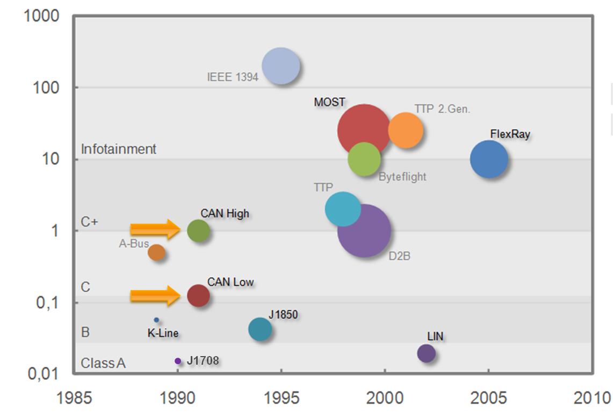

CAN History
CAN Protocol
Maximum Bitrate Mbit/s
Year
Internal | Department | 20/12/2013 | © Robert Bosch Engineering and Business Solutions Vietnam Company Limited 2012. All rights reserved, also regarding any disposal, exploitation, reproduction, editing, distribution, as well as in the event of applications for industrial property rights.

Slide 2
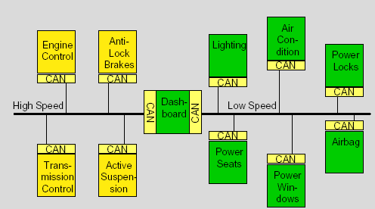
Overview
CAN Protocol
Internal | Department | 20/12/2013 | © Robert Bosch Engineering and Business Solutions Vietnam Company Limited 2012. All rights reserved, also regarding any disposal, exploitation, reproduction, editing, distribution, as well as in the event of applications for industrial property rights.

Slide 3
Overview
CAN Protocol
Is a high-integrity serial data communications bus for real-time applications
Operates at data rates of up to 1 Megabits per second
Has excellent error detection and confinement capabilities
Was originally developed by Bosch for use in cars
Is now being used in many other industrial automation and control applications
Is an international standard: ISO 11898
Internal | Department | 20/12/2013 | © Robert Bosch Engineering and Business Solutions Vietnam Company Limited 2012. All rights reserved, also regarding any disposal, exploitation, reproduction, editing, distribution, as well as in the event of applications for industrial property rights.

Slide 4
CAN Protocol
Characteristics of ‘CAN’
Can is a multi-master Bus
Theoretically No limitation on the number of nodes
Configuration flexibility - No node addressing
Prioritization of messages through “Identifiers”
Multicast reception with the time synchronization
System wide data consistency
Guarantee of latency times
Error detection and error signaling
automatic retransmission of corrupted messages as soon as the bus is idle again
Distinction between temporary errors and permanent failures of nodes and autonomous switching off of defect nodes
Internal | Department | 20/12/2013 | © Robert Bosch Engineering and Business Solutions Vietnam Company Limited 2012. All rights reserved, also regarding any disposal, exploitation, reproduction, editing, distribution, as well as in the event of applications for industrial property rights.
Notes:
k
k
k
k
k
k
k
k
k
k
k
k
k
k

Slide 5
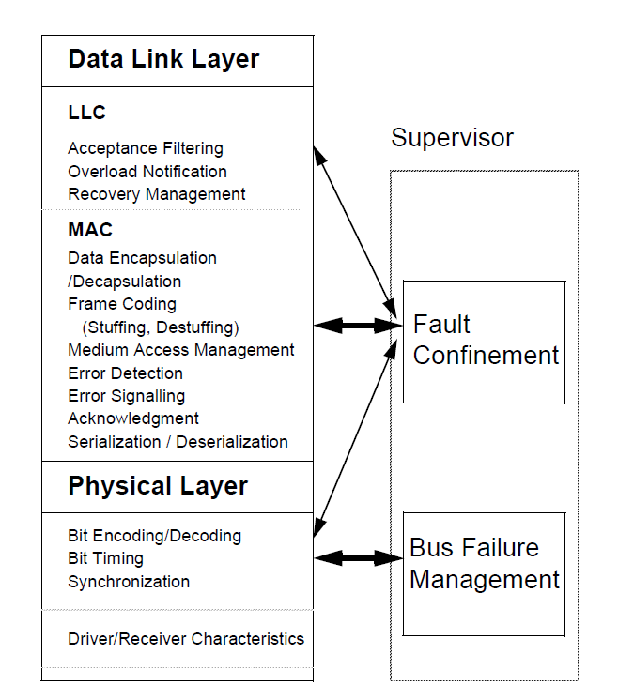
CAN Protocol
Internal | RBVH/EMB3 | 20/12/2013 | © Robert Bosch Engineering and Business Solutions Vietnam Company Limited 2012. All rights reserved, also regarding any disposal, exploitation, reproduction, editing, distribution, as well as in the event of applications for industrial property rights.

Slide 6
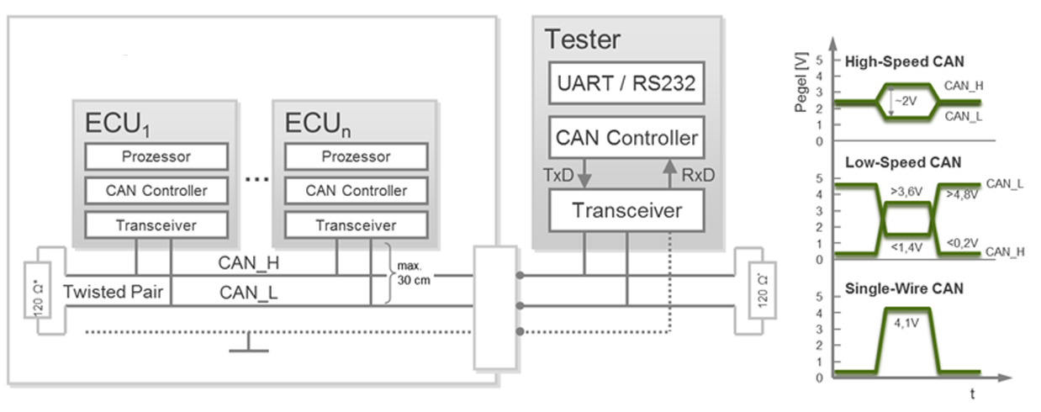
Physical Layer
CAN Protocol
Bit rate: up to 1Mbit/s
Bidirectional Dual-wire bus with 40-50m maximum in length
Bus must be terminated at both ends with terminators
Multi-Master
CAN bus level
Vehicle
Volt
OBD connector
Internal | Department | 20/12/2013 | © Robert Bosch Engineering and Business Solutions Vietnam Company Limited 2012. All rights reserved, also regarding any disposal, exploitation, reproduction, editing, distribution, as well as in the event of applications for industrial property rights.

Slide 7
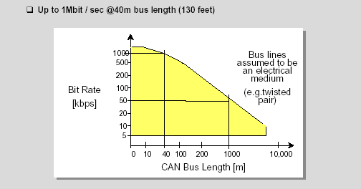
Physical Layer
CAN Protocol
Relation between Baud Rate and Bus Length
Internal | Department | 20/12/2013 | © Robert Bosch Engineering and Business Solutions Vietnam Company Limited 2012. All rights reserved, also regarding any disposal, exploitation, reproduction, editing, distribution, as well as in the event of applications for industrial property rights.

Slide 8
CAN Protocol
Bus Access and Arbitration
Bus access through CSMA with AMP
NODE
Arbitration phase
A 0 1 0 0
Remainder
B 0 1 0 1
Node B looses arbitration
C 0 1 1 0
Node C looses arbitration
BUS 0 1 0 0
Advantages
No Collision
Transmission of highest priority message within the latency time
Internal | Department | 20/12/2013 | © Robert Bosch Engineering and Business Solutions Vietnam Company Limited 2012. All rights reserved, also regarding any disposal, exploitation, reproduction, editing, distribution, as well as in the event of applications for industrial property rights.

Slide 9
CAN Protocol
Frame Formats
Standard Frame - 11bit Identifier
Extended Frame - 29 bit Identifier
Frame Types
Data Frame
Remote Frame
Error Frame
Overload Frame
Inter-frame Spacing

Slide 10
CAN Protocol
Standard Data Frame Format
Arbitration Field
Control Field
Data Field
CRC Field
ACK
End of Frame
Inter-
Field
mission
RTR
IDE
SOF
11 Bit Identifier
r0
DLC (4)
0 to 64 Bits
15 Bits
7 Bits
3 Bits
Bus Idle
CRC Delimiter
Ack Slot
Bus Idle
Ack Delimiter
Extended Data Frame Format
Arbitration Field
Control Field
Data Field
r1
SOF
SRR
RTR
r0
11 Bit Identifier
IDE
18 Bit Identifier
DLC (4)
0 to 64 Bits
Difference between Standard Frame and Extended Frame
Differs only in Arbitration field and Control field

Slide 11
CAN Protocol
Remote Frame Format
Arbitration Field
Control Field
CRC Field
ACK
End of Frame
Inter-
Field
mission
RTR
IDE
SOF
11 Bit Identifier
r0
DLC (4)
15 Bits
7 Bits
3 Bits
CRC Delimiter
Ack Slot
Ack Delimiter
Node acting as Receiver for certain data initiates a Remote frame
Consists of all the fields except data field as compared to a data frame
Contrary to Data Frames, the RTR bit is recessive
Exists for both the standard and extended format

Slide 12
CAN Protocol
Error Frame Format (Active Error Frame)
Error Condition
Uncompleted
Error Frame
Inter-
Frame
mission
6 Bits
0 -6 Bits
8 Bits
3 Bits
Superposition of
Error Delimiter
Error Flag
Error flag can be transmitted by both Transmitter and Receiver node
Error flag can start within the frame that is currently being transmitted
Types of Error flags
Active Error flag - consists of 6 consecutive ‘dominant’ bit sent by Error Active node
Passive Error flag - consists of 6 consecutive ‘recessive’ bit sent by Error passive node

Slide 13
CAN Protocol
Error Handling
TEC<=255
REC > 127
OR
TEC > 255
Reset
TEC > 127
ERROR
PASSIVE
ERROR
ACTIVE
BUS
OFF
REC <= 127
OR
TEC <= 127
REC <= 127
OR
TEC <= 127
Re-
Initialization
only

Slide 14
CAN Protocol
Error-Active
A node is Error-Active when both the Transmit Error Counter (TEC) and the Receive Error Counter (REC) are below 128.
Error-Active node send six consecutive (Active Error Flag) dominant bits.
Error-Passive
A node becomes Error-Passive when either the Transmit Error Counter or Receive Error Counter exceeds 127.
Error-Passive node send six consecutive (Passive Error Flag) recessive bits.
Bus Off
A node goes into the Bus-Off state when the Transmit Error
Counter is greater than 255.
There is a bus recovery sequence that is defined by the CAN
protocol that allows a node that is Bus-Off to recover.
Internal | Department | 20/12/2013 | © Robert Bosch Engineering and Business Solutions Vietnam Company Limited 2012. All rights reserved, also regarding any disposal, exploitation, reproduction, editing, distribution, as well as in the event of applications for industrial property rights.

Slide 15
CAN Protocol
Overload Frame Format
Condition under which overload frame is transmitted
Receiver requires a delay to receive next Data or Remote frame
Detection of a ‘dominant bit at the first or second bit of Intermission
Detection of a ‘dominant’ bit at the 8th bit of an Error or overload Delimiter
End of Frame or
OverloadFrame
Inter-
Error Delimiter or
mission
Overload Delimiter
6 Bits
0 -6 Bits
8 Bits
3 Bits
Superposition of
Overload
Overload Flag
Delimiter
Overload frame always starts within the Intermission slot of previous frame

Slide 16
CAN Protocol
Interframe Spacing
The space separating Data / Remote frames from any preceding frame
After the transmission of a frame by an Error Active node
Previous Frame
Interframe Spacing
Next frame
3 Bits
Inter-mission
Bus idle
After the transmission of a frame by an Error Passive node
Previous Frame
Interframe Spacing
Next frame
3 Bits
8 Bits
Inter-mission
Suspend
Bus idle
Transmission

Slide 17

CAN Protocol
Message Coding
Non-Return-to-Zero coding
Keeps the frequency of the signal on the bus to minimum.
“1”
“0”
1 1 0 1 0 0 1 1 ………………..
Bit-Stuffing
Ensures sufficient Recessive and Dominant edges for Re-Synchronization.
Data Stream
1
1
2
3
4
5
6
7
8
9
10
1
2
3
1
2
1
2
3
4
5
6
1
2
Bit Stream
1
1
2
3
4
5
S
6
7
8
9
10
S
1
2
3
1
2
1
2
3
4
5
S
6
1
2

Slide 18
CAN Protocol
Bus Synchronization
Hard Synchronization at Start of Frame Bit
All nodes synchronize on leading edge of SOF bit
SOF
IDENTIFIER FIELD
Intermission or Bus idle
Re-synchronization on each recessive to dominant edge
Ensures correct sampling up to the last bit
Bit Stream
1
1
2
3
4
5
S
6
7
8
9
10
S
1
2
3
1
2
1
2
3
4
5
S
6
1
2
Re-Sync
Re-Sync
Re-Sync
Re-Sync
Re-Sync
Re-Sync

Slide 19
CAN Protocol
Message Validation
For transmitter the message is valid, if there is no error until the EOF
For receiver the message is valid, if there is no error until last but one bit
of the EOF
Message Filtering
Identifier based with optional mask register
Mask register must be programmable
Internal | Department | 20/12/2013 | © Robert Bosch Engineering and Business Solutions Vietnam Company Limited 2012. All rights reserved, also regarding any disposal, exploitation, reproduction, editing, distribution, as well as in the event of applications for industrial property rights.
Notes:
CRC Error
# CRC is calculated for bits starting from SOF to end of
data field.
# CRC is 15 bit.
#Transmitter and Receiver calculates the CRC the same
way and if the received CRC and the calculated CRC at
the receiver end is not same, the receiver discards the
frame and transmits and error frame.
************************************************
Acknowledge Error
# A frame must be acknowledged by at least one node,
otherwise Ack error.
# No error frame will be generated as no node has received
any frame, but the transmitter has to transmit once again.
************************************************
Form Error
# If there is dominant bit in,
1. CRC delimiter
2. Acknowledge delimiter
3.End of frame
4. Intermission
an error frame is generated and the message is
repeated.
************************************************
Bit Error
# The transmitted bit and the bit sampled on the bus should be same except in arbitration field and ACK slot. If not,
then a bit error has occured and the transmitter stops the
frame and send an error frame.
************************************************
Stuff Error
# If 6 or more consecutive bits with same polarity is received , then stuff error. An error frame is generated.
# This is applicable for bits from SOF to CRC delimiter.

Slide 20
CAN Protocol
Types of Error Detected in CAN Bus:
CRC Error:
Every node receive the message, Calculate CRC and compare it with
Received CRC.
Acknowledge Error:
Transmitting node send a ACK slot bit as a recessive bit and check for
dominant bit to verify reception.
Form Error:
Generated when any of following bit is detected as a dominant bit where
One should not be.
e.g. CRC delimiter, ACK delimiter, End of Frame, Inter Frame Space.
Bit Error:
Node detect the signal that is opposite of what it send on Bus.
Stuff Error:
Bit stuffing rule is violated when 6-consecutive bits with the same polarity
are detected.
Internal | Department | 20/12/2013 | © Robert Bosch Engineering and Business Solutions Vietnam Company Limited 2012. All rights reserved, also regarding any disposal, exploitation, reproduction, editing, distribution, as well as in the event of applications for industrial property rights.

Slide 21
CAN Protocol
References:
CAN Specification 2.0 – Bosch
Thank you
Internal | Department | 20/12/2013 | © Robert Bosch Engineering and Business Solutions Vietnam Company Limited 2012. All rights reserved, also regarding any disposal, exploitation, reproduction, editing, distribution, as well as in the event of applications for industrial property rights.

