Slide 1
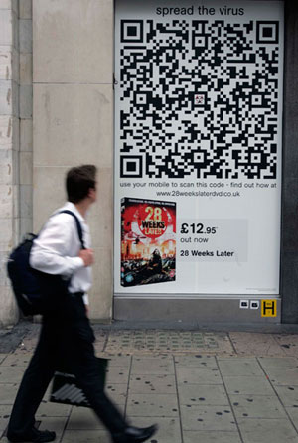
E-Shopping by QR Code
Project Proposal Presentation
Mr.Thanawat Senawat
Mr.Satapat Muangsai

Slide 2
Agenda
Online shopping
Problems
Solution Application Examples
Solutions
Features
Technology Reviews
System Architecture
UI Example
Limitations
Quality Assurance
Project Schedule

Slide 3
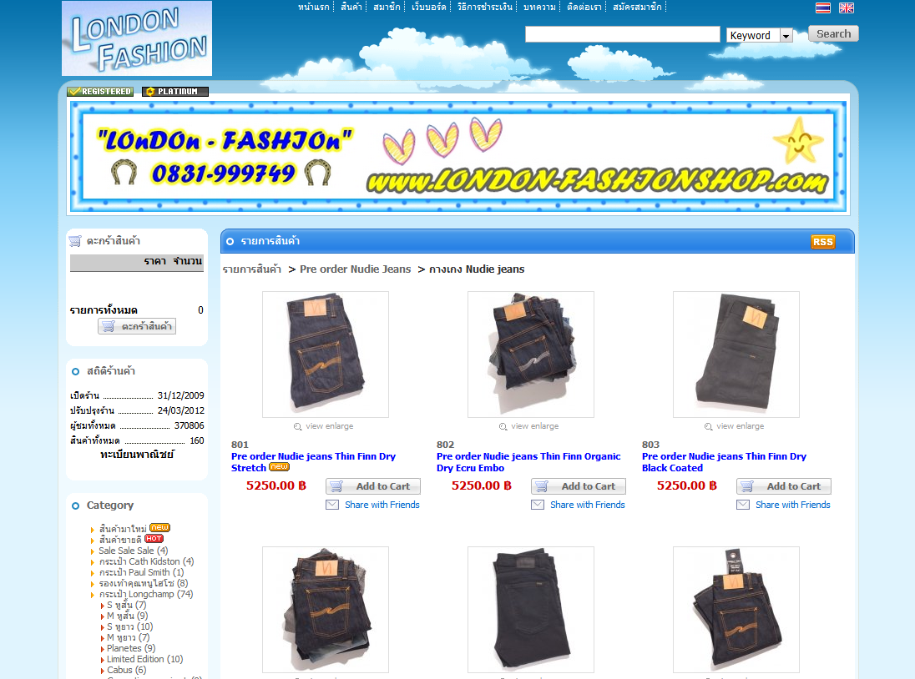
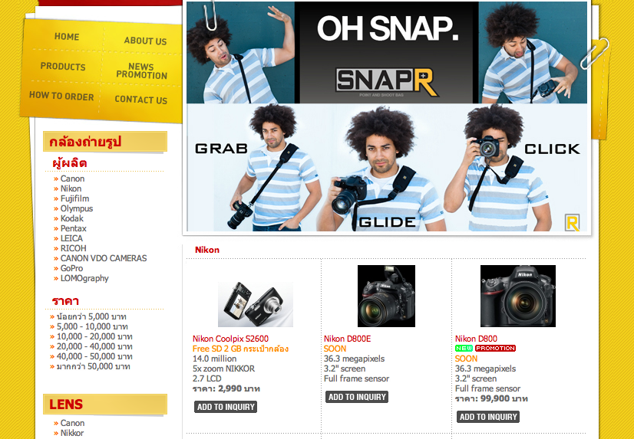
Online shopping
Shopping via Internet
Can shop at home
Save time for making decision
A lot of online shopping stores are now available

Slide 4
Problems
Most online shopping websites are hard to use on smartphones
Too many online shopping websites, so the competition rate is high.
Hard to use for old-age people.
Built in the same way, so they are not interesting.

Slide 5

Solution Application Examples
Home plus
- Korean mobile application
- Using QR-Code
- First QR-Code shopping application in Korea
- Only Korean Version

Slide 6

Solution Application Examples
myShopanion
- iPhone Application
- search products by scan a barcode, by name and by categories
- real-time for shopping advice
- slow when it fetch the data
- too much features make users get confuse

Slide 7

Solution Application Examples
MOBILETAG
- iPhone Application
- less features but easy to use
- Universal barcode reader
- Barcode History
- Search all major merchant and stores
around users
- No shipping

Slide 8
Solutions
Online Shopping + Android Application + QR-Code

Slide 9
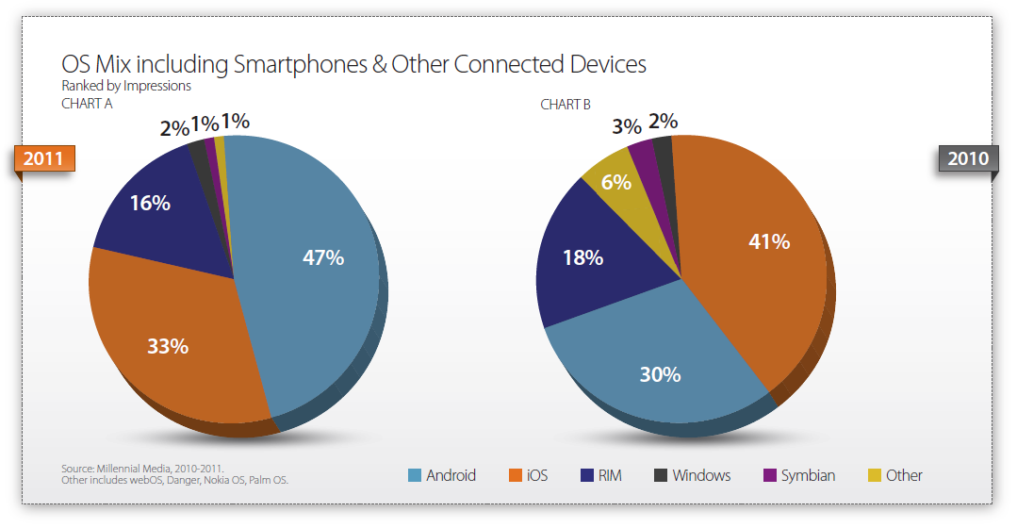
Why Android
A lot of smartphones using Android operating system.

Slide 10
Why Android ?
Open Source Platform
Programming Language
Android Market

Slide 11
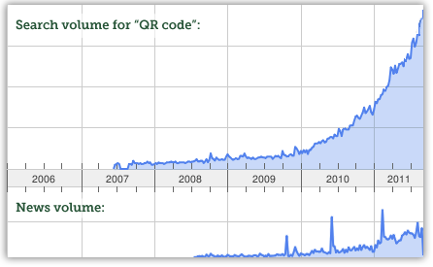
Why QR-Code ?
best way to transmit information from the real world into an application.
best way to promote products by using QR-Code everywhere
Tread of user using QR-Code are increasing

Slide 12
Features
Server Site
Feature 1: user Registration page
Feature 2: login and logout system
Feature 3: administration page
Feature 4: user Information page
Feature 5: product information management
Feature 6: ordered log system
Client Site
Feature 7: login and logout system
Feature 8: QR-code decoder
Feature 9: product information
Feature 10: order product system

Slide 13
Technology Reviews
Android Operating System
QR-Code
PHP
CSS
MySQL

Slide 14
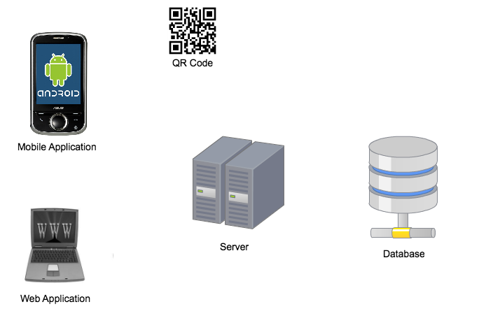
System Architecture
Scan
Get product info
Query request
-Login
Product ordering
Send data
HTTP request
HTTP response
-Registration -User information
-Administration

Slide 15
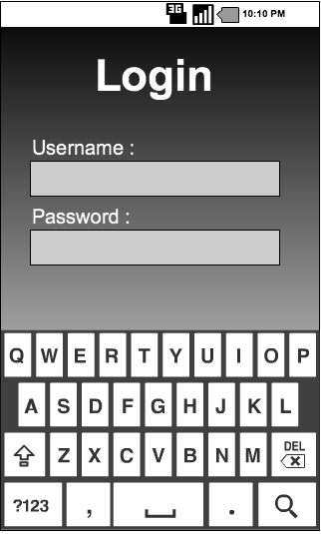
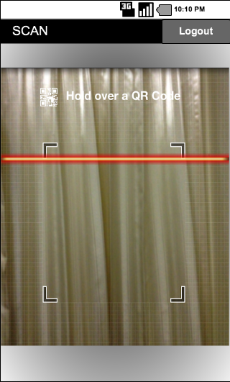
UI Example
Login Page
Scan Code Page

Slide 16
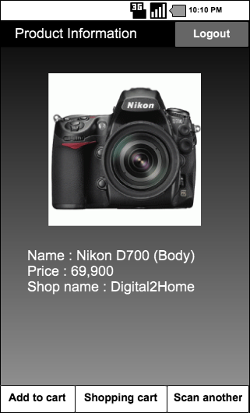
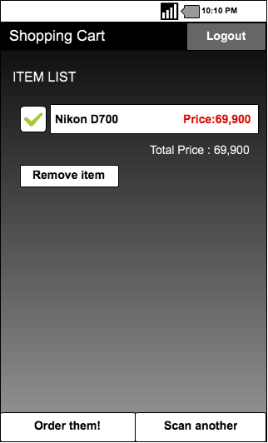
UI Example
Product Information Page
Shopping Cart Page

Slide 17
Limitations
Smart phones, which are using Android OS version 2.2 or later.
Internet connection is required for using our application.
Users can register only on our web application.
Product owners cannot edit the product information by themselves.
Our application can use on mobile phones that are have the camera only.

Slide 18

Quality Assurance
ISO 29110 for Very Small Entity (VSE)

Slide 19
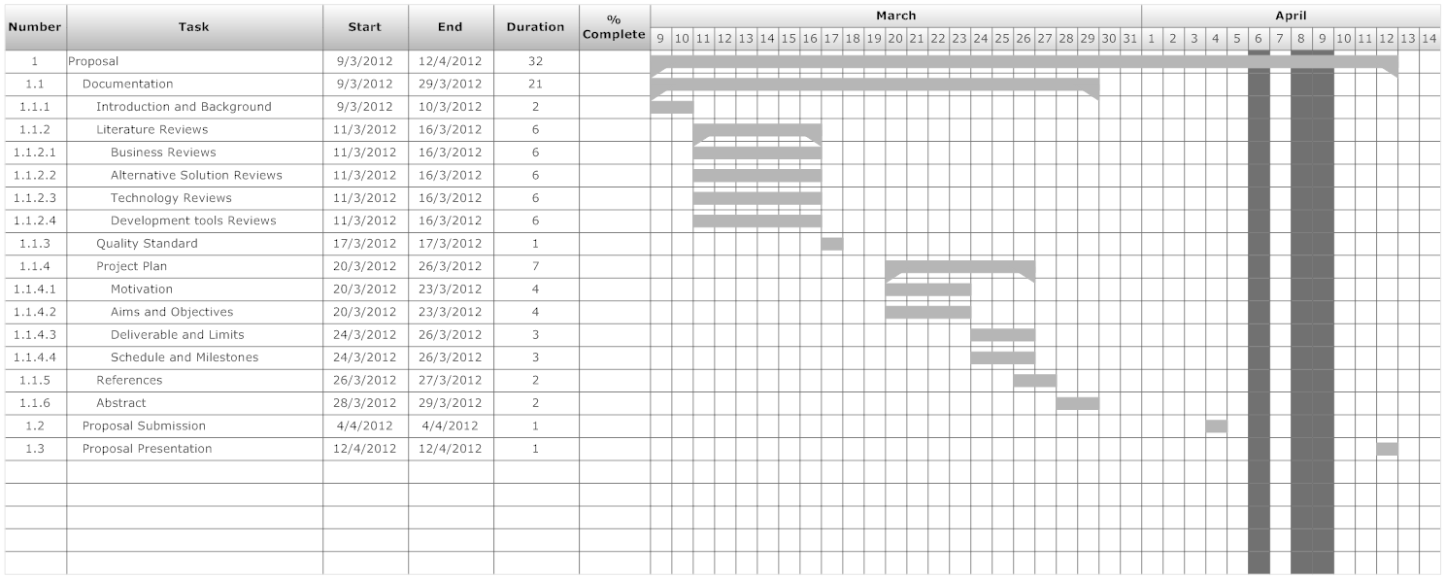
Project Schedule
Proposal Schedule

Slide 20
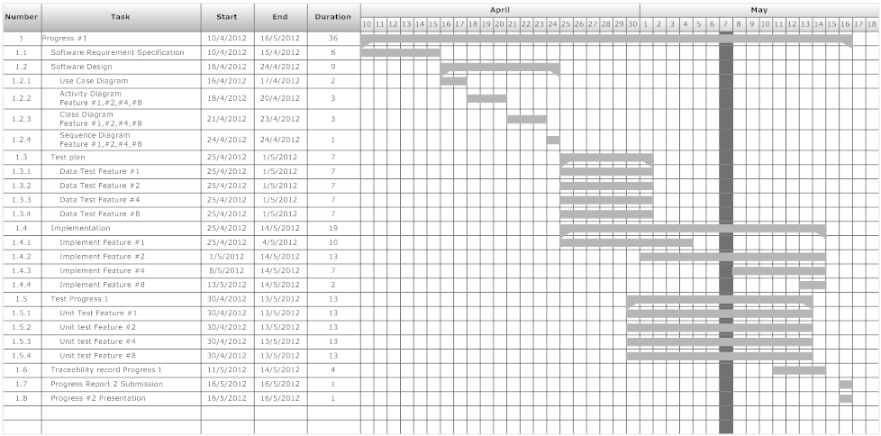
Project Schedule
Progress 1 :

Slide 21
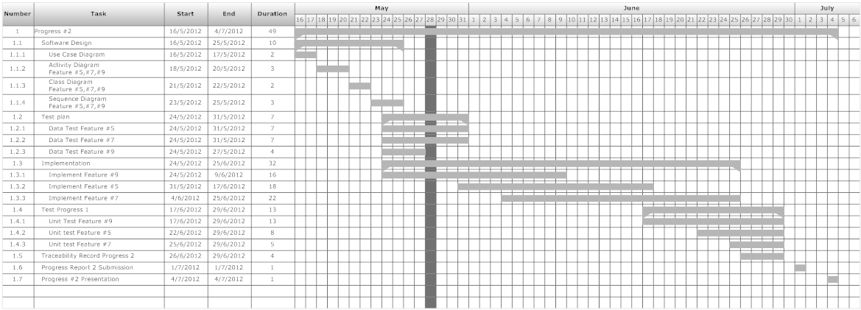
Project Schedule
Progress 2 :

Slide 22
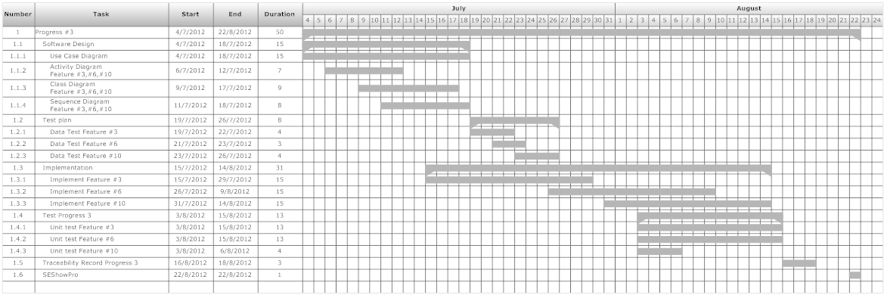
Project Schedule
Progress 3 :

Slide 23
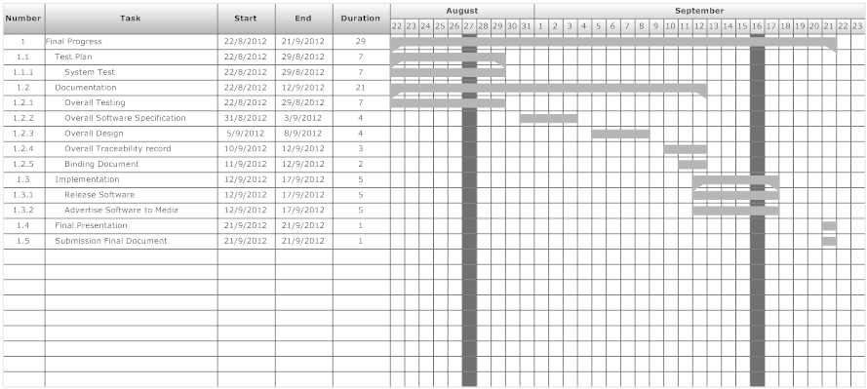
Project Schedule
Final Progress :

Slide 24
Q & A

