Slide 1

EzQL | A language for event processing applications

Slide 2

ABSTRACTIONS

Slide 3
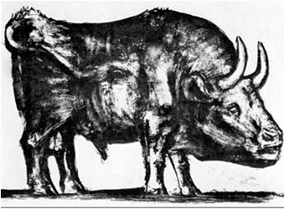
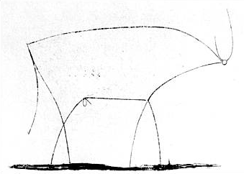

Slide 4


in programming…
Abstract data types

Slide 5

in programming…
Abstract data types
Structured programming

Slide 6

in programming…
Abstract data types
Structured programming
Design patterns

Slide 7
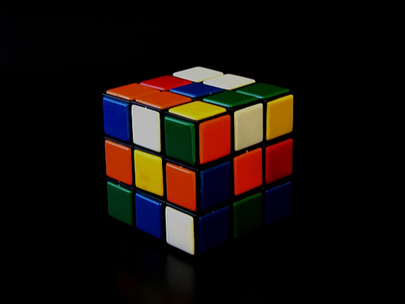

Slide 8
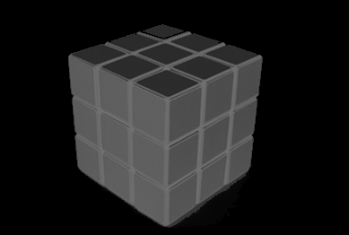

Slide 9
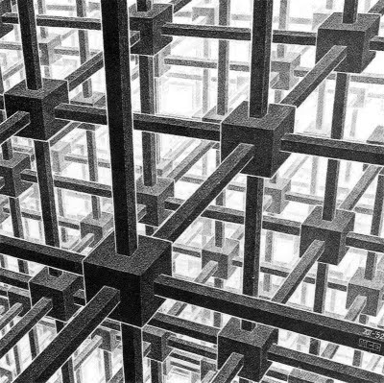

Slide 10
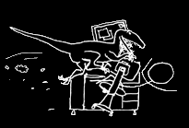
What happens when we use the wrong abstractions?

Slide 11
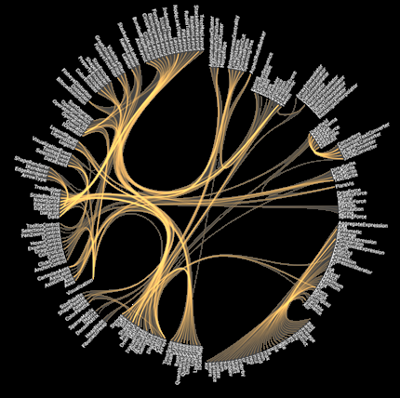
What happens when we use the wrong abstractions?
Tightly-coupled code
.
.

Slide 12
What happens when we use the wrong abstractions?
Tightly-coupled code
Too low-level
.
.

Slide 13
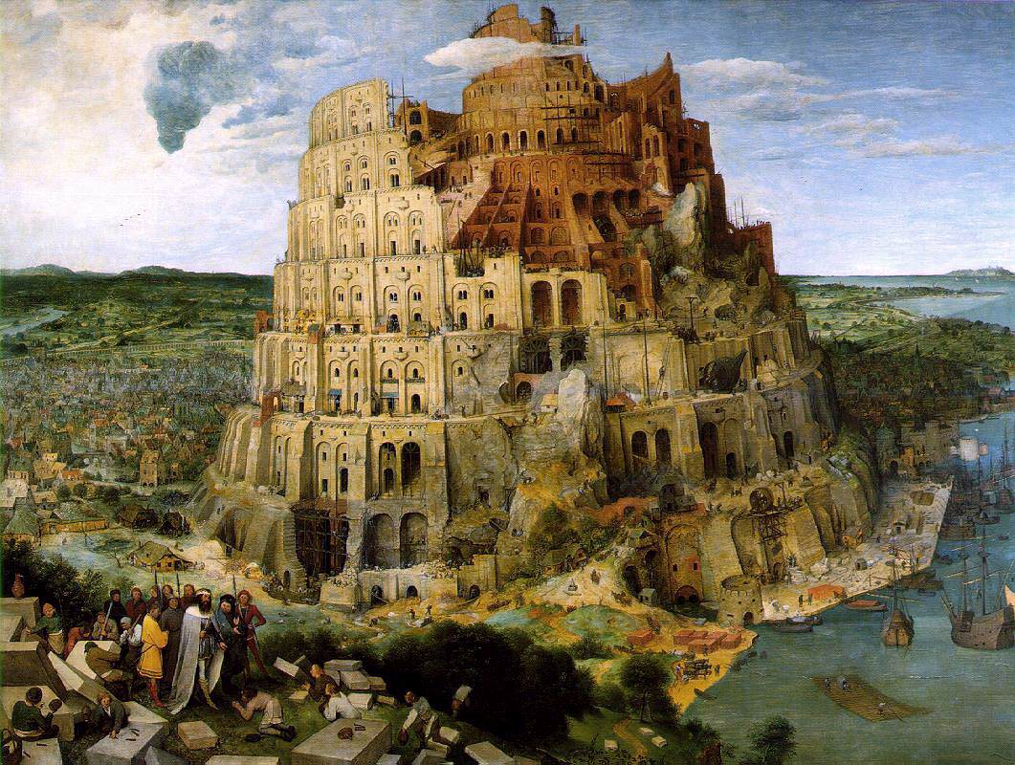
What happens when we use the wrong abstractions?
Tightly-coupled code
Too low-level
Not reusable
Not extensible
Not readable
Not maintainable

Slide 14
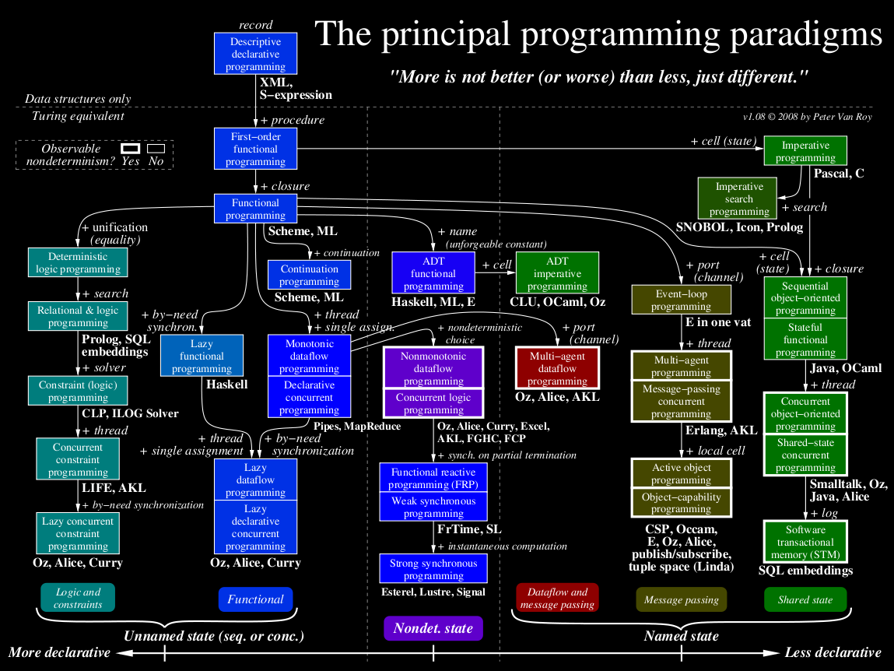

Slide 15
Programming languages are tools to create abstractions

Slide 16
Programming languages are tools to create abstractions
Existing languages have problems

Slide 17
Existing languages have problems
Inappropriate semantics

Slide 18
Inappropriate semantics
70
Noise (dB)
50
11:00
11:10
11:25
Time

Slide 19
Inappropriate semantics
70
Noise (dB)
50
11:00
11:10
11:25
Time

Slide 20
Inappropriate semantics
select max(noise)
from NoiseReadings keep 20 minutes

Slide 21
Inappropriate semantics
70
Maximum
Noise (dB)
50
11:00
11:10
11:25
Time

Slide 22
Inappropriate semantics
70
Price (€)
50
11:00
11:10
11:25
Time

Slide 23
Inappropriate semantics
70
Maximum
Price (€)
50
11:00
11:10
11:25
Time

Slide 24
Inappropriate semantics
WRONG!
70
Maximum
Price (€)
50
11:00
11:10
11:25
Time

Slide 25
Inappropriate semantics
correct maximum
70
Price (€)
50
11:00
11:10
11:25
Time

Slide 26
Inappropriate semantics
select max(noise)
from NoiseReadings keep 20 minutes
create input stream StreamIn
schema (
symbol string,
price float
);
create window Last20Mins
schema (
symbol string,
price float
) keep 20 minutes
insert removed rows into Expired;
insert into Last20Mins
select *
from StreamIn;
create window Expired
schema (
symbol string,
price float
) keep last per symbol;
create window Result
schema (
symbol string,
result float
) keep last per symbol;
insert into Result
select L.symbol,
max(coalesce(max(L.price), 0), coalesce(max(E.price), 0))
from Last20Mins as L full outer join Expired as E
on L.symbol = E.symbol
group by L.symbol;

Slide 27
Existing languages have problems
Inappropriate semantics
Too much burden on top of the developer
Need new operators
SQL-dialects are inappropriate for many problems

Slide 28
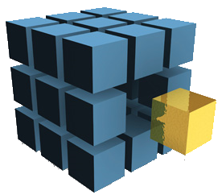
INTRODUCING EzQL

Slide 29
The basics remain the same
noisyReadings =
from ev in noiseReadings[20 min]
where ev.noise > 50

Slide 30
Most important features
Entity model
User defined functions and aggregates
Type-system

Slide 31
Entity model
Time
Time
12h 12m
roomId
A
temperature
23
12h 12m
productId
123
roomId
A
12h 13m
roomId
B
temperature
18
12h 14m
productId
325
roomId
B
12h 15m
roomId
A
temperature
25
12h 17m
roomId
B
temperature
17
12h 17m
productId
123
roomId
B
tempReadings
entries

Slide 32
Entity model
Time
Time
12h 12m
roomId
A
temperature
23
12h 12m
productId
123
roomId
A
12h 13m
roomId
B
temperature
18
12h 14m
productId
325
roomId
B
12h 15m
roomId
A
temperature
25
12h 17m
roomId
B
temperature
17
12h 17m
productId
123
roomId
B
tempReadings
entries

Slide 33
Entity model
entity Room =
createFrom (tempReadings, :roomId)
entity Product =
createFrom (entries, :productId)

Slide 34
Product 123
productId | 123
roomId | “B”
Product 325
productId | 325
roomId | “B”
Room B
roomId | “B”
temperature | 17
Room A
roomId | “A”
temperature | 25

Slide 35
Product.all
Product 123
productId | 123
roomId | “B”
Product 325
productId | 325
roomId | “B”
Room.all
Room B
roomId | “B”
temperature | 17
Room A
roomId | “A”
temperature | 25

Slide 36
Entity model
entity Room =
createFrom (tempReadings, :roomId)
hasMany :products
entity Product =
createFrom (entries, :productId)
belongsTo :room

Slide 37
Product.all
Product 123
productId | 123
roomId | “B”
room
Product 325
productId | 325
roomId | “B”
room
Room.all
Room B
roomId | “B”
temperature | 17
products
Room A
roomId | “A”
temperature | 25
products | ∅

Slide 38
Entity model
“Select the products that are inside rooms where the temperature is greater than 25”
hotProducts =
from p in Product.all
where p.room.temperature > 25
select p

Slide 39
Entity model
“Select the products that are inside rooms where the temperature is greater than 25”
hotProducts =
from p in Product.all
where p.room.temperature > 25
select p

Slide 40
Entity model
“How many products are inside each room?”
productsPerRoom =
from room in Room.all
select room.products.count()

Slide 41
Entity model
“How many products are inside each room?”
productsPerRoom =
from room in Room.all
select room.products.count()

Slide 42
User-defined functions

Slide 43
User-defined functions
def not (b) =
if b then false else true

Slide 44
User-defined functions
def not (b) =
if b then false else true
a = not (b)

Slide 45
User-defined aggregates
max, min, count, sum, … are not enough
Need to write new ones

Slide 46
avg in Coral8
...
typedef struct _AvgData {
C8Int m_sum;
int m_count;
} AvgData;
AvgData initial_data = { 0, 0 };
C8UInt size = 0;
struct AvgData *data_ptr = NULL;
/* Get state (if any) from previous calls. */
data_ptr = (AvgData*)C8GetState(ctx, &size);
// If there is no state from previous calls,
// then this is probably the first invocation
// and we must allocate memory.
if (data_ptr == NULL || (size != sizeof(AvgData))) {
data_ptr = &initial_data;
}
/* Update the sum and count */
if (C8IsPositiveMessage(ctx)) {
data_ptr->m_sum += C8GetInt(ctx, 0);
data_ptr->m_count++;
} else {
/* Negative message - a row just exited the
window */
data_ptr->m_sum -= C8GetInt(ctx, 0);
data_ptr->m_count--;
}
/* Set the result */
C8SetOutputFloat(ctx,
(C8Float) (data_ptr->m_sum) / data_ptr->m_count);
/* Save state */
C8SetState(ctx, data_ptr, sizeof(AvgData));
return;
...

Slide 47
avg in Coral8
...
typedef struct _AvgData {
C8Int m_sum;
int m_count;
} AvgData;
AvgData initial_data = { 0, 0 };
C8UInt size = 0;
struct AvgData *data_ptr = NULL;
/* Get state (if any) from previous calls. */
data_ptr = (AvgData*)C8GetState(ctx, &size);
// If there is no state from previous calls,
// then this is probably the first invocation
// and we must allocate memory.
if (data_ptr == NULL || (size != sizeof(AvgData))) {
data_ptr = &initial_data;
}
/* Update the sum and count */
if (C8IsPositiveMessage(ctx)) {
data_ptr->m_sum += C8GetInt(ctx, 0);
data_ptr->m_count++;
} else {
/* Negative message - a row just exited the
window */
data_ptr->m_sum -= C8GetInt(ctx, 0);
data_ptr->m_count--;
}
/* Set the result */
C8SetOutputFloat(ctx,
(C8Float) (data_ptr->m_sum) / data_ptr->m_count);
/* Save state */
C8SetState(ctx, data_ptr, sizeof(AvgData));
return;
...
WHAT?!

Slide 48
avg in EzQL
def avg(n) =
let c = count (n)
if c == 0 then null else sum(n) / c

Slide 49
avg in EzQL
def avg(n) =
let c = count (n)
if c == 0 then null else sum(n) / c

Slide 50
avg in EzQL
def avg(n) =
let c = count (n)
if c == 0 then null else sum(n) / c
def count(n:[‘a]) =
let acc = 0
when | ev in n.added() -> acc + 1
| ev in n.expired() -> acc – 1
acc
def sum(n:[int]) =
let acc = 0
when | ev in n.added() -> acc + ev.value
| ev in n.expired() -> acc – ev.value
acc

Slide 51
avg in EzQL
...
typedef struct _AvgData {
C8Int m_sum;
int m_count;
} AvgData;
AvgData initial_data = { 0, 0 };
C8UInt size = 0;
struct AvgData *data_ptr = NULL;
data_ptr = (AvgData*)C8GetState(ctx, &size);
if (data_ptr == NULL || (size != sizeof(AvgData))) {
data_ptr = &initial_data;
}
if (C8IsPositiveMessage(ctx)) {
data_ptr->m_sum += C8GetInt(ctx, 0);
data_ptr->m_count++;
} else {
data_ptr->m_sum -= C8GetInt(ctx, 0);
data_ptr->m_count--;
}
C8SetOutputFloat(ctx,
(C8Float) (data_ptr->m_sum) / data_ptr->m_count);
C8SetState(ctx, data_ptr, sizeof(AvgData));
return;
...
def avg(n) =
let c = count (n)
if c == 0 then null else sum(n) / c
def count(n:[‘a]) =
let acc = 0
when | ev in n.added() -> acc + 1
| ev in n.expired() -> acc – 1
acc
def sum(n:[int]) =
let acc = 0
when | ev in n.added() -> acc + ev.value
| ev in n.expired() -> acc – ev.value
acc

Slide 52
Type system
Definition
A tractable syntactic method for proving the absence of certain program behaviors by classifying phrases according to the kinds of values they compute.
in “Types and Programming Languages”

Slide 53
Type system
Type inference
def not (b) =
if b then false else true

Slide 54
Type system
Type inference
def not (b) =
if b then false else true
bool bool

Slide 55
Type system
Parametric polymorphism (generics)
def printEvents (s, fn) =
when ev in s -> print (fn(ev))

Slide 56
Type system
Parametric polymorphism (generics)
def printEvents (s, fn) =
when ev in s -> print (fn(ev))
(stream<T>, T V) void

Slide 57
Type system
Parametric polymorphism (generics)
def printEvents (s, fn) =
when ev in s -> print (fn(ev))
(stream<T>, T V) void
==

Slide 58
Evaluation
58

Slide 59
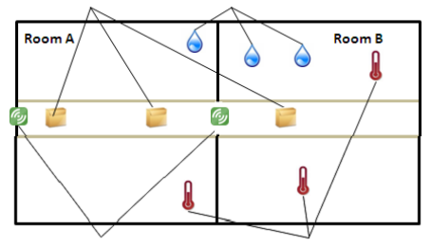
The “too muggy query"
Products
Humidity sensors
RFID readers
Thermometers
“What were the products that spent at least 10 min at more than 20º C and 80% humidity?”

Slide 60
The “too muggy query"
tempReadings = stream of { roomId:string, temperature:int }
entries = stream of { roomId:string, productId:int }
entity Room =
createFrom(tempReadings, :roomId)
entity Product =
createFrom (entries, :productId)
belongsTo :room
member this.temperature = this.room.temperature
defective =
from p in Product.all
where (p.temperature > 25).howLong() >= 10 min

Slide 61
The “too muggy query"
tempReadings = stream of { roomId:string, temperature:int }
entries = stream of { roomId:string, productId:int }
entity Room =
createFrom(tempReadings, :roomId)
entity Product =
createFrom (entries, :productId)
belongsTo :room
member this.temperature = this.room.temperature
defective =
from p in Product.all
where (p.temperature > 25).howLong() >= 10 min

Slide 62
The “too muggy query"
tempReadings = stream of { roomId:string, temperature:int }
entries = stream of { roomId:string, productId:int }
entity Room =
createFrom(tempReadings, :roomId)
entity Product =
createFrom (entries, :productId)
belongsTo :room
member this.temperature = this.room.temperature
defective =
from p in Product.all
where (p.temperature > 25).howLong() >= 10 min

Slide 63
The “too muggy query"
tempReadings = stream of { roomId:string, temperature:int }
entries = stream of { roomId:string, productId:int }
entity Room =
createFrom(tempReadings, :roomId)
entity Product =
createFrom (entries, :productId)
belongsTo :room
member this.temperature = this.room.temperature
defective =
from p in Product.all
where (p.temperature > 25).howLong() >= 10 min

Slide 64
Coral8 Solution (I)
create input stream entries
schema (
product_id string,
room_id string
);
create input stream temp_readings
schema (
room_id string,
temperature integer
);
create window ProductRoom
schema (
product_id string,
room_id string
) keep 2 rows per product_id;

Slide 65
Coral8 Solution (II)
insert into ProductRoom
select * from entries;
create window RoomTemperature
schema (
room_id string,
temperature integer
) keep 2 rows per room_id;
insert into RoomTemperature
select *
from temp_readings;
create local stream OnExit
schema (
product_id string,
old_room_id string
);

Slide 66
Coral8 Solution (III)
insert into OnExit
select entries.product_id, ProductRoom.room_id
from entries left outer join ProductRoom
on entries.product_id = ProductRoom.product_id
where entries.room_id != ProductRoom.room_id;
create local stream OnTemperatureChange
schema (
room_id string,
old_temperature string
);
insert into OnTemperatureChange
select temp_readings.room_id, RoomTemperature.temperature
from temp_readings left outer join RoomTemperature
on temp_readings.room_id = RoomTemperature.room_id
where temp_readings.temperature != RoomTemperature.temperature;

Slide 67
Coral8 Solution (IV)
create window ProductTemperatureCounter
schema (
product_id string, time_above_20 interval, last_update timestamp
) keep last per product_id;
insert into ProductTemperatureCounter
select product_id, 0 seconds, now()
from entries
where room_id = "A";
insert into ProductTemperatureCounter
select E.product_id, if T.temperature > 20
then time_above_20 + now() - C.last_update
else time_above_20
end, now()
from OnExit as E, RoomTemperature as T,
ProductTemperatureCounter as C
where E.old_room_id = T.room_id and E.product_id = C.product_id;

Slide 68
Coral8 Solution (V)
insert into ProductTemperatureCounter
select R.product_id,
if T.old_temperature > 20
then time_above_20 + now() - C.last_update
else time_above_20
end,
now()
from OnTemperatureChange as T, ProductRoom as R,
ProductTemperatureCounter as C
where T.room_id = R.room_id
and R.product_id = C.product_id;

Slide 69

EzQL vs Coral8
tempReadings = stream of { roomId:string, temperature:int }
entries = stream of { roomId:string, productId:int }
entity Room =
createFrom(tempReadings, :roomId)
entity Product =
createFrom (entries, :productId)
belongsTo :room
member this.temperature = this.room.temperature
defective =
from p in Product.all
where (p.temperature > 25).howLong() >= 10 min
-- Algorithm:
--
-- - Always maintain an explicit counter per product containing
-- the number of seconds the product spent at > 20 degrees.
-- This counter also contains the time the product was last
-- updated (last_update).
--
-- - When a product switches rooms, if the temperature in the
-- previous room was > 20, add now() + last_update to the
-- counter and replace the previous last_update with now();
--
-- - When the temperature in a room changes, if the previous
-- temperature was > 20, add now() + last_update to the
-- counter and replace the previous last_update with now();
--
create input stream entries
schema (
product_id string,
room_id string
);
create input stream temp_readings
schema (
room_id string,
temperature integer
);
-- Holds the last two entries per product
create window ProductRoom
schema (
product_id string,
room_id string
) keep 2 rows per product_id;
insert into ProductRoom
select *
from entries;
-- Holds the last two temp_readings per room
create window RoomTemperature
schema (
room_id string,
temperature integer
) keep 2 rows per room_id;
insert into RoomTemperature
select *
from temp_readings;
create local stream OnExit
schema (
product_id string,
old_room_id string
);
-- When a product leaves a room, generate an event containing the
-- product and the old room.
insert into OnExit
select entries.product_id, ProductRoom.room_id
from entries left outer join ProductRoom
on entries.product_id = ProductRoom.product_id
where entries.room_id != ProductRoom.room_id;
create local stream OnTemperatureChange
schema (
room_id string,
old_temperature string
);
-- When the temperature changes, generate an event containing the
-- room and the old temperature
insert into OnTemperatureChange
select temp_readings.room_id, RoomTemperature.temperature
from temp_readings left outer join RoomTemperature
on temp_readings.room_id = RoomTemperature.room_id
where temp_readings.temperature != RoomTemperature.temperature;
-- Per each product, maintain a counter with the time the product
-- spent above 20 degrees and the last time this counter was updated
create window ProductTemperatureCounter
schema (
product_id string,
time_above_20 interval,
last_update timestamp
) keep last per product_id;
-- Initialize this counter
insert into ProductTemperatureCounter
select product_id, 0 seconds, now()
from entries
where room_id = "A";
-- Every time the product leaves the room, checks if the temperature
-- in the old room was > 20 and updates the counter of that product
insert into ProductTemperatureCounter
select E.product_id,
if T.temperature > 20
then time_above_20 + now() - C.last_update
else time_above_20
end,
now()
from OnExit as E, RoomTemperature as T,
ProductTemperatureCounter as C
where E.old_room_id = T.room_id
and E.product_id = C.product_id;
-- Every time the temperature changes, checks if the previous
-- temperature was > 20 and updates the counters of all the products
-- in that room
insert into ProductTemperatureCounter
select R.product_id,
if T.old_temperature > 20
then time_above_20 + now() - C.last_update
else time_above_20
end,
now()
from OnTemperatureChange as T, ProductRoom as R,
ProductTemperatureCounter as C
where T.room_id = R.room_id
and R.product_id = C.product_id;

Slide 70

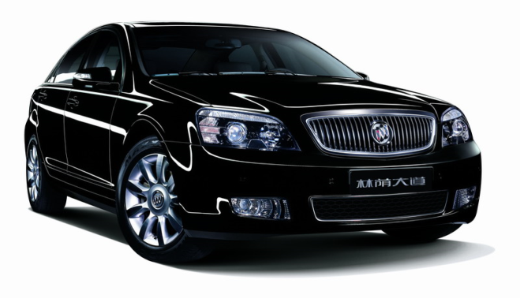
Vehicle tracking using GPS

Slide 71


Slide 72


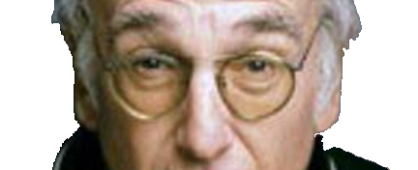

Slide 73


Slide 75
50 m

Slide 76
GPS vehicle tracking
gps = stream of { timestamp:int, vehicleId:int, lat:float, lon:float }
pi = 3.14159265
# Convert from degrees to radians
def deg2rad deg =
deg * pi / 180.0
# Convert from radians to degrees
def rad2deg deg =
deg * 180.0 / pi

Slide 77
GPS vehicle tracking
# Converts from geographical to cartesian coordinates
def geo2cart (lat, lon) =
let (latr, lonr) = (deg2rad lat, deg2rad lon)
(cos latr * cos lonr, cos latr * sin lonr, sin latr)
# Calculates the distance between two positions (in km).
def distance((lat1, lon1), (lat2, lon2)) =
let theta = lon1 - lon2
let d1 = sin (deg2rad lat1) * sin (deg2rad lat2) + cos (deg2rad lat1)
* cos (deg2rad lat2) * cos (deg2rad theta)
let d2 = acos d1
let d3 = rad2deg d2
d3 * 60.0 * 1.1515 * 1.609344

Slide 78
GPS vehicle tracking
# Calculates the center of mass for all positions in the given window.
def centerOfMass(positions:[(float, float)]) =
let (tx, ty, tz, tt) = (0.0, 0.0, 0.0, 0.0)
when | ev in positions.added() ->
let (x, y, z) = geo2cart (ev.value)
(tx + x, ty + y, tz + z, tt + 1.0)
| ev in positions.expired() ->
let (x, y, z) = geo2cart (ev.value)
(tx - x, ty - y, tz - z, tt - 1.0)
# Divide the accumulators by the number of points
let (x, y, z) = (tx / tt, ty / tt, tz / tt)
# Convert back to geographical coordinates
let lon = atan (y / x)
let hyp = sqrt (x * x + y * y)
let lat = atan (z / hyp)
(rad2deg lat, rad2deg lon)

Slide 79
GPS vehicle tracking
entity Vehicle =
createFrom (gps, :vehicleId)
member this.pos = (this.lat, this.lon)

Slide 80
GPS vehicle tracking
# Calculates the center of mass of all vehicles
center =
let positions =
from v in Vehicle.all
select v.pos
centerOfMass(positions.values())
beenTogether_5min =
let allTogetherNow =
from v in Vehicle_all
select (distance (v.pos, center) < 0.05).values().all?()
allTogetherNow[5 min].all?()

Slide 81
GPS vehicle tracking
# Calculates the center of mass of all vehicles
center =
let positions =
from v in Vehicle.all
select v.pos
centerOfMass(positions.values())
beenTogether_5min =
let allTogetherNow =
from v in Vehicle_all
select (distance (v.pos, center) < 0.05).values().all?()
allTogetherNow[5 min].all?()

Slide 82
GPS vehicle tracking
# Calculates the center of mass of all vehicles
center =
let positions =
from v in Vehicle.all
select v.pos
centerOfMass(positions.values())
beenTogether_5min =
let allTogetherNow =
from v in Vehicle_all
select (distance (v.pos, center) < 0.05).values().all?()
allTogetherNow[5 min].all?()

Slide 83
GPS vehicle tracking
# Calculates the center of mass of all vehicles
center =
let positions =
from v in Vehicle.all
select v.pos
centerOfMass(positions.values())
beenTogether_5min =
let allTogetherNow =
from v in Vehicle_all
select (distance (v.pos, center) < 0.05).values().all?()
allTogetherNow[5 min].all?()

Slide 84
GPS vehicle tracking
# Calculates the center of mass of all vehicles
center =
let positions =
from v in Vehicle.all
select v.pos
centerOfMass(positions.values())
beenTogether_5min =
let allTogetherNow =
from v in Vehicle_all
select (distance (v.pos, center) < 0.05).values().all?()
allTogetherNow[5 min].all?()

Slide 85
Conclusions
Existing languages need to be improved
EzQL is more expressive
EzQL includes features to create abstractions
85

Slide 86
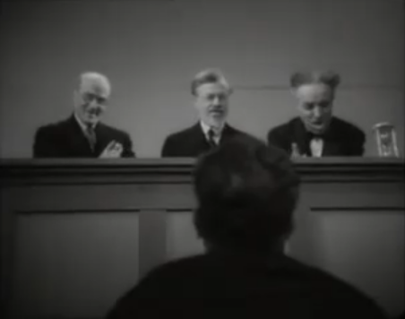


Slide 87
2006129421

Slide 88
Entity model
Time
12h 12m
roomId
A
temperature
23
12h 13m
roomId
B
temperature
18
12h 15m
roomId
A
temperature
25
12h 17m
roomId
B
temperature
17
tempReadings

Slide 89
Entity model
Time
12h 12m
roomId
A
temperature
23
12h 13m
roomId
B
temperature
18
12h 15m
roomId
A
temperature
25
12h 17m
roomId
B
temperature
17
tempReadings

Slide 90
Entity model
entity Room =
createFrom (tempReadings, :roomId)

Slide 91
Entity model
entity Room =
createFrom (tempReadings, :roomId)
Room A
roomId | “A”
temperature | 25
Room B
roomId | “B”
temperature | 17

Slide 92
Entity model
entity Room =
createFrom (tempReadings, :roomId)
Room.all
Room A
roomId | “A”
temperature | 25
Room B
roomId | “B”
temperature | 17

Slide 93
Entity model
“Select the rooms where the temperature is greater than 25”
hotRooms =
from room in Room.all # For all known rooms…
where room.temperature > 25
select room.roomId

Slide 94
Entity model
“Select the rooms where the temperature is greater than 25”
hotRooms =
from room in Room.all # For all known rooms…
where room.temperature > 25
select room.roomId
Notes:
O resultado deste query é uma colecção com as salas que passam o filtro

Slide 95
Entity model
Time
12h 12m
roomId
A
temperature
23
12h 13m
roomId
B
temperature
18
12h 15m
roomId
A
temperature
25
12h 17m
roomId
B
temperature
17
tempReadings

