Slide 1
StreamPy
Luís Pureza
pureza@student.dei.uc.pt

Slide 2
Goal
Design and implement a new programming language for Event Stream Processing

Slide 3
Outline
What is Event Stream Processing
Show a few examples
Illustrate problems with current solutions
Introduce our approach

Slide 4
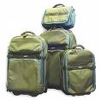

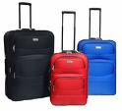
What is Event Stream Processing?
PositionReports
Timestamp | bag | room
11:00 | 12344 | A
11:30 | 53463 | C
12:00 | 87456 | A
12:30 | 12344 | B
13:00 | 23574 | D

Slide 5
What is Event Stream Processing?
“How many bags are in room A?”
“In average, for how long does a bag stay in room B?”
“Which bags didn’t report in the last 20 minutes?”
PositionReports
Timestamp | bag | room
11:00 | 12344 | A
11:30 | 53463 | C
12:00 | 87456 | A
12:30 | 12344 | B
13:00 | 23574 | D

Slide 6

What is Event Stream Processing?
“How many bags are in room A?”
“In average, for how long does a bag stay in room B?”
“Which bags didn’t report in the last 20 minutes?”
PositionReports
Timestamp | bag | room
11:00 | 12344 | A
11:30 | 53463 | C
12:00 | 87456 | A
12:30 | 12344 | B
13:00 | 23574 | D
Event processor

Slide 7
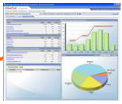
What is Event Stream Processing?
“How many bags are in room A?”
“In average, for how long does a bag stay in room B?”
“Which bags didn’t report in the last 20 minutes?”
PositionReports
Timestamp | bag | room
11:00 | 12344 | A
11:30 | 53463 | C
12:00 | 87456 | A
12:30 | 12344 | B
13:00 | 23574 | D
Event processor

Slide 8
What for?
Financial analysis
Security
Business monitoring
Fraud detection
Health-care monitoring
Network traffic analysis
…

Slide 9
What’s new?
The database won’t work
We may not want to store raw data
A new query must be performed every time an event arrives
Millions of events per second => high latency
Reacting to events as fast as possible may be of critical importance
Notes:
“Para além de ser popular, levanta alguns desafios tecnicos”

Slide 10
What’s new?
The database won’t work
Traditionally, a custom Event Processor is created for every new application
But there are many similarities
Why not build a generic engine?
Notes:
Esta ideia foi perseguida pela comunidade de bases de dados e os primeiros processadores de eventos genéricos nasceram

Slide 11
Languages for ESP
SQL dialects for ESP
Visual queries
Rule-based systems
Procedural (Java, C, Python, …) languages
Notes:
Explciar que nao há nada standard, mas que as linguagens SQL sao parecidas

Slide 12
SQL dialects and its problems

Slide 13
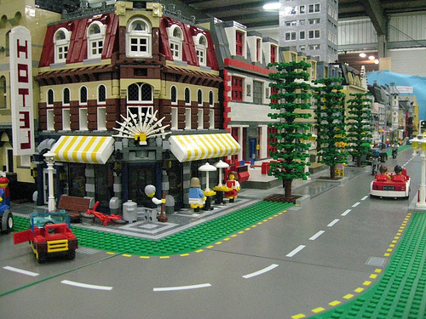
Monitoring noise
Timestamp | Noise (dB)
11:00 | 70
11:10 | 50

Slide 14
Monitoring noise
“What was the loudest reading received in the last 20 minutes?”
insert into LoudestReading
select max(noise)
from NoiseReadings keep 20 minutes
Notes:
Explicar que isto tá feito em CCL mas as outras são parecidas
Explicar o que é um query continuo

Slide 15
Between 11:00 and 11:10
Timestamp | Noise (dB)
11:00 | 70
70
Noise (dB)
11:00
11:10
11:25
Time
Loudest reading: 70 dB

Slide 16
Between 11:10 and 11:20
Timestamp | Noise (dB)
11:00 | 70
11:10 | 50
70
Noise (dB)
50
11:00
11:10
11:25
Time
Loudest reading: 70 dB

Slide 17
Between 11:20 and 11:30
Timestamp | Noise (dB)
11:00 | 70
11:10 | 50
70
Noise (dB)
50
11:00
11:10
11:25
Time
Loudest reading: 50 dB

Slide 18
Success!
Next we try to counquer the stock market
Monitoring ACME stocks…

Slide 19
Between 11:00 and 11:10
Timestamp | Price (€)
11:00 | 70
Price
70
11:00
11:10
11:25
Time
Highest price: 70 €

Slide 20
Between 11:10 and 11:20
Timestamp | Price (€)
11:00 | 70
11:10 | 50
Price
70
50
11:00
11:10
11:25
Time
Highest price: 70 €

Slide 21
Between 11:20 and 11:30
Timestamp | Price (€)
11:00 | 70
11:10 | 50
Price
70
50
11:00
11:10
11:25
Time
Highest price: 50 €

Slide 22
Between 11:20 and 11:30
Timestamp | Price (€)
11:00 | 70
11:10 | 50
WRONG!
Price
70
50
11:00
11:10
11:25
Time
Highest price: 50 €
Notes:
Explicar porque é que isto é importante! Pode parecer que é uma coisa rara.

Slide 23
Correct solution (1)
create input stream StreamIn
schema (
symbol string,
price float
);
create window Last20Mins
schema (
symbol string,
price float
) keep 20 minutes
insert removed rows into Expired;
insert into Last20Mins
select *
from StreamIn;
Notes:
Explicar que isto era na boa se fosse uma coisa rara, mas é muito comum

Slide 24
Correct solution (2)
create window Expired
schema (
symbol string,
price float
) keep last per symbol;
create window Result
schema (
symbol string,
result float
) keep last per symbol;
insert into Result
select L.symbol,
max(coalesce(max(L.price), 0), coalesce(max(E.price), 0))
from Last20Mins as L full outer join Expired as E
on L.symbol = E.symbol
group by L.symbol;

Slide 25
Monitoring noise
“What was the loudest reading received in the last 20 minutes?”
insert into LoudestReading
select max(noise)
from NoiseReadings keep 20 minutes

Slide 26
What happens between events?
Traditionally, engines assume that between events, the value is undefined
This makes sense for a lot of problems…
… but not for others
Emulating other options in existing languages requires too much work
We need new semantics

Slide 27
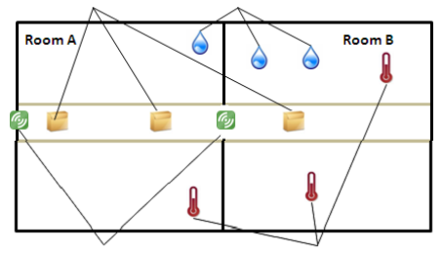
The “too muggy” query
Products
Humidity sensors
RFID readers
Thermometers
“What were the products that spent at least 10 min at more than 20º C and 80% humidity?”

Slide 28
Solution (1)
create input stream entries
schema (
product_id string,
room_id string
);
create input stream temp_readings
schema (
room_id string,
temperature integer
);
create window ProductRoom
schema (
product_id string,
room_id string
) keep 2 rows per product_id;

Slide 29
Solution (2)
insert into ProductRoom
select * from entries;
create window RoomTemperature
schema (
room_id string,
temperature integer
) keep 2 rows per room_id;
insert into RoomTemperature
select *
from temp_readings;
create local stream OnExit
schema (
product_id string,
old_room_id string
);

Slide 30
Solution (3)
insert into OnExit
select entries.product_id, ProductRoom.room_id
from entries left outer join ProductRoom
on entries.product_id = ProductRoom.product_id
where entries.room_id != ProductRoom.room_id;
create local stream OnTemperatureChange
schema (
room_id string,
old_temperature string
);
insert into OnTemperatureChange
select temp_readings.room_id, RoomTemperature.temperature
from temp_readings left outer join RoomTemperature
on temp_readings.room_id = RoomTemperature.room_id
where temp_readings.temperature != RoomTemperature.temperature;

Slide 31
Solution (4)
create window ProductTemperatureCounter
schema (
product_id string, time_above_20 interval, last_update timestamp
) keep last per product_id;
insert into ProductTemperatureCounter
select product_id, 0 seconds, now()
from entries
where room_id = "A";
insert into ProductTemperatureCounter
select E.product_id, if T.temperature > 20
then time_above_20 + now() - C.last_update
else time_above_20
end, now()
from OnExit as E, RoomTemperature as T,
ProductTemperatureCounter as C
where E.old_room_id = T.room_id and E.product_id = C.product_id;

Slide 32
Solution (5)
insert into ProductTemperatureCounter
select R.product_id,
if T.old_temperature > 20
then time_above_20 + now() - C.last_update
else time_above_20
end,
now()
from OnTemperatureChange as T, ProductRoom as R,
ProductTemperatureCounter as C
where T.room_id = R.room_id
and R.product_id = C.product_id;

Slide 33
Solution
But this only solves part of the problem
To support humidity, one would need to:
Create 1 new temporary stream
Create 1 new temporary table
Write 2 new queries
Modify 2 existing queries
Notes:
Explicar que isto não cresce por causa das abstrações, ao passo que nas linguagens normais existem abstracçoes suficientes (objectos, herança…) para desenvolver design patterns que permitem resolver isto

Slide 34
Managing state
RoomTemperature
room_id | temperature
A | 15
B | 19
C | 21
RoomHumidity
room_id | humidity
A | 0.60
B | 0.65
C | 0.75
ProductRoom
product_id | room_id
X | A
Y | A
Z | C

Slide 35
Rooms and products are entities
Room
roomId | A
temperature | 15
humidity | 0.6
Product
productId | X
roomId | A

Slide 36
Let the engine take care of it
Room
roomId | A
temperature | 15
humidity | 0.6
Event processor
Events
Product
productId | X
roomId | A

Slide 37
Using objects in queries
“Get all rooms where temperature > 20 ºC and humidity > 80%”
select room.roomId
from room in all Room
where room.temperature > 20 and room.humidity > 0.8

Slide 38
Modelling associations
Room
roomId | A
temperature | 15
humidity | 0.6
products | [Product X, …]
Event processor
Events
Product
productId | X
roomId | A
room | Room A

Slide 39
Using associations in queries
“Get the current temperature of each product”
select product.room.temperature
from product in all Product

Slide 40
In summary
Some simple queries are difficult to write
Inappropriate semantics
Limited abstractions (too low-level)
Manual state management
Notes:
Na parte do low-level dizer que as janelas têm um tamanho bem definido e às vezes precisamos de janelas dinâmicas e era fixe que o runtime fosse capaz de inferir o tamanho da janela. Dar um exemplo rápido “às vezes posso não saber exactamente quanto preciso, mas sei que esse valor é, no máximo, 100. Devia ser possível dizer ao sistema para guardar os 100 e, quando soubesse que afinal só preciso de 20, então ele faz os calculos sobre os 20 e ignora os outros 80. Actualmente posso criar uma janela de 100, mas se depois precisar de apenas 20 tou lixado”

Slide 41
EzQL – Eventz Query Language
A new language to solve these issues
More generic semantics
New operators
New abstractions (objects!)
Notes:
Na parte do low-level dizer que as janelas têm um tamanho bem definido e às vezes precisamos de janelas dinâmicas e era fixe que o runtime fosse capaz de inferir o tamanho da janela. Dar um exemplo rápido “às vezes posso não saber exactamente quanto preciso, mas sei que esse valor é, no máximo, 100. Devia ser possível dizer ao sistema para guardar os 100 e, quando soubesse que afinal só preciso de 20, então ele faz os calculos sobre os 20 e ignora os outros 80. Actualmente posso criar uma janela de 100, mas se depois precisar de apenas 20 tou lixado”

Slide 42
A taste of EzQL
“What was the maximum price of ACME stocks during the last 20 minutes?”
@createFrom(StockTrades, onNew = :symbol)
class Company
end
max_ACME = Company.all["ACME"].price[20 min].max()
Notes:
Na parte do low-level dizer que as janelas têm um tamanho bem definido e às vezes precisamos de janelas dinâmicas e era fixe que o runtime fosse capaz de inferir o tamanho da janela. Dar um exemplo rápido “às vezes posso não saber exactamente quanto preciso, mas sei que esse valor é, no máximo, 100. Devia ser possível dizer ao sistema para guardar os 100 e, quando soubesse que afinal só preciso de 20, então ele faz os calculos sobre os 20 e ignora os outros 80. Actualmente posso criar uma janela de 100, mas se depois precisar de apenas 20 tou lixado”

Slide 43
Another taste of EzQL
The “too muggy” query – with humidity
@createFrom(temp_readings, onNew = :room_id)
@createFrom(hum_readings, onNew = :room_id)
@hasMany(:products)
class Room
end
@createFrom(entries, onNew = :product_id)
@belongsTo(:room)
class Product
temperature = this.room.temperature
humidity = this.room.humidity
end
from prod in Product.all
where (prod.temperature > 20 and prod.humidity > 0.80).sumIntervals() >= 10 min
select prod
Notes:
Na parte do low-level dizer que as janelas têm um tamanho bem definido e às vezes precisamos de janelas dinâmicas e era fixe que o runtime fosse capaz de inferir o tamanho da janela. Dar um exemplo rápido “às vezes posso não saber exactamente quanto preciso, mas sei que esse valor é, no máximo, 100. Devia ser possível dizer ao sistema para guardar os 100 e, quando soubesse que afinal só preciso de 20, então ele faz os calculos sobre os 20 e ignora os outros 80. Actualmente posso criar uma janela de 100, mas se depois precisar de apenas 20 tou lixado”

Slide 44
Goals for the next semester
Implement a prototype
Show that EzQL is feasible

Slide 45
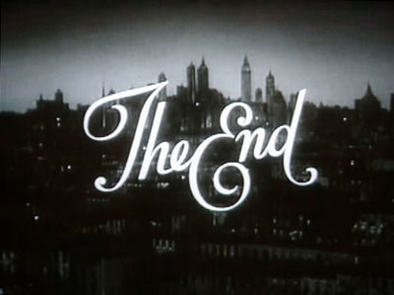
Thank you!

Slide 46
What happens between events?
The value is undefined
The value remains constant
The evolution is well-known
70
Noise (dB)
dB = ?
50
11:00
11:10
11:25
Time

Slide 47
What happens between events?
The value is undefined
The value remains constant
The evolution is well-known
70
Price = 50
Price
50
11:00
11:10
11:25
Time

Slide 48
What happens between events?
The value is undefined
The value remains constant
The evolution is well-known
Value
70
Value = 27
50
11:00
11:10
11:25
Time

Slide 49
Example
“Get all ACME stock data”:
StockTrades
Timestamp | symbol | price
11:00 | ACME | 50
11:30 | ACME | 52
12:00 | XPTO | 70
12:30 | XPTO | 55
13:00 | ACME | 50

Slide 50
Example
“Get all ACME stock data”:
INSERT INTO ACME
SELECT price
FROM StockTrades
WHERE symbol = “ACME”
StockTrades
Timestamp | symbol | price
11:00 | ACME | 50
11:30 | ACME | 52
12:00 | XPTO | 70
12:30 | XPTO | 55
13:00 | ACME | 50

Slide 51
Example
“Get all ACME stock data”:
INSERT INTO ACME
SELECT price
FROM StockTrades
WHERE symbol = “ACME”
StockTrades
Timestamp | symbol | price
11:00 | ACME | 50
11:30 | ACME | 52
12:00 | XPTO | 70
12:30 | XPTO | 55
13:00 | ACME | 50
ACME
Timestamp | symbol | price
11:00 | ACME | 50
11:30 | ACME | 52
13:00 | ACME | 50

Slide 52
Sliding windows
“Calculate the average of ACME’s stock price over the last 3 hours”:
ACME
Timestamp | symbol | price
11:00 | ACME | 50
12:00 | ACME | 60
14:30 | ACME | 70

Slide 53
Sliding windows
“Calculate the average of ACME’s stock price over the last 3 hours”:
INSERT INTO AvgACME
SELECT avg(price)
FROM ACME KEEP 3 HOURS
ACME
Timestamp | symbol | price
11:00 | ACME | 50
12:00 | ACME | 60
14:30 | ACME | 70

Slide 54
Sliding windows
“Calculate the average of ACME’s stock price over the last 3 hours”:
INSERT INTO AvgACME
SELECT avg(price)
FROM ACME KEEP 3 HOURS
ACME
Timestamp | symbol | price
11:00 | ACME | 50
12:00 | ACME | 60
14:30 | ACME | 70
AvgACME
Timestamp | avg(price)
11:00 | 50
12:00 | 55
14:30 | 65

Slide 55
Many types of sliding windows
KEEP 3 HOURS
KEEP 10
KEEP 10 LARGEST BY price
KEEP LAST PER symbol
KEEP ALL

Slide 56
In summary…
Streams + Windows + SELECT
Other languages are quite similar (albeit with different syntax)

Slide 57
State of the Art - Conclusion
SQL is great for simple things – the meaning of a query is explicit in its code
However, complex problems still require complex queries
Sometimes it’s better to describe the solution as a sequence of small steps
This is where procedural languages shine;
Couldn’t we have the best of both worlds: the power of a procedural language with the expressiveness of SQL?

Slide 58
Some concrete problems

Slide 59
Discrete vs continuous
Events are discrete and stateless
This works for many scenarious:
Earthquake reports
Orders placed in an online store
Heart beats
Noise readings sampled periodically

Slide 60
Discrete vs continuous
However, some systems are truly continuous:
The price of a product is updated on change reports
The result of a football match is updated when a goal is scored
Unlike noise, the temperature of a room may be assumed to remain constant between two sensor readings

Slide 61
Managing state
Price
11:00
11:10
11:25
Time

Slide 62
Managing state
Price
11:00
11:10
11:25
Time

Slide 63
Managing state
StockPrices
Timestamp | symbol | price
11:00 | ACME | 50
11:15 | XPTO | 45
11:30 | ACME | 52
12:00 | XPTO | 70
12:30 | XPTO | 55
StockVolume
Timestamp | symbol | volume
11:10 | ACME | 2000
11:25 | XPTO | 800
11:40 | ACME | 2500
12:15 | XPTO | 600
12:40 | ACME | 2100

Slide 64
Managing state
StockPrices
Timestamp | symbol | price
11:00 | ACME | 50
11:15 | XPTO | 45
11:30 | ACME | 52
12:00 | XPTO | 70
12:30 | XPTO | 55
StockVolume
Timestamp | symbol | volume
11:10 | ACME | 2000
11:25 | XPTO | 800
11:40 | ACME | 2500
12:15 | XPTO | 600
12:40 | ACME | 2100
StockMaximums
symbol | max(price) | max(volume)
ACME | 52 | 2500
XPTO | 70 | 800
What were the greatest prices and volumes?

Slide 65
Managing state
INSERT INTO StockMaximums
SELECT symbol, max(price), max(volume)
FROM StockPrices P JOIN StockVolumes V
ON P.symbol = V.symbol
GROUP BY symbol

Slide 66
Managing state
INSERT INTO StockMaximums
SELECT symbol, max(price), max(volume)
FROM StockPrices P JOIN StockVolumes V
ON P.symbol = V.symbol
GROUP BY symbol

Slide 67
TODO
Objects and O/RM
Semantic windows
Sub-windows
conclude

Slide 68
Spare slides

Slide 69
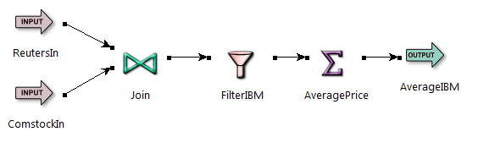
StreamBase EventFlow

Slide 70
StreamBase EventFlow
Mostly SQL equivalent operators
Nothing new here

Slide 71
Oracle Rules Manager
Conceptually:
on <event>
if <condition>
then <action>

Slide 72
Oracle Rules Manager
Conceptually:
on <event>
if <condition>
then <action>
on StockTick(symbol, price)
if symbol = “ACME” and price > 100
then buyStocks(symbol)

Slide 73
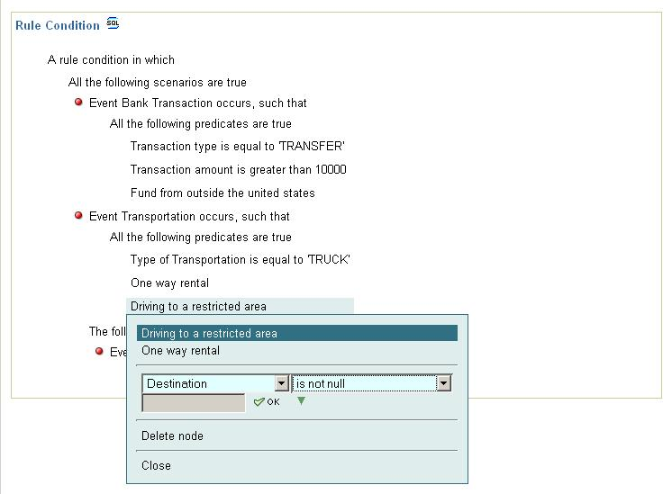
Oracle Rules Manager
In practice:

Slide 74
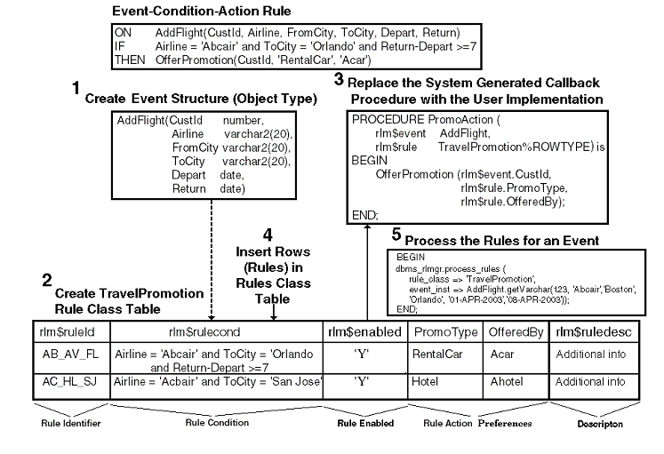
Oracle Rules Manager
In practice (no GUI):

Slide 75
Oracle Rules Manager
In practice (creating a rule):
INSERT INTO CompTravelPromo (rlm$ruleid, PromoType, OfferedBy, rlm$rulecond)
VALUES ('UN-HT-FL', 'RentalCar', 'Acar',
'<condition>
<and join="Flt.CustId = Car.CustId">
<object name="Flt">
Airline=''Abcair'' and ToCity=''Orlando''
</object>
<object name="Car">
CarType = ''Luxury''
</object>
</and>
</condition>');

Slide 76
Oracle Rules Manager
Supports composite events
Sequencing (A before B)
Negation (A doesn’t ocurr)
Set semantics (A AND B)
Any N (At least 5 As)
Collection

Slide 77
Oracle Rules Manager
Disadvantages:
Good to detect events, no so good to process them
PL/SQL is not suited for complex application development
The paradigm doesn’t scale

Slide 78
Apama MonitorScript
Procedural (Java, C, Python, …) language
Unlike SQL which is declarative
Good for operations that are difficult to express in SQL

Slide 79
Apama MonitorScript
Monitors are event processing ``agents''
Monitors can create listeners that await on events
When an event arrives, it processes it
Monitors can have state
route creates new events that will be caught by other monitors
actions are similar to methods

Slide 80
Apama MonitorScript
monitor ProcessMarket {
// Last price per company
dictionary <string, int> last;
action onload {
Tick tick;
on all Tick(): tick {
processTick(tick);
}
on all PriceRequest(): ev {
processPriceRequest(ev);
}
}
action processTick(Tick tick) {
last[tick.sym] := tick.price;
route TickAck(tick.sym);
}
action processPriceRequest(PriceRequest ev) {
if (last.hasKey(ev.sym)) then {
route PriceReply(ev.sym, last[ev.sym]);
}
}
}

Slide 81
Apama MonitorScript
No querying capabilities

