Slide 1
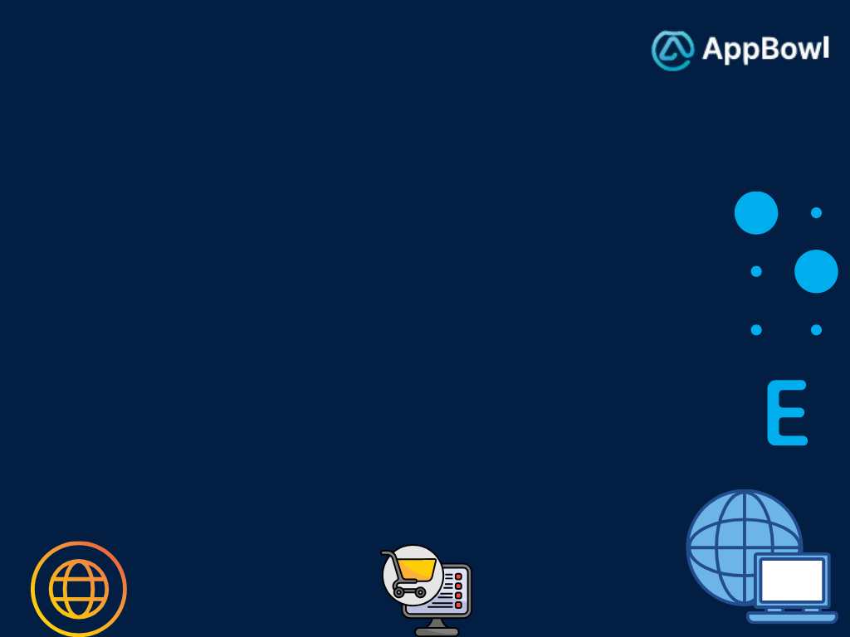
"Welcome You All! Today, we are excited to walk you through our website’s design and user flow. We’ve crafted an intuitive and seamless experience to ensure users can easily navigate and explore all the features we offer. Let’s dive into the journey and discover how our website delivers value and innovation to our users."

Slide 2

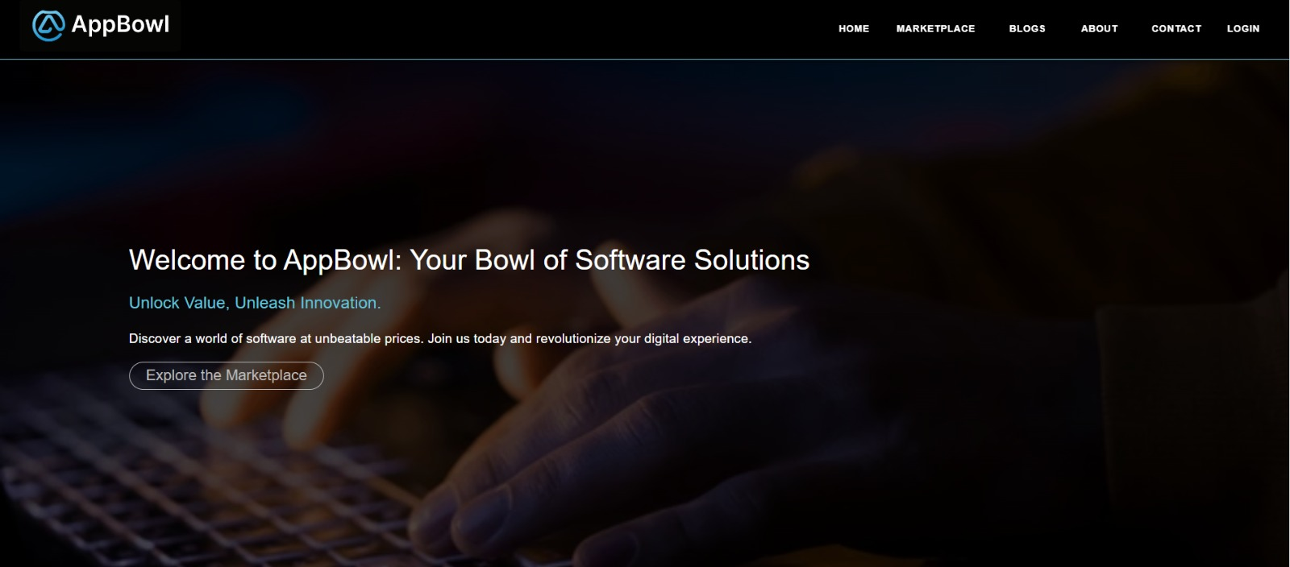
1. Header : AppBowl logo for brand identity in Left, Navigation links for "Home," “marketplace," “Blogs," "Contact .“, “Login” at Right 2. Hero Banner: A long banner with a strong tagline and a “Explore the marketplace“ button

Slide 3

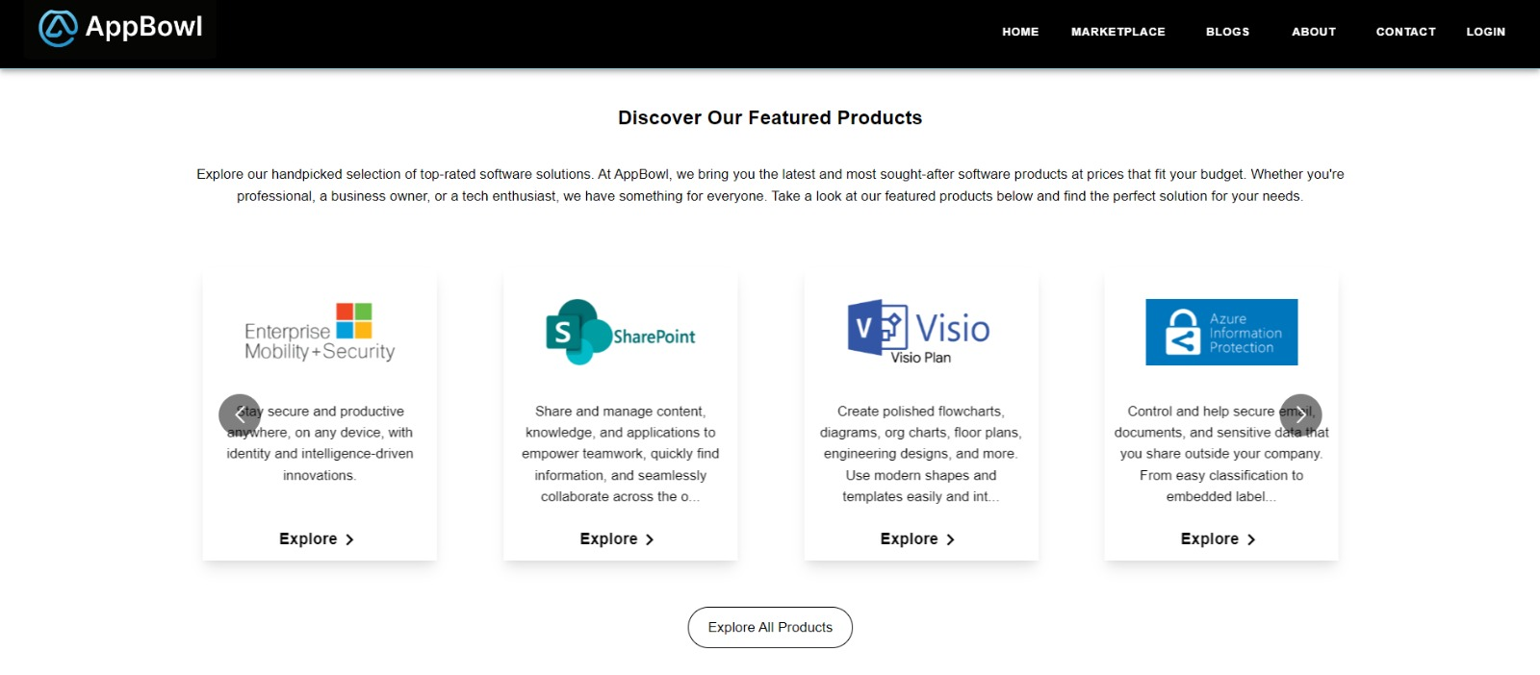
3. Discover Our Featured Products Section (Second Image)Grid Layout: Four horizontally arranged product cards, equally spaced Each Card: Title at the top, followed by a short product description, and a button for "Explore“ Call to Action: A larger button at the bottom for "Explore All Products" to guide users further Clear Structure: Each card has a uniform design, making it easy to scan.

Slide 4


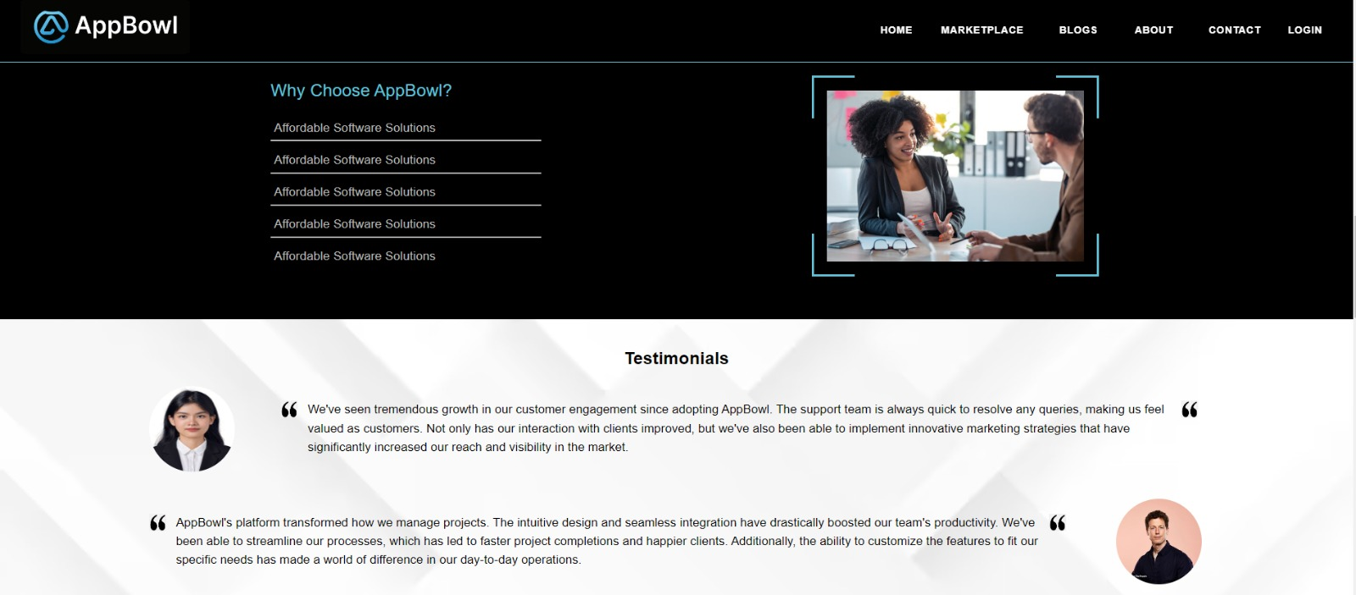
4. Why Choose AppBowl Section (First Image)Layout: Two-column design Left Column: Text-based content highlighting AppBowl's key selling points. The list is vertically aligned, creating a clean reading flow Right Column: An image of professionals interacting, visually supporting the brand message Contrast: Dark background with bright text and image, making both the text and visuals pop.

Slide 5

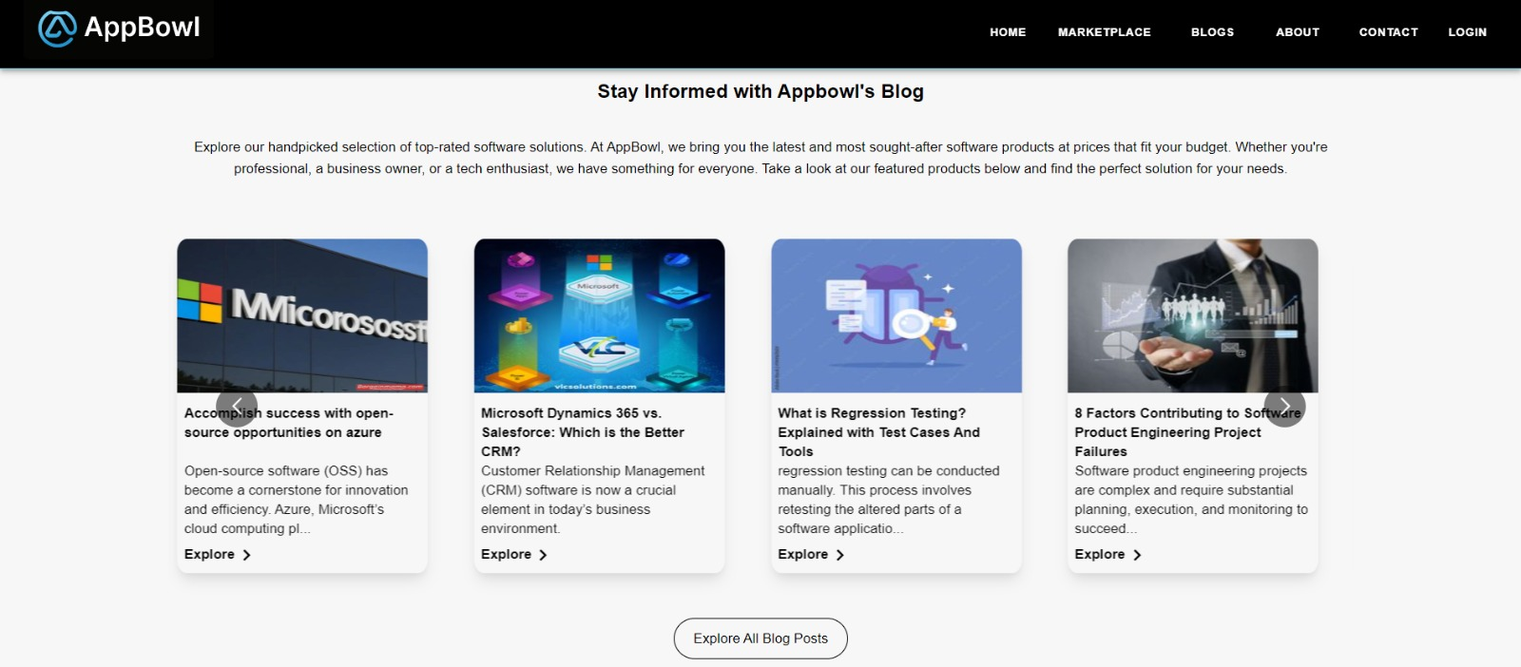
5. Blog section

Slide 6
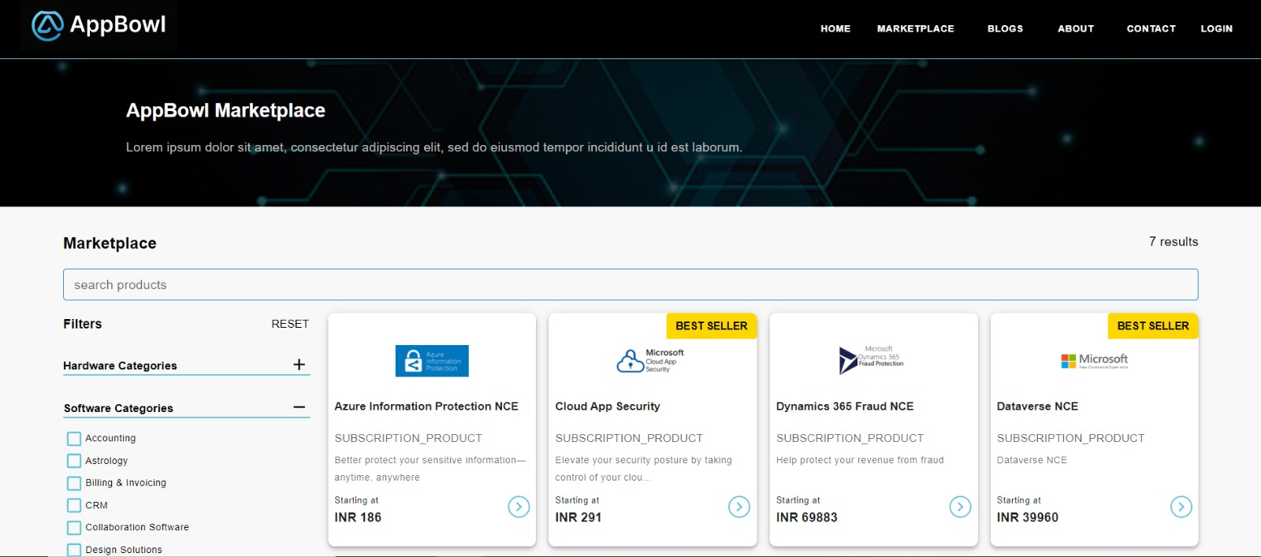
Product Listing Page with Filters

Slide 7
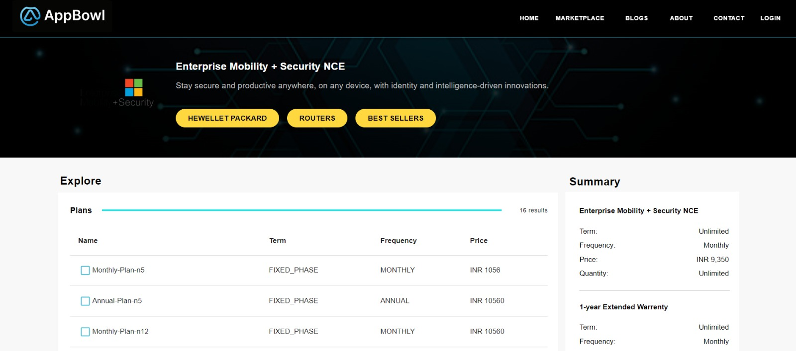
Product Plan List With Selected Plan Summery

Slide 8
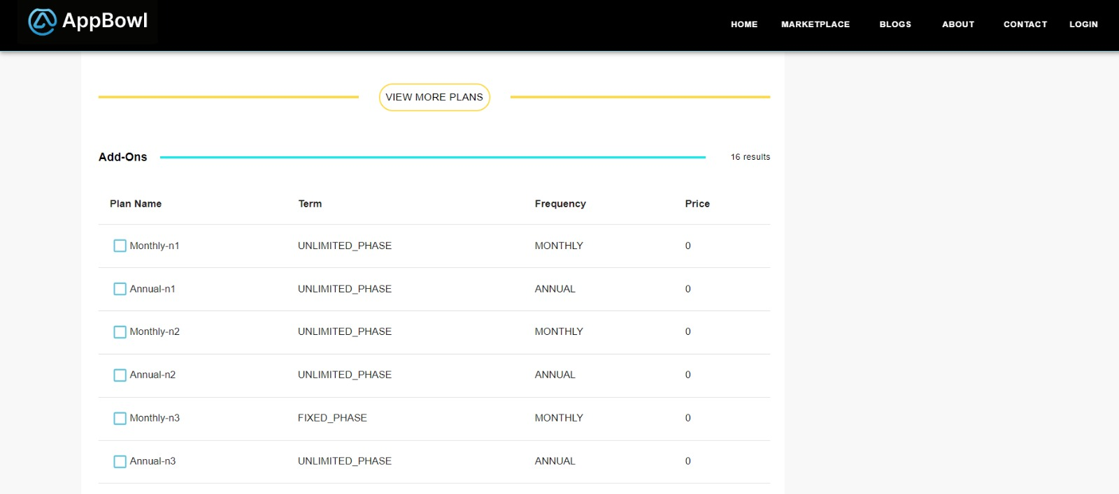
Product Addon List

Slide 9
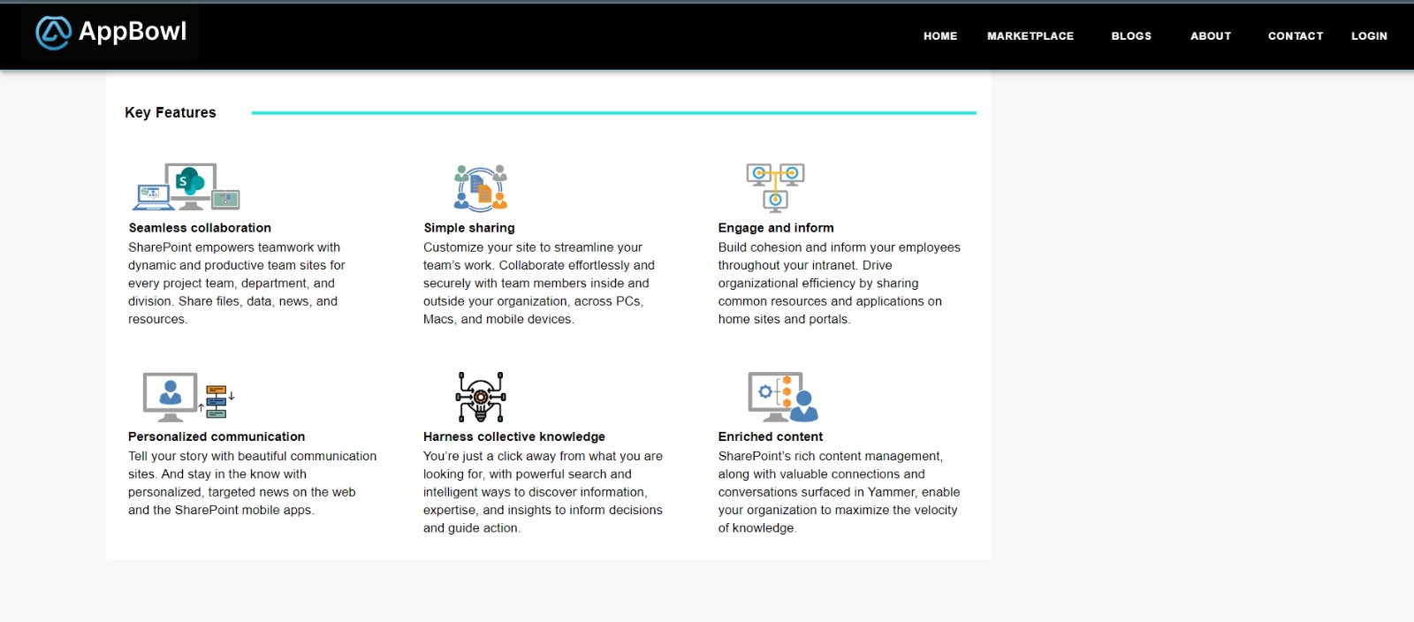
Product Key Features

Slide 10
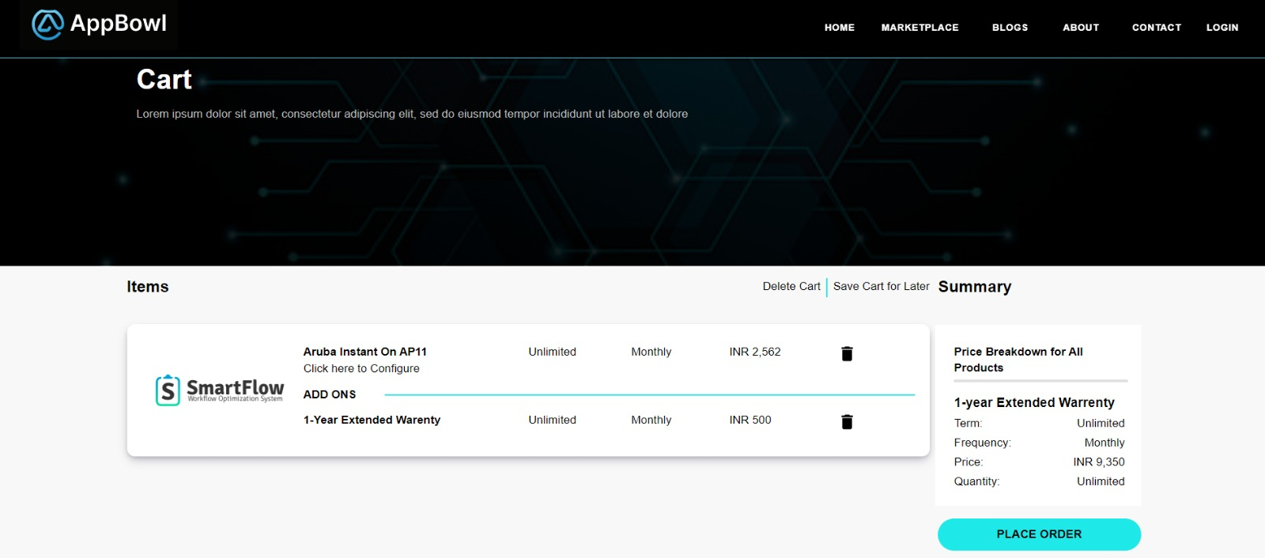
Cart Detail Page

Slide 11
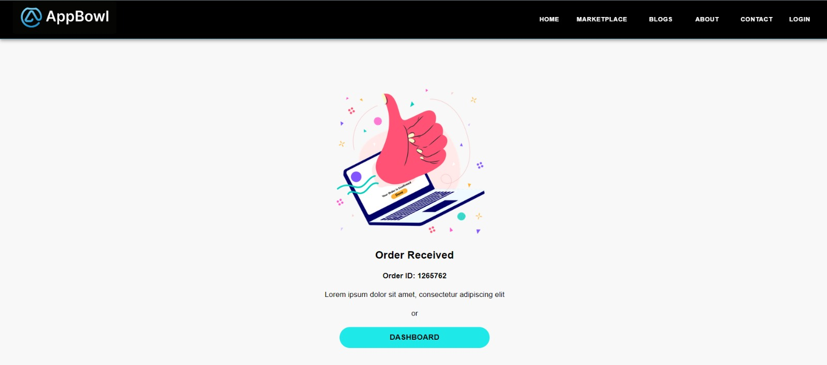
Order Success Page

Slide 12
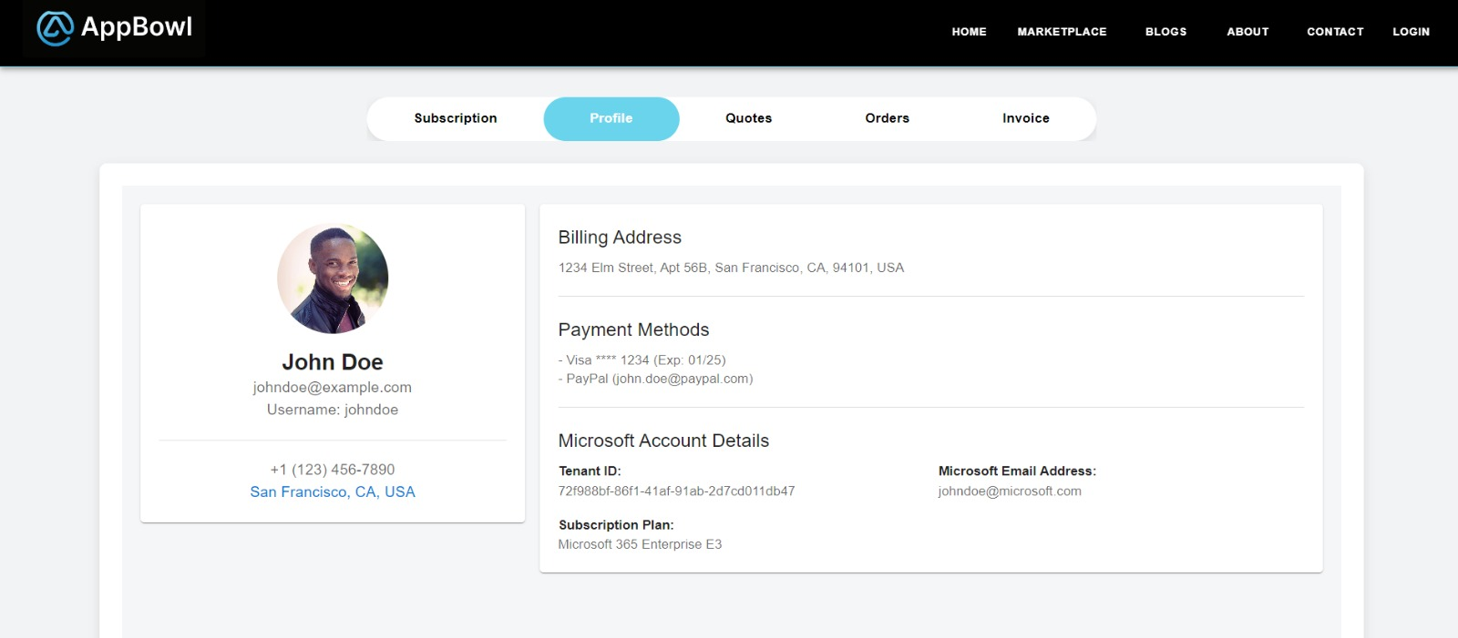
Customer Profile Page

Slide 13
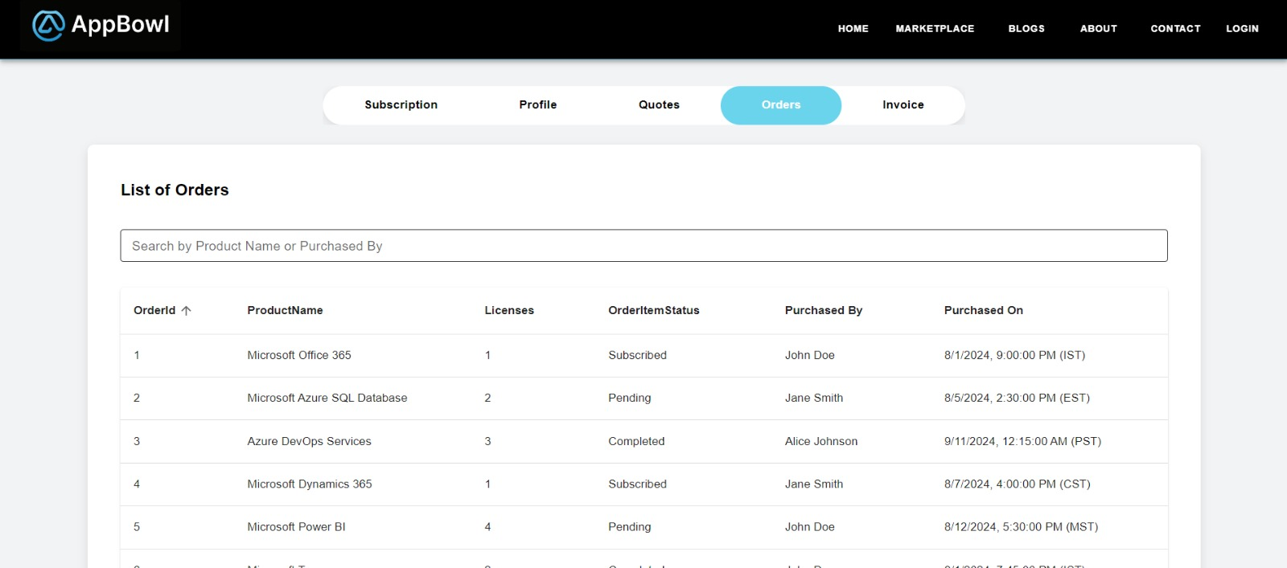
Customer order list

Slide 14
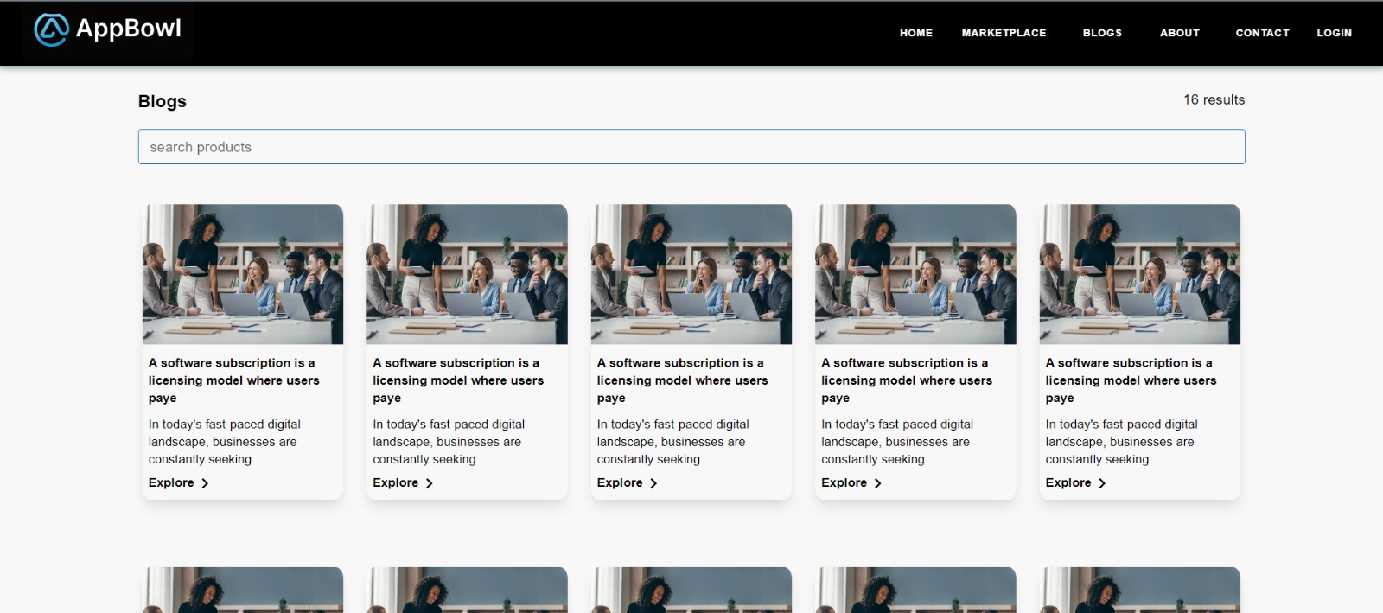
Blog Listing Page

Slide 15
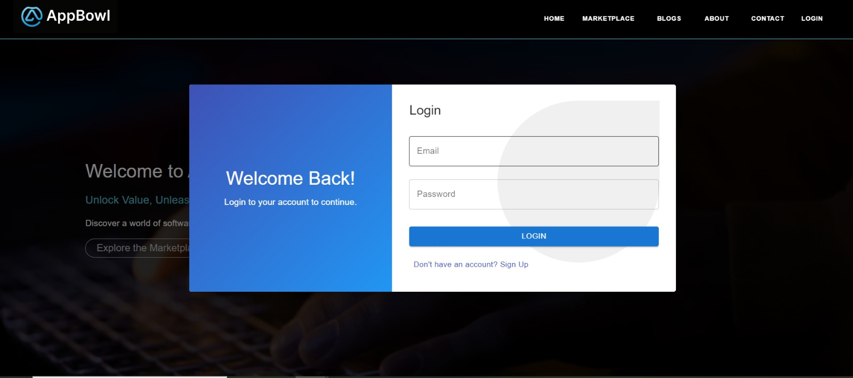
Login popup

Slide 16
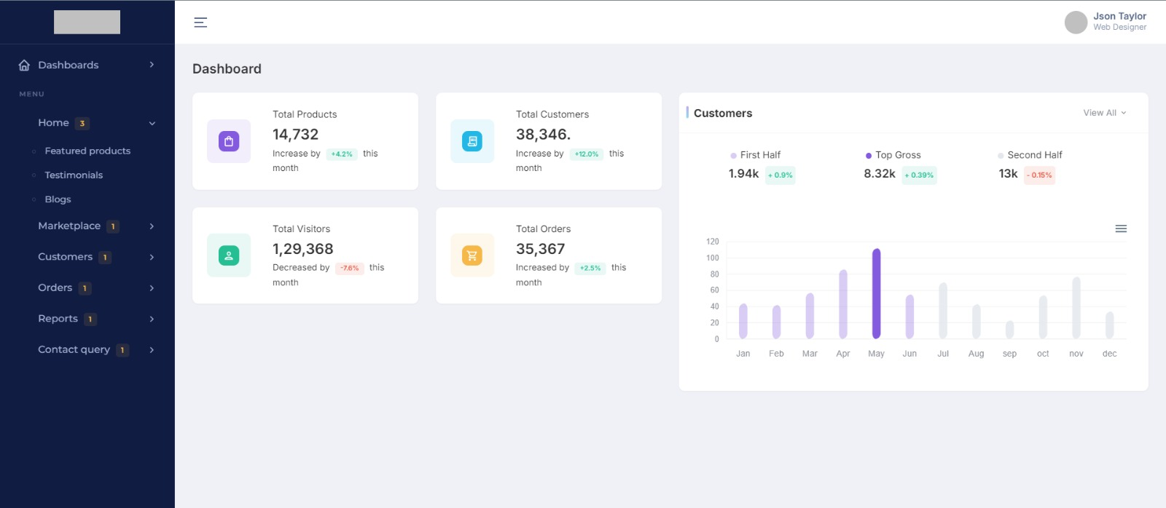
Admin Panel with a main dashboard and sidebar.

Slide 17
Completed Works
Product listing
Product Detail
Site UX
Site API
Database Architecture
Admin panel UX

Slide 18
Work in Progress!
Site ui improment
Authentication
Cart
Orders
Payment gateway
Dashboards
Admin panel

Slide 19
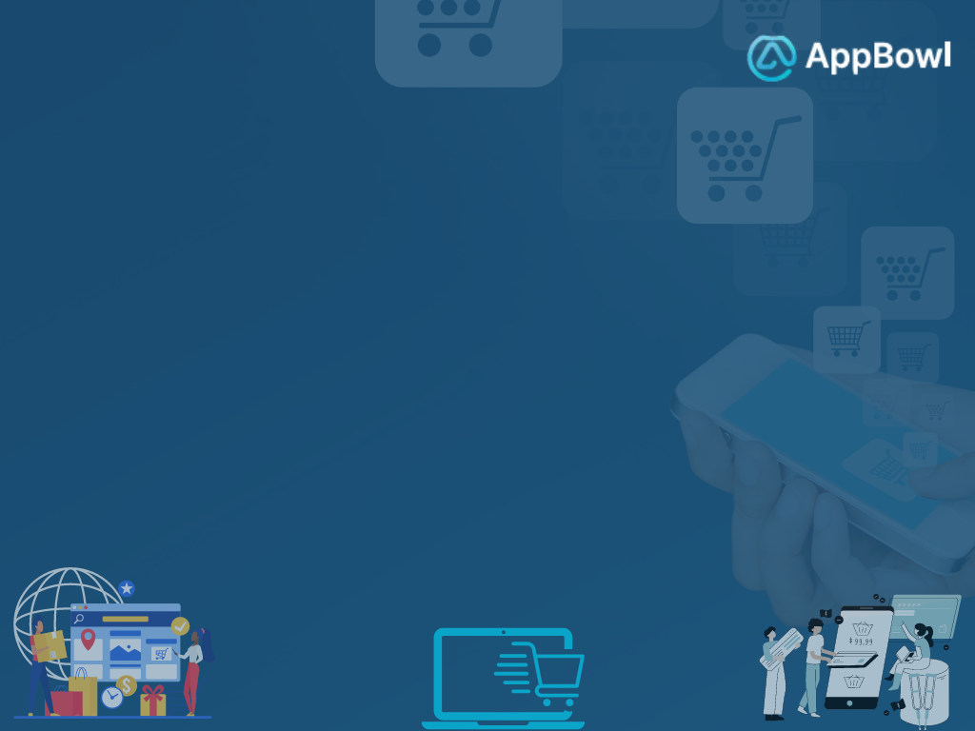
"Thank you for your attention! We hope this presentation gave you valuable insights into our website’s design and functionality. We’re excited to continue enhancing the user experience and look forward to any feedback or questions you may have. Stay connected, and let’s innovate together!"

