Slide 1
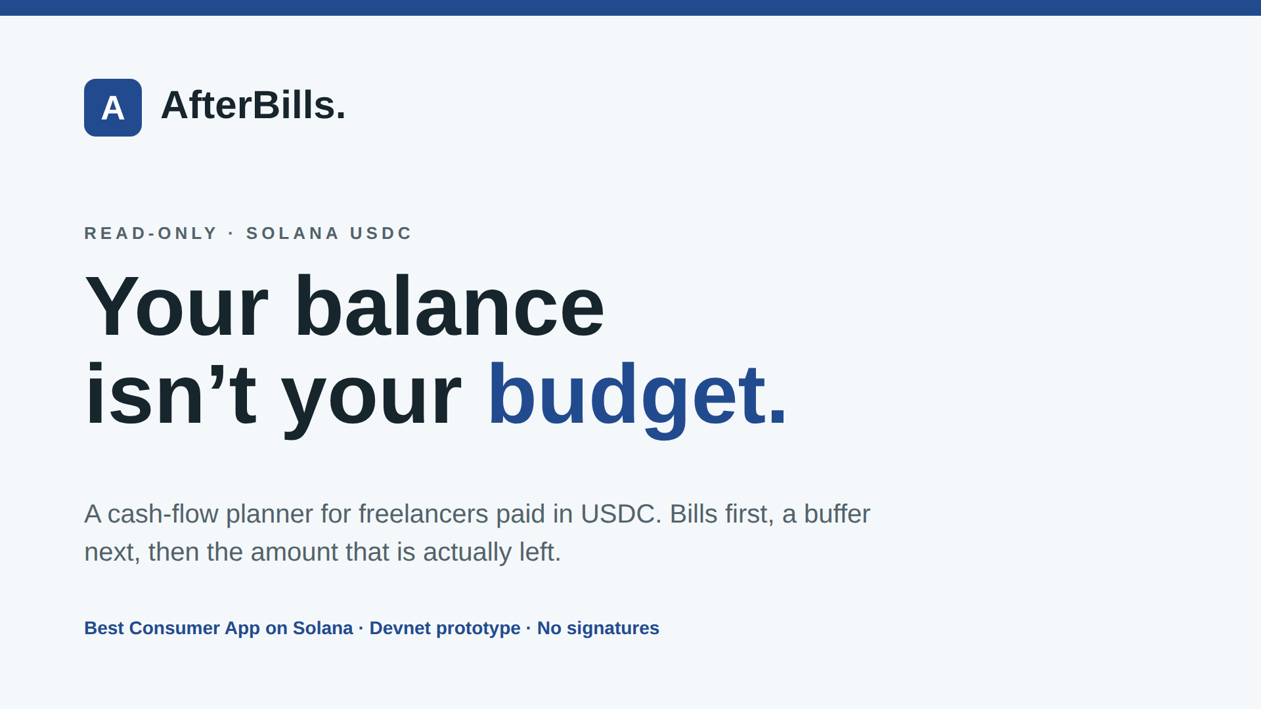
Notes:
AfterBills is a read-only cash-flow planner for freelancers paid in Solana USDC. It is a devnet prototype built for the Best Consumer App on Solana track.

Slide 2
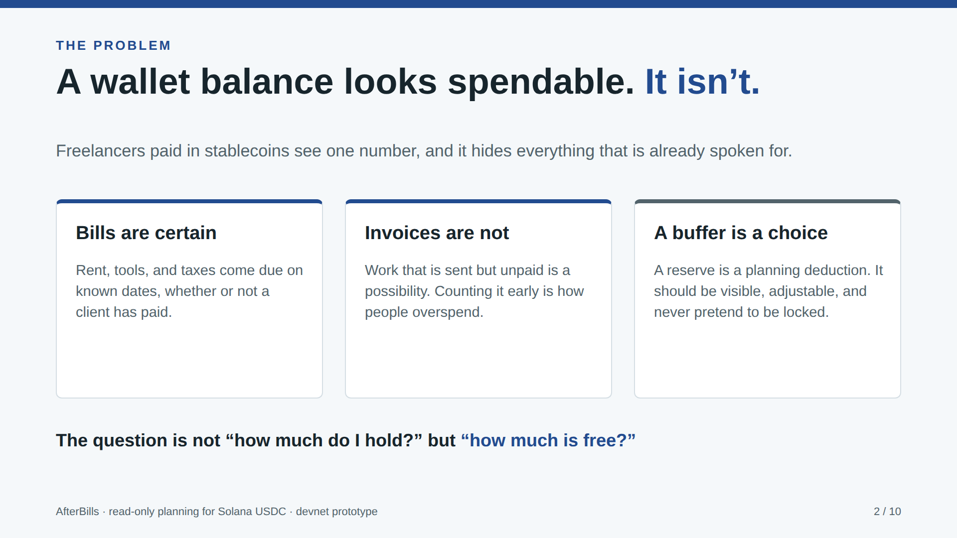
Notes:
A wallet balance looks like spendable money, but rent, tools and taxes are certain, and unpaid invoices are only a possibility.

Slide 3
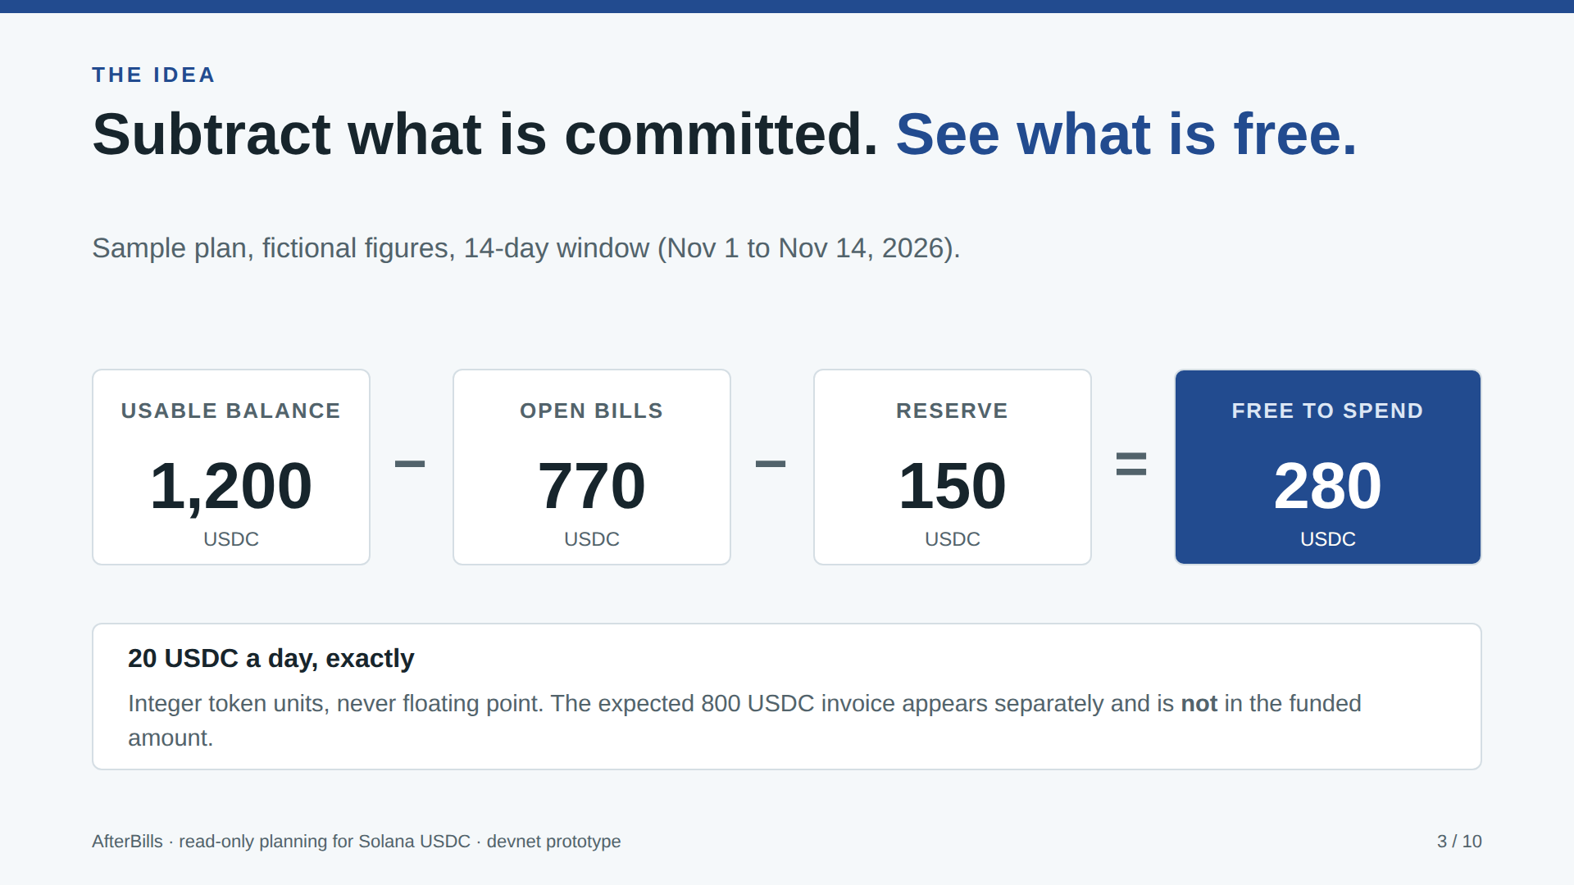
Notes:
The sample plan is fictional: 1,200 USDC usable, minus 770 in open bills, minus a 150 reserve, leaves 280 free, or 20 a day over 14 days. The expected 800 invoice is not counted.

Slide 4
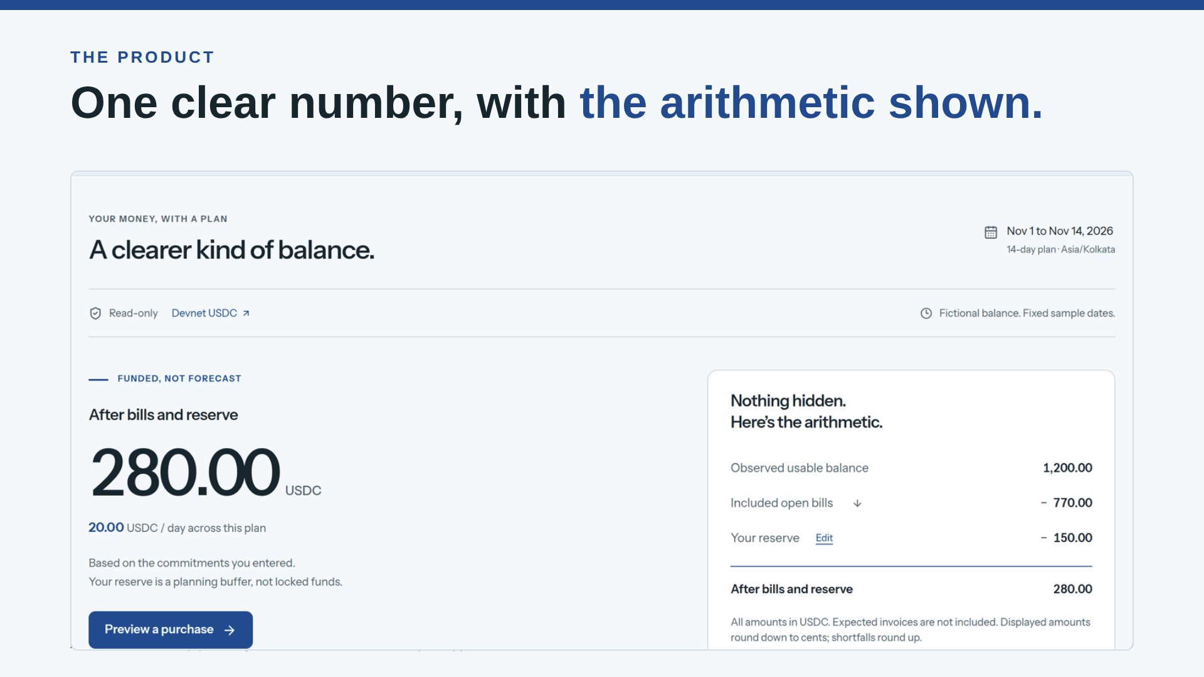
Notes:
The dashboard shows one number and the arithmetic behind it. Every figure is exact integer math.

Slide 5
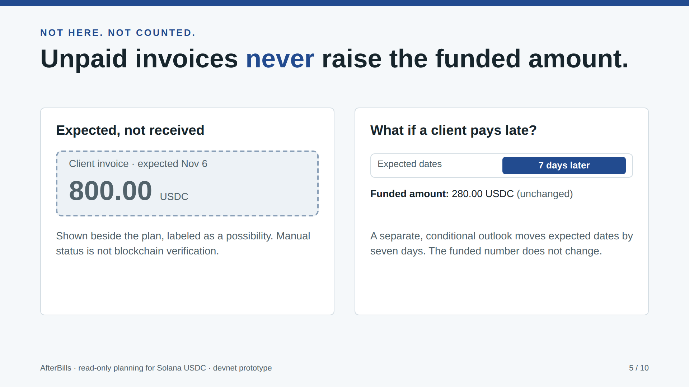
Notes:
Unpaid invoices never raise the funded amount. A separate outlook shows what happens if a client pays seven days late.

Slide 6
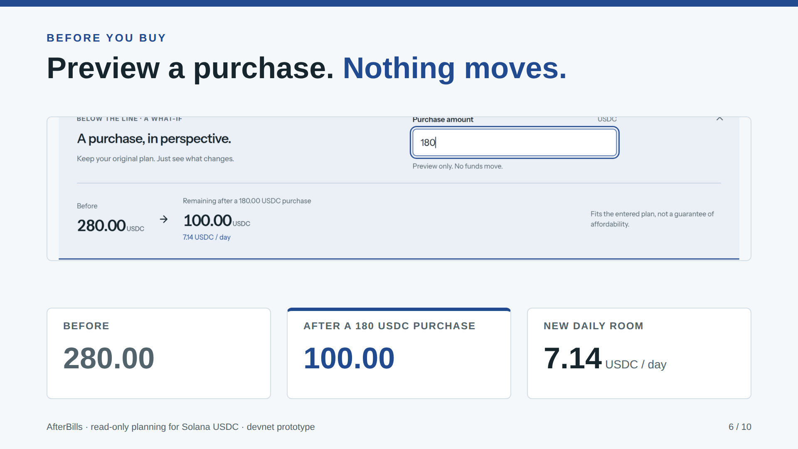
Notes:
Previewing a 180 USDC purchase leaves 100 free, about 7.14 a day. Nothing is signed or moved.

Slide 7
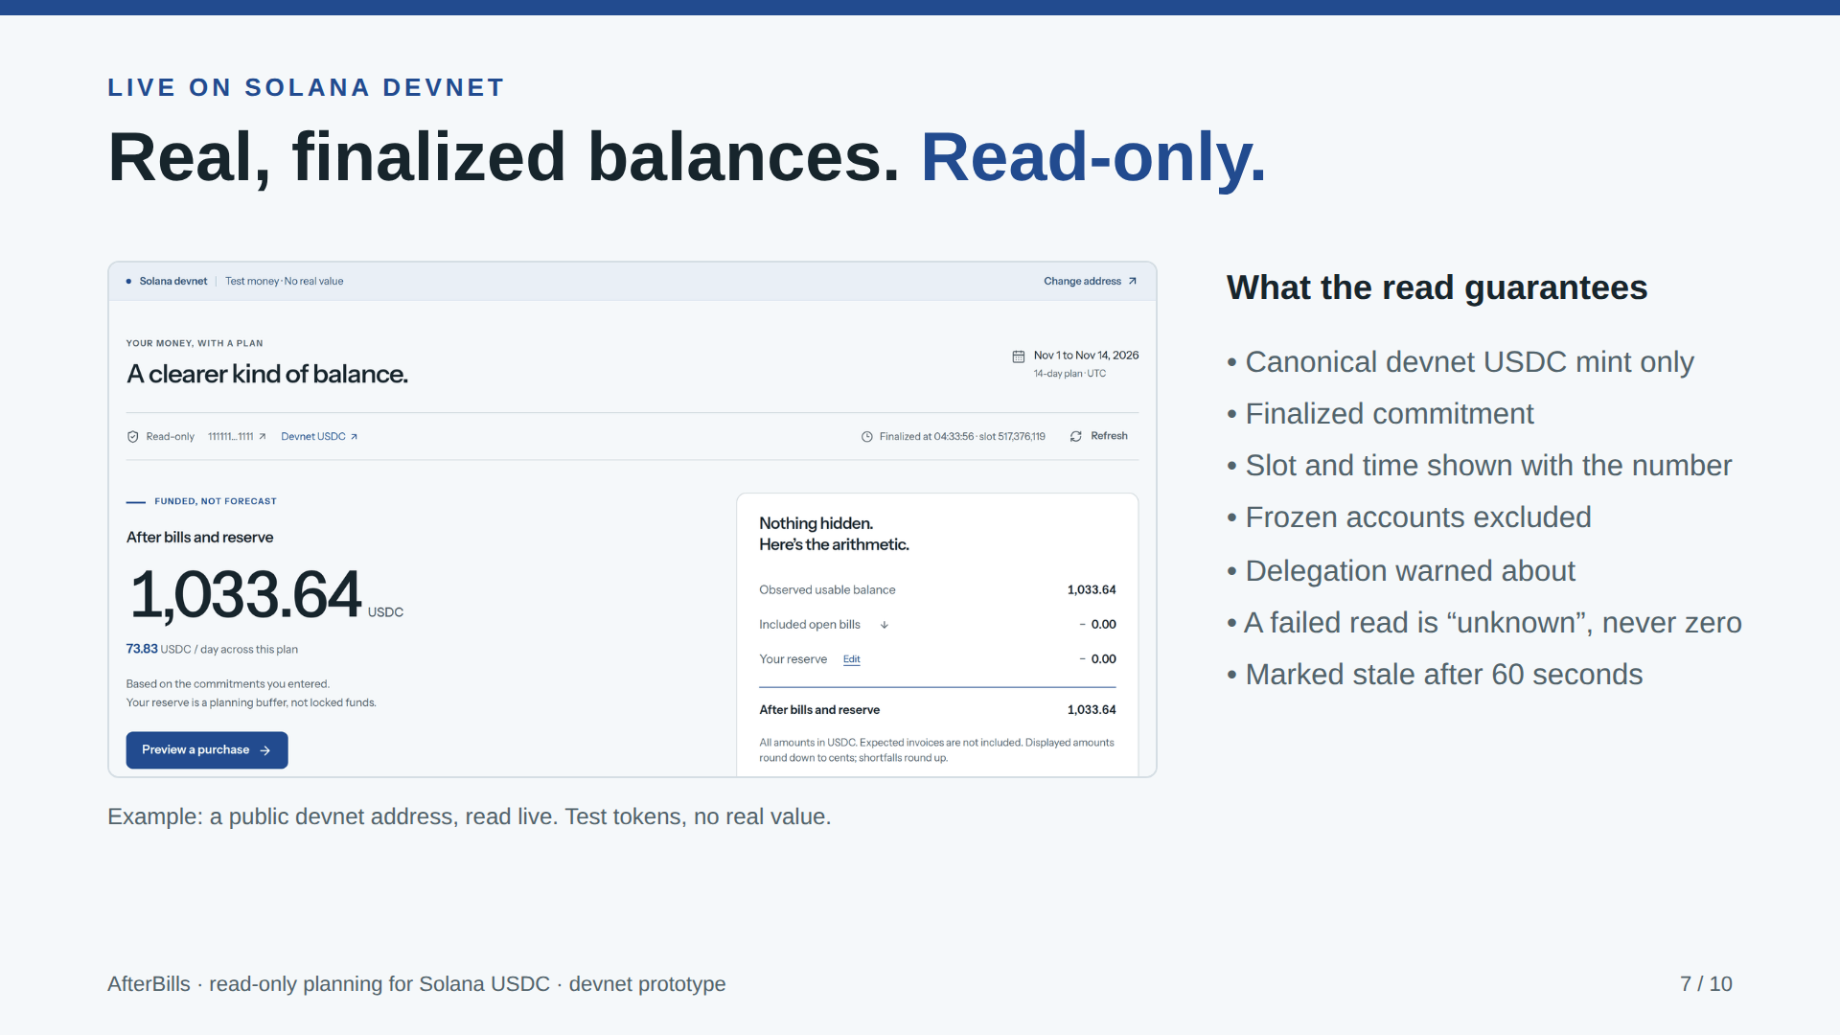
Notes:
Live mode reads real, finalized devnet USDC for a public address, shows slot and time, excludes frozen accounts, warns about delegation, and treats a failed read as unknown rather than zero.

Slide 8
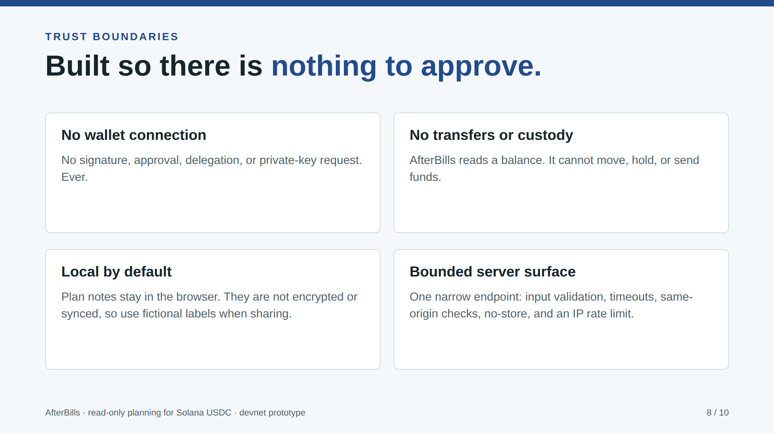
Notes:
There is no wallet connection, no signature, and no transfer. Notes stay in the browser, unencrypted. The one server route is narrow and rate limited.

Slide 9
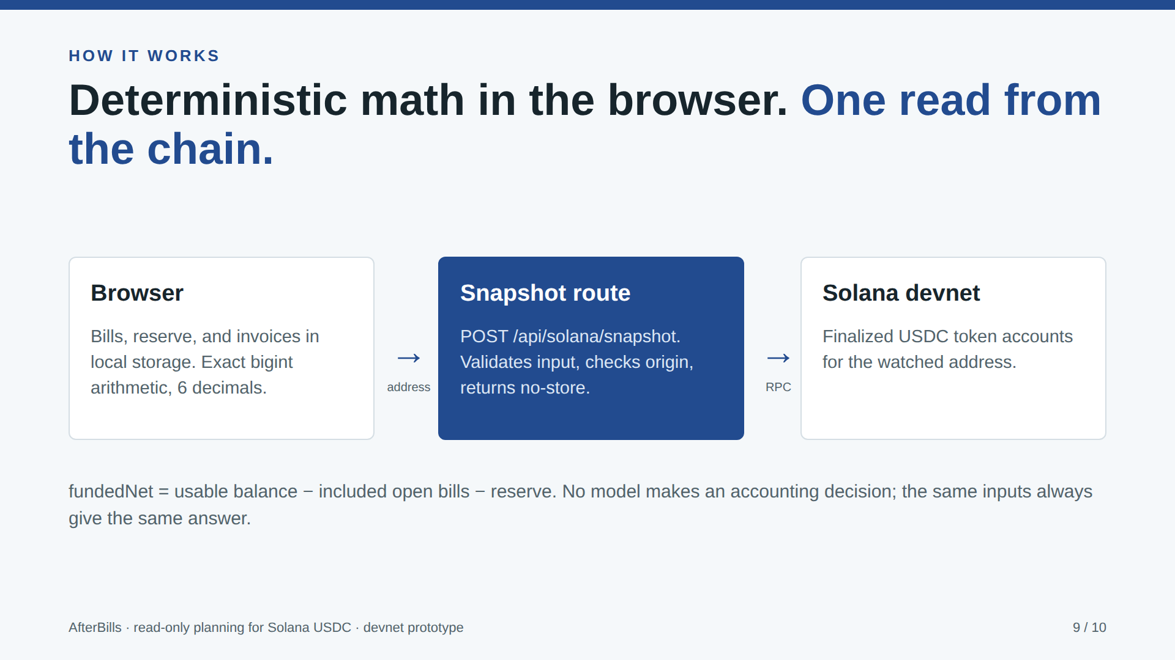
Notes:
The browser does the math. A single route reads finalized token accounts from Solana devnet.

Slide 10
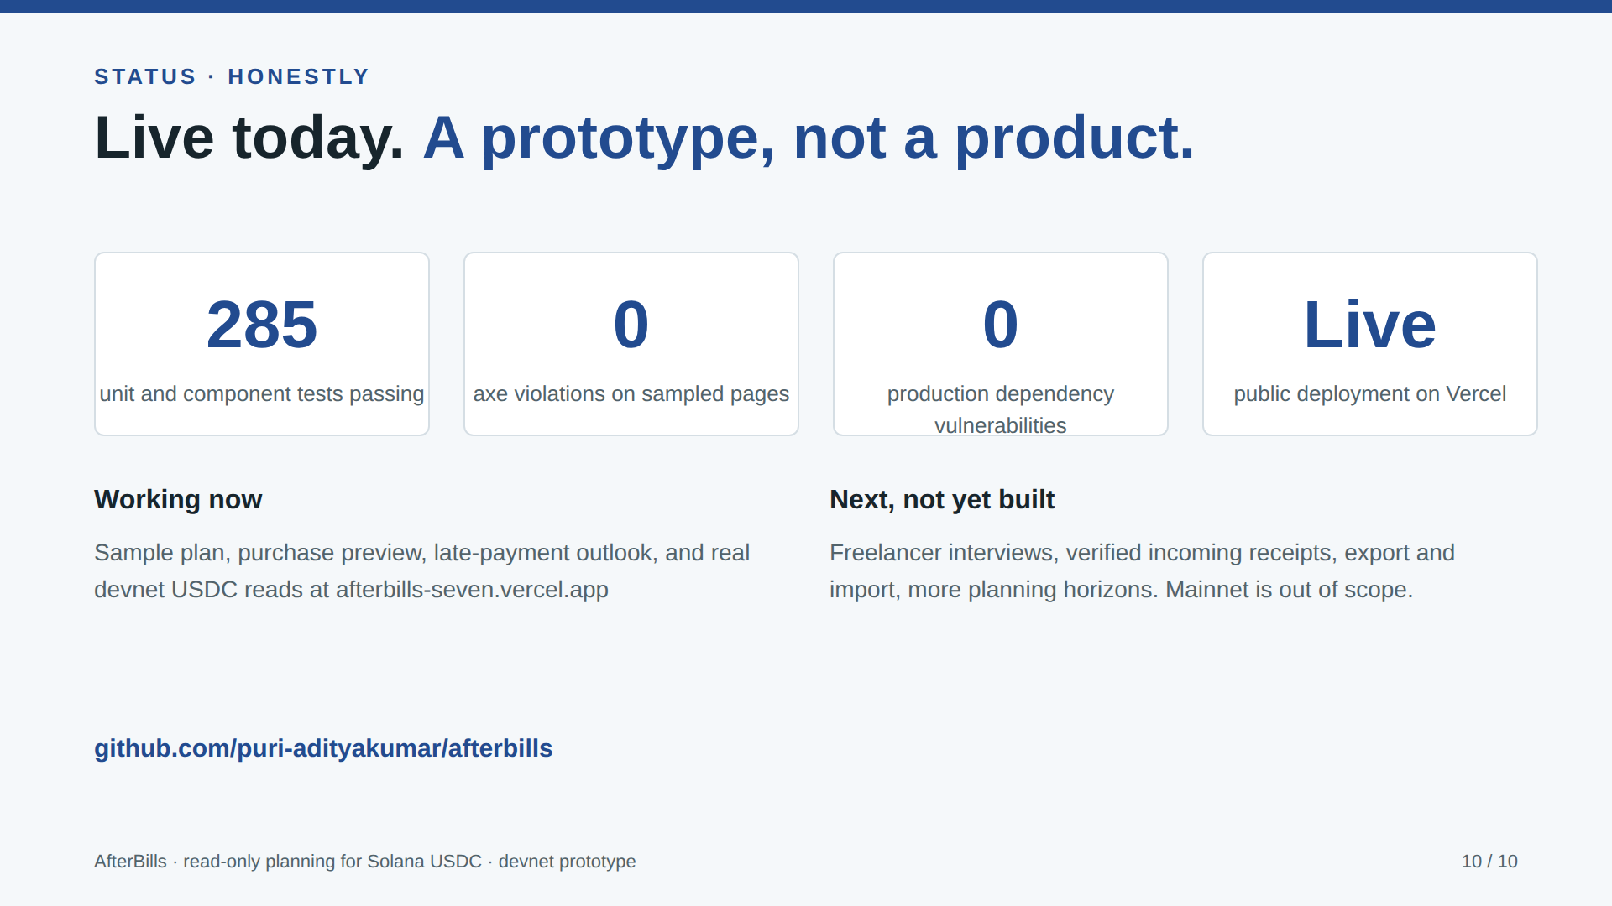
Notes:
285 tests pass, no axe violations on sampled pages, zero production dependency vulnerabilities, and it is live on Vercel. Interviews, receipts and export are next, not built. Nothing is claimed beyond that.

