Slide 1
Introduction to RACS

Slide 2
Introducing RACS
The RACS protocol has been designed for efficient and secure remote use of secure elements via the internet.
It also provides smartcard readers virtualization, and therefore facilitates secure elements deployment in environments dealing with virtual machines and cloud computing.
ISO7816 APDU
TLS
TCP
IP

Slide 3
RACS Uniform Resource Identifier
RACS client establihes a secure (TLS) connection with a remote server, it collects the list of hosted secure elements, and thereafter it powers on a secure element, resets the device and exchanges APDU requests and responses.
RACS defines an URI (Uniform Resource Identifier), such as
ServerName:Port/SEID
It comprises the server name or IP address, the TCP port and a SE identifier (the SEID).
Therefore it creates a concept somewhat similar to a WEB of secure elements, or a WEB of cryptographic procedures.

Slide 4
A PKI Infrastructure
In order to enforce strong mutual authentication both RACS client and server are equipped with X509 certificates, dealing with asymmetric cryptography (RSA or Elliptic Curves).
The client SUBJECT attribute, more precisely the Common Name (CN) field of this attribute identifies a legitimate client, and is associated within the server to an index UID, the user identifier.

Slide 5
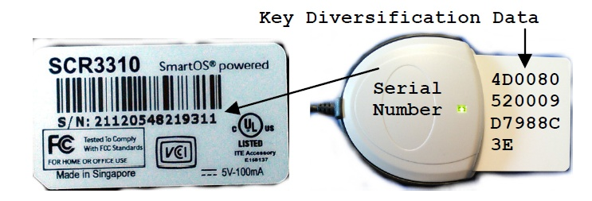
How to allocate SEID ?
Reader Serial Number
Smartcard Reader Index

Slide 6
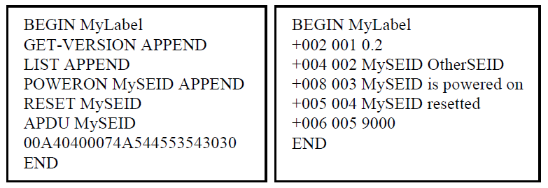
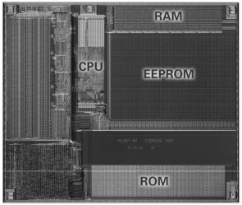
RACS Requests and Responses
SEID
LIST
RESET
POWERON
SHUTDOWN
APDU
IO

Slide 7
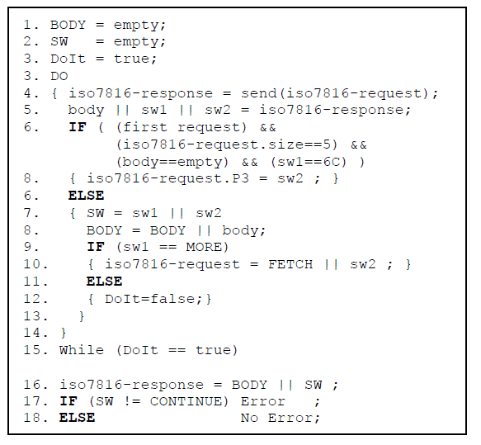
APDU Command

Slide 8
Security Policy
Only users equipped with valid certificates successfully establish TLS sessions.
A user identifier (UID) is derived from the certificate Common Name (CN) attribute.
A TLS session is identified by a unique identifier (the SID).
Every secure element has two states, unlocked and locked.
  The SHUTDOWN command forces the unlocked state; the POWERON command switches the SE state from locked to unlocked.
  In the locked state the SE may be only used by the SID that previously locked it.
At the end of a TLS session all used SEs are unpowered and unlocked.

Slide 9
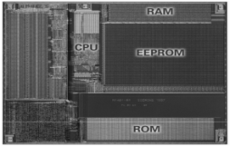
UID, SID, AID
uid
TLS
sid
sid
POWERON
seid
seid
aid
aid

Slide 10
SEID Locking
Unlocked
Power Off
Locked(SID)
Power On
POWERON(SID)
POWERON
(Other-SID)
SHUTDOWN(All-SID)
DENIED
END Of TLS SESSION(SID)

Slide 11
Access Control
The server manages two kinds of table:
  The Users-Table stores for each CN a list of authorized SEIDs.
  Each SEID is linked to a SEID-Table storing for every AID (embedded application) a list of authorized CNs.

Slide 12
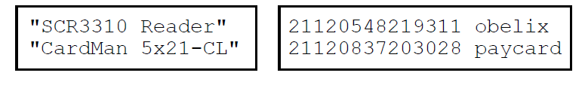
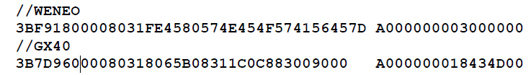
SEID files
type.txt file
readersn.txt file
atr.txt File (DEPRECATED)

Slide 13
TypeTable (type.txt)
According to the PCSC standard each smartcard reader MAY manage three attributes
  Vendor
  Type
  Serial Number
Hypothesis: The Type attribute is unique for a class of reader
The TypeTable indicates that a given type is associated to a true unique Reader Serial Number (SN)
  Some readers don’t support the SN option or has a fix (fake) SN
Example
  "Weneo Reader"
  "SCR33x USB Smart Card Reader"
  "SDI010 Contactless Reader"
  "SDI010 Smart Card Reader"

Slide 14
ReaderSN table
Establishes the relationship between reader serial number and SEID
For some dual interfaces readers (contact / contactless) a SN may be shared by two different SEIDs
Example
  // lecteur scr133
  21120548219311 obelix
  // Lecteur OMNIKEY 5321
  OKCM002040110172830810179479861 paycard
  // LECTEUR SID010
  21120837203028 paycard "SDI010 Contactless Reader"
  21120837203028 contact "SDI010 Smart Card Reader"

Slide 15
AtrTable (atr.txt)
Hypothesis: Each SE class is uniquely identified by an ATR
  See https://smartcard-atr.apdu.fr/
Each SE has a Issuer Security Domain (ISD), associated to an Application Identifier (AID) 16 bytes at the most
The AtrTable manages the relationship between ATR and ISD
Example
  // WENEO
  3BF91800008031FE4580574E454F574156457D A000000003000000
  // GX40
  3B7D96000080318065B08311C0C883009000 A000000018434D00
  // JCOP41 NFC
  3BFA1800008131FE454A434F503431563232319D A000000003000000
This table is deprecated

Slide 16
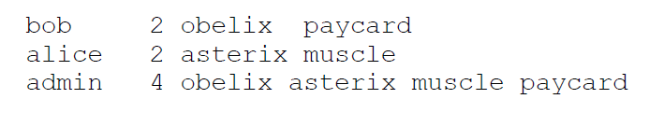
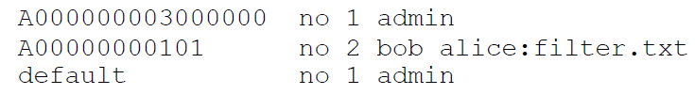
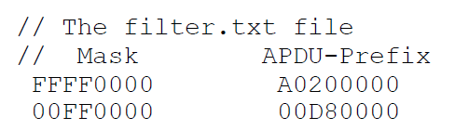
Access Control Files
users.txt file
seid.txt file
Filter.txt file

Slide 17
UserTable (users.txt)
The Common Name attribute is found in the client X509 certificate
Each CommonName (CN) has a UserID, an integer value (from 0 to n)
The UserID (UISD) is allowed from the first CN occurrence in UserTable.
A CN not referenced in this table has no UID and therefore has no access to SE
Example
  client 4 725 obelix asterix paycard // 4 SE
  client2 0 // 0 SE
  Admin all // All SE

Slide 18
SEID Table
Each AID is associated to a white or black access list
A default option is available
AID no listed in the SEID-Table are accessed according to the se_default_access attribute defined in the config.txt file (yes=access, no=access denied)
Example:
  // AID or default, no=WhiteList yes=BlackList , #CN, list of CN
  A000000003000000 no 3 pascal client admin
  A00000000101 no 3 pascal client admin
  default no 2 pascal admin

Slide 19
CardSn table
Establishes the relationship between secure element server name (SN) and SEID
The Server Name is defined by ATR historical bytes.
Example
  //CARD_SN SEID
  key1.com key1

