Slide 1
Forecasting of OG orders.
May - July, 2018.

Slide 2
Overview

Slide 3
Overview: Work done.
Study efficacy of work done in Phase 3.
Find behavioral commonalities of bad stores.
Problem statement:
1494 stores with OG facility.
Forecast quarterly demand, one month in advance.
Improve existing accuracy.
Develop seasonal indices.
Study current model – find possible improvements.
Improve forecasts
Implement scaling.
@85.3%
04
Some forecasts are bad. Why?
Find driver variables
Build classification model
@85.1%
03
Study forecasting model for 4 quarters.
Find seasonal indices
Find better models
@85.1%
02
x
Current
Model
@ 82%
01
Models
Notes:
01: Ad - hoc technique
02: Comprehensive approach to index set.
03: BSTS - Uses sophisticated techniques to get idea of prior behavior of unknown parameters, does not allow non integral seasonal indices.
04: TBATS - allows non integral, varying seasonal indices.
05: Market research file for driver variables.
06: Conditional forest vs random forest.

Slide 4
Overview – Results.
CURRENT: 18%
PROPOSED: 14.9%
12.8
BSTS + WM
TBATS + WM
TBATS + Custom
BSTS + Custom
IMPROVEMENT: 310 BPS

Slide 5
Phase 1.
Seasonal Indices found, quarter wise study of model efficiency done.

Slide 6
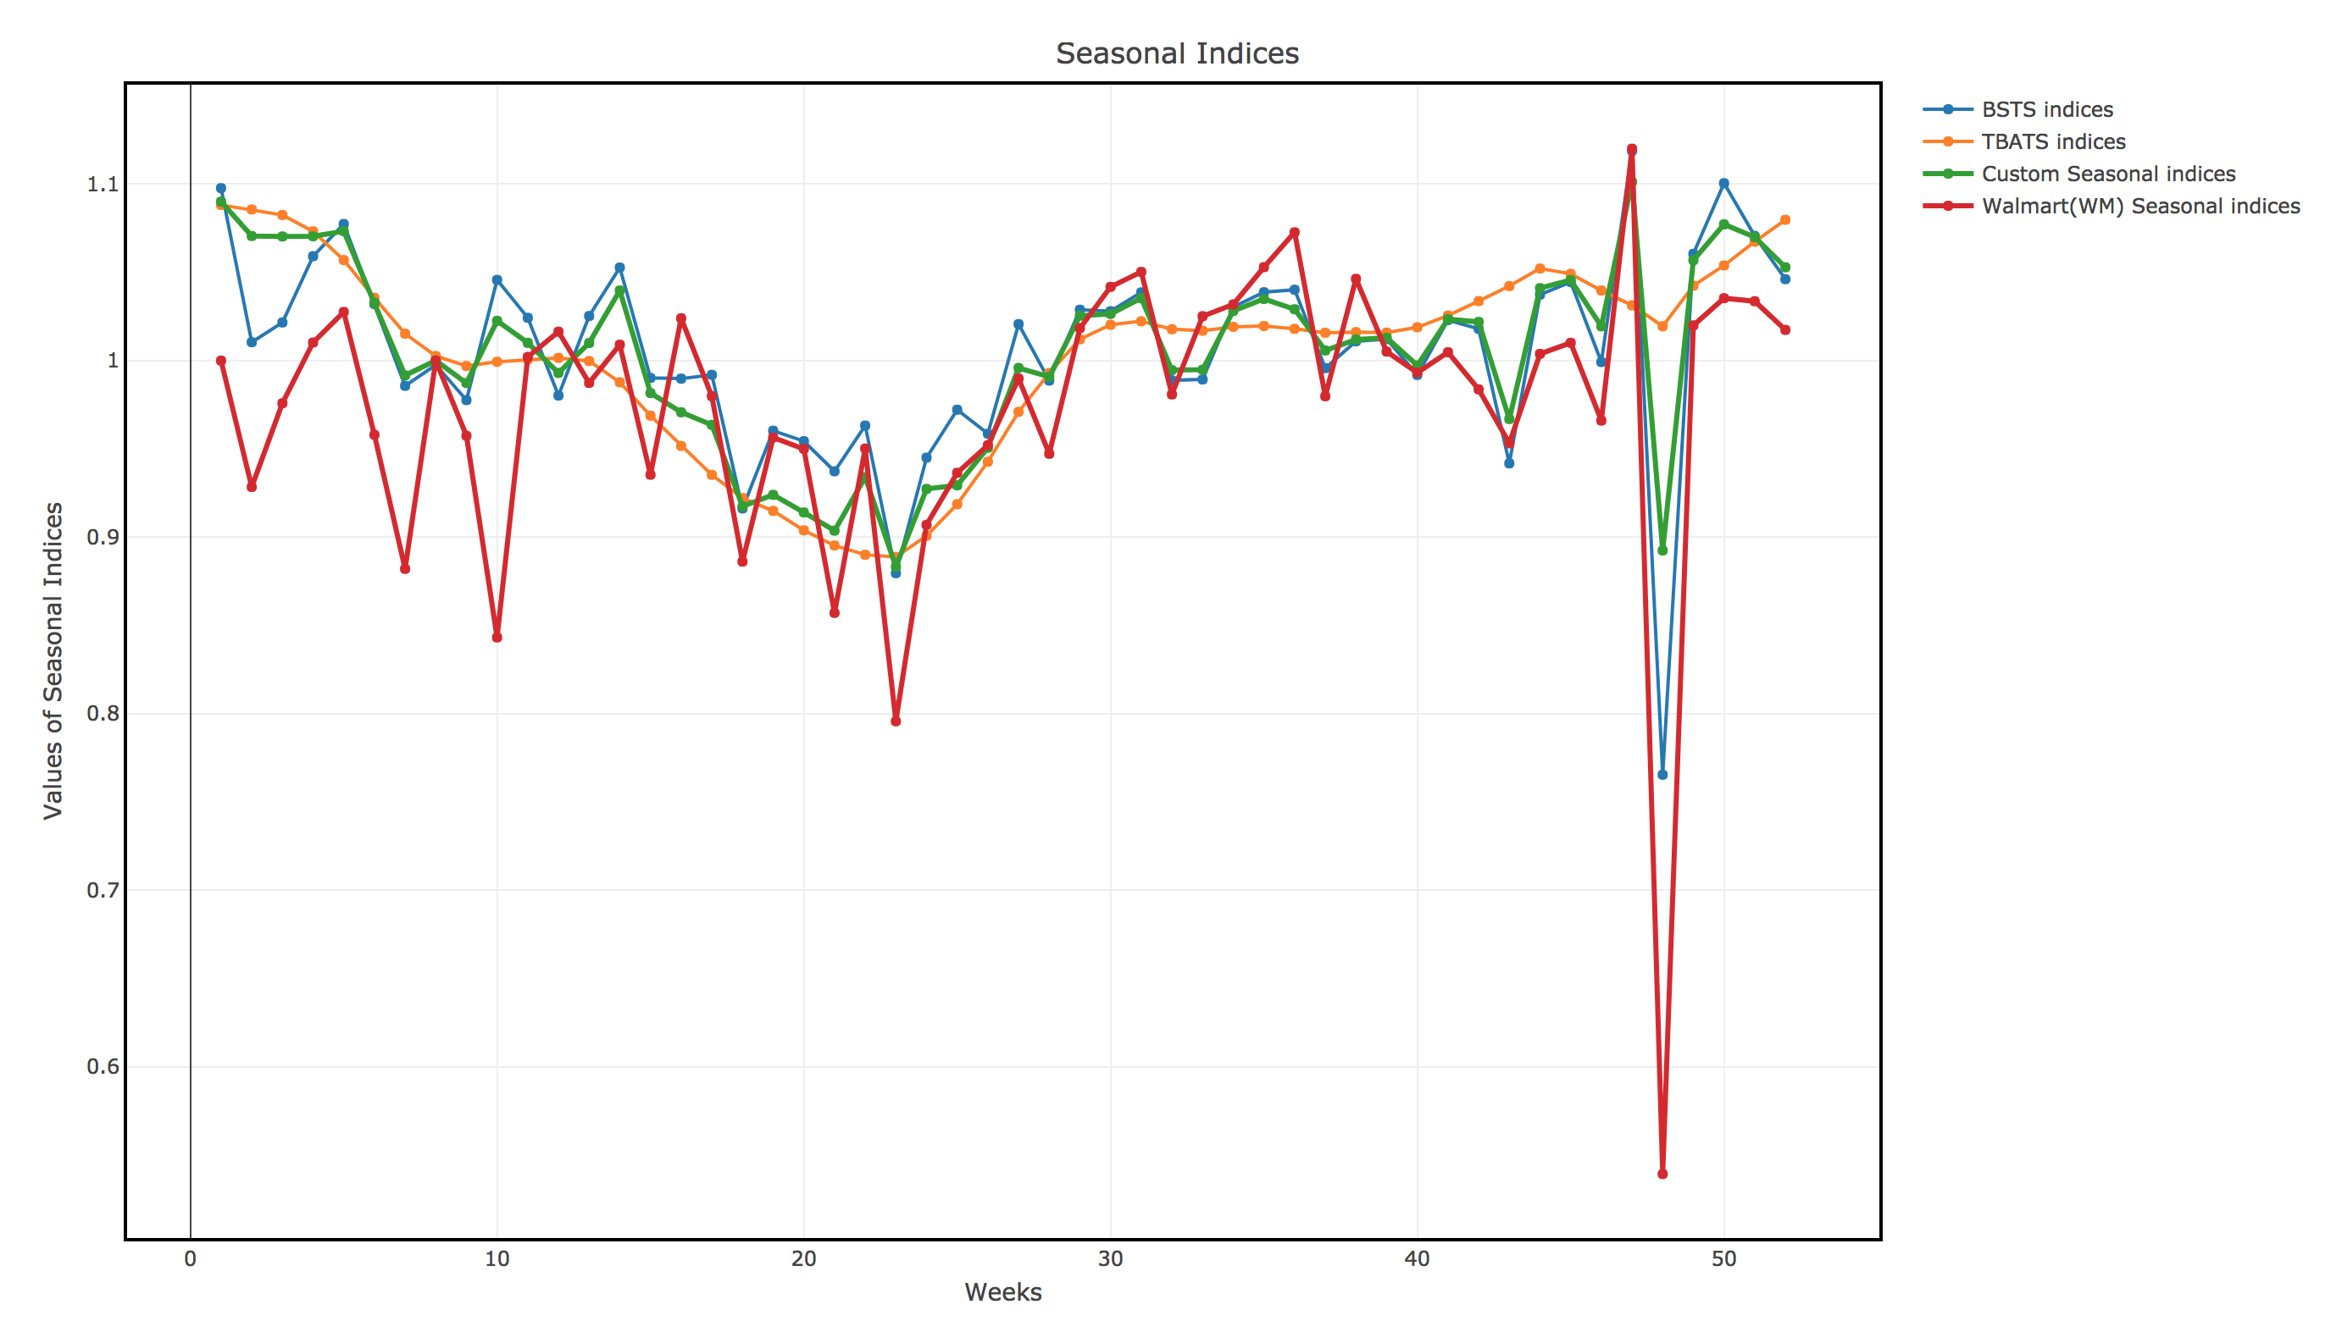
Phase 1: Seasonal Indices.
Technical Details:
100 mature stores chosen.
Seasonal Indices calculated via BSTS and TBATS.
BSTS fluctuates too much.
TBATS is too smooth.
Built an ensemble seasonal index - using weighted average, followed by smoothing.

Slide 7
Phase 1: Quarterly Forecasting analysis.
BSTS + WM
BSTS + Custom
BSTS + WM
BSTS + WM
TBATS + Custom
Q1
Q2
Q3
Q4
FY 18-19
FY 17 - 18
Old: 12.9%
New: 10.8%
Old: 19.5%
New: 15.4%
Old: 24.5%
Current: 19.0%
1022 stores
FY 17 -18
FY 17 - 18
585 stores
Old: 13.2%
New: 12.7%
536 stores
828 stores.
BSTS + WM
TBATS + Custom
BSTS + WM
BSTS + Custom

Slide 8
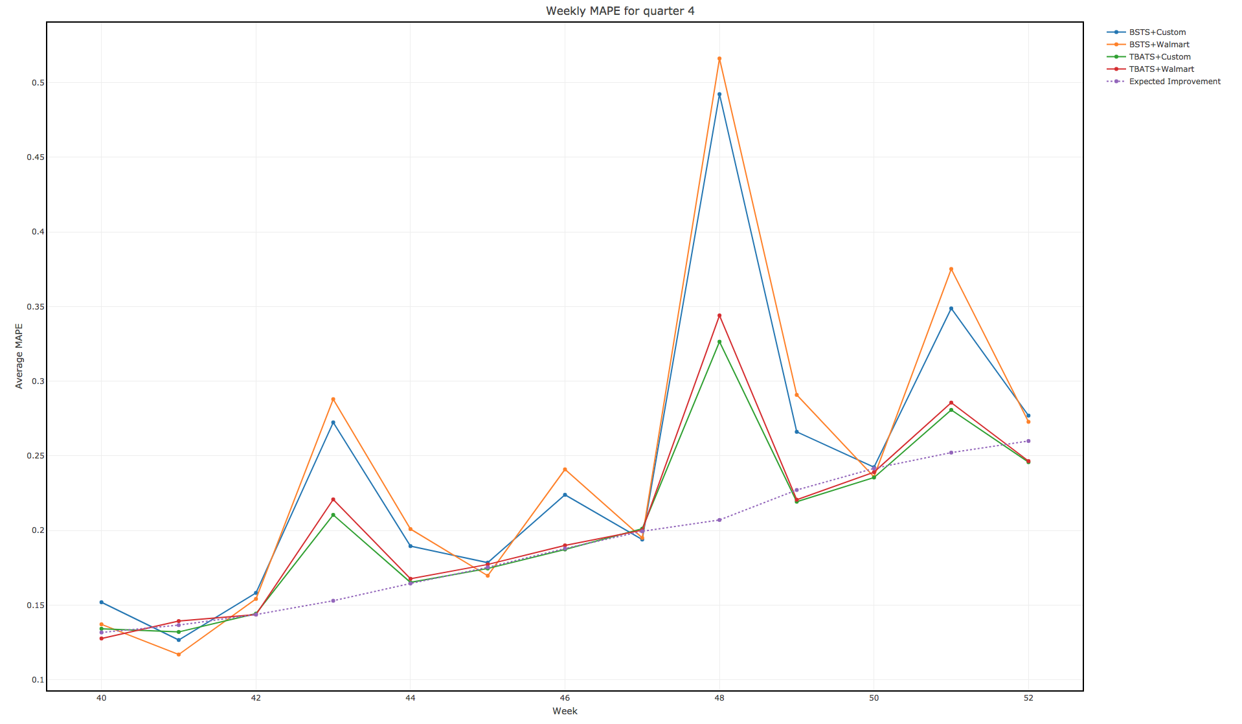
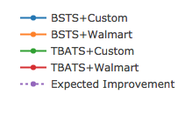
Phase 1: Case Study - Q4
Christmas
Thanksgiving

Slide 9
Phase 2
Driver Variables for classification found, Classification model built.

Slide 10
Phase 2: Forecast improvement during Easter, Thanksgiving and Christmas
Introduction
For each of these time points, a labelling done based on MAPE value of forecast of a store.
A store is GOOD if:
Easter: MAPE<=0.33; Good: 887, Bad: 139
Thanksgiving: MAPE<=0.32; Good: 626, Bad: 199
Christmas: MAPE<=0.82; Good: 742, Bad: 83
Driver variables found. (ANOVA)
Classification using training data. (Ensemble model)
Confusion matrix built to test accuracy on holdout sample (20% of whole dataset)
Procedure

Slide 11
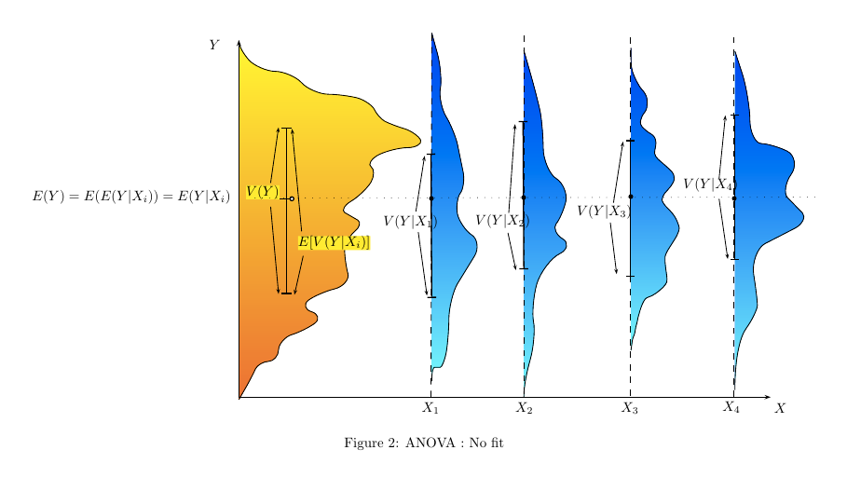
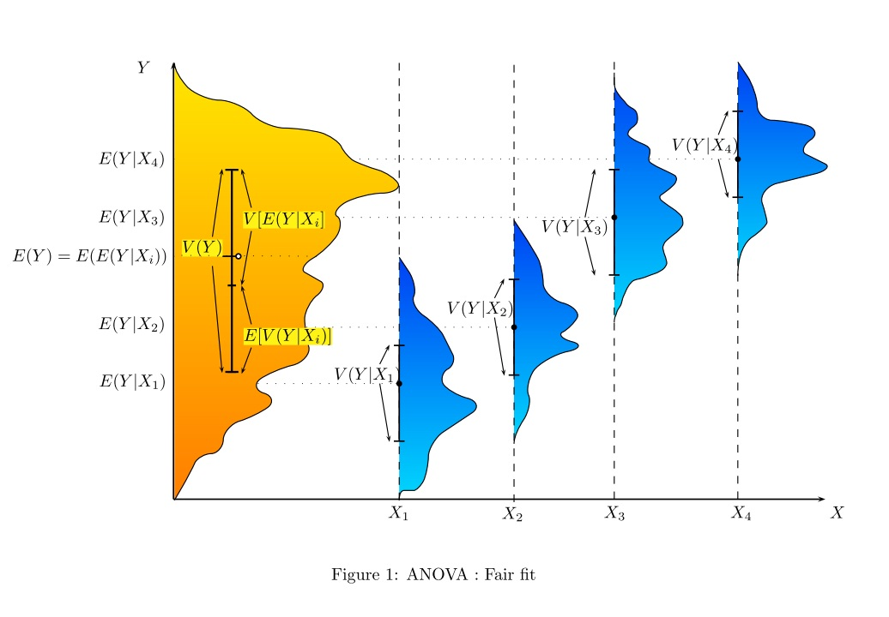
ANOVA
We want to leverage demographic information about a store to build a classification model – if it is Good/Bad.
ANOVA is used to analyze if differences among group means in a labelled variable is significant.
Example figure
Example figure

Slide 12
Ensemble Classification Model.
Age
Male
Female
Education
Minor
Young (18 - 45)
Old
Minor
Young (18-45)
Old
Low (No diploma)
High
Income
Low (<30K)
Medium (30K - 75K)
High
Occupation
Executive/Admin
Clerical
Others
Demographic Information
Medium (College)
Demographic Information
Ensemble Model
RF
CF
Good/Bad

Slide 13
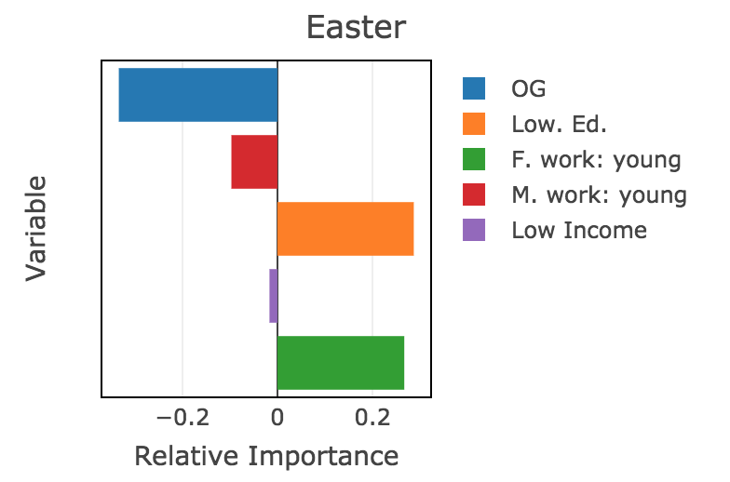
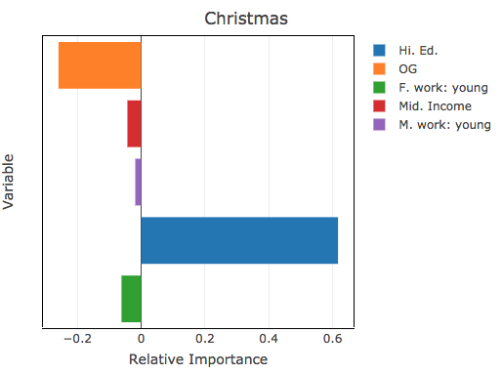
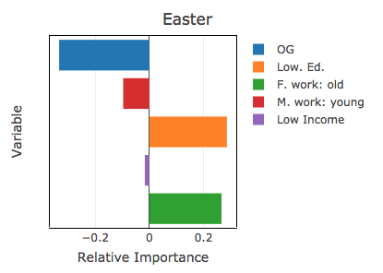
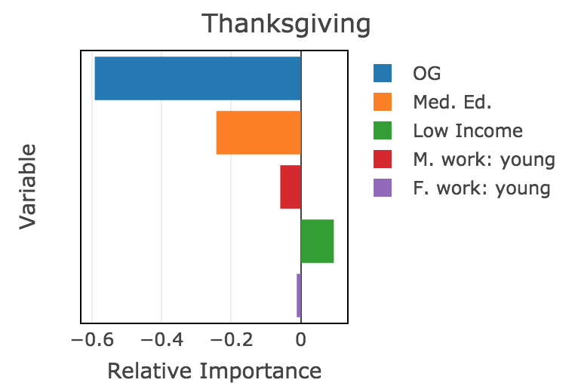
Relative Variable Importance (Magnitude & Direction)
 | G | B
G | 175 | 0
B | 0 | 29
 | G | B
G | 122 | 0
B | 2 | 40
 | G | B
G | 149 | 0
B | 0 | 15

Slide 14
Phase 3
Forecasts for Bad stores improved.

Slide 15
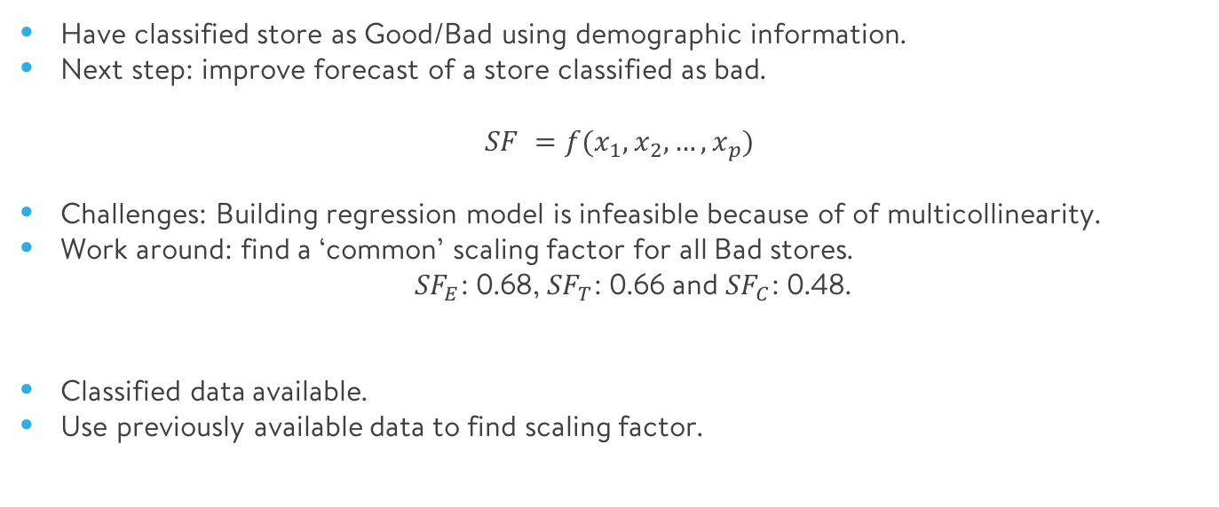
Phase 3: Details.
Introduction
Have classified store as Good/Bad using demographic information.
Next step: improve forecast of a store classified as bad.
$$SF =f(x_{1},x_{2},…,x_{p})$$
Challenges: Building regression model is infeasible because of of multicollinearity.
Work around: find a ‘common’ scaling factor for all Bad stores.
${SF}_{E}$: 0.68, ${SF}_{T}$: 0.66 and ${SF}_{C}$: 0.48.
Classified data available.
Use previously available data to find scaling factor.
Procedure

Slide 16
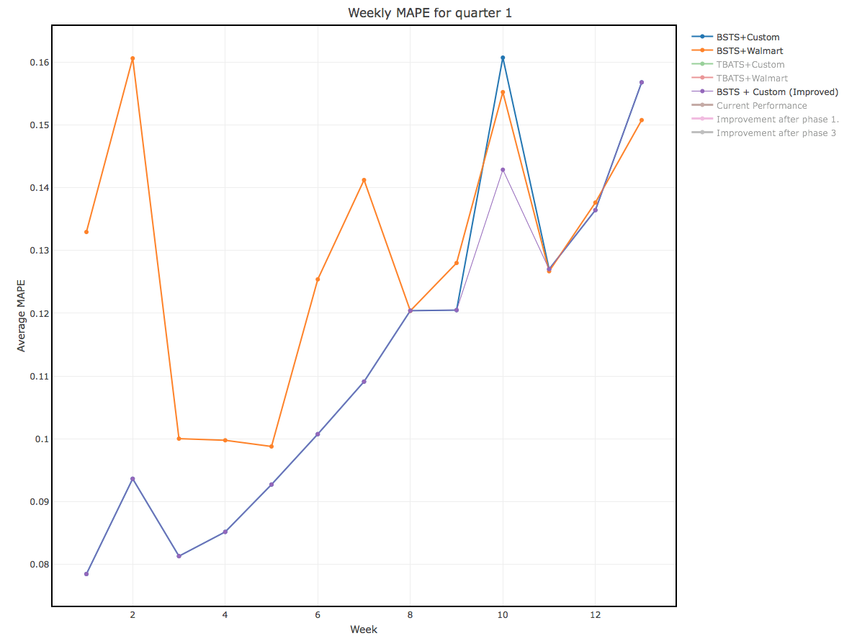
Phase 3: Results

Slide 17
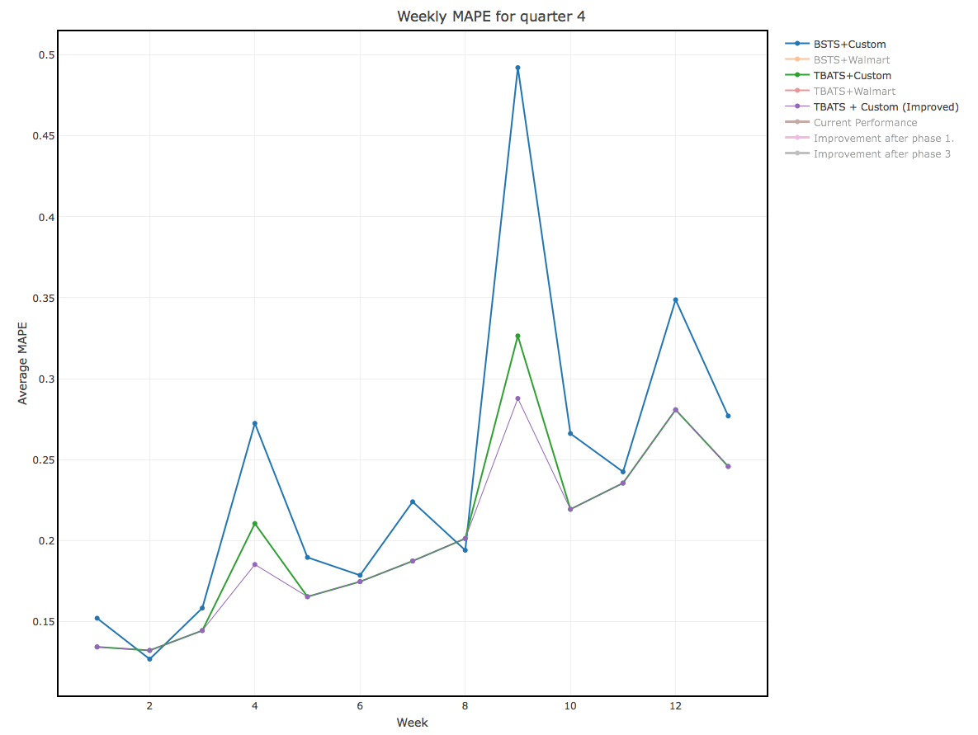
Phase 3: Results

Slide 18
Phase 4
Utility of Phase 4 studied.

Slide 19
Phase 4: judging marginal utility of Phase 3.
Results
Improvement in overall performance due to scaling:
Quarter 1: from 11.25%, MAPE drops to 11.09% [16 basis points]
Quarter 4: from 20.40%, MAPE drops to 19.90% [50 basis points]
Improvement in performance of forecasts of bad stores due to scaling:
Easter: 51.2%% to 29.2%
Thanksgiving: 52% to 35%.
Christmas: 110% to 58%.
We look at locations of bad stores.
We find that 80 stores are performing poorly for both Thanksgiving and Christmas – more study needed.

Slide 20
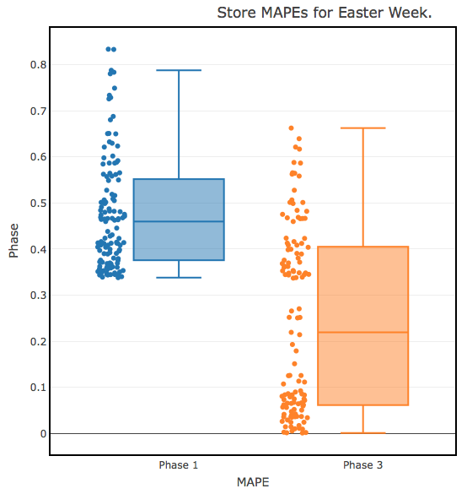
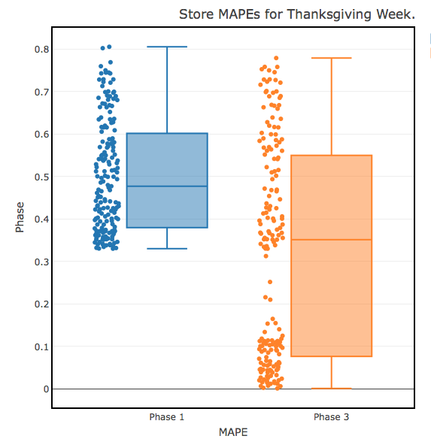
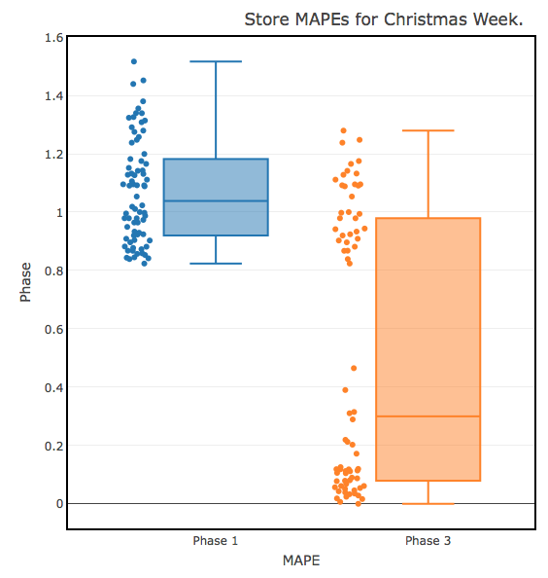
E: 51% 29%
T: 52% 35%
C: 110% 58%

Slide 21
Process | Steps
We use 100 ’mature’ stores to generate seasonal indices using BSTS/TBATS model.
Q1: Store/Week
Q2: Store/Week
Q3: Store/Week
Q4: Store/Week
01
Generate seasonal indices
Study of forecasting models
02
Driver variable importance on next slide.
Income: 3 groups: Low (<= 30k)/Mid (30k – 75k)/High (>75k)
Education has 3 groups: Low(< Diploma)/Mid(<=Bachelors)/High
Age has 3 groups: Minor/Young (18 - 45) /Old (>45)
Use ANOVA to find driver variables.
Use Random Forests + C.I. Forests to build classification model for 3 time points.
03
Behavior of bad stores studied.
Scaling factor found for each of the three critical time points.
Scaling Factor: Median of MAPE values of BAD stores.
Easter: 0.68;
Thanksgiving: 0.66
Christmas: 0.48
04
Still exploring this area. Some initial results discussed here.
Week Level View: Quarter 1 and Quarter 4.
Special Attention to Bad Stores:
Easter: 51% to 27%; graphical view
Thanksgiving: 53% to 34%; graphical view
Christmas: 112% to 55%; graphical view
See how the scaling is affecting behavior of BAD stores in particular, and overall model in general.

Slide 22
Process | Steps
Seasonal Indices found
Next Step?
BSTS
TBATS
Weighted average (Business input would be good)
Smoothing using Lowess.
85.1%
Bad Forecasts
85.3%
Driver variables found using ANOVA
Ensemble classification model:
CF + RF
Get more input on driver variables.
Look at behavioral commonalities for bad stores.
Include regression variables in BSTS/ARIMAX model.
Other Models
Scaling
Shift to
Q1, Q3: BSTS + C
Q2,Q4:TBATS + C
Scaling done using single factor for
Easter
Thanksgiving
Christmas
82%
85.1%
86-87%
15

Slide 23
Thanks!
More information in Appendix

