Slide 1
STREAMLINING AIR TRAVEL

Slide 2
TEAM
Aniruddh goudar
Hemant gaikwad
Bhavani devulapalli
Laxmi deeksha vempati
Harika pUrma
GROUP 12

Slide 3

The project's purpose is to make flight reservations easier for the user by providing them with customization to enhance their experience.
Flight booking systems can be integrated with other travel services such as hotels, car rentals so that the users need not move to other platforms, and they can plan everything in a single place.
This system also helps the users in finding real-time information about the flight schedules, availability and prices.
PURPOSE

Slide 4
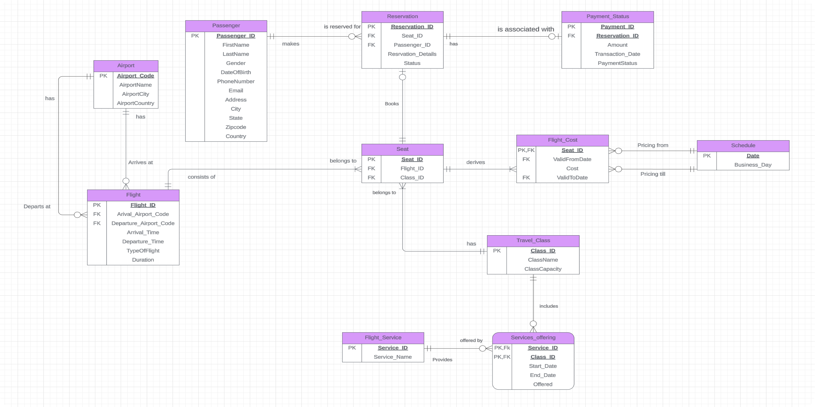
Entity Relationship Diagram(ERD)

Slide 5
The database contains
12 tables, 3 views, 12 Table level checks,
1 computed column based on user defined function,
3 non-clustered indexes, 10 stored procedures,
4 user defined functions, 5 DML triggers,
2 column data encryption
Database Schema

Slide 6
Business Logic flow
Stored procedures Flight_Availability, GetFlightDetailsByLocation, UpdateFlightDetails, BookFlightForPassenger, GetFlightDetailsForPassenger, PassengerCRUD, UpdatePayment, CancelReservation, ConfirmReservation and CalculateTotalrevenue perform various tasks related to managing a flight booking system
1
Triggers InsertSeatsOnFlightInsert , Insert_Payment , Set_Cost and FlightUpdateLog automate various tasks such as seat insertion, payment status calculation, cost setting, change logging, and reservation status updating, enhancing the functionality and efficiency of the flight booking system.
2
Views SerivceDepedingOnClass , ServiceAndClass and ServiceOfferingToClasses offer insights into service offerings and their associations with different travel classes, providing valuable information for analyzing and managing service allocation based on class specifications in the flight booking system.
3

Slide 7
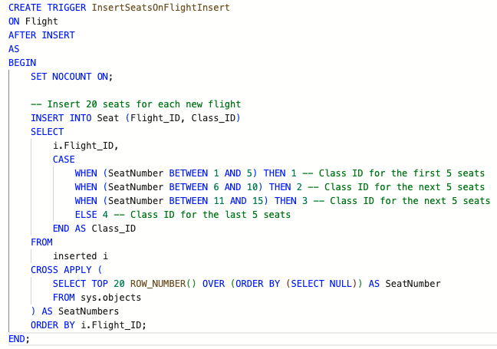
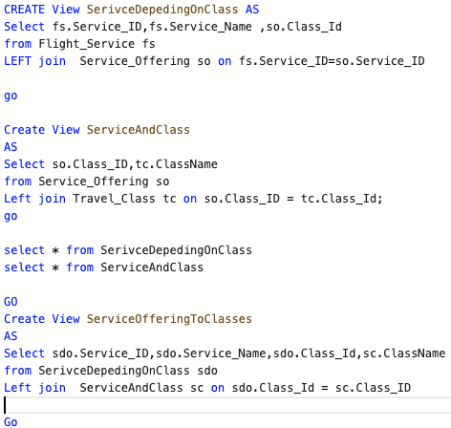
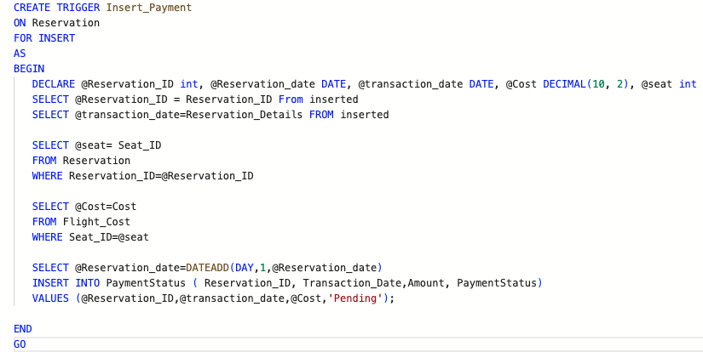
Triggers ,Views, Encryption

Slide 8
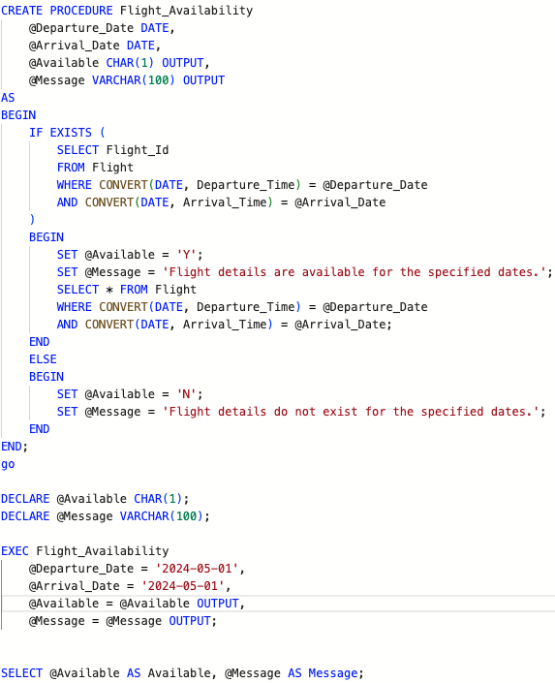
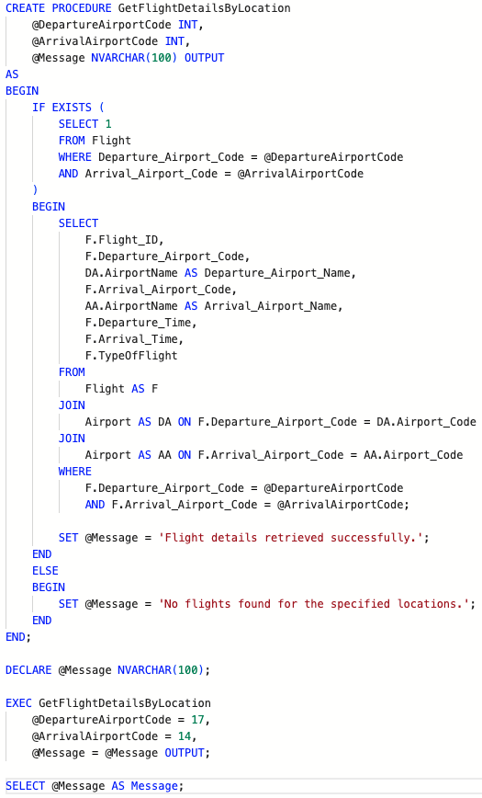
Stored Procedures

Slide 9
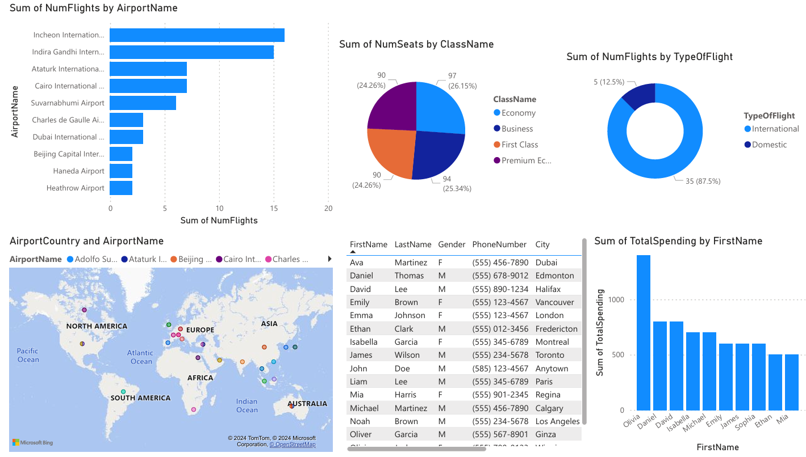
POWER BI REPORT

Slide 10
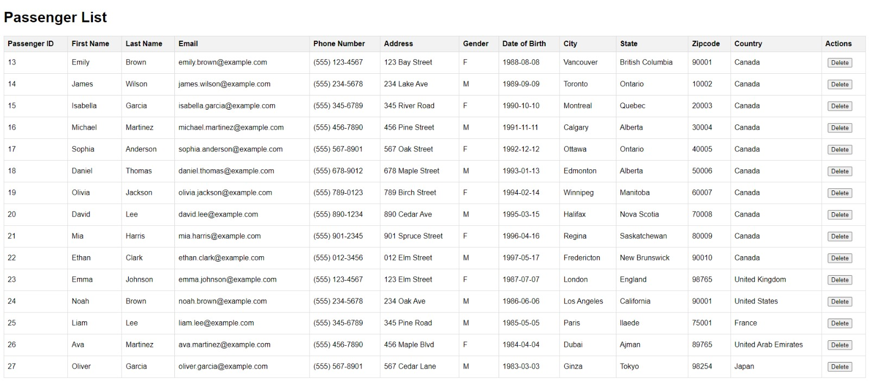
GUI

Slide 11

Conclusion
The project aims to design a comprehensive database for a flight booking system. It addresses the complex procedure of flight reservations in today's society and sets clear objectives for the database design:
Keeping track of and securely storing booking records.
Ensuring easy retrieval of booking information.
Preventing data loss and maintaining data integrity.
Minimizing data entry errors.
Restricting access to authorized users.
Reducing duplication through a centralized database.
Streamlining paperwork.

