Slide 1

Portfolio
Name: P.Purna Gayathri
Organization: Micro IT
Topic: Portfolio

Slide 2
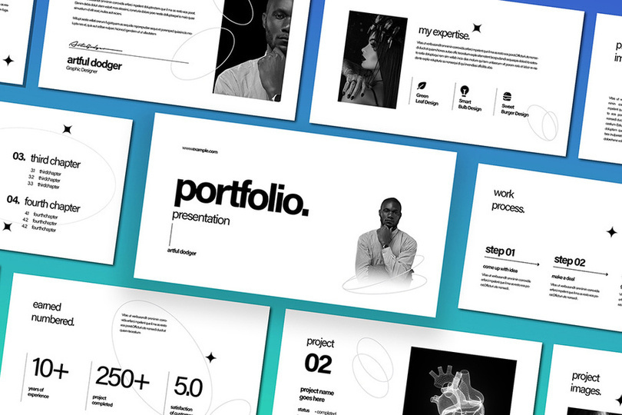
Introduction
This project guides you in understanding how types of portfolios are divided,created, managed, and optimized to fulfill financial aspirations.

Slide 3

Overview
What is Portfolio
Types of Portfolio
How to create a Portfolio
Uses of Portfolio
Tools used in Portfolio Management
Portfolio Templates
Conclusion

Slide 4

What is Portfolio
Portfolio is a visual representation of one's professional journey, highlighting expertise, creativity, and accomplishments through carefully selected projects and experiences.

Slide 5
Types of Portfolio
There are several types of Portfolio ,5 Main types are:
1.Investment Portfolio
2.Project Portfolio
3.Professional Portfolio 4.Student Portfolio 5.Digital Portfolio
These portfolios serve different purposes and are used in various contexts, such as finance, project management, education, and career development.

Slide 6
Types of Portfolio
1.Investment Portfolio: Financial assets management
2. Project Portfolio: Managing multiple projects strategically
3.Professional Portfolio: Showcasing work experience and skills
4. Student Portfolio: Tracking academic progress and achievements
5.Digital Portfolio: Online showcase of work, projects, and achievements

Slide 7
How to create a Portfolio
To create your Portfolio, follow these steps:
*About Me:
Briefly introduce yourself, your career goals, and why you choose to study B.Tech.
*Education:
Include your degree, major, GPA, relevant coursework, and any honors or awards.

Slide 8
How to create a Portfolio
*Skills:
List your technical skills (programming languages, software, etc.), and any soft skills relevant to your field
*Projects:
Showcase your individual or group projects, including the problem you addressed, your role, and the outcome.
*Experience:
Highlight any internships, research experiences, or volunteer work that demonstrates your skills and experience.

Slide 9
How to create a Portfolio
*Awards/Recognition:
Mention any academic awards, competitions, or certifications you have earned.

Slide 10
Uses of Portfolio
A Portfolio provides a organized way to present work, achievements, and progress.
Portfolios serve multiple purposes, including career advancement, investment management, academic assessment, professional development, marketing, personal branding, and project management. They provide a comprehensive way to showcase skills, experience, achievements, and progress, helping individuals and organizations achieve their goals and objectives.

Slide 11

Tools used in Portfolio Management
Some popular portfolio management tools include:
1. Morningstar Direct
2. FactSet
3. Bloomberg Terminal
4. Excel
5. RiskMetrics
6. Aladdin by BlackRock
7. MSCI Barra
8. Smartsheet
9. Kantata
10. Celoxis
These tools help with investment tracking, risk management, financial modeling, and project management.

Slide 12
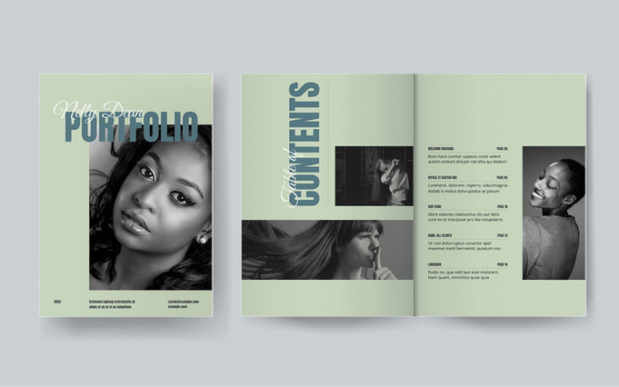

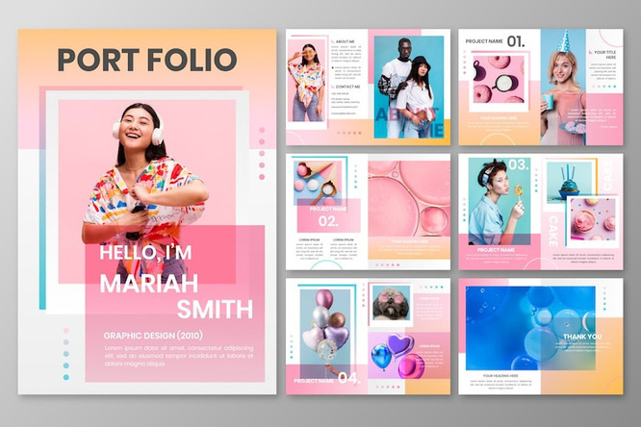


Portfolio Templates

Slide 13
Conclusion
This project heavily relied on my skills and contributions, allowing me to showcase my expertise and make a significant impact.The project's outcome was largely influenced by my involvement, demonstrating my value and capabilities.

Slide 14
Thank you

