Slide 1
TNS DATA SCIENCE CAPSTONE PROJECT
Manufacturing Equipment Output Prediction Using Linear Regression
A data-driven project focused on predicting hourly machine production output using operating conditions, material properties, and environmental parameters.
Problem
Data & Analysis
Model & Deployment
Define the manufacturing challenge and prediction goal.
Explore the dataset, understand key variables, and identify patterns.
Build a linear regression model and package it for use with FastAPI and Docker.
Key Technologies: Python · Pandas · NumPy · Scikit-learn · FastAPI · Docker

Slide 2


LIBRARIES AND TOOLS USED
Libraries and Tools Used for Modeling and Deployment
We selected a practical stack for data preparation, modeling, visualization, and deployment — balancing performance, ease of use, and production readiness.
Python Libraries
Deployment Tools
Pandas
NumPy
FastAPI
Docker
Best for structured data cleaning and feature engineering. Compared with lower-level tools, it offers faster analysis, readable syntax, and seamless handling of tabular manufacturing data.
Efficient numerical computing for arrays and vectorized operations. It outperforms plain Python loops for speed and is the foundation for many scientific libraries.
Used to expose the model as a fast prediction API. It is more modern and performant than traditional frameworks for building lightweight, typed, and well-documented services.
Packages the app and dependencies into a consistent container. It reduces environment issues compared with manual setup and makes deployment portable across systems.
Scikit-learn
Matplotlib
Reliable machine learning workflows with a consistent API. It is easier to use than many custom ML frameworks for classical regression, preprocessing, and evaluation.
Flexible, publication-ready plotting with full control over charts. It is more customizable than many high-level libraries when precise figure formatting is needed.
Seaborn
Statistical visualizations with cleaner defaults than Matplotlib alone. It makes it easier to spot trends, correlations, and distributions in exploratory analysis.

Slide 3
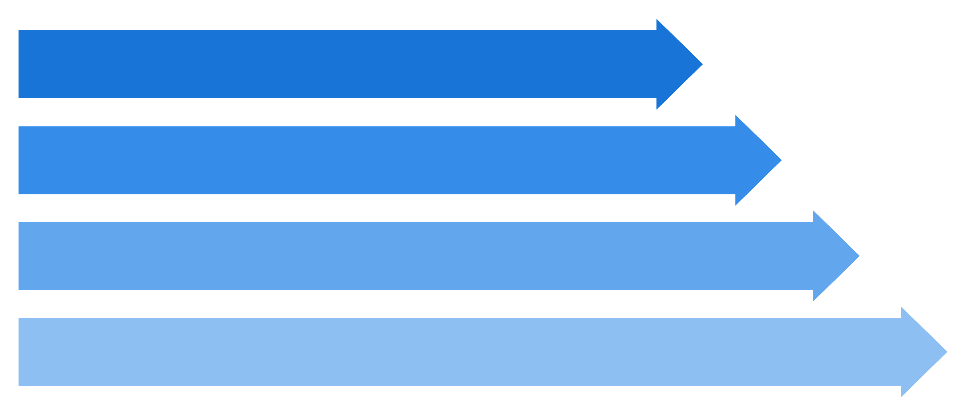
PROJECT STEPS & METHODOLOGY
Project Methodology & Workflow
Data Collection
Exploratory Analysis
Preprocessing & Features
Train, Eval & Deploy
This project follows a structured end-to-end workflow, moving from raw data preparation through model building and validation to final deployment.

Slide 4
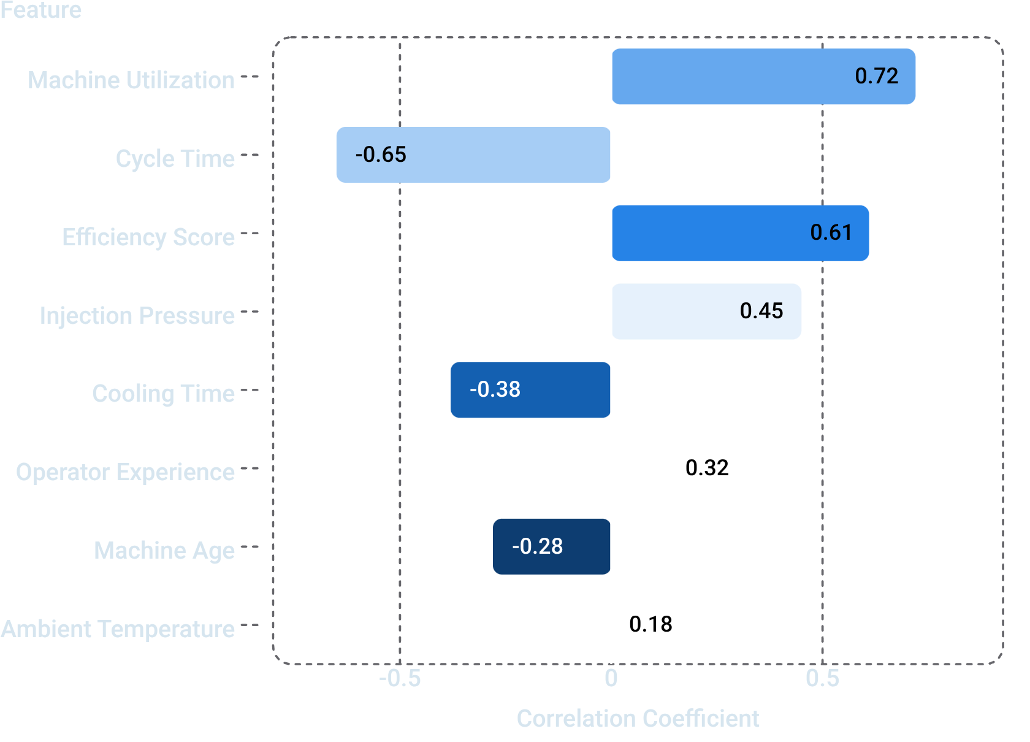
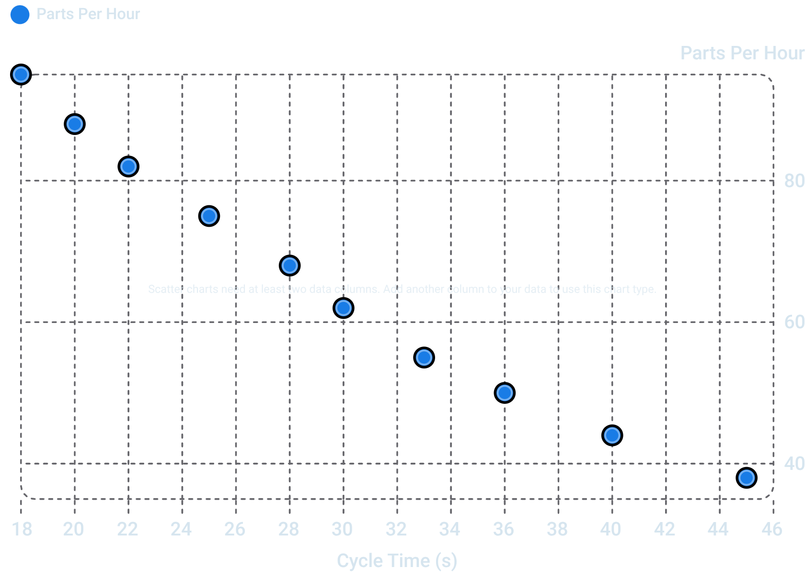
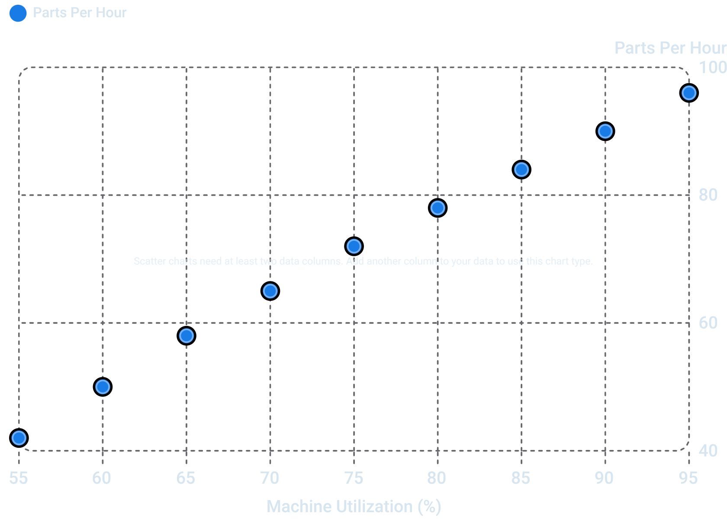

EXPLORATORY DATA ANALYSIS
Feature Analysis & Correlation Insights
Feature Correlation with Parts Per Hour
Cycle Time vs. Parts Per Hour
Machine Utilization vs. Parts Per Hour
What We Understood from the Charts
Key Correlations Discovered
Feature-to-Output Relationships
Feature Selection & Model Building Insights
Machine Utilization shows the strongest positive relationship with Parts Per Hour, while Cycle Time has the strongest negative relationship. Efficiency Score and Injection Pressure also appear meaningfully associated with higher output.
The scatter plots confirm a clear downward trend for Cycle Time as output decreases, and an upward trend for Machine Utilization as output increases. These patterns suggest output is more sensitive to operational efficiency than to slower environmental or age-related factors.
These findings guided us to prioritize utilization, cycle timing, and efficiency-related variables in feature selection, while treating weaker correlations as supporting signals. This helped shape the model around the variables most likely to improve predictive performance.

Slide 5
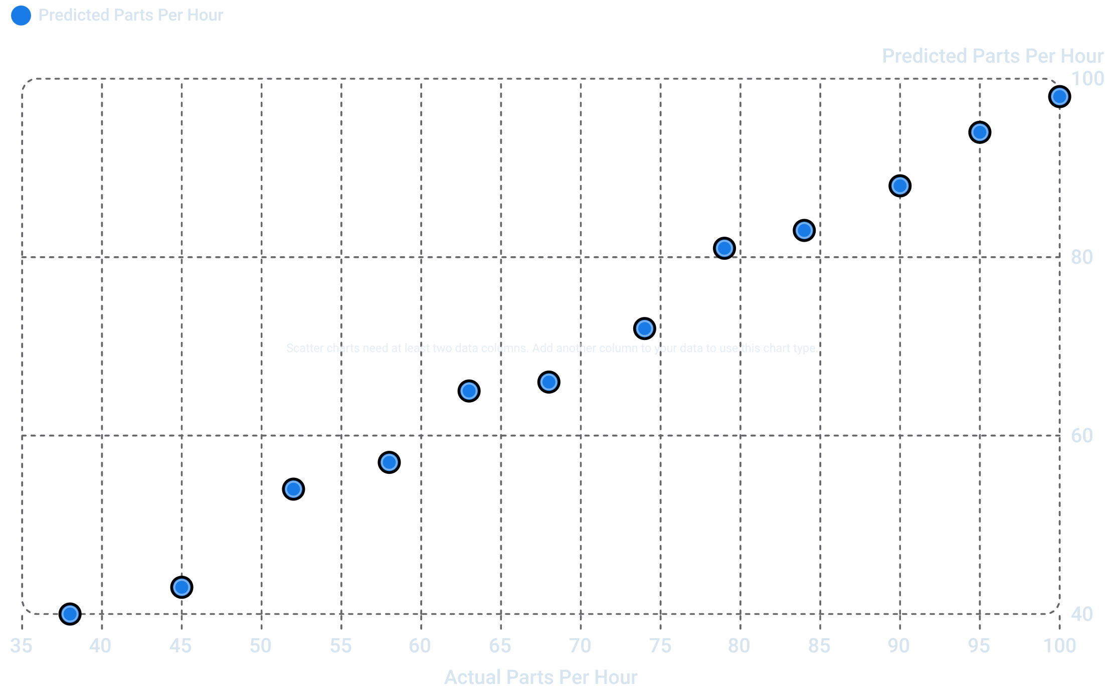
MODEL RESULTS
Linear Regression Model & Performance Metrics
Model Summary
Actual vs. Predicted Parts Per Hour
Linear Regression trained on 800 samples, evaluated on 200 held-out test samples. Input features include machine, material, environmental, and operational parameters.
Evaluation Metrics
Metric | Value
Mean Absolute Error (MAE) | [Actual Value]
Mean Squared Error (MSE) | [Actual Value]
Root Mean Squared Error (RMSE) | [Actual Value]
R² Score | [Actual Value]
Replace all bracketed placeholders with values from your model's test-set evaluation output.
Points clustering tightly along the diagonal (Actual = Predicted) indicate strong model fit. Deviations from the diagonal represent prediction error. Replace chart with actual test-set output values before final submission.
Interpretation
R² Score
MAE and RMSE
Scatter Plot Fit
The R² score shows how much of the variation in parts per hour is explained by the model. A value closer to 1 means the model explains more of the outcome, while a value near 0 means limited explanatory power.
MAE shows the average size of prediction errors in parts per hour, while RMSE penalizes larger errors more heavily. Lower values for both indicate better prediction accuracy.
If the points cluster tightly around the diagonal, the model is performing well with small residuals. Wider scatter around the line would indicate weaker predictions and higher error.

Slide 6

DEPLOYMENT & CONCLUSION
Deployment Architecture, Business Impact & Future Scope
Deployment Architecture
Business Impact
Production Planning — Forecast output to optimize scheduling
Machine Monitoring — Detect low-output conditions early
Data-Driven Decisions — Replace guesswork with model predictions
User Input
Future Scope
Advanced Models — Random Forest / XGBoost for improved accuracy
Real-Time IoT Integration — Stream live machine sensor data into predictions
Monitoring Dashboard — Visual production monitoring and alerting interface
Machine params via form or API
Predicted Parts Per Hour
Dockerized Deployment Pipeline
FastAPI Endpoint
JSON response returned to client
Receives and validates REST input
Linear Regression Model
Preprocessing Module
Trained model generates prediction
Encoding and scaling features
FastAPI serves predictions via a REST endpoint. The entire service — API, preprocessing, and model — is containerized using Docker for reproducible, platform-independent deployment.
Thank You — Questions Welcome
TNS Data Science Capstone Project · Manufacturing Equipment Output Prediction Using Linear Regression

