Slide 1
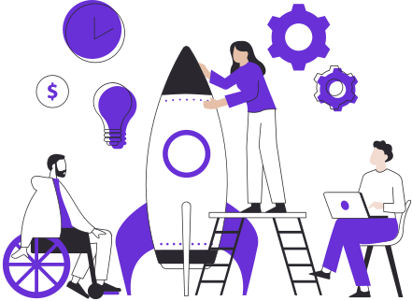
Brand Up.
Build your brand with most tailored and masters of businesses.
GET STARTED

Slide 2




Marketing
We do marketing for you and make people visit your website.
Lead generation
These services will lead people to remember your brand and visit and recommend to others.
We build funnels for the constant repeating people to your website.
Branding
We brand the website and products with most unique and consious way.

Slide 3
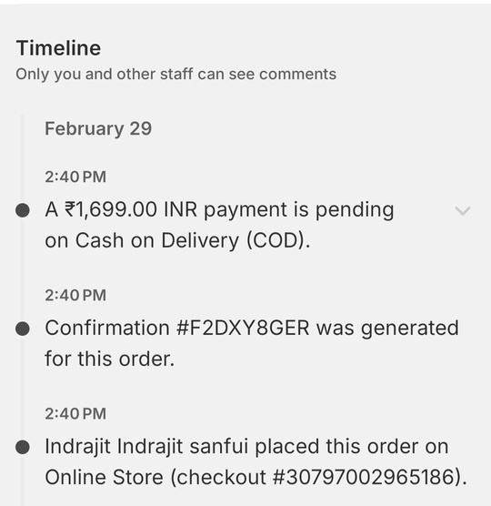


Real time Results
Achieved real time leads for a website
Got upto 25 recurring customers
Handed over profit upto 5000rs in 2weeks
The profit is exclusion of marketing and other maintenance charges. So getting 5000rs profit is a big one which is not even saturated in market
50 leads
we rendered a brand got them 50 leads for their online brand
Payout and order proof

Slide 4
SAAS
Buy white labeled software and sell it with your branding.
GET STARTED

Slide 5





Who are the users?
Early birds who are interested in getting the recurrent income and stable in wealth and people trying to enter into market.

Slide 6






API and templates
Branded
We avail people to integrate whatever feature they needed.
Pre build templates
Easy plugins

Slide 7


No-Code website deveopment
This feature helps to the people those who are interested in building the website for their personal use with no programming knowledge.

Slide 8

Thank you.
D.Purnachand

