Slide 1
Graph Representations
Graphs, fundamental data structures, depict relationships and connections within data. Understanding graph representations enables efficient processing, analysis, and optimization of complex networks.

Slide 2
Adjacency Matrix
Definition
Characteristics
Applications
The adjacency matrix is a square matrix where each cell represents a connection between vertices. A value of 1 signifies an edge, while 0 indicates no connection.
For undirected graphs, the matrix is symmetric, reflecting reciprocal connections. For directed graphs, asymmetry exists, indicating one-way relationships.
Adjacency matrices are well-suited for dense graphs where edge existence checks are frequent, such as in network flow algorithms and graph traversal techniques.

Slide 3
Let G = (V, E) be a graph with n vertices, n>= 1. The adjacency matrix of G is a two- dimensional n x n array, say adj-mat. If the edge (Vi, Vj) (<Vi,Vj>for a digraph) is in E(G), adj-mat[ill = 1. If there is no such edge in E(G), adj~mat[i]U] = 0. The adjacency matrices for graphs Gi, G3, and G4 are shown in Figure. The adjacency matrix for an undirected graph is symmetric since the edge (Vi, V,) is in E(G) iff the edge (vi, Vj) is also in E(G). In contrast, the adjacency matrix for a digraph need not be symmetric. (This is true of G3.) ) For undirected graphs, we can save space by storing only the upper or lower triangle of the matrix.

Slide 5
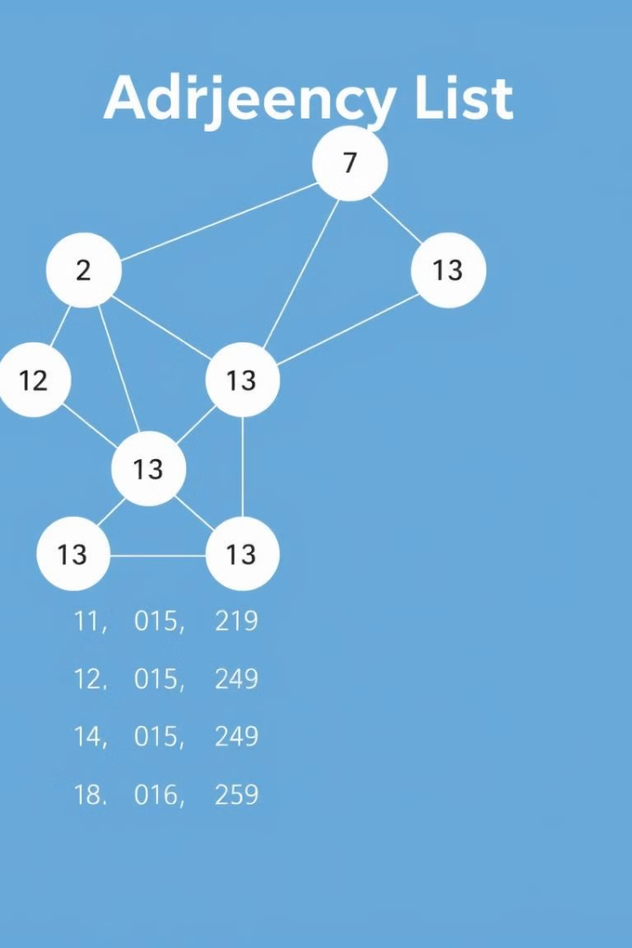
Adjacency List
1
Definition
2
Characteristics
The adjacency list representation stores each vertex's connections in a list of adjacent vertices, offering space efficiency for sparse graphs.
Adjacency lists enable quick retrieval of all adjacent vertices of a node, ideal for operations like finding connected components or shortest paths.
3
Applications
Widely used in breadth-first search (BFS), depth-first search (DFS), and pathfinding algorithms, adjacency lists excel in tasks requiring neighbor exploration.

Slide 6
Adjacency Multilist
Definition
Characteristics
Applications
The adjacency multilist structure optimizes undirected graphs by representing each edge only once, shared by the two vertices it connects.
This representation avoids redundant edge storage, offering flexibility for dynamic operations like edge insertions and deletions.
Ideal for dynamic graphs and bidirectional traversals, adjacency multilists are prevalent in collaborative systems and networks requiring real-time updates.

Slide 7
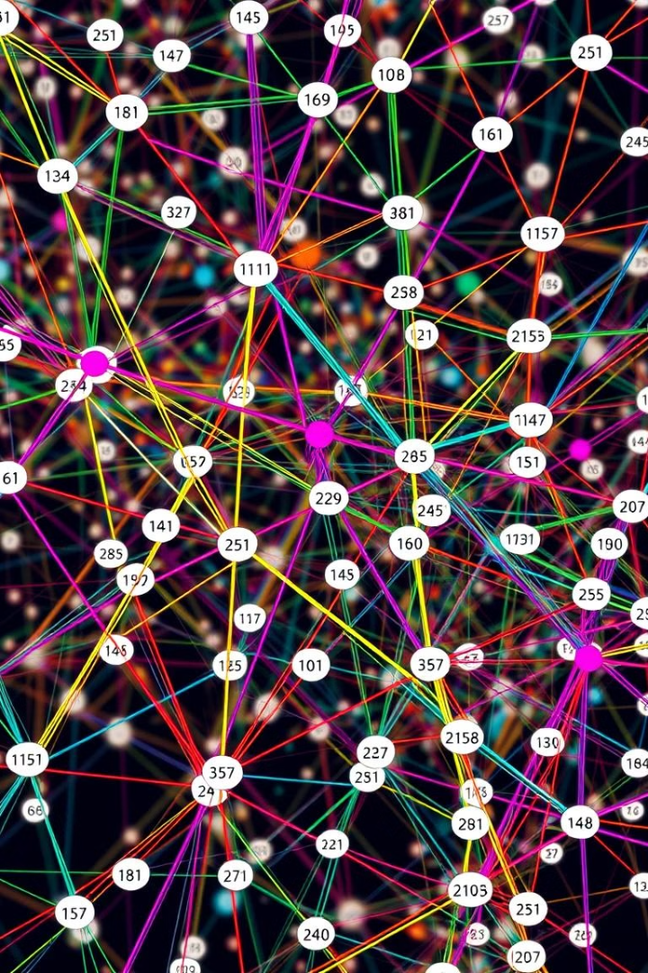
Weighted Graphs
1
Definition
Weighted graphs enhance the representation of connections by assigning numerical weights to edges, reflecting aspects like distance, cost, or capacity.
2
Applications
Essential in various algorithms, weighted graphs underpin shortest path calculations using Dijkstra's algorithm and minimum spanning tree computations.
3
Real-World Use
Weighted graphs find applications in transportation and logistics networks, modeling road networks, optimizing routes, and managing resource allocation.

Slide 8
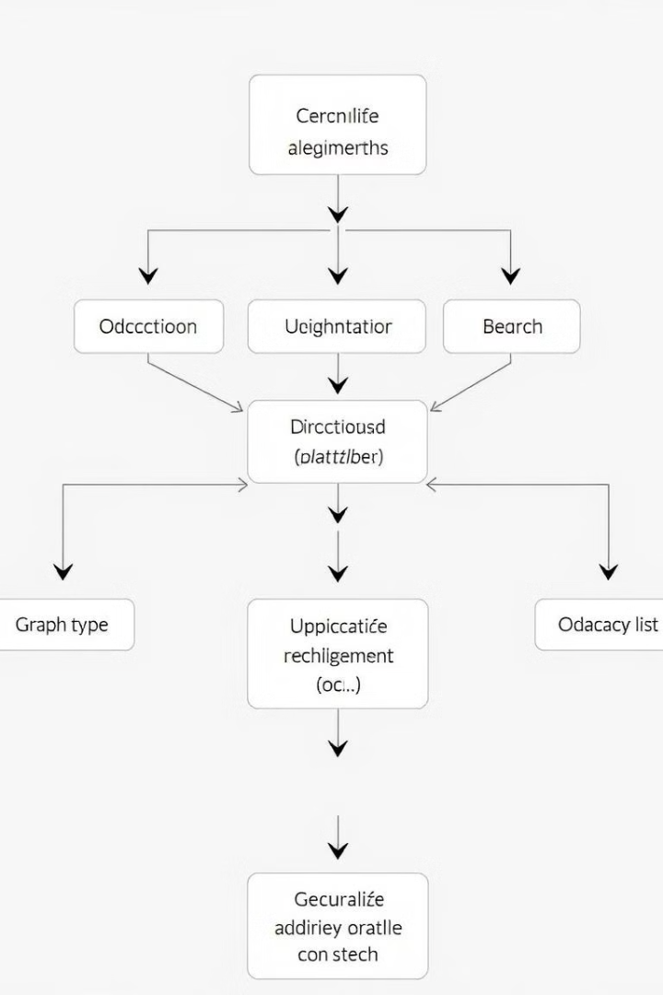
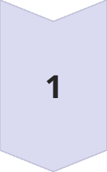
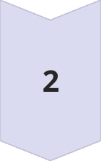
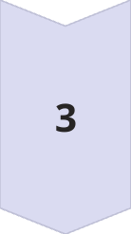
Choosing the Right Representation
Graph Type
Determine whether the graph is directed or undirected, dense or sparse, and weighted or unweighted.
Operations
Identify the primary operations required, such as edge existence checks, neighbor retrieval, or edge insertions and deletions.
Performance
Consider the space and time complexities associated with each representation, selecting the most efficient option for the given application.

Slide 9
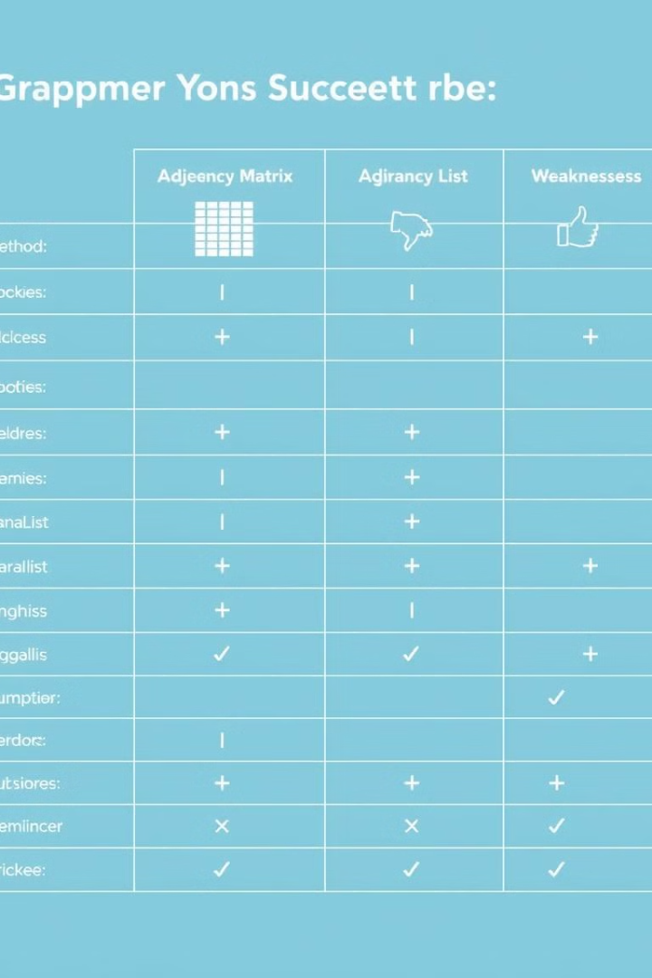
Advantages and Disadvantages
Representation
Advantages
Disadvantages
Adjacency Matrix
Simple to implement, efficient for dense graphs
High space consumption for sparse graphs, inefficient for neighbor retrieval
Adjacency List
Space-efficient for sparse graphs, efficient for neighbor retrieval
Less intuitive than matrix, potentially slower for dense graphs
Adjacency Multilist
Space-efficient for undirected graphs, flexible for dynamic operations
Potentially more complex to implement, less efficient for directed graphs

Slide 10
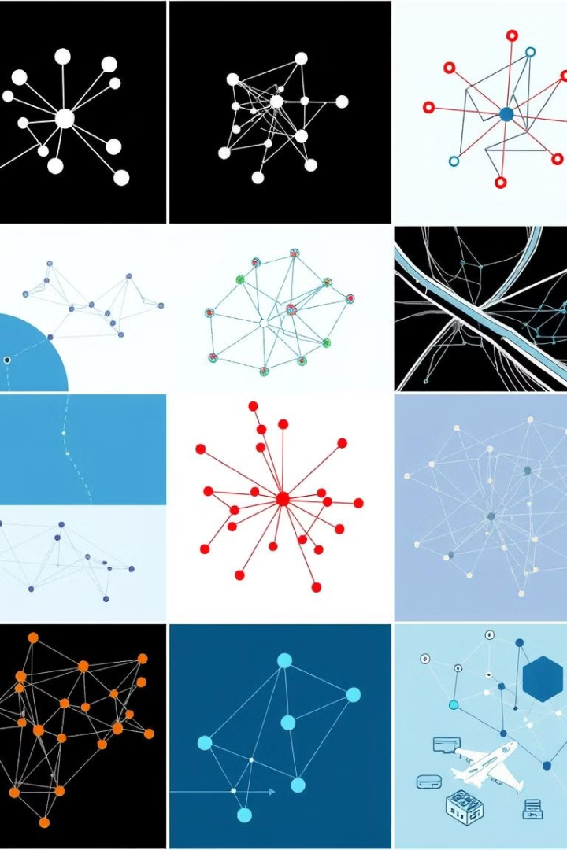




Real-World Applications
Social Networks
Transportation Networks
Analyze user connections, recommend friends, and understand network structures.
Optimize routes, manage traffic flow, and analyze transportation patterns.
Computer Networks
Machine Learning
Route data packets, manage network resources, and ensure efficient communication.
Model complex relationships, analyze data patterns, and build predictive models.

