Slide 1
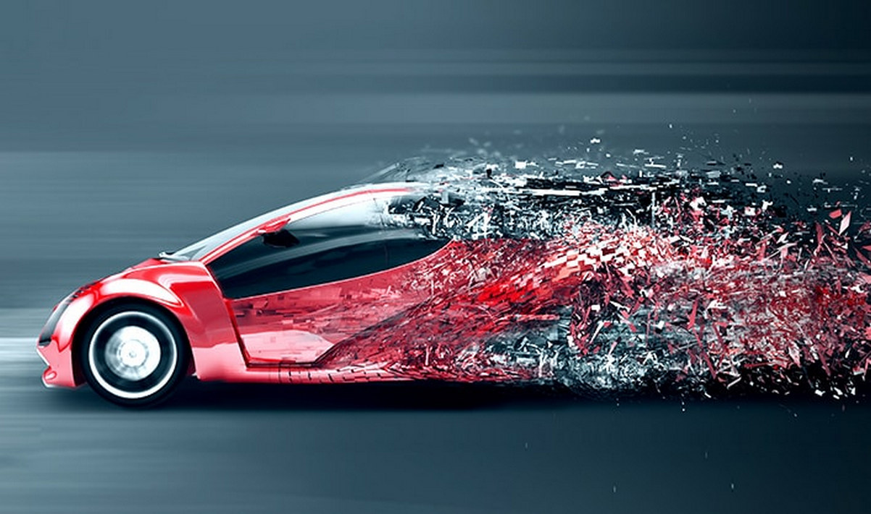
Exploratory Data Analysis - Automobile
Prepared By: Purnananda Behera
EDA: Automobile Dataset

Slide 2
About the Data
Contents: Insurance risk rating, normalized losses, engine, body style, mileage, price for each car model.
Source: https://archive.ics.uci.edu/ml/datasets/automobile
Data Volume: 205 records, 26 columns
Attribute Information:
1. symboling: -3, -2, -1, 0, 1, 2, 3.
2. normalized-losses: continuous from 65 to 256.
3. make: alfa-romero, audi, bmw, chevrolet, dodge, honda, isuzu, jaguar, mazda, mercedes-benz, mercury, mitsubishi, nissan, peugot, plymouth, porsche, renault, saab, subaru, toyota, volkswagen, volvo
4. fuel-type: diesel, gas.
5. aspiration: std, turbo.
6. num-of-doors: four, two.
7. body-style: hardtop, wagon, sedan, hatchback, convertible.
8. drive-wheels: 4wd, fwd, rwd.
9. engine-location: front, rear.
10. wheel-base: continuous from 86.6 120.9.
11. length: continuous from 141.1 to 208.1.
12. width: continuous from 60.3 to 72.3.
13. height: continuous from 47.8 to 59.8.
14. curb-weight: continuous from 1488 to 4066.
15. engine-type: dohc, dohcv, l, ohc, ohcf, ohcv, rotor.
16. num-of-cylinders: eight, five, four, six, three, twelve, two.
17. engine-size: continuous from 61 to 326.
18. fuel-system: 1bbl, 2bbl, 4bbl, idi, mfi, mpfi, spdi, spfi.
19. bore: continuous from 2.54 to 3.94.
20. stroke: continuous from 2.07 to 4.17.
21. compression-ratio: continuous from 7 to 23.
22. horsepower: continuous from 48 to 288.
23. peak-rpm: continuous from 4150 to 6600.
24. city-mpg: continuous from 13 to 49.
25. highway-mpg: continuous from 16 to 54.
26. price: continuous from 5118 to 45400.
EDA: Automobile Dataset

Slide 3
Data Clean-up
Variable Identification
Symbolling, Price, Mileage, and other necessary variables to support initial hypothesis
Univariate Analysis
Explored the data for individual column. Refer notebook.
Bi-variate Analysis
Explored the data for multiple column. Refer notebook.
Cleaning missing values
Detecting, analysing and treating outliers
Replaced missing values of non numeric fields with categorical mean value.
Deriving variables
Engine size and horsepower outliers are kept because they represent real world data.
Introduced few new variables like avg-mpg, isrisky, price-range, etc.
EDA: Automobile Dataset

Slide 4
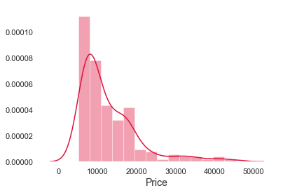
Problem 1
Do the Body Size, Style and Engine Specification determine the car price?
Our study focus on the relationship between car prices with body size, style and engine specification determine the car prices?
EDA: Automobile Dataset

Slide 5
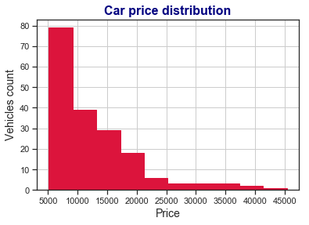
Car Price - Distribution
Distribution of Car Prices
Majority of cars belongs to lower price brackets (<$20K).
Car prices range in between $5K to $45K.
The car prices skewed to the right (right-skewed): The mean and median are greater than the mode.
Note: Price mentions here is in $ dollar.
EDA: Automobile Dataset

Slide 6
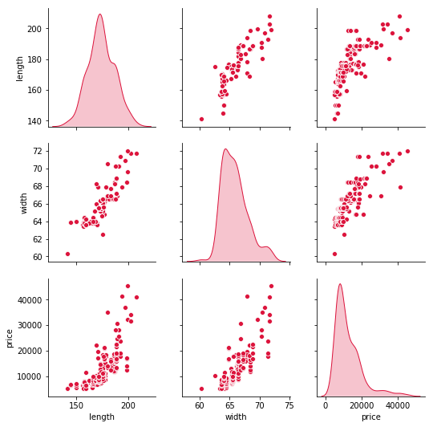
Body Size (Length, Width) vs Car Price
Body size (length & width) has strong correlations with price.
Whenever there is increase in length or width of cars that escalate the car price irrespective of body style.
EDA: Automobile Dataset

Slide 7
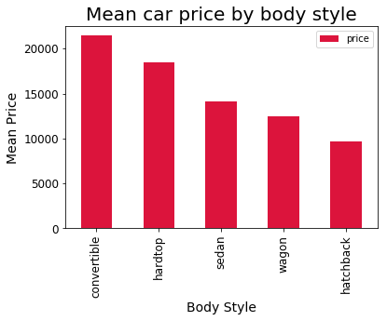
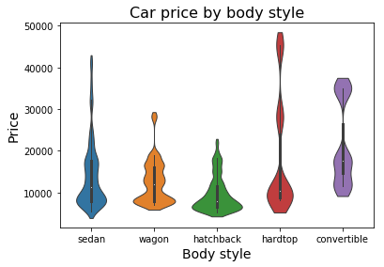
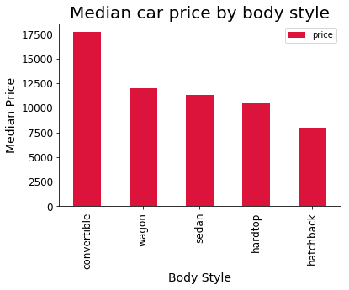
Body Styles vs Car Price
Convertibles and hardtops cars are the costliest car models.
EDA: Automobile Dataset

Slide 8
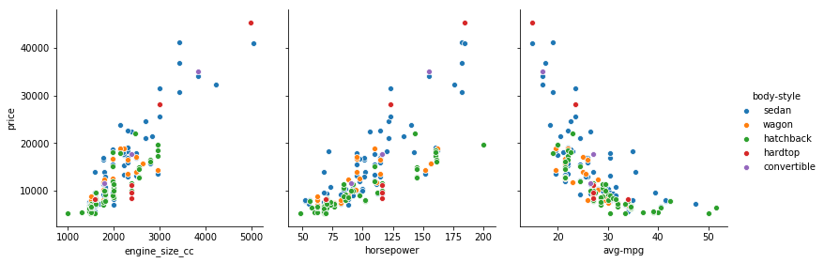
Engine Specs vs Car Price
Engine size (CC) & horse power has strong correlations with price, where as mileage ((city-mpg + highway-mpg)/2) is negatively correlated with price.
EDA: Automobile Dataset

Slide 9
Problem 1: Summary
Do the Body Size, Style and Engine Specification determine the car price?
Bigger vehicles are priced above the smaller ones.
Convertibles and hardtops cars are priced above the hatchback, sedan and wagon.
Cars having bigger engines and more horse power are priced higher.
Also less mileage cars are priced higher, and may be when body size and power get increase which impact to mileage and it get declined.
EDA: Automobile Dataset

Slide 10
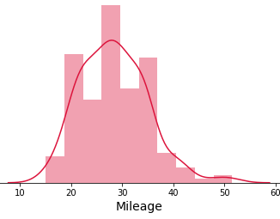
Problem 2
Which type of cars are better in terms of mileage?
Our study focus on the relationship between mileage with body style, fuel type and engine specs to determine the mileage efficient car?
EDA: Automobile Dataset

Slide 11
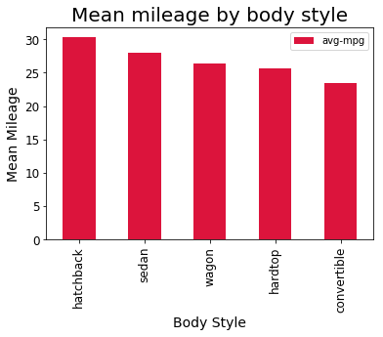
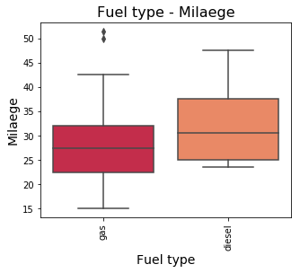
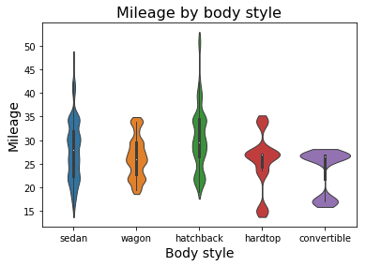
Body styles and Fuel type vs Mileage
Hatchback cars has the highest mileage followed by sedan class. Also Diesel based cars gives more mileage then the Gas based cars.
EDA: Automobile Dataset

Slide 12
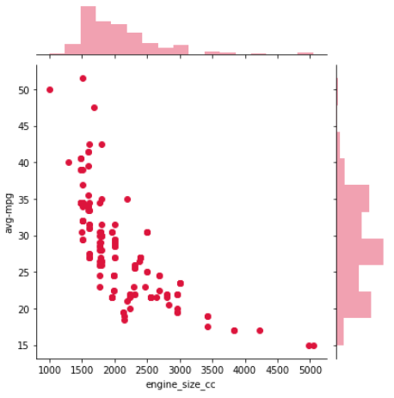
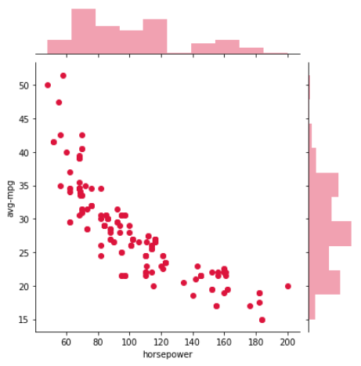
Engine specs vs Mileage
Engine specs (Engine size & Horsepower) has negative correlations with mileage.
Whenever engine size and horsepower of cars get increase that impact the mileage of the cars and it get declined irrespective of body style.
EDA: Automobile Dataset

Slide 13
Problem 2: Summary
Which type of cars are better in terms of mileage?
Hatchback and sedan cars produce better mileage.
Cars having smaller engines and less horse power produce better mileage.
Diesel cars produce better mileage compare to cars with Gas fuel type.
EDA: Automobile Dataset

Slide 14
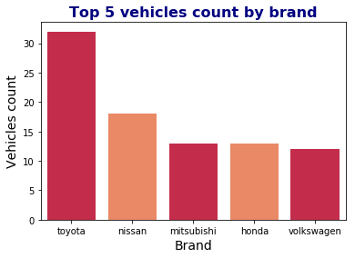
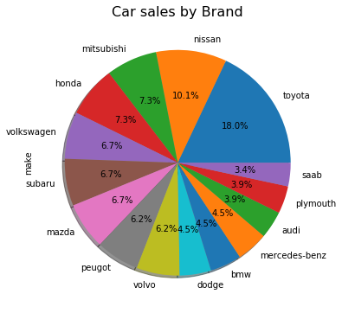
Problem 3
Which are highest selling cars based on brand, body style and price slab?
Toyota lead the list with highest number of cars selling followed by Nissan.
Our study focus on extracting popular cars through various fields.
EDA: Automobile Dataset

Slide 15
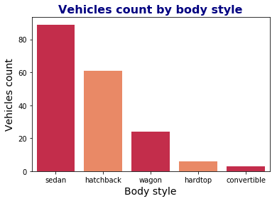
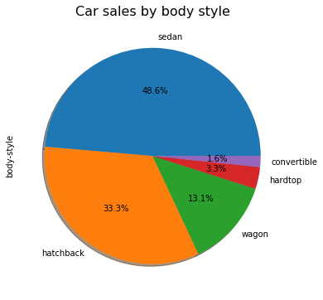
Car sales with body style
Sedan segment lead the list with highest number of cars selling followed by hatchback followed by body style.
EDA: Automobile Dataset

Slide 16
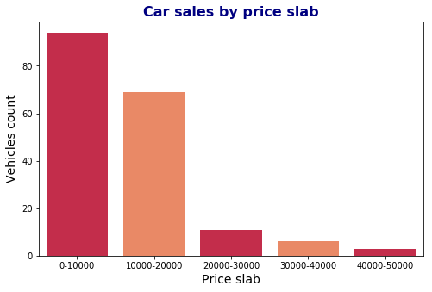
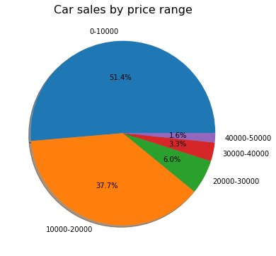
Car sales with price range
Cars under $10k lead the list with highest number of selling followed by Cars under $10k to $20k.
EDA: Automobile Dataset

Slide 17
Problem 3: Summary
Which are highest selling cars based on brand, body style and price slab?
Toyota sells highest number of cars followed by Nissan in brand category.
Sedan segment sells highest number of cars with 48% followed by hatchback.
Cars under $10k lead the list with highest number of selling followed by Cars in between $10k to $20k on price range basis.
EDA: Automobile Dataset

Slide 18
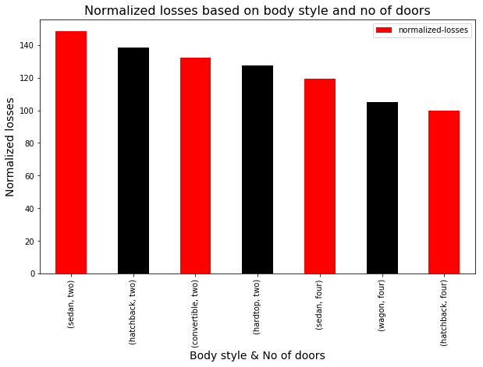
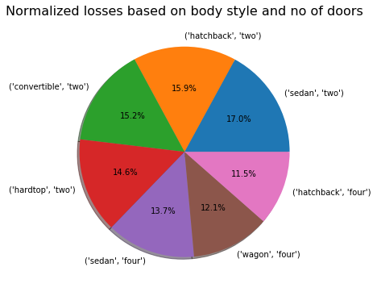
Problem 4
Which are highest normalized loss reported cars based on body style and no of doors?
Sedan with two doors cars reported highest average losses followed by hatchback two doors.
Our study focus on normalized losses reported by cars based on body style and no of doors.
EDA: Automobile Dataset

Slide 19
Problem 4: Summary
Which are highest normalized loss reported cars based on body style and no of doors?
Sedan with two doors cars reported highest normalized losses followed by hatchback with two doors cars.
Two doors cars has more number of losses than the four door cars.
EDA: Automobile Dataset

Slide 20
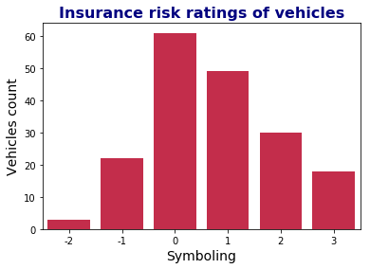
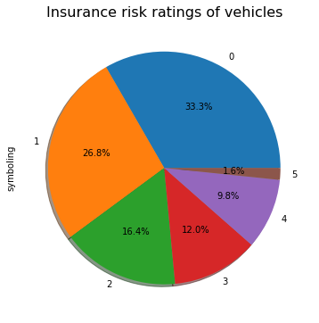
Problem 5
Does body size influence symbolling?
Symboling value shows how risky or safe a vehicle is, from an insurer’s perspective. It can range from -3 to +3.
-3 indicates a safe car while +3 denotes a risky one.
Based on the Symboling distribution, majority cars fall under 0 or 1 risk category which is less risky or less safer.
Our study focus to find relationship between body size and symbolling.
EDA: Automobile Dataset

Slide 21
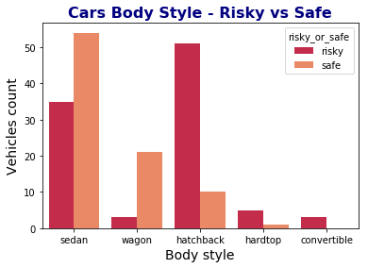
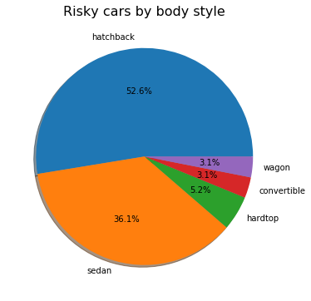
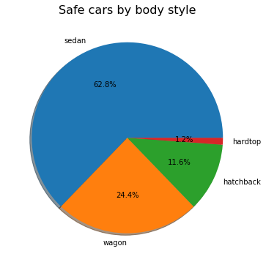
Cars Body Style – Risky / Safe
Introduced new column to classify risky or safe.
Majority of cars in hatchback, hardtop and convertible are in risky category.
EDA: Automobile Dataset

Slide 22
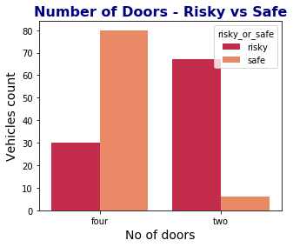
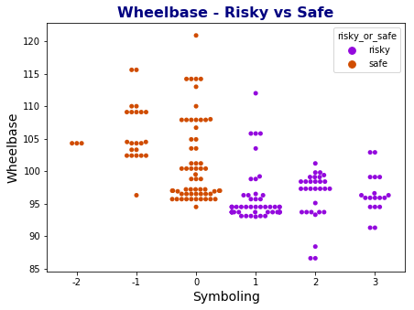
Wheelbase, No of Doors – Risky / Safe
A two door cars is more risky compare to the four doors cars. May be two doors cars are design for drive enjoyment, due to that cars may be driven by an enthusiast.
More the wheelbase, more stable the car is. Declining in wheelbase is making risky the cars.
EDA: Automobile Dataset

Slide 23
Problem 5: Summary
Does body size influence symbolling?
Based on the Symboling distribution, majority cars fall under 0 or 1 risk category which is less risky or less safer.
Majority of cars in hatchback, hardtop and convertible are in risky category.
A two door cars is more risky compare to the four doors cars. May be two doors cars are design for drive enjoyment, due to that cars may be driven by an enthusiast.
More the wheelbase, more stable the car is. Declining in wheelbase is making risky the cars.
EDA: Automobile Dataset

Slide 24
Thank You
GitHub Notebook:
https://github.com/purnananda/Automobile_EDA/blob/master/Automobile_EDA.ipynb
https://github.com/purnananda/Automobile_EDA/blob/master/Automobile_EDA_Data_Cleaning.ipynb
References:
UCI Machine Learning Repository: https://archive.ics.uci.edu/ml/datasets/automobile
Different Types of Engine: https://www.mechanicalbooster.com/2016/08/different-types-of-engine.html
EDA: Automobile Dataset

