Slide 1
STOCK PRICE . PREDICTION
K.Purna sai-AP20110010598
Sk.Riyaz-AP20110010599
Abhinay-AP20110010607
Tarun Gopi-AP20110010632

Slide 2
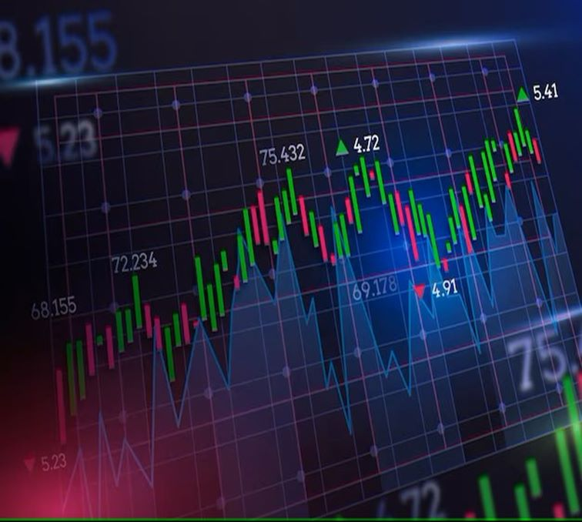
What is Stock Market?
A stock market is a public market where you can buy and sell shares for publicly listed
companies. The stocks, also known as equities, represent ownership in the company. The stock
exchange is the mediator that allows the buying and selling of shares.

Slide 3
Importance of Stock Market
• Stock markets help companies to raise capital.
• It helps generate personal wealth.
● Stock markets serve as an indicator of the state of the economy.
• It is a widely used source for people to invest money in companies with high growth
potential.

Slide 4
TIME SERIES FORECASTING
Time series forecasting is a technique used in data analysis to predict future values based on historical patterns and trends within a time series dataset. Time series data is a sequence of data points collected at regular intervals over time, such as daily stock prices, hourly temperature measurements, or monthly sales data.
The goal of time series forecasting is to identify and capture the underlying patterns and dependencies in the data in order to make accurate predictions about future values. This can be valuable for various applications, such as predicting stock prices, forecasting demand for a product, or anticipating future sales.

Slide 5
Methods in time series forecasting
Moving Average (MA):This method calculates the average of the previous 'n' data points to forecast the next value
Autoregressive (AR): AR models use past values of the time series to predict future values. The model assumes that future values depend linearly on previous values and incorporates a lag of the dependent variable
Linear Regression: Linear regression is a straightforward and widely used technique that assumes a linear relationship between the independent variables and the dependent variable.

Slide 6
CODE
import numpy as np
import pandas as pd
import matplotlib.pyplot as plt
from sklearn.metrics import mean_absolute_percentage_error
from sklearn.metrics import mean_squared_error as mse
import os
df=pd.read_csv("C:/Users/purna/Desktop/TSF/tcs_stock.csv",usecols=['Date','Close'],parse_dates=['Date'],index_col='Date')
df.head()#return the first n rows by default 5

Slide 7
df.shape #return no.of data points
df.loc['2015-01-01',:]
df.info()
print("Min:",df.index.min(),df.Close.min()) #printing the least number of date and closing price from the data set
print("Max:",df.index.max(),df.Close.max())
plt.figure(figsize=(17,5))
df.Close.plot()
plt.title("Closing Price",fontsize=20)
plt.show()
plt.figure(figsize=(17,5))
stock_price=pd.concat([df.Close[:'2015-06-12'],df.Close['2015-06-15':]])
plt.plot(stock_price)
plt.title("Closing Price Adjusted",fontsize=20)
plt.show()

Slide 8
prev_values=stock_price.iloc[:180]
y_test=stock_price.iloc[180:]
def plot_pred(pred,title):
plt.figure(figsize=(17,5))
plt.plot(prev_values,label='Train')
plt.plot(y_test,label='Actual')
plt.plot(pred,label="Predicted")
plt.ylabel("stock prices")
plt.title(title,fontsize=20)
plt.legend()
plt.show()

Slide 9
#Average of previouse values
y_av=pd.Series(np.repeat(prev_values.mean(),68),index=y_test.index)
mse(y_av,y_test)
plot_pred(y_av,"Average")
np.sqrt(mse(y_av,y_test))
y_train=stock_price[80:180]
y_test=stock_price[180:]
print("y train:",y_train.shape,"\ny test:",y_test.shape)

Slide 10
X_train=pd.DataFrame([list(stock_price[i:i+80]) for i in range(100)],
columns=range(80,0,-1),index=y_train.index)
X_test=pd.DataFrame([list(stock_price[i:i+80]) for i in range(100,168)],
columns=range(80,0,-1),index=y_test.index)
X_train
from sklearn.linear_model import LinearRegression
lr=LinearRegression()
lr.fit(X_train,y_train)
y_lr=lr.predict(X_test)
y_lr=pd.Series(y_lr,index=y_test.index)
mse(y_test,y_lr)
np.sqrt(mse(y_test,y_lr))

Slide 11
Benefits of time series forecasting
Future Prediction
Exploiting Patterns and Trends
Handling Seasonality and Trends:
Real-time Resource Optimization:monitoring:

Slide 12
CONCLUSION
time series forecasting for stock prices is a valuable and challenging task that has significant implications for investors, traders, and financial institutions. By leveraging historical patterns and trends in stock price data, forecasting models aim to predict future price movements and enable better decision-making.

Slide 13
FUTURE WORK
DEEPLEARNING
I currently predicted the future value for only one stock and in my future i will take a set of stocks and implement it using deep learning.

Slide 14
References
Hyndman, R. J., & Athanasopoulos, G. (2018). Forecasting: Principles and Practice. OTexts
Kim, S., & Han, I. (2000). Genetic algorithms approach to feature discretization in artificial neural networks for the prediction of stock price index. Expert Systems with Applications, 19(2), 125-132
Montgomery, D. C., Peck, E. A., & Vining, G. G. (2012). Introduction to Linear Regression Analysis (5th Edition). John Wiley & Sons.
Draper, N. R., & Smith, H. (1998). Applied Regression Analysis (3rd Edition). John Wiley & Sons.

