Slide 1
BASE - Collaboration Tool for Researchers
Team Members:
Abhinav Sethi
Gautam Sharma
Nivishree Palvannan
Purna Srivatsa

Slide 2
Problem statement
Problem:
The pandemic has made the life and work of software engineering researchers virtual too. Prior to the pandemic, researchers met up physically to discuss progress, share work and papers, make updates and to assign work to each of the team members.
Solution:
The software tool we build is going to help researchers organize their work in common virtual space and collaborate more efficiently with other researchers. The tool will also provide a way to map out the literature review in a visually descriptive way and allow researchers to maintain, edit or add the content of their literature review in a commonly shared space.

Slide 3
Use Case # 1 - Upload research papers
Preconditions
User has registered and is logged in
Main Flow:
User creates a new repository by providing a name[S1]
Uploads research papers as pdf files to existing repositories[S2]
Subflows
[S1] The tool automatically extracts major keywords
[S2] Users can manually input the keywords and parameters
Alternative Flows
[E1] User is not authenticated
[E2] User has not uploaded the file in the correct format

Slide 4
Use Case # 2 - Organize and edit repository data/ research paper data
Preconditions
User must have access to their own data after authentication
Main Flow:
User will view all his/her repositories and papers [S1]. User will select the paper in the
Repository of their choice to edit/update [S2]. User will go ahead and update the necessary
data of the paper [S3].
Subflows
[S1] User searches repository by name or by scrolling through the list of repositories.
[S2] The paper selected by the user and the data associated with it will be displayed
in a central window
[S3] Software will provide the data in an editable format for user to edit any part of it
Alternative Flows
[E1] No repositories available

Slide 5
Use Case # 3 - Collaborate/Connect with other researchers
Preconditions
User has permission and access to connect with other users and to view/edit the common data
Main Flow
User will view all common repositories and papers [S1]. User can view and access all the team
members and have a way to message or notify them [S2]. Bot will update members of same
team/group when updates are made to common data [S3].
Subflows
[S1] User searches repository by name or by scrolling through the list of common repositories.
[S2] User should be able to access the paper and the profiles of his/her team members.
[S3] User should be able to update/edit or comment on the paper of his/her team members.
Alternative Flows
[E1] User is not part of any shared repositories

Slide 6
Use Case # 4 - Visualize research/literature review
Preconditions
User must have access to their own data after authentication
Main Flow
User will view all his/her repositories and papers [S1].
User will select the paper in the repository of their choice to visualize [S2].
User will be presented with a visual view of the literature review [S3].
Subflows
[S1] User searches repository by name or by scrolling through the list of repositories.
[S2] User will be provided options on the method of visualization before
redirecting to visualisation page.
[S3] Software will display the visualization and provide options for user to interact with
visualization like clicking, zooming, highlighting.
Alternative Flows
[E1] No repositories available

Slide 7
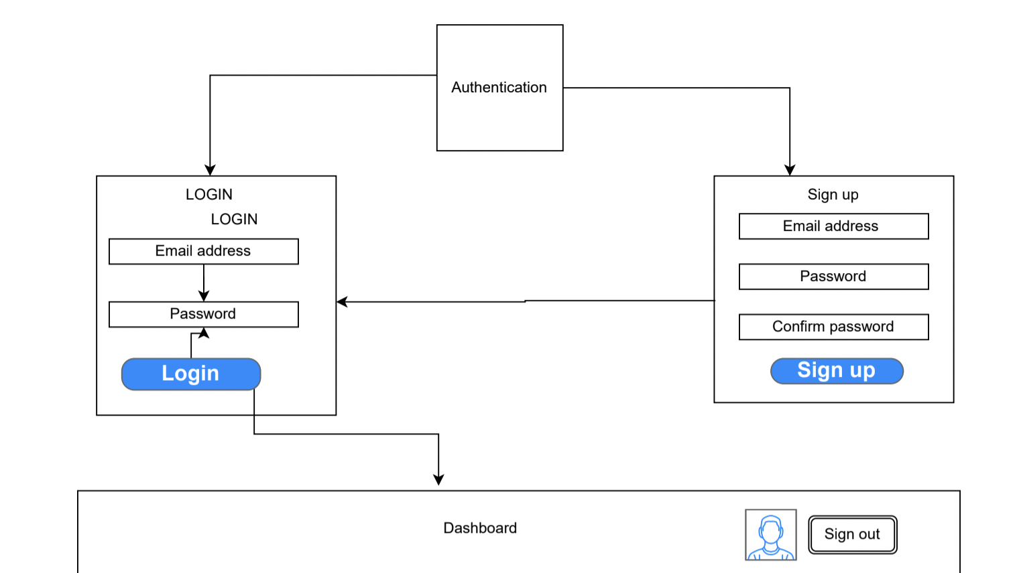
Activity Diagram

Slide 8
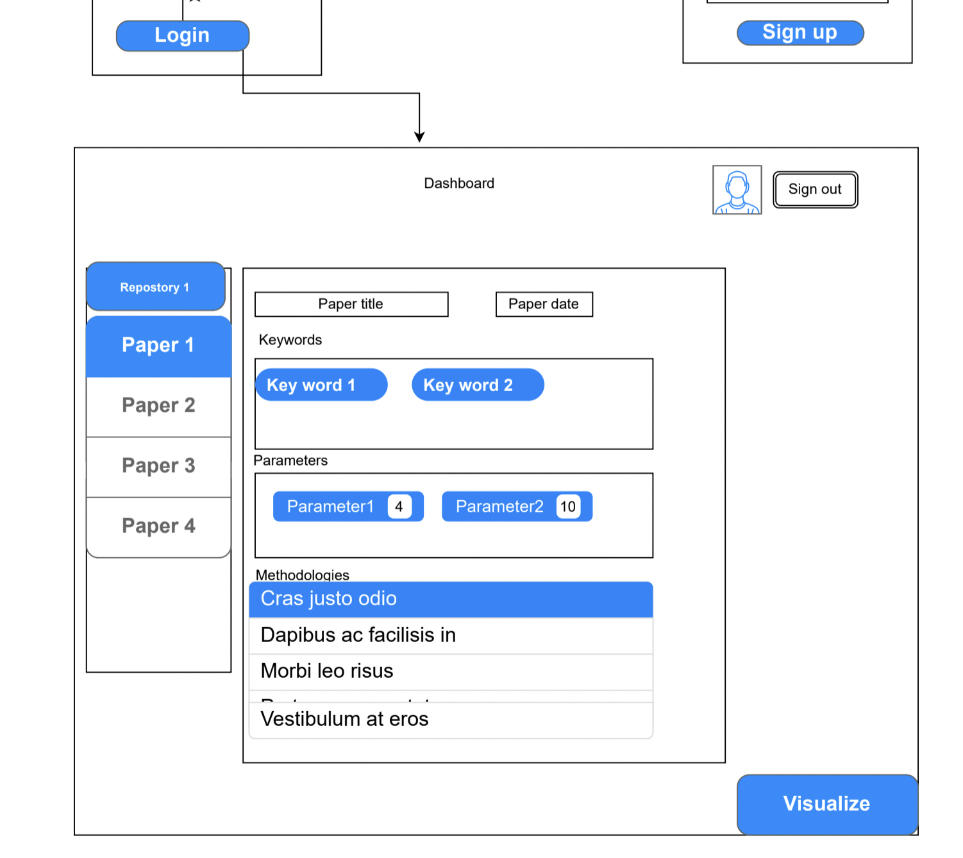
Activity Diagram

Slide 9
Conclusion
Research collaboration tool based on a layered client-server architecture
Intended to aid researchers in better organizing their work
Enables researchers to share their findings
Provides visual representation of related research papers

Slide 10
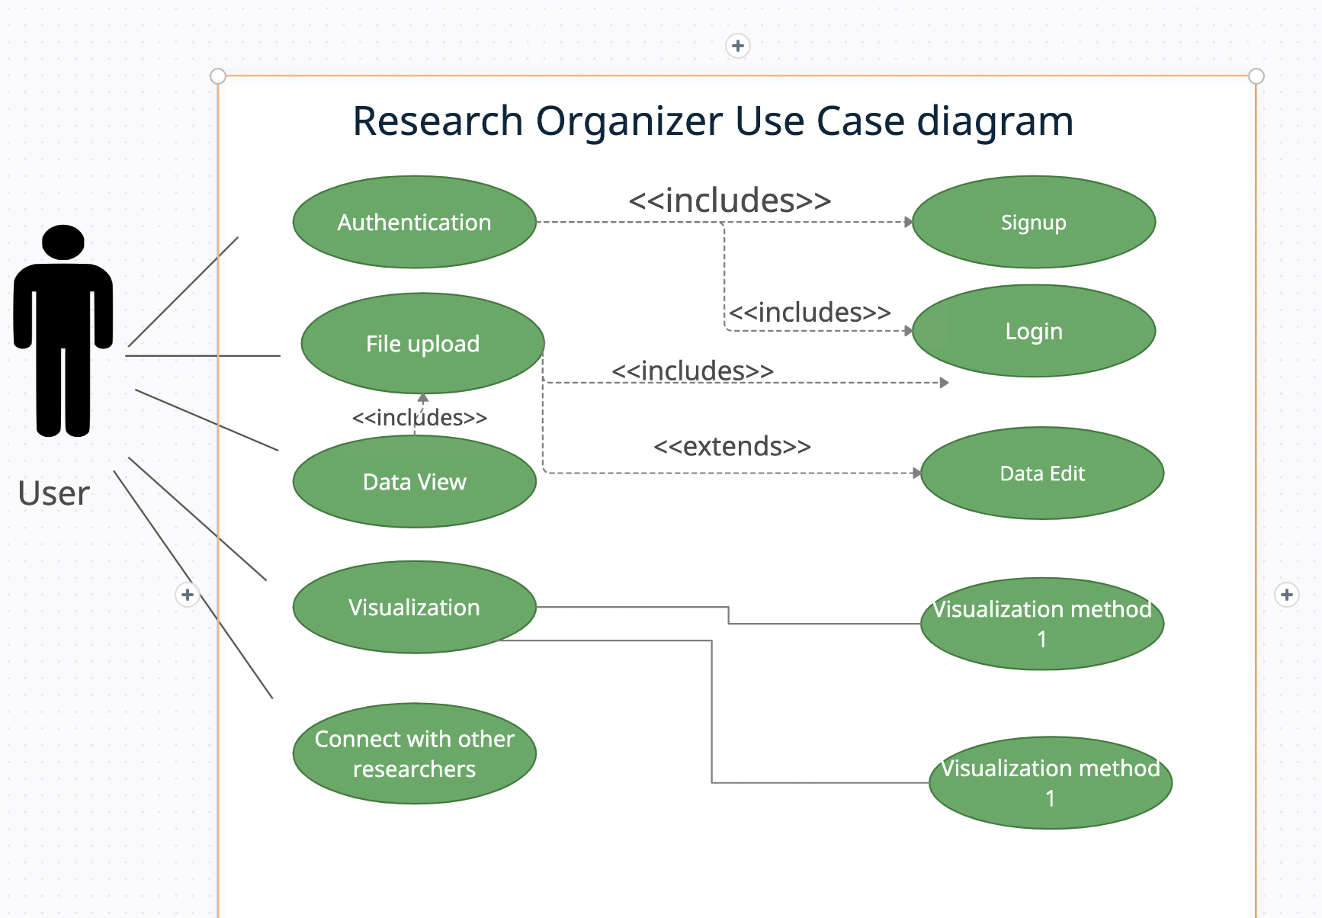
Use Case Diagram

Slide 11
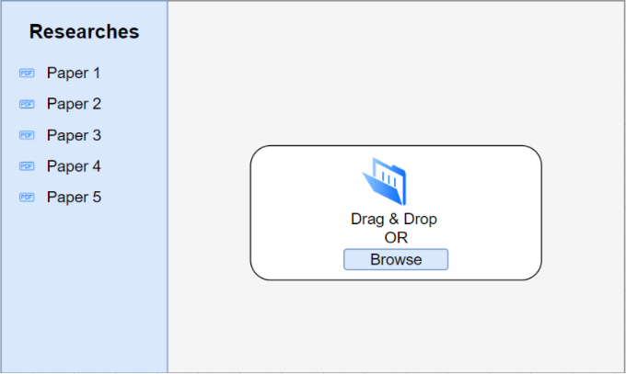
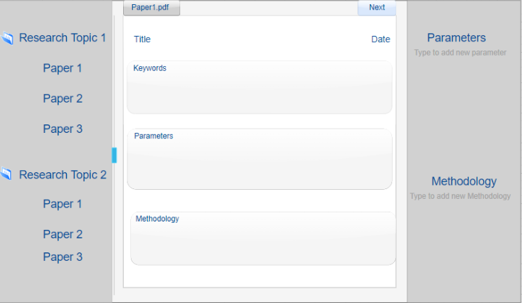
Wireframes

