Slide 1





Terrorism
Name : Purnata Phalane.
E-mail id : phalanepurnata9@gmail.com
Disclaimer: The content is curated for educational purposes only.
Notes:
Slides: Prepare a short slide deck (10-12 slides) summarizing the project objectives, methodology, and key results.

Slide 2
OUTLINE
Abstract of the Project
Problem Statement
Proposed Solution
System Architecture
Conclusion
Future Scope

Slide 3
Abstract
Terrorism remains a critical global threat, characterized by the use of violence or the threat of violence to instill fear, coerce societies, and achieve political, ideological, or religious objectives. This phenomenon has evolved significantly over time, with terrorist groups adapting to new technologies, communication methods, and geopolitical dynamics. The impact of terrorism extends beyond the immediate loss of life and destruction; it creates long-lasting social, economic, and political instability. Terrorist activities also contribute to the erosion of civil liberties, disrupt global trade, and pose challenges to international security frameworks.
The complexities of modern terrorism lie in its diverse manifestations, including state-sponsored terrorism, religious extremism, and the rise of decentralized and cyber-based networks. While counterterrorism efforts have led to the disruption of several high-profile attacks, the emergence of lone-wolf actors and online radicalization adds layers of difficulty to preventing future threats.
This abstract explores the ongoing and future challenges of combating terrorism, emphasizing the importance of international collaboration, intelligence sharing, and strategies that address the root causes of extremism. A comprehensive approach that combines military, diplomatic, and social interventions is vital for mitigating the spread and impact of terrorism in the 21st century.

Slide 4
Problem Statement
Terrorism remains one of the most significant global security threats, causing loss of life, destabilization of governments, and widespread fear among populations. Despite extensive efforts by governments, international organizations, and counterterrorism agencies.Addressing this problem requires coordinated global efforts, effective intelligence-sharing, and targeted interventions to prevent radicalization, disrupt terrorist activities, and promote long-term peace and stability.
This problem statement emphasizes the ongoing nature of the issue, outlines its effects, and identifies key challenges in tackling it.

Slide 5
Proposed Solution
Enhanced International Cooperation and Intelligence Sharing: Terrorism operates across borders, making
international collaboration essential. Governments should strengthen alliances and improve the exchange of
intelligence to track and prevent terrorist activities. This includes sharing data on known terrorist groups,
financial transactions, travel patterns, recruitment activities. Regional and global cooperation can help identify
and eliminate threats before they manifest.
Counter-Radicalization Programs: Preventing radicalization before it leads to terrorism is crucial. Governments and
civil society organizations should implement comprehensive counter-radicalization programs that focus on
education, mentorship, and community engagement. These programs should provide alternative narratives to combat
extremist ideologies, especially among vulnerable populations. Special attention should be given to at-risk youth who
may be targeted by radical groups.
Online Surveillance and Counter-Extremism Measures: As social media and online platforms are increasingly
used for recruiting and spreading extremist ideologies, monitoring and regulating online content is vital. Governments
should work with tech companies to improve the identification and removal of extremist propaganda and
recruitment
materials. Public awareness campaigns and digital literacy programs can also empower individuals to critically
engage with online content and report harmful material.
Addressing Root Causes of Terrorism: Long-term solutions to terrorism require addressing the socio-economic
and political factors that fuel extremism, such as poverty, political oppression, lack of education, and social inequality
Development programs in conflict-prone areas, as well as initiatives that promote good governance and human
rights, are crucial in reducing the appeal of terrorist ideologies. Investing in education and economic opportunities
for marginalized communities can reduce the likelihood of young people turning to violent extremism.

Slide 6
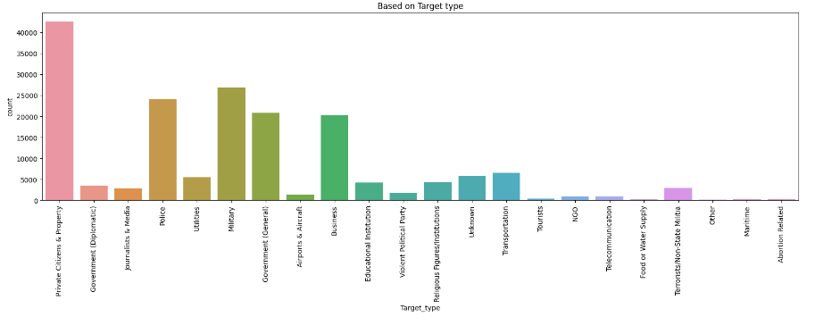
System Architecture

Slide 7
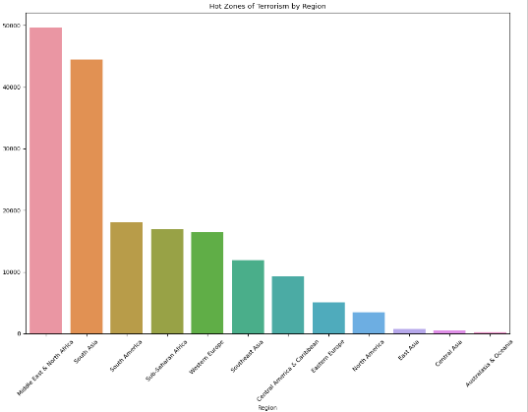
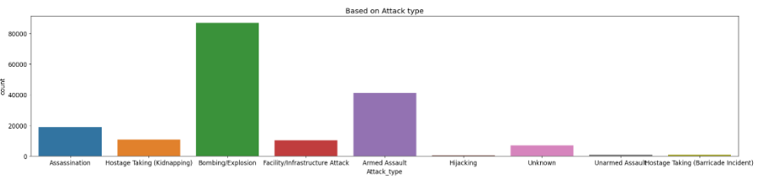

Slide 8
Conclusion
Terrorism is a complex and persistent global issue that poses significant threats to peace, security, and human rights. While counterterrorism efforts have made progress in disrupting terrorist activities, the evolving nature of terrorism—driven by technological advancements, ideological extremism, and decentralized networks—continues to present formidable challenges. It is evident that combating terrorism requires a multifaceted approach, including intelligence-sharing, international cooperation, addressing the root causes of radicalization, and ensuring the protection of civil liberties.
The long-term solution to terrorism lies not only in military and law enforcement measures but also in tackling the underlying political, social, and economic factors that foster extremism. The global community must work together to create a more secure and just environment, where individuals are not driven toward violence and hatred. While eliminating terrorism entirely may be an impossible task, continued vigilance, collaboration, and commitment to human rights will help minimize its impact and foster a more peaceful world.

Slide 9
Future Scope
The future of terrorism is likely to evolve as new threats and challenges emerge. As technology advances, particularly in the realms of cyber capabilities, artificial intelligence, and communication networks, terrorism could become even more sophisticated and widespread. Here are several key areas in which terrorism may evolve in the coming years:
Cyber-Terrorism and Digital Attacks: The growing reliance on digital infrastructure means that cyber-terrorism could become a significant focus for terrorist groups. Attacks on critical infrastructure, financial systems, or even the spread of disinformation could disrupt economies, governance, and social order, with far-reaching effects. The future could see an increase in digital warfare targeting governments, businesses, and individuals.
Use of Advanced Technologies: As technologies such as drones, artificial intelligence, and bioengineering become more accessible, they could be weaponized by terrorist organizations. For instance, drones could be used for surveillance, delivering explosives, or targeting high-profile figures. Additionally, bioterrorism using genetically engineered viruses or toxins may become a new frontier for terrorist groups.
Decentralized Networks and Lone-Wolf Attacks: The trend toward more decentralized, networked terrorist organizations—often with little to no central leadership—could continue to grow. This shift makes it more difficult to track and disrupt terrorist plots, as individuals or small cells acting independently may be harder to identify. "Lone-wolf" attacks may increase, where individuals are radicalized online and carry out attacks without direct group affiliation.
Radicalization through Social Media and Online Platforms: The future may see an increased role of social media and digital platforms in the radicalization of individuals. Terrorist groups are increasingly exploiting these platforms to spread propaganda, recruit new members, and incite violence. Combating the spread of extremist content and countering online radicalization will be a critical challenge.
Emerging Geopolitical Conflicts and Extremist Ideologies: As global power dynamics shift, new geopolitical conflicts could provide fertile ground for terrorism. Ideologies may also become more fragmented or diversified, with groups adopting new motivations based on religious, political, or social grievances. Understanding these changing ideologies will be crucial for developing effective counterterrorism strategies.
Environmental and Resource Conflicts: Climate change and resource scarcity could fuel new tensions and conflict, potentially leading to new sources of terrorism. Areas affected by environmental disasters, scarcity of water or food, and migration pressures might witness radicalization, as some groups may use these crises as a pretext for violence.
Global Cooperation and Intelligence Sharing: The future scope of terrorism also highlights the growing need for enhanced global cooperation in intelligence sharing, counterterrorism strategies, and combating transnational crime.

Slide 10
Thank you!
Notes:
thank you very much for joining this PPT, keep learning.
10

