Slide 1


CRICKET EQUIPMENT STORE BY PUrNA TEJA REDDY-20025460 Sravani agatamudi – 20030994 Gautham askani -20025842
B9IS109 WEB DEVELOPMENT FOR
INFORMATION SYSTEMS CA

Slide 2

INtroduction
This project is a Cricket Equipment Store designed to provide a simple, user-friendly platform for customers to explore and purchase cricket gear online.
Purpose: To create a website where users can:
Browse through various cricket equipment.
View product details.
Add items to the cart and place orders.
Manage their accounts securely.

Slide 3
architecture
Flask: Python-based backend framework used for API routes and server-side logic.
React: JavaScript library for building user interfaces.
MongoDB: NoSQL database to store user details, product data, and images.
AWS Hosting: Used AWS for hosting the website and making it accessible online.
Version Control: Pushed the project code to GitHub for version control and collaboration.

Slide 4
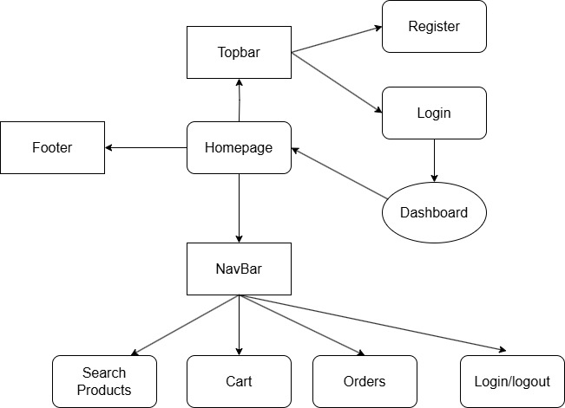
Flow Diagram

Slide 5
Backend Functionality
Features:
User authentication (JWT-based secure login)
CRUD operations for products, cart, and buying.
Order processing.
Challenges Overcome:
Handling JWT token expiry
Connecting Flask with MongoDB efficiently

Slide 6
Frontend Functionality
Features:
Interactive UI with React
Search bar, product filters, and pagination
Toast notifications (e.g., "Item added to cart!")
Challenges Overcome:
Managing state across components
Ensuring responsiveness on all devices

Slide 7
Database Design
Database Design
Structure:
Collections for Users, Products, Orders, Addresses
Key Focus Areas:
Storing secure user credentials
Managing image storage

Slide 8
Live demonstration
Live presentation of website functionality.

Slide 9
ConclusioN
Thus building this website helped us gain knowledge.
Built API routes using Flask and connected to MongoDB.
Managed user data, login credentials, and product information.
Integrated frontend (React) with backend (Flask) for smooth data flow.
Deployed the project on AWS for live access.
Gained hands-on experience in full-stack web development and teamwork.

Slide 10

Thank you

