Slide 1

MID TERM PROJECT REPORT ON: COMPONENT MANAGEMENT SYSTEM Guided By Dr. Vinod Pathari Mr. Dhanaraj K. J
Presented by : Purnendu Kumar Roy M120368CA

Slide 2
OUTLINE OF PRESENTATION
Introduction
Problem Definition
Background
Literature survey
Design
Work done
Conclusion
References

Slide 3
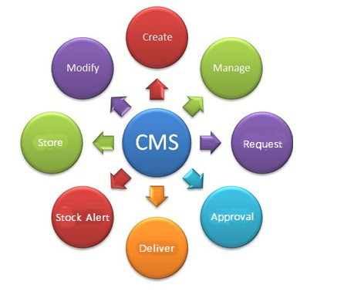
INTRODUCTION
Component Management System is a web application to improve the component management in store of Electronics and Communication Engineering Department of NIT Calicut. CMS will store all transaction details of component, user details and along with it also provide easy interface to search users and components. Users can easily get no dues. This system provides GUI based interface which is very user friendly.

Slide 4
Problem Definition
Component Management is a web application which automates the component and to be made available in ECED departmental website. The CMS site administrator should have the provision to add component, edit/delete/update existing components, search for components, view all components, issue/return of components and check no dues for users. Administrator should also have provision to create new user account, delete/update user’s profile and maintain the database from where they are purchasing components. Student should be able to search components and get required component issued through the staff-in-charge. Student can request for the purchase of component if its not available in the store. CMS will generate report that includes minimum stock alters, components issued to users/labs, request for components, component status, damaged components, issue no dues and view all capital components.

Slide 5
Background
The term “CMS” has been applied to file based system (paper based) where Administrator will record the transactions in stock register which is currently done manually which consumes lot of time and results in errors. Students usually purchase components from outside which are needed for the project, because they do not have the facility to know the components that are available in the store. This results in duplication in many occasions. There are a lot of components being used in electronics department by users.

Slide 6
Literature Survey
Existing System
The concept of Component Management System is not new. A similar project was already designed and implemented to address the component management system. The existing system has developed CMS in PHP language, HTML/CSS, JAVA SCRIPT, JQUERY and MYSQL as a database and this system used Wamp server and it is a windows web development environment, it allows to create web application with PHP and MYSQL database. Alongside, PhpMyAdmin allows to manage easily the database.

Slide 7
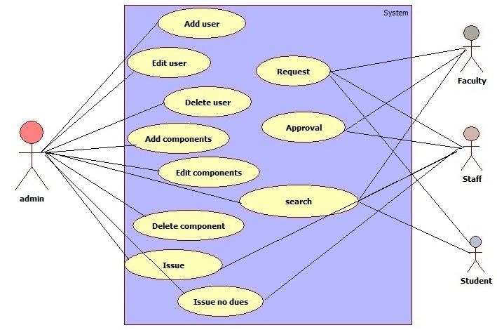
Design
Use case

Slide 8
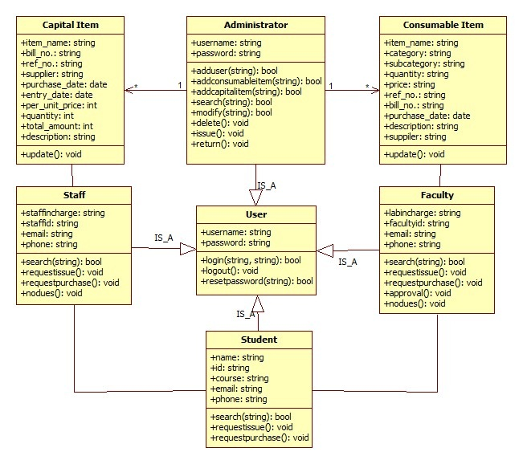
Design contd…
Class Diagram

Slide 9
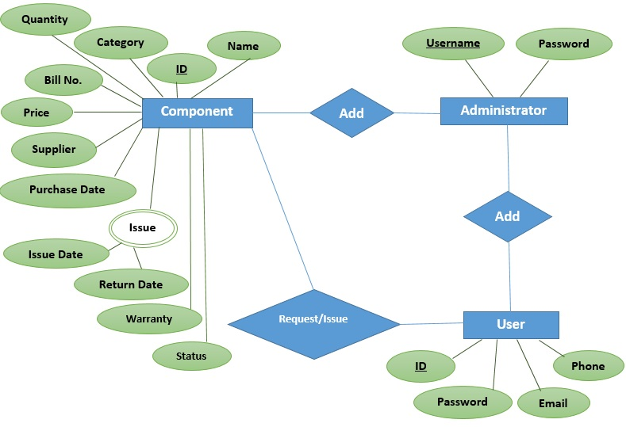
Design contd…
E-R Diagram

Slide 10
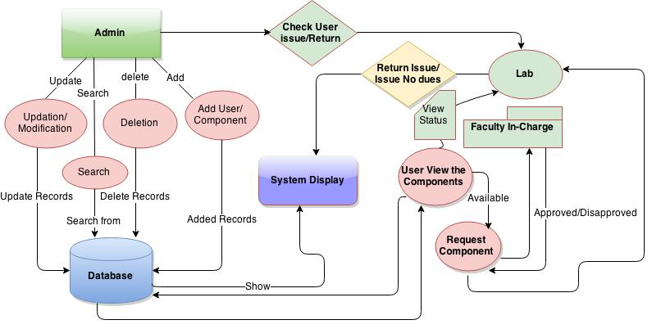
Design contd…
Data Flow Diagram

Slide 11
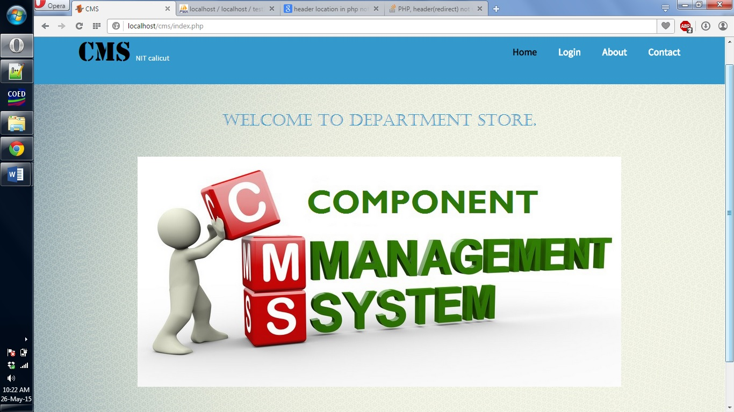
Screen shots:
Home Page

Slide 12
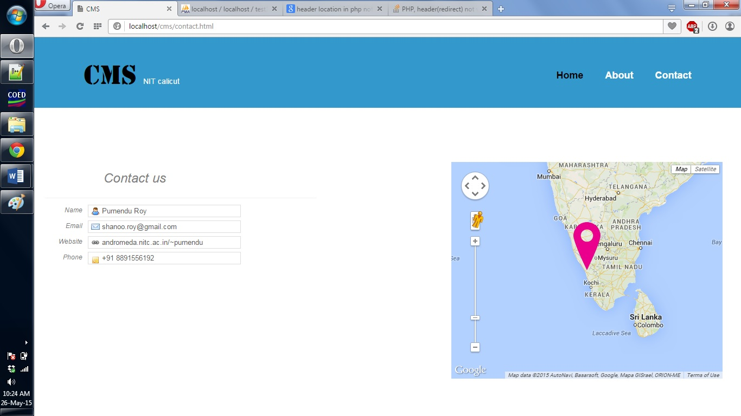
Contact Page:

Slide 13
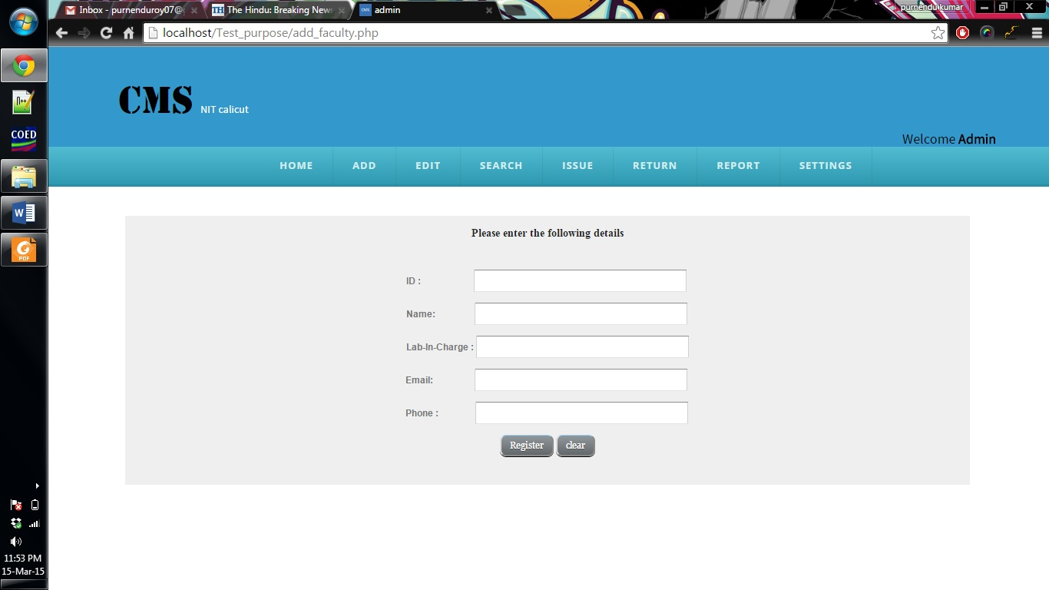
Admin page:

Slide 14
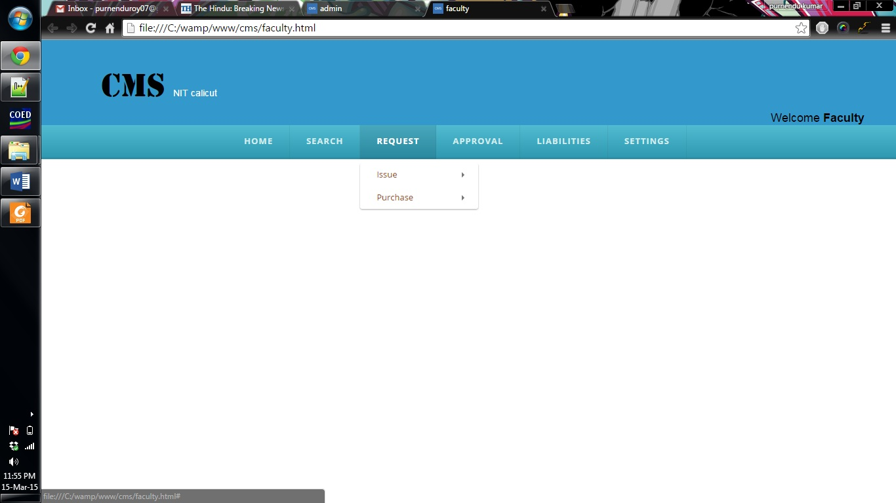
Faculty page:

Slide 15
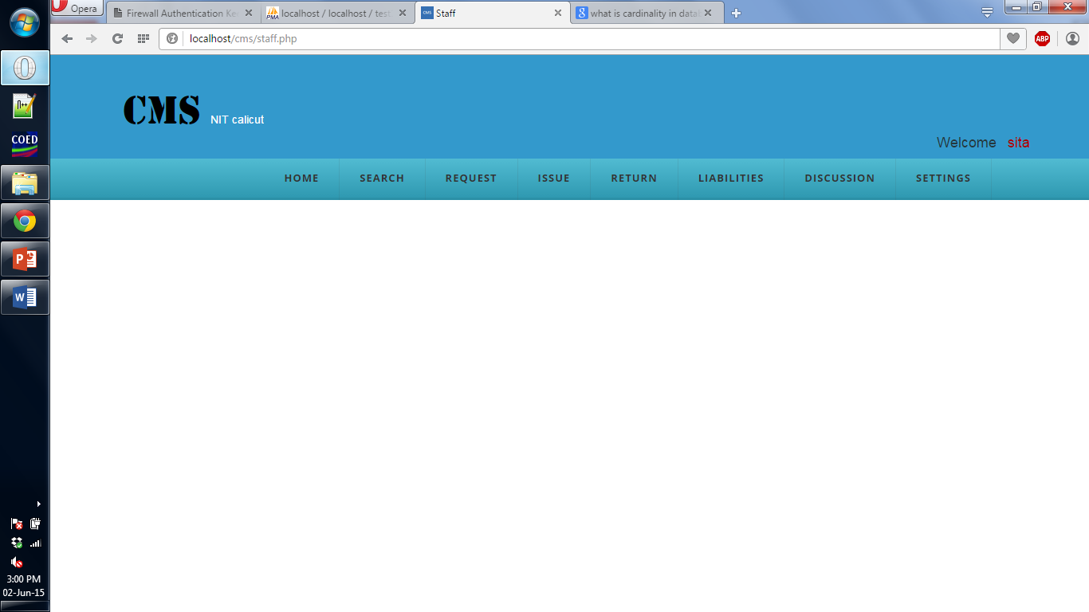
Staff page:

Slide 16
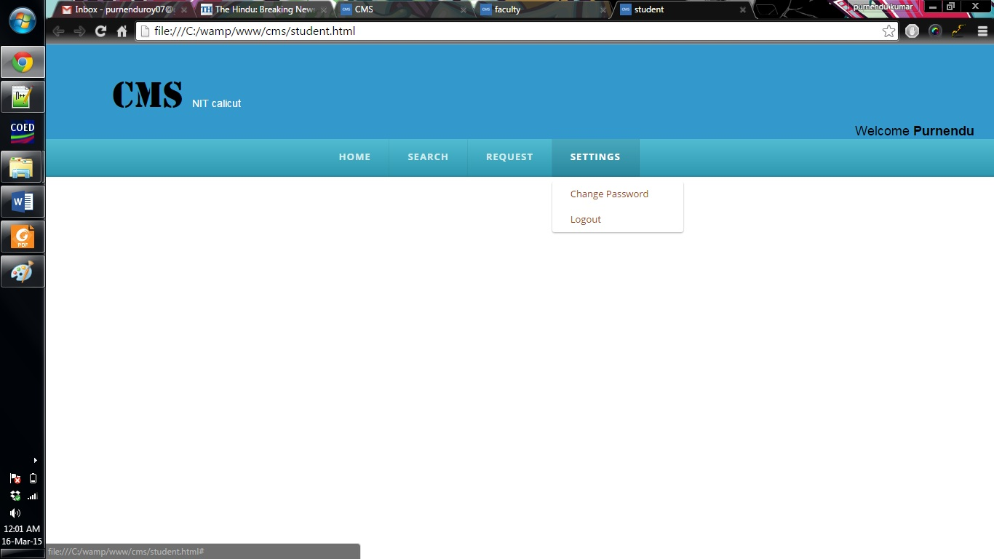
Student page:

Slide 17
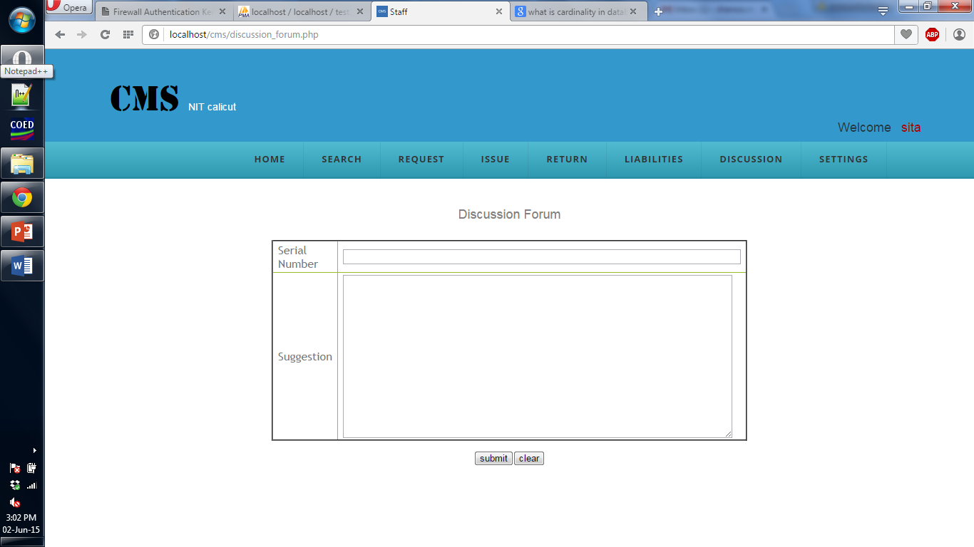
Discussion forum: For Users

Slide 18
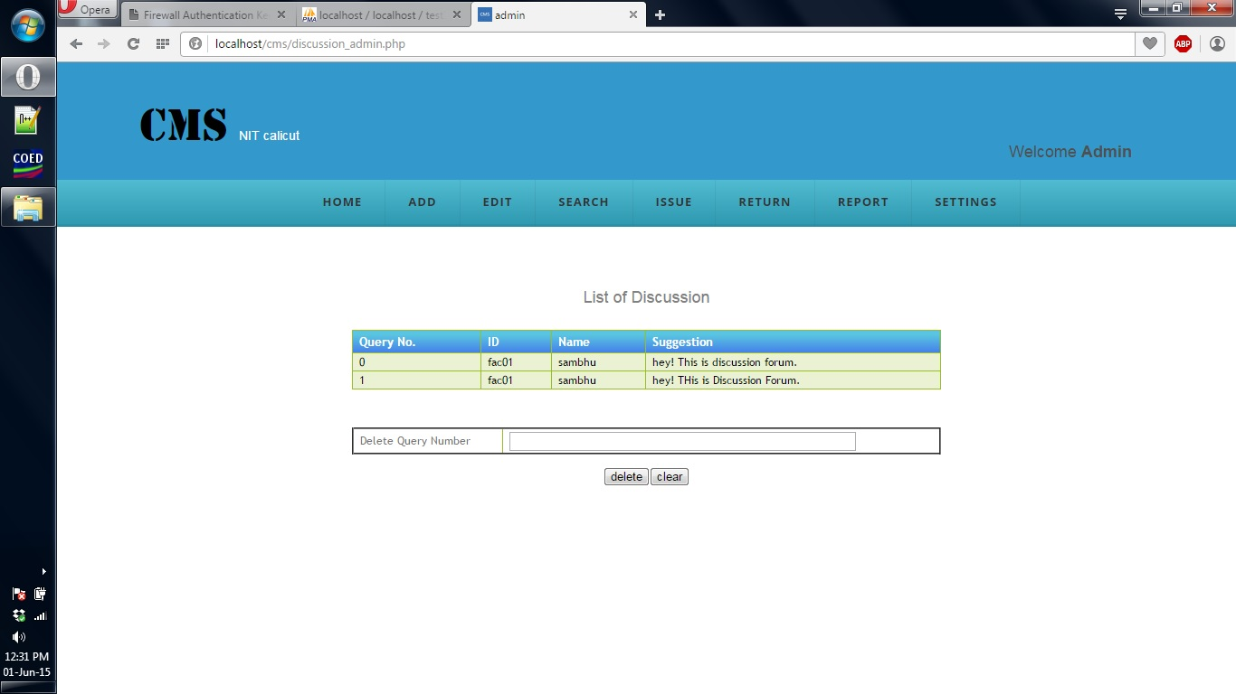
Discussion forum: For administrator

Slide 19
Work Done
Created login system for different types of user for component management system.
Created all of the part of administrator for component Management System.
Created issue and return feature in CMS.
Created all of the part of faculty page such as search, request issue, approval issue.
Created staff section’s features such as request issue, request purchase, issue request, return Issue, liabilities.
Created all the part of student page such as search, request issue, request purchase, view status, liabilities.
Created contact page for users where users can easily get the location of department.
Created discussion forum for users and administrator.

Slide 20
Conclusion
The “Component management system” will be very helpful for ECE department in NIT Calicut. Users of the system can check the availability of the components without going to the store. This application helps to handle the stock and its transactions in an easy and efficient manner. This will helps to reduce the man power, saves time and will be more accurate.
This helps for more efficient and error free component management.

Slide 21
References
Timothy C. Object Oriented Software Engineering, Tata McGraw-Hill-2005 Edition04.
Navathe, Elmasri Fundamentals of Database Systems, Pearson-2013 Edition06.
Stock register of Electronics and Communication Engineering Department year-2015.
Report of Component Management System by Ramsy Razack year-2013.
http://www.virtualsplat.com/software-solution/store-management-software.asp Accessed on Jan 2015.
"IEEE P1233", Draft Guide to Developing System Requirements Specifications. 1993. http://www.cse.msu.edu/~chengb/RE-491/Papers/IEEE-SRS-practice.pdf Accessed on Feb 2015.
Jay Greenspan, David Wall, MySQL / PHP Database Applications, 2nd Edition Oct. 2003.
http://www.tutorialspoint.com/mysql/mysql-using-joins.htm Accessed on Jan 2015.
http://w3schools.invisionzone.com/index.php?showtopic=47997 Accessed on Feb 2015.
http://www.w3schools.com/php/default.asp Accessed on Feb 2015.
http://stackoverflow.com/questions/16358361/php-headerredirect-not-working-on-live-server Accessed on May 2015

Slide 22
Thank You.

