Slide 1
An Operational Analytics Dashboard for Hospital Performance Management
By Dr. Purnendu Shekhar Pandey
Notes:
Introduce the context of hospital analytics and Power BI’s role in operational decision-making.

Slide 2
What is Power BI?
• Microsoft’s Business Intelligence and
data visualization tool
• Connects, transforms, and visualizes data
from multiple sources
• Helps hospitals and businesses
make informed, data-driven decisions
Notes:
Introduce Power BI as an integrated analytics platform enabling data storytelling.

Slide 3
Why Power BI for Management?
• Seamless integration with Excel
• DAX enables analytical calculations (% of growth, avg. cost)
• Power Query helps clean data
• Interactive dashboards for department-level insights e.g for Doctors and operations team we can create two different dashboards.
• Secure, cloud-based sharing for management teams
Notes:
Show Power BI’s power for operational decision-making in healthcare.

Slide 4
Excel vs Power BI – Key Differences
Feature | Excel | Power BI
Purpose | Data entry & static reports | Dynamic analytics & interactive dashboards
Data Handling | Handles up to ~1 million rows | Handles millions of rows efficiently
Visualization | Basic charts and graphs | Advanced, interactive visuals and slicers
Collaboration | File-based sharing (email, drive) | Cloud-based, real-time sharing via Power BI Service
Automation | Manual updates | Scheduled data refresh and auto-updates
Language / Engine | Formulas and pivot tables | DAX (Data Analysis Expressions) and Power Query (ETL + analytics)
Notes:
Contrast Excel’s individual analytical use with Power BI’s scalable, enterprise-level analytics.

Slide 5
Power BI Workflow
1️⃣ Connect – Import hospital data from Excel, SQL, or APIs
2️⃣ Transform – Clean and prepare using Power Query
3️⃣ Visualize – Build KPI dashboards for various operations
4️⃣ Share – Publish insights to Power BI Service or Teams
Notes:
Emphasize this end-to-end process for real-world BI projects.

Slide 6
Key Components of Power BI
• Power BI Desktop – Build & analyze dashboards
• Power BI Service – Share reports in the cloud
• Power BI Mobile – Monitor metrics on-the-go
• Power BI Gateway – Secure data refresh for hospital systems
Notes:
Link components to roles in hospital and business data management.

Slide 7
Power BI Interface Overview
Interface Component | Description | Purpose in Analytics Workflow
1. Power Query Editor | Opens when we click “Transform Data”. It’s used for data cleaning, shaping, and preparation before visualization. | - Remove duplicates, nulls, and errors- Merge or append tables- Create calculated columns- Apply filters and transformations
2. Report View | The main canvas where we build dashboards and reports using charts, cards, slicers, and visuals. | - Design interactive dashboards- Add filters, visuals, and KPIs- Format layouts and colors
3. Data (Tabular) View | Displays your data tables in tabular format after transformation — similar to Excel sheets. | - Inspect loaded data- Verify calculations- Create new columns or measures
4. Model View | Shows relationships between tables — visual diagram connecting them using Primary Keys and Foreign Keys. | - Establish relationships- Define data model structure- Enable multi-table analytics and DAX calculations
Notes:
Link components to roles in hospital and business data management.

Slide 8
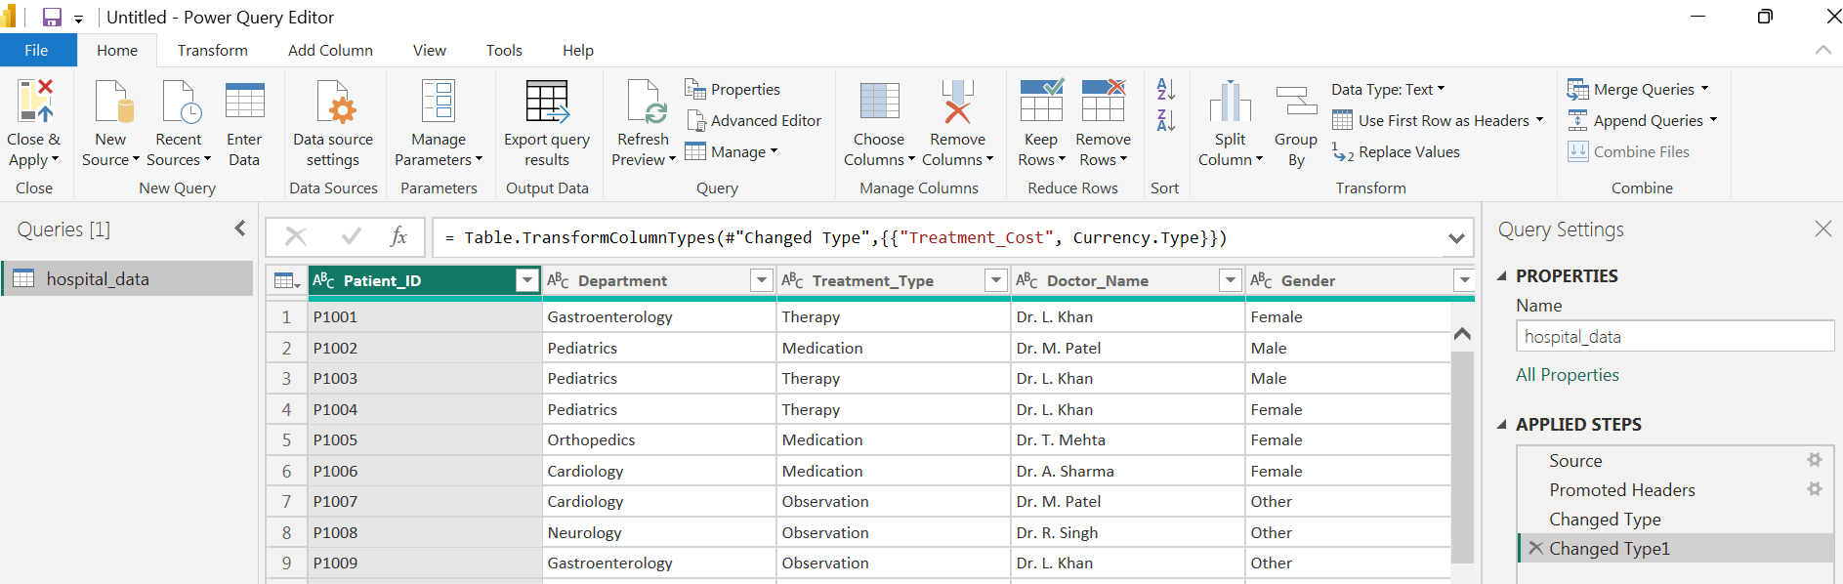
Power Query Editor
Notes:
Link components to roles in hospital and business data management.

Slide 9
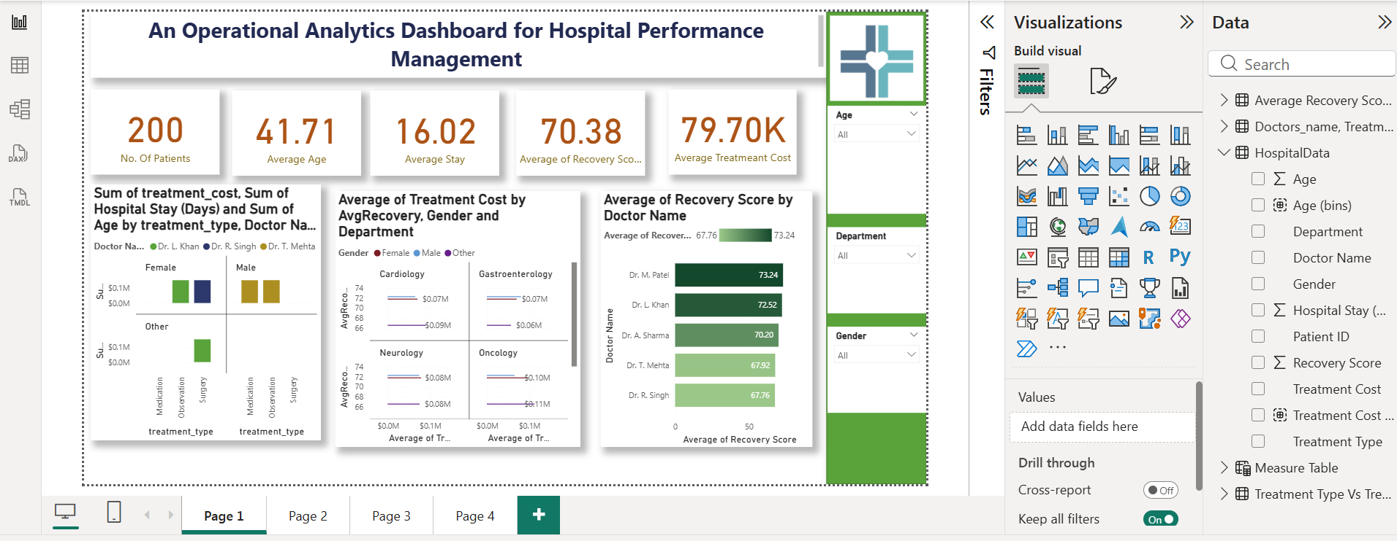
Report View
Notes:
Link components to roles in hospital and business data management.

Slide 10
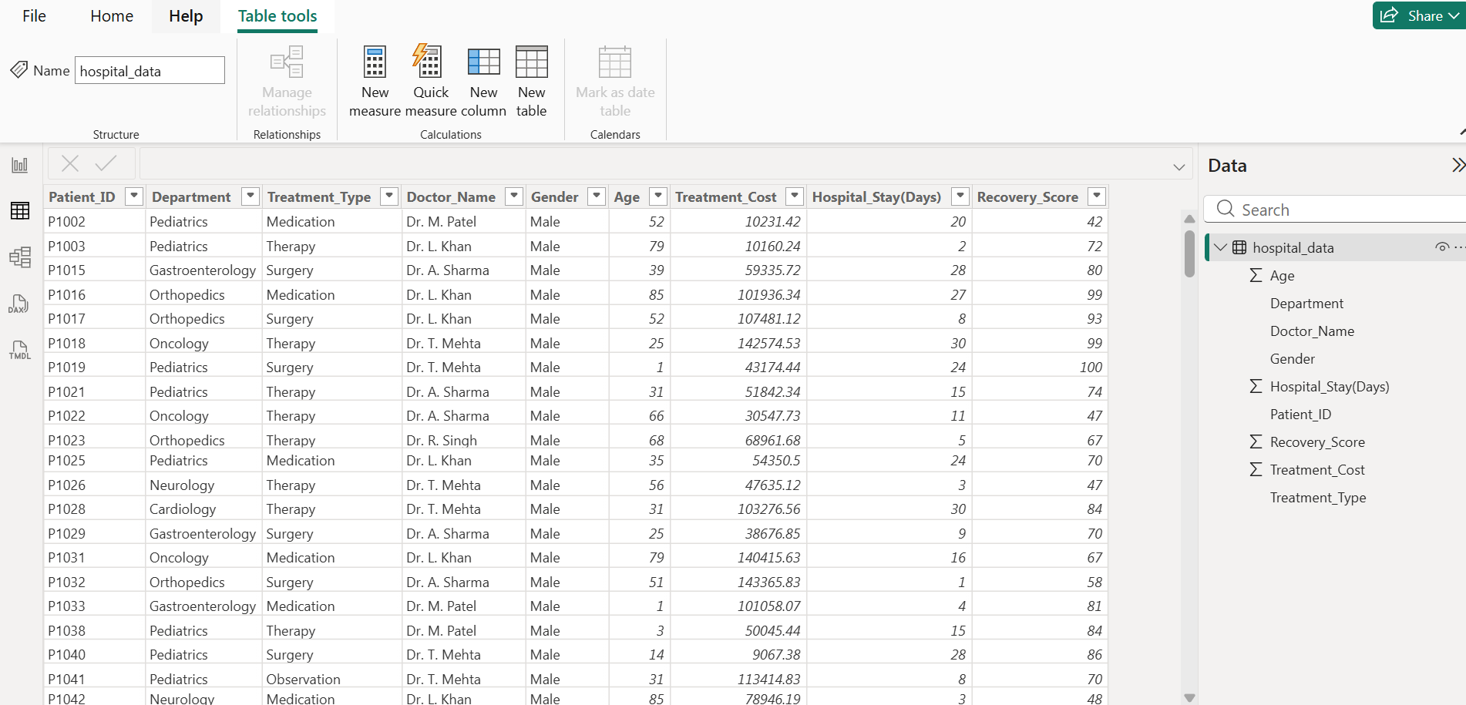
Data (Tabular) View
Notes:
Link components to roles in hospital and business data management.

Slide 11
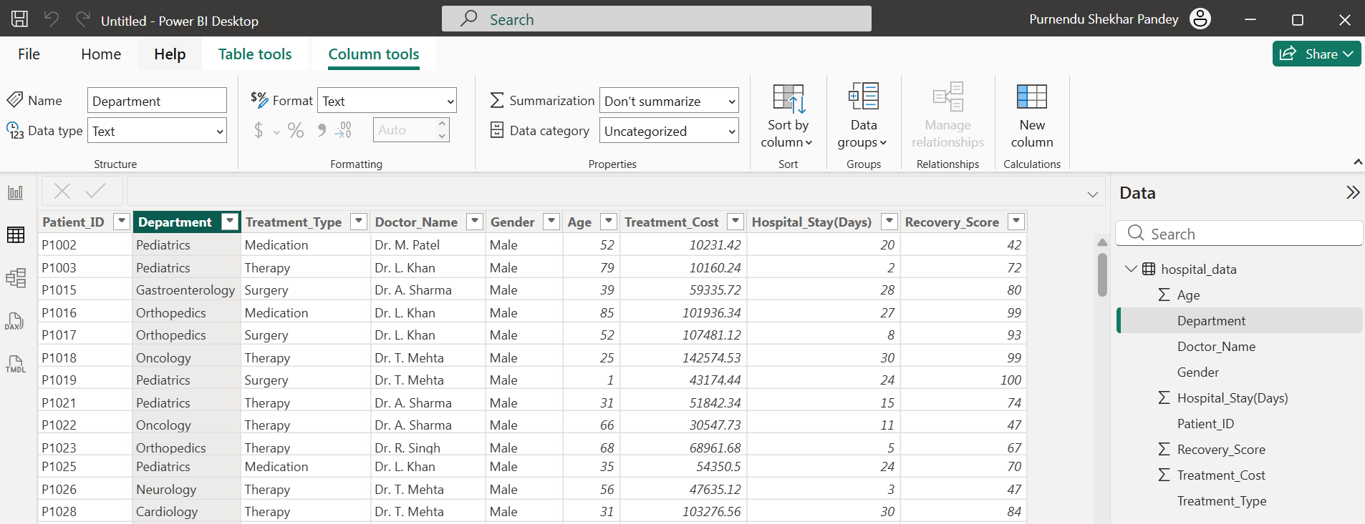
Data (Tabular) View
Notes:
Link components to roles in hospital and business data management.

Slide 12
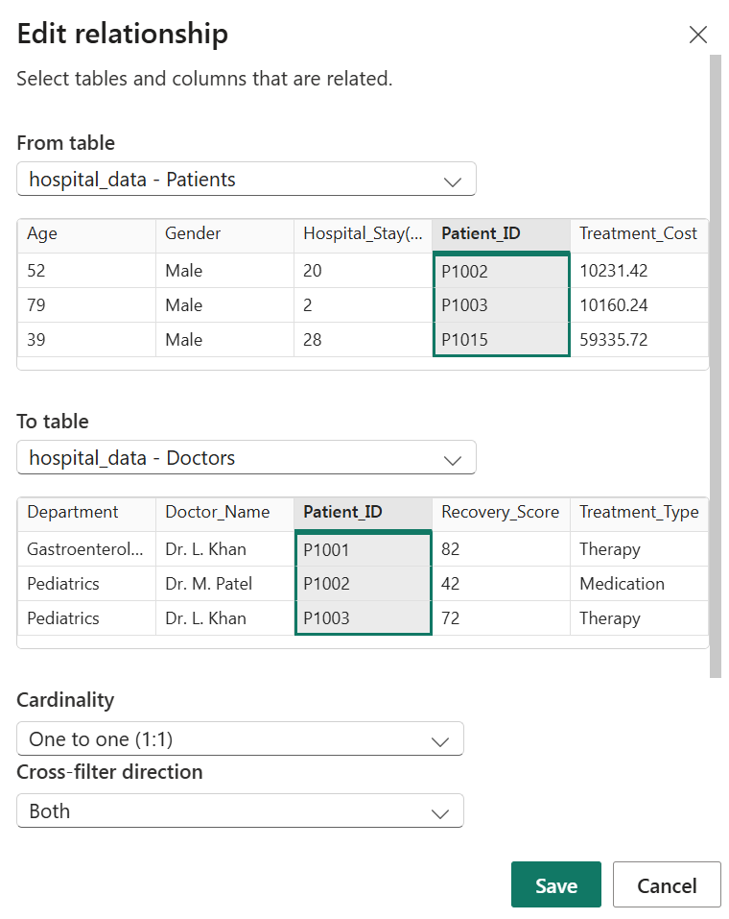
Model View
Notes:
Link components to roles in hospital and business data management.

Slide 13
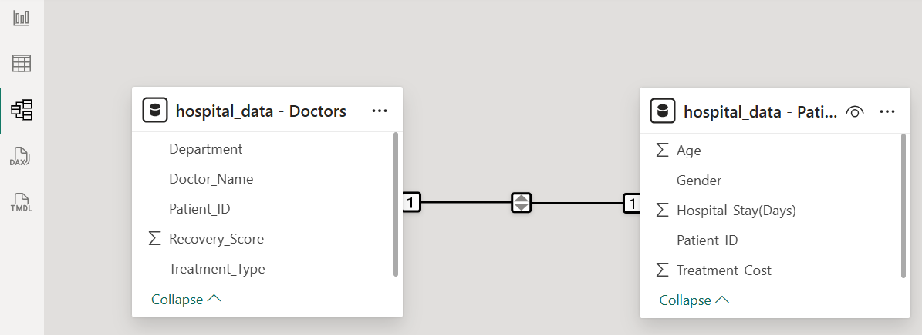
Model View
Notes:
Link components to roles in hospital and business data management.

Slide 14
Hands-on Example – Hospital Operational Dashboard
Dataset: Hospital Departments & Patient Treatments
Visuals:
• KPI: Average Treatment Cost (₹)
• KPI: Average Recovery Score
• Bar Chart: Patients by Department
• Pie Chart: Gender Distribution
• Line Chart: Recovery Score by Department
• Slicer: Treatment Type
Notes:
Demonstrate how Power BI reveals performance trends and operational insights.

Slide 15
DAX for Hospital Analytics
Example Calculations:
Average_Cost = AVERAGE(hospital_data[Treatment_Cost])
Average_Stay = AVERAGE(hospital_data[Hospital_Stay(Days)])
Recovery_Index = AVERAGE(hospital_data[Recovery_Score])
Applications:
• Compare department efficiency
• Measure cost-effectiveness per treatment
Notes:
Highlight DAX as Power BI’s formula engine for KPIs.

Slide 16
Understanding Primary Key and Foreign Key
in Power BI Models
• Primary Key: Unique identifier in a table
• Foreign Key: Field linking to another table
Purpose:
• Establish relationships between tables
• Enable joined analysis (e.g., patient data + department data)
• Maintain referential integrity
Notes:
Explain how Power BI data modeling uses keys to relate multiple tables for holistic analysis.

Slide 17
Publishing and Sharing Insights
• Publish dashboards to Power BI Service
• Share with department heads or stakeholders
• Schedule automatic refresh for live metrics
• Discuss insights directly via Microsoft Teams
Notes:
Demonstrate how Power BI enhances collaborative data-driven culture.

Slide 18
Conclusion & Q&A
• Power BI transforms data into actionable insights
• Enhances transparency, efficiency, and strategic decisions
• Encourages analytical thinking across departments
Thank You!
Notes:
Summarize benefits and invite questions from audience.

