Slide 1
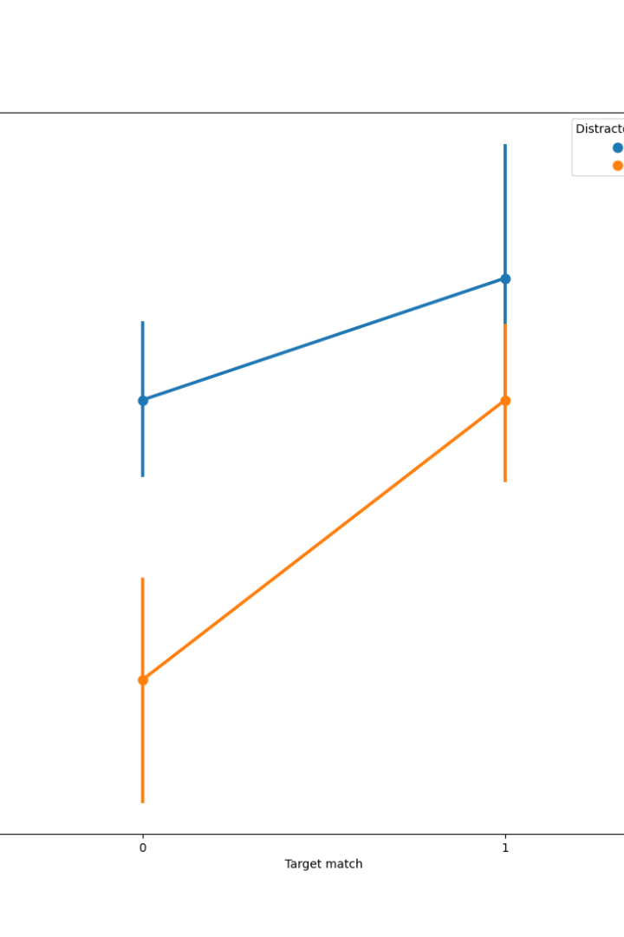

Python Sentimental Analysis Project
Python Sentiment Analysis Project with NLTK and Transformers aims to classify Amazon reviews using natural language processing techniques. This involves analyzing and categorizing the sentiments expressed in the reviews to determine whether they are positive, negative, or neutral.
by Purnendu Shekhar Achary

Slide 2

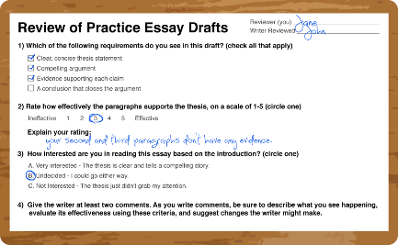
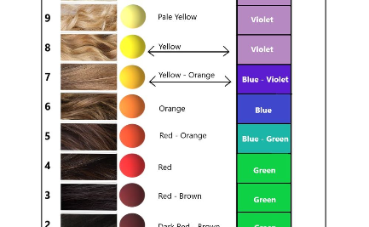

Problem Statement: Sentiment Analysis
Negative Sentiments
Positive Sentiments
Neutral Sentiments
Identifying and analyzing negative sentiments expressed in Amazon reviews is crucial for understanding customer dissatisfaction and areas of improvement.
Recognizing and categorizing positive sentiments in the reviews will help in identifying the aspects that customers appreciate and enjoy.
Addressing neutral sentiments is important for comprehensively understanding customer feedback and making informed decisions based on it.

Slide 3
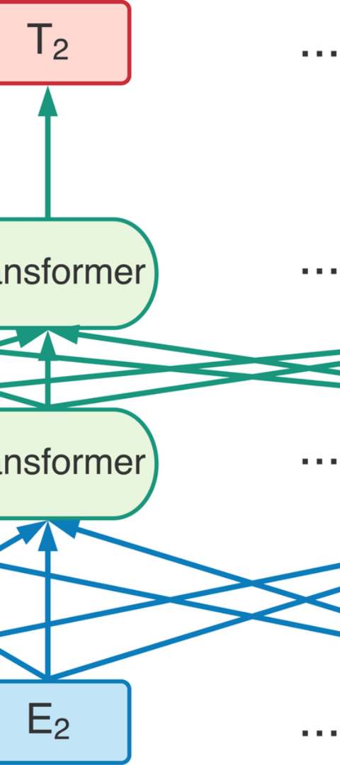
Building a Sentiment Analysis Model
1
Model Training
Creating and training a sentiment analysis model using NLTK and Transformers to interpret the sentiments expressed in Amazon reviews.
2
Data Preprocessing
Preparing and cleaning the Amazon review data to ensure accuracy and consistency in sentiment analysis model training.
3
Model Evaluation
Evaluating the trained model's performance in categorizing the sentiments expressed in Amazon reviews accurately.

Slide 4

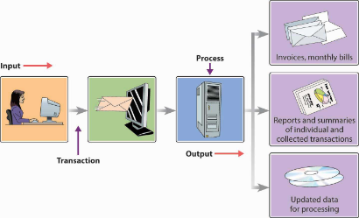
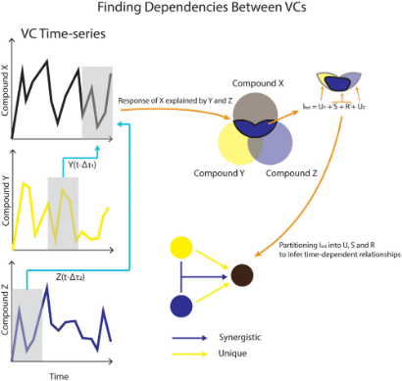
System Development Approach
Efficient Data Processing
Robust Model Architecture
Real-time Analysis
Implementing efficient data processing techniques to handle a large volume of Amazon reviews for sentiment analysis.
Constructing a robust and scalable model architecture to handle varied review sentiments effectively.
Developing a system that can provide real-time sentiment analysis results for Amazon reviews to facilitate prompt decision-making.

Slide 5
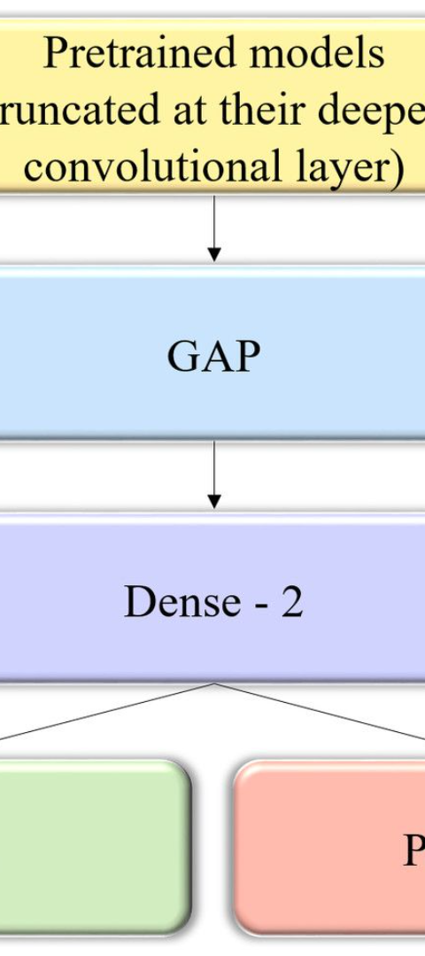
Algorithm Used: VADER and Roberta Pretrained Model
1
VADER Algorithm
2
Roberta Pretrained Model
Utilizing the VADER algorithm for sentiment analysis, which is specifically designed to work well with social media texts.
Integrating the Roberta Pretrained Model from Huggingface's Pipeline to improve the accuracy and efficiency of sentiment analysis.

Slide 6
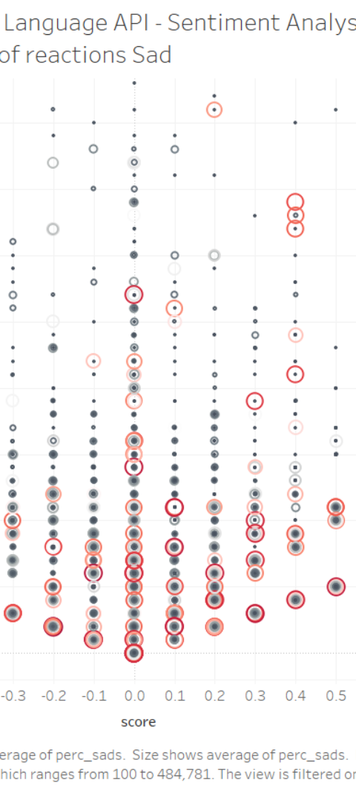



Visualize Result
Input Reviews
Inputting Amazon reviews into the sentiment analysis system for processing and analysis.
Sentiment Classification
Categorizing the sentiments expressed in the Amazon reviews as positive, negative, or neutral based on the analysis.
Result Interpretation
Interpreting the sentiment analysis results to extract insights and actionable information from the reviews.

Slide 7
Conclusion
Insightful Analysis
Decision Support
Continuous Enhancement
The sentiment analysis of Amazon reviews provides valuable insights into customer perceptions and sentiments toward products and services.
Empowering businesses with the information needed to make informed decisions and strategic improvements based on customer feedback.
Enabling the continuous enhancement of products and services by leveraging the sentiments expressed in the Amazon reviews.

Slide 8

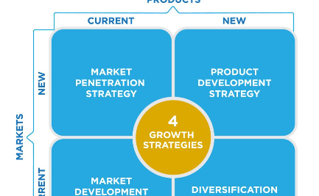

Future Scope
Advanced Technologies
Market Expansion Opportunities
Innovative Solutions
Exploring advanced technologies to further improve the accuracy and efficiency of sentiment analysis in Amazon reviews.
Developing innovative solutions to enhance the sentiment analysis process and its applications in various industries.
Identifying market expansion opportunities and potential through detailed sentiment analysis insights from Amazon reviews.

Slide 9

References
1
NLTK Book
2
Transformers Documentation
http://www.nltk.org/book/
https://huggingface.co/transformers/
3
Python Sentiment Analysis on Amazon Reviews
Published Paper, Author Name, Date

