Slide 1

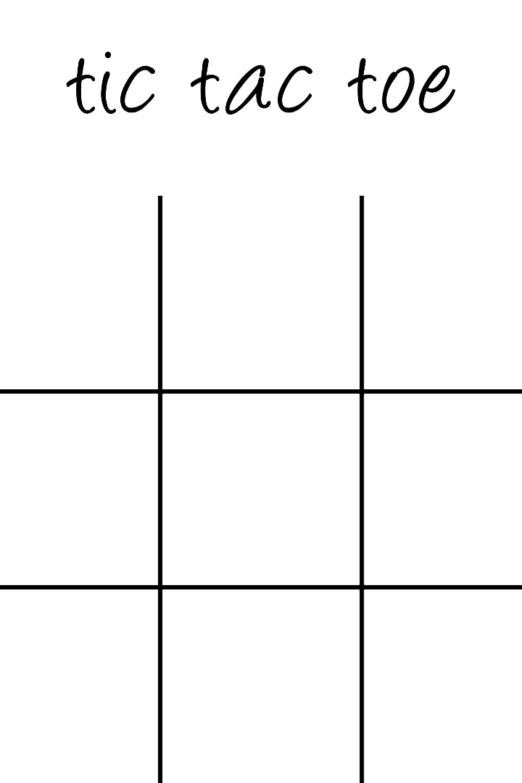

Exploring the Fun World of Tic Tac Toe with Java GUI
Welcome to the fascinating world of Tic Tac Toe game created with Java GUI. Let's take a closer look at how this simple yet exciting game works and explore its applications.
by Purnendu Shekhar Achary

Slide 2

Simple Game, Complex Working: How Tic Tac Toe Works
1
Board Creation
The game is played on a 3x3 grid. On each turn, the player marks a square with “X” or “O” until someone gets three in a row.
2
Winning Logic
If a player gets three marks in a horizontal, vertical, or diagonal row, they win. If there’s a tie, the game ends.
3
Player Interface
Players interact with the game through a simple-to-use graphical user interface designed with the Java GUI library.

Slide 3

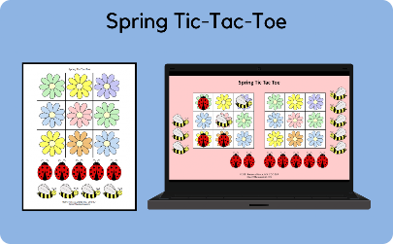
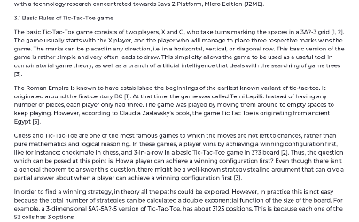
Uses of Tic Tac Toe: More Than Just a Game
Fun for Kids
Therapeutic Value
Teaching Basic Concepts
This simple game is also a great way to teach children strategy, logic, and critical thinking skills.
Tic Tac Toe can be used as an effective cognitive therapy tool to improve short-term memory, attention, and motor skills.
It's a good starting point for aspiring computer scientists exploring topics like graphical user interface, event handling, and more.

Slide 4

Advantages and Disadvantages of Using Java GUI for Tic Tac Toe
Advantages
Java is a popular programming language known for its reliability, security, and ease of use. It provides a wide variety of functions to create rich interfaces such as Tic Tac Toe. Java GUI offers a user-friendly interface that can be designed easily using drag and drop functions.
Disadvantages
Java can be sometimes slow to start up, and due to its popularity, it can be discovered by exploits. Java GUI may also be limited when it comes to more complex interfaces or features.

Slide 5
Tic Tac Toe Game: Future Scope and Looking Ahead
1
Adding Multiplayer Modes
Development of multiplayer modes, where players can play with their friends from different parts of the world. Java GUI can be used to create reliable local multiplayer system or full-featured online multiplayer systems.
2
AI Opponent
Developing the AI for Tic Tac Toe game, so that the players without any opposing player can challenge the AI and play.
3
Making It More Engaging
Exploring options to make the game more engaging by changing its existing rules or adding new elements to it.

Slide 6
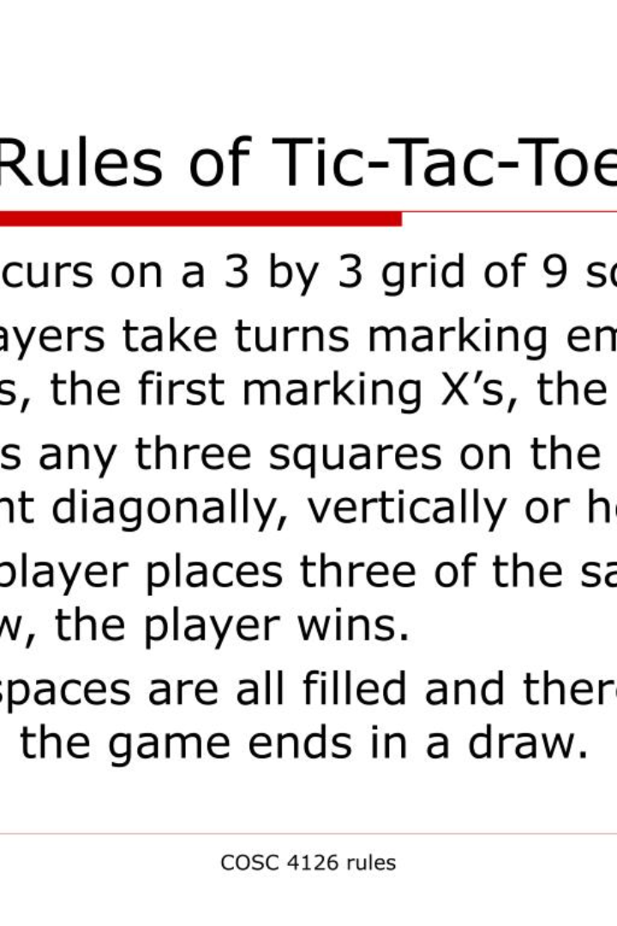
Conclusion
Tic Tac Toe game using Java GUI is an immensely enjoyable and educational experience that can help you improve your cognitive skills while having good fun. With its simple design, it’s a great starting point for aspiring game developers or computer scientists looking to learn exciting new technologies.

