Slide 1

Hospital Management System (HealthSure)
Project Walkthrough
Presented by: Purnendu Shekhar Achary – Intern (1806521)
Module: Recipient
Date:

Slide 2



Project Overview: Streamlining Healthcare
The Hospital Management System (HMS) is a comprehensive digital solution designed to modernise and streamline hospital operations and healthcare workflows.
Core Purpose
Key Stakeholders
To enhance efficiency, reduce administrative burden, and improve the overall patient experience.
Designed to serve a diverse group including Patients, Doctors, Hospital Administrators, Insurers, and Pharmacists, ensuring a holistic approach to healthcare management.

Slide 3
System Modules: A Modular Approach
The HMS is built on a foundation of interconnected modules, each handling specific functionalities to ensure seamless operations.
Providers
Manages Doctor profiles, availability schedules, and specialisations.
Admin
Oversees system settings, user roles, and audit logs for security and compliance.
Recipient
Serves as the patient portal, facilitating insurance verification and provider search.
Insurance
Handles policy details, plan management, and claims processing.
Pharmacy
Manages prescription fulfilment and inventory.

Slide 4




Recipient Module: Patient-Centric Design
The Recipient module empowers patients with direct access to essential healthcare information and services.
Patient Portal
Key Features
Core Principles
A user-friendly interface enabling patients to manage their healthcare journey efficiently.
View comprehensive insurance details.
Designed for simplicity, accuracy, and secure access, ensuring patient data integrity and ease of use.
Search for healthcare providers based on various criteria.

Slide 5

My Contribution: Enhanced Recipient Features
My focus has been on developing and refining critical functionalities within the Recipient module, ensuring a robust and intuitive user experience.
1
View Insurance Details
Built an intuitive interface for viewing insurance details with search, filters, and a dedicated detail view page, ensuring smooth navigation, clear insights, and graceful error handling.
2
Search for Providers
Developed advanced search capabilities allowing filtering by name, specialisation, and location, ensuring patients find the right care provider.
3
Smart UI Logic & Validations
Integrated intelligent user interface logic and robust validation rules to guide users, prevent errors, and ensure data integrity.

Slide 6



Key Features: Recipient Module
View Insurance Details
Search for Providers
Developed a robust and user-focused insurance view module where recipients can:
Implemented an advanced, criteria-based doctor search allowing recipients to:
Search by plan name
Search by doctor name or address, with options for Starts With or Contains
Filter by coverage status (All, Active, Expired)
Apply date filters to refine resultsIntegrated features like sorting, pagination, and input validation ensure a seamless user experience.
Select specialization from a dynamically populated dropdown (fetched from the database)
Supports sorting, pagination, and enterprise-grade validation for input safety.
Handled system-level failures gracefully using custom exception handling.
Built-in custom exception handling ensures reliability during system issues.
Also built a dedicated detail view page to provide recipients with a clear, at-a-glance summary of their selected insurance policy.
This module is also integrated with appointment booking, enabling users to find and connect with providers seamlessly.

Slide 7
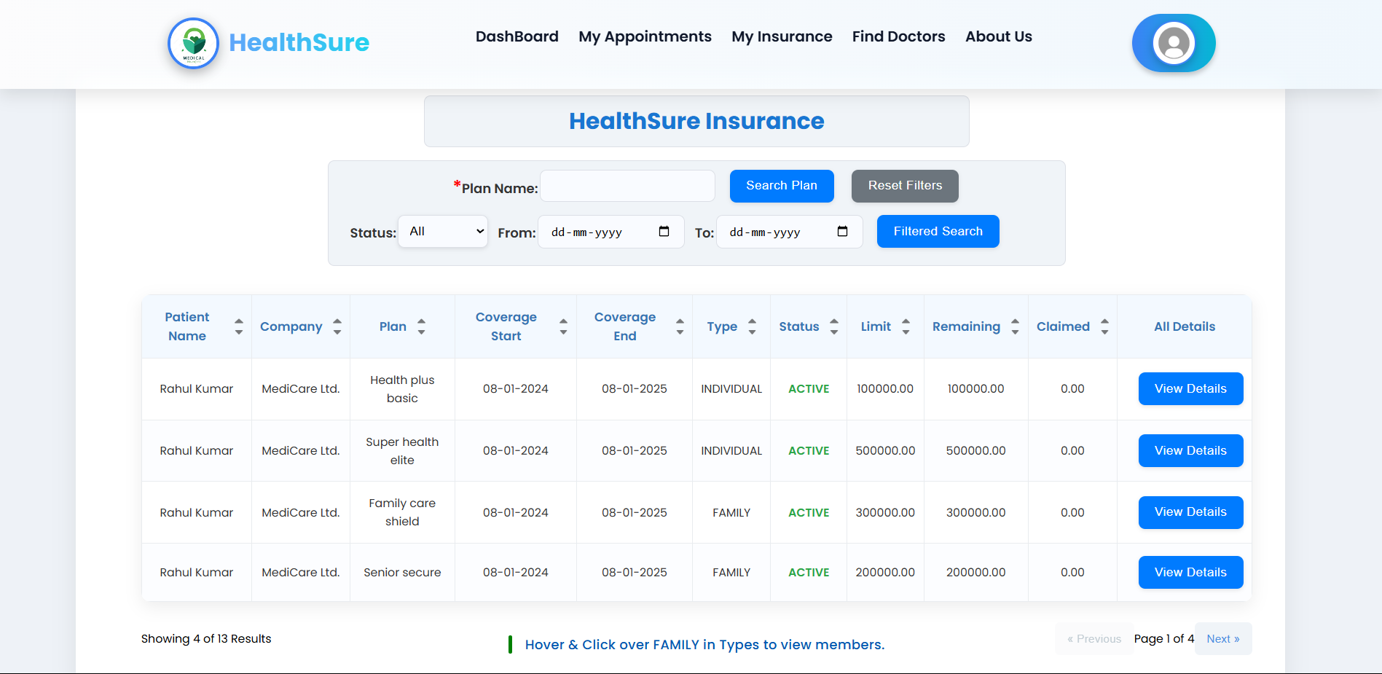
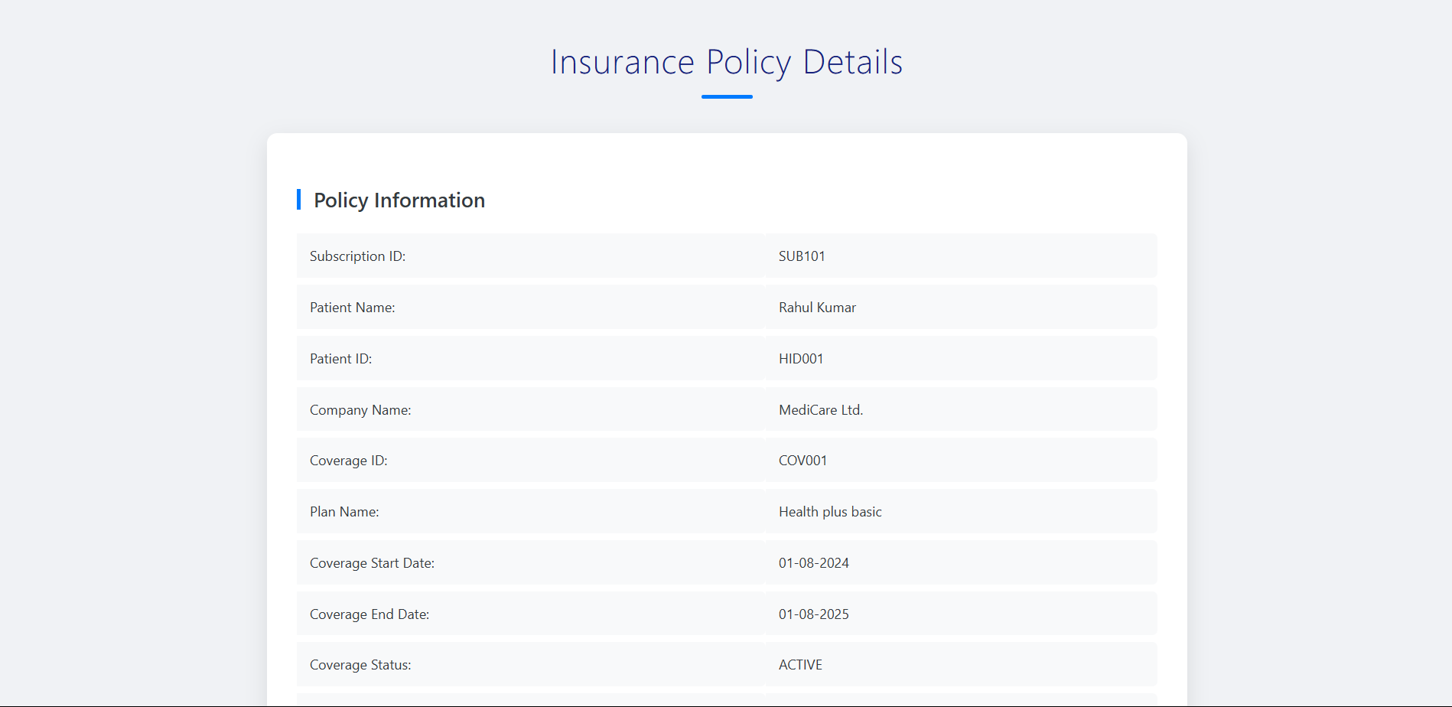
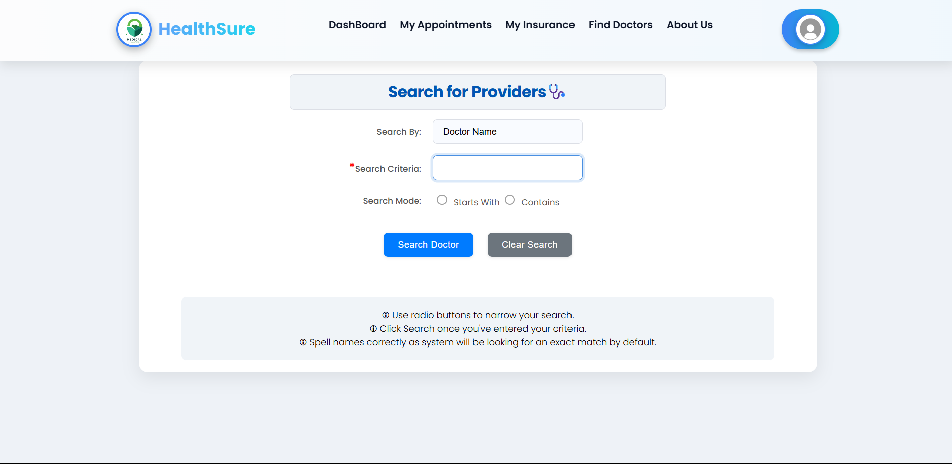
UI Screens: Visualising the Experience
These are illustrative examples of the user interface screens, showcasing the design and functionality implemented within the Recipient module. Actual screenshots will be presented during the live walkthrough.
Health Sure Insurance Page
View Details Page Insurance
Search providers Page

Slide 8





Architecture and Tech Stack: Robust Foundations
The HMS is built on a layered architecture, ensuring maintainability, scalability, and a clear separation of concerns.
View Layer
Leveraging JSF and JSP for dynamic and interactive user interfaces.
Controller Layer
Manages user requests and orchestrates data flow between the view and business logic.
DAO Layer
Defines the contract for data operations, ensuring abstraction from persistence details.
DAOImpl Layer
Provides concrete implementations of data access operations.
Database
Utilises MySQL for reliable and efficient data storage.
Key Principles: Custom exceptions for robust error handling, and strict separation of concerns for modular development.

Slide 9






The Core Technologies: A Visual Overview
The Hospital Management System leverages a robust and modern technology stack to ensure performance, reliability, and maintainability.
Java 1.8
JSF 2.2 & JSP
The primary programming language powering the backend logic and application foundation.
Frameworks used for building dynamic, interactive, and robust user interfaces.
Hibernate 3.6
MySQL
An Object-Relational Mapping (ORM) framework for efficient and seamless database interaction (XML config).
The relational database management system chosen for reliable and scalable data storage.
Log4j
System Reliability & Modularity
A logging framework for enabling robust debugging, auditing, and monitoring of application activities.
Achieved through custom exceptions for precise error handling and strict separation of concerns for maintainable and scalable development.

Slide 10



Wrap-Up & Code review
We've explored the modular design of the Hospital Management System and delved into the specifics of the Recipient module, highlighting its user-centric design and the clean backend layering.
Modular Design
User-Centric
Clean Backend
Ensures scalability and ease of maintenance.
Prioritises ease of use and patient experience.
Promotes robust and efficient data handling.

