Slide 1

EDA on Facebook Data

Slide 2
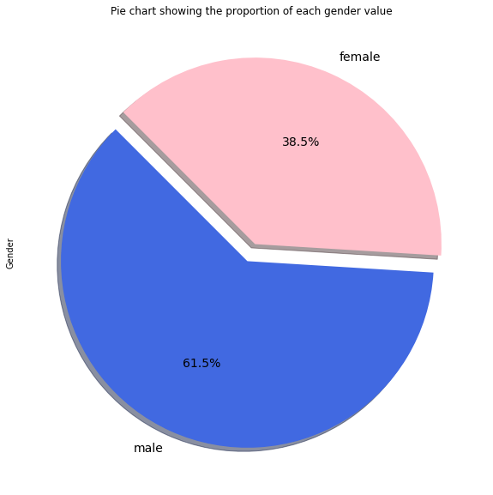
Users on Facebook by gender
There are more no of male than female on facebook

Slide 3
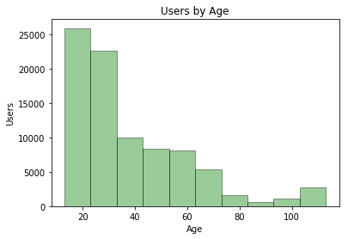
Users on Facebook by Age
Youth presence is more on facebook

Slide 4
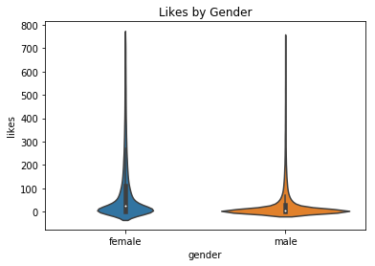
Likes by gender
Female does more likes than male

Slide 5
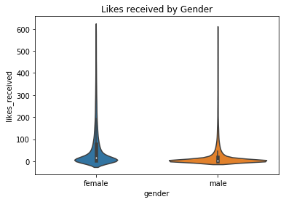
Likes received by gender
Female gets more likes on their posts than male

Slide 6
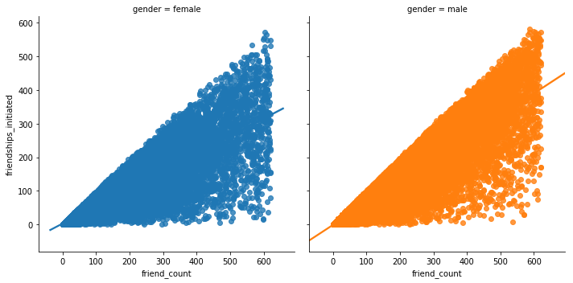
Friends count and friendship initiated by gender
Men have more friends and they have initiated more friendships

Slide 7
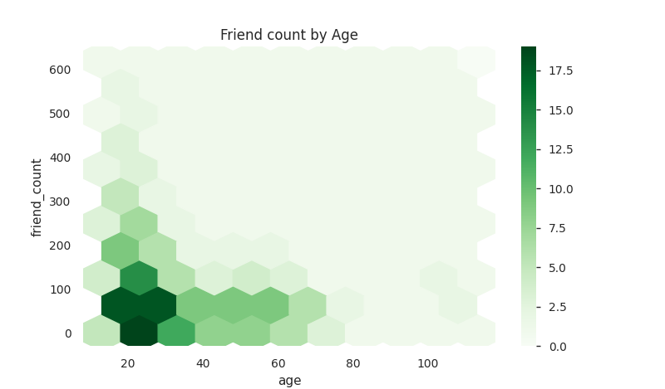
Friends count by Age
Person with age between 15-30 have more friends count

Slide 8
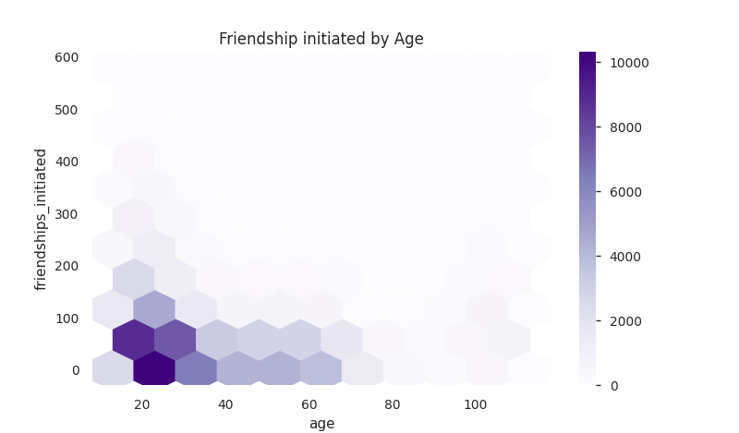
Friendship initiated by Age
Person with age between 15-30 has sent more friend requests

Slide 9
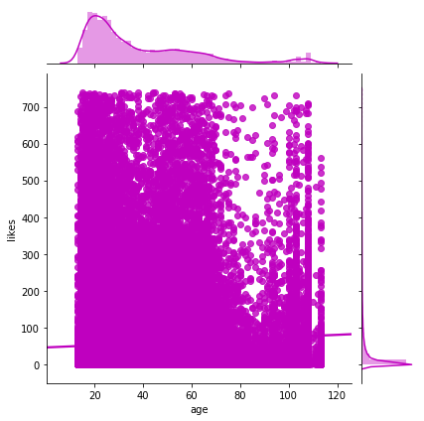
Likes by Age
Number of likes decreased with higher age group

Slide 10
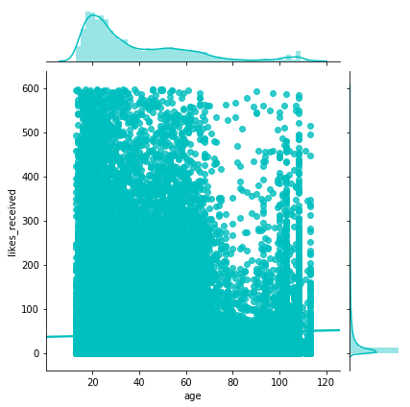
Likes received by Age
Number of likes received decreased with higher age group

Slide 11
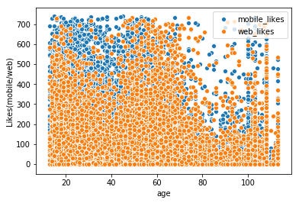
Likes from mobile and web
People more often used mobile than web to like posts

Slide 12
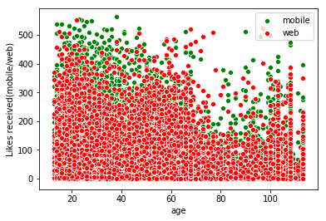
Likes received from mobile and web
People received more likes on mobile than web

