Slide 1


Best Stock to Invest in
Dheeraj Reddy – 100811270
Pooja Vasan – 100799175
Purnima Yadav – 100800499
Vasundara – 100800734

Slide 2
Content
Introduction
Why expert system is needed?
Expert System indicators- MACD, Stochastics
Tools and Techniques
Use cases
Conclusion
Methodology

Slide 3

Introduction
Stock market prediction determines the future movement of the stock value of a financial exchange keeping in mind the factors like politics, interest rates and economic growth.
There is a research which proves that the prediction of stock market using Expert System – fuzzy logic, yields an accuracy of 98.3% for the Istanbul Stock Exchange.
In this project, we have developed an expert system that uses its knowledge base and inferencing techniques and indicators such as MACD and Stochastic to predict the best time to invest in Stocks.

Slide 4

Why do we need an Expert System?
They can explain market status, interprets patterns and can be helpful to investors’ decision making.
One expert system may contain knowledge from more than one human expert thus making the solutions more efficient.
Questions asked by the expert system:
Does the investor mind invest in risky companies?
Does the investor have specific field/ area of interest to invest in?
Are there any companies that the investor wants to avoid?

Slide 5
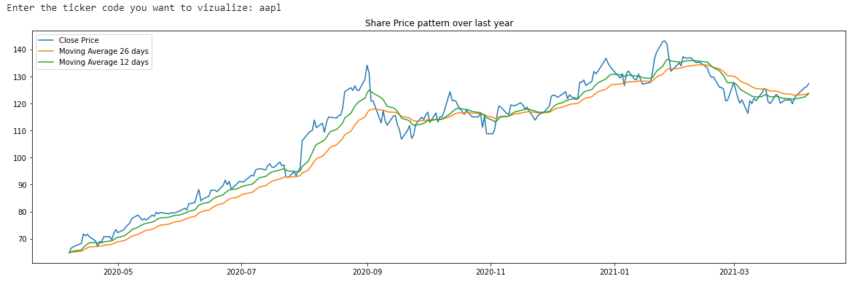
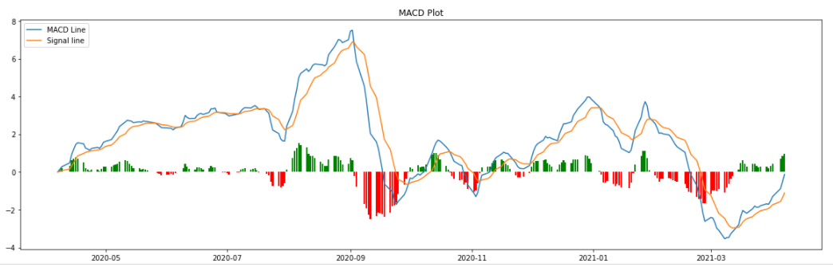
Expert System Indicators- MACD: Moving Average Convergence Divergence
One of the simplest and most effective indicators.
As the name suggests, it is all about convergence and divergence of the two moving averages.
As MACD is unbounded, traders can look for signal line crossovers, centerline crossovers and divergences to generate signals.
General rule of 26-12 Moving average method is used

Slide 6
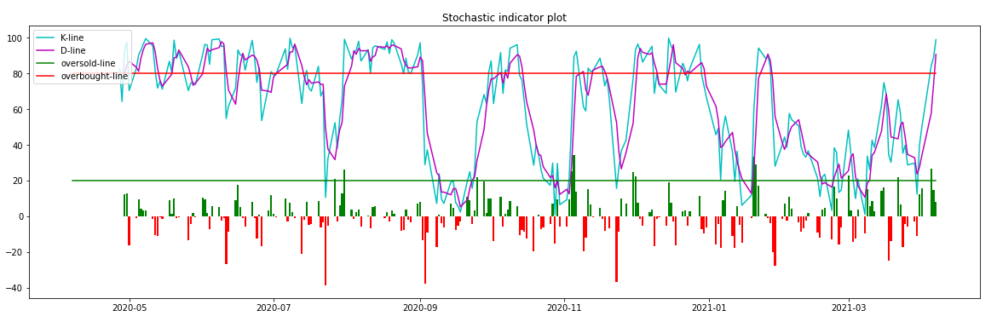
Expert System Indicators- Stochastic Indicator
This indicator measures the relationship between an issue’s closing price and its price range over a predetermined period.
It determines whether a stock has moved into overbought or oversold position.
The K-line and D-line are calculated based on the 14-day high and low values of a stock.

Slide 7

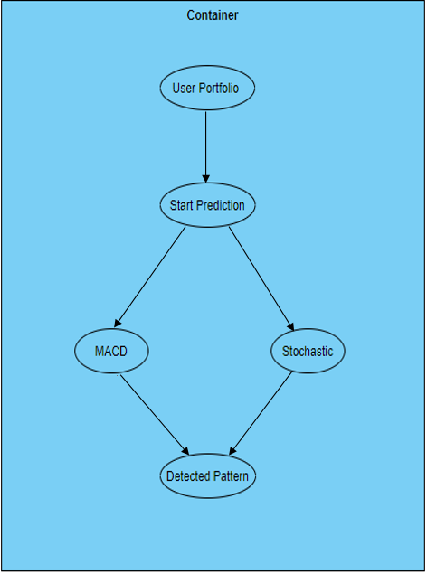
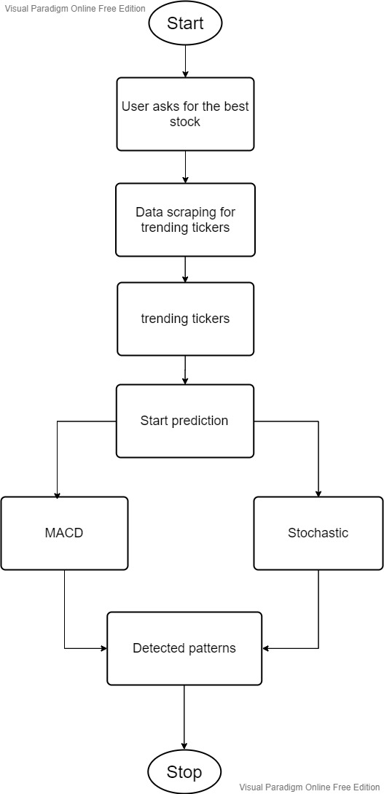
Methodology

Slide 8
Tools and Techniques
Python-
Numpy for Mathematical calculations.
Data-
We have scraped financial news from Yahoo! Finance.
Web Scraping-
We have used BeautifulSoup to scrape and parse data from the PR News wire website.
Pandas for data extraction.
Matplotlib for visualization

Slide 9
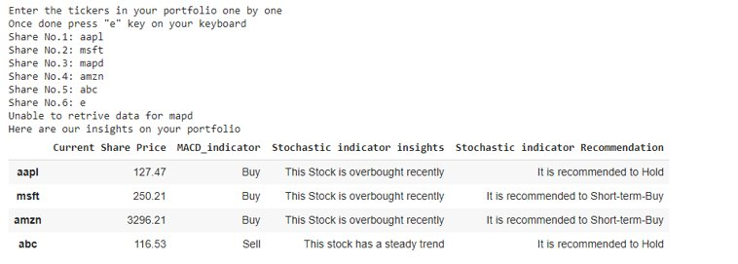
Use Case – 1 (Portfolio Management)

Slide 10
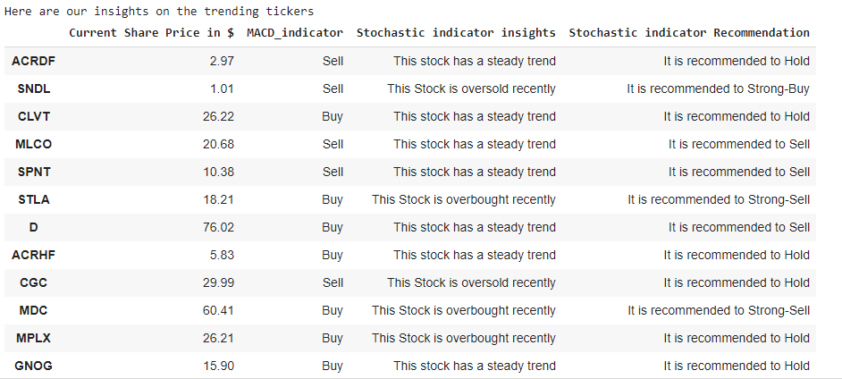
Use Case – 2 (Trending shares today)

Slide 11

Conclusion
Stock Market Buy/ Sell indicators done on rule based expert system
Data scraping is done from PR news wire website to get trending tickers.
An attempt is made to suggest the best stocks based on the MACD and Stochastic Oscillator experts.
This expert system might perform poorly for highly volatile stocks.

Slide 12
Thank you

