Slide 1
PS3 Fee Collection
Automated Fee Management System

Slide 2
Project Overview
A web‑based solution for managing student fee payments.
Provides secure login, fee tracking, receipt generation, and admin dashboards.
Designed for schools/colleges to streamline financial operations.

Slide 3
Architecture Overview
Frontend: React (SPA) communicating with REST APIs.
Backend: Node.js + Express with MongoDB for data persistence.
Authentication via JWT, logging with Winston, environment config via dotenv.

Slide 4
Key Features
🔐 Secure user authentication and role‑based access.
📊 Real‑time dashboard for fee statistics.
🧾 Automated receipt generation (PDF).
💳 Online payment integration.
🛠️ Admin panel for managing students, fees, and payments.

Slide 5
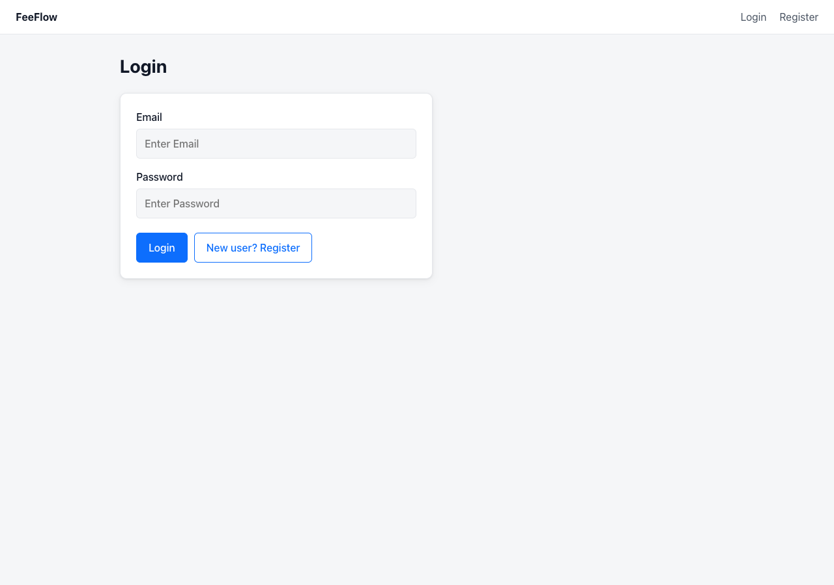
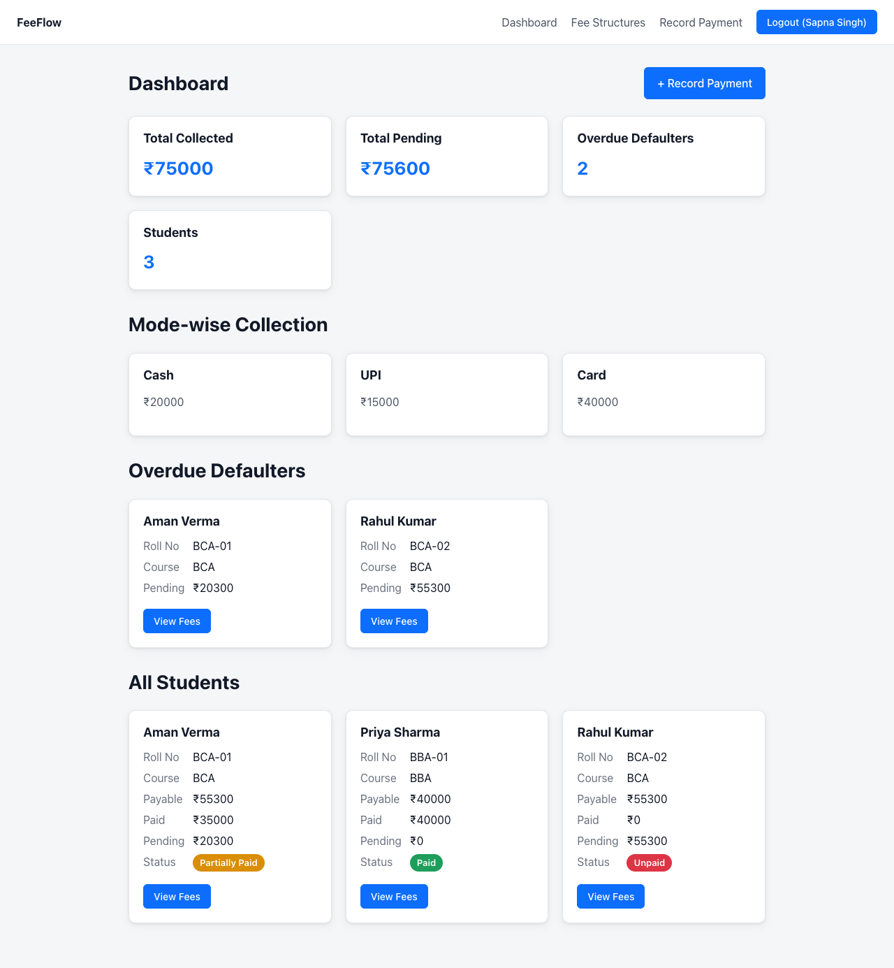
Application UI Snapshots

Slide 6
Technologies Used
Frontend: React, JavaScript, HTML5, CSS3
Backend: Node.js, Express.js
Database: MongoDB
Auth: JWT, bcrypt
Styling: Bootstrap (custom corporate theme)
Tools: Git, Docker (optional), npm

