Slide 1

EWD Project
Student: Bohdan Andoniiev, s23005 Tutor: Stanisław Horawa

Slide 2
Goal of the experiment
2
The goal of the project is to build the predicting model to predict the obesity level of persons.

Slide 3
Data
Link to the data: https://www.kaggle.com/datasets/fatemehmehrparvar/obesity-levels/data
Features:
Gender: Feature, Categorical, "Gender" Age : Feature, Continuous, "Age" Height: Feature, Continuous Weight: Feature Continuous family_history_with_overweight: Feature, Binary, " Has a family member suffered or suffers from overweight? "
FAVC : Feature, Binary, " Do you eat high caloric food frequently? " FCVC : Feature, Integer, " Do you usually eat vegetables in your meals? " NCP : Feature, Continuous, " How many main meals do you have daily? " CAEC : Feature, Categorical, " Do you eat any food between meals? " SMOKE : Feature, Binary, " Do you smoke? " CH2O: Feature, Continuous, " How much water do you drink daily? " SCC: Feature, Binary, " Do you monitor the calories you eat daily? " FAF: Feature, Continuous, " How often do you have physical activity? " TUE : Feature, Integer, " How much time do you use technological devices such as cell phone, videogames, television, computer and others? "
CALC : Feature, Categorical, " How often do you drink alcohol? " MTRANS : Feature, Categorical, " Which transportation do you usually use? " NObeyesdad : Target, Categorical, "Obesity level"

Slide 4
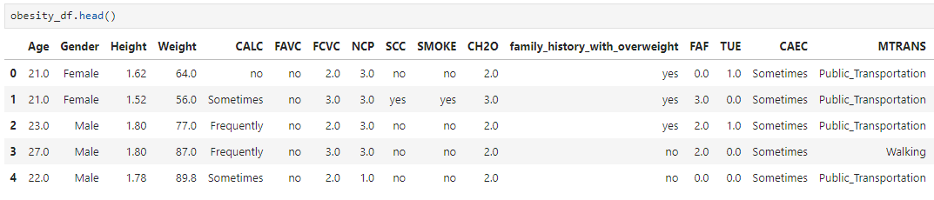
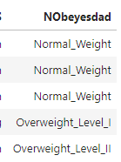
Exploratory Data Analysis – head of the dataset

Slide 5
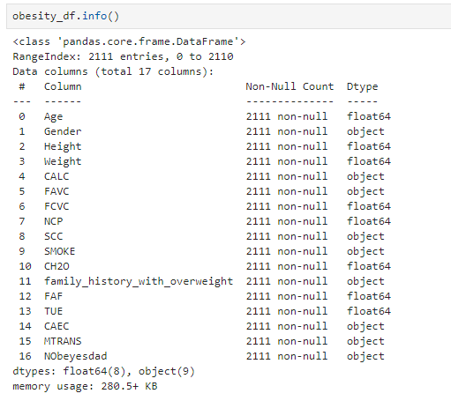
Exploratory Data Analysis – information about dataset

Slide 6
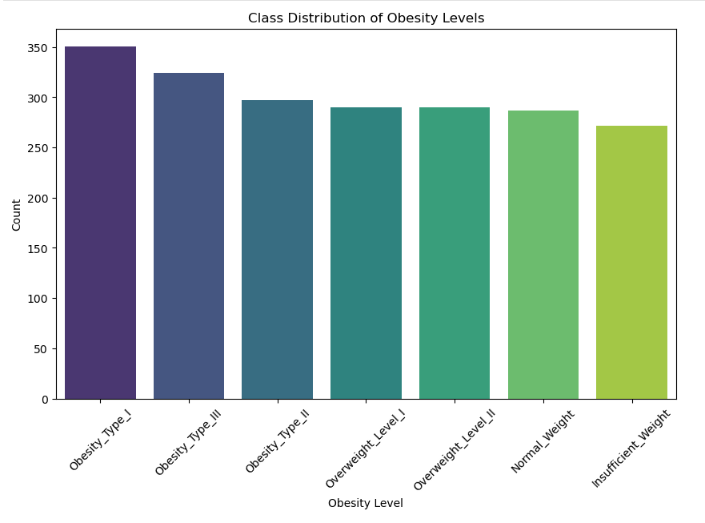
Exploratory Data Analysis – distribution of instances for every class

Slide 7
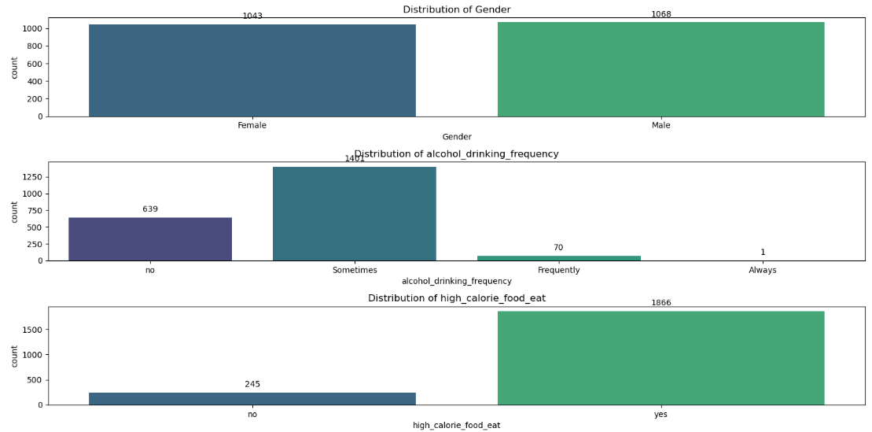
Exploratory Data Analysis – distribution of categorical features

Slide 8
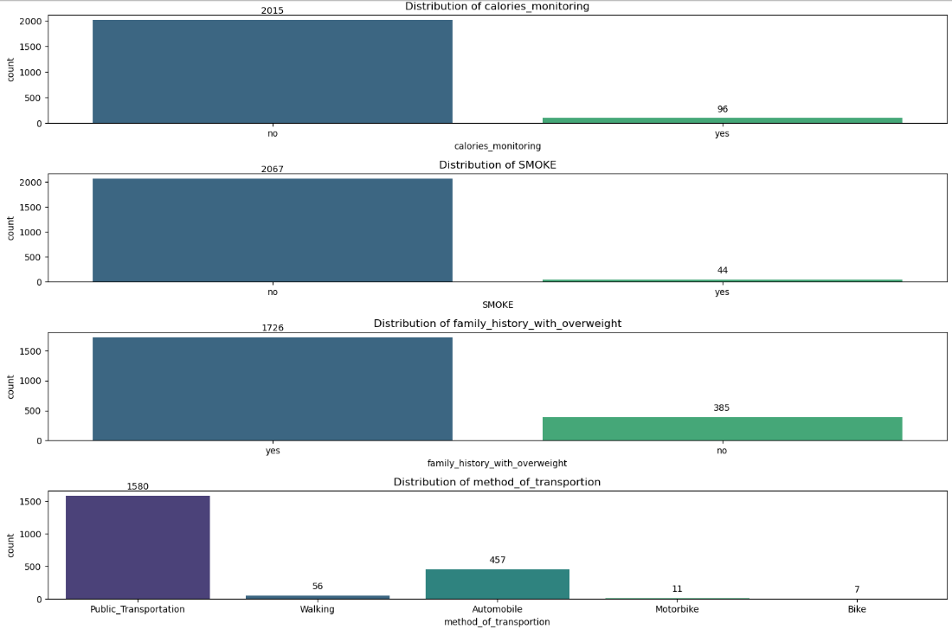
Exploratory Data Analysis – distribution of categorical features

Slide 9
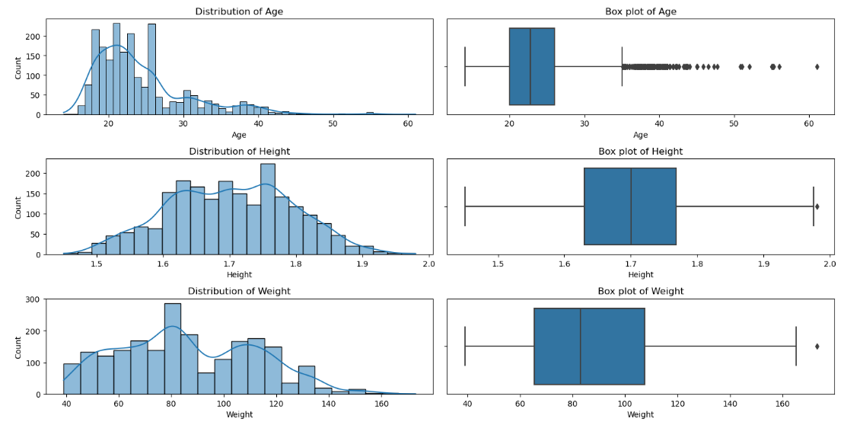
Exploratory Data Analysis – distribution of continuous features

Slide 10
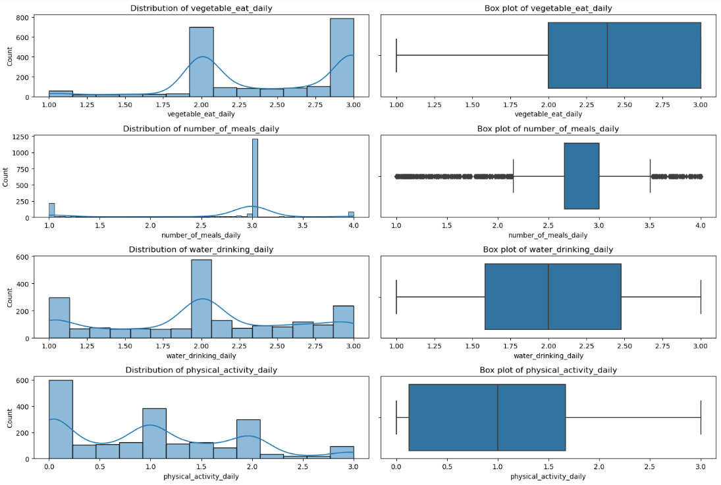
Exploratory Data Analysis – distribution of continuous features

Slide 11
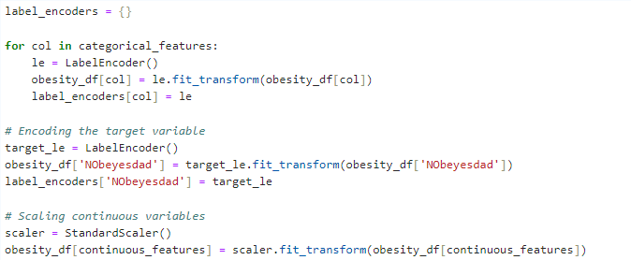
Data Preprocessing
Now, we need to encode our categorical variables and scale continuous values.
The categorical variables that need encoding: gender, alcohol_drinking_frequency, high_calorie_food_eat, food_between_meals, calories_monitoring, calories_monitoring, SMOKE, family_history_with_overweight, method_of_transportation, NObeyesdad(our target variable).
The continuous variables that need scaling: Age, Height, Weight, vegetable_eat_daily, number_of_meals_daily, water_drinking_daily, physical_activity_daily, electronics_usage_daily.

Slide 12
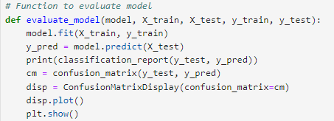
Model training
For the training, I picked the following models:
Logistic Regression
Decision Tree Classifier
Random Forest Classifier
Support Vector Machine
K-Nearest Neighbors
For each model we will:
Train the model
2) Evaluate the model and prepare a classification report along with confusion matrix
3) Perform cross-validation to validate the model performance

Slide 13
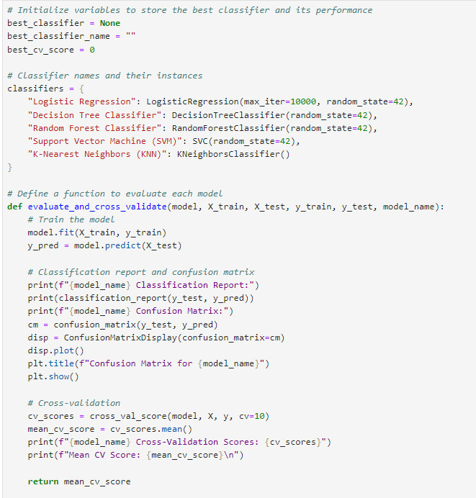
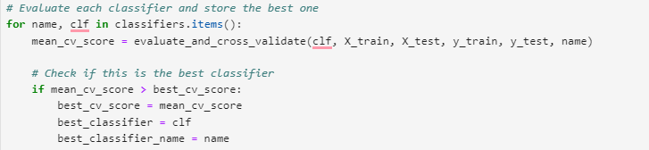
Model training

Slide 14

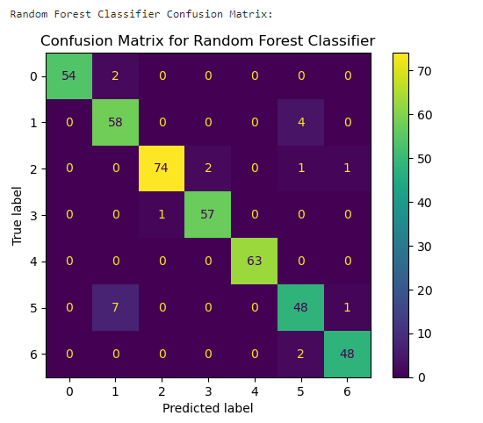
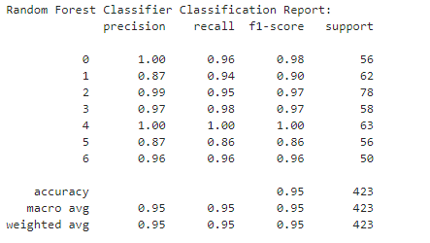
Evaluation

Slide 15
Thank You for Your Attention

