Slide 1

DBInserter
Submitted By:
Puroo Kulshrestha (201500535)

Slide 2

Content
Introduction
Problem Statement
Objectives
Functionalities
Implementation Details
Screenshots
Conclusion

Slide 3


Introduction
DBInserter is implemented in C language. DBInserter connects to sqlite database, and it insert the records given in "file.csv" into database.
This project is only compitable with sqlite3 database, and it test.db created in source folder only.
Project is to develop a database application and queries using libraries and api’s.

Slide 4


Problem Statement
My aim is to develop a software for the users in which a user can store their data into database.
Currently, this software only work on read, insert and display the database data.
Most of the humans store their data in sheets/paper and this type of data can’t last long.
We have to develop a software which can resolve all of the above problems.

Slide 5
Objectives
This software provides facility to store the data in database safe and secure.
It provides a good platform, where not only institutes but ground level worker can store their data safe.
The scope is this project is very broad in terms of gaining knowledge.
It helps you gain more knowledge about database, sql and C programming.

Slide 6
Functionalities
The main requirement of this software is to develop a database application and queries using libraries and API’s. Names, company names, account numbers, Social Security numbers and client numbers are examples of identifying information that a business can store in a database.
Keep your data safe and secure.
Store unlimited data in database.
The results seen as soon as compiler show the table created successfully.
Save any type of data into database.

Slide 7

Implementation Details
This pick csv file from hardcoded path "library.csv" in source folder. Sample csv is also given.
Sqlite3, Mingw and visual studio code should already be installed at your machine, prior to compiling and executing this project.
This project is only compitable with sqlite3 database, and it test.db created in source folder only.
To comile download this project in any location at your machine, and change the "home" path given in Makefile located in source folder.

Slide 8
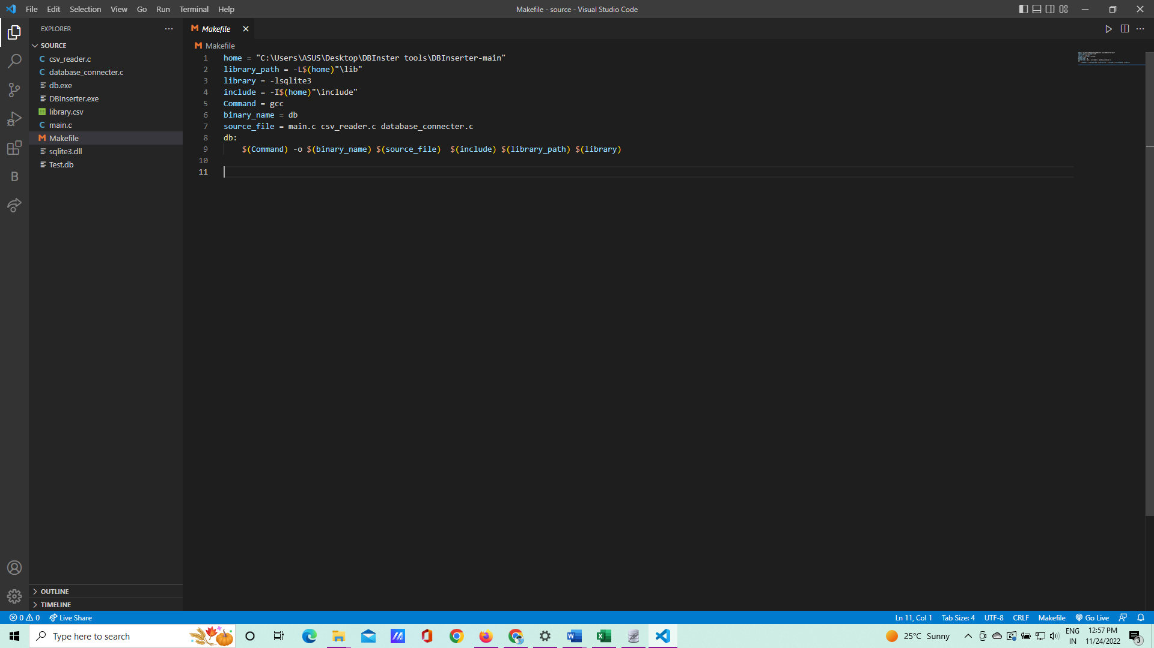
Screenshots : Makefile

Slide 9
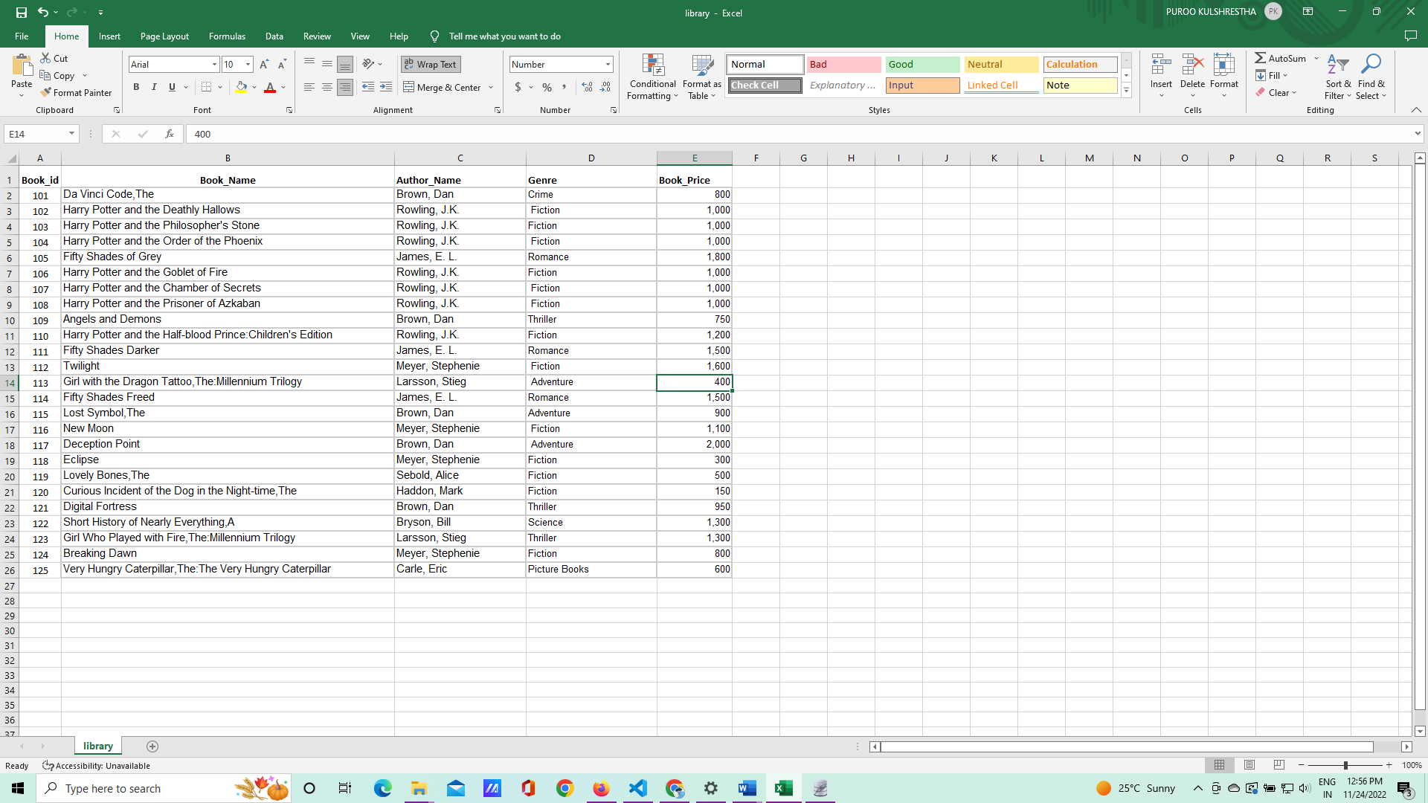
Screenshots : .csv file

Slide 10
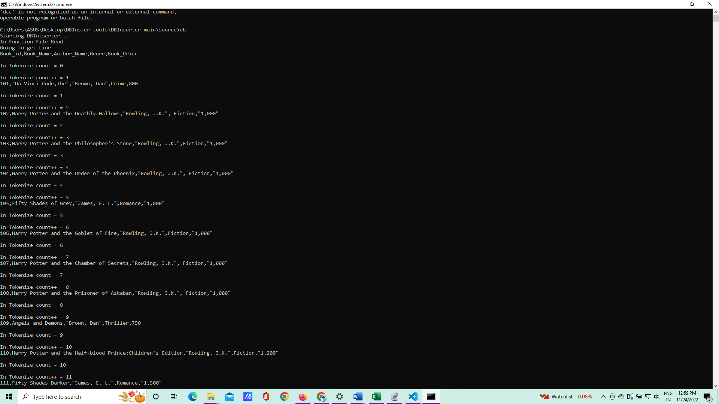
Screenshots : compile the .db file

Slide 11
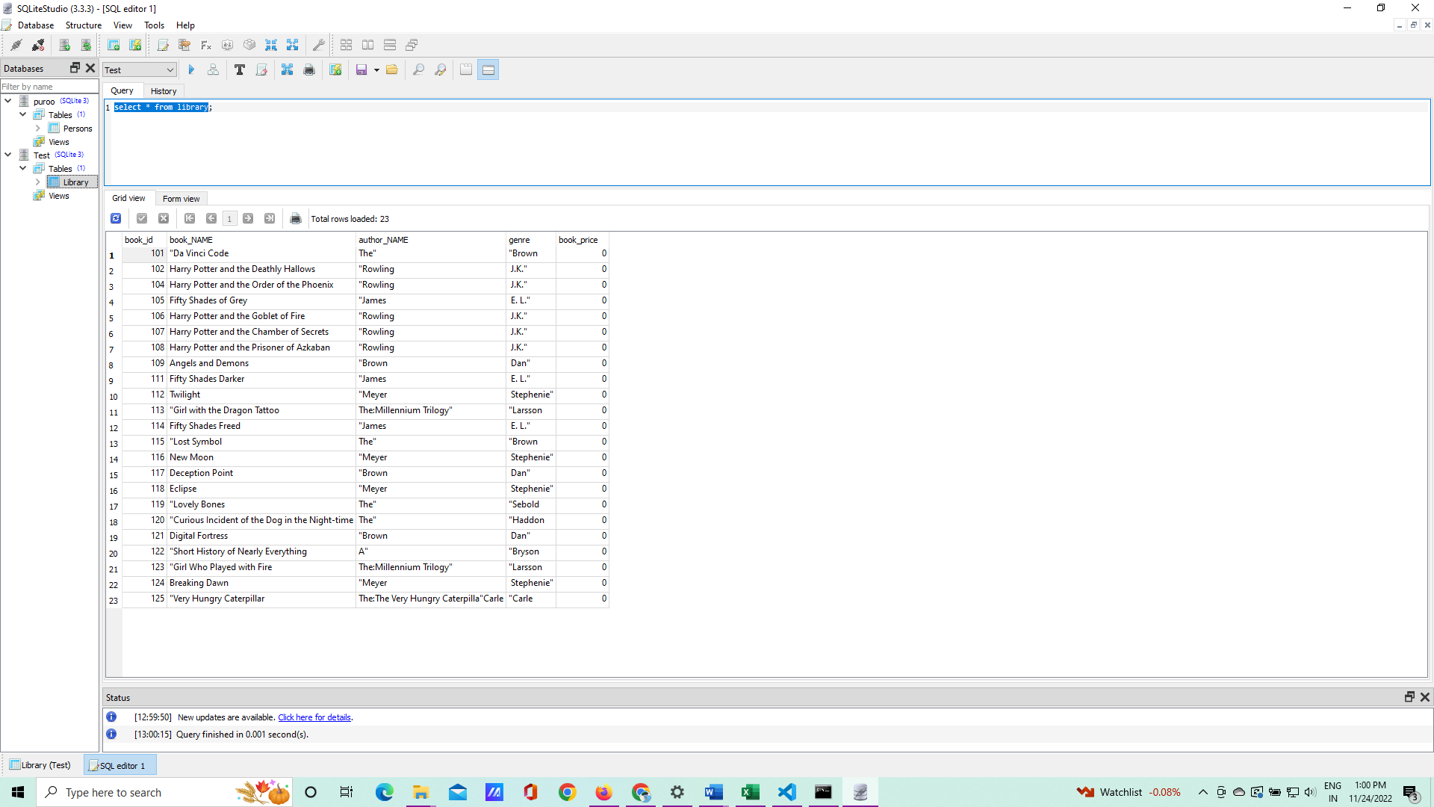
Screenshots : data stored in the database

Slide 12
Conclusion
This application provide your data safe.
It save time since user does not see other stuff.
SQLite does memory allocation, including setting up alternative memory allocators appropriate for safety-critical real-time embedded systems and application-defined memory allocators.
All student/user get extra knowledge and skills.

Slide 13


