Slide 1

Snakey
Submitted By:
Puroo Kulshrestha (201500535)

Slide 2

Content
Introduction
Problem Statement
Objectives
Functionalities
Implementation Details
Screenshots
Conclusion

Slide 3

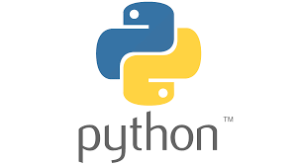
Introduction
Python is an interpreted, object-oriented, high-level programming language. Python's simple, easy to learn syntax emphasizes readability and therefore reduces the cost of program maintenance. Python supports modules and packages, which encourages program modularity and code reuse.
Snakey is a simple game that involves controlling a snake that moves around the screen and eats food. As the snake eats food, it grows longer, and the player's objective is to prevent the snake from colliding with the walls or its own body.
Pygame is a powerful library for game development, offering a wide range of features to simplify your coding journey.

Slide 4

Problem Statement
Currently, this game has simple feature like moving snake in any direction and as long as snake eating food he grows until he collides with external walls.
The snake game in Python is not directly related to any contemporary issue, it can be used as an educational tool to promote coding skills and programming literacy among individuals
Building games and applications using Python is a growing trend in the tech industry, and game development using Python is a popular choice among developers.

Slide 5
Objectives
My aim is to develop a interactive and entertaining game for the users.
Developing a snake game in Python are to create a technically sound game that provides an engaging and enjoyable experience for the player.
The scope is this project is very broad in terms of gaining knowledge.
It helps you gain more knowledge about Pygame.

Slide 6

Functionalities
The game must be optimized for smooth gameplay, responsive controls, and efficient collision detection. Visually appealing graphics and animations, appropriate sound effects, and user-friendly controls are also important to create an engaging user experience.
Keep user interactive.
Enhance the overall gaming experience.
The game is accessible to as many players as possible.

Slide 7

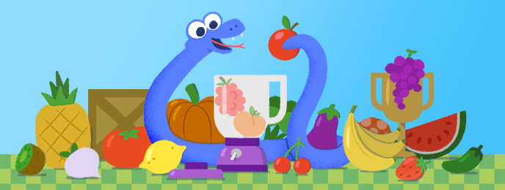
Implementation Details
To set up the development environment. This involves installing the necessary software and libraries, such as Pygame.
Implement the Snake and testing his moving skills and collision detection.
Implement the food.
Final step is to debug and testing the game source code.

Slide 8
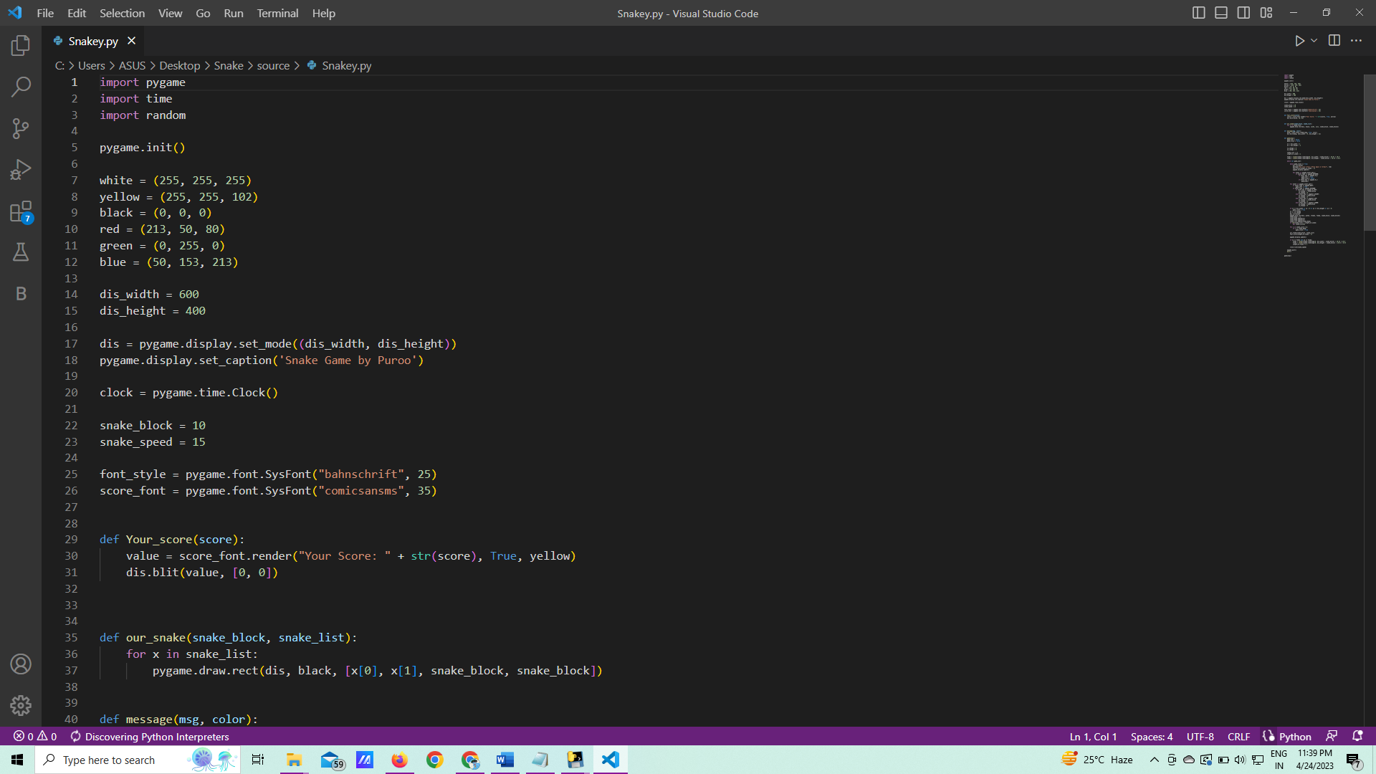
Screenshots :

Slide 9
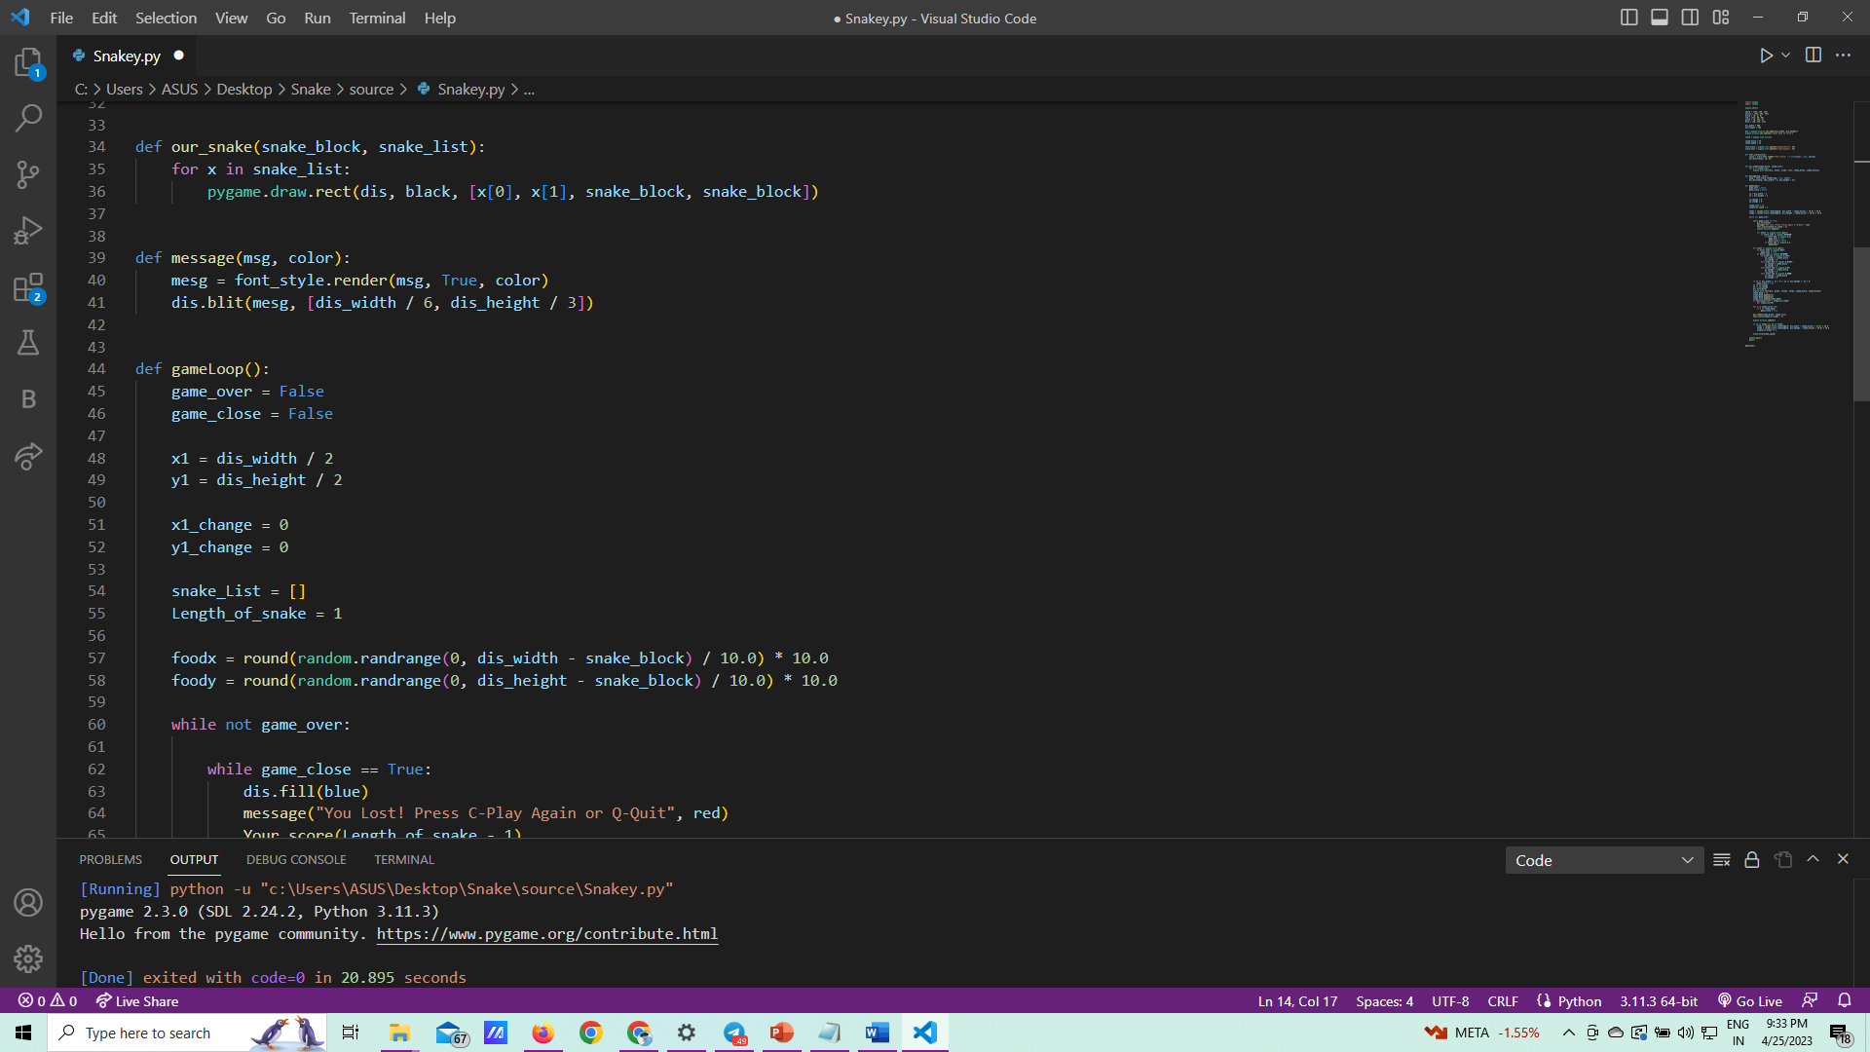
Screenshots :

Slide 10
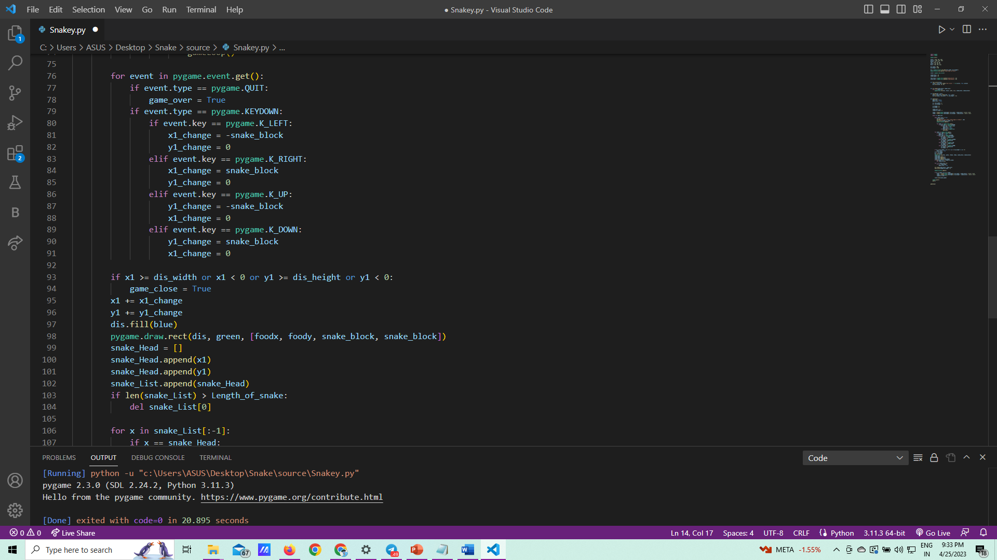
Screenshots :

Slide 11
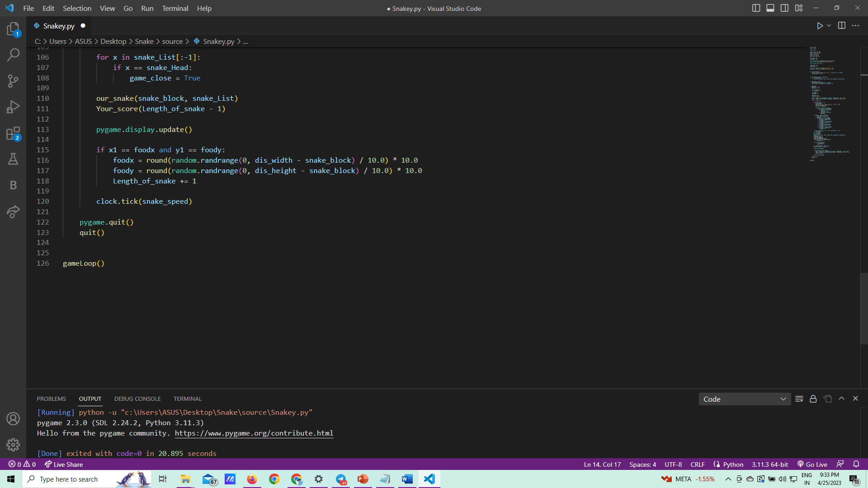
Screenshots :

Slide 12
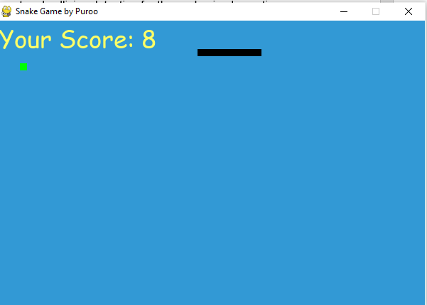
Screenshots :

Slide 13

Conclusion
The snake game in Python is a simple yet engaging game that is popular among users of all ages.
The game requires a thorough understanding of Python programming concepts and algorithms, as well as a good grasp of game development principles.
The use of VS Code as the development environment provides a powerful and efficient platform for coding, debugging, and testing the game.
All student/user get extra knowledge and skills.

Slide 14


