Slide 1
Using Power Point
Rey Abolofia

Slide 2
Start with an outline
Style templates
Adding text to a slide
Adding images to a slide
Slide transitions / animations
This will be your first slide
after the title slide.

Slide 3
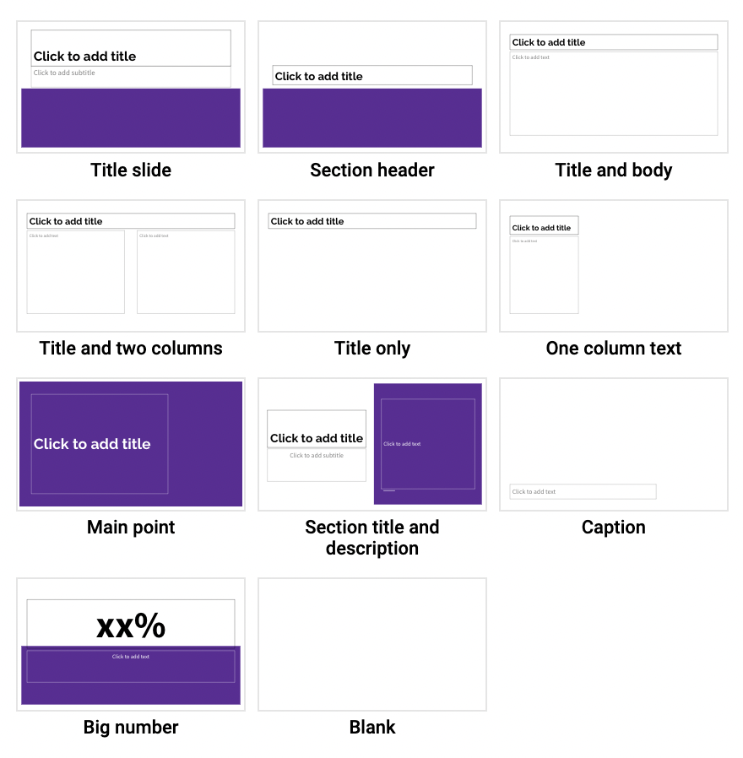
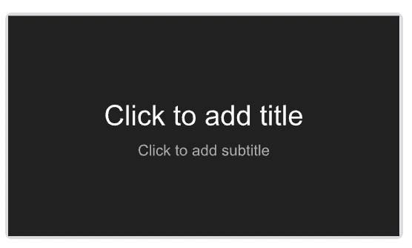
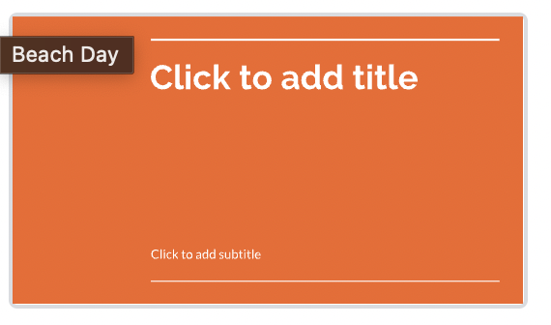
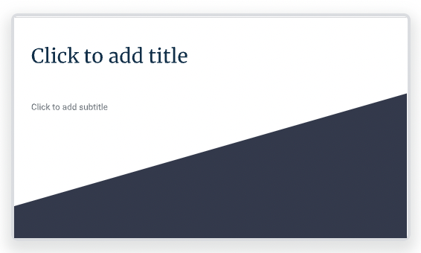
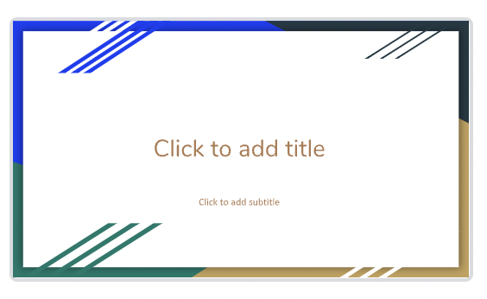
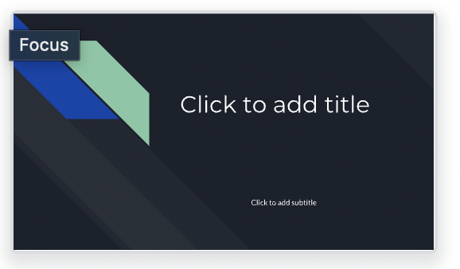
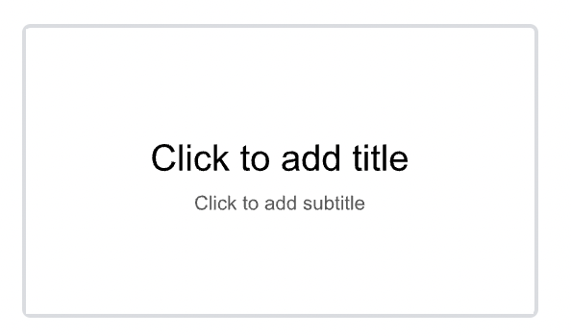
Templates do the styling work for you!
Templates add color!
Templates each provide several slide options!

Slide 4
Use the text box tool to add text
Select the text box tool
Click and drag to place a text box
Click in text box to begin writing
Change the color, font, size to your liking

Slide 5

Show don’t tell with Images
People hate reading.
Use images, pictures, or drawings whenever possible.

Slide 6
Animations are fun
Too many transitions can be distracting
Only use a transition if you have to.
But
Don’t
Go
Overboard

Slide 7
Conclusion
Use a Template!
Add Text!
But Prefer Images!
Avoid Animations!
Share what you’ve learned

Slide 8
Thank you!

