Slide 1
Data Type Validator
Project created and presented by WTCS team

Slide 2
Team “WTCS”
Pictures

Slide 3
Wisconsin Technical College System
WTCS is an administrative and coordinating state agency that:
implements statewide policies and standards established by the WTCS Board;
administers state funding provided for technical college programs and services.
monitors and reports on federal requirements related to technical college operations;
and administers funding received under the federal Carl Perkins and Adult Education and Family Literacy Acts.

Slide 4
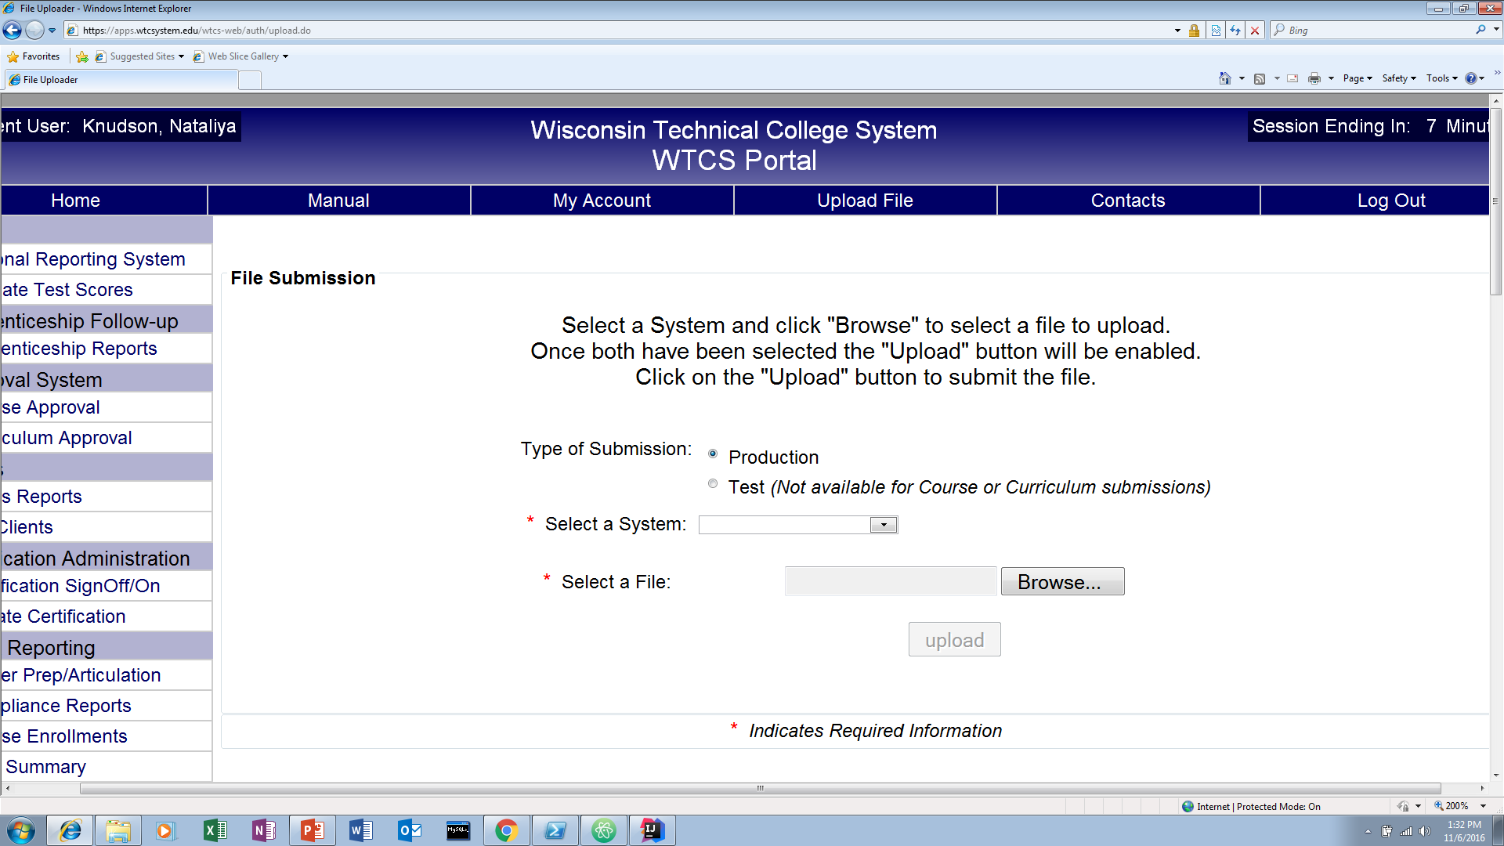
File Upload on WTCS Portal

Slide 5
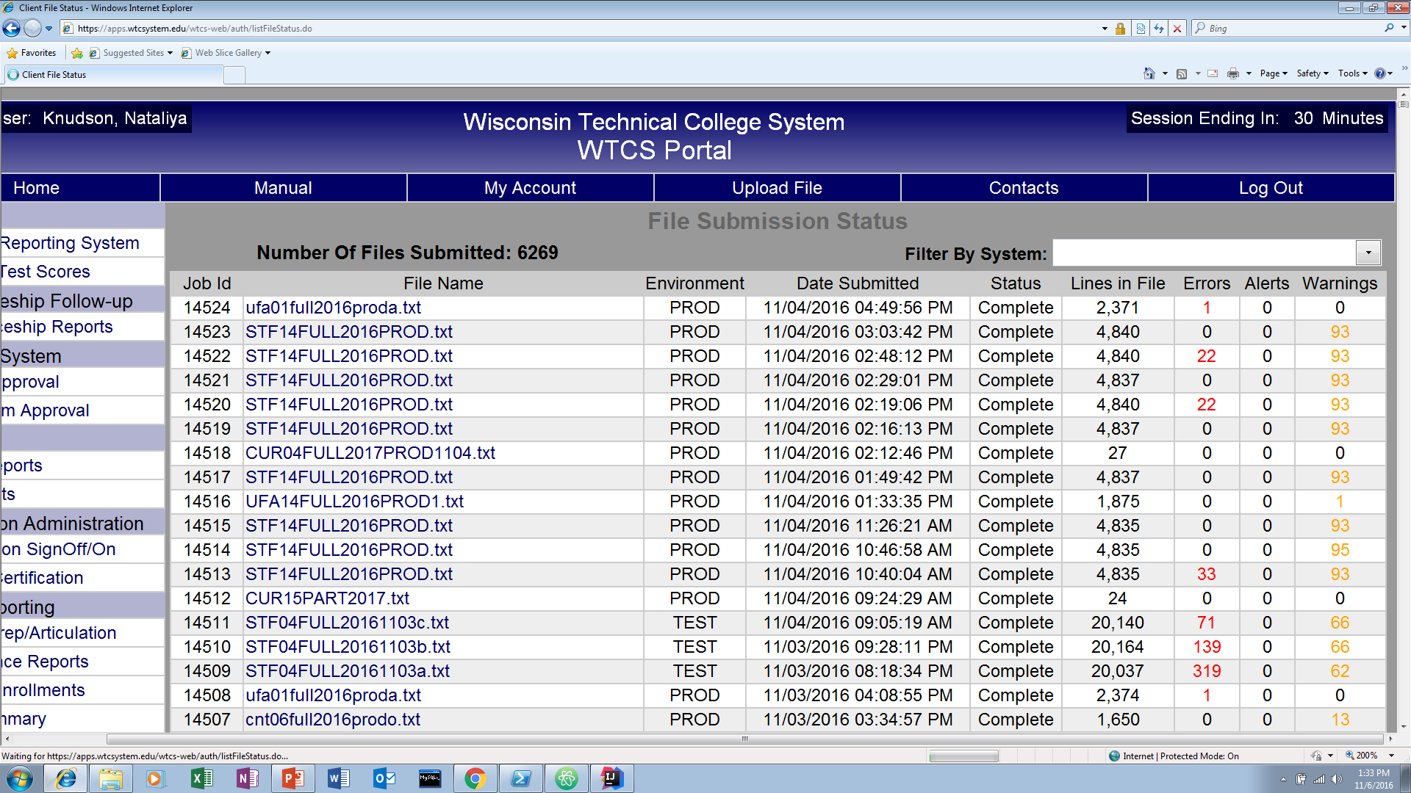
File Submissions

Slide 6
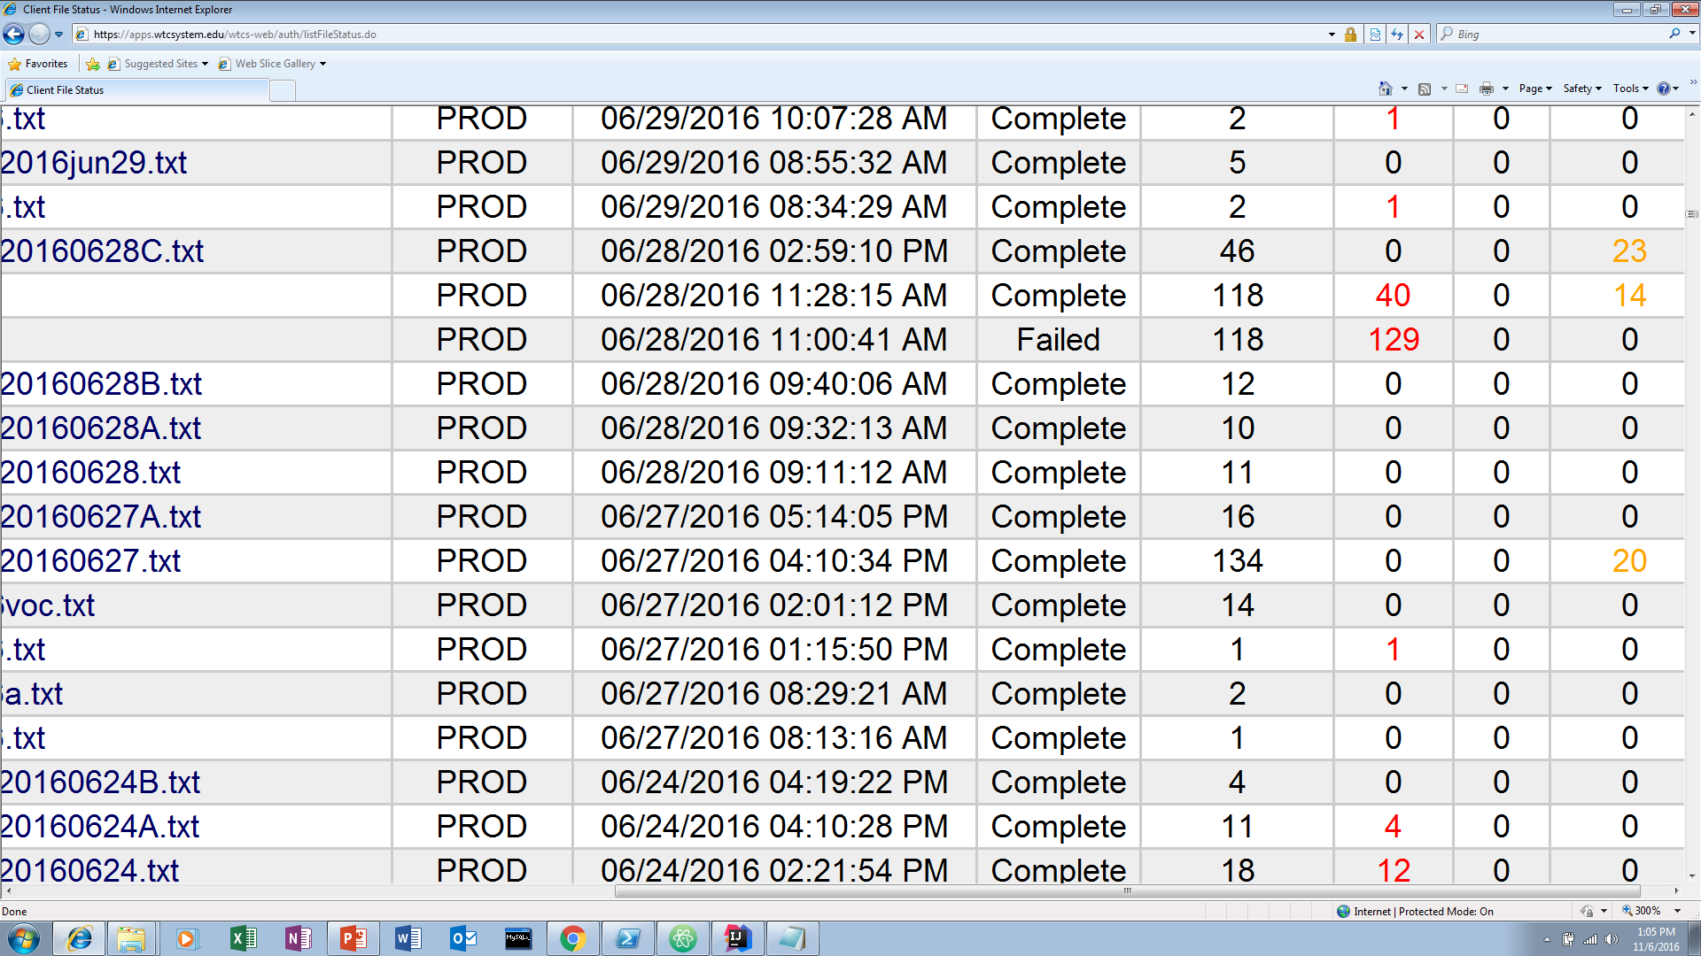
Failed File Submission

Slide 7
School Policies

Slide 8
Get Involved!

Slide 9


Slide 10
Handouts

