Slide 1
Data Type Validator
Project created and presented by WTCS team

Slide 2
Team “WTCS”
Pictures

Slide 3
Wisconsin Technical College System
WTCS is an administrative and coordinating state agency that:
implements statewide policies and standards established by the WTCS Board;
administers state funding provided for technical college programs and services.
monitors and reports on federal requirements related to technical college operations;
and administers funding received under the federal Carl Perkins and Adult Education and Family Literacy Acts.

Slide 4
Current system and problem

Slide 5
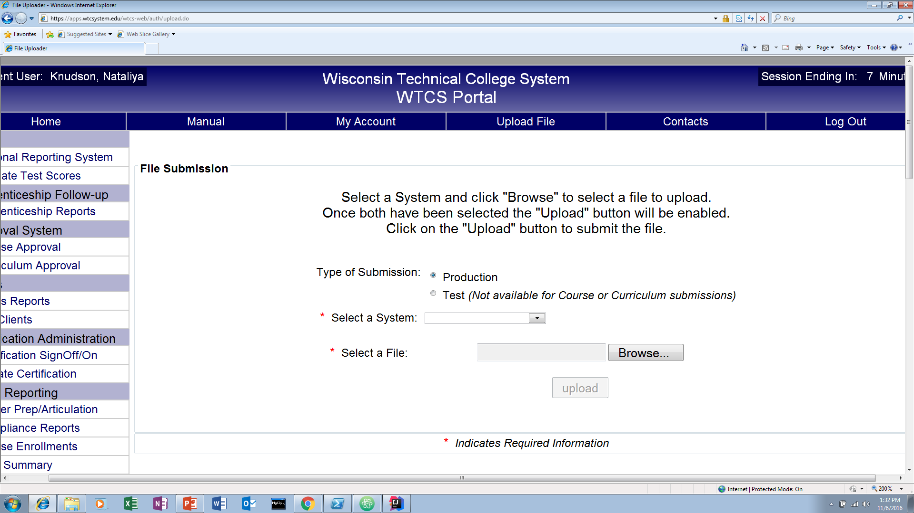
File Upload on WTCS Portal

Slide 6
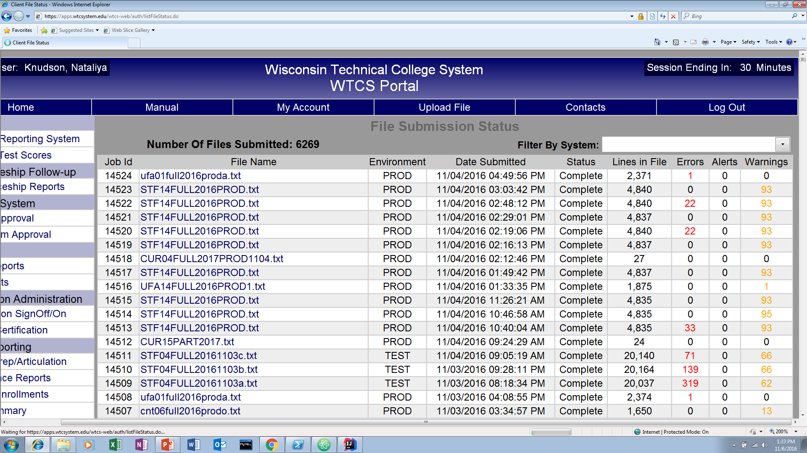
File Submissions

Slide 7
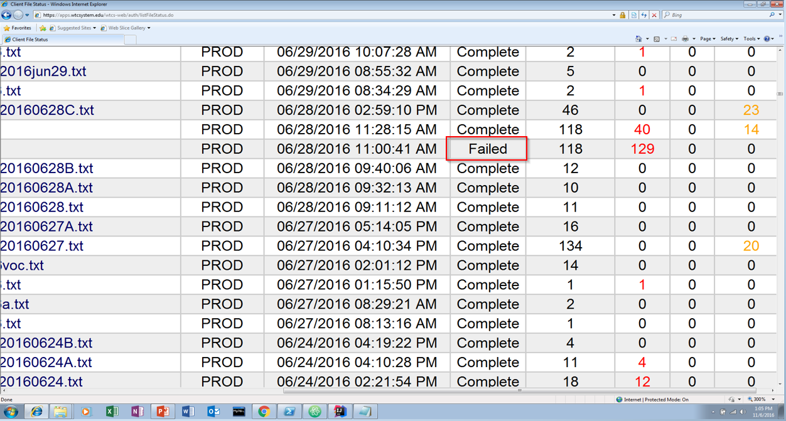
Failed File Submission

Slide 8
Our solution -- TODO: NK

Slide 9
School Policies -- TODO NK

Slide 10
How we did it

Slide 11
Agile development and evolutionary architecture
Started simple
coding isValid functionality
returning boolean
Refactored
more complex, extensible
returning custom error object

Slide 12
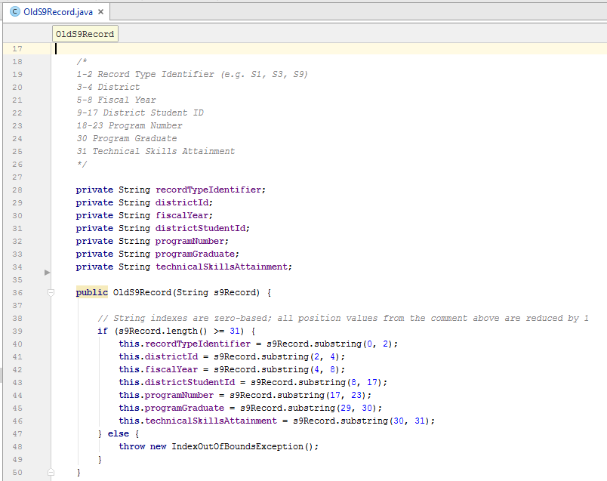
Getting isValid functionality
Relatively hard-coded constructor of S9 record

Slide 13
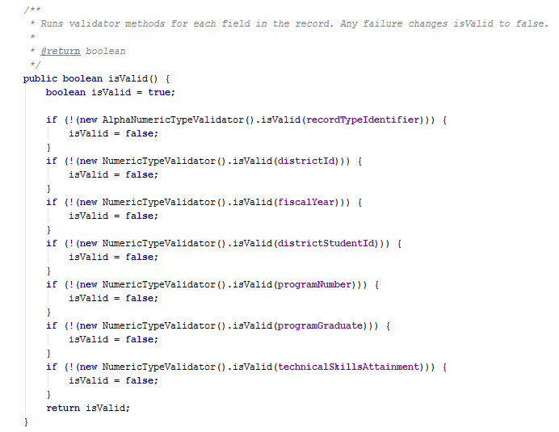
Getting isValid functionality
Initial isValid() method of S9 record

Slide 14
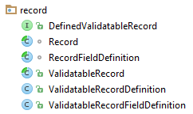
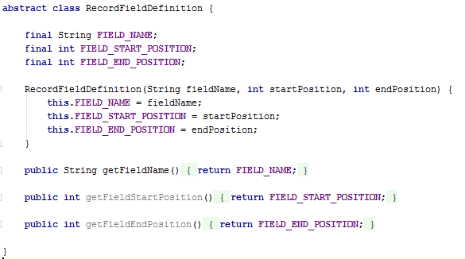
Getting isValid functionality
More abstract record definition

Slide 15
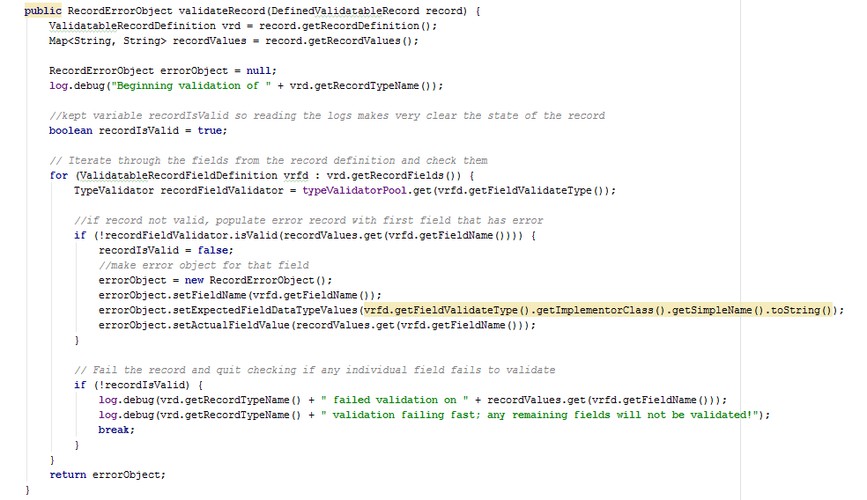
Getting isValid functionality
Validator engine (record-level)

Slide 16
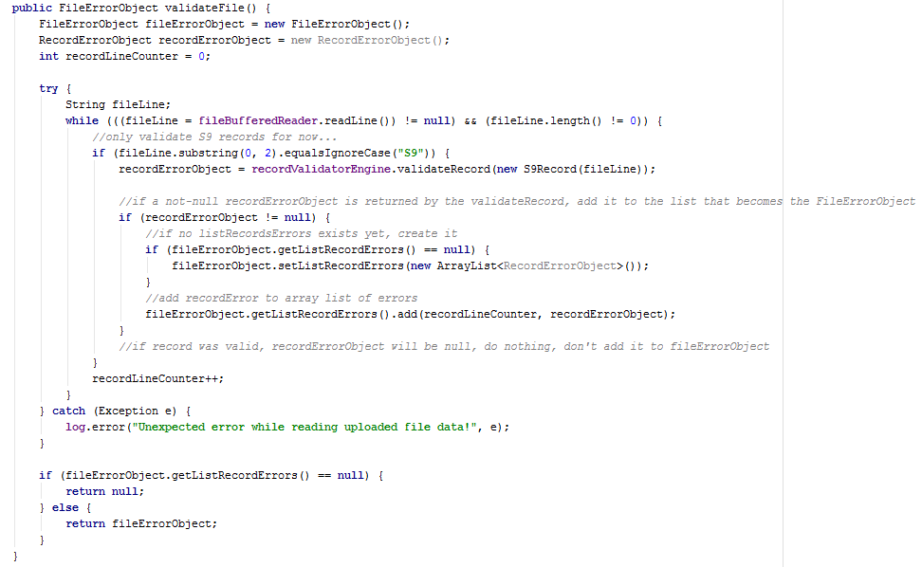
Getting isValid functionality
Validator engine (file-level)

Slide 17
What to return from isValid?
Simple boolean
Custom error object
Stop at first broken line in file?
Stop at first broken field in record?

Slide 18
What to display in web service?
Simple OK/Not OK status
As text on .jsp
Complex error object
As String on .jsp
As something prettier on .jsp
As JSON/XML on .jsp

Slide 19
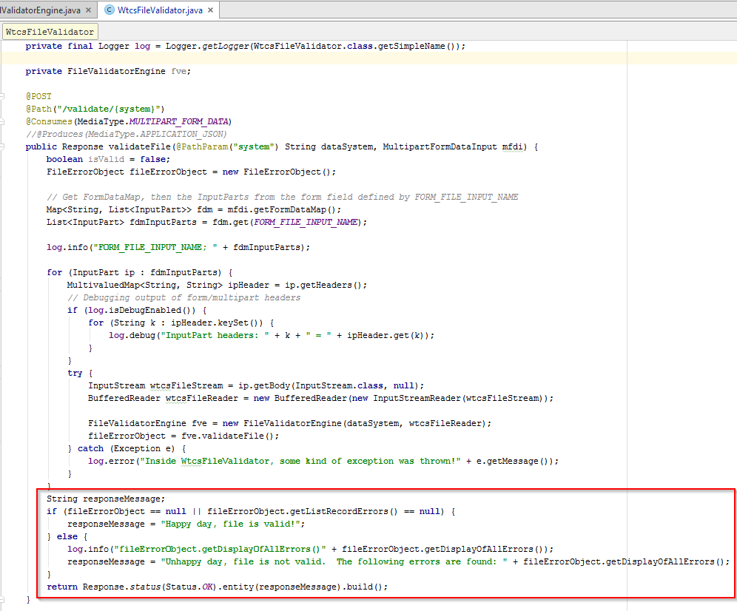
What to display in web service?

Slide 20
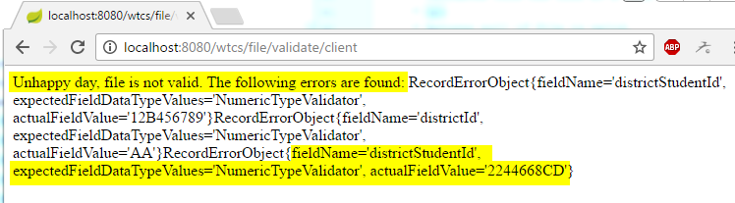
What to display in web service?

Slide 21
Underlying class diagrams -- TODO: CW

Slide 22
Get Involved!

Slide 23


Slide 24
Handouts

