Slide 1

Software Development for Environmental Scientists
Level 2 : 9th, 23rd March 2018

Slide 2
Introductions
Housekeeping
Your course instructor: Jane
You
Name;
How much do you know about…
Object oriented design & development
Exception classes and testing

Slide 3
Course Overview
Day 1
Shifting your thinking
OO basics & concepts
Design methodology
Diagrams
Python syntax
Day 2
More OO concepts
Standards & Naming
Design patterns
Exception classes
Testing
Admin
Q & A

Slide 4
Day 1
Software Development for Environmental Scientists

Slide 5
Transitioning to the OO Paradigm
Rather than having a main program to do everything, populate your system with objects that can do things for themselves.
You are an instructor at a conference. Your session is over and now conference attendees need to go to their next session.
How would functional decomposition design cope with this?
Would you do this in real life?
OF COURSE NOT!!!
What would you do instead?
Notes:
Scenario: You are an instructor at a conference. Your session is over and now
conference attendees need to go to their next session
With functional decomposition, you would develop a program to solve this problem that would have you the instructor do everything:
get the roster, loop through each attendee, look up their next session,
find its location, generate a route, and, finally,
tell the attendee how to get to their next class
You would do everything, attendees would do (almost) nothing
What would you do instead?
You would assume that everyone has a conference program, knows where they need to be next, and will get their on their own. All you would do is end the session and head off to your next activity
At worst, you would have a list of the next sessions at the front of the class and you would tell everyone “use this info to locate your next session”
Compare / Contrast
In the first scenario, you know everything, you are responsible for everything, if something changes you would be responsible for handling it you give very explicit instructions to each entity in the system.
In the second scenario, you expect the other entities to be self sufficient you give very general instructions and you expect the other entities to know how to apply those general instructions to their specific situation.
Benefits of the second scenario
The biggest benefit is that entities of the system have their own responsibilities. indeed this approach represents a shift of responsibility away from a central control program to the entities themselves.
Suppose we had attendees and student volunteers in our session and that volunteers needed to do something special in between sessions:
First approach: the session leader needs to know about the special case and remember to tell volunteers to do it before going to the next session.
Second approach: the session leader tells each person “Go to your next session”; volunteers will then automatically handle the special case without the session leader needing to know anything about it.
We can add new types of attendees without impacting the leader.
(from http://www.cs.colorado.edu/~kena/classes/5448/f12/lectures/02-ooparadigm.pdf
which is highly recommended, no really, look at it!)

Slide 6
Object Oriented Design - basics
Highly cohesive, minimally coupled
Abstraction
Encapsulation
Polymorphism
Inheritance
Object, Class, Method, Message, Interface
Exercise
identify relationships, methods and attributes
identify objects and messages
Notes:
We need a shift in thinking to go from the functional decomposition design method to the object oriented design paradigm. Here we must think in terms of discrete entities which perform specific tasks, look after their own data and have a public face to interact with each other. Objects send messages to each other without any need to know how the message is processed or what internal data may be involved.
The data and methods are bound together, but the objects are more independent of each other resulting in a highly cohesive but loosely coupled design. It makes plugging in extra functionality much simpler.
The four paradigms of OO are:
Abstraction – a set of concepts that some entity provides you in order to achieve a task
Encapsulation - users see only the services available from an object, but not how those services are implemented
Polymorphism - two or more objects respond to the same message but may do so in different ways
Inheritance - allows an object to have the same behaviour as another and extend or tailor that behaviour to provide special action for specific needs
The basic definitions are:
Object a collection of private data and a set of operations that can be performed on that data.
Class the blueprint for an object such that many objects can be made with identical operations but varying data.
Method an operation for accessing and manipulating data within an object.
Message a request for a specific action to be performed by a specific object.
Interface a collection of methods which specify how messages can be sent to an object.
A starter…
https://en.wikipedia.org/wiki/Object-oriented_programming
https://www.codeproject.com/Articles/22769/Introduction-to-Object-Oriented-Programming-Concep

Slide 7
Python Objects
Integer
Float
String
Double
List
Dictionary
Everything is an object
Exercise: Explore some Python objects.
Notes:
Python resources:
http://www.diveintopython.net/
http://www.tutorialspoint.com/python/python_classes_objects.htm

Slide 8
OO concepts
Static/class vs instance attributes
Constructors & destructors
Overloading
Overriding
Scope and privacy
Notes:
OO Terminology
Class: A user-defined prototype for an object that defines a set of attributes that characterize any object of the class. The attributes are data members (class variables and instance variables) and methods, accessed via dot notation.
Class variable: A variable that is shared by all instances of a class. Class variables are defined within a class but outside any of the class's methods. Class variables aren't used as frequently as instance variables are.
Data member: A class variable or instance variable that holds data associated with a class and its objects.
Function overloading: The assignment of more than one behaviour to a particular function. The operation performed varies by the types of objects (arguments) involved.
Instance variable: A variable that is defined inside a method and belongs only to the current instance of a class.
Inheritance : The transfer of the characteristics of a class to other classes that are derived from it.
Instance: An individual object of a certain class. An object that belongs to a class Circle, for example, is an instance of the class Circle.
Instantiation : The creation of an instance of a class.
Method : A special kind of function that is defined in a class definition.
Object : A unique instance of a data structure that's defined by its class. An object comprises both data members (class variables and instance variables) and methods.
Operator overloading: The assignment of more than one function to a particular operator.
This is really good and well worth reading thoroughly to get to grips with the syntax:
http://www.tutorialspoint.com/python/python_classes_objects.htm
In Python, the runtime environment ‘knows’ which object (i.e. instance of a class) you are using when you call a method or access an attribute. It does this by silently passing a ‘self’ pointer into the class’ code. Therefore all your methods have to have ‘self’ as their first argument, and you should refer to all attributes as ‘self.attribute’. This maintains the scope of the name you’ve used to be precisely the one which belongs to the object.
class X(Y)
"Make a class named X that is-a Y."
class X(object): def __init__(self, J)
"class X has-a __init__ that takes self and J parameters."
class X(object): def M(self, J)
"class X has-a function named M that takes self and J parameters.“
<in both of the above, the class is declared to explicitly inherit from the base ‘object’ class common to all Python types.>
foo = X()
"Set foo to an instance of class X."
foo.M(J)
"From foo get the M function, and call it with parameters self, J."
foo.K = Q
"From foo get the K attribute and set it to Q."
(http://learnpythonthehardway.org/book/ex41.html)
Other very good resources:
http://www.toptal.com/python/python-class-attributes-an-overly-thorough-guide
http://www.diveintopython.net/object_oriented_framework/class_attributes.html
http://effbot.org/pyfaq/how-can-i-overload-constructors-or-methods-in-python.htm
http://stackoverflow.com/questions/682504/what-is-a-clean-pythonic-way-to-have-multiple-constructors-in-python (also factory methods)

Slide 9
The Methodology
Identify scope
Identify key domain concepts
Detailed requirements
Object behaviour
Analysis and design are the hardest parts of OO, after that implementation is a doddle!
Exercise: Library – identify objects and messages
Notes:
Scope
What’s in and what’s out… who are the users? (actors) and what do they do? (use cases) This is the equivalent of a requirement specification which you saw when doing procedural design.
Domain Concepts
Use cases are an external view of the system, so we need a framework to hang the internals on, and the concepts provide the vocabulary by identifying atomic entities, their definitions and their relationships.
Detailed Requirements
We flesh out the system using objects and classes and identify the relationships between them. If it’s a large system, then we’d actually start with bigger ‘lumps’ of functional responsibility and develop a component diagram.
Object Behaviour
We think about scenarios and construct sequence diagrams to model behaviour. We might look at state diagrams to represent the behaviour of a single object – an object may behave differently to the same message depending upon its internal state.

Slide 10
Modelling the problem: CRC
Class, Responsibility & Collaboration
A way to identify your classes, their jobs and their interactions
Scenario based
Start simply, move features around as necessary
All ideas are potential good ideas
Exercise: Library system CRC
Notes:
This is moving on from identifying nouns and noun phrases and into developing the messages, data and objects in a system.
CRC stands for Class, Responsibility & Collaboration.
It’s a brainstorming opportunity. Each person assumes the role of a class or an actor, and they go through a scenario in order to identify what information they hold, how they are grouped, whom they collaborate with, and what messages pass between them. They each take responsibility for an aspect of the system functionality.
• Class
A set of objects that share common structure and common behaviour
Super-class : a class from which another class inherits
Subclass : a class that inherits from one or more classes/interfaces
• Responsibility
Some behaviour for which an object is held accountable.
• Collaboration
Process whereby several objects cooperate to provide some higher-level behaviour.
http://userpages.umbc.edu/~cseaman/ifsm636/lect1108.pdf
coweb.cc.gatech.edu/ice-gt/uploads/794/CRCProject.doc

Slide 11
What is a well-formed class?
Completeness
Sufficiency
Primitiveness
High cohesion
Low coupling
Notes:
Completeness
Everything that is needed is present
Sufficiency
Everything that is present is needed
Primitiveness
Everything that is present is primitive
High cohesion
Everything that is present is required to be together
Low coupling
Everything to which we are coupled is required

Slide 12
Diagrams
Structure
Component
Class
Behaviour
Use case
Sequence
Exercise : diagrams for library system
Notes:
As with functional decomposition and procedural design, it’s really helpful to get things straight on a piece of paper first (or appropriate tool if available). It allows you space to think through the problem, sketch out options for solutions, work through them and iterate until you have something which satisfies all the requirements.
Component Diagram
Represents big chunks of grouped functionality; you’re not sure precisely what objects are inside, just there will be some and the result will be that a complex job will be done. For example, in a big banking system, there may be components such as customer database, transactions, web facilities, overnight processing etc. If you had to think about classes straight away, it’d get way too complicated.
Use Case
This is a static representation of behaviour: there are actors (a user, another system etc) which do ‘stuff’ to the system. A use case is a simple scenario of the actions an actor will expect to be able to do. For example, if you (a customer) were ringing up to order something, you’d need to ‘check item status’ and ‘place order’, possibly also ‘establish credit’. A salesperson would also need to do the first two, and perhaps a supervisor also interacts with the last. There’s also a ‘fill orders’ which is where the shipping clerk interacts. The use cases form the basis of scenarios for the system which you can then work through to tease out CRC.

Slide 13
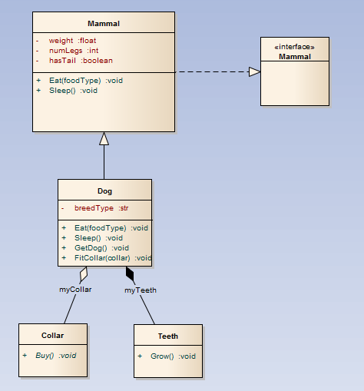
Class Diagram
Notes:
The class diagram is probably the most useful to straighten out class relationships such as inheritance, aggregation, composition, interface, and association. There are various other things you can represent, but these are a good starting point.
Inheritance: this provides the polymorphism found in OO design. A superclass, sometimes also called a base class, holds all the attributes and methods which are common amongst all its descendents. For example, a class Shape may have an attribute of isRendered and a method RenderShape() which toggles its appearance on a display. This is common irrespective of whether the shape is a square or a circle. However, the Circle and Square subclasses would have their own data for dimensions: radius, and height & length respectively. If you called an abstract function GetArea() on the abstracted class Shape, it would pass on the responsibility of finding the area to specific GetArea() overridden methods in the individual concrete classes,Circle and Square.
An ‘IS A’ relationship.
Aggregation: classes which are often found together and reference each other but can exist separately
Composition: one class contains another which cannot exist otherwise
These are ‘HAS A’ relationships.
Interface: this is the way of representing what your public face is to the outside world. In reality, each class has a public face – its public methods. However, if you want a class to do its own version of another classes methods but you already inherit from a superclass, then you should only inherit additional interfaces. This is strictly enforced in Java, not in C++. The disadvantage of multiple inheritance is that you can end up with the same grandparent via different routes, at which point the runtime code does not know how to resolve which way to go! Python doesn’t specifically have the notion of interfaces, it allows multiple inheritance, but you will see it in other languages.
Association: a looser relationship than aggregation or composition, but indicates that classes need to ‘know’ about each other in some way.
https://sparxsystems.com.au/resources/uml2_tutorial/uml2_classdiagram.html

Slide 14
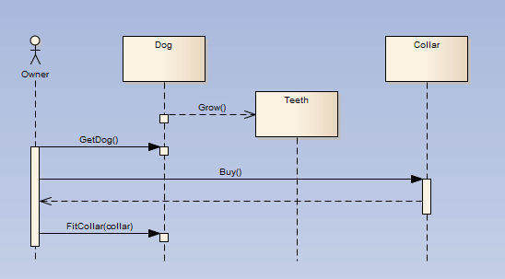
Sequence Diagram
Notes:
A sequence diagram represents the path through a system for a given scenario. You cannot hope to capture all possible paths although some tools allow for alternate paths and iteration, but since you’ll be sketching on paper, stick to one path!
In the diagram, time goes down the page, and it’s normal to have the prods to the system, the actors, on the left, with objects appearing left to right as they’re needed.

Slide 15
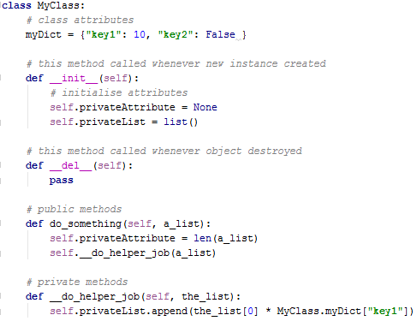
Python syntax
Notes:
Class attributes *can* be changed in an object instance – Python won’t stop you!
But you can use MyClass.myDict without needing to create an instance of the class.
The special methods with ‘__’ either side are inherited from the base ‘object’ class used by everything in Python. Here, we have over-ridden their behaviour. __init__ is the object constructor, __del__ is the destructor and it’s good practice to put them both in even if they just do nothing (pass).
Methods cannot be overloaded in Python, which means you have to be a bit clever if you want overloaded constructors.
It’s convention to use ‘_’ in front of methods which are private to the class. They also won’t have a docstring so users of your class should steer clear.
In Python, it’s easy to break the rules of OO so you *must* adhere to conventions and not cheat! Other languages have keywords which enforce OO: public, protected, private,
On the subject of how you divide up classes between files, it should be ‘sensible’! See these threads:
http://stackoverflow.com/questions/106896/how-many-python-classes-should-i-put-in-one-file
http://stackoverflow.com/questions/2864366/are-classes-in-python-in-different-files

Slide 16
Summary
OO introduction
A shift in thinking
A new vocabulary
Analysing the problem
Nouns and verbs
CRC
Scenarios
Diagrams

Slide 17
Day 2
Software Development for Environmental Scientists

Slide 18
Concepts of Object Technology - revision
What is an object?
What is an association?
What is aggregation?
And what is composition?
Multiplicity and navigability
What is a class?
What is inheritance?
A well-formed class is…?
Diagrams…
Any other definitions or concepts we need to clarify?
Notes:
I found this article while looking for something else, as is always the way, but it’s quite helpful in suggesting the balance between diagrams and code:
https://www.techrepublic.com/article/show-class-collaboration-in-your-application-development-with-uml-sequence-diagrams/
Also worth looking at…
Python 3 doesn’t appear to be a whole heap different from Python 2 for day-to-day use. There are fundamental alterations whereby code written for one is not compatible with the other. However, there are conversion routines you can run. This is a very good article on the main differences http://nbviewer.ipython.org/github/rasbt/python_reference/blob/master/tutorials/key_differences_between_python_2_and_3.ipynb

Slide 19
More OO concepts
Public, protected, private
Access to parent class from sub-class
super() and multiple inheritance
Interfaces and abstract classes
Composition vs inheritance
Multiple inheritance
Notes:
Privacy
Python uses underscores to try to make things hidden…
Ignoring the effect on wildcard imports, single underscores are a Python naming convention indicating a name is meant for internal use. It is generally not enforced by the Python interpreter and meant as a hint to the programmer only.
A double underscore prefix causes the Python interpreter to rewrite the attribute (variable or method) name in order to avoid naming conflicts in subclasses.
This post is excellent:
https://dbader.org/blog/meaning-of-underscores-in-python
Super
Super is a shortcut to access your parent class (and it has changed in Python3)
Get started with this:
http://www.pythonforbeginners.com/super/working-python-super-function
This one has some useful info. on its interaction with multiple inheritance:
https://www.programiz.com/python-programming/methods/built-in/super
And discover some niggles with this:
https://stackoverflow.com/questions/19608134/why-is-python-3-xs-super-magic
but opinions are divided…
“Python's Super is nifty, but you can't use it”
https://fuhm.net/super-harmful/
“Python’s super() considered super!”
https://rhettinger.wordpress.com/2011/05/26/super-considered-super/
“Things to Know About Python Super”
http://www.artima.com/weblogs/viewpost.jsp?thread=237121
Python allows multiple inheritance and has a strict left-to-right search for matching methods/attributes. This can work to your advantage, but often leads to complex relationships and unintended consequences. It’s very complex and not for the faint-hearted – avoid if at all possible.
Interfaces and ABCs
It is possible to define an abstract base class / interface in Python.
An interface is a little like a blank book: it's a class with a set of method definitions that have no code.
An abstract class is the same thing, but not all functions need to be empty; some can have code.
If you inherit from either, you need to define the empty methods to create a concrete class.
http://stackoverflow.com/questions/372042/difference-between-abstract-class-and-interface-in-python
Defining an Interface or Abstract Base Class
https://www.safaribooksonline.com/library/view/python-cookbook-3rd/9781449357337/ch08s12.html
https://docs.python.org/3/library/abc.html
Composition vs Inheritance
Composition-based solutions break up a problem into distinct responsibilities and encapsulate the implementation of each into separate objects. In an inheritance-based solution, a given object often has multiple responsibilities it has inherited from its various ancestors.
https://robots.thoughtbot.com/reusable-oo-composition-vs-inheritance
https://www.thoughtworks.com/insights/blog/composition-vs-inheritance-how-choose
https://stackoverflow.com/questions/49002/prefer-composition-over-inheritance
There are many articles, but I thought these the most useful.
Multiple Inheritance
In the multiple inheritance scenario, any specified attribute is searched first in the current class. If not found, the search continues into parent classes in depth-first, left-right fashion without searching same class twice.
https://www.programiz.com/python-programming/multiple-inheritance
The danger is when you have the same attribute/method in more than one parent: then the one that’s used is dependent on the order in which you inherited… eek!

Slide 20
Standards & Naming
Why is it important?
What should we aim for?
What are the rules?
Exercise : Code review of the library system
Notes:
Meaningful naming is arguably even more important in OO than in procedural programming. If done properly, most code will read like a piece of prose and will be self explanatory. When done badly, it’s worse than confusing.
Typically, class names are nouns which encapsulate the job of the class: NetCDFFileReader
Attributes are names which explain their purpose: fileLocation
Methods are actions: readFile(), processSSTData()
or checks: isOpen(), isValid()
or data setters and getters: setFileLocation(), getFileLocation()
You already know that comments are important, so in the OO world they are used to describe a class and provide details of all the public methods available on it up front, in the case of Python, it’s in the docstring. Private methods aren’t exempt from comments, it’s just that you’d not put them in the docstring, also you should keep attribute comments local too.
Look up the rules for the language you use: for Python it’s https://www.python.org/dev/peps/pep-0008/

Slide 21
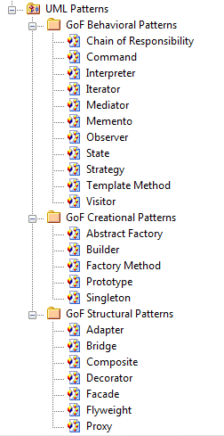
Design Patterns
There are often standard problems which crop up in a design, and they’ve probably all been seen before!
Just to make you aware that these exist and you can look them up so that you don’t re-invent the wheel.
Notes:
Just to make you aware that you’ll see a lot of references to design patterns, and also people calling various things ‘anti-patterns’.
GoF refers to the ‘Gang of Four’ authors who wrote a very influential book: Design Patterns: Elements of Reusable Object-Oriented Software (http://en.wikipedia.org/wiki/Design_Patterns – this is well worth a read)
We’ll introduce a few which may help address common problems:
Singleton
Factory
Visitor
Iterator
See this extremely useful quick guide to patterns, what they look like, when to use them and examples:
http://refcardz.dzone.com/refcardz/design-patterns
You can download the pdf.

Slide 22
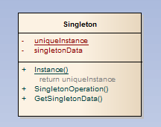
GoF pattern: singleton
This pattern ensures a class only has one instance, and provides a global point of access to it.
Notes:
Singleton is known as a creational pattern - it's used to construct objects such that they can be decoupled from the implementing system. The definition of Singleton provided in the original Gang of Four book on Design Patterns states: Ensure a class has only one instance and provide a global point of access to it.
We just provide one point of access to create an instance of the Singleton class. The constructor is kept private, giving the getInstance() method the responsibility of providing access to the Singleton.
When you need to ensure there's one instance of an object, available to a number of other classes, you may want to use the Singleton pattern. Singletons are used a lot where you need to provide a registry, or something like a thread pool. Logging is also another popular use of Singletons, providing one single access point to an applications log file.
There are many downsides, and several authorities discourage the use of the singleton maintaining that it indicates poor design.
http://java.dzone.com/articles/design-patterns-singleton
-----------------------------------------------------------------------------------------
This isn’t easy to do in Python!
http://stackoverflow.com/questions/6760685/creating-a-singleton-in-python
There are several ways of implementing a singleton, here’s another:
In Java:
public class SingleObject {
//create an object of SingleObject
private static SingleObject instance = new SingleObject();
//make the constructor private so that this class cannot be
//instantiated
private SingleObject(){}
//Get the only object available
public static SingleObject getInstance(){
return instance;
}
public void showMessage(){ System.out.println("Hello World!");
}
}
And then
public class SingletonPatternDemo {
public static void main(String[] args) {
//illegal construct
//Compile Time Error: The constructor SingleObject() is not visible
//SingleObject object = new SingleObject();
//Get the only object available
SingleObject object = SingleObject.getInstance();
//show the message
object.showMessage();
}
}
(http://www.tutorialspoint.com/design_pattern/singleton_pattern.htm)

Slide 23
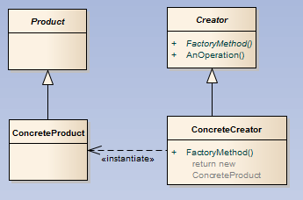
GoF pattern: factory method
This pattern defines an interface for creating an object, but lets subclasses decide which class to instantiate. It lets a class defer instantiation to subclasses. (example)
Notes:
Factory Method is known as a creational pattern - it's used to construct objects such that they can be decoupled from the implementing system. The definition of Factory Method provided in the original Gang of Four book on Design Patterns states: Define an interface for creating an object, but let the subclasses decide which class to instantiate. The Factory method lets a class defer instantiation to subclasses
The Creator hides the creation and instantiation of the Product from the client. This is a benefit to the client as they are now insulated from any future changes - the Creator will look after all of their creation needs, allowing decoupling. Furthermore, once the Creator and the Product conform to an interface that the client knows, the client doesn't need to know about the concrete implementations of either. The factory method pattern really encourages coding to an interface in order to deal with future change.
Here the Creator provides an interface for the creation of objects, known as the factory method. All other methods in our abstract Creator are written only to operate on the Products created in the ConcreteCreator. The Creator doesn't create the products - that work is done by its subclasses, such as ConcreteCreator.
The idea behind the Factory Method pattern is that it allows for the case where a client doesn't know what concrete classes it will be required to create at runtime, but just wants to get a class that will do the job. The FactoryMethod builds on the concept of a simple Factory, but lets the subclasses decide which implementation of the concrete class to use. You'll see factories used in logging frameworks, and in a lot of scenarios where the client doesn't need to know about the concrete implementations. It's a good approach to encapsulation.
One thing not illustrated in the code example is the possibility to pass a paramater through to the creator in order to choose which type of concrete class to create. For example, we could have made FileLoggerCreator that could take a string parameter, allowing us to choose between XML and flat files.
http://java.dzone.com/articles/design-patterns-factory
-----------------------------------------------------------------------------------------
https://github.com/Reading-eScience-Centre/edal-java/blob/master/common/src/main/java/uk/ac/rdg/resc/edal/dataset/DatasetFactory.java

Slide 24
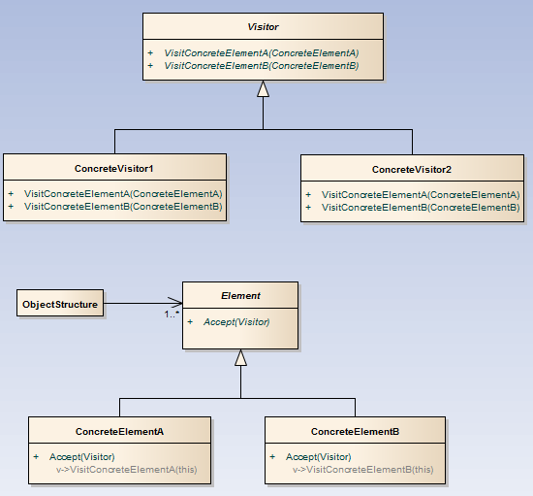
GoF pattern: visitor
This pattern represents an operation to be performed on the elements of an object structure. It lets you define a new operation without changing the classes of the elements on which it operates.
Notes:
Shopping in the supermarket is a common example, where the shopping cart is your set of elements. When you get to the checkout, the cashier acts as a visitor, taking the disparate set of elements (your shopping), some with prices and others that need to be weighed, in order to provide you with a total.
The Visitor is known as a behavioural pattern, as it's used to manage algorithms, relationships and responsibilities between objects. The definition of Visitor provided in the original Gang of Four book on Design Patterns states: Allows for one or more operation to be applied to a set of objects at runtime, decoupling the operations from the object structure.
What the Visitor pattern actually does is create an external class that uses data in the other classes. If you need to perform operations across a disparate set of objects, Visitor might be the pattern for you. The GoF book says that the Visitor pattern can provide additional functionality to a class without changing it.
The core of this pattern is the Visitor interface. This interface defines a visit operation for each type of ConcreteElement in the object structure. Meanwhile, the ConcreteVisitor implements the operations defined in the Visitor interface. The concrete visitor will store local state, typically as it traverses the set of elements. The element interface simply defines an accept method to allow the visitor to run some action over that element - the ConcreteElement will implement this accept method.
http://java.dzone.com/articles/design-patterns-visitor
-----------------------------------------------------------------------------------------

Slide 25
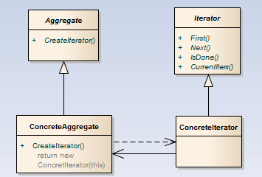
GoF patter: iterator
This pattern provides a way to access the elements of an aggregate object sequentially without exposing its underlying representation. (example)
Notes:
The Iterator pattern is known as a behavioural pattern, as it's used to manage algorithms, relationships and responsibilities between objects.. The definition of Iterator as provided in the original Gang of Four book on Design Patterns states: Provides a way to access the elements of an aggregate object without exposing its underlying represenation.
The Aggregate defines an interface for the creation of the Iterator object. The ConcreteAggregate implements this interface, and returns an instance of the ConcreteIterator. The Iterator defines the interface for access and traversal of the elements, and the ConcreteIterator implements this interface while keeping track of the current position in the traversal of the Aggregate.
Using this pattern, you can build on the standard concept of iteration to define special iterators that only return specific elements in the data set.
This pattern is useful when you need access to elements in a set without access to the entire representation. When you need a uniform traversal interface, and multiple traversals may happen across elements, iterator is a good choice.
It also makes you code much more reasonable, getting rid of the typical for loop syntax across sections of your codebase.
http://java.dzone.com/articles/design-patterns-iterator
-----------------------------------------------------------------------------------------
https://github.com/Reading-eScience-Centre/edal-java/blob/master/common/src/main/java/uk/ac/rdg/resc/edal/util/Array1D.java

Slide 26
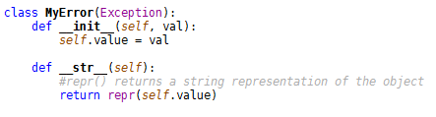
Exceptions and Exception Classes
Error messages in the console when your program crashes
AttributeError, NameError, SyntaxError, others…
Create a new exception class by inheriting from the Python base class and over-riding methods as appropriate
Exercise : create exception classes and derived classes
Notes:
Others include TypeError, IndentationError, IOError, KeyError, ZeroDivisionError and you’ve probably seen most of them!
https://docs.python.org/2/library/exceptions.html
https://docs.python.org/3/library/exceptions.html
How should we deal with them? The only reason they crash your program and appear on the console is because you’re not catching and handling them. The mechanism to do this is pretty straightforward, but you have to make sure you are consistent. Not everyone thinks exceptions and their handling is a good idea, so read up on it and use it if you think it’s worthwhile; often it’s a case of appropriateness.
The code is
try:
<your code>
except:
<your code if any exception is thrown>
<tends to get highlighted as bad practice though…>
OR
except ValueError:
<your code if a ValueError exception is thrown>
OR
except ValueError as valErr:
<as above, but you can interrogate ‘valErr’ for useful information>
OR
except (RuntimeError, TypeError, NameError):
<your code to handle these three types of exception>
OPTIONALLY
else:
<your code if the ‘try’ block succeeds and you don’t want to
protect the subsequent code with more try blocks>
OPTIONALLY
finally:
<your code which *always* gets executed, even if there’s another
exception, or a break or a return statement>
You can use ‘raise’ either on its own, or with a specific exception to ‘pass the buck’ up the call stack.
https://docs.python.org/2/tutorial/errors.html
https://docs.python.org/3/tutorial/errors.html

Slide 27
Testing (1)
The ‘nosetest’ framework for Python will run all functions prepended with ‘test’ as in
def test_function_is_correct():
<do stuff>
There is a ‘decorator’ syntax which allows you to specify expected exceptions
@raises(Exception)
def test_function_throws_exception():
<do stuff>
Exercise : tests for your code including exceptions – use TDD to expand the functionality of your classes.
Notes:
We can use Test Driven Development to drive the implementation of the classes we know we need. The Python ‘nosetests’ framework allows use of exceptions and checking that they get thrown when we think they do.
While we’re on the subject of ‘decorators’… this is a technique used in many languages whereby meta-data on a class or method or attribute may be specified.
See https://nose.readthedocs.org/en/latest/testing_tools.html for a list of those you can use in the nosetest framework. You may find the following particularly useful:
@with_setup(setup_func, teardown_func)
@istest(test_func)
@raises(exception_class)
Because exceptions can be tricky, you may need to apply a little thought to the testing, the following examples are useful:
@raises(TypeError, ValueError)
def test_raises_type_error():
raise TypeError("This test passes")
@raises(Exception)
def test_that_fails_by_passing():
pass
And:
from nose.tools import *
l = []
d = dict()
@raises(Exception)
def test_Exception1():
'''this test should pass''‘
l.pop()
@raises(KeyError)
def test_Exception2():
'''this test should pass''‘
d[1]
@raises(KeyError)
def test_Exception3():
'''this test should fail (IndexError raised but KeyError was expected)''‘
l.pop()
def test_Exception4():
'''this test should fail with KeyError''‘
d[1]
And for testing a custom exception:
def test_bad_token():
sc = SomeClass('xxx', account_number)
with assert_raises(MyCustomException) as e:
sc.method_that_generates_exception()
assert_equal(e.exception.status, 403)
assert_equal(e.exception.msg, 'Invalid User')
Where:
class MyCustomException(Exception):
def __init__(self, status, uri, msg=""):
self.uri = uri
self.status = status
self.msg = msg
super(Exception, self).__init__(msg)

Slide 28
Testing (2)
Using function based testing doesn’t allow you to keep information for the test run other than by using global variables, BAD!!!!
Use class based testing in nosetest framework:
Naming convention
Class setup and teardown
Method setup and teardown
Hold data with self.attribute=data
Same nosetools assertion methods available
Notes:
In class_code/classAcode.py:
class ClassA(object): def __init__(self): self.value = "Some Value" def return_true(self): return True def raise_exc(self, val): raise KeyError(val)
And then in test_code/classAtests.py:
from class_code.classAcode import ClassA import nose.tools as ns
class TestA(object): @classmethod def setup_class(cls): """This method is run once for each class before any tests are run""" print('setup_class\n') @classmethod def teardown_class(cls): """This method is run once for each class _after_ all tests are run"“” print('teardown_class\n') def setUp(self): """This method is run once before _each_ test method is executed""" # use self.attribute to keep anything which needs to be accessed later print('setUp method\n') def tearDown(self): """This method is run once after _each_ test method is executed""" print('tearDown method\n') def test_init(self): print('test_init method\n') a = ClassA() ns.assert_equal(a.value, "Some Value") ns.assert_not_equal(a.value, "Incorrect Value") def test_return_true(self): print('test_return_true method\n') a = ClassA() ns.assert_equal(a.return_true(), True) ns.assert_not_equal(a.return_true(), False) def test_raise_exc(self): print('test_raise_exc method\n') a = ClassA() ns.assert_raises(KeyError, a.raise_exc, "A value") @ns.raises(KeyError) def test_raise_exc_with_decorator(self): print('test_raise_exc_with_decorator method\n') a = ClassA() a.raise_exc("A message")

Slide 29
Admin
Feedback
Post-course assessment
Notes:
FEEDBACK
This is really important for us so that we can continue to make improvements. Please use the back of the sheet if you want to say anything not covered by the questions, or email us (resc@reading.ac.uk) or me (j.p.lewis@reading.ac.uk).
ASSESSMENT
This has the purpose of seeing how much you’ve picked up over the course, and seeing whether your approach to a software task has changed since the pre-course assessment (hopefully for the better!). There’s no pass/fail ☺

Slide 30
Q & A session
Any topics we’ve talked about so far
Unclear what to do
Why it’s done
Further info.

Slide 31


