Slide 1

Encoding Privacy
Sophie Richardson – Policy Advisor
Office of the Privacy Commissioner
Purplecon
15 November 2018

Slide 2
WHAT IS PRIVACY FOR?
...preserving people’s control over their information in the face of technology that lessens that control.

Slide 3
1. Why do you need the information?

Slide 4
2. Get it directly from the person, if you can.

Slide 5
3. Tell the person you are collecting information and why.

Slide 6
4. Don’t collect the information illegally or unfairly.

Slide 7
5. Keep it in a safe place.

Slide 8
6. Let people access their information.

Slide 9
7. Let people correct their information if it’s wrong.

Slide 10
8. Before you use information, make sure it’s accurate.

Slide 11
9. Don’t keep it longer than you need it.

Slide 12
10. Only use it for the purpose you collected it.

Slide 13
11. Don’t disclose it, unless you have good reason.

Slide 14
12. Don’t assign unique identifiers unless necessary.

Slide 15


Slide 16
Security
Privacy
Privacy
Security
Privacy
Security

Slide 17
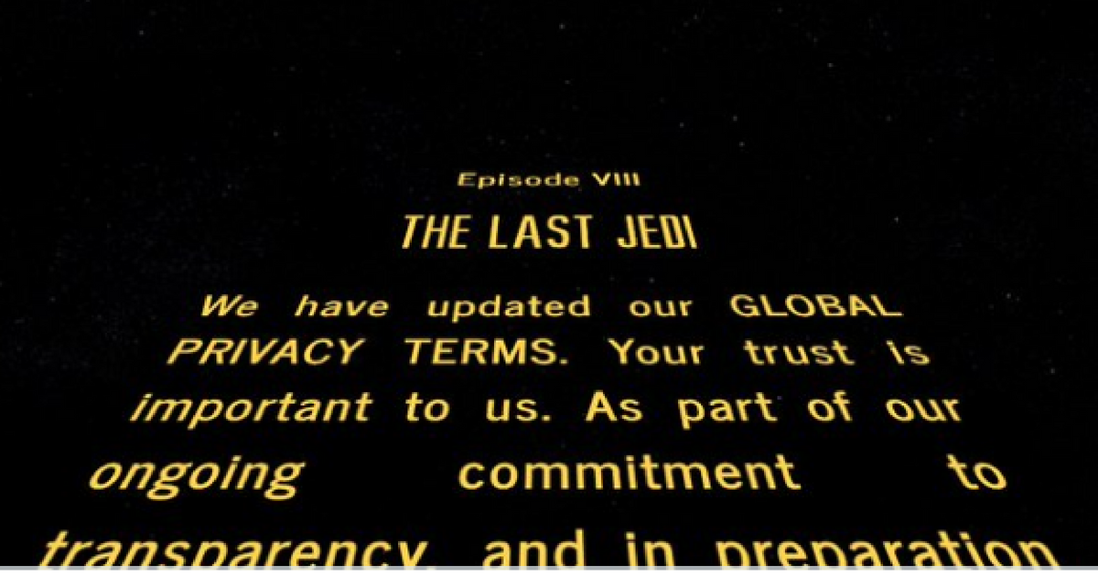

Slide 18
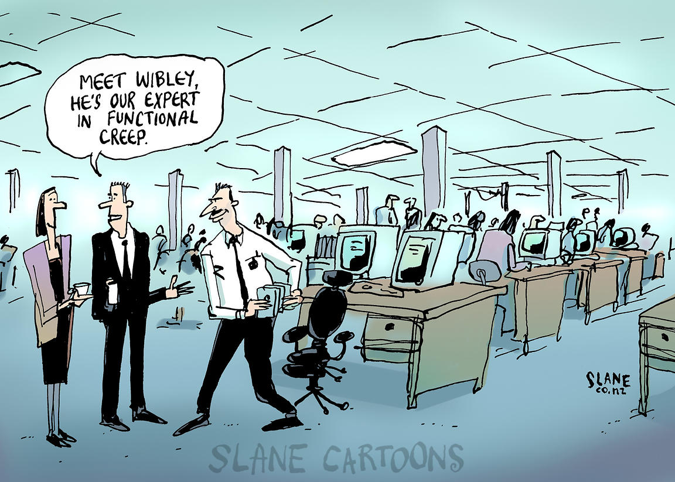

Slide 19

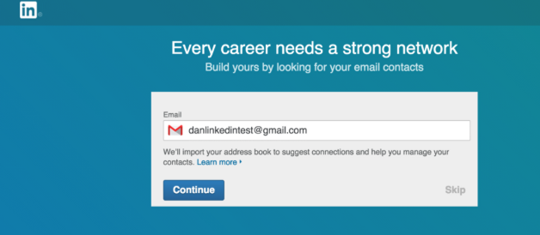
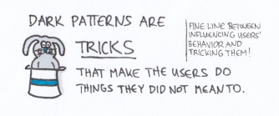
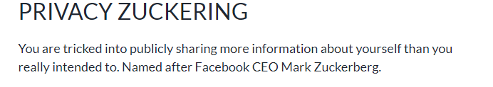

Slide 20

That’s all folks!
OPC Policy Team
policy@privacy.org.nz
AskUs
https://www.privacy.org.nz/further-resources/knowledge-base/

