Slide 1

Scrum-Agile Approach for ChadaTech
Evaluating
Scrum-Agile
Through the SNHU Travel Project
Bora Yang

Slide 2




Scrum-Agile Team Roles
Product Owner
Represents customer needs
Manages the Product Backlog
Sets priorities and clarifies requirements
Scrum Master
Helps the team follow Scrum
Removes obstacles
Supports communication and teamwork
Development Team
Builds and tests the product
Completes Sprint work
Works together to meet requirements

Slide 3
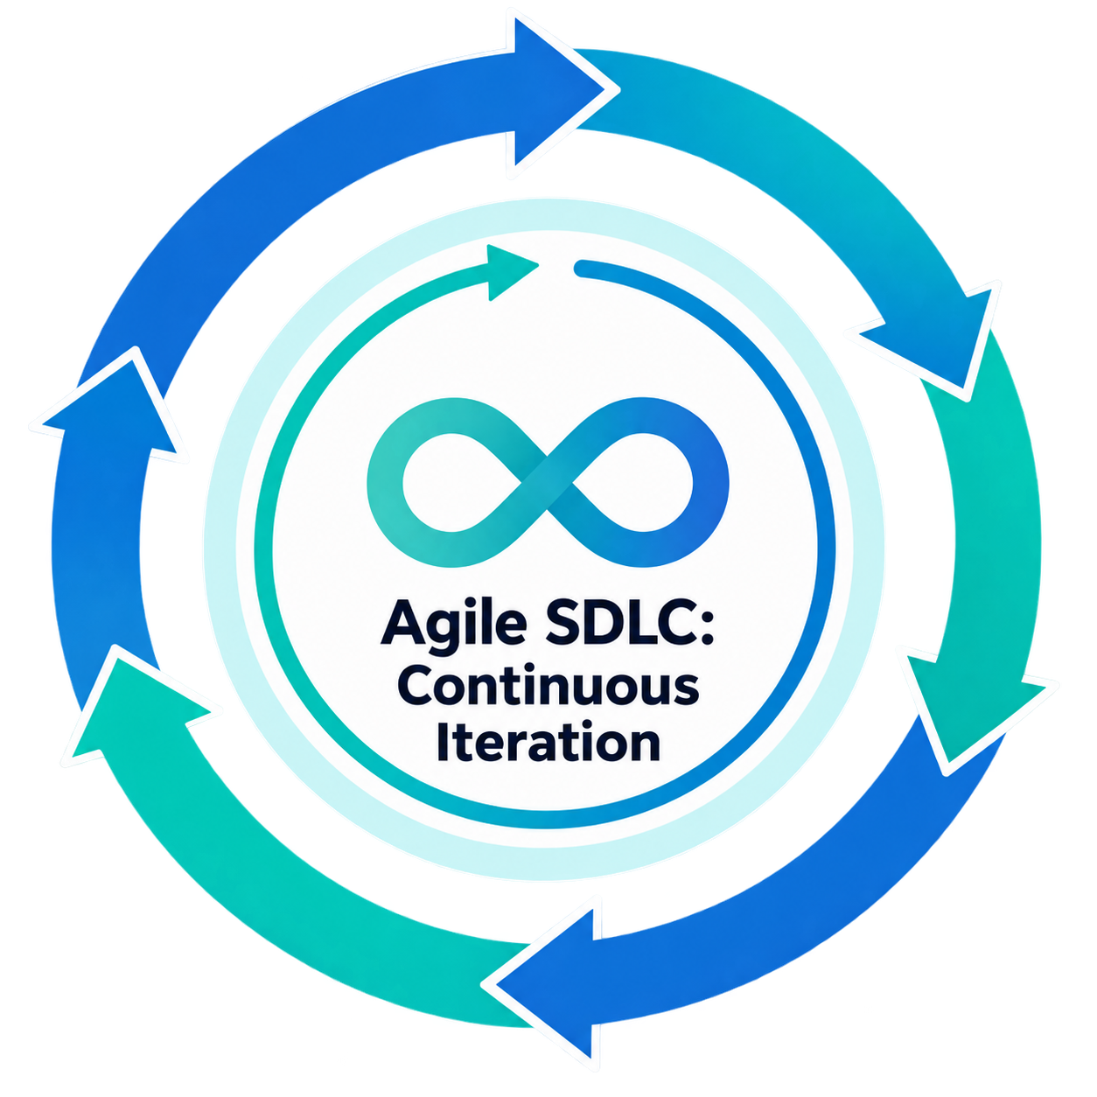





Agile Phases
Plan & Design
Define goals and user needs
Create the structure and interface
Launch
Release the product to users
Develop & Test
Build the features
Check that the features work correctly
Review
Collect feedback and identify improvements
Deploy
Deliver the working product

Slide 4
Waterfall vs Agile
Waterfall Model
Agile Model
Analysis
Test
Deploy
sprint
Design
Sprint
Implementation
Review
Develop
Testing
Maintenance
Plan
Design
Launch
Waterfall follows a fixed plan,
while Agile adapts continuously through feedback and iteration

Slide 5
Waterfall or Agile Approach
Agile
Limited
Customer
involvement
Frequent
changes
High
uncertainty
Predictable
project
Waterfall
Agile
Fixed
requirements
Frequent
feedback
Waterfall

Slide 6
References
Serrador, P., & Zadeh, A. A. (2025). When Agile works: Unveiling the secrets to Agile success. Engineering Management Journal.
Santoso, J. T., Raharjo, B., & Wibowo, M. C. (2024). Agile project management practice to support project management success. Quality - Access to Success.
Maravić Čisar, S., Pinter, R., Čisar, P., & Đikanović, P. (2025). The impact of Scrum methodology on student motivation and problem-solving skills. Interdisciplinary Description of Complex Systems, 23(2), 159–181.
Ziebell, A., Mielke, F., & Saintot, V. M. (2026). Mindful Scrum: Mobilising mindfulness practices to foster agility in project management teams. International Journal of Project Management, 44, 102829.
Southern New Hampshire University. (n.d.). CS250-Module One: SDLC methodologies.

