Slide 1
Sprites and tiles in games
Purpleloop

Slide 2
Disclaimer
The present document is based on my personal work and experience and come as it is.
It may differ from industry/academic standards in game development.

Slide 3
What is a sprite
A sprite is an image used in a user interface.
Sprites history finds it's background with computer games, and appeared in the 80's.
It is often small chunk of a bigger image.
Sprites are stored in memory for optimization of the rendering
Sprites can be used as tiles to compose a tile-based image.
Sprites are particularly used in animations, where each sprite is a frame of the animation.
Sprite can represent various elements, like characters, objects.

Slide 4
Single sprites vs. Sprite sets
Sprites can be small independant images but grouping them in a global image is often more interesting in terms of management (for instance during ressource loading)
The global image contains a set of sprites (a sprite set) and is often named « sprite sheet ».
As an example, a sprite sheet can contain all animations sequences for a given character or groups all variations of a same object.

Slide 5
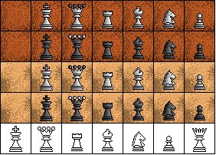
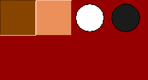
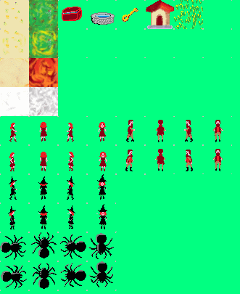

Examples of sprite sets
An Othello / Reversi set
A builder and crate set (Sokoban inspired)
Witch Fantasy
A game essay

Slide 6
Indexes - Series
Attributes
  Start location (x,y)
  Sprite width
  Sprite height
  Count
Naming

Slide 7
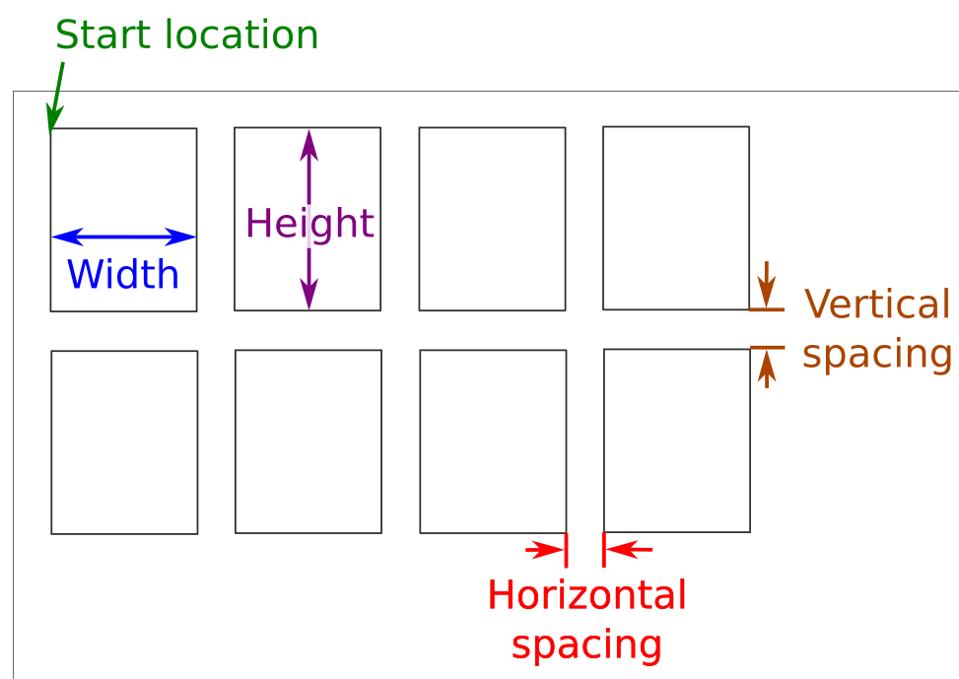
Indexes - Grid
Attributes
  Start location (x,y)
  Sprite width
  Sprite height
  Number of sprites per line
  Number of lines
  Horizontal spacing
  Vertical spacing
Naming : in grid order per column then per line

Slide 8
Tiles and maps
Tiles are small images, like sprites, but more designed to represent a background image or an environment with static objects of notable locations.
Maps are « coded », generally in a 2D array.
Each code is mapped to a given tile

Slide 9
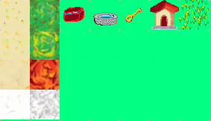
Code – Tiles mapping
#
C
F
K
H
.
#
Spring
Summer
Automn
Winter

Slide 10
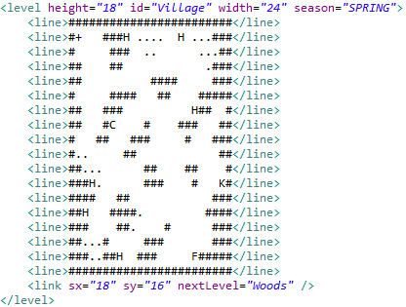
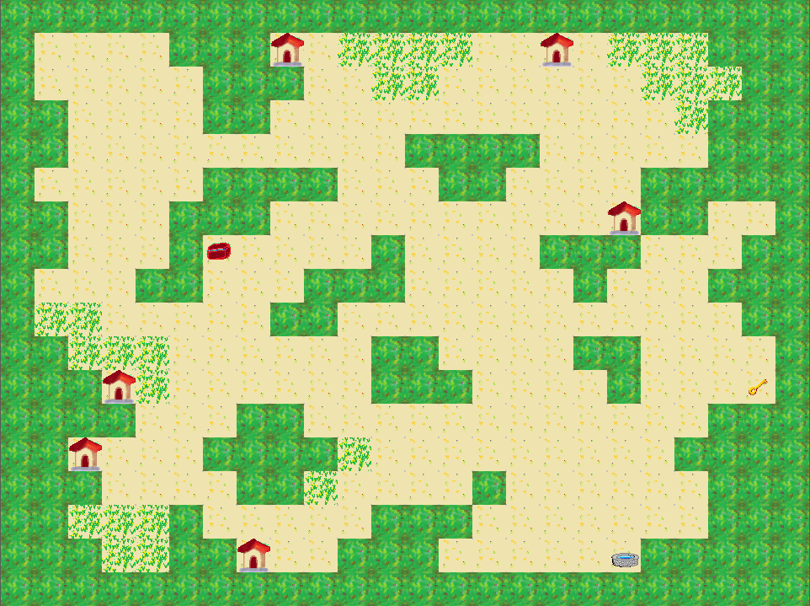
Map / Rendering

