Slide 1
Human Action Recognition using Fusion of Multimodal Sensor Data
HUANG FUXING (E0147025)
LOW KANG JIANG (E0146478)
TEY PENG MOK (E0146914)
YEO KUN SONG (E0146426)

Slide 2


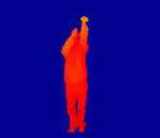
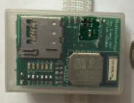
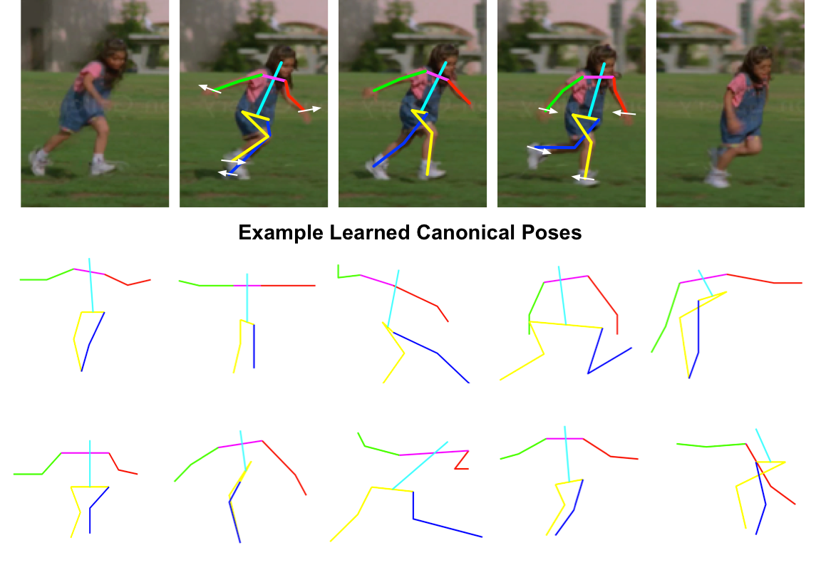

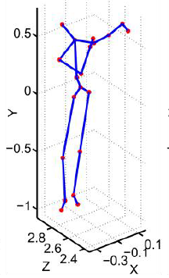
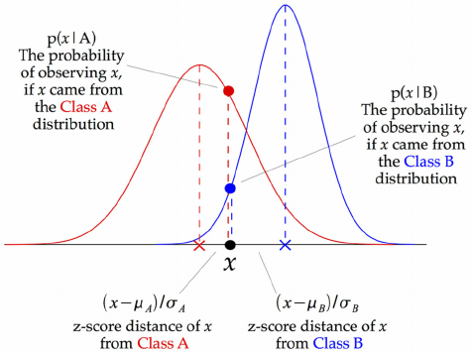
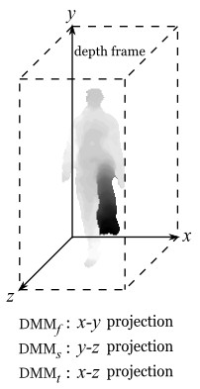
Human Action Recognition Background
Business objective
Dataset/Features
Tools & Classifier algorithm
Action Recognition
Gaussian Naïve Bayes Classifier
Depth Motion Maps
27 actions
8 subjects
4 trials
3 sensors
861 datasets

Slide 3

Human Action Recognition Approaches
1
Data processing which involves reshaping array representation for each dataset into a standardized 2-D form which can be fed into the classification algorithm.
2
Building classification model using Gaussian Naïve Bayes Classifier single sensor data.
3
Building classification model using fusion of multimodal sensors data under simple majority voting mechanism.
4
Evaluating action recognition performance in terms of recognition accuracy for all the models.

Slide 4
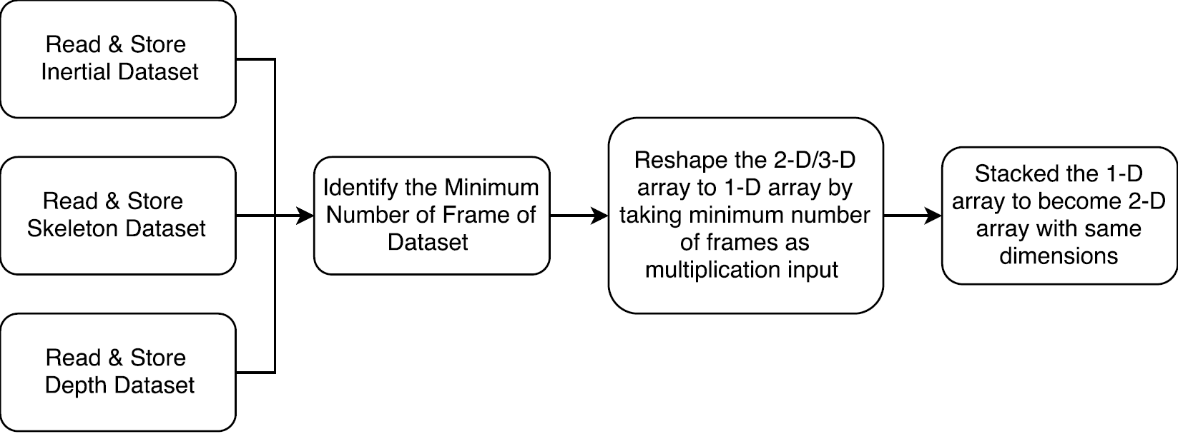
Human Action Recognition Approaches: Data Processing
Read & Store 861 Datasets
Read the .mat file using scipy for inertial, skeleton and depth dataset
Minimum Frame Identification
Identify the minimum data-frame among the dataset of inertial, skeleton and depth dataset
Reshape the 2-D/3-D array to 1-D array
Reshape the 2-D array of inertial dataset to 1-D array (6*minimum frame)
Reshape the 3-D array of skeleton dataset to 1 -D array (20*3* minimum frame)
Reshape the 3-D array of depth dataset to 1-D array (240*320*minimum frame)
Stacked the 1-D array to become 2-D array
Stack up the 1-D array to become 2-D array with 861 action labels for each type of sensors to be fit into the classification model

Slide 5
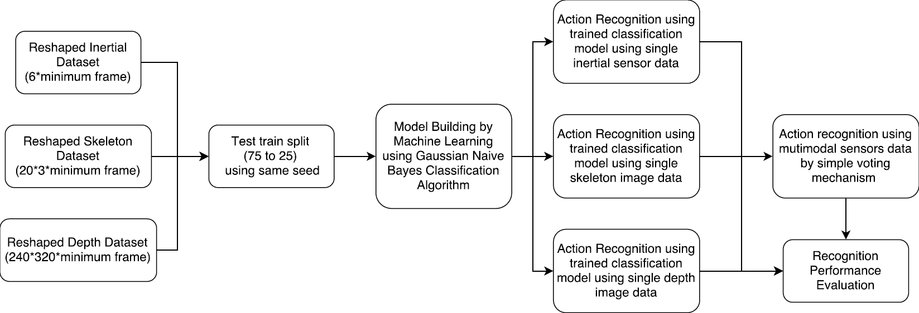
Human Action Recognition Approaches: Data Modelling and Action Recognition

Slide 6



Human Action Recognition Why use minimum frame?
The correlation of the same action perform by different subjects under different trial is highest at the beginning frame.
More robust if the model is be able to recognize different action with less but concise input data to provide the shortest delay or real-time recognition.
Computing resource needed is the much lesser and the model can be trained in the shortest time.

Slide 7
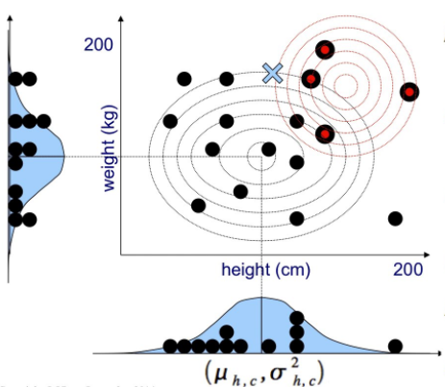
Human Action Recognition Why use Gaussian Naïve Bayes Classifier?
Facts
Subjects performed the same action at different speed in different trials
Subjects had different heights
The same action was repeated in a natural way which made each trial slightly different
Sense Making Assumption
Each action class is independent of the other known action class
Human body proportion such as height, weight, arm length, etc. tends to follow the Gaussian distribution
Sensors reading collected from the subjects who performed the 27 actions also possesses a normal distribution due to the difference in the height and speed

Slide 8
Demo
“Appreciation requires demonstration”

Slide 9
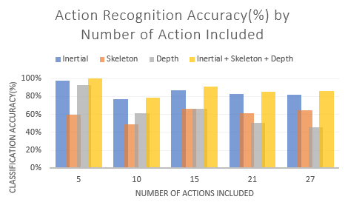
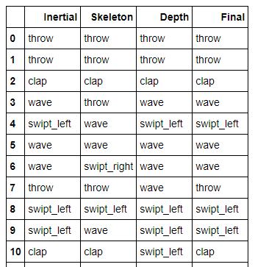


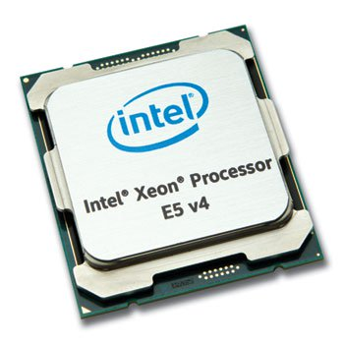
Human Action Recognition Fusion of multimodal sensor classification result
Simple Majority Voting Mechanism
Intel Xeon E5-2676v3
m4.4xlarge
16 vCPUs
64 GiB memory
2.4 GHz
53.5 ECUs
EBS only

Slide 10
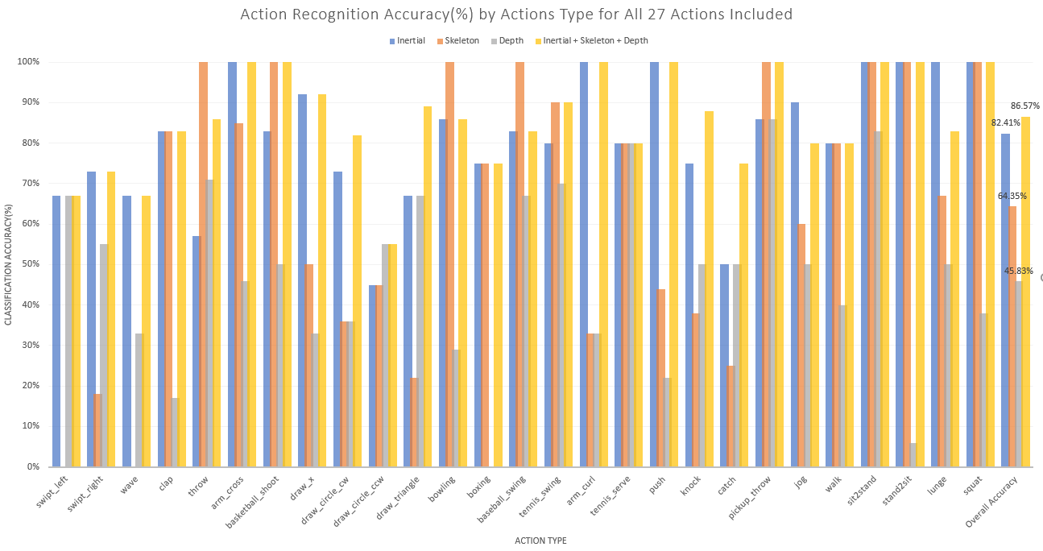
Human Action Recognition 27 Actions Recognition Performance Evaluation
5
18
4
4.16%

Slide 11
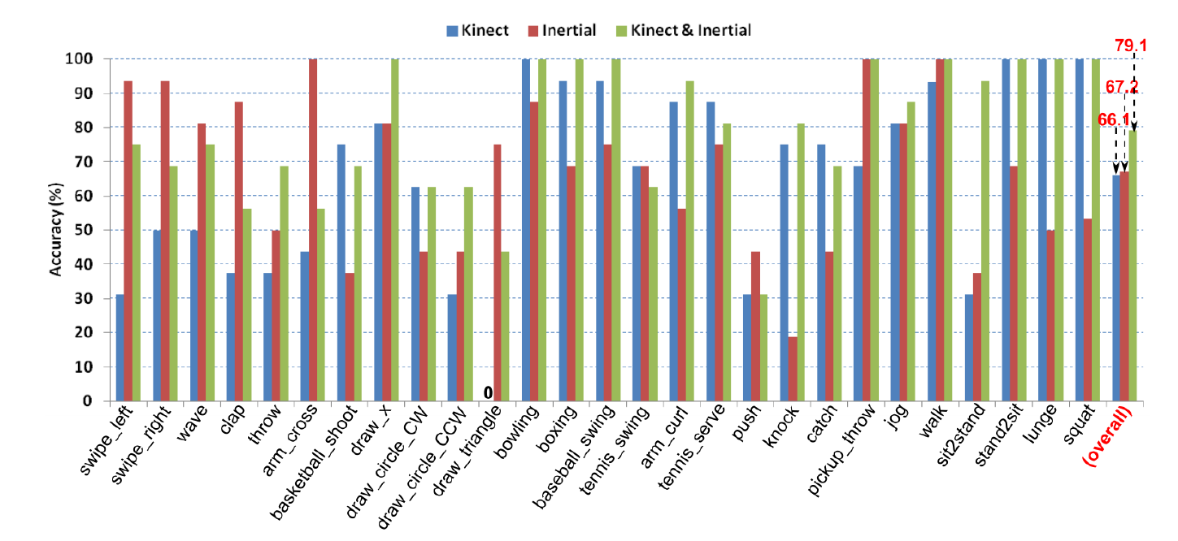
Human Action Recognition 27 Actions Recognition Performance Evaluation
7.47%

Slide 12
Comparison to Original Methodology Skeleton data – DMM + PCA
(4,2)
(3,1)
(6,4,2)
(6,2)
(5,1)
4
(6,4)
(5,3,1)
2
(5,3)
5
6
20 x 3 x n frames
20 x 2 x n frames
20 x 3 (DMMs)
60

Slide 13
Comparison to Original Methodology Skeleton data – DMM + PCA
PCA – dimension reduction
120 features
9 PCA components = 95% of total explained variance
Results
Method | Accuracy
Trim Frame | 64%
DMM (no PCA) | 69%
DMM (with PCA) | 70%

Slide 14
Comparison to Original Methodology Inertial data – Binning + Statistical feature
1
Divide time frames into 6 intervals
2
Calculate Median, Mean, Standard Deviation, Variance for each interval
3
Concatenate back into 1D array
Results
Method | Accuracy
Trim Frame | 82%
Binning + stat | 85%

Slide 15

Human Action Recognition Conclusion
Gaussian Naïve Bayes Classifier has been proved to be able to classify the human actions with the assumption that the data captured by the sensors are normally distributed
Minimum frame approach has been used to standardize the 1-D array to be fit into the classification model to reduce the computational requirement which can lead to ensure less delay on the recognition process or even real-time action recognition
Not all actions accuracy can be improved by the fusion of multimodal of sensors data. Indeed, the accuracy of some actions were dropped hence the accuracies are very much action dependent.

Slide 16
Thank You
“Somewhere in me is a curiosity sensor. I want to know what’s over the next hill. You know, people can live longer without food than without information. Without information, you’d go crazy.”

